Slide 1
TouchDevelop Tips and Types for Programming via Touch
Thomas Ball
Principal Researcher
Research in Software Engineering, Microsoft Research
Thanks to Michal Moskal, Sebastian Burckhardt and the TouchDevelop team
Notes:
TouchDevelop (www.touchdevelop.com) brings a modern programming experience to devices where touch is the primary input mechanism, such as smartphones and tablets. The TouchDevelop environment does this through an interlocking set of features, including:
a simple statically-typed scripting language;
syntax-directed editing with a context-sensitive virtual keyboard;
code completion and refactoring features;
integrated search of platform APIs;
cloud-based sharing, searching and synthesis of code.
In this talk, I’ll demonstrate the TouchDevelop Web App and focus on some of the unique features of the TouchDevelop language, including support for client/cloud shared data. Additionally, I’ll describe how the TouchDevelop Web App was written in TypeScript, a typed superset of JavaScript that compiles to plain JavaScript (www.typescriptlang.org). The TouchDevelop web application is a complete rewrite of the C#/XAML-based TouchDevelop application for Windows Phone.

Slide 2
TouchDevelop in Three Parts
Windows Phone 7 app
Web App, via TypeScript
Cloud types

Slide 3
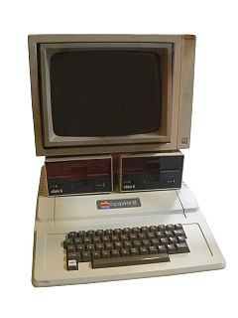
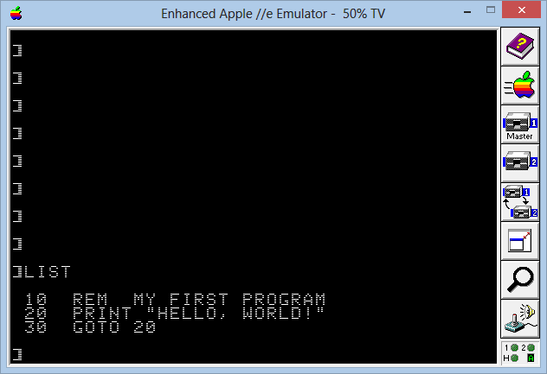

My first computer: The Apple ][
It wanted to be programmed

Slide 4
I learned programming bottom-up
BASIC, 1979
6502 assembler, 1980
PL/C, 1983
FORTRAN, 1984
C, 1985
ML, 1986
Lisp, 1987
C++, 1990
…
…

Slide 5

Smartphones now are the first computers
Very hi-res displays, hi-powered CPUs, fancy sensors, network, …
No keyboard to speak of.
No BASIC prompt.
Notes:
But nowadays, people have these amazing computers, but just consumption devices, they don’t invite programming.

Slide 6
Can “we” program on these things?
At Microsoft Research we try to see what’s possible.
Notes:
So let me put my researcher hat on, later I’ll get to the developer hat.

Slide 7
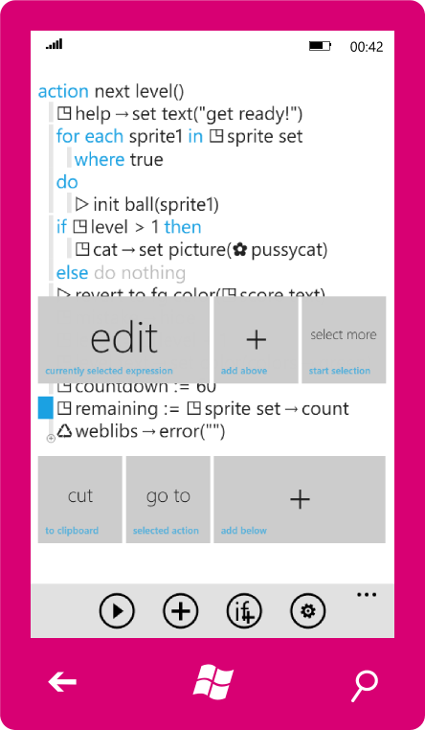
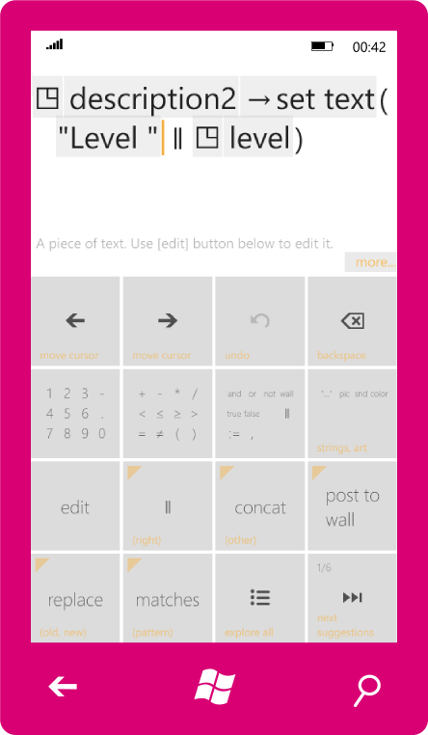
Programming the phone – no PC required!
TouchDevelop is a Windows Phone 7 app bringing the joy of programming 8-bit computers to the smartphone age.
Notes:
Well, yes we can!
TouchDevelop is an app for wp7 that lets you program by tapping on the screen. The editor itself has two modes – tree editing and expression editing with intelli-sense (lots of smarts), language design, so it’s nice for touch

Slide 8
Demo: TouchDevelop on the phone
https://www.touchdevelop.com/doc/videos/endtoend.mp4
https://www.touchdevelop.com/szht/

Slide 9
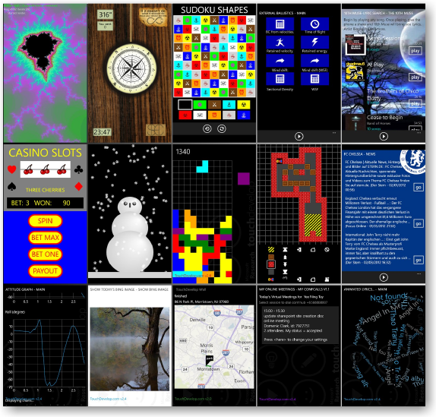
It works!
200,000+ downloads
Full social experience
10,000 scripts
Great for education
http://touchdevelop.com/gallery/
Notes:
We went through a number of iterations of the editor, and the whole social aspects. In the end, were quite successful.

Slide 10
Learning programming top-down with TouchDevelop
Touch-first programming with a single fingertip
High-level APIs for sensors, media, services, social
Search, social experience, synthesis to get to code quickly
Scripting with static types

Slide 11
Why Static Types?
Programming by fingertip -> context-sensitive help
Describe APIs via types
Enable intellibuttons, code synthesis, …

Slide 12
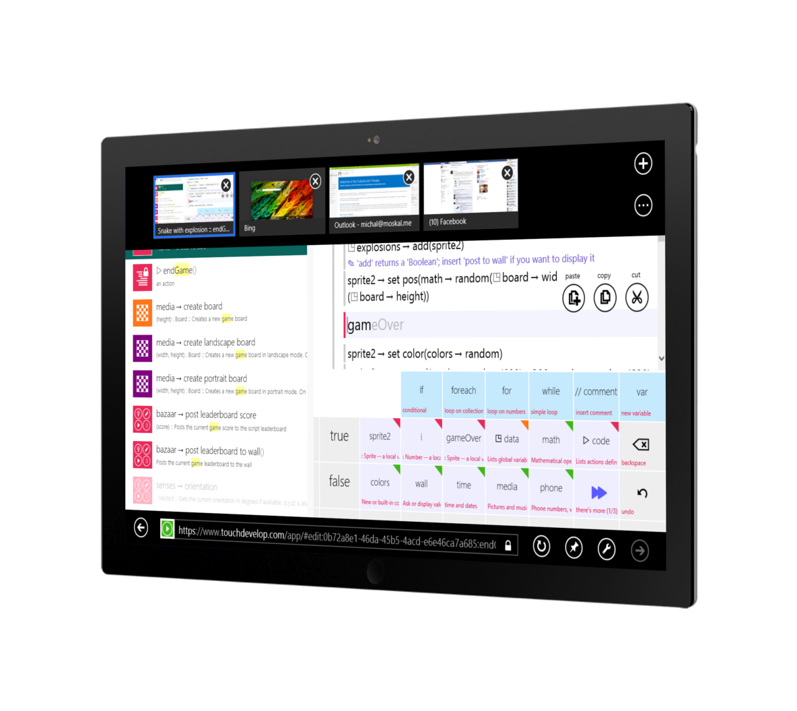

Bigger is better.
Multiplatform means more.
Make it a webapp!
Notes:
Well, we have limited our scope to one form factor and one platform. But there are bigger touch-devices out there, and they are going to get popular.
There are interesting problems in programming the Uis for multiple device sizes – both TD and scripts running in it. Also, this was going to get us far broader reach, and we could see what sort of synergies appear with respect to script sharing.

Slide 13

What’s a web app?
What do we have?
.js
152,000 lines of C#
12,000 lines of XAML
125,000 lines of C#
(plus 10,000 lines of tools in C#)
RGB
0 24 143
RGB
0 188 242
RGB
0 216 204
RGB
127 186 0
RGB
186 216 10
RGB
255 175 0
RGB
255 140 0
RGB
232 17 35
RGB
244 114 208
RGB
155 79 150
Notes:
[dev hat]
Cloud stuff we can reuse, just need to change the protocol a bit.
The core experience of TD is editing code, there’s more though. This is why I was the one starting JS rewrite – I was responsible lang/editor on the phone since the beginning. Others did libraries, intelli sense, social etc.

Slide 14
HTML5 & CSS3 instead of XAML
It’s immediate (just refresh the page)
It’s popular (just bing around for answers)
It’s fast (CSS animations, rendering speed)
It’s simple (e.g., list viewer is just a <div>)
It’s resilient (doesn’t crash on errors)
Notes:
So I needed to learn about these. And I tell you these things have changed in the last 5 years, it’s a lot better. Who did some web programming in the last 2 years?
HTML5 is somewhat different than XAML, there are different tradeoffs – no designer, but immediate, not data-binding or controls (at least we didn’t use any)
Immediate – mention HTML node inspectors/ debuggers
Popular – warning about 5 years ago
Speed – code rendering comparison
They could have worked a bit on the logo.

Slide 15
Now to that JavaScript thing...
It’s immediate (just refresh the page)
It’s popular (just bing around for answers)
It’s reasonably fast (with modern JITs)
It’s not simple (e.g., 20 ways of doing OO)
It’s not resilient (a typo makes it crash)
.js
Notes:
For immediate, mention JS debuggers in modern browsers.
And finally they don’t even HAVE a logo ☺
You see, I’ve been using various forms of ML most of my life (SML, OCaml, Nemerle, F#) – a strongly typed, mostly functional languages. TD is written in C#, which by now has slurped most of ML features, with a different surface syntax. [put researcher hat] I’ve been working on formal verification of critical software. So I *really* don’t feel so well about that dynamic typing busness. [dev hat on]
Now it may all be fine if you’re one dev working on a simple app, as I said we had 150k lines of code to bring over.

Slide 16
We really like types
TypeScript makes for
an easier C# to JavaScript transition.
TypeScript – a superset of JavaScript, compiles to idiomatic JS and adds:
Type annotations and inference
Syntax for classes, interfaces & modules
Enables tool support (in VS and web)
In developer preview
Notes:
So we were rally happy to learn about this incubation project. It was TypeScript. We were one of the early adopters, later going through a number of language revisions etc ;) Who heard about it?
We were all new to JS, and especially for people after me it was really helpful to have familiar structure.
Tool support – intellisense, find references, rename, etc. It’s not really about plugin implementation – it’s the language that makes it easy.

Slide 17
TypeScript $⊇$ JavaScript
What goes in JavaScript goes in TypeScript.
For better or worse.
You can skip type annotations or just use :any
You can copy&paste JS snippets from the web
You can use existing JS libraries
Type annotations for DOM, WinRT and jQuery are included – you get type-checking there!
You can write more.

Slide 18
C# --> TypeScript (classes)
namespace Microsoft.TouchDevelop.Runtime {
public sealed class SpriteRepr
: ReferenceRepr
{
private GameBoardRepr parent;
private List<SpringRepr> springs
= new List<SpringRepr>();
public Vector2 ComputeForces(
Vector4 posSpeed)
{ ... }
}
}
module TDev.RT {
export class Sprite
extends RTValue
{
private parent: Board;
private springs: Spring[] = [];
public computeForces(
posSpeed: Vector4): Vector2
{ ... }
}
}
Notes:
It’s slightly different but you get the idea. Isn’t what we did for most of the code, Script#

Slide 19
C# --> TypeScript (statements)
foreach (var spring in this.springs) {
force +=
spring.ForceOn(this);
}
for (int i = 0; i < touchPts.Count;
i++)
{
var unitNormal = touchPts[i];
var d =
Vector2.Dot(unitNormal, force);
if (d > 0) continue;
force = unitParallel * d;
}
this.springs.forEach((spring) => {
force = force.add(spring.forceOn(this));
})
for (var i = 0; i < this.touchPts.length;
i++)
{
var unitNormal = this.touchPts[i];
var d =
Vector2.dot(unitNormal, force);
if (d > 0) continue;
force = unitParallel * d;
}

Slide 20
Demo: TypeScript

Slide 21
TypeScript highlights
The high-order bit.
Smoother migration from C# to crazy JavaScript.
Avoids lots of runtime errors
(even though there are no 100% guarantees)
IntelliSense is useful
Usually quite functional style
Notes:
Current intellisense already useful!
Current debugger not so bad, can debug in different browsers

Slide 22
The outcome
WP7 App: 152,000 lines of C# 12,000 lines of XAML
Web App: 47,000 lines of TypeScript 3,500 lines of CSS 79 lines of HTML
(but we’re not quite done yet)
Notes:
5 person team, we didn’t destroy the code
This isn’t exactly apples to apples comparison – there is quite a few APIs in the library missing. Also this was a rewrite, so I knew better what was needed etc.
However, the TS code tends to be more functional, and at least the way it works out for me – shorter.
The HTML line count is a bit misleading. We actually create quite a bit of HTML inline, in the code, and the 79 lines is just the loader, a single html file.

Slide 23
Demo: TouchDevelop on the Web

Slide 24
What about TouchDevelop, the language?
A statically-typed imperative language
TouchDevelop, the environment, is what makes the experience compelling
New language feature coming soon: cloud types

Slide 25
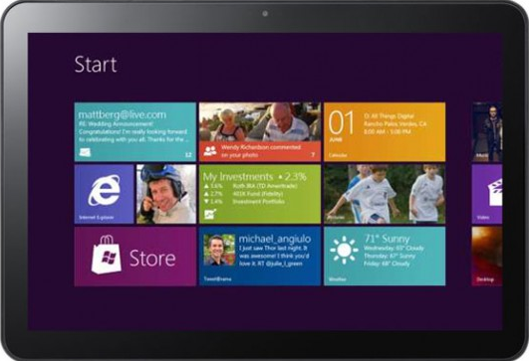
Standard Model: Shared Data on Server
App Code
Database
Data API
Programmer communicates with server
Each query is a server roundtrip
Programmer exposed to
Slow connection (unpleasant experience)
Connection errors, disconnected operation (app stops working)
Atomicity errors (cannot update multiple entities simultaneously)
Notes:
Running example: Grocery List
Can add and remove items
On multiple phones
Lists are synced automatically with server when connected
Works just fine without connection to server as well
Challenges: Consistency , Responsiveness,
Intermittent Connectivity
Eventual Consistency is what we want.

Slide 26
Revisions Model: Replica on Device
App Code
Database
Sync API
Local Replica
Data
API
Separation of Data API from Sync API.
Much simpler to write apps that provide good experience
Predictable latency (access to local storage)
Works when disconnected
Support for atomic updates (a kind of transaction)
Notes:
Running example: Grocery List
Can add and remove items
On multiple phones
Lists are synced automatically with server when connected
Works just fine without connection to server as well
Challenges: Consistency , Responsiveness,
Intermittent Connectivity
Eventual Consistency is what we want.

Slide 27
Target: Non-enterprise Apps
Need simple solution for average app programmers
Most apps can benefit from structured offline storage
User settings, navigation context, collaborative apps, social features in apps
Best target: small DBs that fit on device
For example, index of your MP3 collection
Not necessarily all actual MP3 files

Slide 28
Data Model: Cloud Types
Primitive cloud types
Cloud Integers (get, set, add)
Cloud Strings (get, set, set-if-empty)
Structured cloud types
Cloud Tables (cf. relational tables with implicit primary key)
Cloud Arrays (cf. key-value stores)
Cloud Sets (cf. observed-remove sets by Shapiro et al.)

Slide 29
Global State is a Revision Diagram
fork
fork copies state
join merges state
Cloud types define automatic conflict resolution at joins
Diagrams are flexible, permit
Fully asynchronous communication
disconnected operation
fork
fork
join
join
fork
fork
join
Notes:
Revision Diagrams
simple mental model for reasoning about state + consistency
Akin to source control systems
Resolve all conflicts (no failure)

Slide 30
Example: Birdwatching
Let’s build an app for a birdwatchers
Let’s first try something simple: count the number of bald eagles we have all seen.
var eagles : cloud integer;

Slide 31
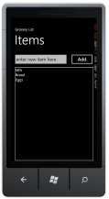
Don’t use Set() to increment
var eagles : cloud integer;
code on device 1
storage
code on device 2
eagles.Set(1)
Set() operations do not commute.
Last writer wins.
eagles.Set(1)
eagles.Get() -> 1
Notes:
Last Writer to check into main revision wins
This is not a “lost update”
Corresponds to what you would get with transactions
Is what the user wants most of the time

Slide 32
Use Add() to increment
var eagles : cloud integer;
code on device 1
storage
code on device 2
eagles.Add(1)
eagles.Add(1)
eagles.Get() -> 2
Notes:
Last Writer to check into main revision wins
This is not a “lost update”
Corresponds to what you would get with transactions
Is what the user wants most of the time

Slide 33
Next step: different birds
Want to count not just eagles, but all kinds of birds
Can use a cloud array for this (similar to key-value store, with values having cloud types)
var birds: cloud array
[
name: string
]
{
count : cloud integer
}

Slide 34
Direct access to entries
var birds: cloud array
[name: string]
{count : cloud integer}
code on device 1
storage
code on device 2
birds[“jay”].count.Add(5)
birds[“jay”].count.Add(1) birds[“gull”].count.Add(2)
birds[“jay”].count.Get()
-> 6
No initialization necessary
Conceptually, all (infinite) entries already exist
-> avoid create-if-not-exist antipattern

Slide 35
What we have today
Research Detailed mechanics of how track updates and consistently applying them to replicas, for a bunch of “cloud types”: integers, strings, tables, key-value stores
TouchDevelop implementation
all of the cloud types
directly integrated into language & IDE
windows phone client
azure service based on table/blob storage

Slide 36
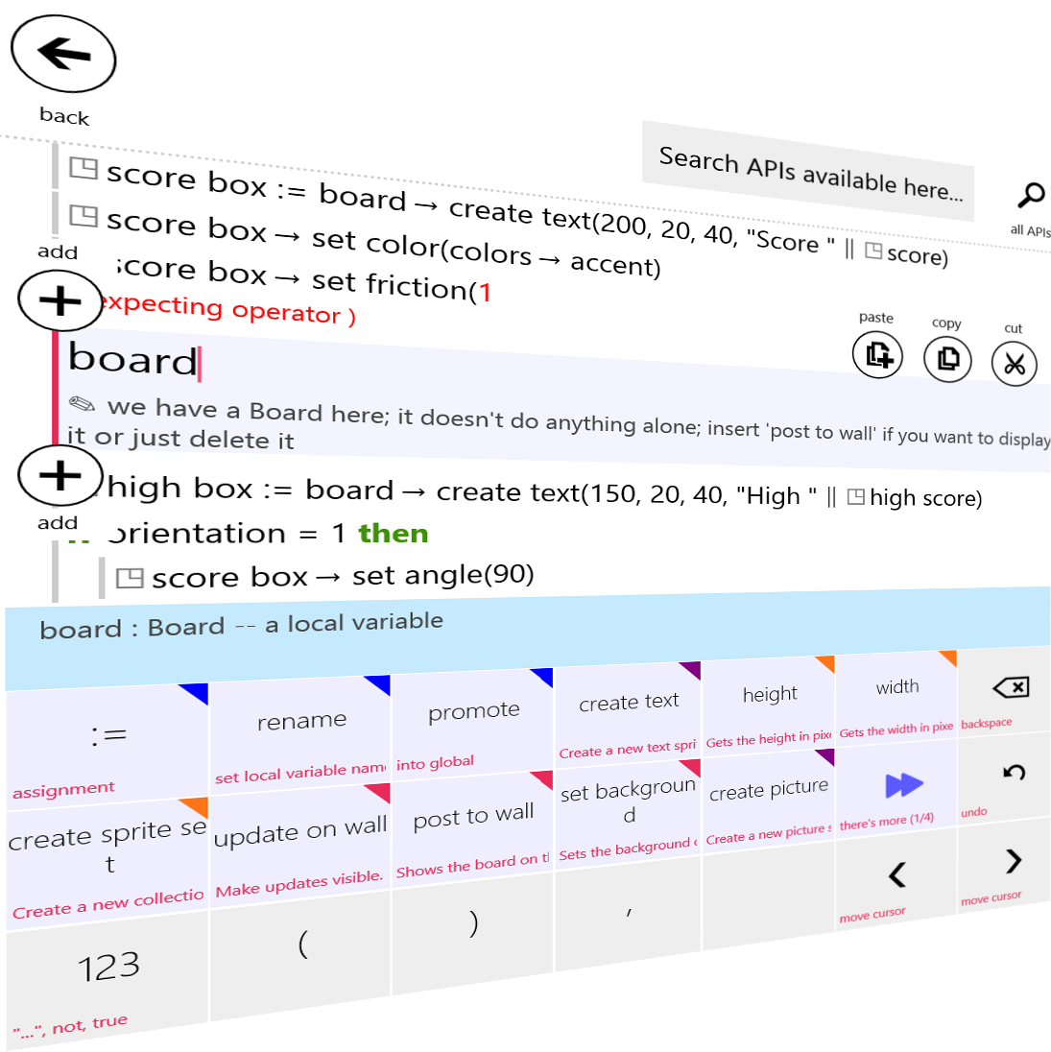
Take aways
Big web apps?
TypeScript is going to help you!
Types are good

Slide 37
Resources
touchdevelop.com
typescriptlang.org
Questions?
Notes:
Started implementing it in JS, and failed.

Slide 38
Define a class
class Greeter {
greeting: string;
constructor (message: string) {
this.greeting = message;
}
greet() {
echo("Hello, " + this.greeting);
}
}
var greeter = new Greeter("BUILD");
greeter.greet();
Notes:
Do a demo

Slide 39
Override a method, with JS flavor
class Greeter {
constructor (public greeting: string) {}
greet(s:string) {
echo(s + " " + this.greeting)
}
}
Greeter.prototype.greet = function (s) {
echo(s + " and " + this.greeting);
};

Slide 40
Interfaces are for classes, right?
module Cloud1 { export function fetch(path:string) { return ""; } export function somethingElse() { ... } }
interface CloudIface { fetch(path:string):string; }
var Cloud:CloudIface = Cloud1;
Cloud1.somethingElse = () => { };

Slide 41
The ‘this’ pointer – you *will* get confused
class Greeter {
constructor (public greeting: string) {}
greet() {
// the difference between function and =>
[2011, 2012].forEach(function (n) {
echo(this.greeting + " " + n);
})
}
}

Slide 42
There is no block scope
function echo(s) => console.log(s);
var fruits = ["pears", "oranges", "bananas"];
var callbacks = [];
var i;
for (i = 0; i < fruits.length; ++i) {
callbacks.push(() => echo(fruits[i]))
}
callbacks.forEach((cb) => cb());
// prints: undefined, undefined, undefined
// i == fruits.length here, which is out of range
callbacks = [];
for (i = 0; i < fruits.length; ++i) {
var fruit = fruits[i];
callbacks.push(() => echo(fruit))
}
callbacks.forEach((cb) => cb());
// prints: bananas, bananas, bananas
// there is just one copy of 'fruit' variable; the loop/block doesn't introduce a scope!
// if you really need a scope inside of a loop - create a function and call it immedietly:
callbacks = [];
for (i = 0; i < fruits.length; ++i) {
(() => {
var fruit = fruits[i];
callbacks.push(() => echo(fruit))
}())
}
callbacks.forEach((cb) => cb());
// prints: pears, oranges, bananas

Slide 43
It’s a functional language
callbacks = [];
fruits.forEach((fruit) => {
callbacks.push(() => echo(fruit))
})
callbacks.forEach((cb) => cb());
// prints: pears, oranges, bananas
// as expected; it's also shorter
// speaking of short - this also works:
// (or should; right now it seems to crash the compiler)
callbacks = fruits.map((fruit) => { return () => echo(fruit) })
callbacks.forEach((cb) => cb());
// prints: pears, oranges, bananas

Slide 44
Don’t use for(each)
// no no no
for (var v in obj) { ... }
// yes yes yes
Object.keys(obj).forEach((v) => { ... })

