Slide 1
Finding Race Conditions and Data Races
Madan Musuvathi Microsoft Research
John Erickson Windows SE
Sebastian Burckhardt Microsoft Research

Slide 2


My Team at MSR
Research in Software Engineering
http://research.microsoft.com/rise

Slide 3
My Team at MSR
Research in Software Engineering
http://research.microsoft.com/rise
Build program analysis tools
Research new languages and runtimes
Study new logics and build faster inference engines
Improve software engineering methods

Slide 4

http://research.microsoft.com/rise
We ship our tools
(Many are open source)
We publish a lot
We make lots of movies

Slide 5
This talk is about Race Conditions

Slide 6
This talk is about Race Conditions
And how to deal with them

Slide 7
Talk Outline
Cuzz: a tool for finding race conditions
Race condition = a timing error in a program
DataCollider: a tool for finding data races
Data race = unsynchronized access to shared data
A data race is neither necessary not sufficient for a race condition

Slide 8
Cuzz: Concurrency Fuzzing Find Race Conditions With ProbabiliSTIC Guarantees

Slide 9
Cuzz Demo

Slide 10
Cuzz: Concurrency Fuzzing
Disciplined randomization of thread schedules
Finds all concurrency bugs in every run of the program
With reasonably-large probability
Scalable
In the no. of threads and program size
Effective
Bugs in IE, Firefox, Office Communicator, Outlook, …
Bugs found in the first few runs

Slide 11

Concurrency Fuzzing in Three Steps
Parent
Child
void* p = malloc;
CallCuzz();
CreateThd(child);
CallCuzz();
p->f ++;
void* p = malloc;
CreateThd(child);
p->f ++;
void* p = malloc;
RandDelay();
CreateThd(child);
RandDelay();
p->f ++;
void* p = malloc;
RandDelay();
CreateThd(child);
Instrument calls to Cuzz
Insert random delays
Use the Cuzz algorithm to determine when and by how much to delay
Init();
RandDelay();
DoMoreWork();
RandDelay();
free(p);
Init();
RandDelay();
DoMoreWork();
Init();
CallCuzz();
DoMoreWork();
CallCuzz();
free(p);
Init();
DoMoreWork();
free(p);
RandDelay();
p->f ++;
RandDelay();
free(p);
This is where all
the magic is

Slide 12
Find all “use-after-free” bugs
All nodes involve the use and free
of some pointer
Problem:
For every unordered pair, say (b,g),
cover both orderings:
e.g.
a
ThreadCreate(…)
if b frees a pointer used by g, the following
execution triggers the error
b
g
b
c
g
b
c
g
c
h
g
b
c
SetEvent(e)
WaitEvent(e)
e
i
f
ThreadJoin(…)

Slide 13
Find all “use-after-free” bugs
a
Approach 1: enumerate all interleavings
b
g
c
h
e
i
f

Slide 14
Find all “use-after-free” bugs
a
Approach 2: enumerate all unordered pairs
b -> g
g -> b
b -> h
…
b
g
c
h
e
i
f

Slide 15
Find all “use-after-free” bugs
a
Two interleavings find all use-after-free bugs
b
g
a
b
c
e
g
h
i
f
c
h
a
g
h
b
c
i
e
f
e
i
f

Slide 16
Find all “use-after-free” bugs
a
Two interleavings find all use-after-free bugs
b
g
a
b
c
e
g
h
i
f
c
h
a
g
h
b
c
i
e
f
e
i
Cuzz picks each with 0.5 probability
f

Slide 17
Find all “use-after-free” bugs
For a concurrent program with n threads
There exists n interleavings that find all use-after-free bugs
Cuzz explores each with probability 1/n

Slide 18
Concurrency Bug Depth
Number of ordering constraints sufficient to find the bug
Bugs of depth 1
Use after free
Use before initialization
A: …
B: fork (child);
C: p = malloc();
D: …
E: …
F: ….
G: do_init();
H: p->f ++;
I: …
J: …

Slide 19
Concurrency Bug Depth
Number of ordering constraints sufficient to find the bug
Bugs of depth 2
Pointer set to null between a null check and its use
A: …
B: p = malloc();
C: fork (child);
D: ….
E: if (p != NULL)
F: p->f ++;
G:
H: …
I: p = NULL;
J : ….

Slide 20
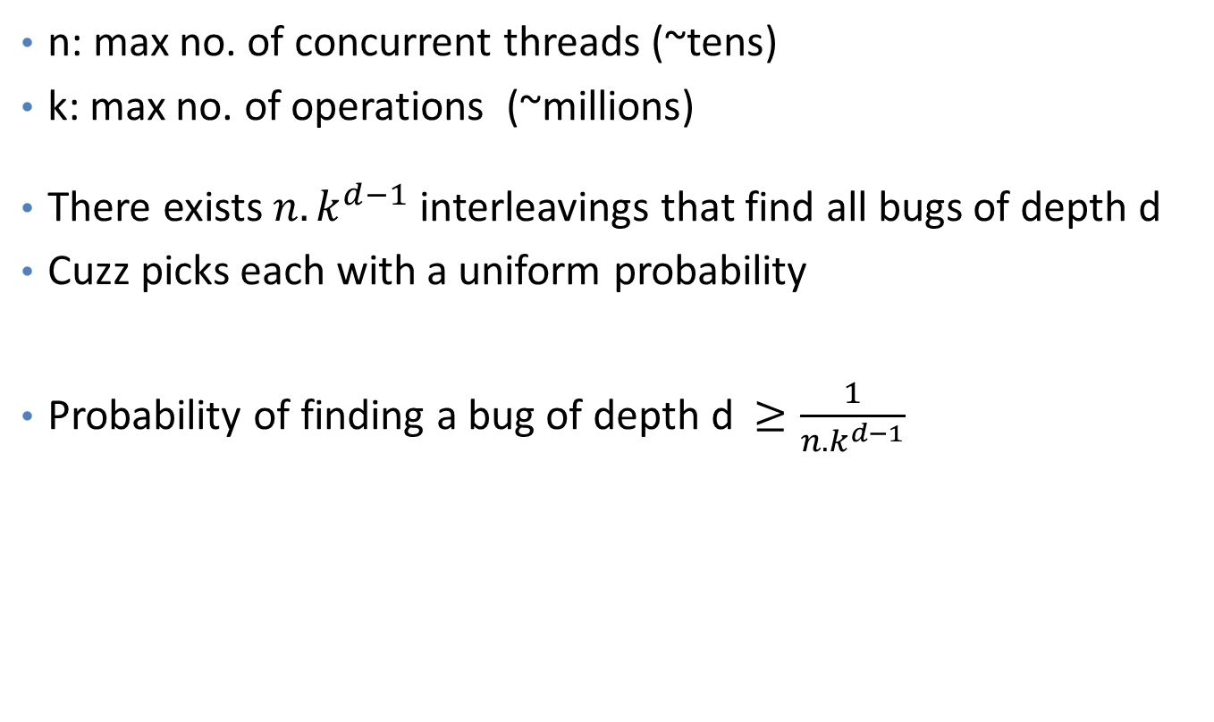
Cuzz Guarantee
n: max no. of concurrent threads (~tens)
k: max no. of operations (~millions)
There exists $n{.k}^{d−1}$ interleavings that find all bugs of depth d
Cuzz picks each with a uniform probability
Probability of finding a bug of depth d $≥\frac{1}{n{.k}^{d−1}}$

Slide 21
Cuzz Algorithm
Inputs: n: estimated bound on the number of threads
k: estimated bound on the number of steps
d: target bug depth
// 1. assign random priorities >= d to threads
for t in [1…n] do priority[t] = rand() + d;
// 2. chose d-1 lowering points at random
for i in [1...d) do lowering[i] = rand() % k;
steps = 0;
while (some thread enabled) {
// 3. Honor thread priorities
Let t be the highest-priority enabled thread;
schedule t for one step;
steps ++;
// 4. At the ith lowering point, set the priority to i
if steps == lowering[i] for some i
priority[t] = i;
}

Slide 22
Empirical bug probability w.r.t worst-case bound
Probability increases with n, stays the same with k
In contrast, worst-case bound = 1/nk^{d-1}

Slide 23
Why Cuzz is very effective
Cuzz (probabilistically) finds all bugs in a single run
Programs have lots of bugs
Cuzz is looking for all of them simultaneously
Probability of finding any of them is more than the probability of finding one
Buggy code is executed many times
Each dynamic occurrence provides a new opportunity for Cuzz

Slide 24
DataCollider: (Near) Zero-Overhead Data-Race Detection

Slide 25
Data Races
Concurrent accesses to shared data without appropriate synchronization
Good indicators of
Missing or wrong synchronization (such as locks)
Unintended sharing of data

Slide 26

A Data Race in Windows
RunContext(...)
{
pctxt->dwfCtxt &=
~CTXTF_RUNNING;
}
RestartCtxtCallback(...)
{
pctxt->dwfCtxt |=
CTXTF_NEED_CALLBACK;
}
Clearing the RUNNING bit swallows the setting of the NEED_CALLBACK bit
Resulted in a system hang during boot
This bug caused release delays
Reproducible only on one hardware configuration
The hardware had to be shipped from Japan to Redmond for debugging

Slide 27
DataCollider
A runtime tool for finding data races
Low runtime overheads
Readily implementable
Works for kernel-mode and user-mode Windows programs
Successfully found many concurrency errors in
Windows kernel, Windows shell, Internet Explorer, SQL server, …

Slide 28
(Our) Definition of a Data Race
Two operations conflict if
The physical memory they access overlap
At least one of them is a write
A race occurs when conflicting operations are simultaneously performed
By any agent: the CPU, the GPU, the DMA controller, …
A data race is a race in which at least one of the operations is a data operation
Synchronization races are not errors
Need a mechanism to distinguish between data and sync. operations

Slide 29
False vs Benign Data Races
LockAcquire ( l );
gRefCount++;
gStatsCount++;
LockRelease ( l );
LockAcquire ( l );
gRefCount++;
LockRelease ( l );
gStatsCount++;
gRefCount++;
False
Benign
Buggy

Slide 30
Existing Dynamic Approaches for Data-Race Detection
Log data and synchronizations operations at runtime
Infer conflicting data access that can happen concurrently
Using happens-before or lockset reasoning
LockAcquire ( l );
gRefCount++;
LockRelease ( l );
gRefCount++;
happens-before
LockAcquire ( l );
gRefCount++;
LockRelease ( l );
x
happens-before

Slide 31
Challenge 1: Large Runtime Overhead
Example: Intel Thread Checker has 200x overhead
BOE calculation for logging overheads
Logging sync. ops ~ 2% to 2x overhead
Logging data ops ~ 2x to 10x overhead
Logging debugging information (stack trace) ~ 10x to 100x overhead
Large overheads skew execution timing
A kernel build is “broken” if it does not boot within 30 seconds
SQL server initiates deadlock recovery if a transaction takes more than 400 microseconds
Browser initiates recovery if a tab does not respond in 5 seconds

Slide 32
Challenge 2: Complex Synchronization Semantics
Synchronizations can be homegrown and complex
(e.g. lock-free, events, processor affinities, IRQL manipuations,…)
Missed synchronizations can result in false positives
MyLockAcquire ( l );
gRefCount++;
MyLockRelease ( l );
?
MyLockAcquire ( l );
gRefCount++;
MyLockRelease ( l );
happens-before

Slide 33

DataCollider Key Ideas
Use sampling
Randomly sample accesses as candidates for data-race detection
Cause a data-race to happen, rather than infer its occurrence
No inference => oblivious to synchronization protocols
Catching threads “red handed” => actionable error reports
Use hardware breakpoints for sampling and conflict detection
Hardware does all the work => low runtime overhead

Slide 34
Algorithm (yes, it fits on a slide)
Randomly sprinkle code breakpoints on memory accesses
When a code breakpoint fires at an access to x
Set a data breakpoint on x
Delay for a small time window
Read x before and after the time window
Detects conflicts with non-CPU writes
Or writes through a different virtual address
Ensure a constant number of code-breakpoint firings per second
PeridoicallyInsertRandomBreakpoints();
OnCodeBreakpoint( pc ) {
// disassemble the instruction at pc
(loc, size, isWrite) = disasm( pc );
temp = read( loc, size );
if ( isWrite )
SetDataBreakpointRW( loc, size );
else
SetDataBreakpointW( loc, size );
delay();
ClearDataBreakpoint( loc, size );
temp’ = read( loc, size );
if(temp != temp’ || data breakpt hit)
ReportDataRace( );
}

Slide 35
Sampling Instructions
Challenge: sample hot and cold instructions equally
if (rand() % 1000 == 0)
{
cold ();
}
else
{
hot ();
}

Slide 36
Sampling Using Code Breakpoints
Samples instructions independent of their execution frequency
Hot and code instructions are sampled uniformly
Sampling distribution is determined by DataCollider
Sampling rate is determined by the program
Set a breakpoint at location X
repeat {
t = fair_coin_toss();
while( t != unfair_coin_toss() );
print( t );
}
Run the program till it executes X
Sample X

Slide 37
Sampling Using Code Breakpoints
Samples instructions independent of their execution frequency
Hot and code instructions are sampled uniformly
Over time, code breakpoints aggregate towards cold-instructions
Cold instructions have a high sampling probability when they execute
Cold-instruction sampling is ideal for data-race detection
Buggy data races tend to occur on cold-paths
Data races on hot paths are likely to be benign

Slide 38
Experience from Data Collider
All nontrivial programs have data races
Most (>90%) of the dynamic occurrences are benign
Benign data race = The developer will not fix the race even when given infinite resources
Many of the benign races can be heuristically pruned
Races on variables with names containing “debug”, “stats”
Races on variables tagged as volatile
Races that occur often
Further research required to address the benign data-race problem

Slide 39
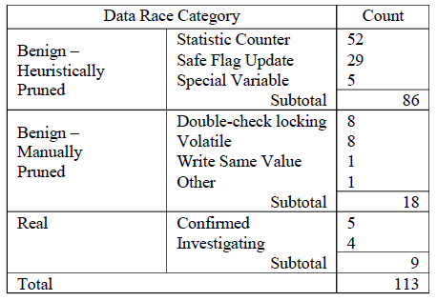

Slide 40
Conclusions
Two tools for finding concurrency errors
Cuzz: Inserts randomized delays to find race conditions
DataCollider: Uses code/data breakpoints for finding data races efficiently
Both are easily implementable
Email: madanm@microsoft.com for questions/availability

