Slide 1
0. 样例SalerReward
Program SalerReward (INPUT,OUTPUT)
Dim apple, huawei, xiaomi As Integer
Dim day As Integer
Dim applePrice, huaweiPrice, xiaomiPrice As Double
Dim appleProfit, huaweiProfit, xiaomiProfit As Double
Dim totalApple, totalHuawei, totalXiaomi As Interger
Dim appleSales, huaweiSales, xiaomiSales As Interger
Dim totalSales, totalProfits, profitRate As Double
Dim reward As String
applePrice = 10,000
huaweiPrice = 5,000
xiaomiPrice = 2,000
appleProfit = 3,000 // rate = 30%
huaweiProfit = 1,000 //rate = 20%
xiaomiProfit = 200 // rate = 10%
totalApple = 0
totalHuawei = 0
totalXiaomi = 0
day = 1
While (day <=30)
Input(apple, huawei, xiaomi)
totalApple = totalApple + apple
totalHuawei = totalHuawei + huawei
totalXiaomi = totalXiaomi + xiaomi
day = day + 1
EndWhile
Output("Apple sold: ", totalApple)
Output("Huawei sold: ", totalHuawei)
Output("Xiaomi sold: ", totalXiaomi)
appleSales = applePrice * totalApple
huaweiSales = huaweiPrice * totalHuawei
xiaomiSales = xiaomiPrice * totalXiaomi
xiaomiSales = xiaomiPrice * totalXiaomi
totalSales = appleSales + huaweiSales + xiaomiSales
Output("Total sales: ", totalSales)
totalProfits = appleProfit * totalApple + huaweiProfit * totalHuawei + xiaomiProfit * totalXiaomi
profitRate = totalProfits / totalSales // 计算利润率
Output("Total profits: ", totalProfits)
If (totalSales >= 100,000)
Then
If (profitRate >= 0.2)
Then
reward = "Diamond"
Else If (profitRate < 0.2 && profitRate >= 0.15)
Then
reward = "Gold"
Else
reward = "Silver"
Endif
Else If (totalSales < 100,000 && totalSales >= 60,000)
Then
If (profitRate >= 0.2)
Then
reward = "Gold"
Else
reward = "Silver"
Endif
Else If (profitRate >= 0.2)
Then
reward = "Silver"
Else
reward = "No Reward"
Endif
Output("Reward is: ", reward)
End SalerReward

Slide 2
1. Def-Use 表
变量名 | 定义节点 | 使用节点
apple | 21 | 22
huawei | 21 | 23
xiaomi | 21 | 24
appleProfit | 13 | 35
huaweiProfit | 14 | 35
xiaomiProfit | 15 | 35
day | 19,25 | 20,25
applePrice | 10 | 30
huaweiPrice | 11 | 31
xiaomiPrice | 12 | 32
totalApple | 16,22 | 22,27,30,35
totalHuawei | 17,23 | 23,28,31,35
totalXiaomi | 18,24 | 24,29,32,35
appleSales | 30 | 33
huaweiSales | 31 | 33
xiaomiSales | 32 | 33
totalSales | 33 | 34,36,38,49
totalProfits | 35 | 36,37
profitRate | 36 | 40,43,51,57
reward | 42,45,47,53,55,59,61 | 63

Slide 3
2. 程序切片
据程序片测试的方法，请写出以下变量的程序切片
profitRate:
S(profitRate, 36) = {10-26, 30-33, 35, 36}
S(profitRate, 40) = {10-26, 30-33, 35, 36}
S(profitRate, 43) = {10-26, 30-33, 35, 36}
S(profitRate, 51) = {10-26, 30-33, 35, 36}
S(profitRate, 57) = {10-26, 30-33, 35, 36}
total Apple：
S (totalApple, 16) = {16}
S (totalApple, 22) = {16, 19, 20, 21, 22, 25, 26}
S (totalApple, 27) = {16, 19, 20, 21, 22, 25, 26}
S (totalApple, 30) = {16, 19, 20, 21, 22, 25, 26}
S (totalApple, 35) = {16, 19, 20, 21, 22, 25, 26}
huaweiSales：
S(huaweiSales, 31) = {11, 17, 19, 20, 21, 23, 25, 26, 31}
S(huaweiSales, 33) = {11, 17, 19, 20, 21, 23, 25, 26, 31}
reward:
S (reward, 42) = {10-26, 30-33, 35, 36, 38-42}
S (reward, 45) = {10-26, 30-33, 35, 36, 38-45}
S (reward, 47) = {10-26, 30-33, 35, 36, 38-47}
S (reward, 53) = {10-26, 30-33, 35, 36, 38-53}
S (reward, 55) = {10-26, 30-33, 35, 36, 38-55}
S (reward, 59) = {10-26, 30-33, 35, 36, 38-59}
S (reward, 61) = {10-26, 30-33, 35, 36, 38-61}
S (reward, 63) = {10-26, 30-33, 35, 36, 38-61}

Slide 4
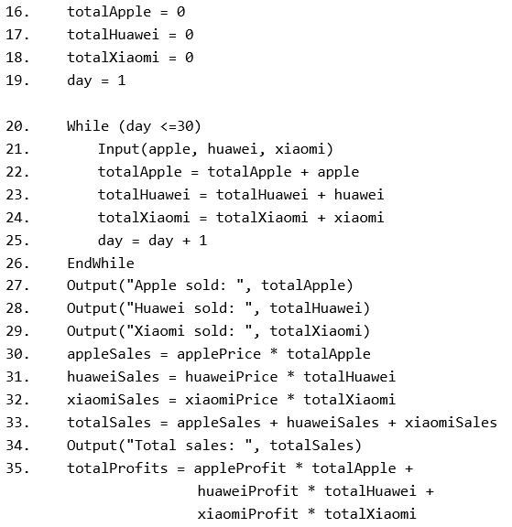
2. 程序切片
据程序片测试的方法，请写出以下变量的程序切片
totalApple: (def: 16,22; use: 22,27,30,35)
S (totalApple, 16) = {16}
S (totalApple, 22) = {16, 19, 20, 21, 22, 25, 26}
S (totalApple, 27) = {16, 19, 20, 21, 22, 25, 26}
S (totalApple, 30) = {16, 19, 20, 21, 22, 25, 26}
S (totalApple, 35) = {16, 19, 20, 21, 22, 25, 26}
只有16行的赋值和while循环对totalApple作出贡献。
27，30，35是无贡献的use

Slide 5
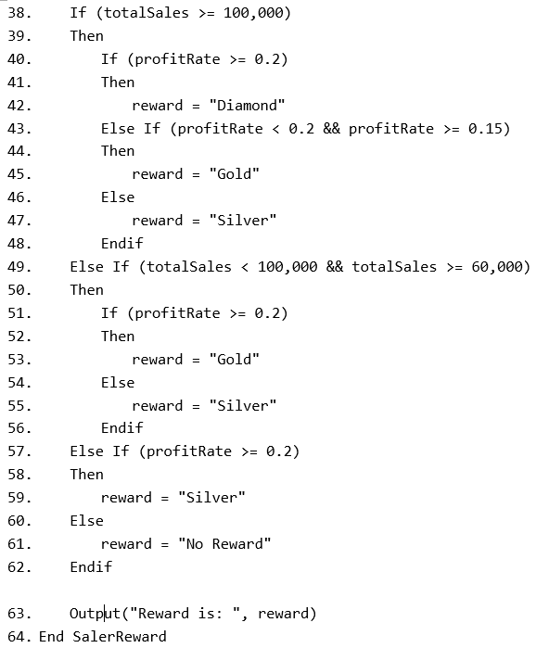
2. 程序切片
reward: (def: 42,45,47,53,55,59,61; use: 63)
S (reward, 42) = {10-26, 30-33, 35, 36, 38-42}
S (reward, 45) = {10-26, 30-33, 35, 36, 38-45}
S (reward, 47) = {10-26, 30-33, 35, 36, 38-47}
S (reward, 53) = {10-26, 30-33, 35, 36, 38-53}
S (reward, 55) = {10-26, 30-33, 35, 36, 38-55}
S (reward, 59) = {10-26, 30-33, 35, 36, 38-59}
S (reward, 61) = {10-26, 30-33, 35, 36, 38-61}
S (reward, 63) = {10-26, 30-33, 35, 36, 38-61}
分支条件依赖变量totalSales和profitRate。
如果涉及条件分支，语句前的分支都应该包含在切片中。

Slide 6
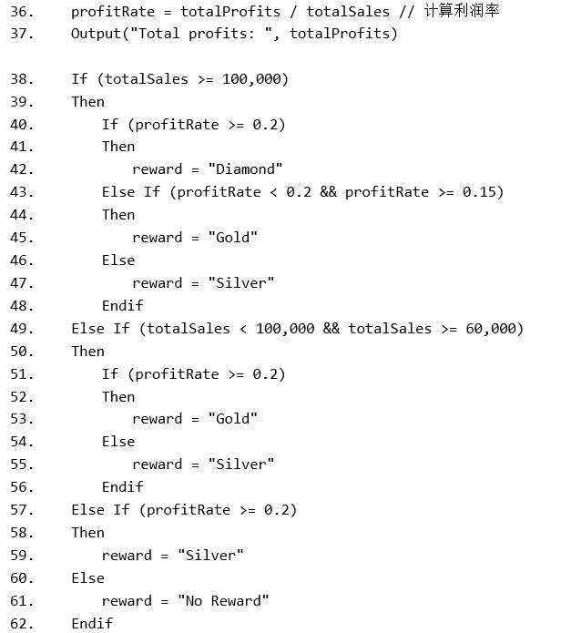
2. 程序切片
profitRate: (def: 36; use: 40,43,51,57)
S(profitRate, 36) = {10-26, 30-33, 35, 36}
S(profitRate, 40) = {10-26, 30-33, 35, 36}
S(profitRate, 43) = {10-26, 30-33, 35, 36}
S(profitRate, 51) = {10-26, 30-33, 35, 36}
S(profitRate, 57) = {10-26, 30-33, 35, 36}
profitRate依赖变量totalProfits和totalSales。其中totalSales不仅在定义时被依赖，在使用的分支条件中也被依赖。
只有语句36对profitRate作定义，因此所有切片都长一样。

Slide 7
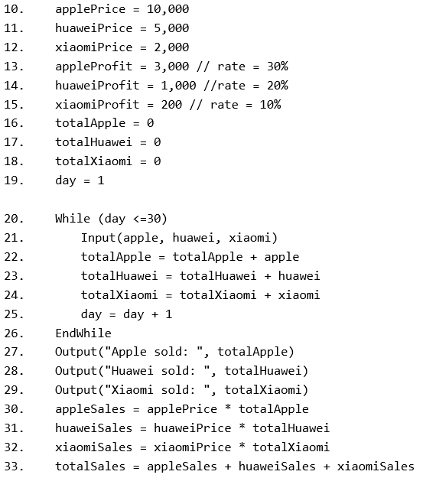
2. 程序切片
huaweiSales: (def: 31; use: 33)
S(huaweiSales, 31) = {11, 17, 19, 20, 21, 23, 25, 26, 31}
S(huaweiSales, 33) = {11, 17, 19, 20, 21, 23, 25, 26, 31}
依赖huaweiPrice
依赖totalHuawei

Slide 8
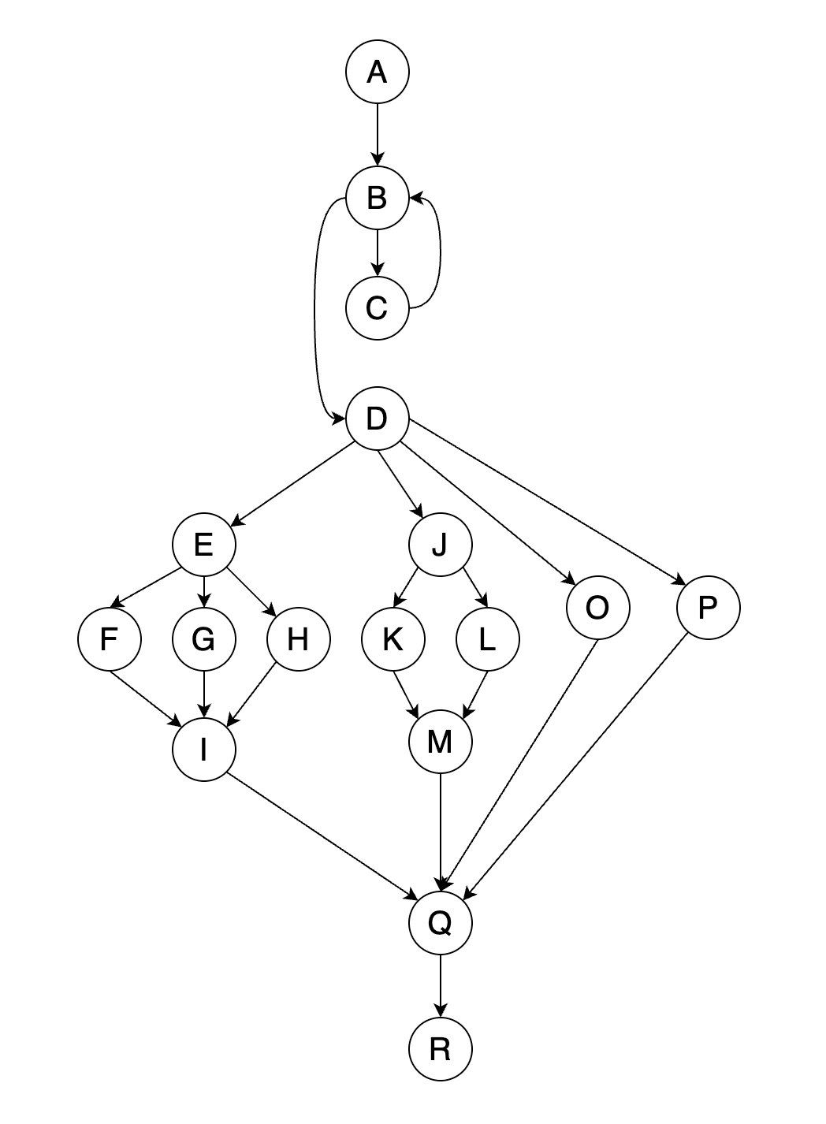
3. DD路径图
While循环
If分支（注意每个分支包含头尾，不可省略I与M）

Slide 9
4. 基本路径
MaCabe圈数: V(G) = e - n + 2p = 23 – 17 + 2 = 8
基本路径的总数为8。
A→B→D→E→F→I→Q→R
A→B→C→B→D→E→F→I→Q→R
A→B→D→E→G→I→Q→R
A→B→D→E→H→I→Q→R
A→B→D→J→K→M→Q→R
A→B→D→J→L→M→Q→R
A→B→D→O→Q→R
A→B→D→P→Q→R
以上是一个样例，基本路径能够覆盖所有分支即可。
其中B→C→B可以放在任意路径上，但只能出现一次。

