Slide 1
Architecture of Enterprise Applications 6 Multithreading
Haopeng Chen
REliable, INtelligent and Scalable Systems Group (REINS)
Shanghai Jiao Tong University
Shanghai, China
http://reins.se.sjtu.edu.cn/~chenhp
e-mail: chen-hp@sjtu.edu.cn

Slide 2
Contents and Objectives
Contents
Introduction to Thread
Multithreading in Java
Objectives
能够根据业务需求，识别存在多线程访问的场景，设计并实现基于Java多线程模型的并发方案

Slide 3
Processes and Threads
In concurrent programming, there are two basic units of execution: processes and threads.
In the Java programming language, concurrent programming is mostly concerned with threads.
Processes
A process has a self-contained execution environment. A process generally has a complete, private set of basic run-time resources; in particular, each process has its own memory space.
Threads
Threads are sometimes called lightweight processes. Both processes and threads provide an execution environment, but creating a new thread requires fewer resources than creating a new process.
Threads exist within a process — every process has at least one. Threads share the process's resources, including memory and open files. This makes for efficient, but potentially problematic, communication.

Slide 4
Thread Objects
Each thread is associated with an instance of the class Thread.
There are two basic strategies for using Thread objects to create a concurrent application.
To directly control thread creation and management, simply instantiate Thread each time the application needs to initiate an asynchronous task.
To abstract thread management from the rest of your application, pass the application's tasks to an executor.

Slide 5
Defining and Starting a Thread
An application that creates an instance of Thread must provide the code that will run in that thread.
There are two ways to do this:
Provide a Runnable object.
The Runnable interface defines a single method, run, meant to contain the code executed in the thread. The Runnable object is passed to the Thread constructor, as in the HelloRunnable example:
public class HelloRunnable implements Runnable {
public void run() {
System.out.println("Hello from a thread!");
}
public static void main(String args[]) {
(new Thread(new HelloRunnable())).start();
}
}

Slide 6
Defining and Starting a Thread
An application that creates an instance of Thread must provide the code that will run in that thread.
There are two ways to do this:
Subclass Thread.
The Thread class itself implements Runnable, though its run method does nothing. An application can subclass Thread, providing its own implementation of run, as in the HelloThread example:
public class HelloThread extends Thread {
public void run() {
System.out.println("Hello from a thread!");
}
public static void main(String args[]) {
(new HelloThread()).start();
}
}

Slide 7
Pausing Execution with Sleep
Thread.sleep causes the current thread to suspend execution for a specified period.
public class SleepMessages {
public static void main(String args[]) throws InterruptedException
{
String importantInfo[] = {
"Mares eat oats", "Does eat oats",
"Little lambs eat ivy", "A kid will eat ivy too"
};
for (int i = 0; i < importantInfo.length; i++) {
//Pause for 4 seconds
Thread.sleep(4000);
//Print a message
System.out.println(importantInfo[i]);
}
}
}

Slide 8
Interrupts
An interrupt is an indication to a thread that it should stop what it is doing and do something else.
It's up to the programmer to decide exactly how a thread responds to an interrupt, but it is very common for the thread to terminate.
A thread sends an interrupt by invoking interrupt on the Thread object for the thread to be interrupted.
for (int i = 0; i < importantInfo.length; i++) {
// Pause for 4 seconds
try {
Thread.sleep(4000);
} catch (InterruptedException e) {
// We've been interrupted: no more messages.
return;
}
// Print a message
System.out.println(importantInfo[i]);
}

Slide 9
Interrupts
What if a thread goes a long time without invoking a method that throws InterruptedException?
Then it must periodically invoke Thread.interrupted, which returns true if an interrupt has been received. For example:
for (int i = 0; i < inputs.length; i++) {
heavyCrunch(inputs[i]);
if (Thread.interrupted()) {
// We've been interrupted: no more crunching.
return;
}
}
In more complex applications, it might make more sense to throw an InterruptedException:
if (Thread.interrupted()) {
throw new InterruptedException();
}

Slide 10
Joins
The join method allows one thread to wait for the completion of another.
If t is a Thread object whose thread is currently executing,
t.join();
causes the current thread to pause execution until t's thread terminates.
Overloads of join allow the programmer to specify a waiting period. However, as with sleep, join is dependent on the OS for timing, so you should not assume that join will wait exactly as long as you specify.
Like sleep, join responds to an interrupt by exiting with an InterruptedException.

Slide 11
The SimpleThreads Example
SimpleThreads consists of two threads.
The first is the main thread that every Java application has.
The main thread creates a new thread from the Runnable object, MessageLoop, and waits for it to finish.
If the MessageLoop thread takes too long to finish, the main thread interrupts it.
The MessageLoop thread prints out a series of messages.
If interrupted before it has printed all its messages, the MessageLoop thread prints a message and exits.

Slide 12
The SimpleThreads Example
public class SimpleThreads {
// Display a message, preceded by
// the name of the current thread
static void threadMessage(String message) {
String threadName = Thread.currentThread().getName();
System.out.format("%s: %s%n", threadName, message);
}
private static class MessageLoop implements Runnable {
public void run() {
String importantInfo[] = {
"Mares eat oats", "Does eat oats", "Little lambs eat ivy", "A kid will eat ivy too”
};
try {
for (int i = 0; i < importantInfo.length; i++) {
// Pause for 4 seconds
Thread.sleep(4000);
// Print a message
threadMessage(importantInfo[i]);
}
} catch (InterruptedException e) {
threadMessage("I wasn't done!");
}
}
}

Slide 13
The SimpleThreads Example
public static void main(String args[]) throws InterruptedException {
// Delay, in milliseconds before
// we interrupt MessageLoop
// thread (default one hour).
long patience = 1000 * 60 * 60;
// If command line argument
// present, gives patience
// in seconds.
if (args.length > 0) {
try {
patience = Long.parseLong(args[0]) * 1000;
} catch (NumberFormatException e) {
System.err.println("Argument must be an integer.");
System.exit(1);
}
}

Slide 14
The SimpleThreads Example
threadMessage("Starting MessageLoop thread");
long startTime = System.currentTimeMillis();
Thread t = new Thread(new MessageLoop());
t.start();
threadMessage("Waiting for MessageLoop thread to finish");
// loop until MessageLoop
// thread exits
while (t.isAlive()) {
threadMessage("Still waiting...");
// Wait maximum of 1 second
// for MessageLoop thread
// to finish.
t.join(1000);
if (((System.currentTimeMillis() - startTime) > patience)
&& t.isAlive()) {
threadMessage("Tired of waiting!");
t.interrupt();
// Shouldn't be long now
// -- wait indefinitely
t.join();
}
}
threadMessage("Finally!");
}
}

Slide 15
Synchronization
Threads communicate primarily by sharing access to fields and the objects reference fields refer to.
This form of communication is extremely efficient, but makes two kinds of errors possible: thread interference and memory consistency errors. The tool needed to prevent these errors is synchronization.
However, synchronization can introduce thread contention, which occurs when two or more threads try to access the same resource simultaneously and cause the Java runtime to execute one or more threads more slowly, or even suspend their execution. Starvation and livelock are forms of thread contention.

Slide 16
Thread Interference
Consider a simple class called Counter
class Counter {
private int c = 0;
public void increment() { c++; }
public void decrement() { c--; }
public int value() { return c; }
}
if a Counter object is referenced from multiple threads, interference between threads may prevent this from happening as expected.

Slide 17
Thread Interference
Suppose Thread A invokes increment at about the same time Thread B invokes decrement.
If the initial value of c is 0, their interleaved actions might follow this sequence:
Thread A: Retrieve c.
Thread B: Retrieve c.
Thread A: Increment retrieved value; result is 1.
Thread B: Decrement retrieved value; result is -1.
Thread A: Store result in c; c is now 1.
Thread B: Store result in c; c is now -1.
Thread A's result is lost, overwritten by Thread B.

Slide 18
Memory Consistency Errors
Memory consistency errors occur when different threads have inconsistent views of what should be the same data.
The key to avoiding memory consistency errors is understanding the happens-before relationship.
This relationship is simply a guarantee that memory writes by one specific statement are visible to another specific statement.

Slide 19
Memory Consistency Errors
Suppose a simple int field is defined and initialized:
int counter = 0;
The counter field is shared between two threads, A and B. Suppose thread A increments counter:
counter++;
Then, shortly afterwards, thread B prints out counter:
System.out.println(counter);
If the two statements had been executed in the same thread, it would be safe to assume that the value printed out would be "1".
But if the two statements are executed in separate threads, the value printed out might well be "0", because there's no guarantee that thread A's change to counter will be visible to thread B — unless the programmer has established a happens-before relationship between these two statements.

Slide 20
Unsafe Mutilple Threads
public class UnSafeMultipleThreads<Static, c> { static void threadMessage(String message) { String threadName = Thread.currentThread().getName(); System.out.format("%s: %s%n", threadName, message); } Counter c = new Counter(); private class CounterLoop implements Runnable { public void run() { try { for (int i = 0; i < 100; i++) { // Pause for 1 seconds Thread.sleep(1000); // Print a message threadMessage(String.valueOf(c.value())); c.increment(); } } catch (InterruptedException e) { threadMessage("I wasn't done!"); } } }

Slide 21
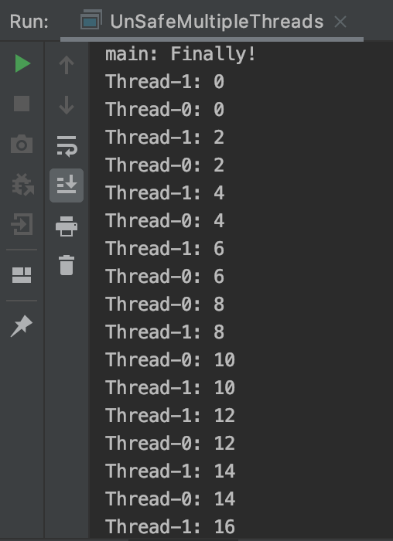
Unsafe Mutilple Threads
public static void main(String args[]) throws InterruptedException { // Delay, in milliseconds before // we interrupt MessageLoop // thread (default one hour). long patience = 1000;// * 60 * 60; threadMessage("Starting MessageLoop thread"); long startTime = System.currentTimeMillis(); UnSafeMultipleThreads s = new UnSafeMultipleThreads(); Thread t1 = new Thread(s.new CounterLoop()); t1.start(); Thread t2 = new Thread(s.new CounterLoop()); t2.start(); threadMessage("Waiting for MessageLoop thread to finish"); } }

Slide 22
Synchronized Methods
To make a method synchronized, simply add the synchronized keyword to its declaration:
public class SynchronizedCounter {
private int c = 0;
public synchronized void increment() { c++; }
public synchronized void decrement() { c--; }
public synchronized int value() { return c; }
}
If count is an instance of SynchronizedCounter, then making these methods synchronized has two effects:
First, it is not possible for two invocations of synchronized methods on the same object to interleave. When one thread is executing a synchronized method for an object, all other threads that invoke synchronized methods for the same object block (suspend execution) until the first thread is done with the object.
Second, when a synchronized method exits, it automatically establishes a happens-before relationship with any subsequent invocation of a synchronized method for the same object. This guarantees that changes to the state of the object are visible to all threads.

Slide 23
Intrinsic Locks and Synchronization
Synchronization is built around an internal entity known as the intrinsic lock or monitor lock.
Intrinsic locks play a role in both aspects of synchronization: enforcing exclusive access to an object's state and establishing happens-before relationships that are essential to visibility.

Slide 24
Intrinsic Locks and Synchronization
Every object has an intrinsic lock associated with it.
By convention, a thread that needs exclusive and consistent access to an object's fields has to acquire the object's intrinsic lock before accessing them, and then release the intrinsic lock when it's done with them.
A thread is said to own the intrinsic lock between the time it has acquired the lock and released the lock. As long as a thread owns an intrinsic lock, no other thread can acquire the same lock. The other thread will block when it attempts to acquire the lock.
When a thread releases an intrinsic lock,
a happens-before relationship is established between that action and any subsequent acquisition of the same lock.

Slide 25
Intrinsic Locks and Synchronization
Locks In Synchronized Methods
When a thread invokes a synchronized method,
it automatically acquires the intrinsic lock for that method's object and releases it when the method returns.
The lock release occurs even if the return was caused by an uncaught exception.
You might wonder what happens when a static synchronized method is invoked,
since a static method is associated with a class, not an object.
In this case, the thread acquires the intrinsic lock for the Class object associated with the class. Thus access to class's static fields is controlled by a lock that's distinct from the lock for any instance of the class.

Slide 26
Intrinsic Locks and Synchronization
Synchronized Statements
Another way to create synchronized code is with synchronized statements.
Unlike synchronized methods, synchronized statements must specify the object that provides the intrinsic lock:
public void addName(String name) {
synchronized(this) {
lastName = name;
nameCount++;
}
nameList.add(name);
}
In this example, the addName method needs to synchronize changes to lastName and nameCount, but also needs to avoid synchronizing invocations of other objects' methods.

Slide 27
Intrinsic Locks and Synchronization
Synchronized statements are also useful for improving concurrency with fine-grained synchronization.
public class MsLunch {
private long c1 = 0;
private long c2 = 0;
private Object lock1 = new Object();
private Object lock2 = new Object();
public void inc1() {
synchronized(lock1)
{ c1++; }
}
public void inc2() {
synchronized(lock2)
{ c2++; }
}
}
Use this idiom with extreme care. You must be absolutely sure that it really is safe to interleave access of the affected fields.

Slide 28
Intrinsic Locks and Synchronization
Reentrant Synchronization
Recall that a thread cannot acquire a lock owned by another thread.
But a thread can acquire a lock that it already owns.
Allowing a thread to acquire the same lock more than once enables reentrant synchronization.
This describes a situation where synchronized code, directly or indirectly, invokes a method that also contains synchronized code, and both sets of code use the same lock.
Without reentrant synchronization, synchronized code would have to take many additional precautions to avoid having a thread cause itself to block.

Slide 29
Atomic Access
In programming, an atomic action is one that effectively happens all at once.
There are actions you can specify that are atomic:
Reads and writes are atomic for reference variables and for most primitive variables (all types except long and double).
Reads and writes are atomic for all variables declared volatile (including long and double variables).

Slide 30
Atomic Access
Atomic actions cannot be interleaved, so they can be used without fear of thread interference.
However, this does not eliminate all need to synchronize atomic actions, because memory consistency errors are still possible.
Using volatile variables reduces the risk of memory consistency errors,
because any write to a volatile variable establishes a happens-before relationship with subsequent reads of that same variable

Slide 31
Liveness
A concurrent application's ability to execute in a timely manner is known as its liveness.
Deadlock
Deadlock describes a situation where two or more threads are blocked forever, waiting for each other.
Here's an example.
Alphonse and Gaston are friends, and great believers in courtesy.
A strict rule of courtesy is that when you bow to a friend, you must remain bowed until your friend has a chance to return the bow.
Unfortunately, this rule does not account for the possibility that two friends might bow to each other at the same time.

Slide 32
Liveness
package org.reins; public class Deadlock { static class Friend { private final String name; public Friend(String name) { this.name = name; } public String getName() { return this.name; } public synchronized void bow(Friend bower) { System.out.format("%s: %s" + " has bowed to me!%n", this.name, bower.getName()); bower.bowBack(this); } public synchronized void bowBack(Friend bower) { System.out.format("%s: %s" + " has bowed back to me!%n", this.name, bower.getName()); } }

Slide 33
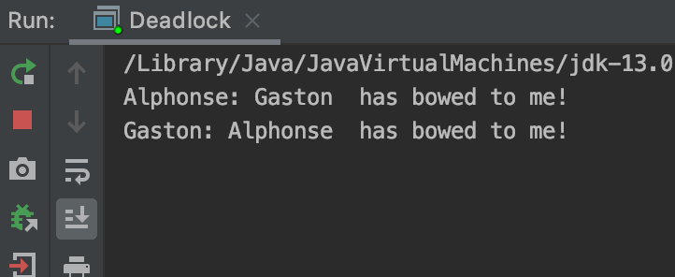
Liveness
public static void main(String[] args) { final Friend alphonse = new Friend("Alphonse"); final Friend gaston = new Friend("Gaston"); new Thread(new Runnable() { public void run() { alphonse.bow(gaston); } }).start(); new Thread(new Runnable() { public void run() { gaston.bow(alphonse); } }).start(); } }

Slide 34
Starvation and Livelock
Starvation
Starvation describes a situation where a thread is unable to gain regular access to shared resources and is unable to make progress. This happens when shared resources are made unavailable for long periods by "greedy" threads.
Livelock
A thread often acts in response to the action of another thread. If the other thread's action is also a response to the action of another thread, then livelock may result. As with deadlock, livelocked threads are unable to make further progress. However, the threads are not blocked — they are simply too busy responding to each other to resume work.

Slide 35
Guarded Blocks
Threads often have to coordinate their actions.
The most common coordination idiom is the guarded block.
Such a block begins by polling a condition that must be true before the block can proceed.
Suppose,
for example guardedJoy is a method that must not proceed until a shared variable joy has been set by another thread.
public void guardedJoy() {
// Simple loop guard. Wastes
// processor time. Don't do this!
while(!joy) { }
System.out.println("Joy has been achieved!");
}

Slide 36
Guarded Blocks
A more efficient guard invokes Object.wait to suspend the current thread.
The invocation of wait does not return until another thread has issued a notification that some special event may have occurred — though not necessarily the event this thread is waiting for:
public synchronized void guardedJoy() {
// This guard only loops once for each special event, which may not
// be the event we're waiting for.
while(!joy) {
try { wait(); }
catch (InterruptedException e) {}
}
System.out.println("Joy and efficiency have been achieved!");
}

Slide 37
Guarded Blocks
When wait is invoked, the thread releases the lock and suspends execution.
At some future time, another thread will acquire the same lock and invoke Object.notifyAll, informing all threads waiting on that lock that something important has happened:
public synchronized notifyJoy() {
joy = true;
notifyAll();
}
Some time after the second thread has released the lock, the first thread reacquires the lock and resumes by returning from the invocation of wait.

Slide 38
Guarded Blocks
Let‘s use guarded blocks to create a Producer-Consumer application.
This kind of application shares data between two threads:
the producer, that creates the data, and the consumer, that does something with it.
The two threads communicate using a shared object.
Coordination is essential:
the consumer thread must not attempt to retrieve the data before the producer thread has delivered it,
and the producer thread must not attempt to deliver new data if the consumer hasn't retrieved the old data.

Slide 39
Guarded Blocks
public class Drop { // Message sent from producer to consumer. private String message; // True if consumer should wait for producer to send message, // false if producer should wait for consumer to retrieve message. private boolean empty = true; public synchronized String take() { // Wait until message is available. while (empty) { try { wait(); } catch (InterruptedException e) {} } // Toggle status. empty = true; // Notify producer that status has changed. notifyAll(); return message; }

Slide 40
Guarded Blocks
public synchronized void put(String message) { // Wait until message has been retrieved. while (!empty) { try { wait(); } catch (InterruptedException e) {} } // Toggle status. empty = false; // Store message. this.message = message; // Notify consumer that status has changed. notifyAll(); } }

Slide 41
Guarded Blocks
import java.util.Random;
public class Producer implements Runnable {
private Drop drop;
public Producer(Drop drop) { this.drop = drop; }
public void run() {
String importantInfo[] = { "Mares eat oats", "Does eat oats",
"Little lambs eat ivy", "A kid will eat ivy too" };
Random random = new Random();
for (int i = 0; i < importantInfo.length; i++) {
drop.put(importantInfo[i]);
try {
Thread.sleep(random.nextInt(5000));
} catch (InterruptedException e) {}
}
drop.put("DONE");
}
}

Slide 42
Guarded Blocks
import java.util.Random;
public class Consumer implements Runnable {
private Drop drop;
public Consumer(Drop drop) { this.drop = drop; }
public void run() {
Random random = new Random();
for (String message = drop.take();
! message.equals("DONE"); message = drop.take()) {
System.out.format("MESSAGE RECEIVED: %s%n", message);
try { Thread.sleep(random.nextInt(5000)); }
catch (InterruptedException e) {}
}
}
}

Slide 43
Guarded Blocks
public class ProducerConsumerExample {
public static void main(String[] args) {
Drop drop = new Drop();
(new Thread(new Producer(drop))).start();
(new Thread(new Consumer(drop))).start();
}
}

Slide 44
Immutable Objects
An object is considered immutable if its state cannot change after it is constructed.
Maximum reliance on immutable objects is widely accepted as a sound strategy for creating simple, reliable code.
Immutable objects are particularly useful in concurrent applications.
Since they cannot change state, they cannot be corrupted by thread interference or observed in an inconsistent state.

Slide 45
Immutable Objects
Programmers are often reluctant to employ immutable objects, because they worry about the cost of creating a new object as opposed to updating an object in place.
The impact of object creation is often overestimated, and can be offset by some of the efficiencies associated with immutable objects.
These include decreased overhead due to garbage collection, and the elimination of code needed to protect mutable objects from corruption.

Slide 46
A Synchronized Class Example
public class SynchronizedRGB {
// Values must be between 0 and 255.
private int red;
private int green;
private int blue;
private String name;
private void check(int red, int green, int blue) {
if (red < 0 || red > 255 || green < 0 || green > 255 || blue < 0 || blue > 255)
{ throw new IllegalArgumentException();
}
}
public SynchronizedRGB(int red, int green, int blue, String name) {
check(red, green, blue);
this.red = red;
this.green = green;
this.blue = blue;
this.name = name;
}

Slide 47
A Synchronized Class Example
public void set(int red, int green, int blue, String name) {
check(red, green, blue);
synchronized (this) {
this.red = red;
this.green = green;
this.blue = blue;
this.name = name;
}
}
public synchronized int getRGB() {
return ((red << 16) | (green << 8) | blue);
}
public synchronized String getName() { return name; }
public synchronized void invert() {
red = 255 - red;
green = 255 - green;
blue = 255 - blue;
name = "Inverse of " + name;
}
}

Slide 48
A Synchronized Class Example
SynchronizedRGB must be used carefully to avoid being seen in an inconsistent state.
Suppose, for example, a thread executes the following code:
SynchronizedRGB color = new SynchronizedRGB(0, 0, 0, "Pitch Black");
...
int myColorInt = color.getRGB(); //Statement 1
String myColorName = color.getName(); //Statement 2
If another thread invokes color.set after Statement 1 but before Statement 2, the value of myColorInt won't match the value of myColorName. To avoid this outcome, the two statements must be bound together:
synchronized (color) {
int myColorInt = color.getRGB();
String myColorName = color.getName();
}
This kind of inconsistency is only possible for mutable objects — it will not be an issue for the immutable version of SynchronizedRGB.

Slide 49
A Synchronized Class Example
public class SynChronizedRGBDemo { SynchronizedRGB color; public SynChronizedRGBDemo() { color = new SynchronizedRGB(0, 0, 0, "Pitch Black"); } public void demo() { Thread t1 = new Thread(new Runnable() { @Override public void run() { int myColorInt = color.getRGB(); //Statement 1 System.out.println(myColorInt); try { Thread.sleep(1000); } catch (InterruptedException e) { e.printStackTrace(); } String myColorName = color.getName(); //Statement 2 System.out.println(myColorName); } }); t1.start();

Slide 50
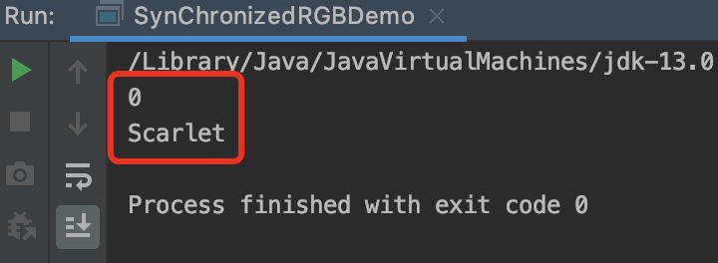
A Synchronized Class Example
Thread t2 = new Thread(new Runnable() { @Override public void run() { color.set(255, 0, 0, "Scarlet"); } }); t2.start(); } public static void main(String args[]) throws InterruptedException { SynChronizedRGBDemo s = new SynChronizedRGBDemo(); s.demo(); } }

Slide 51
A Strategy for Defining Immutable Objects
The following rules define a simple strategy for creating immutable objects.
Don't provide "setter" methods — methods that modify fields or objects referred to by fields.
Make all fields final and private.
Don't allow subclasses to override methods. The simplest way to do this is to declare the class as final. A more sophisticated approach is to make the constructor private and construct instances in factory methods.
If the instance fields include references to mutable objects, don't allow those objects to be changed:
Don't provide methods that modify the mutable objects.
Don't share references to the mutable objects.

Slide 52
A Strategy for Defining Immutable Objects
final public class ImmutableRGB {
// Values must be between 0 and 255.
final private int red;
final private int green;
final private int blue;
final private String name;
private void check(int red, int green, int blue) {
if (red < 0 || red > 255 || green < 0 || green > 255 || blue < 0 || blue > 255)
{ throw new IllegalArgumentException(); }
}
public ImmutableRGB(int red, int green, int blue, String name) {
check(red, green, blue);
this.red = red;
this.green = green;
this.blue = blue;
this.name = name;
}

Slide 53
A Strategy for Defining Immutable Objects
public int getRGB() {
return ((red << 16) | (green << 8) | blue);
}
public String getName() { return name; }
public ImmutableRGB invert() {
return new ImmutableRGB(255 - red, 255 - green,
255 - blue, "Inverse of " + name);
}
}

Slide 54
High Level Concurrency Objects
We'll look at some of the high-level concurrency. Most of these features are implemented in the new java.util.concurrent packages.
Lock objects support locking idioms that simplify many concurrent applications.
Executors define a high-level API for launching and managing threads. Executor implementations provided by java.util.concurrent provide thread pool management suitable for large-scale applications.
Concurrent collections make it easier to manage large collections of data, and can greatly reduce the need for synchronization.
Atomic variables have features that minimize synchronization and help avoid memory consistency errors.
ThreadLocalRandom provides efficient generation of pseudorandom numbers from multiple threads.

Slide 55
Lock Objects
Lock objects work very much like the implicit locks used by synchronized code.
As with implicit locks, only one thread can own a Lock object at a time.
Lock objects also support a wait/notify mechanism, through their associated Condition objects.
The biggest advantage of Lock objects over implicit locks is their ability to back out of an attempt to acquire a lock.
The tryLock method backs out if the lock is not available immediately or before a timeout expires (if specified).
The lockInterruptibly method backs out if another thread sends an interrupt before the lock is acquired.

Slide 56
Lock Objects
import java.util.concurrent.locks.Lock;
import java.util.concurrent.locks.ReentrantLock;
import java.util.Random;
public class Safelock {
static class Friend {
private final String name;
private final Lock lock = new ReentrantLock();
public Friend(String name) { this.name = name; }
public String getName() { return this.name; }
public boolean impendingBow(Friend bower) {
Boolean myLock = false;
Boolean yourLock = false;
try {
myLock = lock.tryLock();
yourLock = bower.lock.tryLock();
} finally {
if (! (myLock && yourLock)) {
if (myLock) { lock.unlock(); }
if (yourLock) { bower.lock.unlock(); }
}
}
return myLock && yourLock;
}

Slide 57
Lock Objects
public void bow(Friend bower) {
if (impendingBow(bower)) {
try {
System.out.format("%s: %s has" + "bowed to me!%n", this.name, bower.getName());
bower.bowBack(this);
} finally {
lock.unlock();
bower.lock.unlock();
}
} else {
System.out.format("%s: %s started" + " to bow to me, but saw that" +
" I was already bowing to" + " him.%n", this.name, bower.getName());
}
}
public void bowBack(Friend bower) {
System.out.format("%s: %s has" + " bowed back to me!%n", this.name, bower.getName());
}
}

Slide 58
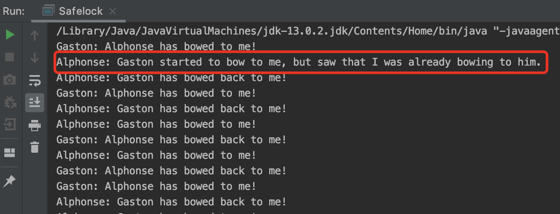
Lock Objects
static class BowLoop implements Runnable {
private Friend bower;
private Friend bowee;
public BowLoop(Friend bower, Friend bowee) {
this.bower = bower;
this.bowee = bowee;
}
public void run() {
Random random = new Random();
for (;;) {
try { Thread.sleep(random.nextInt(10)); }
catch (InterruptedException e) {}
bowee.bow(bower);
}
}
}
public static void main(String[] args) {
final Friend alphonse = new Friend("Alphonse");
final Friend gaston = new Friend("Gaston");
new Thread(new BowLoop(alphonse, gaston)).start();
new Thread(new BowLoop(gaston, alphonse)).start();
}
}

Slide 59
Executors
In all of the previous examples,
there's a close connection between the task being done by a new thread, as defined by its Runnable object, and the thread itself, as defined by a Thread object.
This works well for small applications, but in large-scale applications, it makes sense to separate thread management and creation from the rest of the application.
Objects that encapsulate these functions are known as executors.
Executor Interfaces define the three executor object types.
Thread Pools are the most common kind of executor implementation.
Fork/Join is a framework for taking advantage of multiple processors.

Slide 60
Executor Interfaces
The java.util.concurrent package defines three executor interfaces:
The Executor Interface
The Executor interface provides a single method, execute, designed to be a drop-in replacement for a common thread-creation idiom. If r is a Runnable object, and e is an Executor object you can replace
(new Thread(r)).start();
With
e.execute(r);

Slide 61
Executor Interfaces
The java.util.concurrent package defines three executor interfaces:
The ExecutorService Interface
The ExecutorService interface supplements execute with a similar, but more versatile submit method.
Like execute, submit accepts Runnable objects, but also accepts Callable objects, which allow the task to return a value.
The submit method returns a Future object, which is used to retrieve the Callable return value and to manage the status of both Callable and Runnable tasks.

Slide 62
Executor Interfaces
The java.util.concurrent package defines three executor interfaces:
The ScheduledExecutorService Interface
The ScheduledExecutorService interface supplements the methods of its parent ExecutorService with schedule, which executes a Runnable or Callable task after a specified delay.

Slide 63
Thread Pools
Most of the executor implementations in java.util.concurrent use thread pools, which consist of worker threads.
This kind of thread exists separately from the Runnable and Callable tasks it executes and is often used to execute multiple tasks.
Using worker threads minimizes the overhead due to thread creation
One common type of thread pool is the fixed thread pool. This type of pool always has a specified number of threads running.
An important advantage of the fixed thread pool is that applications using it degrade gracefully.

Slide 64
Thread Pools
A simple way to create an executor that uses a fixed thread pool is
to invoke the newFixedThreadPool factory method in java.util.concurrent.Executors
This class also provides the following factory methods:
The newCachedThreadPool method creates an executor with an expandable thread pool. This executor is suitable for applications that launch many short-lived tasks.
The newSingleThreadExecutor method creates an executor that executes a single task at a time.

Slide 65
Fork/Join
The fork/join framework is an implementation of the ExecutorService interface that helps you take advantage of multiple processors.
It is designed for work that can be broken into smaller pieces recursively.
The goal is to use all the available processing power to enhance the performance of your application.
Your code should look similar to the following pseudocode:
if (my portion of the work is small enough)
do the work directly
else
split my work into two pieces
invoke the two pieces and wait for the results
Wrap this code in a ForkJoinTask subclass, typically using one of its more specialized types, either RecursiveTask (which can return a result) or RecursiveAction.

Slide 66
Fork/Join
Suppose that you want to blur an image.
The original source image is represented by an array of integers, where each integer contains the color values for a single pixel.
Performing the blur is accomplished by working through the source array one pixel at a time.
Each pixel is averaged with its surrounding pixels (the red, green, and blue components are averaged), and the result is placed in the destination array.
Since an image is a large array, this process can take a long time.
You can take advantage of concurrent processing on multiprocessor systems by implementing the algorithm using the fork/join framework.

Slide 67
Fork/Join
public class ForkBlur extends RecursiveAction {
private int[] mSource;
private int mStart;
private int mLength;
private int[] mDestination;
// Processing window size; should be odd.
private int mBlurWidth = 15;
public ForkBlur(int[] src, int start, int length, int[] dst) {
mSource = src;
mStart = start;
mLength = length;
mDestination = dst;
}

Slide 68
Fork/Join
protected void computeDirectly() {
int sidePixels = (mBlurWidth - 1) / 2;
for (int index = mStart; index < mStart + mLength; index++) {
// Calculate average.
float rt = 0, gt = 0, bt = 0;
for (int mi = -sidePixels; mi <= sidePixels; mi++) {
int mindex = Math.min(Math.max(mi + index, 0),
mSource.length - 1);
int pixel = mSource[mindex];
rt += (float)((pixel & 0x00ff0000) >> 16) / mBlurWidth;
gt += (float)((pixel & 0x0000ff00) >> 8) / mBlurWidth;
bt += (float)((pixel & 0x000000ff) >> 0) / mBlurWidth;
}
// Reassemble destination pixel.
int dpixel = (0xff000000 ) |
(((int)rt) << 16) |
(((int)gt) << 8) |
(((int)bt) << 0);
mDestination[index] = dpixel;
}
}
...

Slide 69
Fork/Join
Now you implement the abstract compute() method, which either performs the blur directly or splits it into two smaller tasks. A simple array length threshold helps determine whether the work is performed or split.
protected static int sThreshold = 100000;
protected void compute() {
if (mLength < sThreshold) {
computeDirectly();
return;
}
int split = mLength / 2;
invokeAll(
new ForkBlur(mSource, mStart, split, mDestination),
new ForkBlur(mSource, mStart + split, mLength - split, mDestination));
}

Slide 70
Fork/Join
If the previous methods are in a subclass of the RecursiveAction class, then setting up the task to run in a ForkJoinPool is straightforward, and involves the following steps:
Create a task that represents all of the work to be done.
// source image pixels are in src
// destination image pixels are in dst
ForkBlur fb = new ForkBlur(src, 0, src.length, dst);
Create the ForkJoinPool that will run the task.
ForkJoinPool pool = new ForkJoinPool();
Run the task.
pool.invoke(fb);

Slide 71
Atomic Variables
The java.util.concurrent.atomic package defines classes that support atomic operations on single variables.
All classes have get and set methods that work like reads and writes on volatile variables.
That is, a set has a happens-before relationship with any subsequent get on the same variable.
The atomic compareAndSet method also has these memory consistency features, as do the simple atomic arithmetic methods that apply to integer atomic variables.

Slide 72
Atomic Variables
class Counter {
private int c = 0;
public void increment() {
c++;
}
public void decrement() {
c--;
}
public int value() {
return c;
}
}

Slide 73
Atomic Variables
One way to make Counter safe from thread interference is to make its methods synchronized, as in SynchronizedCounter:
class SynchronizedCounter {
private int c = 0;
public synchronized void increment() {
c++;
}
public synchronized void decrement() {
c--;
}
public synchronized int value() {
return c;
}
}

Slide 74
Atomic Variables
Replacing the int field with an AtomicInteger allows us to prevent thread interference without resorting to synchronization, as in AtomicCounter:
import java.util.concurrent.atomic.AtomicInteger;
class AtomicCounter {
private AtomicInteger c = new AtomicInteger(0);
public void increment() {
c.incrementAndGet();
}
public void decrement() {
c.decrementAndGet();
}
public int value() {
return c.get();
}
}

Slide 75
Virtual Threads
Virtual threads are lightweight threads that reduce the effort of writing, maintaining, and debugging high-throughput concurrent applications.
Note:
This is a preview feature.
A preview feature is a feature whose design, specification, and implementation are complete, but is not permanent.
A preview feature may exist in a different form or not at all in future Java SE releases.

Slide 76
Virtual Threads
What is a Platform Thread?
A platform thread is implemented as a thin wrapper around an operating system (OS) thread.
A platform thread runs Java code on its underlying OS thread, and the platform thread captures its OS thread for the platform thread's entire lifetime.
Consequently, the number of available platform threads is limited to the number of OS threads.
Platform threads typically have a large thread stack and other resources that are maintained by the operating system. Platform threads support thread-local variables.
Platforms threads are suitable for running all types of tasks but may be a limited resource.

Slide 77
Virtual Threads
What is a Virtual Thread?
Like a platform thread, a virtual thread is also an instance of java.lang.Thread.
However, a virtual thread isn't tied to a specific OS thread.
A virtual thread still runs code on an OS thread.
However, when code running in a virtual thread calls a blocking I/O operation, the Java runtime suspends the virtual thread until it can be resumed. The OS thread associated with the suspended virtual thread is now free to perform operations for other virtual threads.
Unlike platform threads,
virtual threads typically have a shallow call stack, performing as few as a single HTTP client call or a single JDBC query.
Virtual threads are suitable for running tasks that spend most of the time blocked, often waiting for I/O operations to complete. However, they aren't intended for long-running CPU-intensive operations.

Slide 78
Virtual Threads
Thread thread = Thread.ofVirtual().start(() -> System.out.println("Hello"));
thread.join();
try {
Thread.Builder builder = Thread.ofVirtual().name("MyThread");
Runnable task = () -> {
System.out.println("Running thread");
};
Thread t = builder.start(task);
System.out.println("Thread t name: " + t.getName());
t.join();
} catch (InterruptedException e) {
e.printStackTrace();
}

Slide 79
Virtual Threads
public class CreateNamedThreadsWithBuilders {
public static void main(String[] args) {
try {
Thread.Builder builder =
Thread.ofVirtual().name("worker-", 0);
Runnable task = () -> {
System.out.println("Thread ID: " +
Thread.currentThread().threadId());
};
// name "worker-0"
Thread t1 = builder.start(task);
t1.join();
System.out.println(t1.getName() + " terminated");
// name "worker-1"
Thread t2 = builder.start(task);
t2.join();
System.out.println(t2.getName() + " terminated");
} catch (InterruptedException e) {
e.printStackTrace();
}
}
}

Slide 80
Virtual Threads
while (true) {
Socket clientSocket = serverSocket.accept();
// Accept incoming connections
// Start a service thread
Thread.ofVirtual().start(() -> {
try (
PrintWriter out =
new PrintWriter(clientSocket.getOutputStream(), true);
BufferedReader in = new BufferedReader(
new InputStreamReader(clientSocket.getInputStream()));
) {
String inputLine;
while ((inputLine = in.readLine()) != null) {
System.out.println(inputLine);
out.println(inputLine);
}
} catch (IOException e) {
e.printStackTrace();
}
Multithreaded Client Server Example
public class EchoServer {
public static void main(String[] args) throws IOException {
if (args.length != 1) {
System.err.println("Usage: java EchoServer <port>");
System.exit(1);
}
int portNumber = Integer.parseInt(args[0]);
try (
ServerSocket serverSocket =
new ServerSocket(Integer.parseInt(args[0]));
) {

Slide 81
Virtual Threads
Multithreaded Client Server Example
public class EchoClient {
public static void main(String[] args) throws IOException {
if (args.length != 2) {
System.err.println(
"Usage: java EchoClient <hostname> <port>");
System.exit(1);
}
String hostName = args[0];
int portNumber = Integer.parseInt(args[1]);
try (
Socket echoSocket = new Socket(hostName, portNumber);
PrintWriter out =
new PrintWriter(echoSocket.getOutputStream(), true);
BufferedReader in =
new BufferedReader(
new InputStreamReader(echoSocket.getInputStream()));
) {
BufferedReader stdIn =
new BufferedReader(
new InputStreamReader(System.in));
String userInput;
while ((userInput = stdIn.readLine()) != null) {
out.println(userInput);
System.out.println("echo: " + in.readLine());
if (userInput.equals("bye")) break;
}
} catch (UnknownHostException e) {
System.err.println("Don't know about host " + hostName);
System.exit(1);
} catch (IOException e) {
System.err.println("Couldn't get I/O for the connection to " +
hostName);
System.exit(1);
}
}
}

Slide 82
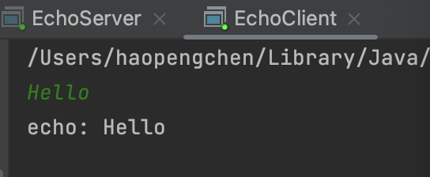
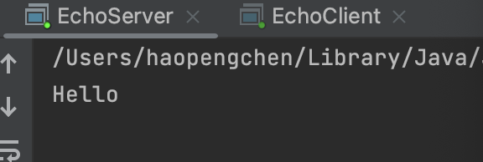
Virtual Threads
Multithreaded Client Server Example

Slide 83
From
Lesson: Concurrency
https://docs.oracle.com/javase/tutorial/essential/concurrency/
进程与线程的一个简单解释
http://www.ruanyifeng.com/blog/2013/04/processes_and_threads.html
Virtual Threads
https://docs.oracle.com/en/java/javase/20/core/virtual-threads.html#GUID-DC4306FC-D6C1-4BCC-AECE-48C32C1A8DAA

Slide 84

Thank You!

