Slide 1
Architecture of Enterprise Applications 7 Memory Caching
Haopeng Chen
REliable, INtelligent and Scalable Systems Group (REINS)
Shanghai Jiao Tong University
Shanghai, China
http://reins.se.sjtu.edu.cn/~chenhp
e-mail: chen-hp@sjtu.edu.cn

Slide 2
Contents and Objectives
Contents
MemCached
Redis
Caching Samples in Spring Web Applications
Objectives
能够根据业务需求，设计并实现基于分布式缓存的数据访问方案，实现数据访问性能的优化

Slide 3
MemCached
Memcached
Free & open source, high-performance, distributed memory object caching system, generic in nature, but intended for use in speeding up dynamic web applications by alleviating database load.
Memcached is an in-memory key-value store for small chunks of arbitrary data (strings, objects) from results of database calls, API calls, or page rendering.
Memcached is simple yet powerful.
Its simple design promotes quick deployment, ease of development, and solves many problems facing large data caches.
Its API is available for most popular languages.
At heart it is a simple Key/Value store.

Slide 4
MemCached
Installing memcached with Homebrew and Lunchy
Step 1 — Install Homebrew
$/bin/bash -c "$(curl -fsSL https://raw.githubusercontent.com/Homebrew/install/HEAD/install.sh)"
Step 2 — Install memcached
$ brew install Memcached
Step 3 — Start/Stop memcached
$ brew services start memcached
$ brew services stop memcached

Slide 5
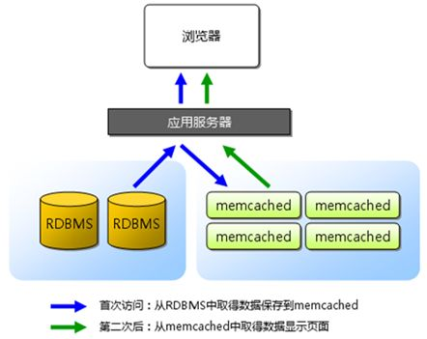
MemCached - Principle

Slide 6
Caching Data with Spring
Book.java
public class Book { private String isbn; private String title; public Book(String isbn, String title) { this.isbn = isbn; this.title = title; } public String getIsbn() { return isbn; } public void setIsbn(String isbn) { this.isbn = isbn; } public String getTitle() { return title; } public void setTitle(String title) { this.title = title; } @Override public String toString() { return "Book{" + "isbn='" + isbn + '\'' + ", title='" + title + '\'' + '}'; } }

Slide 7
Caching Data with Spring
SimpleBookRepository.java
public class SimpleBookRepository implements BookRepository { @Override @Cacheable("books") public Book getByIsbn(String isbn) { simulateSlowService(); return new Book(isbn, "Some book"); } // Don't do this at home private void simulateSlowService() { try { long time = 3000L; Thread.sleep(time); } catch (InterruptedException e) { throw new IllegalStateException(e); } } }
BookRepository.java
public interface BookRepository { Book getByIsbn(String isbn); }

Slide 8
Caching Data with Spring
AppRunner.java
@Component public class AppRunner implements CommandLineRunner { private static final Logger logger = LoggerFactory.getLogger(AppRunner.class); private final BookRepository bookRepository; public AppRunner(BookRepository bookRepository) { this.bookRepository = bookRepository; } @Override public void run(String... args) throws Exception { logger.info(".... Fetching books"); logger.info("isbn-1234 -->" + bookRepository.getByIsbn("isbn-1234")); logger.info("isbn-4567 -->" + bookRepository.getByIsbn("isbn-4567")); logger.info("isbn-1234 -->" + bookRepository.getByIsbn("isbn-1234")); logger.info("isbn-4567 -->" + bookRepository.getByIsbn("isbn-4567")); logger.info("isbn-1234 -->" + bookRepository.getByIsbn("isbn-1234")); logger.info("isbn-1234 -->" + bookRepository.getByIsbn("isbn-1234")); } }

Slide 9
Caching Data with Spring
Se33537SpringcacheApplication.java
@SpringBootApplication @EnableCaching public class Se33537SpringcacheApplication { public static void main(String[] args) { SpringApplication.run(Se33537SpringcacheApplication.class, args); } }
pom.xml
<dependency> <groupId>org.springframework.boot</groupId> <artifactId>spring-boot-starter-cache</artifactId> </dependency>

Slide 10
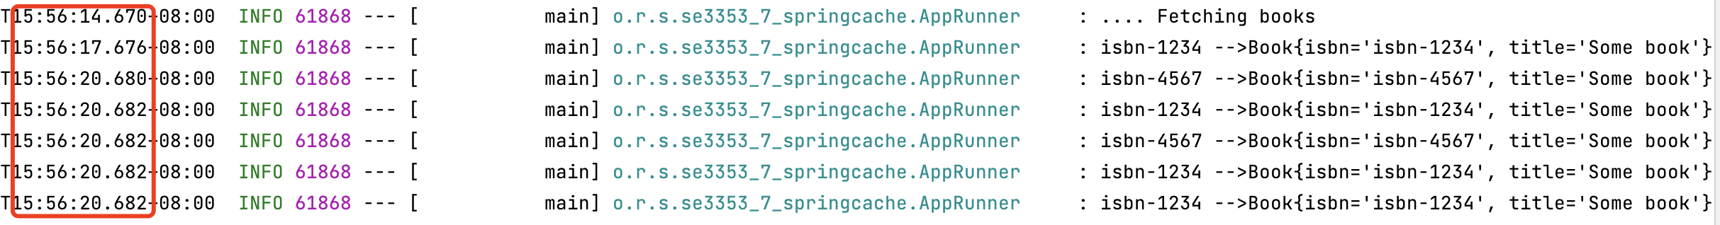
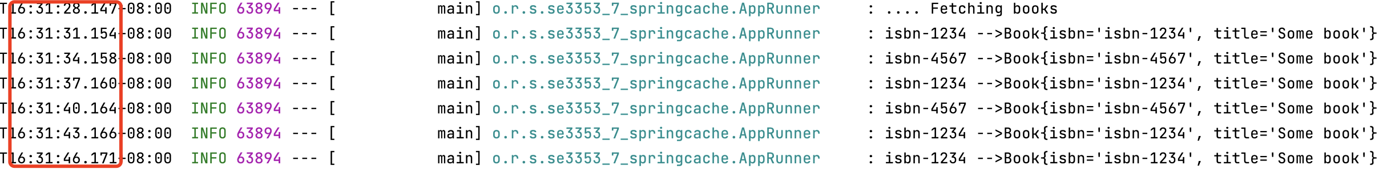
Caching Data with Spring
With Caching
Without Caching

Slide 11
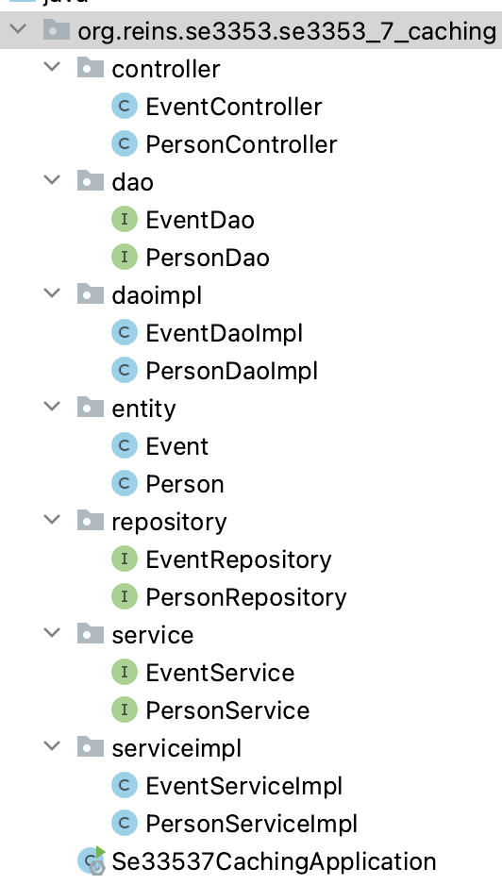
Caching Data with Spring
PersonController.java
@RestController public class PersonController { private static final Logger logger = LoggerFactory.getLogger(PersonController.class); @Autowired private PersonService personService; @GetMapping(value = "/findPerson/{id}") public Person findPerson(@PathVariable("id") String id) { logger.info(".... Fetching books"); System.out.println("Searching Person: " + id); Person person = personService.findPersonById(Integer.valueOf(id)); logger.info(".... Got books"); return person; } }

Slide 12
Caching Data with Spring
PersonDaoImpl.java
@Repository public class PersonDaoImpl implements PersonDao { @Autowired private PersonRepository personRepository; @Override @Cacheable("books") public Person findOne(Integer id) { simulateSlowService(); return personRepository.getOne(id); } private void simulateSlowService() { try { long time = 3000L; Thread.sleep(time); } catch (InterruptedException e) { throw new IllegalStateException(e); } } }

Slide 13
Caching Data with Spring
Se33537CachingApplication.java
@SpringBootApplication @EnableCaching public class Se33537CachingApplication { public static void main(String[] args) { SpringApplication.run(Se33537CachingApplication.class, args); } }

Slide 14
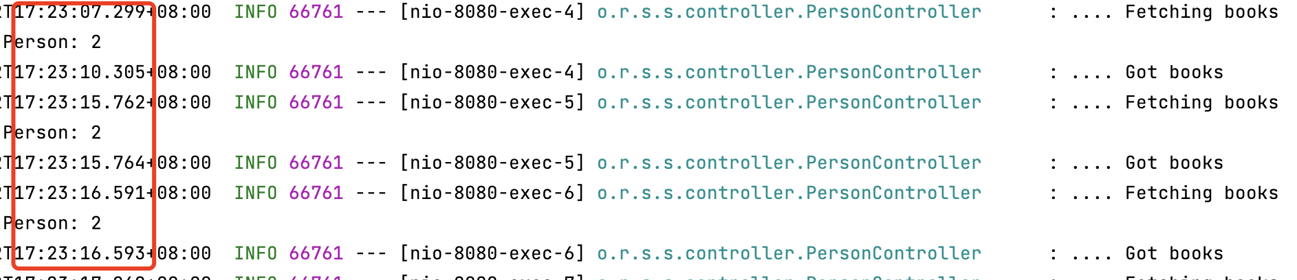
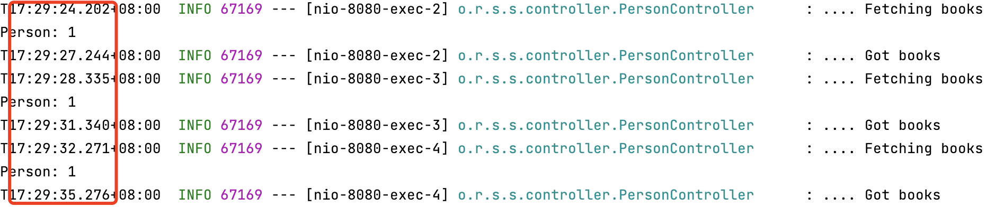
Caching Data with Spring
With Caching
Without Caching

Slide 15
MemCached - Storage Commands
set
Most common command. Store this data, possibly overwriting any existing data. New items are at the top of the LRU.
add
Store this data, only if it does not already exist. New items are at the top of the LRU. If an item already exists and an add fails, it promotes the item to the front of the LRU anyway.
replace
Store this data, but only if the data already exists. Almost never used, and exists for protocol completeness (set, add, replace, etc)
append
Add this data after the last byte in an existing item. This does not allow you to extend past the item limit. Useful for managing lists.
prepend
Same as append, but adding new data before existing data.
cas
Check And Set (or Compare And Swap). An operation that stores data, but only if no one else has updated the data since you read it last. Useful for resolving race conditions on updating cache data.

Slide 16
MemCached - Retrieval Commands
get
Command for retrieving data. Takes one or more keys and returns all found items.
gets
An alternative get command for using with CAS. Returns a CAS identifier (a unique 64bit number) with the item. Return this value with the cas command. If the item's CAS value has changed since you gets'ed it, it will not be stored.
delete
Removes an item from the cache, if it exists.
incr/decr
Increment and Decrement. If an item stored is the string representation of a 64bit integer, you may run incr or decr commands to modify that number. You may only incr by positive values, or decr by positive values. They does not accept negative values.
If a value does not already exist, incr/decr will fail.

Slide 17
MemCached
memcached also allows you to make better use of your memory.
Each node is completely independent (top).
Each node can make use of memory from other nodes (bottom)

Slide 18
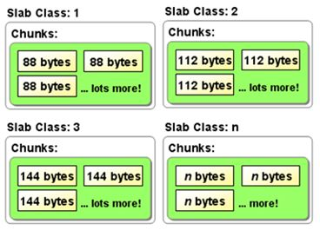
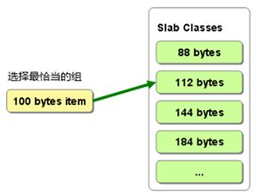
MemCached - Memory Management

Slide 19
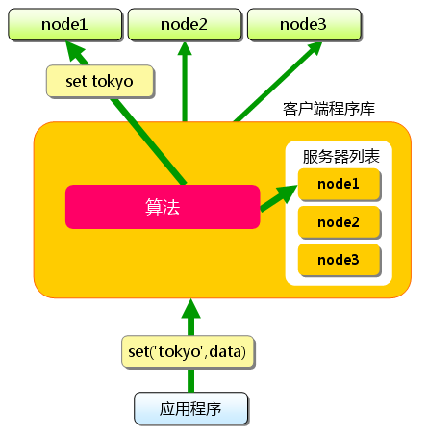
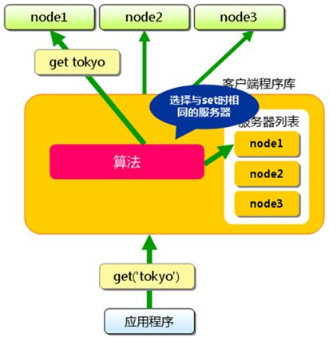
MemCached - Distribution

Slide 20
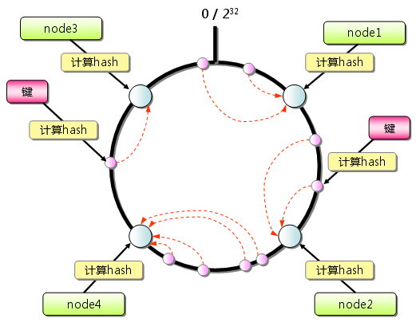
MemCached - Distribution

Slide 21
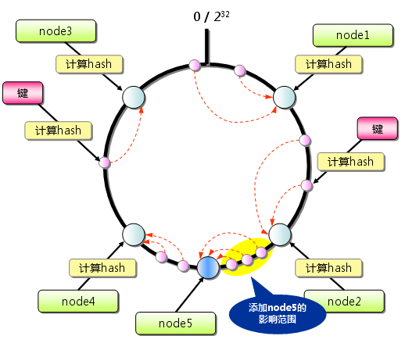
MemCached - Distribution

Slide 22
Redis
Redis is what is called a key-value store,
often referred to as a NoSQL database.
The essence of a key-value store is the ability to store some data, called a value, inside a key.
Redis is an open source, BSD licensed, advanced key-value store.
It is often referred to as a data structure server since keys can contain strings, hashes, lists, sets and sorted sets.
In order to achieve its outstanding performance, Redis works with an in-memory dataset.
Depending on your use case, you can persist it either by dumping the dataset to disk every once in a while, or by appending each command to a log.
Redis also supports trivial-to-setup master-slave replication,
with very fast non-blocking first synchronization, auto-reconnection on net split and so forth.

Slide 23
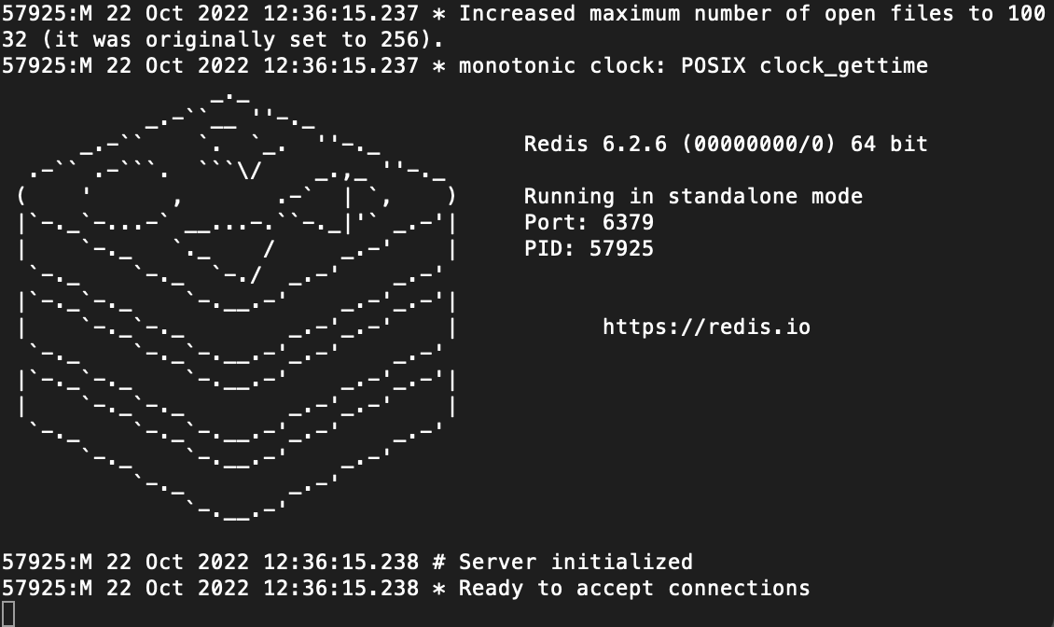
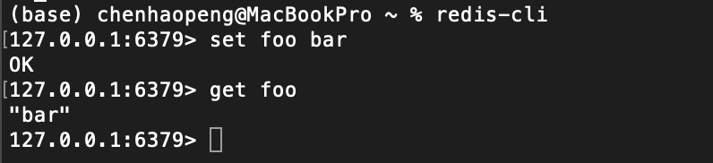
Redis
https://redis.io/docs/getting-started/installation/
Download, extract and compile Redis with:
$ brew install redis
Start and Stop redis server
$ redis-server
Ctrl-C
Run redis Client
$ redis-cli
redis> set foo bar
OK
redis> get foo
"bar"

Slide 24
Redis - structure in Redis

Slide 25
Redis - String
String in Redis

Slide 26
Redis - List
List in Redis

Slide 27
Redis - Set
Set in Redis

Slide 28
Redis - Hash
Hash in Redis

Slide 29
Redis - Sorted Set
Sorted set in Redis

Slide 30
Redis

Slide 31
Redis - Example
application.properties
# Redis数据库索引（默认为0） spring.data.redis.database=0 # Redis服务器地址 spring.data.redis.host=localhost # Redis服务器连接端口 spring.data.redis.port=6379 # Redis服务器连接密码（默认为空） spring.data.redis.password= # 连接超时时间（毫秒） spring.data.redis.timeout=300

Slide 32
Redis - Example
PersonDaoImpl.java
@Repository public class PersonDaoImpl implements PersonDao { @Autowired private PersonRepository personRepository; @Autowired private RedisTemplate redisTemplate; @Override public Person findOne(Integer id) { Person person = null; String p = (String)redisTemplate.opsForValue().get("user" + id); if (p == null) { person = personRepository.getOne(id); redisTemplate.opsForValue().set("user" + id, JSON.toJSONString(person)); } else { person = JSON.parseObject(p, Person.class); System.out.println("Person: " + id + " is in Redis"); } return person; }
}

Slide 33
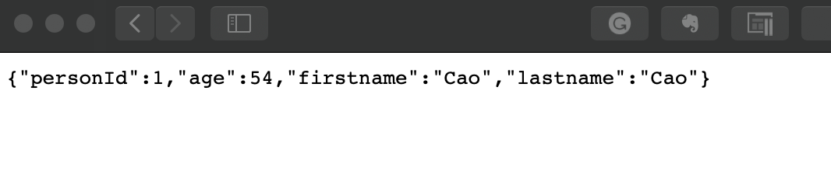
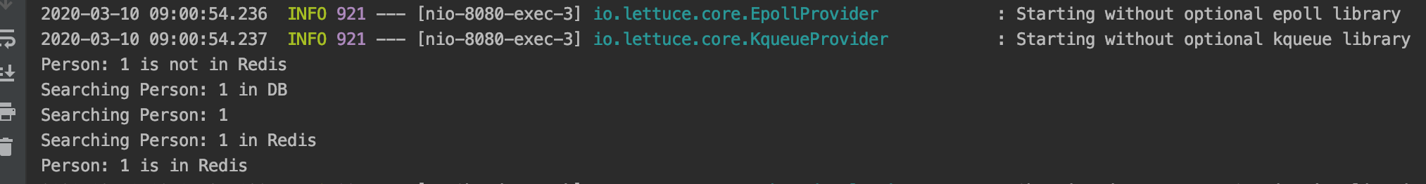
Redis - Example

Slide 34
Messaging with Redis
MessagingRedisApplication.java
@SpringBootApplication public class MessagingRedisApplication { private static final Logger LOGGER = LoggerFactory.getLogger(MessagingRedisApplication.class); @Bean RedisMessageListenerContainer container(RedisConnectionFactory connectionFactory, MessageListenerAdapter listenerAdapter) { RedisMessageListenerContainer container = new RedisMessageListenerContainer(); container.setConnectionFactory(connectionFactory); container.addMessageListener(listenerAdapter, new PatternTopic("chat")); return container; }

Slide 35
Messaging with Redis
MessagingRedisApplication.java
@Bean MessageListenerAdapter listenerAdapter(Receiver receiver) { return new MessageListenerAdapter(receiver, "receiveMessage"); } @Bean Receiver receiver() { return new Receiver(); } @Bean StringRedisTemplate template(RedisConnectionFactory connectionFactory) { return new StringRedisTemplate(connectionFactory); } public static void main(String[] args) throws InterruptedException { ApplicationContext ctx = SpringApplication.run(MessagingRedisApplication.class, args); } }

Slide 36
Messaging with Redis
Receiver.java
package com.example.messagingredis; import java.util.concurrent.atomic.AtomicInteger; import org.slf4j.Logger; import org.slf4j.LoggerFactory; public class Receiver { private static final Logger LOGGER = LoggerFactory.getLogger(Receiver.class); private AtomicInteger counter = new AtomicInteger(); public void receiveMessage(String message) { LOGGER.info("Received <" + message + ">"); counter.incrementAndGet(); LOGGER.info("counter <" + counter.get() + ">"); } public int getCount() { return counter.get(); } }

Slide 37
Messaging with Redis
MsgController.java
package com.example.messagingredis; import org.springframework.beans.factory.annotation.Autowired; import org.springframework.data.redis.core.StringRedisTemplate; import org.springframework.web.bind.annotation.*; import org.springframework.web.context.WebApplicationContext; @RestController public class MsgController { @Autowired WebApplicationContext applicationContext; @GetMapping(value = "/msg") public void findOne( ) { StringRedisTemplate template = applicationContext.getBean(StringRedisTemplate.class); // Send a message with a POJO - the template reuse the message converter System.out.println("Sending an email message."); template.convertAndSend("chat", "Hello from Redis in HTTP!"); }; }

Slide 38
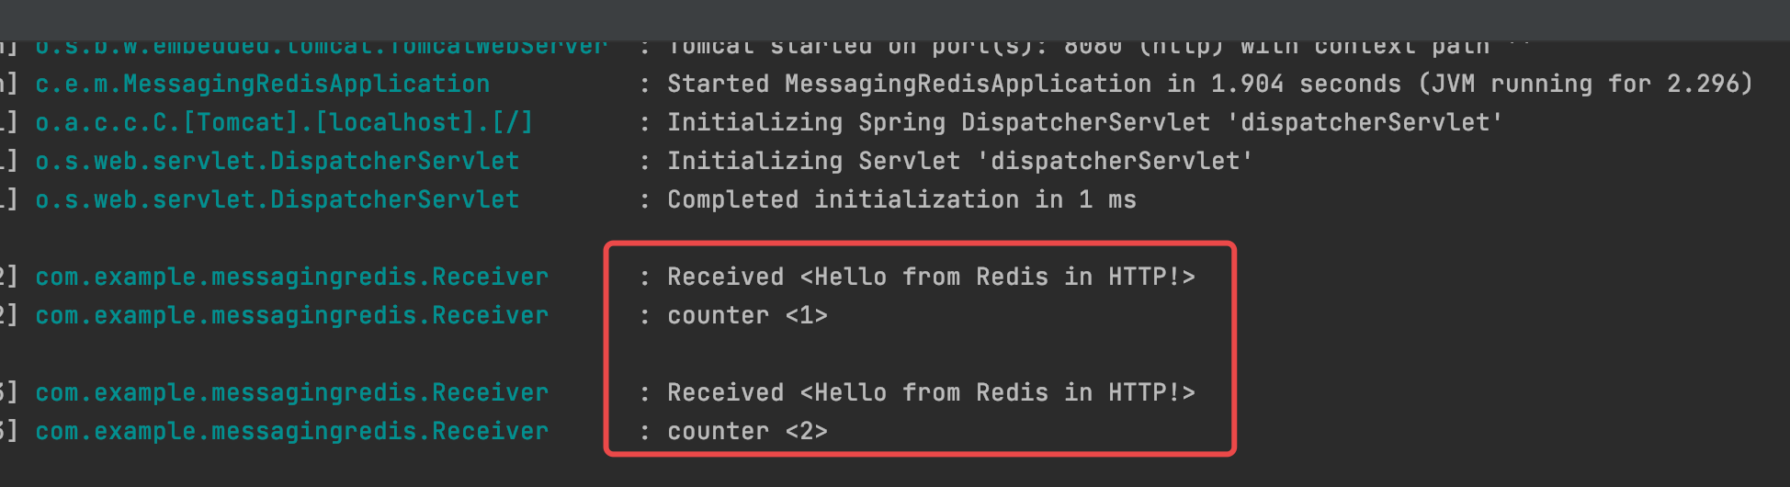
Messaging with Redis
pom.xml
<dependency> <groupId>org.springframework.boot</groupId> <artifactId>spring-boot-starter-data-redis</artifactId> </dependency>

Slide 39
References
MemCached
https://memcached.org/
MemCached
https://github.com/memcached/memcached/wiki
xmemcached
https://code.google.com/archive/p/xmemcached/
HomeBrew
https://brew.sh
Installing memcached on Mac with Homebrew and Lunchy
https://gist.github.com/tomysmile/ba6c0ba4488ea51e6423d492985a7953
Memcached结合Spring
https://www.jianshu.com/p/56d9d79d75b3
Accessing Memcached from the command line
http://www.alphadevx.com/a/90-Accessing-Memcached-from-the-command-line
Caching Data with Spring
https://spring.io/guides/gs/caching/

Slide 40
References
Redis
https://redis.io
Spring Data Redis
https://docs.spring.io/spring-data/redis/docs/2.2.5.RELEASE/reference/html/#get-started
https://github.com/ZhangZiSheng001/spring-data-projects/tree/master/spring-data-redis-demo
Retwis
https://github.com/spring-projects/spring-data-keyvalue-examples
https://docs.spring.io/spring-data/data-keyvalue/examples/retwisj/current/
Jedis
https://github.com/xetorthio/jedis
SpringBoot整合Redis实战项目
https://www.cnblogs.com/david1216/p/11473764.html
Redis in Action
JOSIAH L. CARLSON, Manning Publications Co, 2013
Messaging with Redis
https://spring.io/guides/gs/messaging-redis/

Slide 41

Thank You!

