Slide 1
Architecture of Enterprise Applications 10 Microservices & Serverless
Haopeng Chen
REliable, INtelligent and Scalable Systems Group (REINS)
Shanghai Jiao Tong University
Shanghai, China
http://reins.se.sjtu.edu.cn/~chenhp
e-mail: chen-hp@sjtu.edu.cn

Slide 2
Contents and Objectives
Contents
Microservice
Routing and Filtering
Severless
Function Service
Objectives
能够根据业务需求，抽象出系统中的微服务，并能够基于Spring框架开发对应的微服务

Slide 3
Microservices
Microservice architectures are the ‘new normal’.
Building small, self-contained, ready to run applications can bring great flexibility and added resilience to your code.
Spring Boot’s many purpose-built features make it easy to build and run your microservices in production at scale.
And don’t forget, no microservice architecture is complete without Spring Cloud ‒ easing administration and boosting your fault-tolerance.
What are microservices?
Microservices are a modern approach to software whereby application code is delivered in small, manageable pieces, independent of others.
Why build microservices?
Their small scale and relative isolation can lead to many additional benefits, such as easier maintenance, improved productivity, greater fault tolerance, better business alignment, and more.

Slide 4
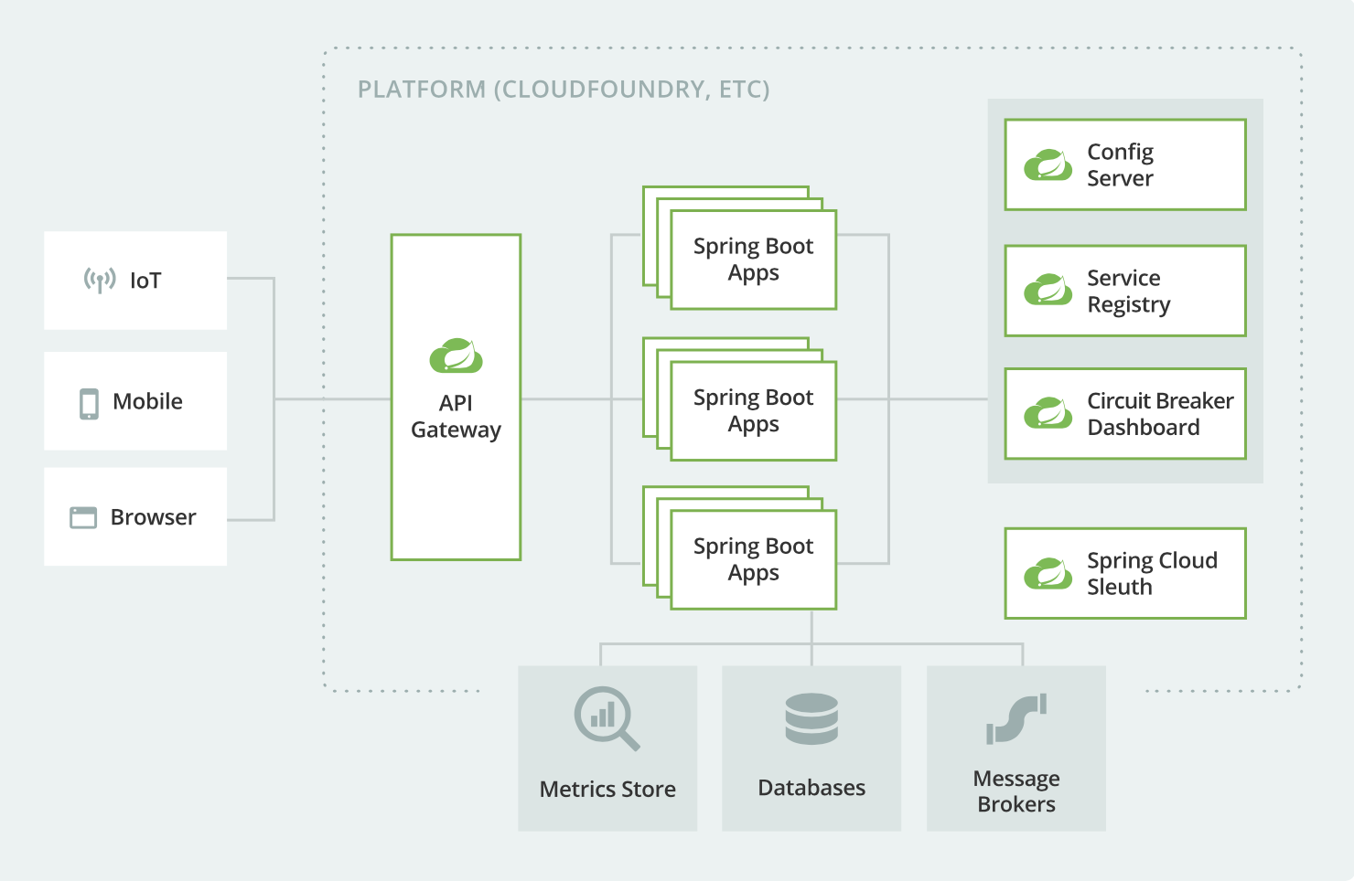
Microservice resilience with Spring Cloud
The distributed nature of microservices brings challenges.
service discovery, load-balancing, circuit-breaking, distributed tracing, and monitoring

Slide 5
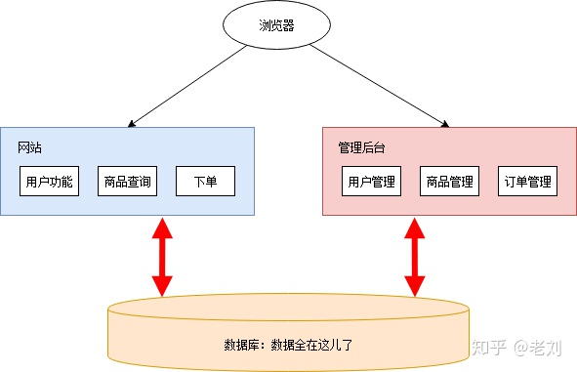
Microservice – a sample
在线商店
From：一文详解微服务架构 https://www.zhihu.com/question/65502802

Slide 6
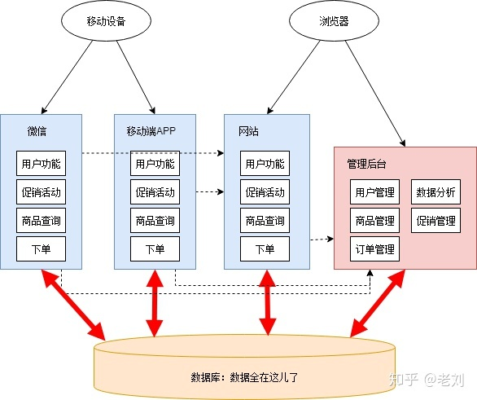
Microservice – a sample
移动端
From：一文详解微服务架构 https://www.zhihu.com/question/65502802

Slide 7
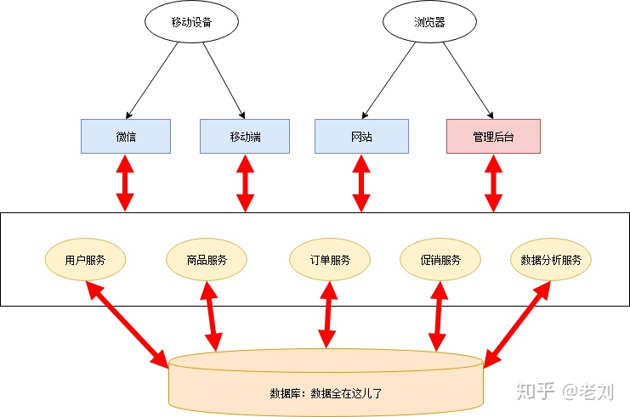
Microservice – a sample
服务独立+共享数据库
From：一文详解微服务架构 https://www.zhihu.com/question/65502802

Slide 8
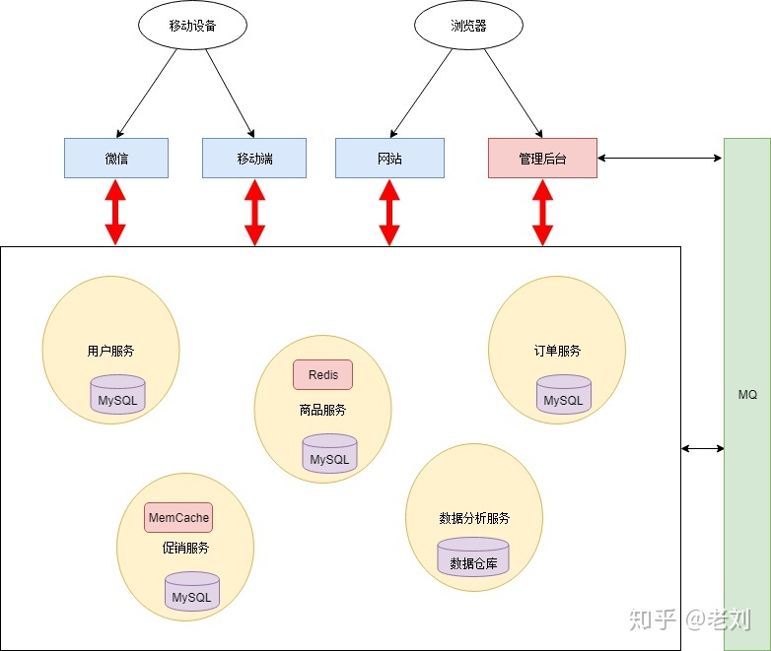
Microservice – a sample
独立数据库+消息队列
From：一文详解微服务架构 https://www.zhihu.com/question/65502802

Slide 9
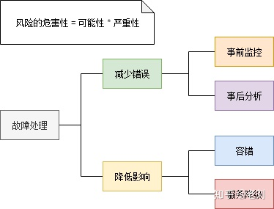
Microservice – a sample
故障处理
From：一文详解微服务架构 https://www.zhihu.com/question/65502802

Slide 10
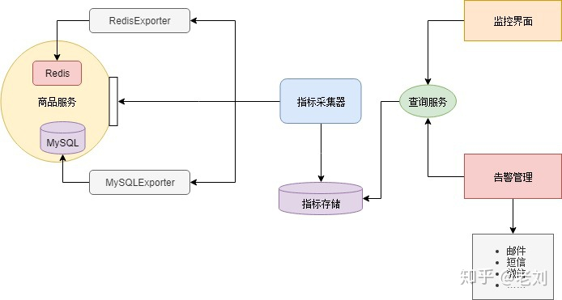
Microservice – a sample
监控-发现故障
From：一文详解微服务架构 https://www.zhihu.com/question/65502802

Slide 11
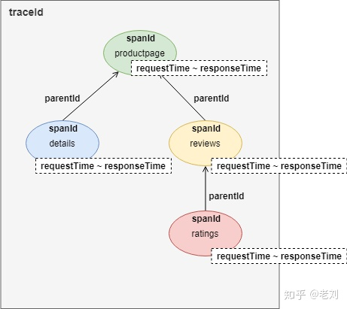
Microservice – a sample
定位问题-链路跟踪
From：一文详解微服务架构 https://www.zhihu.com/question/65502802

Slide 12
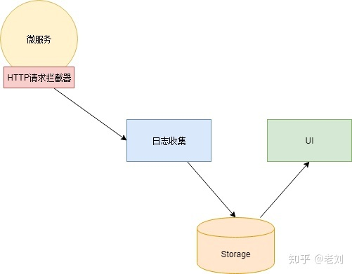
Microservice – a sample
日志收集
From：一文详解微服务架构 https://www.zhihu.com/question/65502802

Slide 13
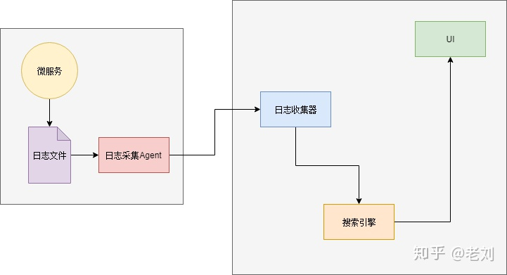
Microservice – a sample
分析问题-日志分析
From：一文详解微服务架构 https://www.zhihu.com/question/65502802

Slide 14
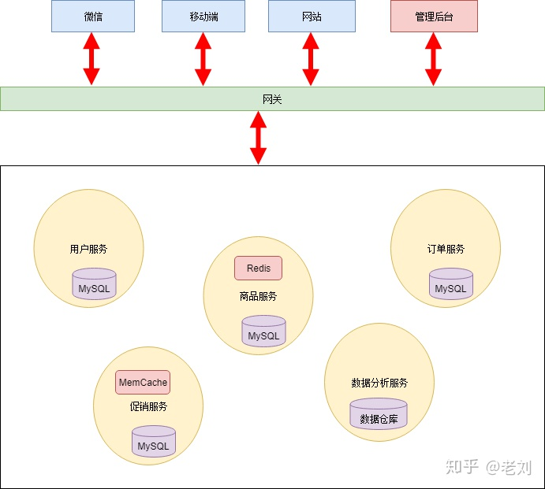
Microservice – a sample
网关
From：一文详解微服务架构 https://www.zhihu.com/question/65502802

Slide 15
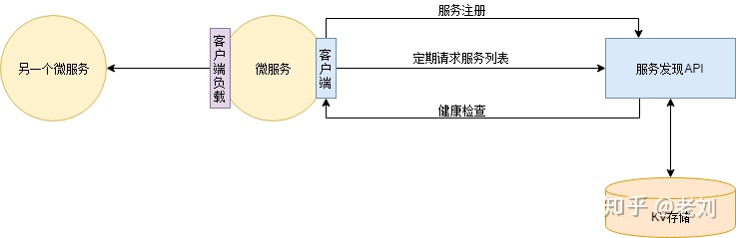
Microservice – a sample
服务注册于发现 - 动态扩容
From：一文详解微服务架构 https://www.zhihu.com/question/65502802

Slide 16
Service Registration & Discovery
In the cloud,
applications can’t always know the exact location of other services.
A service registry, such as Netflix Eureka, or a sidecar solution, such as HashiCorp Consul, can help.
Spring Cloud provides DiscoveryClient implementations for popular registries such as Eureka, Consul, Zookeeper, and even Kubernetes' built-in system.
There’s also a Spring Cloud Load Balancer to help you distribute the load carefully among your service instances.

Slide 17
Eureka
Eureka is
a REST (Representational State Transfer) based service that is primarily used in the AWS cloud for locating services for the purpose of load balancing and failover of middle-tier servers.
We call this service, the Eureka Server.
Eureka also comes with a Java-based client component, the Eureka Client, which makes interactions with the service much easier.
The client also has a built-in load balancer that does basic round-robin load balancing.
At Netflix, a much more sophisticated load balancer wraps Eureka to provide weighted load balancing based on several factors like traffic, resource usage, error conditions etc. to provide superior resiliency.

Slide 18
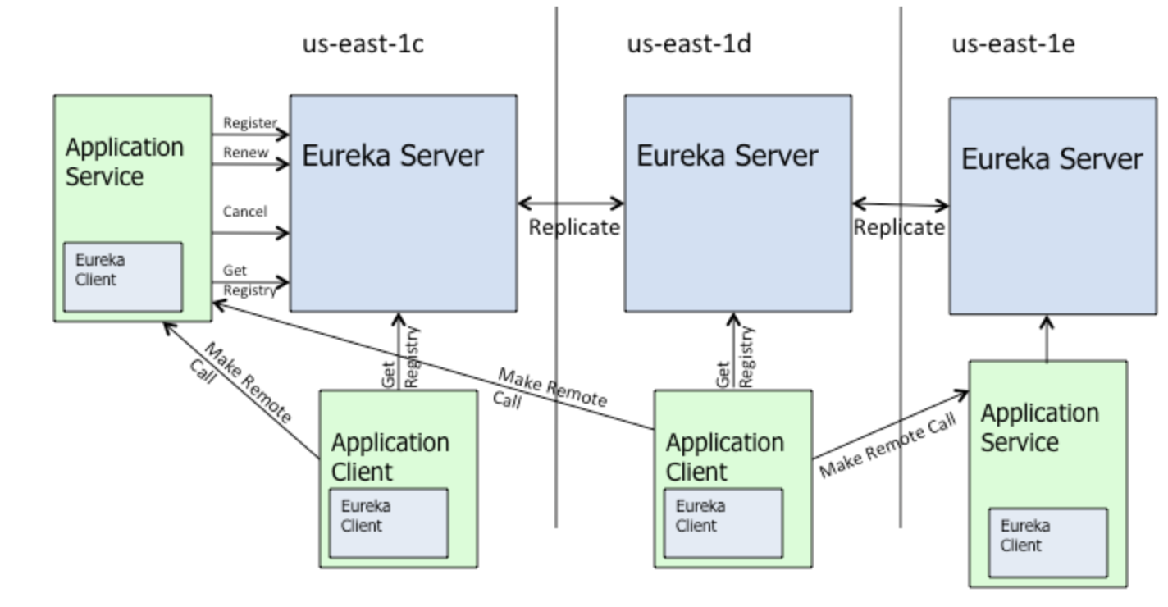
Eureka
High-Level Architecture
There is one eureka cluster per region which knows only about instances in its region. There is at the least one eureka server per zone to handle zone failures.

Slide 19
Service Application
pom.xml
<dependencies>
<dependency> <groupId>org.springframework.cloud</groupId> <artifactId>spring-cloud-starter-netflix-eureka-server</artifactId> </dependency>
</dependencies>
<dependencyManagement> <dependencies> <dependency> <groupId>org.springframework.cloud</groupId> <artifactId>spring-cloud-dependencies</artifactId> <version>${spring-cloud.version}</version> <type>pom</type> <scope>import</scope> </dependency> </dependencies> </dependencyManagement>

Slide 20
Service Application
Main java class
@EnableEurekaServer @SpringBootApplication public class ServiceRegistrationAndDiscoveryServiceApplication { public static void main(String[] args) { SpringApplication.run(
ServiceRegistrationAndDiscoveryServiceApplication.class, args); } }

Slide 21
Service Application
resources/application.properties
server.port=8761 eureka.client.register-with-eureka=false eureka.client.fetch-registry=false logging.level.com.netflix.eureka=OFF logging.level.com.netflix.discovery=OFF

Slide 22
Client Application
pom.xml
<dependencies> <dependency> <groupId>org.springframework.boot</groupId> <artifactId>spring-boot-starter-web</artifactId> </dependency> <dependency> <groupId>org.springframework.cloud</groupId> <artifactId>spring-cloud-starter-netflix-eureka-client</artifactId> </dependency> </dependencies>
<dependencyManagement> <dependencies> <dependency> <groupId>org.springframework.cloud</groupId> <artifactId>spring-cloud-dependencies</artifactId> <version>${spring-cloud.version}</version> <type>pom</type> <scope>import</scope> </dependency> </dependencies> </dependencyManagement>

Slide 23
Client Application
Main java class
@SpringBootApplication public class ServiceRegistrationAndDiscoveryClientApplication { public static void main(String[] args) { SpringApplication.run(ServiceRegistrationAndDiscoveryClientApplication.class, args); } } @RestController class ServiceInstanceRestController { @Autowired private DiscoveryClient discoveryClient; @RequestMapping("/service-instances/{applicationName}") public List<ServiceInstance> serviceInstancesByApplicationName( @PathVariable String applicationName) { return this.discoveryClient.getInstances(applicationName); } }

Slide 24
Client Application
resources/application.properties
spring.application.name=a-bootiful-client

Slide 25
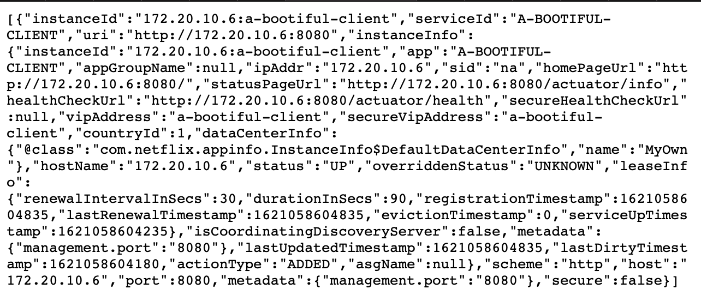
Test the Application
http://localhost:8080/service-instances/a-bootiful-client

Slide 26
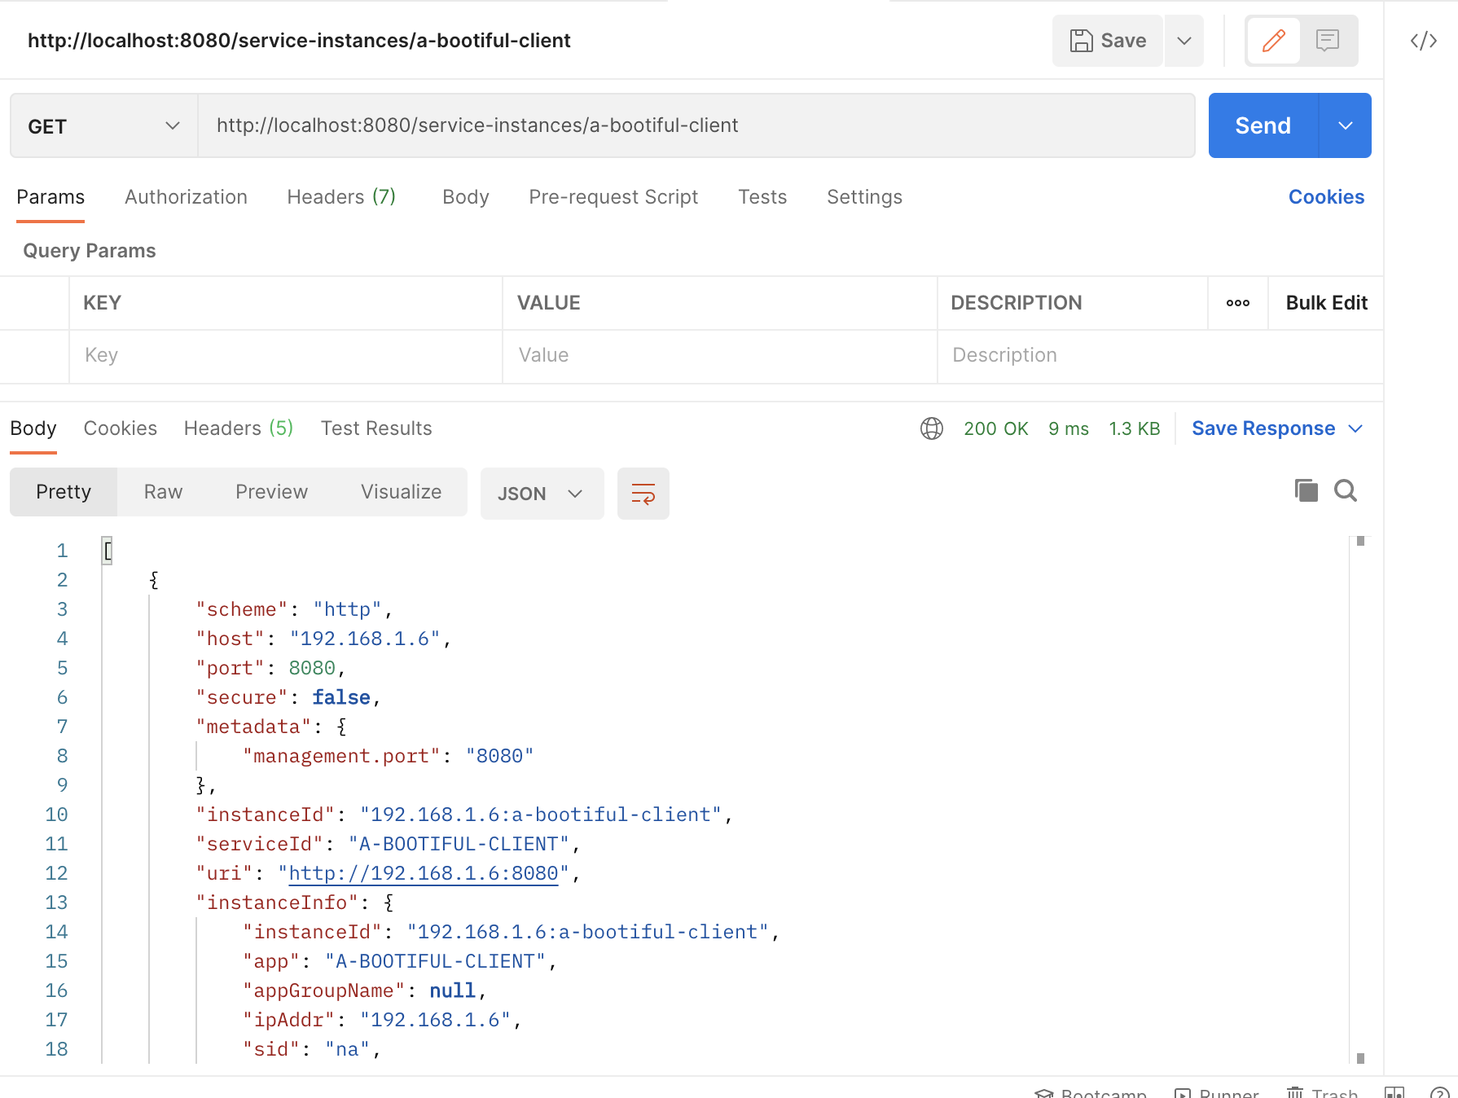
Test the Application
http://localhost:8080/service-instances/a-bootiful-client

Slide 27
Spring Cloud Gateway
pom.xml
<dependencies> <dependency> <groupId>org.springframework.cloud</groupId> <artifactId>spring-cloud-starter-gateway</artifactId> </dependency> <dependency> <groupId>org.springframework.cloud</groupId> <artifactId>spring-cloud-starter-circuitbreaker-reactor-resilience4j</artifactId> </dependency> <dependency> <groupId>org.springframework.cloud</groupId> <artifactId>spring-cloud-starter-contract-stub-runner</artifactId> <exclusions> <exclusion> <artifactId>spring-boot-starter-web</artifactId> <groupId>org.springframework.boot</groupId> </exclusion> </exclusions> </dependency> <dependency> <groupId>org.springframework.boot</groupId> <artifactId>spring-boot-starter-test</artifactId> <scope>test</scope> </dependency> </dependencies>
<!-- https://mvnrepository.com/artifact/io.netty/netty-resolver-dns-native-macos --> <dependency> <groupId>io.netty</groupId> <artifactId>netty-resolver-dns-native-macos</artifactId> <version>4.1.97.Final</version> <classifier>osx-aarch_64</classifier> </dependency>

Slide 28
Spring Cloud Gateway
Main Java Class
@SpringBootApplication @EnableConfigurationProperties(UriConfiguration.class) @RestController public class Se335310GatewayApplication { public static void main(String[] args) { SpringApplication.run(Se335310GatewayApplication.class, args); } @Bean public RouteLocator myRoutes(RouteLocatorBuilder builder, UriConfiguration uriConfiguration) { String httpUri = uriConfiguration.getHttpbin(); return builder.routes() .route(p -> p .path("/get") .filters(f -> f.addRequestHeader("Hello", "World")) .uri(httpUri)) .route(p -> p .host("*.circuitbreaker.com") .filters(f -> f .circuitBreaker(config -> config .setName("mycmd") .setFallbackUri("forward:/fallback"))) .uri(httpUri)) .build(); }
@RequestMapping("/fallback") public Mono<String> fallback() { return Mono.just("fallback"); } }

Slide 29
Spring Cloud Gateway
Main Java Class
@ConfigurationProperties class UriConfiguration { private String httpbin = "http://httpbin.org:80"; public String getHttpbin() { return httpbin; } public void setHttpbin(String httpbin) { this.httpbin = httpbin; } }

Slide 30
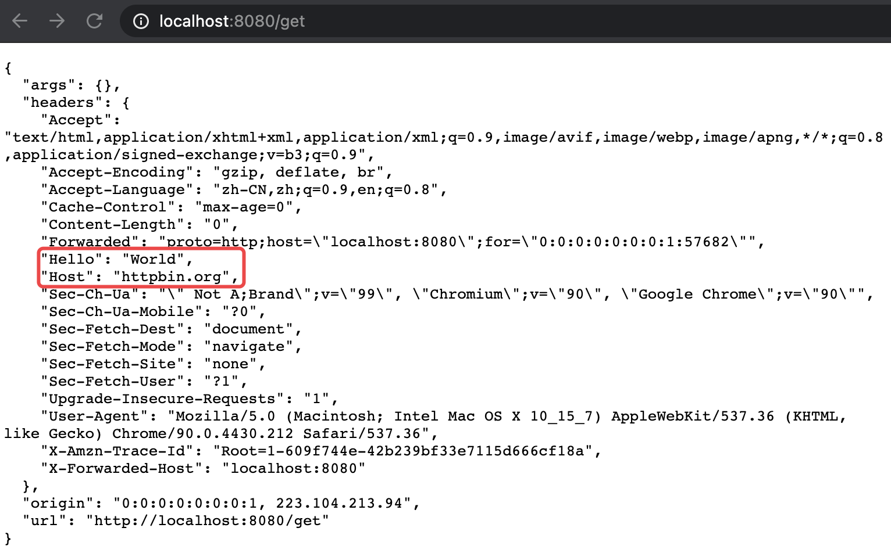
Test the Gateway
http://localhost:8080/get

Slide 31
Routing and Filtering – Book App
Main Java Class
@RestController
@RequestMapping("/books") @SpringBootApplication public class RoutingAndFilteringBookApplication { @RequestMapping(value = "/available") public String available() { return "Spring in Action"; } @RequestMapping(value = "/checked-out") public String checkedOut() { return "Spring Boot in Action"; } public static void main(String[] args) { SpringApplication.run(RoutingAndFilteringBookApplication.class, args); } }

Slide 32
Routing and Filtering – Book App
application.properties
spring.application.name=book server.port=8090

Slide 33
Routing and Filtering – Edge Service
Main Java Class
@SpringBootApplication public class GatewayApplication { public static void main(String[] args) { SpringApplication.run(GatewayApplication.class, args); } @Bean public RouteLocator myRoutes(RouteLocatorBuilder builder) { return builder.routes() .route(p -> p .path("/books/**")
.filters(f->f.rewritePath("/books","")) .uri("http://localhost:8090/")) .build(); } }

Slide 34
Routing and Filtering – Edge Service
application.properties
server.port=8080

Slide 35
Test Gateway
You can access the book application
directly at localhost:8090/available and
through the Gateway service at localhost:8080/books/available.
Visit one of the Book service endpoints
(localhost:8080/books/available or localhost:8080/books/checked-out)

Slide 36
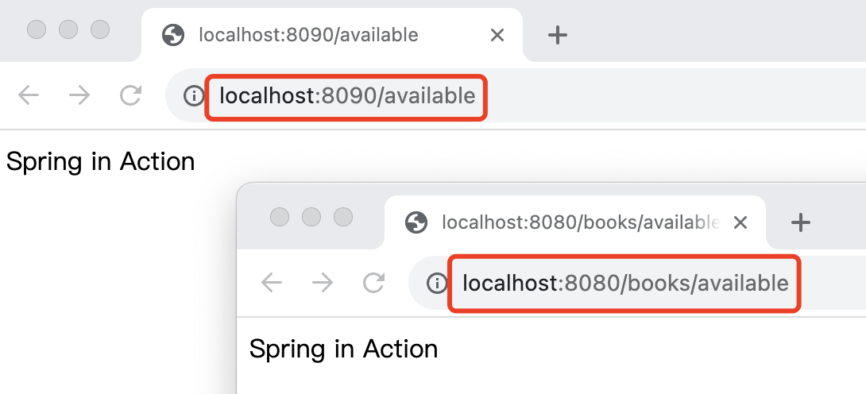
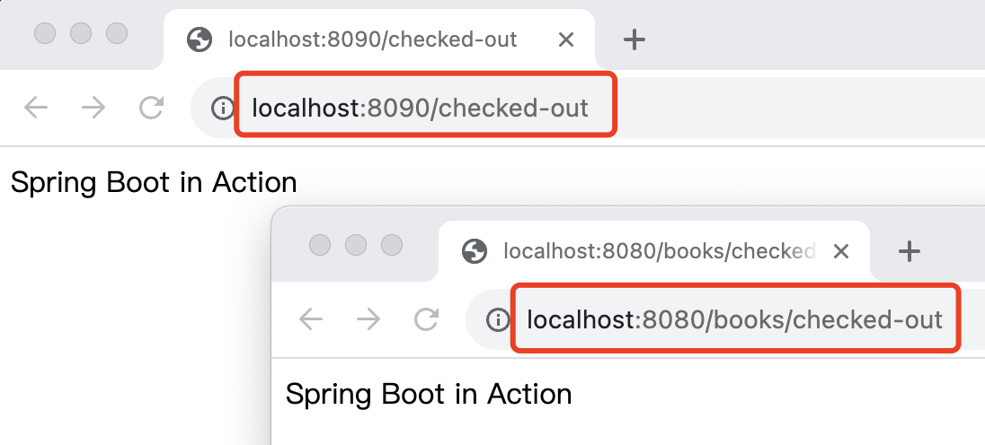
Test Netflix Zuul Gateway

Slide 37
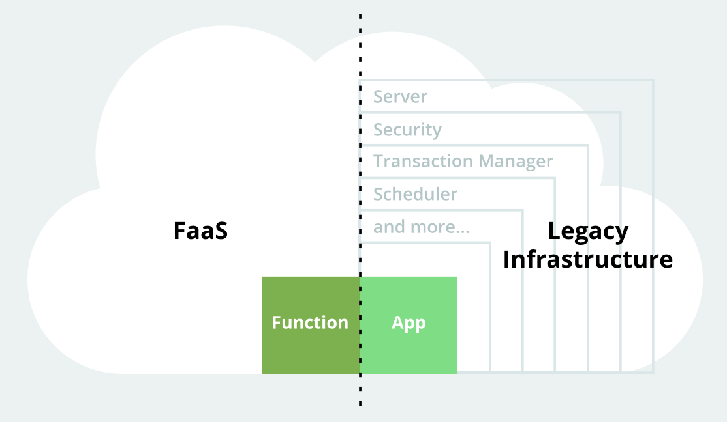
Serverless
Serverless applications
take advantage of modern cloud computing capabilities and abstractions to let you focus on logic rather than on infrastructure.
In a serverless environment, you can concentrate on writing application code while the underlying platform takes care of scaling, runtimes, resource allocation, security, and other “server” specifics.

Slide 38
Serverless
What is serverless?
Serverless workloads are “event-driven workloads that aren’t concerned with aspects normally handled by server infrastructure.”
Concerns like “how many instances to run” and “what operating system to use” are all managed by a Function as a Service platform (or FaaS), leaving developers free to focus on business logic.
Serverless characteristics?
Serverless applications have a number of specific characteristics, including:
Event-driven code execution with triggers
Platform handles all the starting, stopping, and scaling chores
Scales to zero, with low to no cost when idle
Stateless

Slide 39
Spring Cloud Function
Spring Cloud Function
provides capabilities that lets Spring developers take advantage of serverless or FaaS platforms.
Spring Cloud Function
provides adaptors so that you can run your functions on the most common FaaS services including :
Amazon Lambda, Apache OpenWhisk, Microsoft Azure, and Project Riff.
Spring Cloud Function is a project with the following high-level goals:
Promote the implementation of business logic via functions.
Decouple the development lifecycle of business logic from any specific runtime target so that the same code can run as a web endpoint, a stream processor, or a task.
Support a uniform programming model across serverless providers, as well as the ability to run standalone (locally or in a PaaS).
Enable Spring Boot features (auto-configuration, dependency injection, metrics) on serverless providers.

Slide 40
Function Sample
Main Java Class
@SpringBootApplication public class FunctionsampleApplication { @Bean public Function<Flux<String>, Flux<String>> uppercase() { return flux -> flux.map(value -> value.toUpperCase()); } @Bean public Function<Flux<Integer>, Flux<Integer>> name() { return e -> e.map(value -> value * 2) ; } @Bean public Function<Flux<Integer>, Flux<Integer>> square() { return e -> e.map(value -> value * value) ; } @Bean public Function<Flux<Integer>, Flux<Integer>> compose() { return e -> name().compose(square()).apply(e); } @Bean public Function<Flux<Integer>, Flux<Integer>> andThen() { return e -> name().andThen(square()).apply(e); } public static void main(String[] args) { SpringApplication.run(FunctionsampleApplication.class, args); } }

Slide 41
Function Sample
pom.xml
<dependency> <groupId>org.springframework.boot</groupId> <artifactId>spring-boot-starter</artifactId> </dependency> <dependency> <groupId>org.springframework.boot</groupId> <artifactId>spring-boot-starter-web</artifactId> </dependency> <dependency> <groupId>org.springframework.cloud</groupId> <artifactId>spring-cloud-function-web</artifactId> </dependency>
<dependencyManagement> <dependencies> <dependency> <groupId>org.springframework.cloud</groupId> <artifactId>spring-cloud-dependencies</artifactId> <version>${spring-cloud.version}</version> <type>pom</type> <scope>import</scope> </dependency> </dependencies> </dependencyManagement>

Slide 42
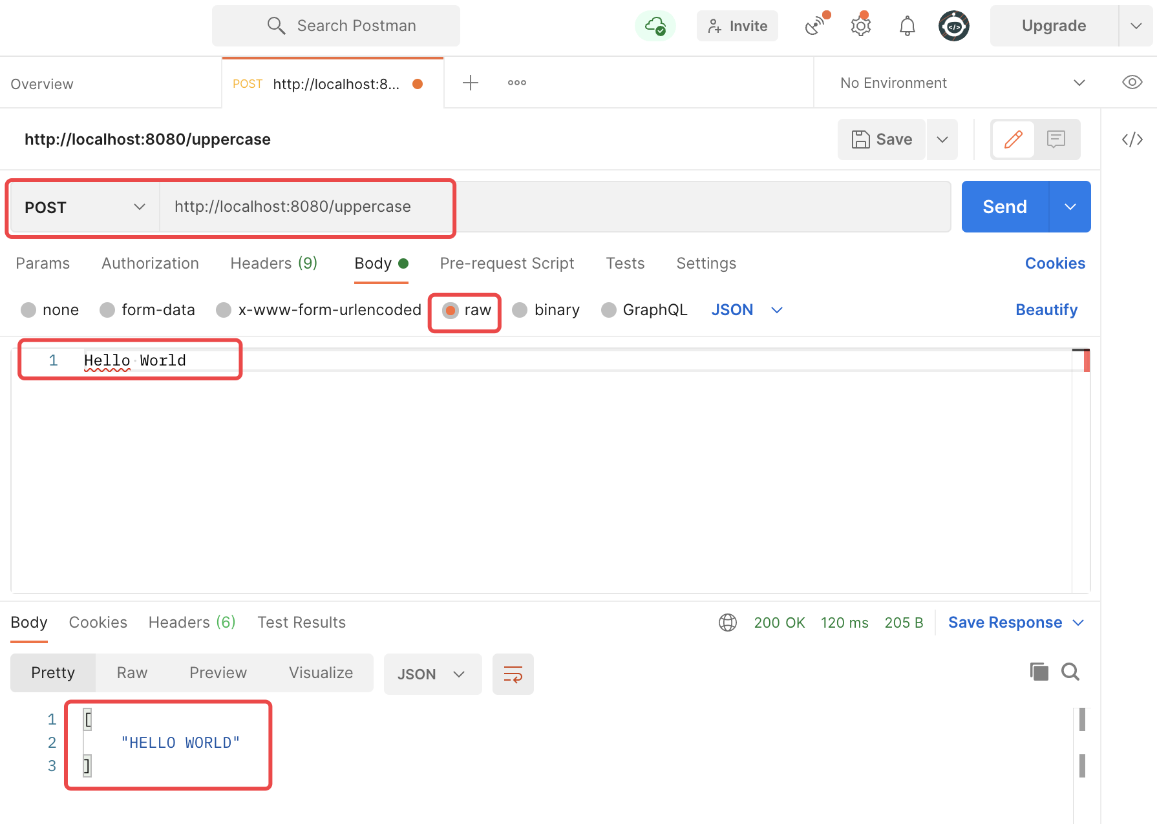
Function Sample
Notes:
http://localhost:8080/uppercase

Slide 43
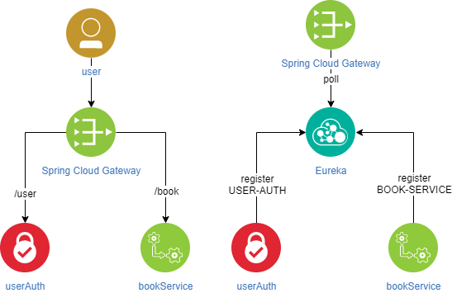
Microservice Demo

Slide 44
Microservice Demo Eureka
application.yaml
server: port: 8040 spring: application: name: Eureka eureka: instance: prefer-ip-address: true client: fetch-registry: false register-with-eureka: false serviceUrl: defaultZone: http://localhost:8040/eureka

Slide 45
Microservice Demo Eureka
EurekaApplication
@SpringBootApplication @EnableEurekaServer public class EurekaApplication { public static void main(String[] args) { SpringApplication.run(EurekaApplication.class, args); } }

Slide 46
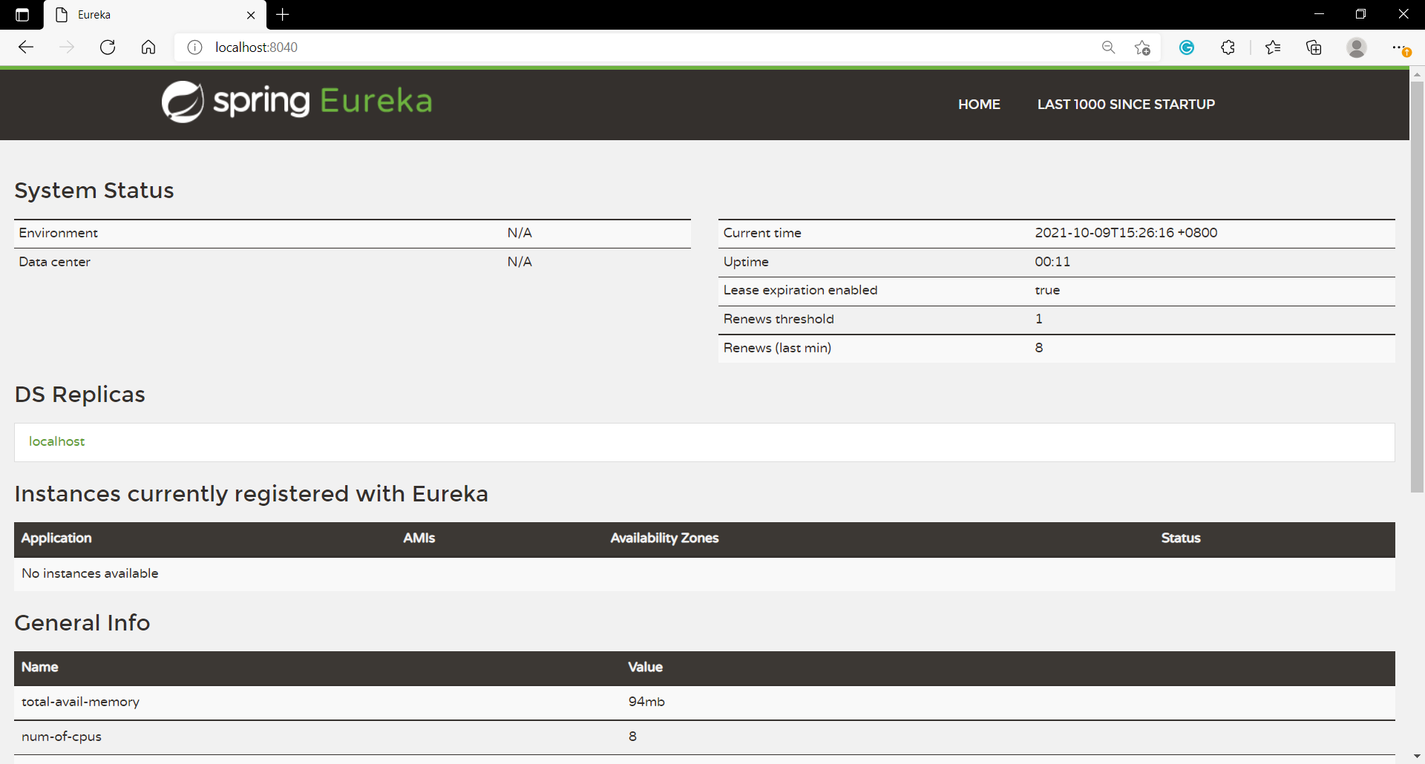
Microservice Demo Eureka

Slide 47
Microservice Demo Book Service
application.yaml
spring: application: name: book-service
eureka: instance: prefer-ip-address: true ip-address: localhost client: registerWithEureka: true fetchRegistry: true serviceUrl: defaultZone: http://localhost:8040/eureka
server: port: 11130

Slide 48
Microservice Demo Book Service
BookController
@Slf4j @RestController public class BookController { @RequestMapping("/buyBook") public ResultDTO checkAuth(@RequestHeader("userName") String userName, @RequestParam("bookName") String bookName){ log.info("userName: {}, bookName: {}", userName, bookName); return ResultDTO.success(String.format("userName: %s, bookName: %s", userName, bookName)); } }

Slide 49
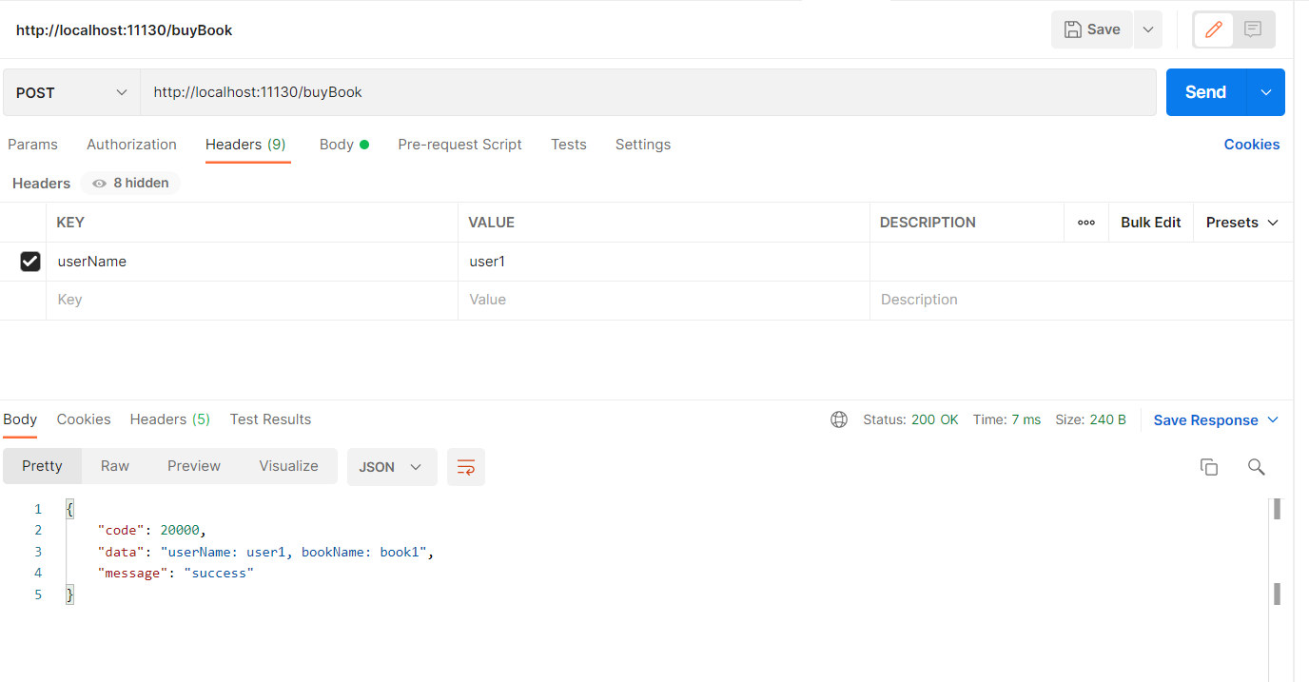
Microservice Demo Book Service
Notes:
http://localhost:11130/buyBook

Slide 50
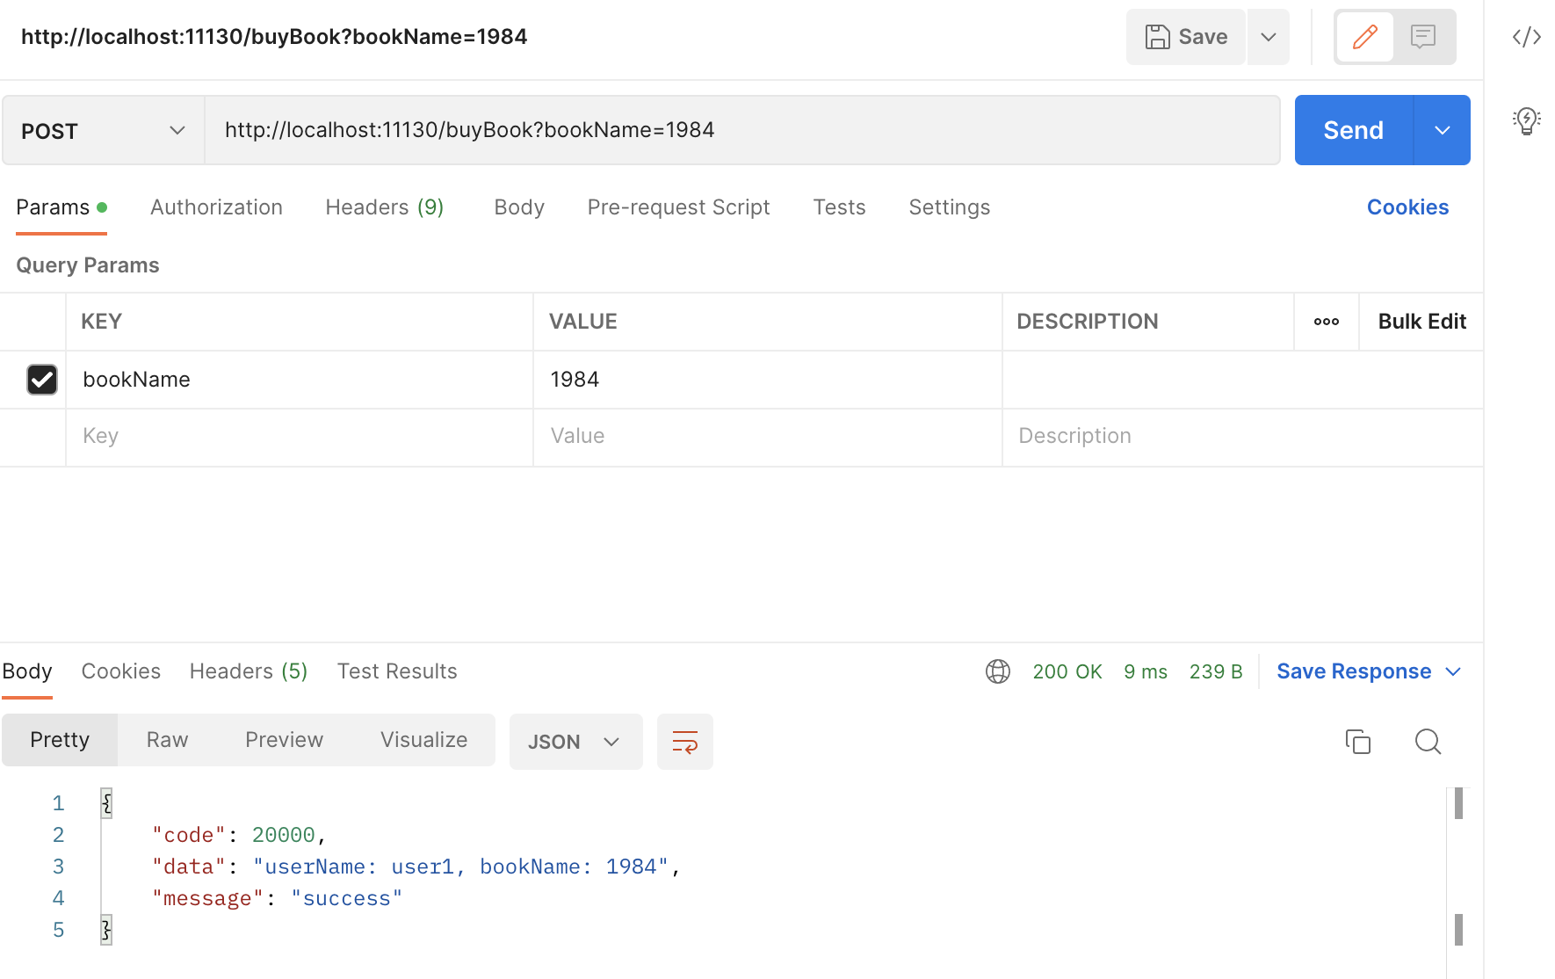
Microservice Demo Book Service
Notes:
http://localhost:11130/buyBook

Slide 51
Microservice Demo User Authorize
application.yaml
spring: application: name: user-auth
eureka: instance: prefer-ip-address: true ip-address: localhost client: registerWithEureka: true fetchRegistry: true serviceUrl: defaultZone: http://localhost:8040/eureka
server: port: 11230

Slide 52
Microservice Demo User Authorize
UserinfoController
@ResponseBody @PostMapping("/Login") public Response login(Userinfo userinfo){ return userinfoService.verify(userinfo); }

Slide 53
Microservice Demo User Authorize
UserinfoService
public Response verify(Userinfo userinfo) { Response response = new Response(); QueryWrapper<Userinfo> queryWrapper = new QueryWrapper<>(); queryWrapper.eq("username", userinfo.getUsername()); if(usernameExist(userinfo.getUsername())){ Userinfo _userinfo = userinfoMapper.selectOne(queryWrapper); if(Objects.equals(userinfo.getPassword(), _userinfo.getPassword())) { response.setCode(200); response.setMessage("success"); response.setData(createTokenPair(_userinfo)); } else … } else … return response; }

Slide 54
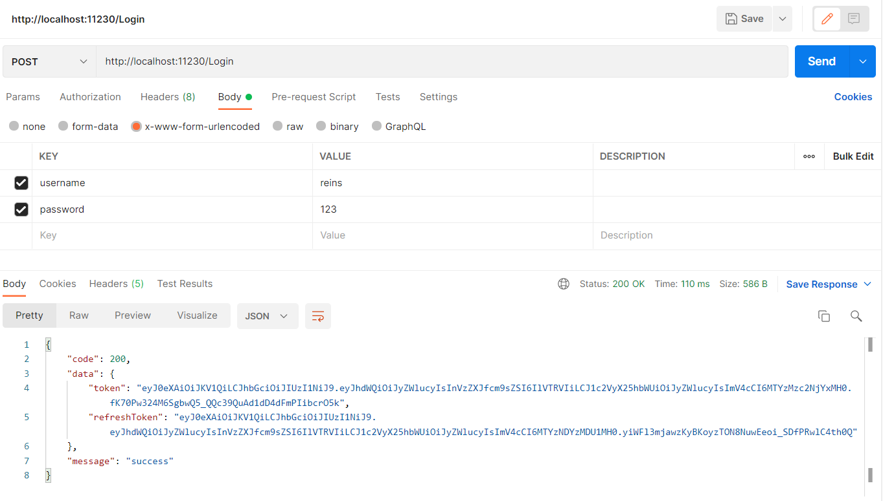
Microservice Demo User Authorize
Notes:
http://localhost:11230/Login

Slide 55
Microservice Demo Gateway
application.yaml
server: port: 8080 error: include-message: always spring: cloud: gateway: globalcors: cors-configurations: '[/**]': allowedOrigins: "*" allowedMethods: - GET - POST application: name: gateway

Slide 56
Microservice Demo Gateway
application.yaml
eureka: instance: prefer-ip-address: true ip-address: localhost client: registerWithEureka: true fetchRegistry: true serviceUrl: defaultZone: http://localhost:8040/eureka eureka-service-url-poll-interval-seconds: 10

Slide 57
Microservice Demo Gateway
MainGateway
@SpringBootApplication @EnableDiscoveryClient @EnableEurekaClient public class MainGateway { public static void main(String[] args) { SpringApplication.run(MainGateway.class, args); } @Autowired JwtCheckFilter jwtCheckFilter; @Bean public RouteLocator myRoutes(RouteLocatorBuilder builder) { return builder.routes() .route(r -> r.path("/book/**") .filters(f -> f.rewritePath("/book","").filter(jwtCheckFilter)) .uri("lb://BOOK-SERVICE") ).route(r->r.path("/user/**") .filters(f->f.rewritePath("/user","")) .uri("lb://USER-AUTH") ) .build(); } }

Slide 58
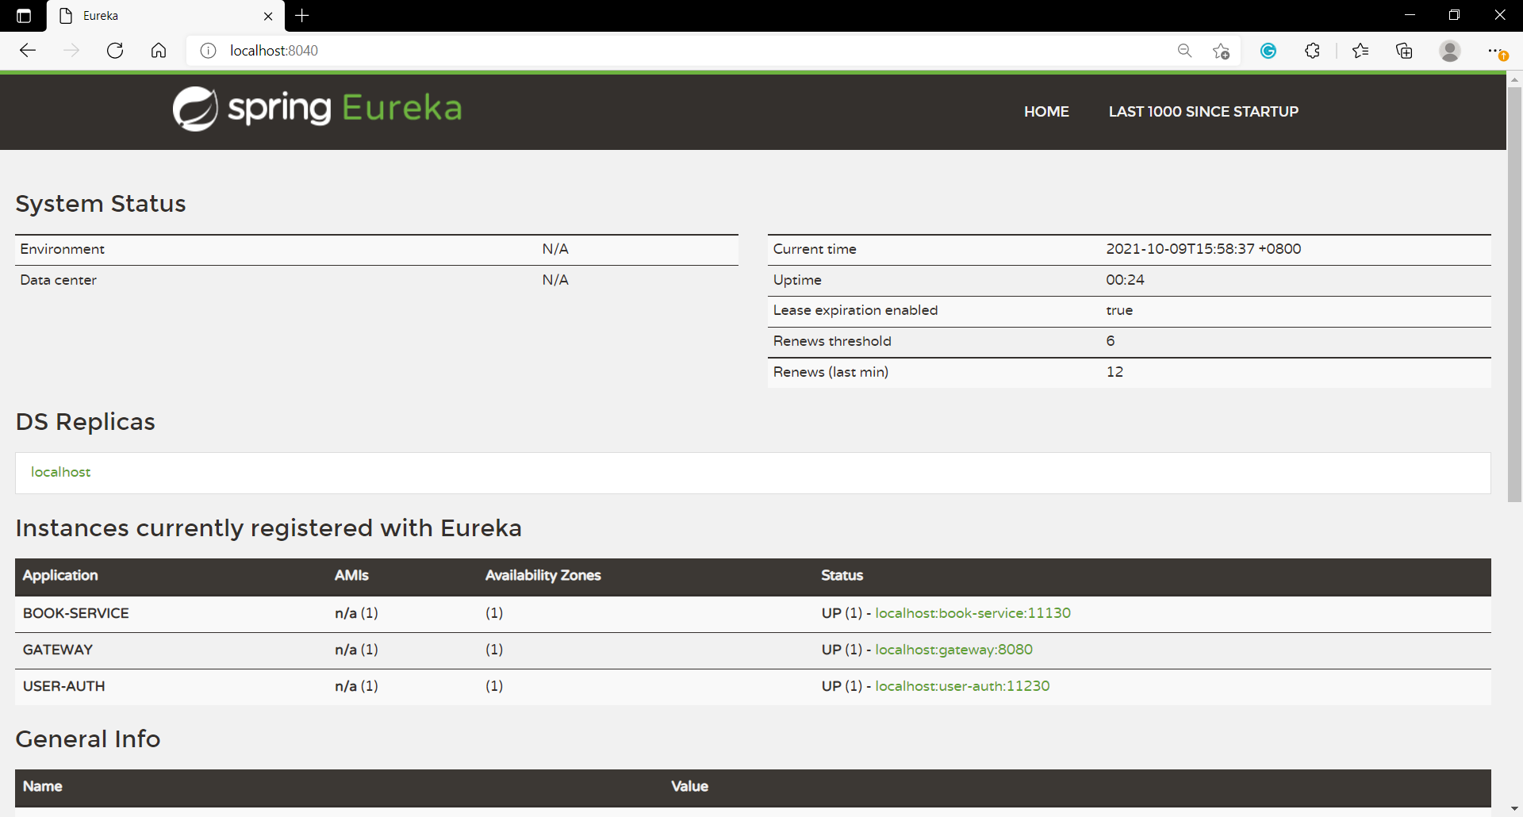
Microservice Demo Service Register

Slide 59
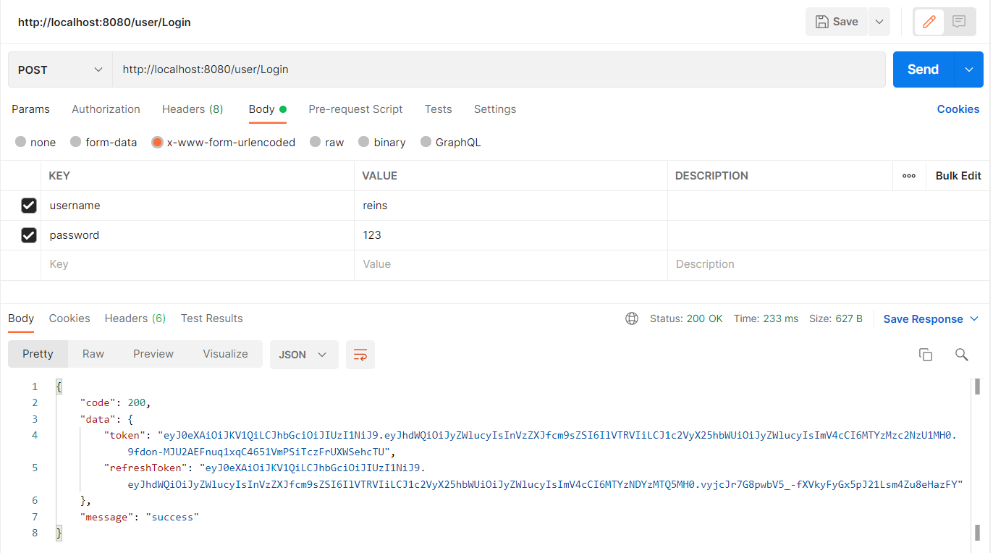
Microservice Demo Gateway

Slide 60
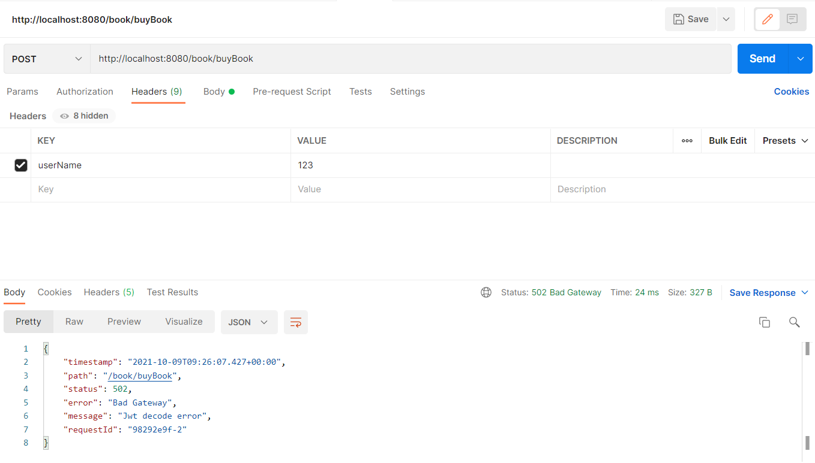
Microservice Demo Gateway
Notes:
http://localhost:8080/book/buyBook

Slide 61
Microservice Demo Gateway
JwtCheckFilter
public Mono<Void> filter(ServerWebExchange exchange, GatewayFilterChain chain) { String jwtToken = exchange.getRequest().getHeaders().getFirst("token"); UserInfo userInfo = jwt.parseToken(jwtToken); System.out.println(userInfo); if(userInfo != null && userInfo.getUsername()!=null) { ServerHttpRequest request = exchange.getRequest().mutate() .header("userName", userInfo.getUsername()) .build(); return chain.filter(exchange.mutate().request(request).build()); } throw new ResponseStatusException(HttpStatus.BAD_GATEWAY, "Jwt decode error"); }

Slide 62
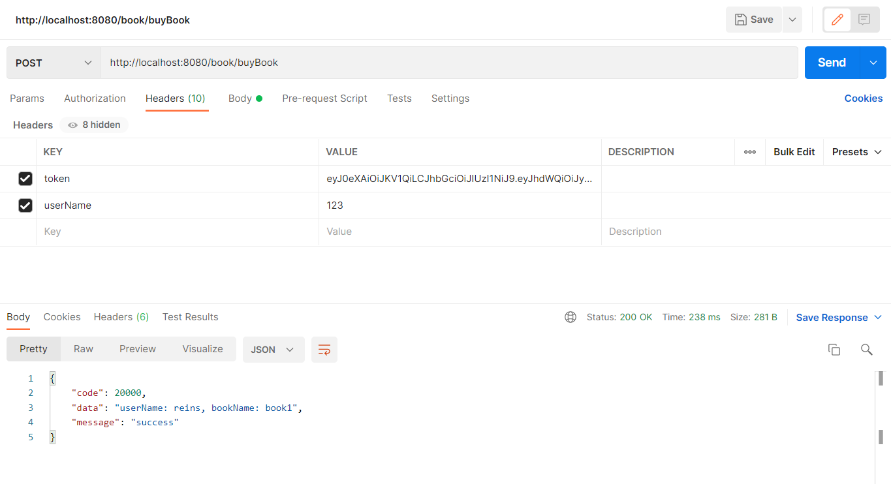
Microservice Demo Gateway

Slide 63
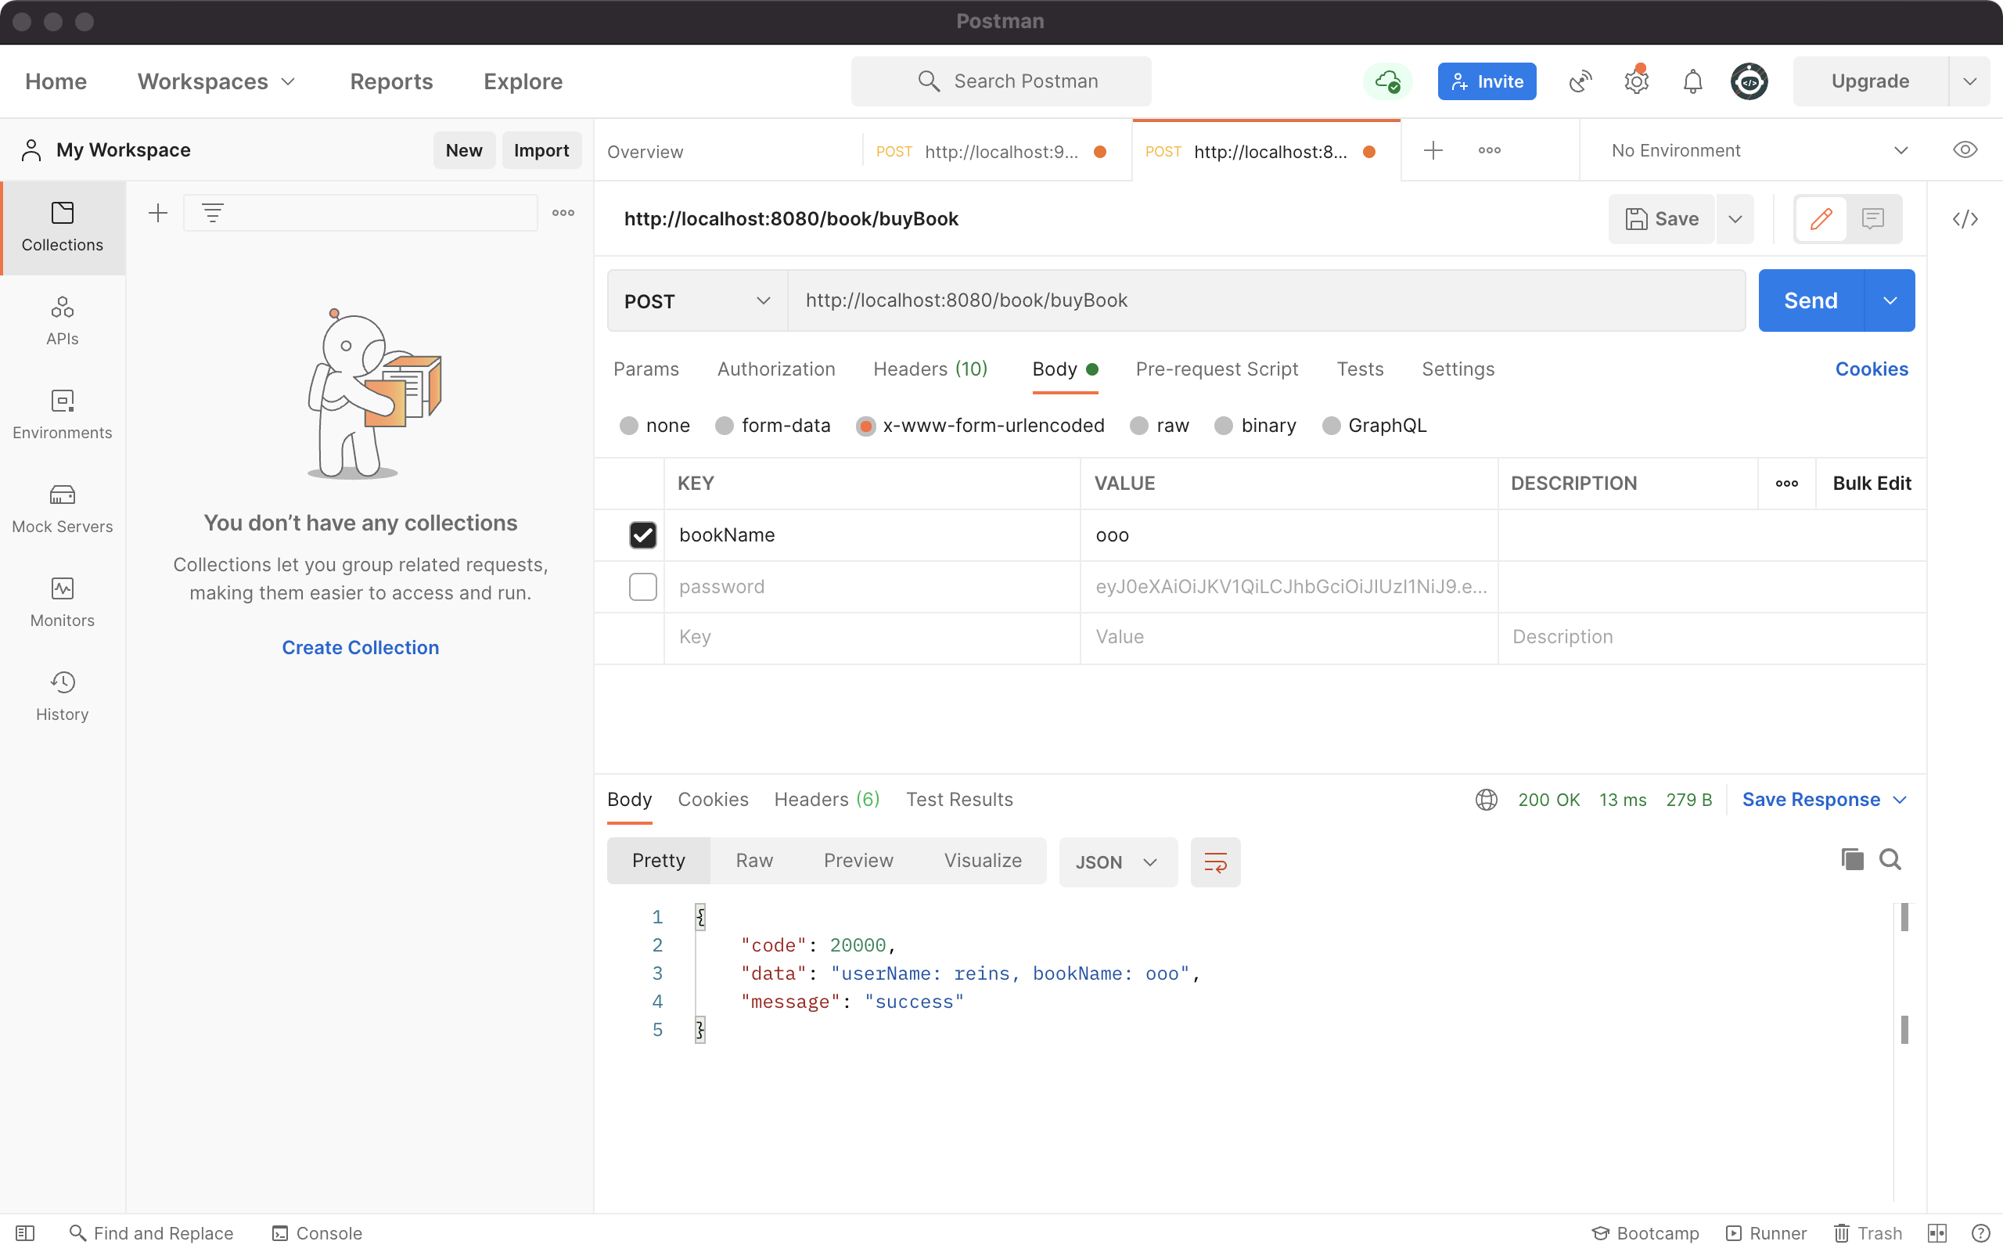
Microservice Demo Gateway

Slide 64
References
Microservices
https://spring.io/microservices
【微服务】使用spring cloud搭建微服务框架，整理学习资料
https://www.cnblogs.com/ztfjs/p/9230374.html
一文详解微服务架构
https://www.zhihu.com/question/65502802
Eureka
https://github.com/Netflix/eureka
https://github.com/Netflix/eureka/wiki/Eureka-at-a-glance
Service Registration & Discovery
https://spring.io/guides/gs/service-registration-and-discovery/
Building a Gateway
https://spring.io/guides/gs/gateway/
Getting Started with Spring Cloud Gateway
https://spring.io/blog/2019/06/18/getting-started-with-spring-cloud-gateway

Slide 65
References
Serverless
https://spring.io/serverless
Spring Cloud Function GitHub’s repository
https://github.com/spring-cloud/spring-cloud-function
JDK8新特性-java.util.function-Function接口
https://blog.csdn.net/huo065000/article/details/78964382

Slide 66

Thank You!

