Slide 1
Architecture of Enterprise Applications 26 Storm
Haopeng Chen
REliable, INtelligent and Scalable Systems Group (REINS)
Shanghai Jiao Tong University
Shanghai, China
http://reins.se.sjtu.edu.cn/~chenhp
e-mail: chen-hp@sjtu.edu.cn

Slide 2
Contents and Objectives
Storm
Basic Concepts
Quick Start
Other Issues
Objectives
能够针对高性能计算需求，设计并实现基于Storm的流数据处理方案

Slide 3

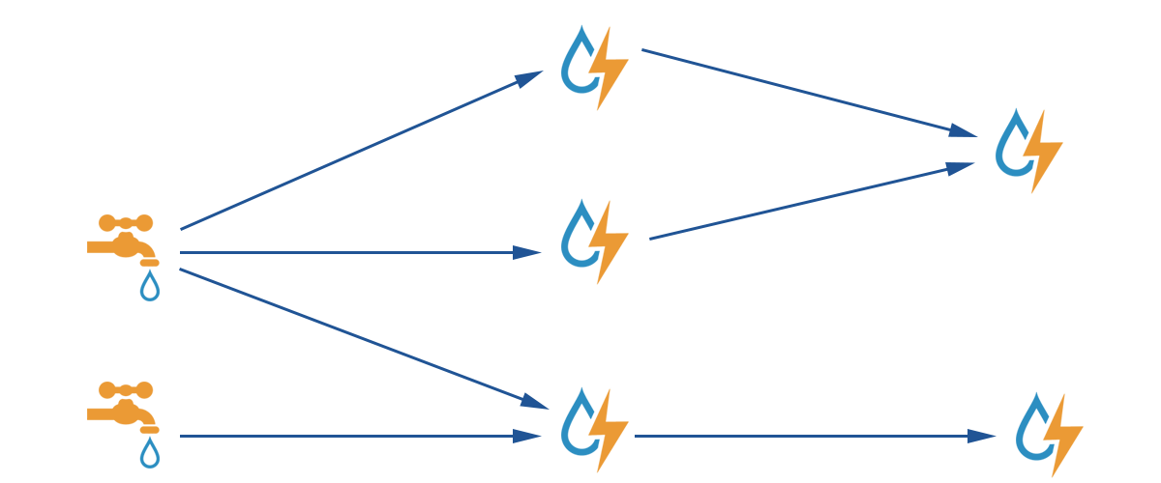
Apache Storm
https://storm.apache.org/index.html

Slide 4
Why use Apache Storm？
Apache Storm is a free and open source distributed realtime computation system.
Apache Storm makes it easy to reliably process unbounded streams of data, doing for realtime processing what Hadoop did for batch processing.
Apache Storm is simple, can be used with any programming language, and is a lot of fun to use!
Apache Storm has many use cases:
realtime analytics, online machine learning, continuous computation, distributed RPC, ETL, and more. Apache Storm is fast: a benchmark clocked it at over a million tuples processed per second per node. It is scalable, fault-tolerant, guarantees your data will be processed, and is easy to set up and operate.
Apache Storm integrates with the queueing and database technologies you already use.
An Apache Storm topology consumes streams of data and processes those streams in arbitrarily complex ways, repartitioning the streams between each stage of the computation however needed. Read more in the tutorial

Slide 5
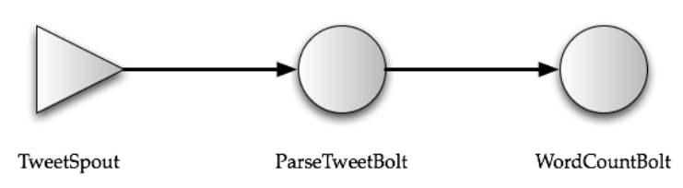
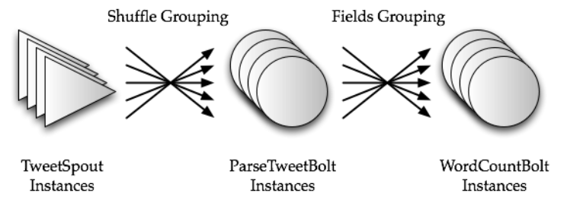
Apache Storm
Word Count

Slide 6
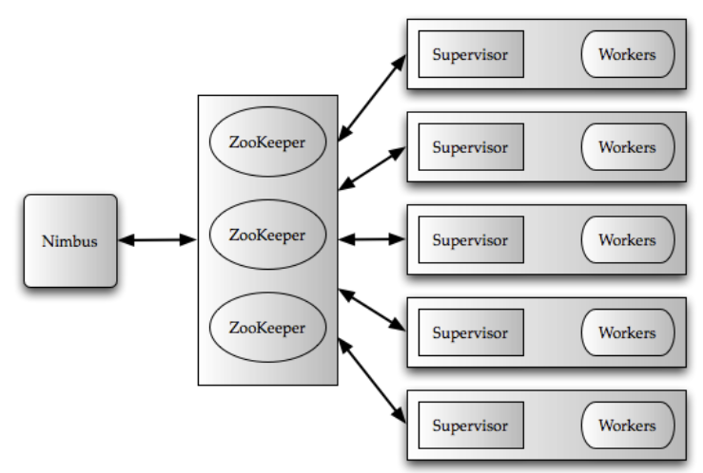
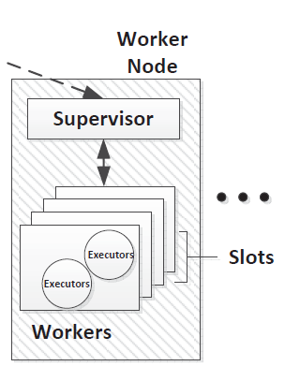
Apache Storm Architecture

Slide 7
Components of a Storm Cluster
A Storm cluster is superficially similar to a Hadoop cluster.
Whereas on Hadoop you run "MapReduce jobs", on Storm you run "topologies".
"Jobs" and "topologies" themselves are very different -- one key difference is that a MapReduce job eventually finishes, whereas a topology processes messages forever (or until you kill it).
There are two kinds of nodes on a Storm cluster:
the master node and the worker nodes.
The master node runs a daemon called "Nimbus" that is similar to Hadoop's "JobTracker".
Nimbus is responsible for distributing code around the cluster, assigning tasks to machines, and monitoring for failures.

Slide 8
Components of a Storm Cluster
Each worker node runs a daemon called the "Supervisor".
The supervisor listens for work assigned to its machine and starts and stops worker processes as necessary based on what Nimbus has assigned to it.
Each worker process executes a subset of a topology; a running topology consists of many worker processes spread across many machines.
All coordination between Nimbus and the Supervisors is done through a Zookeeper cluster.
Additionally, the Nimbus daemon and Supervisor daemons are fail-fast and stateless; all state is kept in Zookeeper or on a local disk.
This means you can kill -9 Nimbus or the Supervisors and they'll start back up as nothing happened. This design leads to Storm clusters being incredibly stable.

Slide 9
Apache Storm
Topologies
To do realtime computation on Storm, you create what are called “topologies”.
A topology is a graph of computation.
Each node in a topology contains processing logic, and links between nodes indicate how data should be passed around between nodes.
Running a topology is straightforward. First, you package all your code and dependencies into a single jar. Then, you run a command like the following:
storm jar all-my-code.jar org.apache.storm.MyTopology arg1 arg2
This runs the class org.apache.storm.MyTopology with the arguments arg1 and arg2.
The main function of the class defines the topology and submits it to Nimbus.
The storm jar part takes care of connecting to Nimbus and uploading the jar.

Slide 10
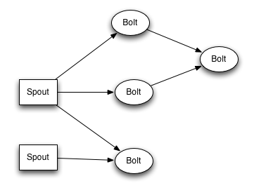
Apache Storm Stream
Streams
The core abstraction in Storm is the “stream”.
A stream is an unbounded sequence of tuples.
Storm provides the primitives for transforming a stream into a new stream in a distributed and reliable way.
The basic primitives Storm provides for doing stream transformations are “spouts” and “bolts”.

Slide 11
Apache Storm Stream
The basic primitives Storm provides for doing stream transformations are “spouts” and “bolts”.
Spouts and bolts have interfaces that you implement to run your application-specific logic.
A spout is a source of streams.
For example, a spout may read tuples off of a Kestrel queue and emit them as a stream. Or a spout may connect to the Twitter API and emit a stream of tweets.
A bolt consumes any number of input streams, does some processing, and possibly emits new streams.
Complex stream transformations, like computing a stream of trending topics from a stream of tweets, require multiple steps and thus multiple bolts.
Bolts can do anything from run functions, filter tuples, do streaming aggregations, do streaming joins, talk to databases, and more.

Slide 12
Apache Storm Stream
Networks of spouts and bolts
are packaged into a “topology” which is the top-level abstraction that you submit to Storm clusters for execution.
A topology is a graph of stream transformations where each node is a spout or bolt.
Edges in the graph indicate which bolts are subscribing to which streams.
When a spout or bolt emits a tuple to a stream, it sends the tuple to every bolt that subscribed to that stream.
Links between nodes in your topology indicate how tuples should be passed around.
Each node in a Storm topology executes in parallel.
A topology runs forever, or until you kill it.
Storm will automatically reassign any failed tasks.
Additionally, Storm guarantees that there will be no data loss, even if machines go down and messages are dropped.

Slide 13
Data Model
Storm uses tuples as its data model.
A tuple is a named list of values, and a field in a tuple can be an object of any type.
Out of the box, Storm supports all the primitive types, strings, and byte arrays as tuple field values.
To use an object of another type, you just need to implement a serializer for the type.
Every node in a topology must declare the output fields for the tuples it emits.

Slide 14
Data Model
For example,
this bolt declares that it emits 2-tuples with the fields "double" and "triple"
public class DoubleAndTripleBolt extends BaseRichBolt {
private OutputCollectorBase _collector;
@Override public void prepare(Map conf, TopologyContext context, OutputCollectorBase collector) {
_collector = collector;
}
@Override public void execute(Tuple input) {
int val = input.getInteger(0);
_collector.emit(input, new Values(val*2, val*3));
_collector.ack(input);
}
@Override public void declareOutputFields(OutputFieldsDeclarer declarer) {
declarer.declare(new Fields("double", "triple"));
}
}

Slide 15
A simple topology
Let's look at the ExclamationTopology definition from storm-starter:
TopologyBuilder builder = new TopologyBuilder();
builder.setSpout("words", new TestWordSpout(), 10);
builder.setBolt("exclaim1", new ExclamationBolt(), 3)
.shuffleGrouping("words");
builder.setBolt("exclaim2", new ExclamationBolt(), 2)
.shuffleGrouping("exclaim1");
This topology contains a spout and two bolts.
The spout emits words, and each bolt appends the string "!!!" to its input.
The nodes are arranged in a line: the spout emits to the first bolt which then emits to the second bolt.
If the spout emits the tuples ["bob"] and ["john"], then the second bolt will emit the words ["bob!!!!!!"] and ["john!!!!!!"].

Slide 16
A simple topology
If you wanted component "exclaim2"
to read all the tuples emitted by both component "words" and component "exclaim1", you would write component "exclaim2"'s definition like this:
builder.setBolt("exclaim2", new ExclamationBolt(), 5)
.shuffleGrouping("words")
.shuffleGrouping("exclaim1");

Slide 17
A simple topology
Spouts are responsible for emitting new messages into the topology.
TestWordSpout in this topology emits a random word from the list ["nathan", "mike", "jackson", "golda", "bertels"] as a 1-tuple every 100ms.
The implementation of nextTuple() in TestWordSpout looks like this:
public void nextTuple() {
Utils.sleep(100);
final String[] words =
new String[] {"nathan", "mike", "jackson", "golda", "bertels"};
final Random rand = new Random();
final String word = words[rand.nextInt(words.length)];
_collector.emit(new Values(word));
}

Slide 18
A simple topology
ExclamationBolt appends the string "!!!" to its input.
public static class ExclamationBolt implements IRichBolt {
OutputCollector _collector;
@Override public void prepare(Map conf, TopologyContext context, OutputCollector collector) {
_collector = collector;
}
@Override public void execute(Tuple tuple) {
_collector.emit(tuple, new Values(tuple.getString(0) + "!!!"));
_collector.ack(tuple);
}
@Override public void cleanup() { }
@Override public void declareOutputFields(OutputFieldsDeclarer declarer) {
declarer.declare(new Fields("word"));
}
@Override public Map<String, Object> getComponentConfiguration() {
return null;
}
}

Slide 19
A simple topology
ExclamationBolt can be written more succinctly by extending BaseRichBolt, like so:
public static class ExclamationBolt extends BaseRichBolt {
OutputCollector _collector;
@Override public void prepare(Map conf, TopologyContext context, OutputCollector collector){
_collector = collector;
}
@Override public void execute(Tuple tuple) {
_collector.emit(tuple, new Values(tuple.getString(0) + "!!!"));
_collector.ack(tuple);
}
@Override public void declareOutputFields(OutputFieldsDeclarer declarer) {
declarer.declare(new Fields("word"));
}
}

Slide 20
Running Topology in Local Mode
Storm has two modes of operation:
local mode and distributed mode.
In local mode, Storm executes completely in a process by simulating worker nodes with threads. Local mode is useful for testing and development of topologies.
Common configurations for local mode
Config.TOPOLOGY_MAX_TASK_PARALLELISM: This config puts a ceiling on the number of threads spawned for a single component.
Config.TOPOLOGY_DEBUG: When this is set to true, Storm will log a message every time a tuple is emitted from any spout or bolt.
To launch your topology in local mode you could run
$ storm local topology.jar <MY_MAIN_CLASS> -c topology.debug=true

Slide 21
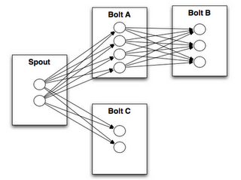
Apache Storm
Stream groupings
A stream grouping tells a topology how to send tuples between two components.

Slide 22
Apache Storm
Stream groupings
Remember, spouts and bolts execute in parallel as many tasks across the cluster.
If you look at how a topology is executing at the task level, it looks something like this:
When a task for Bolt A emits a tuple to Bolt B, which task should it send the tuple to?
A “stream grouping” answers this question by telling Storm how to send tuples between sets of tasks.
WordCountTopology reads sentences off of a spout and streams out of WordCountBolt the total number of times it has seen that word before:
TopologyBuilder builder = new TopologyBuilder();
builder.setSpout("sentences", new RandomSentenceSpout(), 5);
builder.setBolt("split", new SplitSentence(), 8)
.shuffleGrouping("sentences");
builder.setBolt("count", new WordCount(), 12)
.fieldsGrouping("split", new Fields("word"));

Slide 23
Apache Storm
Defining Bolts in other languages
public static class SplitSentence extends ShellBolt implements IRichBolt {
public SplitSentence() {
super("python3", "splitsentence.py");
}
public void declareOutputFields(OutputFieldsDeclarer declarer)
{
declarer.declare(new Fields("word"));
}
}
import storm
class SplitSentenceBolt(storm.BasicBolt):
def process(self, tup):
words = tup.values[0].split(" ")
for word in words:
storm.emit([word])
SplitSentenceBolt().run()

Slide 24
Apache Storm Starter Examples
public class ExclamationTopology extends ConfigurableTopology { public static void main(String[] args) throws Exception { ConfigurableTopology.start(new ExclamationTopology(), args); } protected int run(String[] args) { TopologyBuilder builder = new TopologyBuilder(); builder.setSpout("word", new TestWordSpout(), 10); builder.setBolt("exclaim1", new ExclamationBolt(), 3).shuffleGrouping("word"); builder.setBolt("exclaim2", new ExclamationBolt(), 2).shuffleGrouping("exclaim1"); conf.setDebug(true); String topologyName = "test"; conf.setNumWorkers(3);

Slide 25
Apache Storm Starter Examples
if (args != null && args.length > 0) { topologyName = args[0]; } return submit(topologyName, conf, builder); } public static class ExclamationBolt extends BaseRichBolt { OutputCollector collector; @Override public void prepare(Map<String, Object> conf, TopologyContext context,
OutputCollector collector) { this.collector = collector; }

Slide 26
Apache Storm Starter Examples
@Override public void execute(Tuple tuple) { collector.emit(tuple, new Values(tuple.getString(0) + "!!!")); collector.ack(tuple); } @Override public void declareOutputFields(OutputFieldsDeclarer declarer) { declarer.declare(new Fields("word")); } } }

Slide 27
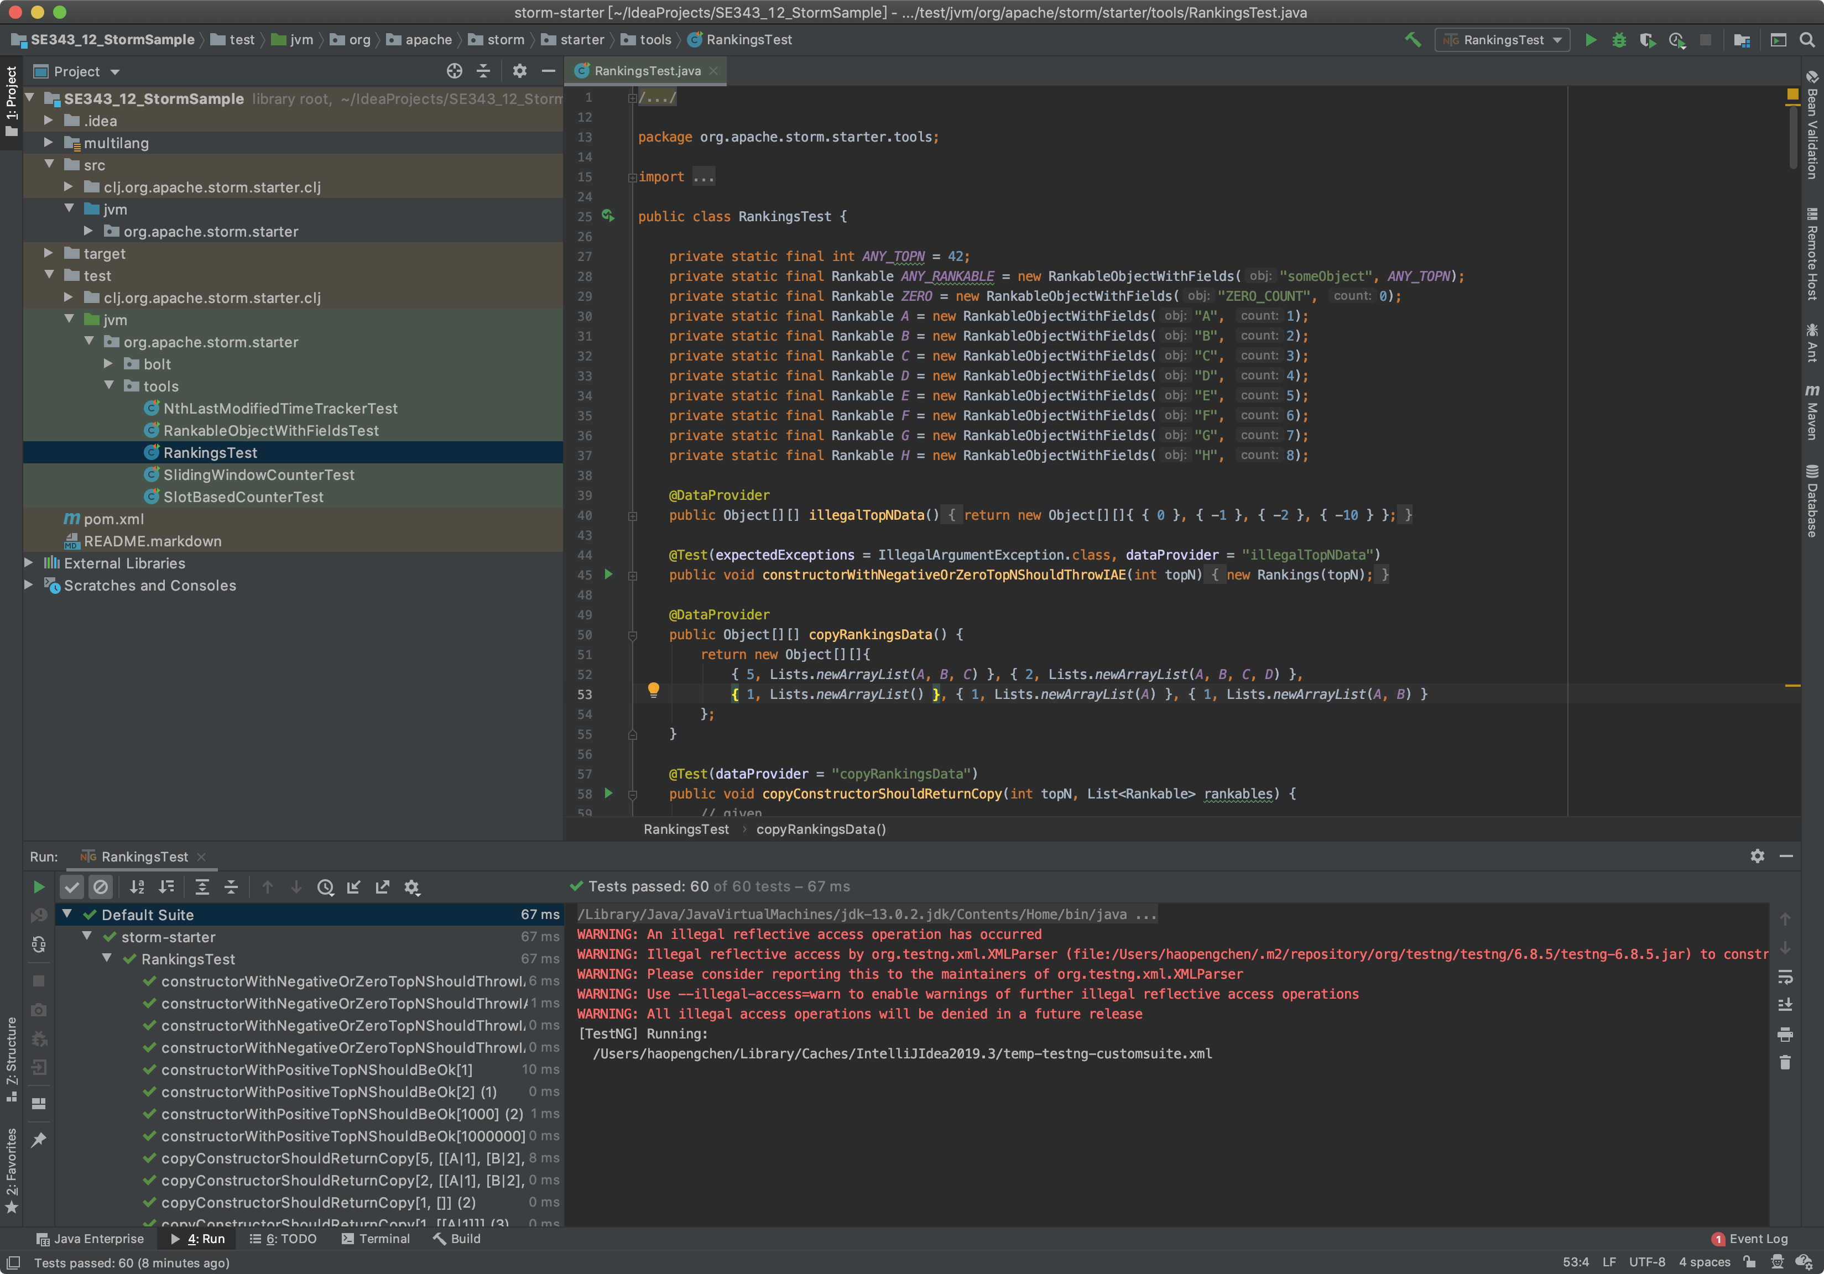
Apache Storm Starter Examples

Slide 28

Apache ZooKeeper
What is ZooKeeper?
ZooKeeper is a high-performance coordination service for distributed applications.
It exposes common services - such as naming, configuration management, synchronization, and group services - in a simple interface so you don't have to write them from scratch.
You can use it off-the-shelf to implement consensus, group management, leader election, and presence protocols. And you can build on it for your own, specific needs.
https://zookeeper.apache.org/

Slide 29
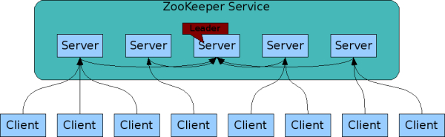
Apache ZooKeeper
Design Goals
ZooKeeper is simple.
ZooKeeper is replicated.
ZooKeeper is ordered.
ZooKeeper is fast.

Slide 30
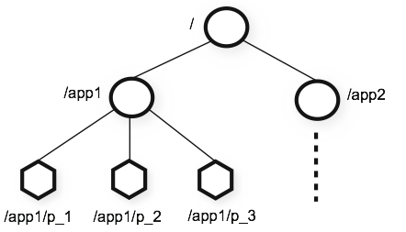
Apache ZooKeeper
Data model and the hierarchical namespace
The namespace provided by ZooKeeper is much like that of a standard file system.
A name is a sequence of path elements separated by a slash (/).
Every node in ZooKeeper's namespace is identified by a path.
ZooKeeper's Hierarchical Namespace

Slide 31
Guarantees
ZooKeeper is very fast and very simple. It provides a set of guarantees. These are:
Sequential Consistency - Updates from a client will be applied in the order that they were sent.
Atomicity - Updates either succeed or fail. No partial results.
Single System Image - A client will see the same view of the service regardless of the server that it connects to. i.e., a client will never see an older view of the system even if the client fails over to a different server with the same session.
Reliability - Once an update has been applied, it will persist from that time forward until a client overwrites the update.
Timeliness - The clients view of the system is guaranteed to be up-to-date within a certain time bound.

Slide 32
Simple API
One of the design goals of ZooKeeper is providing a very simple programming interface. As a result, it supports only these operations:
create : creates a node at a location in the tree
delete : deletes a node
exists : tests if a node exists at a location
get data : reads the data from a node
set data : writes data to a node
get children : retrieves a list of children of a node
sync : waits for data to be propagated

Slide 33
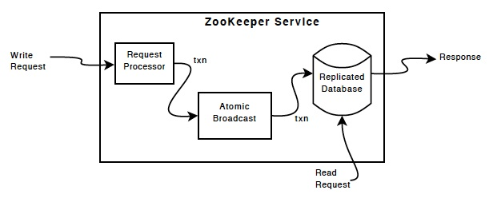
Implementation
ZooKeeper Components shows the high-level components of the ZooKeeper service.

Slide 34
Standalone Operations
To start ZooKeeper you need a configuration file. Here is a sample, create it in conf/zoo.cfg:
tickTime=2000
dataDir=/var/zookeeper
clientPort=2181
Here are the meanings for each of the fields:
tickTime : the basic time unit in milliseconds used by ZooKeeper. It is used to do heartbeats and the minimum session timeout will be twice the tickTime.
dataDir : the location to store the in-memory database snapshots and, unless specified otherwise, the transaction log of updates to the database.
clientPort : the port to listen for client connections
Now that you created the configuration file, you can start ZooKeeper:
bin/zkServer.sh start

Slide 35
Standalone Operations
Connecting to ZooKeeper
$ bin/zkCli.sh -server 127.0.0.1:2181
This lets you perform simple, file-like operations.
Once you have connected, you should see something like:
Connecting to localhost:2181
log4j:WARN No appenders could be found for logger (org.apache.zookeeper.ZooKeeper).
log4j:WARN Please initialize the log4j system properly.
Welcome to ZooKeeper!
JLine support is enabled
[zkshell: 0]

Slide 36
Start Apache Storm
The Storm release contains a file at conf/storm.yaml
storm.zookeeper.servers:
- "127.0.0.1"
nimbus.seeds: [" 127.0.0.1 "]
storm.local.dir: $STORM_HOME/storm-local
supervisor.slots.ports:
- 6700
- 6701
- 6702
- 6703
Here's how to run the Storm daemons:
Nimbus: Run the command bin/storm nimbus under supervision on the master machine.
Supervisor: Run the command bin/storm supervisor under supervision on each worker machine.

Slide 37
References
Apache Storm
https://storm.apache.org/releases/current/Tutorial.html
Example Storm Topologies
https://github.com/apache/storm/tree/2.4.x-branch/examples/storm-starter
ZooKeeper Getting Started Guide
https://zookeeper.apache.org/doc/current/zookeeperStarted.html
Setting up a Storm Cluster
https://storm.apache.org/releases/2.6.0/Setting-up-a-Storm-cluster.html
Storm Tutorial
https://storm.apache.org/releases/2.6.0/Tutorial.html
Intellij IDEA 导入或运行流式处理框架storm以及java.lang.NoClassDefFoundError报错的解决方案
https://blog.csdn.net/weixin_35757704/article/details/75348270
ZooKeeper: Because Coordinating Distributed Systems is a Zoo
https://zookeeper.apache.org/doc/current/index.html

Slide 38

Thank You!

