Slide 1
Architecture of Enterprise Applications 29 Hive
Haopeng Chen
REliable, INtelligent and Scalable Systems Group (REINS)
Shanghai Jiao Tong University
Shanghai, China
http://reins.se.sjtu.edu.cn/~chenhp
e-mail: chen-hp@sjtu.edu.cn
Notes:
export JAVA_HOME=/Library/Java/JavaVirtualMachines/jdk1.8.0_281.jdk/Contents/Home
必须使用jdk低版本，13太高
后续操作都必须在Hive安装目录下，否则metadata会报错

Slide 2
Contents and Objectives
Hive
Basic Concepts
Hive DDL and DML
Other Issues
Objectives
能够根据数据仓库的基础要求，设计基于Hive的数据分析方案

Slide 3
Apache Hive
Hive, a framework for data warehousing on top of Hadoop.
Hive grew from a need to manage and learn from the huge volumes of data that Facebook was producing every day from its burgeoning social network.
After trying a few different systems, the team chose Hadoop for storage and processing, since it was cost-effective and met their scalability needs.
Hive was created to make it possible for analysts with strong SQL skills (but meager Java programming skills) to run queries on the huge volumes of data that Facebook stored in HDFS.
Today, Hive is a successful Apache project used by many organizations as a general-purpose, scalable data processing platform.
https://hive.apache.org/

Slide 4
Running Hive
Hive uses Hadoop, so:
you must have Hadoop in your path OR
$ export HADOOP_HOME=<hadoop-install-dir>
Start NameNode daemon and DataNode daemon:
$ bin/hdfs namenode -format
$ sbin/start-dfs.sh
In addition,
you must use below HDFS commands to create /tmp and /user/hive/warehouse
(aka hive.metastore.warehouse.dir) and set them chmod g+w before you can create a table in Hive.
$ HADOOP_HOME/bin/hadoop fs -mkdir /tmp
$ HADOOP_HOME/bin/hadoop fs -mkdir /user/hive/warehouse
$ HADOOP_HOME/bin/hadoop fs -chmod g+w /tmp
$ HADOOP_HOME/bin/hadoop fs -chmod g+w /user/hive/warehouse

Slide 5
Running Hive
To use the Hive command line interface (CLI) from the shell:
$ HIVE_HOME/bin/hive
Running HiveServer2 and Beeline
Starting from Hive 2.1, we need to run the schematool command below as an initialization step. For example, we can use "derby" as db type.
$ HIVE_HOME/bin/schematool -dbType <db type> -initSchema
HiveServer2 (introduced in Hive 0.11) has its own CLI called Beeline.
HiveCLI is now deprecated in favor of Beeline, as it lacks the multi-user, security, and other capabilities of HiveServer2. To run HiveServer2 and Beeline from shell:
$ HIVE_HOME/bin/hiveserver2
$ HIVE_HOME/bin/beeline -u jdbc:hive2://$HS2_HOST:$HS2_PORT
Notes:
JDK 1.8

Slide 6
Configuration Management Overview
Hive by default gets its configuration from <install-dir>/conf/hive-default.xml
Hive configuration is an overlay on top of Hadoop
it inherits the Hadoop configuration variables by default.
Hive configuration can be manipulated by:
Editing hive-site.xml and defining any desired variables (including Hadoop variables) in it
Using the set command
Invoking Hive (deprecated), Beeline or HiveServer2 using the syntax:
$ bin/hive --hiveconf x1=y1 --hiveconf x2=y2 //this sets the variables x1 and x2 to y1 and y2 respectively
$ bin/hiveserver2 --hiveconf x1=y1 --hiveconf x2=y2 //this sets server-side variables x1 and x2 to y1 and y2 respectively
$ bin/beeline --hiveconf x1=y1 --hiveconf x2=y2 //this sets client-side variables x1 and x2 to y1 and y2 respectively.
Setting the HIVE_OPTS environment variable to "--hiveconf x1=y1 --hiveconf x2=y2" which does the same as above.

Slide 7
Hive, Map-Reduce and Local-Mode
Hive compiler generates map-reduce jobs for most queries.
These jobs are then submitted to the Map-Reduce cluster indicated by the variable:
mapred.job.tracker
While this usually points to a map-reduce cluster with multiple nodes, Hadoop also offers a nifty option to run map-reduce jobs locally on the user's workstation.
This can be very useful to run queries over small data sets – in such cases local mode execution is usually significantly faster than submitting jobs to a large cluster.
Data is accessed transparently from HDFS. Conversely, local mode only runs with one reducer and can be very slow processing larger data sets.

Slide 8
Hive, Map-Reduce and Local-Mode
Starting with release 0.7, Hive fully supports local mode execution.
To enable this, the user can enable the following option:
hive> SET mapreduce.framework.name=local;
In addition,
mapred.local.dir should point to a path that's valid on the local machine (for example /tmp/<username>/mapred/local).
(Otherwise, the user will get an exception allocating local disk space.)

Slide 9
Hive, Map-Reduce and Local-Mode
Starting with release 0.7, Hive also supports a mode to run map-reduce jobs in local-mode automatically.
The relevant options are hive.exec.mode.local.auto, hive.exec.mode.local.auto.inputbytes.max, and hive.exec.mode.local.auto.tasks.max:
hive> SET hive.exec.mode.local.auto=false;
Note that this feature is disabled by default.
If enabled, Hive analyzes the size of each map-reduce job in a query and may run it locally if the following thresholds are satisfied:
The total input size of the job is lower than: hive.exec.mode.local.auto.inputbytes.max (128MB by default)
The total number of map-tasks is less than: hive.exec.mode.local.auto.tasks.max (4 by default)
The total number of reduce tasks required is 1 or 0.
So for queries over small data sets, or for queries with multiple map-reduce jobs where the input to subsequent jobs is substantially smaller (because of reduction/filtering in the prior job), jobs may be run locally.

Slide 10
DDL Operations
The Hive DDL operations are documented in Hive Data Definition Language.
Creating Hive Tables
hive> CREATE TABLE pokes (foo INT, bar STRING);
creates a table called pokes with two columns, the first being an integer and the other a string.
hive> CREATE TABLE invites (foo INT, bar STRING) PARTITIONED BY (ds STRING);
creates a table called invites with two columns and a partition column called ds.
The partition column is a virtual column. It is not part of the data itself but is derived from the partition that a particular dataset is loaded into.
By default, tables are assumed to be of text input format and the delimiters are assumed to be ^A(ctrl-a).

Slide 11
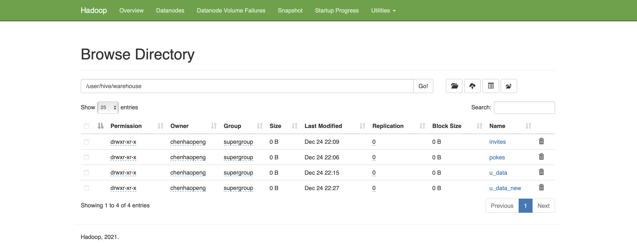
DDL Operations

Slide 12
DDL Operations
Browsing through Tables
hive> SHOW TABLES;
lists all the tables.
hive> SHOW TABLES '.*s';
lists all the table that end with 's'. The pattern matching follows Java regular expressions.
hive> DESCRIBE invites;
OK
foo int
bar string
ds string
# Partition Information
# col_name data_type comment
ds string
Time taken: 0.181 seconds, Fetched: 7 row(s)

Slide 13
DDL Operations
Altering and Dropping Tables
Table names can be changed and columns can be added or replaced:
hive> ALTER TABLE events RENAME TO 3koobecaf;
hive> ALTER TABLE pokes ADD COLUMNS (new_col INT);
hive> ALTER TABLE invites ADD COLUMNS (new_col2 INT COMMENT 'a comment’);
hive> ALTER TABLE invites REPLACE COLUMNS (foo INT, bar STRING, baz INT COMMENT 'baz replaces new_col2');
Note that REPLACE COLUMNS replaces all existing columns and only changes the table's schema, not the data.
The table must use a native SerDe. REPLACE COLUMNS can also be used to drop columns from the table's schema:
hive> ALTER TABLE invites REPLACE COLUMNS (foo INT COMMENT 'only keep the first column');
Dropping tables:
hive> DROP TABLE pokes;

Slide 14
DDL Operations
Metadata Store
Metadata is in an embedded Derby database whose disk storage location is determined by the Hive configuration variable named javax.jdo.option.ConnectionURL.
By default this location is ./metastore_db (see conf/hive-default.xml).
Right now, in the default configuration, this metadata can only be seen by one user at a time.
Metastore can be stored in any database that is supported by JPOX.
The location and the type of the RDBMS can be controlled by the two variables javax.jdo.option.ConnectionURL and javax.jdo.option.ConnectionDriverName.
In the future, the metastore itself can be a standalone server.
If you want to run the metastore as a network server so it can be accessed from multiple nodes, see Hive Using Derby in Server Mode.

Slide 15
DML Operations
The Hive DML operations are documented in Hive Data Manipulation Language.
Loading data from flat files into Hive:
hive> LOAD DATA LOCAL INPATH './examples/files/kv1.txt' OVERWRITE INTO TABLE pokes;
Loads a file that contains two columns separated by ctrl-a into pokes table.
'LOCAL' signifies that the input file is on the local file system. If 'LOCAL' is omitted then it looks for the file in HDFS.
The keyword 'OVERWRITE' signifies that existing data in the table is deleted. If the 'OVERWRITE' keyword is omitted, data files are appended to existing data sets.
NOTES:
NO verification of data against the schema is performed by the load command.
If the file is in hdfs, it is moved into the Hive-controlled file system namespace.
The root of the Hive directory is specified by the option hive.metastore.warehouse.dir in hive-default.xml. We advise users to create this directory before trying to create tables via Hive.

Slide 16
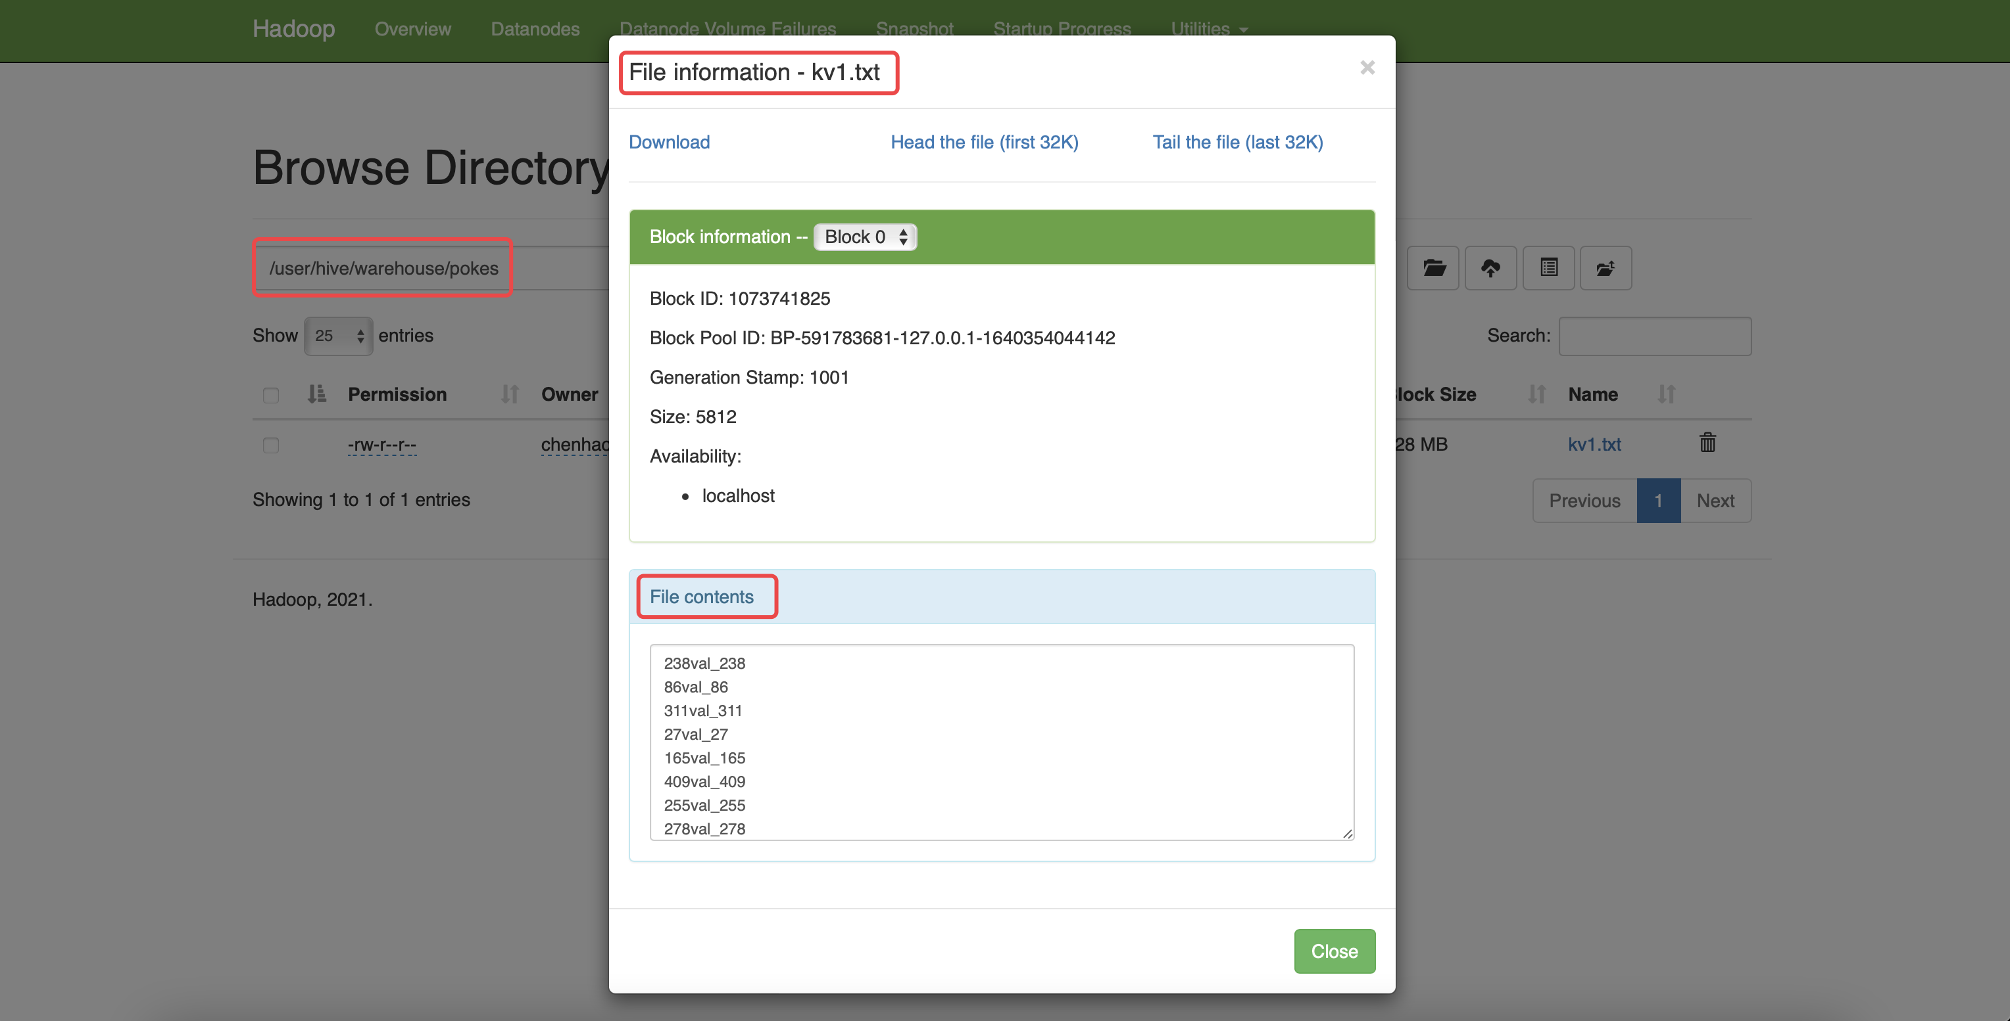
DML Operations

Slide 17
DML Operations
Data Load
hive> LOAD DATA LOCAL INPATH './examples/files/kv2.txt' OVERWRITE INTO TABLE invites PARTITION (ds='2008-08-15’);
hive> LOAD DATA LOCAL INPATH './examples/files/kv3.txt' OVERWRITE INTO TABLE invites PARTITION (ds='2008-08-08');
The two LOAD statements above load data into two different partitions of the table invites.
Table invites must be created as partitioned by the key ds for this to succeed.
hive> LOAD DATA INPATH '/user/myname/kv2.txt' OVERWRITE INTO TABLE invites PARTITION (ds='2008-08-15');
The above command will load data from an HDFS file/directory to the table.
Note that loading data from HDFS will result in moving the file/directory. As a result, the operation is almost instantaneous.

Slide 18
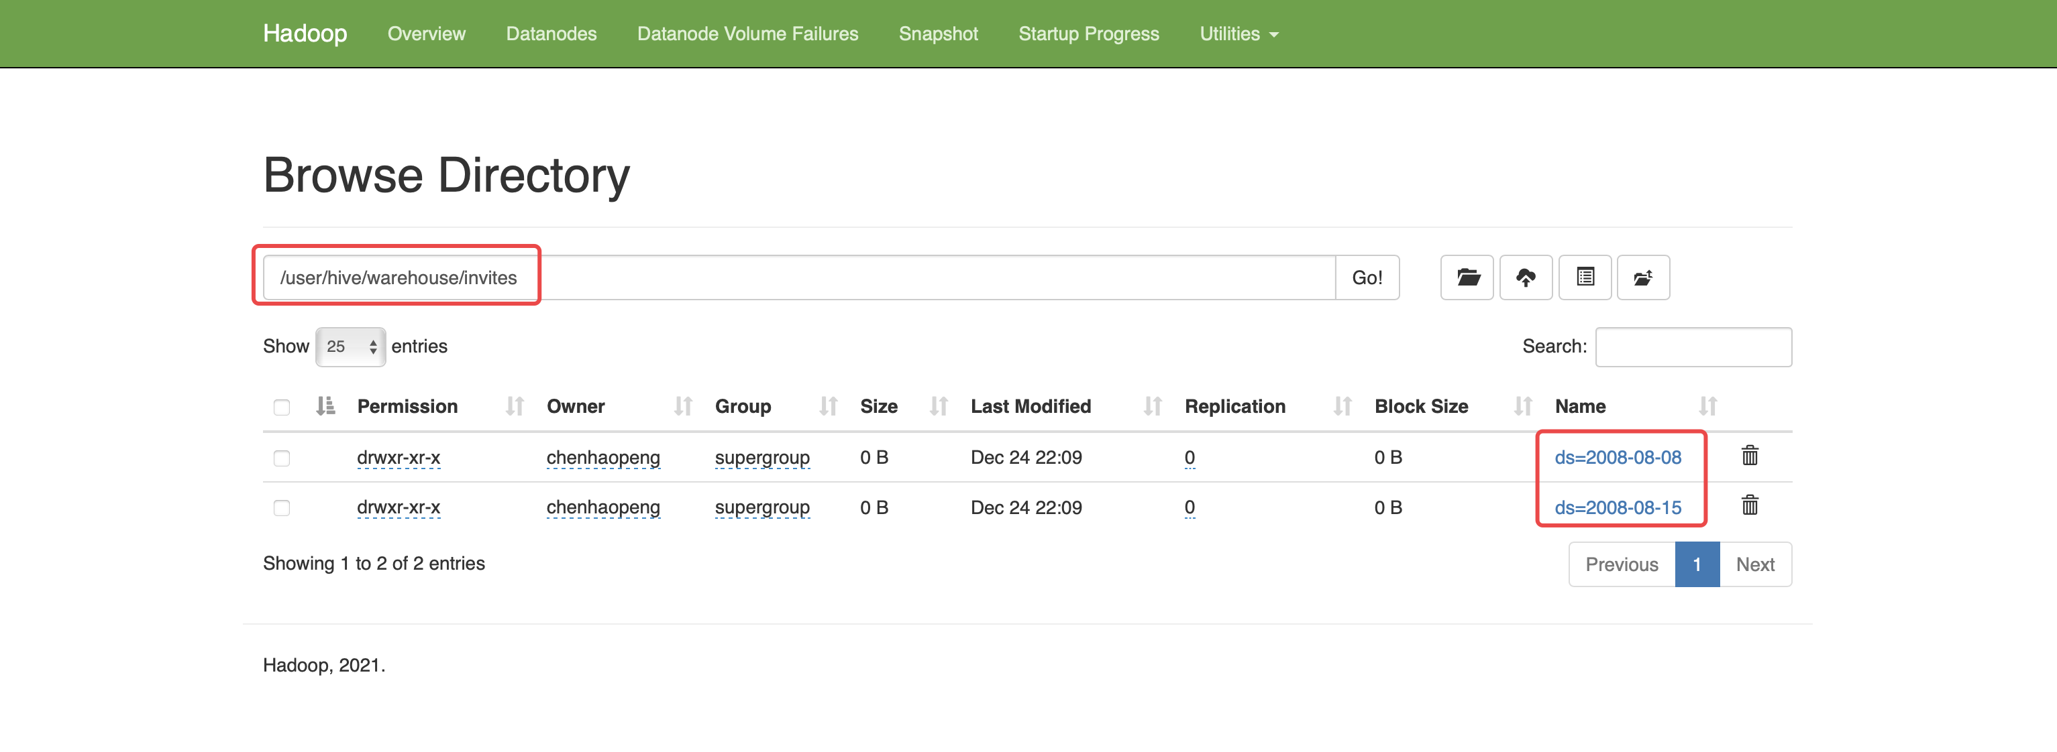
DML Operations

Slide 19
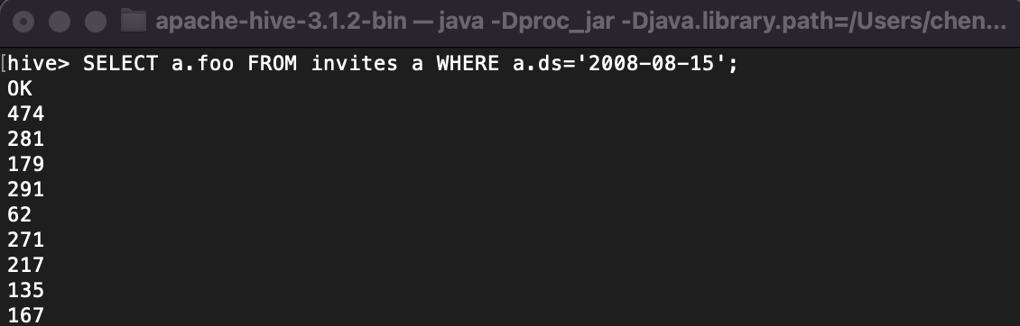
SQL Operations
The Hive query operations are documented in Select.
Example Queries
Some example queries are shown below. They are available in build/dist/examples/queries. More are available in the Hive sources at ql/src/test/queries/positive.
SELECTS and FILTERS
hive> SELECT a.foo FROM invites a WHERE a.ds='2008-08-15';
selects column 'foo' from all rows of partition ds=2008-08-15 of the invites table. The results are not stored anywhere, but are displayed on the console.

Slide 20
SQL Operations
Note that in all the examples that follow, INSERT (into a Hive table, local directory or HDFS directory) is optional.
hive> INSERT OVERWRITE DIRECTORY '/tmp/hdfs_out' SELECT a.* FROM invites a WHERE a.ds='2008-08-15';
selects all rows from partition ds=2008-08-15 of the invites table into an HDFS directory.
The result data is in files (depending on the number of mappers) in that directory. NOTE: partition columns if any are selected by the use of *. They can also be specified in the projection clauses.
Partitioned tables must always have a partition selected in the WHERE clause of the statement.

Slide 21
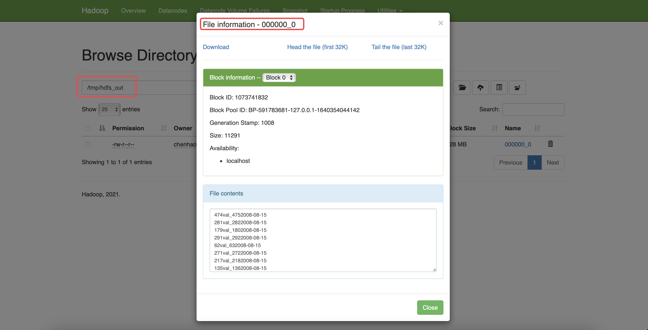
SQL Operations

Slide 22
SQL Operations
SELECTS and FILTERS
hive> INSERT OVERWRITE LOCAL DIRECTORY '/tmp/local_out' SELECT a.* FROM pokes a;
selects all rows from pokes table into a local directory.
hive> INSERT OVERWRITE TABLE events SELECT a.* FROM profiles a;
hive> INSERT OVERWRITE TABLE events SELECT a.* FROM profiles a WHERE a.key < 100;
hive> INSERT OVERWRITE LOCAL DIRECTORY '/tmp/reg_3' SELECT a.* FROM events a;
hive> INSERT OVERWRITE DIRECTORY '/tmp/reg_4' select a.invites, a.pokes FROM profiles a;
hive> INSERT OVERWRITE DIRECTORY '/tmp/reg_5' SELECT COUNT(*) FROM invites a WHERE a.ds='2008-08-15’;
hive> INSERT OVERWRITE DIRECTORY '/tmp/reg_5' SELECT a.foo, a.bar FROM invites a;
hive> INSERT OVERWRITE LOCAL DIRECTORY '/tmp/sum' SELECT SUM(a.pc) FROM pc1 a;
selects the sum of a column. The avg, min, or max can also be used.

Slide 23
SQL Operations
GROUP BY
hive> FROM invites a INSERT OVERWRITE TABLE events SELECT a.bar, count(*) WHERE a.foo > 0 GROUP BY a.bar;
hive> INSERT OVERWRITE TABLE events SELECT a.bar, count(*) FROM invites a WHERE a.foo > 0 GROUP BY a.bar;
Note that for versions of Hive which don't include HIVE-287, you'll need to use COUNT(1) in place of COUNT(*).
JOIN
hive> FROM pokes t1 JOIN invites t2 ON (t1.bar = t2.bar) INSERT OVERWRITE TABLE events SELECT t1.bar, t1.foo, t2.foo;

Slide 24
SQL Operations
MULTITABLE INSERT
FROM src
INSERT OVERWRITE TABLE dest1 SELECT src.* WHERE src.key < 100
INSERT OVERWRITE TABLE dest2 SELECT src.key, src.value WHERE src.key >= 100 and src.key < 200
INSERT OVERWRITE TABLE dest3 PARTITION(ds='2008-04-08', hr='12') SELECT src.key WHERE src.key >= 200 and src.key < 300
INSERT OVERWRITE LOCAL DIRECTORY '/tmp/dest4.out' SELECT src.value WHERE src.key >= 300;
STREAMING
hive> FROM invites a INSERT OVERWRITE TABLE events SELECT TRANSFORM(a.foo, a.bar) AS (oof, rab) USING '/bin/cat' WHERE a.ds > '2008-08-09';
This streams the data in the map phase through the script /bin/cat (like Hadoop streaming). Similarly – streaming can be used on the reduce side (please see the Hive Tutorial for examples).

Slide 25
Simple Example Use Cases
MovieLens User Ratings
First, create a table with tab-delimited text file format:
CREATE TABLE u_data (
userid INT,
movieid INT,
rating INT,
unixtime STRING)
ROW FORMAT DELIMITED
FIELDS TERMINATED BY '\t'
STORED AS TEXTFILE;

Slide 26
Simple Example Use Cases
MovieLens User Ratings
Then, download the data files from MovieLens 100k on the GroupLens datasets page (which also has a README.txt file and index of unzipped files):
wget http://files.grouplens.org/datasets/movielens/ml-100k.zip
or:
curl --remote-name http://files.grouplens.org/datasets/movielens/ml-100k.zip
Unzip the data files:
unzip ml-100k.zip
And load u.data into the table that was just created:
LOAD DATA LOCAL INPATH '<path>/u.data' OVERWRITE INTO TABLE u_data;

Slide 27
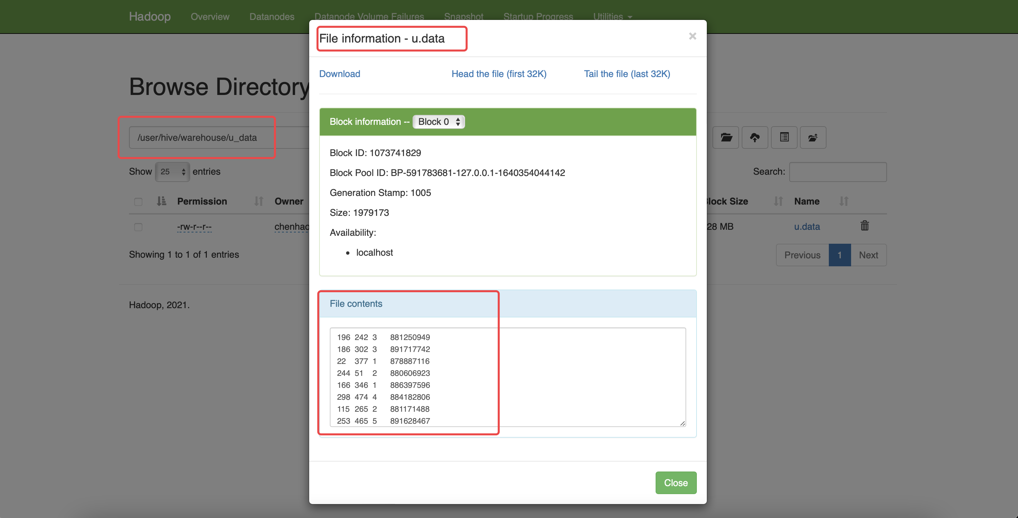
Simple Example Use Cases

Slide 28
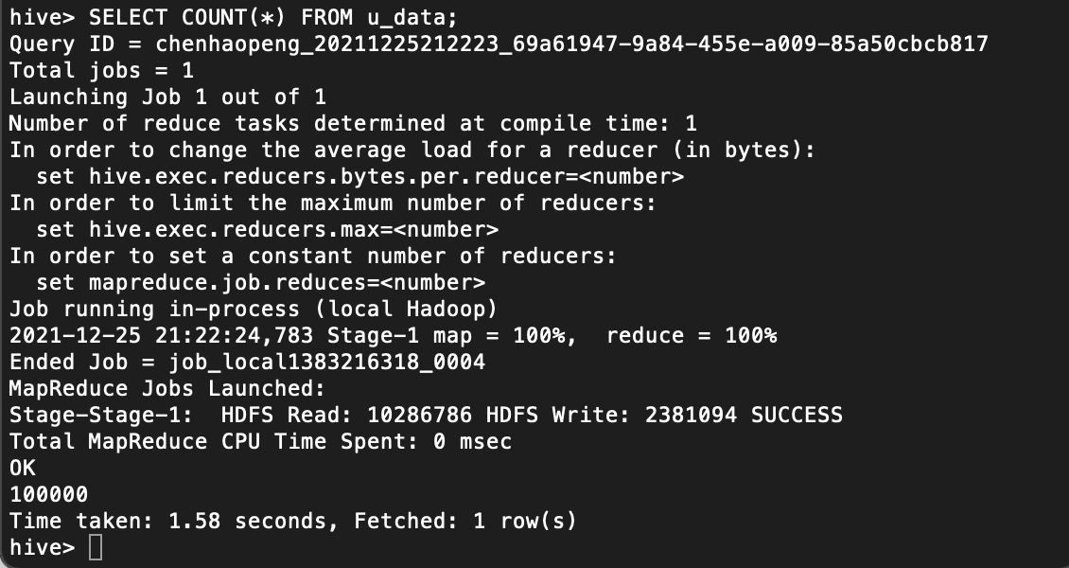
Simple Example Use Cases
Count the number of rows in table u_data:
SELECT COUNT(*) FROM u_data;

Slide 29
Simple Example Use Cases
Now we can do some complex data analysis on the table u_data:
Create weekday_mapper.py:
import sys
import datetime
for line in sys.stdin:
line = line.strip()
userid, movieid, rating, unixtime = line.split('\t’)
weekday = datetime.datetime.fromtimestamp(float(unixtime)).isoweekday()
print ('\t'.join([userid, movieid, rating, str(weekday)]))

Slide 30
Simple Example Use Cases
Use the mapper script:
CREATE TABLE u_data_new (
userid INT,
movieid INT,
rating INT,
weekday INT)
ROW FORMAT DELIMITED
FIELDS TERMINATED BY '\t';
add FILE weekday_mapper.py;
INSERT OVERWRITE TABLE u_data_new
SELECT
TRANSFORM (userid, movieid, rating, unixtime)
USING 'python weekday_mapper.py'
AS (userid, movieid, rating, weekday)
FROM u_data;
SELECT weekday, COUNT(*)
FROM u_data_new
GROUP BY weekday;

Slide 31
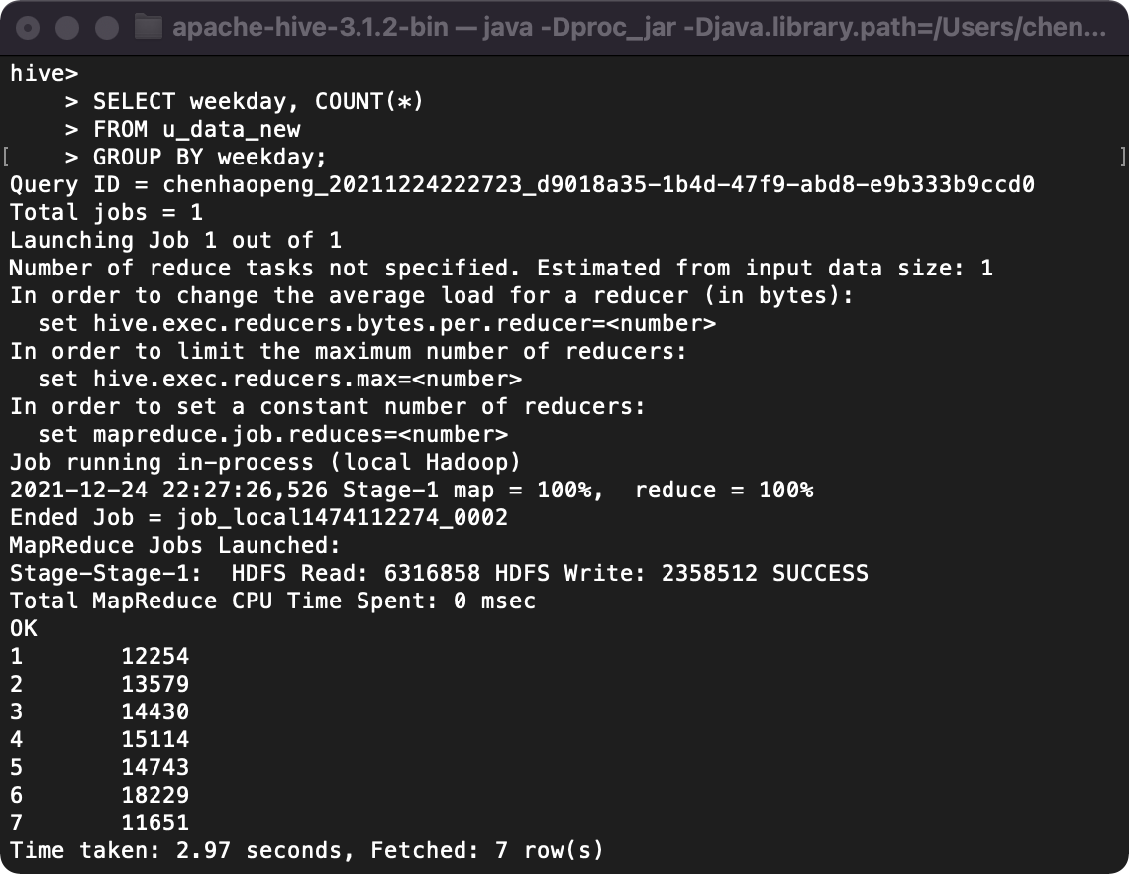
Simple Example Use Cases

Slide 32
An Example
Let’s see how to use Hive to run a query on the weather dataset.
The first step is to load the data into Hive’s managed storage.
Just like an RDBMS, Hive organizes its data into tables. We create a table to hold the weather data using the CREATE TABLE statement:
CREATE TABLE records
(year STRING, temperature INT, quality INT)
ROW FORMAT DELIMITED
FIELDS TERMINATED BY '\t';

Slide 33
An Example
Next we can populate Hive with the data.
This is just a small sample, for exploratory purposes:
LOAD DATA LOCAL INPATH 'input/ncdc/micro-tab/sample.txt'
OVERWRITE INTO TABLE records;
Running this command tells Hive to put the specified local file in its warehouse directory.
There is no attempt, for example, to parse the file and store it in an internal database format, since Hive does not mandate any particular file format.
Files are stored verbatim: they are not modified by Hive.

Slide 34
An Example
In this example, we are storing Hive tables on the local filesystem (fs.default.name is set to its default value of file:///).
Tables are stored as directories under Hive’s warehouse directory, which is controlled by the hive.metastore.warehouse.dir, and defaults to /user/hive/warehouse.
Thus, the files for the records table are found in the /user/hive/warehouse/records directory on the local filesystem:
% ls /user/hive/warehouse/record/sample.txt
In this case, there is only one file, sample.txt, but in general there can be more, and Hive will read all of them when querying the table.

Slide 35
An Example
Now that the data is in Hive, we can run a query against it:
hive> SELECT year, MAX(temperature)
> FROM records
> WHERE temperature != 9999
> AND (quality = 0 OR quality = 1 OR quality = 4 OR quality = 5 OR quality = 9)
> GROUP BY year;
1949 111
1950 22

Slide 36
Hive Services
The Hive shell is only one of several services that you can run using the hive command.
Type hive –service help to get a list of available service names; the most useful are described below.
cli
The command line interface to Hive (the shell). This is the default service.
hiveserver
Runs Hive as a server exposing a Thrift service, enabling access from a range of clients written in different languages.
hwi
The Hive Web Interface.
jar
The Hive equivalent to hadoop jar, a convenient way to run Java applications that includes both Hadoop and Hive classes on the classpath.
metastore
By default, the metastore is run in the same process as the Hive service. Using this service, it is possible to run the metastore as a standalone (remote) process.

Slide 37
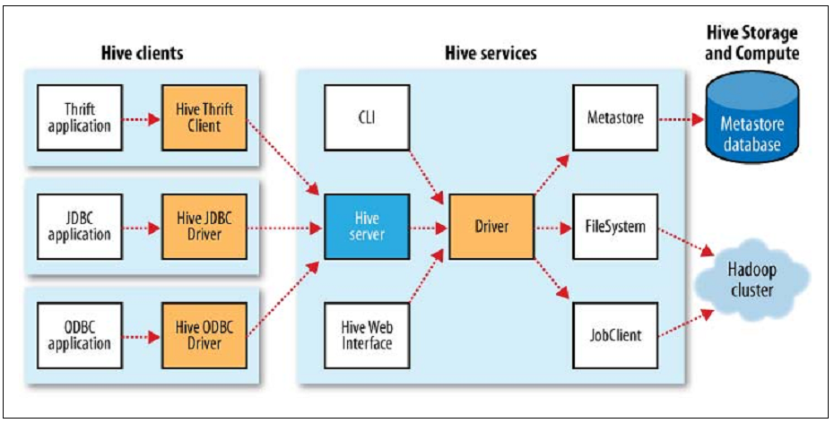
Hive clients

Slide 38
The Metastore
The metastore is the central repository of Hive metadata.
The metastore is divided into two pieces: a service and the backing store for the data.
By default, the metastore service runs in the same JVM as the Hive service and contains an embedded Derby database instance backed by the local disk.
It also supports multiple sessions (and therefore multiple users) is to use a standalone database. This configuration is referred to as a local metastore, since the metastore service still runs in the same process as the Hive service, but connects to a database running in a separate process, either on the same machine or on a remote machine.
Going a step further, there’s another metastore configuration called a remote metastore, where one or more metastore servers run in separate processes to the Hive service.

Slide 39
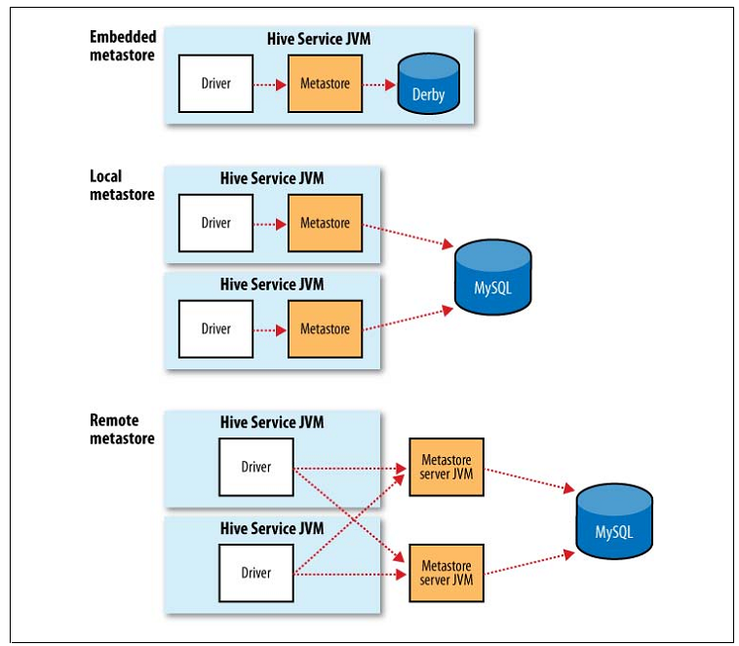
The Metastore

Slide 40
Comparison with Traditional Databases
Schema on Read Versus Schema on Write
In a traditional database, a table’s schema is enforced at data load time. If the data being loaded doesn’t conform to the schema, then it is rejected.
This design is sometimes called schema on write, since the data is checked against the schema when it is written into the database.
Hive, on the other hand, doesn’t verify the data when it is loaded, but rather when a query is issued.
This is called schema on read.
There are trade-offs between the two approaches.
Schema on read makes for a very fast initial load, since the data does not have to be read, parsed, and serialized to disk in the database’s internal format.
Schema on write makes query time performance faster, since the database can index columns and perform compression on the data.

Slide 41
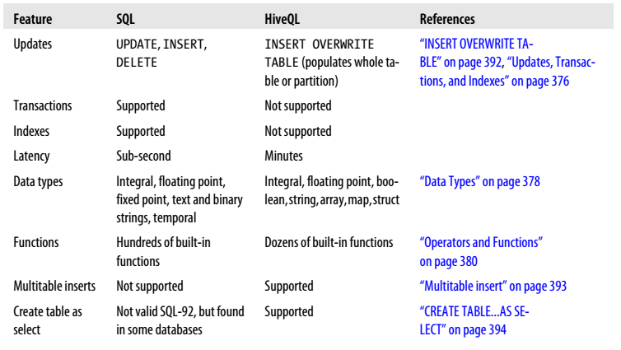
HiveQL
Hive’s SQL dialect, called HiveQL, does not support the full SQL-92 specification.

Slide 42
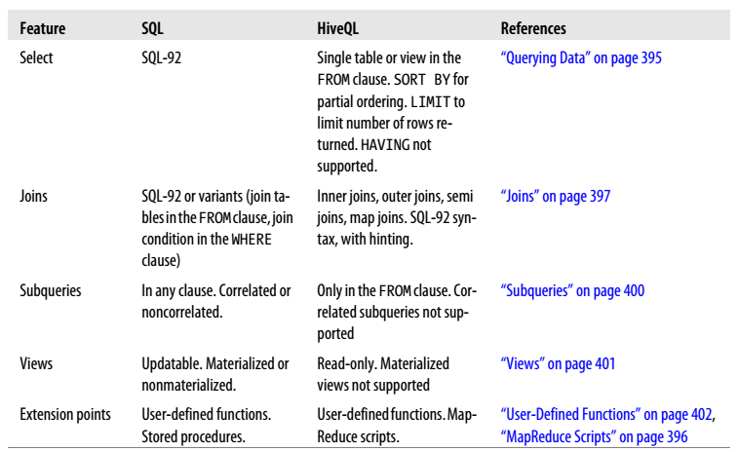
HiveQL
Hive’s SQL dialect, called HiveQL, does not support the full SQL-92 specification.

Slide 43
Tables
A Hive table is logically made up of the data being stored and the associated metadata describing the layout of the data in the table.
The data typically resides in HDFS, although it may reside in any Hadoop filesystem, including the local filesystem or S3.
Hive stores the metadata in a relational database—and not in HDFS.
Managed Tables and External Tables
When you create a table in Hive, by default Hive will manage the data, which means that Hive moves the data into its warehouse directory.
Alternatively, you may create an external table, which tells Hive to refer to the data that is at an existing location outside the warehouse directory.

Slide 44
Tables
Partitions and Buckets
Hive organizes tables into partitions, a way of dividing a table into coarse-grained parts based on the value of a partition column.
Partitions are defined at table creation time using the PARTITIONED BY clause, which takes a list of column definitions.
For the hypothetical log files example, we might define a table with records comprising a timestamp and the log line itself:
CREATE TABLE logs (ts BIGINT, line STRING)
PARTITIONED BY (dt STRING, country STRING);
When we load data into a partitioned table, the partition values are specified explicitly:
LOAD DATA LOCAL INPATH 'input/hive/partitions/file1'
INTO TABLE logs
PARTITION (dt='2001-01-01', country='GB');

Slide 45
Tables
Partitions and Buckets
Tables or partitions may further be subdivided into buckets, to give extra structure to the data that may be used for more efficient queries.
There are two reasons why you might want to organize your tables (or partitions) into buckets.
The first is to enable more efficient queries. Bucketing imposes extra structure on the table, which Hive can take advantage of when performing certain queries.
The second reason to bucket a table is to make sampling more efficient. When working with large datasets, it is very convenient to try out queries on a fraction of your dataset while you are in the process of developing or refining them.
CREATE TABLE bucketed_users (id INT, name STRING)
CLUSTERED BY (id) SORTED BY (id ASC)INTO 4 BUCKETS;

Slide 46
Querying Data
Sorting and Aggregating
hive> FROM records2
> SELECT year, temperature
> DISTRIBUTE BY year
> SORT BY year ASC, temperature DESC;
1949 111
1949 78
1950 22
1950 0
1950 -11

Slide 47
Querying Data
MapReduce Scripts
Using an approach like Hadoop Streaming, the TRANSFORM, MAP, and REDUCE clauses make it possible to invoke an external script or program from Hive.
FROM (
FROM records2
MAP year, temperature, quality
USING 'is_good_quality.py'
AS year, temperature) map_output
REDUCE year, temperature
USING 'max_temperature_reduce.py'
AS year, temperature;

Slide 48
File Formats and Compression
Hive supports several file formats:
Text File
SequenceFile
RCFile
Avro Files
ORC Files
Parquet
Custom INPUTFORMAT and OUTPUTFORMAT
The hive.default.fileformat configuration parameter
determines the format to use if it is not specified in a CREATE TABLE or ALTER TABLE statement.
Text file is the parameter's default value.

Slide 49
File Formats and Compression
RCFile
RCFile (Record Columnar File) is a data placement structure designed for MapReduce-based data warehouse systems. Hive added the RCFile format in version 0.6.0.
RCFile stores table data in a flat file consisting of binary key/value pairs. It first partitions rows horizontally into row splits, and then it vertically partitions each row split in a columnar way.
RCFile stores the metadata of a row split as the key part of a record, and all the data of a row split as the value part.
RCFile combines the advantages of both row-store and column-store to satisfy the need for fast data loading and query processing, efficient use of storage space, and adaptability to highly dynamic workload patterns.
As row-store, RCFile guarantees that data in the same row are located in the same node.
As column-store, RCFile can exploit column-wise data compression and skip unnecessary column reads.

Slide 50
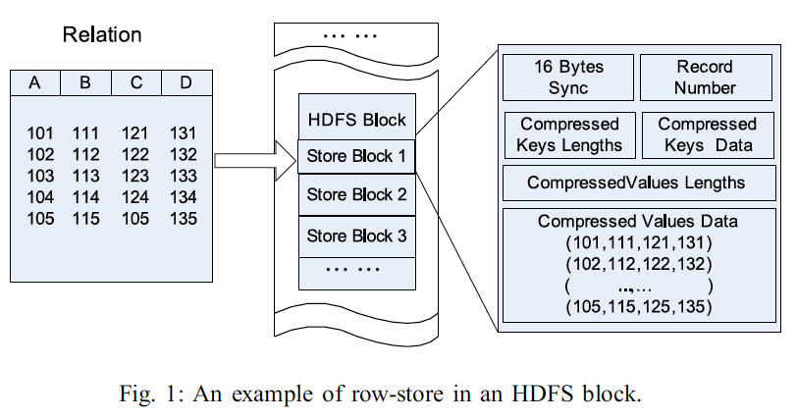
RCFile
2011 ICDE conference paper "RCFile: A Fast and Space-efficient Data Placement Structure in MapReduce-based Warehouse Systems" by Yongqiang He, Rubao Lee, Yin Huai, Zheng Shao, Namit Jain, Xiaodong Zhang, and Zhiwei Xu

Slide 51
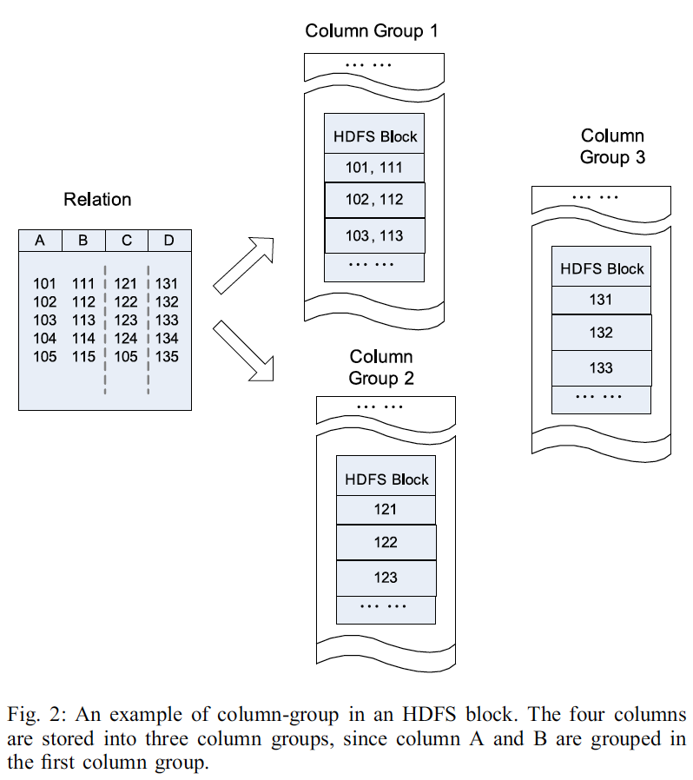
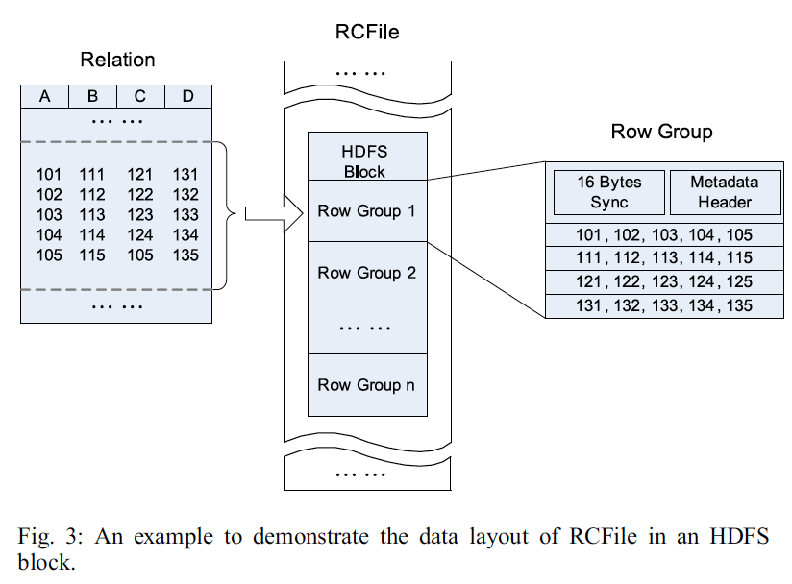
RCFile
2011 ICDE conference paper "RCFile: A Fast and Space-efficient Data Placement Structure in MapReduce-based Warehouse Systems" by Yongqiang He, Rubao Lee, Yin Huai, Zheng Shao, Namit Jain, Xiaodong Zhang, and Zhiwei Xu

Slide 52
ORCFile
The Optimized Row Columnar (ORC) file format provides a highly efficient way to store Hive data.
An ORC file contains groups of row data called stripes, along with auxiliary information in a file footer.
At the end of the file a postscript holds compression parameters and the size of the compressed footer.
The default stripe size is 250 MB. Large stripe sizes enable large, efficient reads from HDFS.
The file footer contains a list of stripes in the file, the number of rows per stripe, and each column's data type. It also contains column-level aggregates count, min, max, and sum.

Slide 53
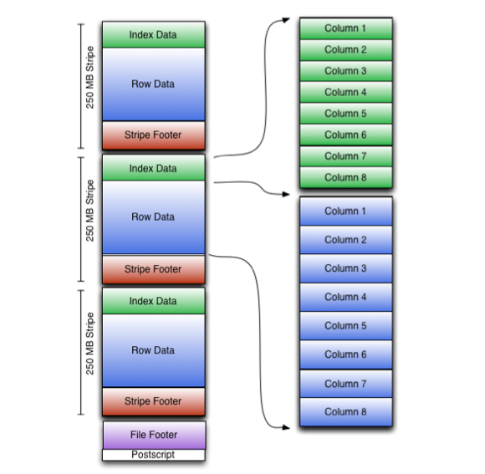
ORCFile
File Structure

Slide 54
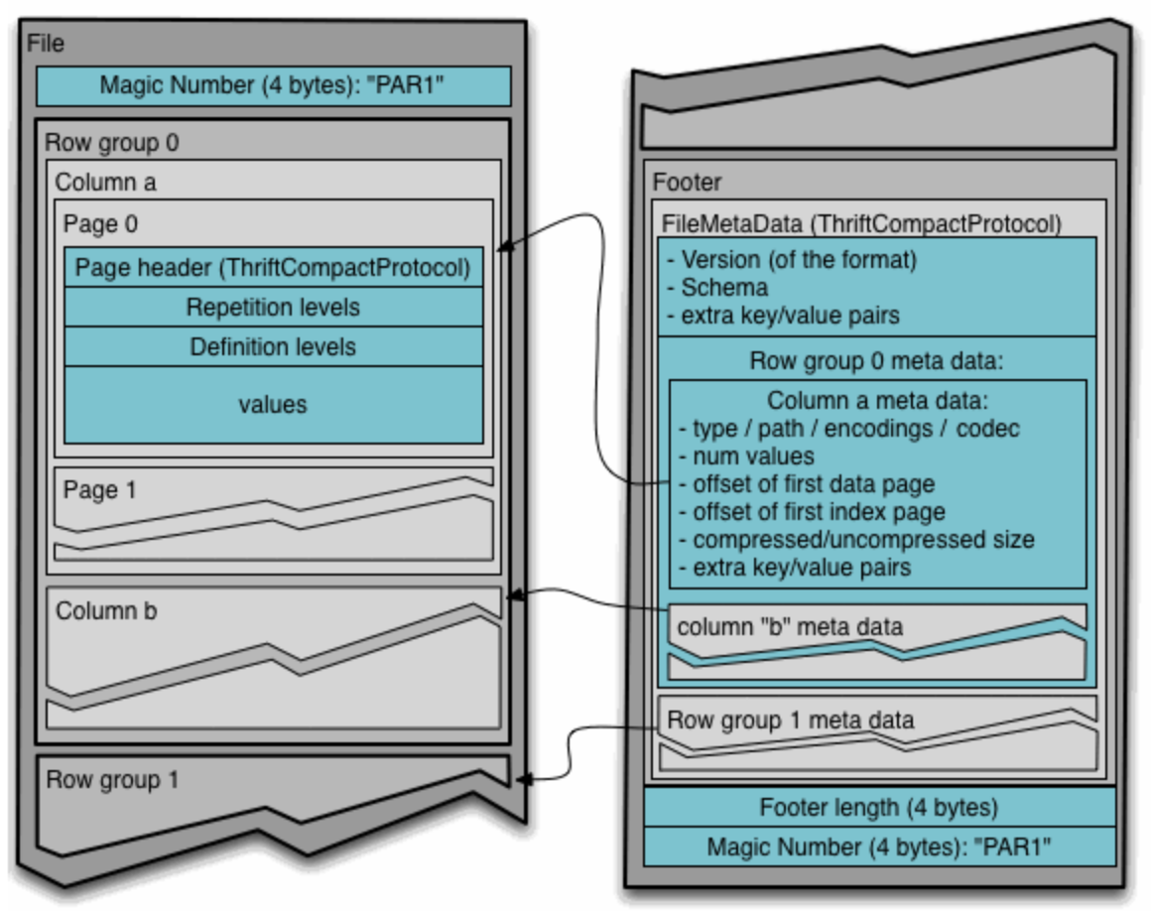
Parquet
Apache Parquet
is a columnar storage format available to any project in the Hadoop ecosystem, regardless of the choice of data processing framework, data model or programming language.
http://parquet.incubator.apache.org/

Slide 55
File Compression
Keeping data compressed in Hive tables has, in some cases,
been known to give better performance than uncompressed storage; both in terms of disk usage and query performance.
You can import text files compressed with Gzip or Bzip2 directly into a table stored as TextFile.
The compression will be detected automatically and the file will be decompressed on-the-fly during query execution. For example:
CREATE TABLE raw (line STRING)
ROW FORMAT DELIMITED FIELDS TERMINATED BY '\t' LINES TERMINATED BY '\n';
LOAD DATA LOCAL INPATH '/tmp/weblogs/20090603-access.log.gz' INTO TABLE raw;
The table 'raw' is stored as a TextFile, which is the default storage.
However, in this case Hadoop will not be able to split your file into chunks/blocks and run multiple maps in parallel. This can cause underutilization of your cluster's 'mapping' power.

Slide 56
File Compression
The recommended practice is to insert data into another table, which is stored as a SequenceFile.
A SequenceFile can be split by Hadoop and distributed across map jobs whereas a GZIP file cannot be. For example:
CREATE TABLE raw (line STRING)
ROW FORMAT DELIMITED FIELDS TERMINATED BY '\t' LINES TERMINATED BY '\n';
CREATE TABLE raw_sequence (line STRING)
STORED AS SEQUENCEFILE;
LOAD DATA LOCAL INPATH '/tmp/weblogs/20090603-access.log.gz' INTO TABLE raw;
SET hive.exec.compress.output=true;
SET io.seqfile.compression.type=BLOCK; -- NONE/RECORD/BLOCK (see below)
INSERT OVERWRITE TABLE raw_sequence SELECT * FROM raw;
The value for io.seqfile.compression.type determines how the compression is performed.
Record compresses each value individually while BLOCK buffers up 1MB (default) before doing compression.

Slide 57
LZO Compression
LZO
is a lossless data compression library that favors speed over compression ratio. See http://www.oberhumer.com/opensource/lzo and http://www.lzop.org for general information about LZO.
Imagine a simple data file that has three columns
id
first name
last name
Let's populate a data file containing 4 records:
19630001 john lennon
19630002 paul mccartney
19630003 george harrison
19630004 ringo starr

Slide 58
LZO Compression
Let's call the data file /path/to/dir/names.txt.
In order to make it into an LZO file, we can use the lzop utility and it will create a names.txt.lzo file.
Now copy the file names.txt.lzo to HDFS.
Hive Queries
Option 1: Directly Create LZO Files
Directly create LZO files as the output of the Hive query.
Use lzop command utility or your custom Java to generate .lzo.index for the .lzo files.
Hive Query Parameters
SET mapreduce.output.fileoutputformat.compress.codec=com.hadoop.compression.lzo.LzoCodec
SET hive.exec.compress.output=true
SET mapreduce.output.fileoutputformat.compress=true
For example:
hive -e "SET mapreduce.output.fileoutputformat.compress.codec=com.hadoop.compression.lzo.LzoCodec; SET hive.exec.compress.output=true;SET mapreduce.output.fileoutputformat.compress=true; <query-string>"

Slide 59
LZO Compression
Hive Queries
Option 2: Write Custom Java to Create LZO Files
Create text files as the output of the Hive query.
Write custom Java code to
convert Hive query generated text files to .lzo files
generate .lzo.index files for the .lzo files generated above
Hive Query Parameters
SET hive.exec.compress.output=false
SET mapreduce.output.fileoutputformat.compress=false
For example:
hive -e "SET hive.exec.compress.output=false;SET mapreduce.output.fileoutputformat.compress=false;<query-string>"

Slide 60
References
Apache Hive
https://hive.apache.org
Hadoop: The Definitive Guide
By Tom White
O’Reilly Publishing

Slide 61

Thank You!

