Slide 1
Architecture of Enterprise Applications 30 Flink
Haopeng Chen
REliable, INtelligent and Scalable Systems Group (REINS)
Shanghai Jiao Tong University
Shanghai, China
http://reins.se.sjtu.edu.cn/~chenhp
e-mail: chen-hp@sjtu.edu.cn
Notes:
export JAVA_HOME=/Library/Java/JavaVirtualMachines/jdk1.8.0_281.jdk/Contents/Home
必须使用jdk低版本，13太高
后续操作都必须在Hive安装目录下，否则metadata会报错

Slide 2
Contents and Objectives
Flink
Basic Concepts
Objectives
能够根据流式数据处理的基础要求，设计基于Flink的流式数据处理方案

Slide 3
Apache Flink
Apache Flink is a framework and distributed processing engine for stateful computations over unbounded and bounded data streams.
Flink has been designed to run in all common cluster environments, perform computations at in-memory speed and at any scale.
https://flink.apache.org/

Slide 4
What is Apache Flink?
Building Blocks for Streaming Applications
The types of applications that can be built with and executed by a stream processing framework are defined by how well the framework controls streams, state, and time.
Streams
Bounded and unbounded streams
Real-time and recorded streams

Slide 5
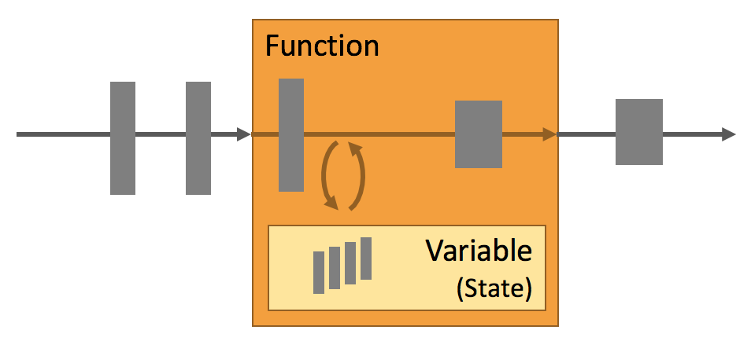
What is Apache Flink?
State
Every non-trivial streaming application is stateful, i.e., only applications that apply transformations on individual events do not require state.
Multiple State Primitives
Pluggable State Backends
Exactly-once state consistency
Very Large State
Scalable Applications

Slide 6
What is Apache Flink?
Time
Most event streams have inherent time semantics because each event is produced at a specific point in time.
Moreover, many common stream computations are based on time, such as windows aggregations, sessionization, pattern detection, and time-based joins.
An important aspect of stream processing is how an application measures time, i.e., the difference between event-time and processing-time.
Flink provides a rich set of time-related features.
Event-time Mode
Watermark Support
Late Data Handling
Processing-time Mode

Slide 7
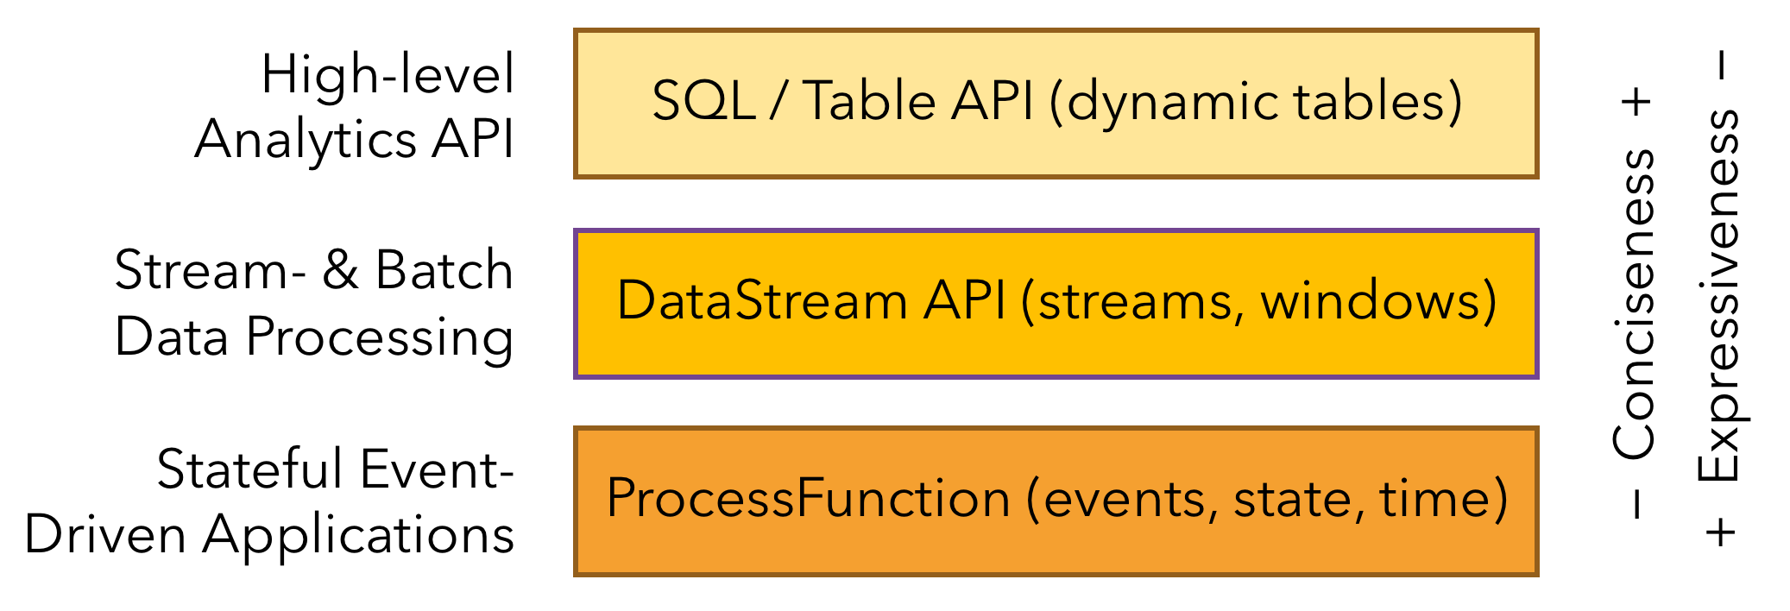
What is Apache Flink?
Layered APIs

Slide 8
What is Apache Flink?
The ProcessFunctions
Flink provides ProcessFunctions to process individual events from one or two input streams or events that were grouped in a window.
ProcessFunctions provide fine-grained control over time and state.
The following example shows a KeyedProcessFunction that operates on a KeyedStream and matches START and END events.
/**
* Matches keyed START and END events and computes the difference between
* both elements' timestamps. The first String field is the key attribute,
* the second String attribute marks START and END events.
*/
public static class StartEndDuration extends KeyedProcessFunction<String, Tuple2<String, String>, Tuple2<String, Long>> {
private ValueState<Long> startTime;

Slide 9
What is Apache Flink?
@Override public void open(Configuration conf) {
// obtain state handle
startTime = getRuntimeContext()
.getState(new ValueStateDescriptor<Long>("startTime", Long.class));
}
/** Called for each processed event. */
@Override public void processElement(
Tuple2<String, String> in, Context ctx, Collector<Tuple2<String, Long>> out) throws Exception {
switch (in.f1) {
case "START":
// set the start time if we receive a start event.
startTime.update(ctx.timestamp());
// register a timer in four hours from the start event.
ctx.timerService() .registerEventTimeTimer(ctx.timestamp() + 4 * 60 * 60 * 1000);
break;
case "END":
// emit the duration between start and end event
Long sTime = startTime.value();
if (sTime != null) {
out.collect(Tuple2.of(in.f0, ctx.timestamp() - sTime));
// clear the state
startTime.clear();
}

Slide 10
What is Apache Flink?
default:
// do nothing
}
}
/** Called when a timer fires. */
@Override public void onTimer( long timestamp, OnTimerContext ctx,
Collector<Tuple2<String, Long>> out) {
// Timeout interval exceeded. Cleaning up the state.
startTime.clear();
}
}

Slide 11
What is Apache Flink?
The DataStream API
The DataStream API provides primitives for many common stream processing operations, such as windowing, record-at-a-time transformations, and enriching events by querying an external data store.
The DataStream API is available for Java and Scala and is based on functions, such as map(), reduce(), and aggregate().

Slide 12
What is Apache Flink?
// a stream of website clicks
DataStream<Click> clicks = ...
DataStream<Tuple2<String, Long>> result = clicks
// project clicks to userId and add a 1 for counting
.map(
// define function by implementing the MapFunction interface.
new MapFunction<Click, Tuple2<String, Long>>() {
@Override
public Tuple2<String, Long> map(Click click) {
return Tuple2.of(click.userId, 1L);
}
})
// key by userId (field 0)
.keyBy(0)
// define session window with 30 minute gap
.window(EventTimeSessionWindows.withGap(Time.minutes(30L)))
// count clicks per session. Define function as lambda function.
.reduce((a, b) -> Tuple2.of(a.f0, a.f1 + b.f1));

Slide 13
What is Apache Flink?
SQL & Table API
Flink features two relational APIs, the Table API and SQL . Both APIs are unified APIs for batch and stream processing, i.e., queries are executed with the same semantics on unbounded, real-time streams or bounded, recorded streams and produce the same results.
The Table API and SQL leverage Apache Calcite for parsing, validation, and query optimization.
The following example shows the SQL query to sessionize a clickstream and count the number of clicks per session.
SELECT userId, COUNT(*)
FROM clicks
GROUP BY SESSION(clicktime, INTERVAL '30' MINUTE), userId

Slide 14
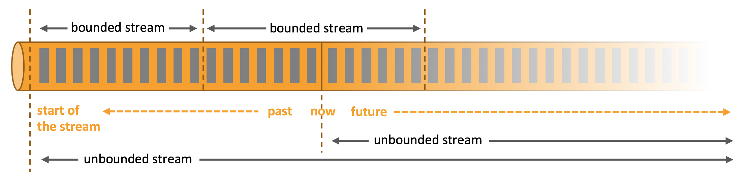
What is Apache Flink? - Architecture
Process Unbounded and Bounded Data

Slide 15
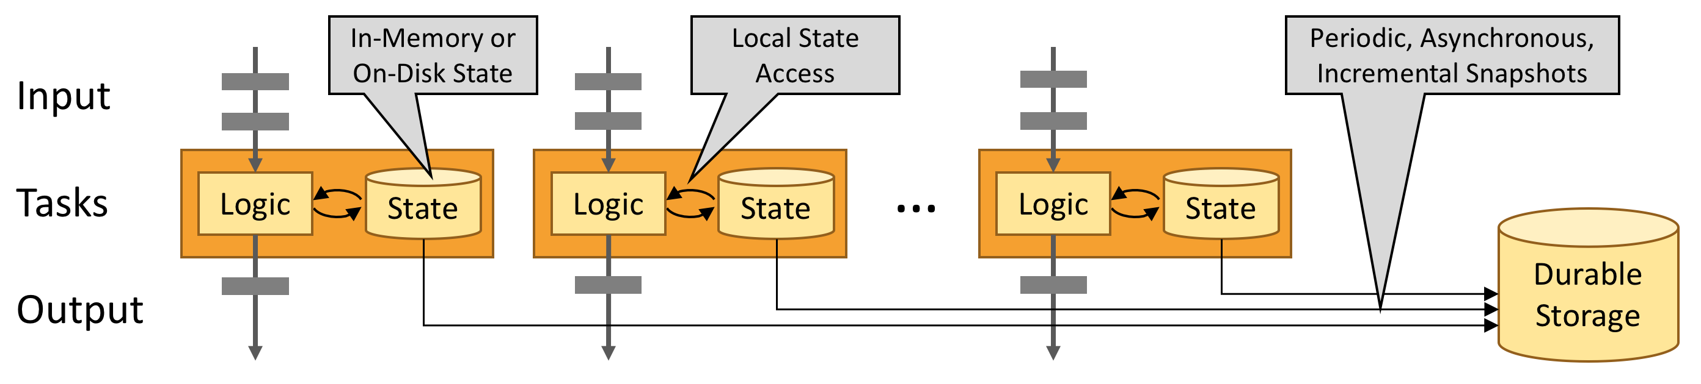
What is Apache Flink? - Architecture
Leverage In-Memory Performance

Slide 16
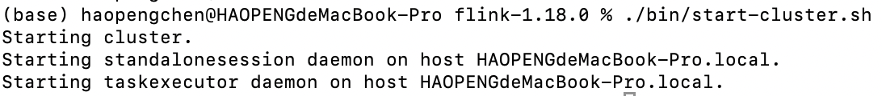
Getting Started
Starting and stopping a local cluster
To start a local cluster, run the bash script that comes with Flink:
$ ./bin/start-cluster.sh
To quickly stop the cluster and all running components, you can use the provided script:
$ ./bin/stop-cluster.sh

Slide 17
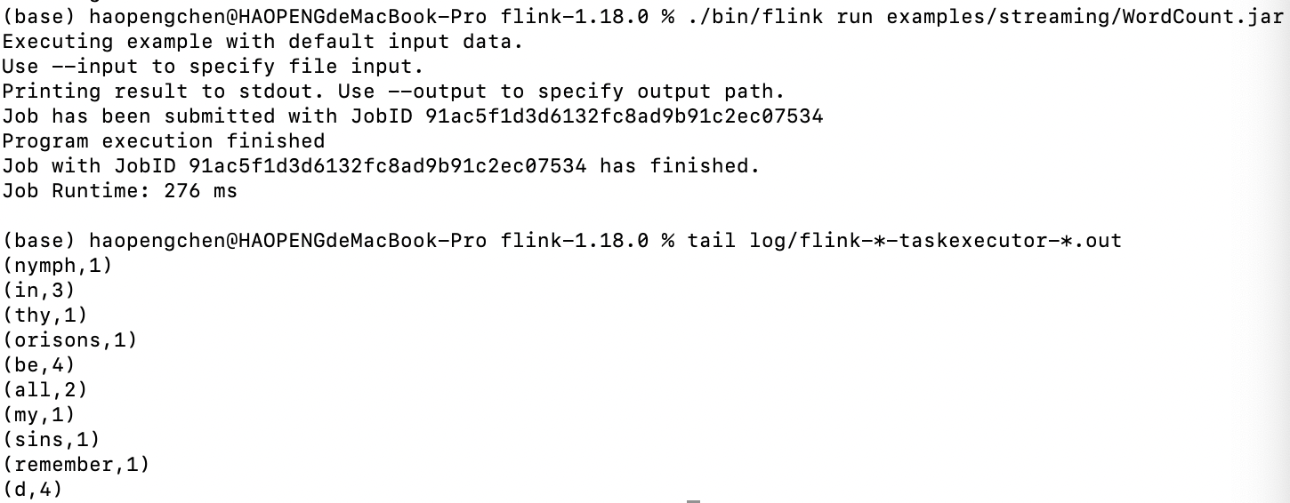
Getting Started
Submitting a Flink job
To deploy the example word count job to the running cluster, issue the following command:
$ ./bin/flink run examples/streaming/WordCount.jar
You can verify the output by viewing the logs:
$ tail log/flink-*-taskexecutor-*.out

Slide 18
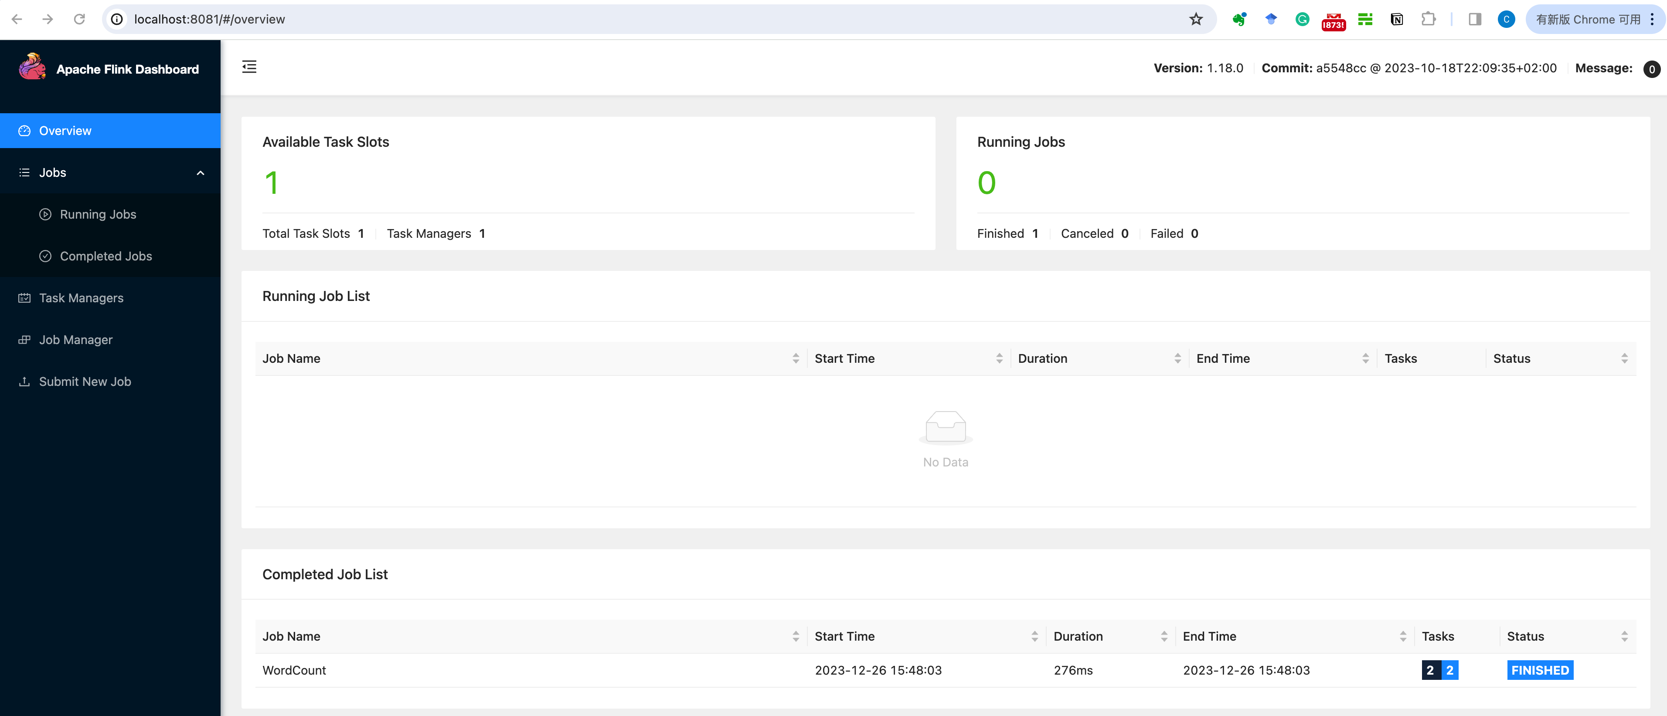
Getting Started

Slide 19
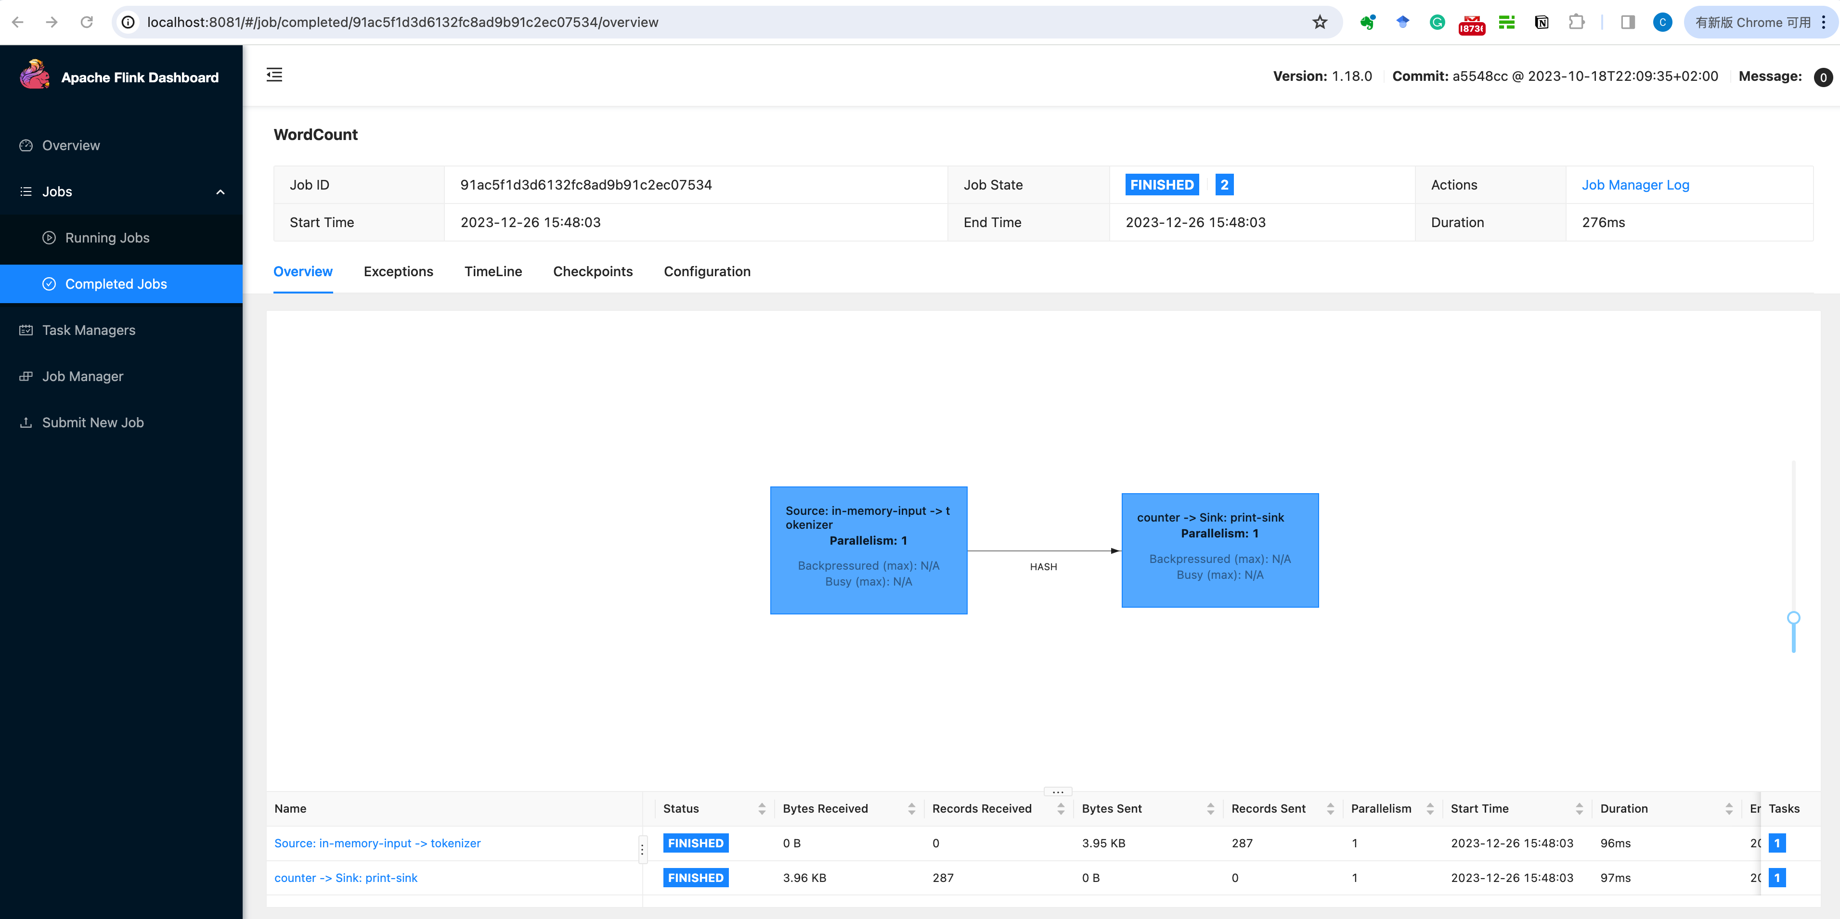
Getting Started

Slide 20
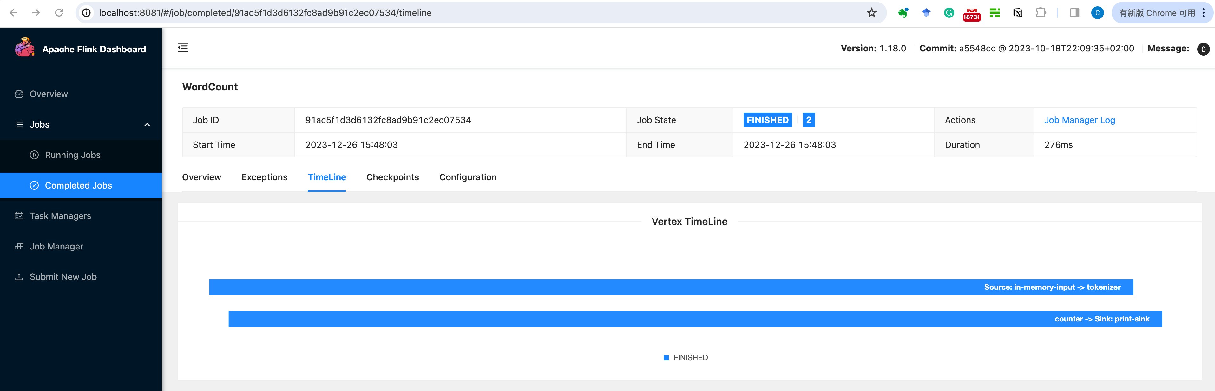
Getting Started

Slide 21
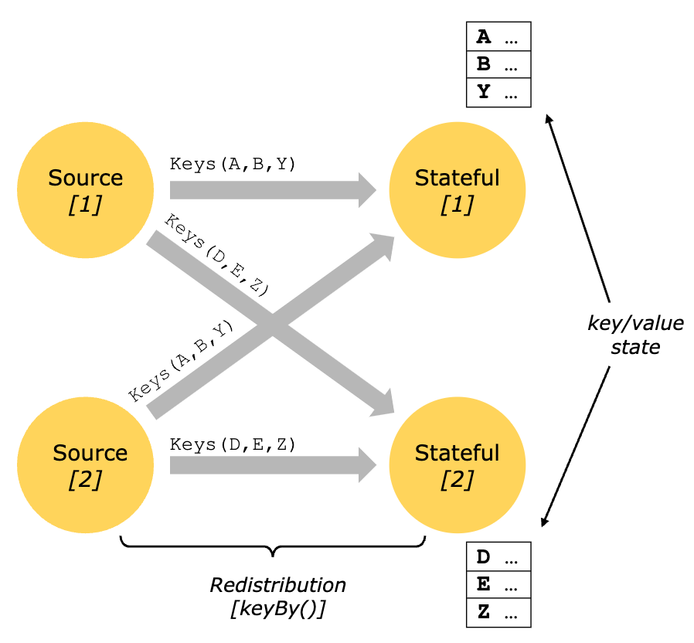
Concepts
Keyed state is maintained in what can be thought of as an embedded key/value store.
The state is partitioned and distributed strictly together with the streams that are read by the stateful operators.

Slide 22
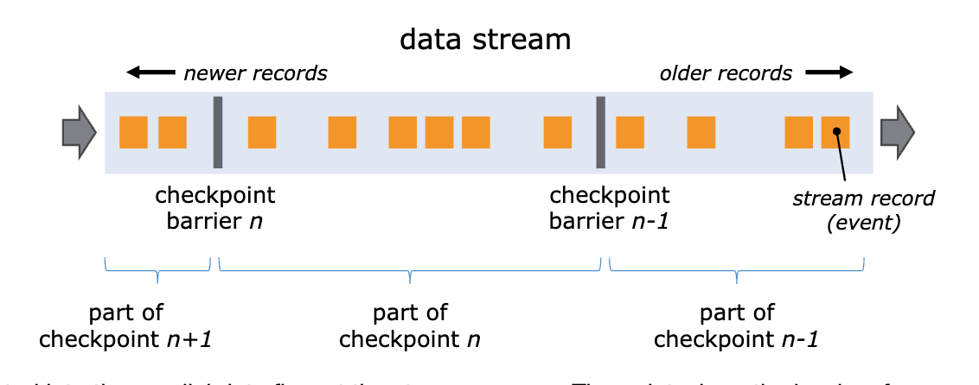
Concepts
State Persistence
Flink implements fault tolerance using a combination of stream replay and checkpointing.
Checkpointing
The central part of Flink’s fault tolerance mechanism is drawing consistent snapshots of the distributed data stream and operator state.

Slide 23
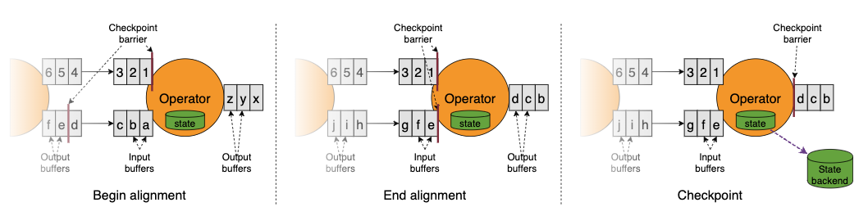
Concepts
State Persistence
Flink implements fault tolerance using a combination of stream replay and checkpointing.
Checkpointing
Barriers

Slide 24
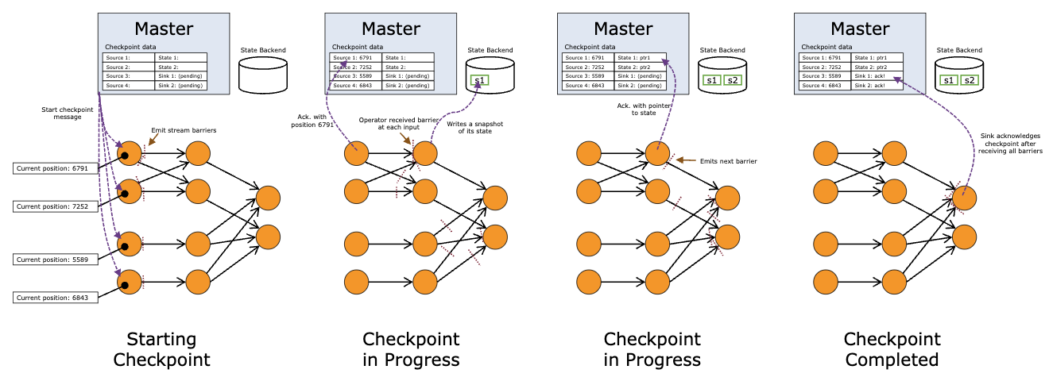
Concepts
State Persistence
Flink implements fault tolerance using a combination of stream replay and checkpointing.
Checkpointing
Snapshotting Operator State

Slide 25
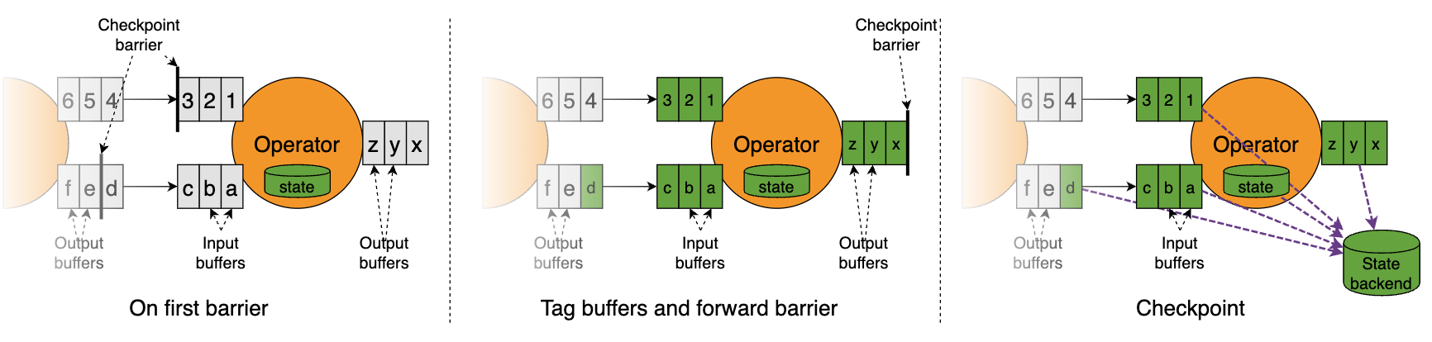
Concepts
State Persistence
Flink implements fault tolerance using a combination of stream replay and checkpointing.
Checkpointing
Unaligned Checkpointing

Slide 26
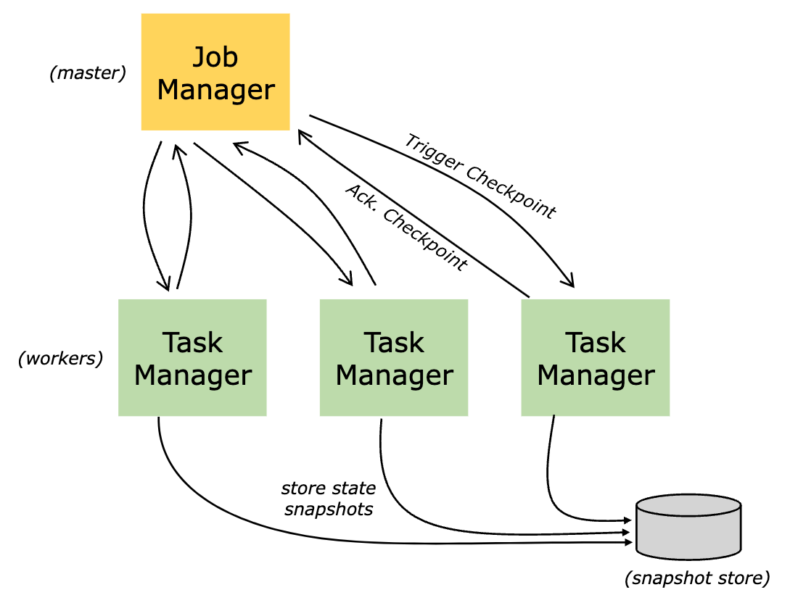
Concepts
State Backends
One state backend stores data in an in-memory hash map, another state backend uses RocksDB as the key/value store.

Slide 27
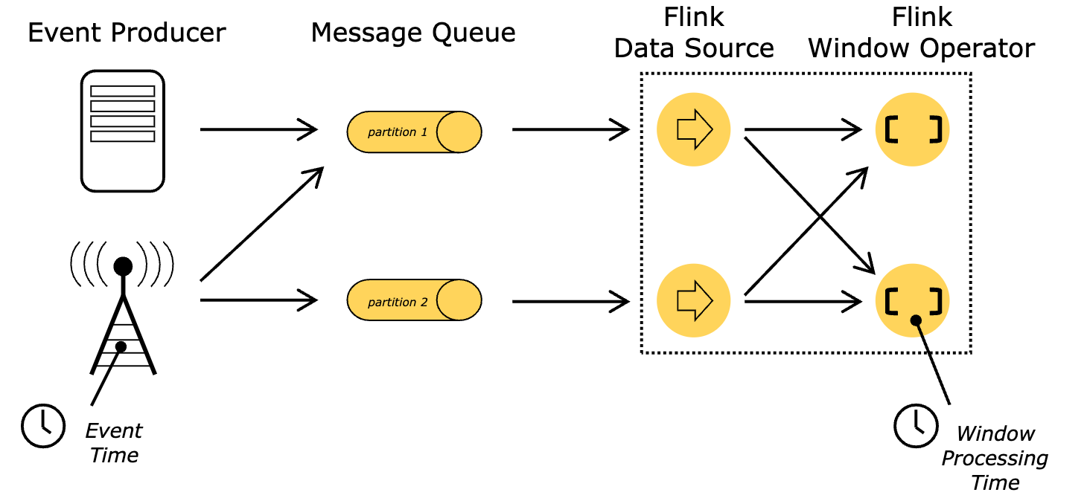
Concepts
Notions of Time: Event Time and Processing Time
Processing time: Processing time refers to the system time of the machine that is executing the respective operation.
Event time: Event time is the time that each individual event occurred on its producing device.

Slide 28
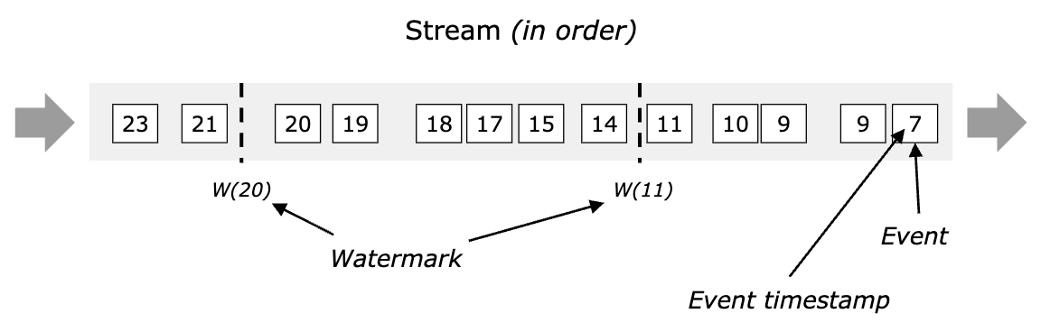
Concepts
The mechanism in Flink to measure progress in event time is watermarks.
Watermarks flow as part of the data stream and carry a timestamp t.
A Watermark(t) declares that event time has reached time t in that stream, meaning that there should be no more elements from the stream with a timestamp t’ <= t (i.e. events with timestamps older or equal to the watermark).

Slide 29
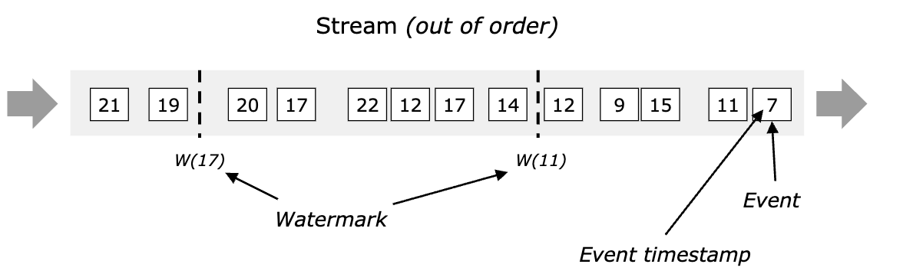
Concepts
The mechanism in Flink to measure progress in event time is watermarks.
Watermarks flow as part of the data stream and carry a timestamp t.
A Watermark(t) declares that event time has reached time t in that stream, meaning that there should be no more elements from the stream with a timestamp t’ <= t (i.e. events with timestamps older or equal to the watermark).

Slide 30
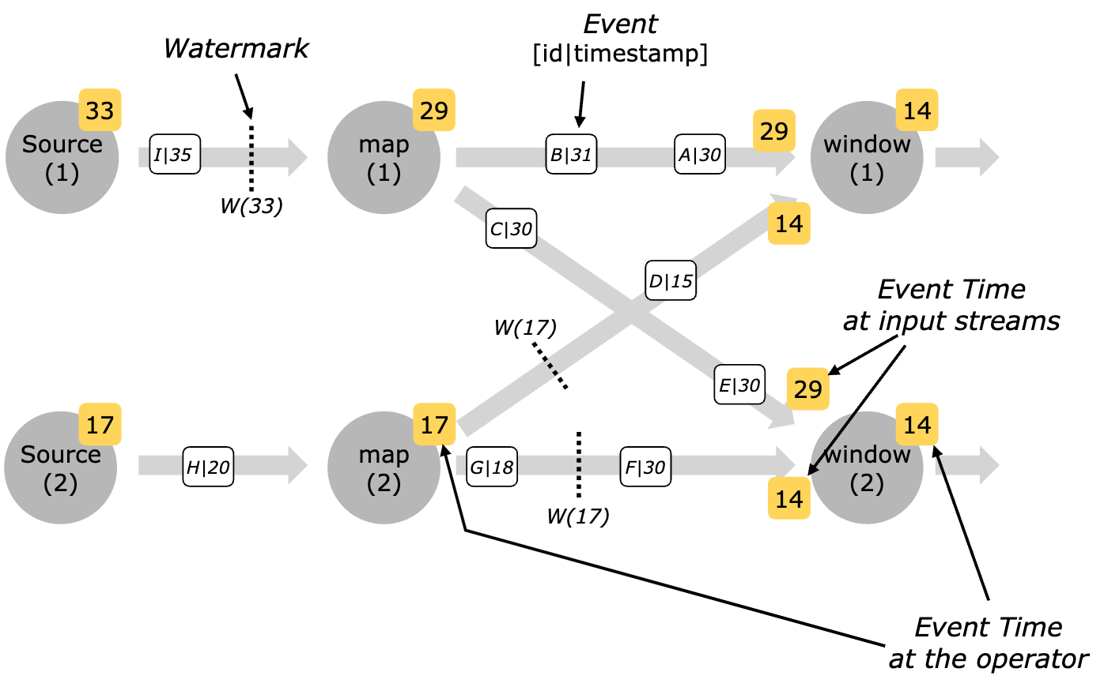
Concepts
Watermarks in Parallel Streams
The figure below shows an example of events and watermarks flowing through parallel streams, and operators tracking event time.

Slide 31
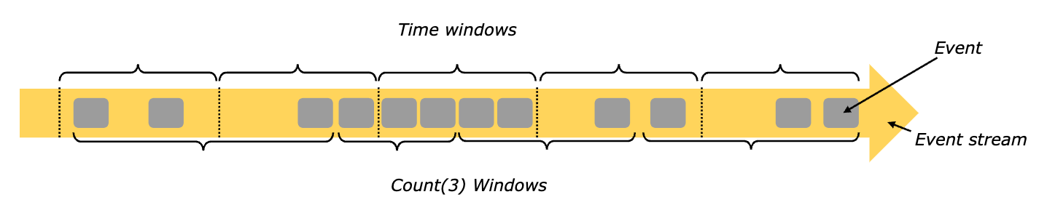
Concepts
Windowing
Aggregating events (e.g., counts, sums) works differently on streams than in batch processing.
For example, it is impossible to count all elements in a stream, because streams are in general infinite (unbounded). Instead, aggregates on streams (counts, sums, etc), are scoped by windows, such as “count over the last 5 minutes”, or “sum of the last 100 elements”.
Windows can be time driven (example: every 30 seconds) or data driven (example: every 100 elements).

Slide 32
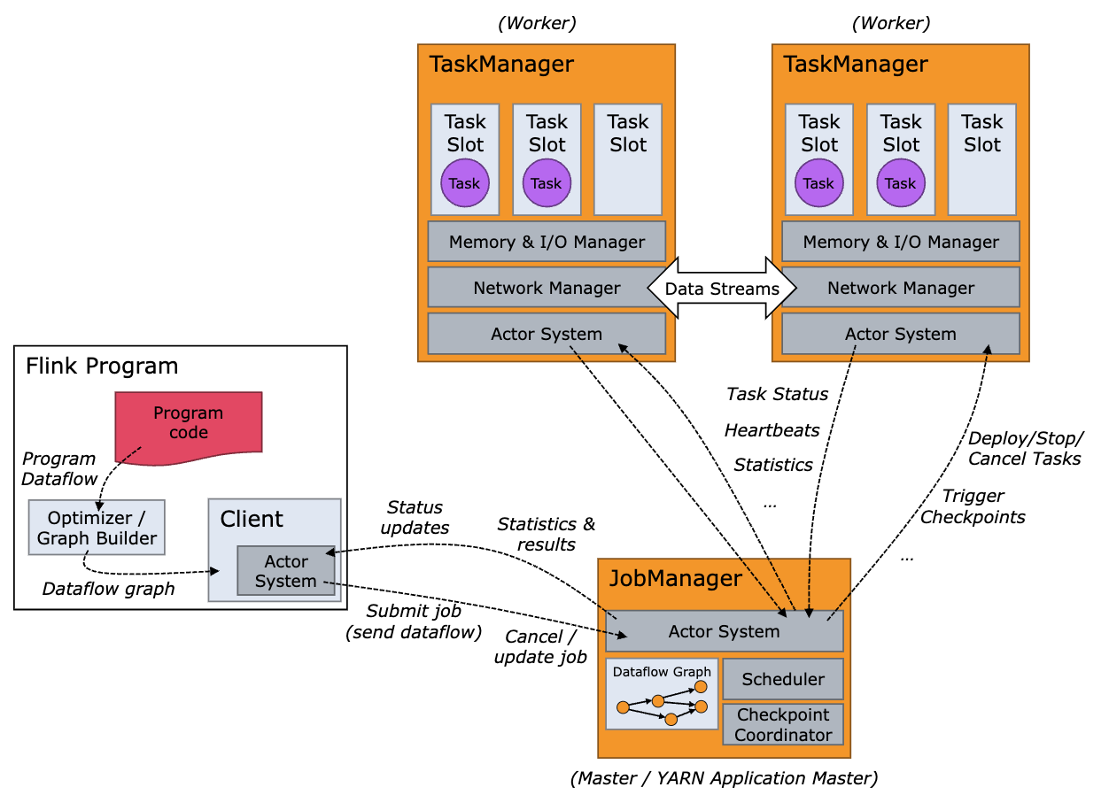
Flink Architecture

Slide 33
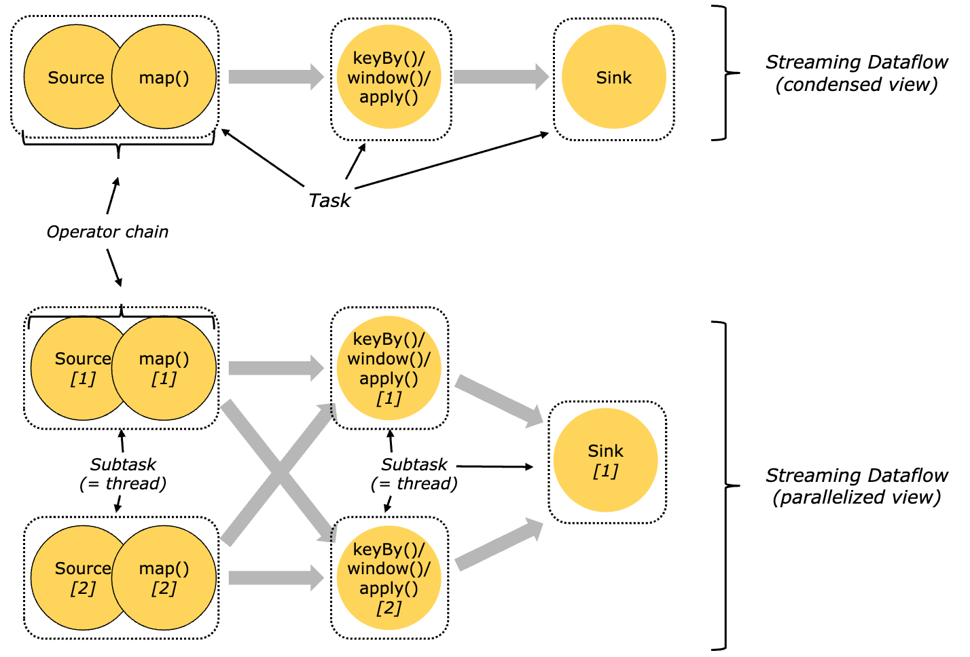
Flink Architecture
Tasks and Operator Chains

Slide 34
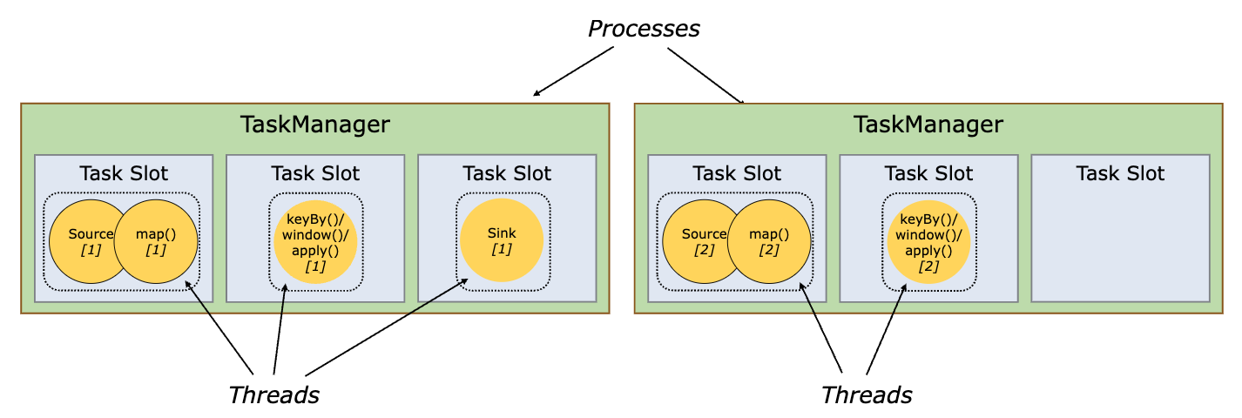
Flink Architecture
Task Slots and Resources

Slide 35
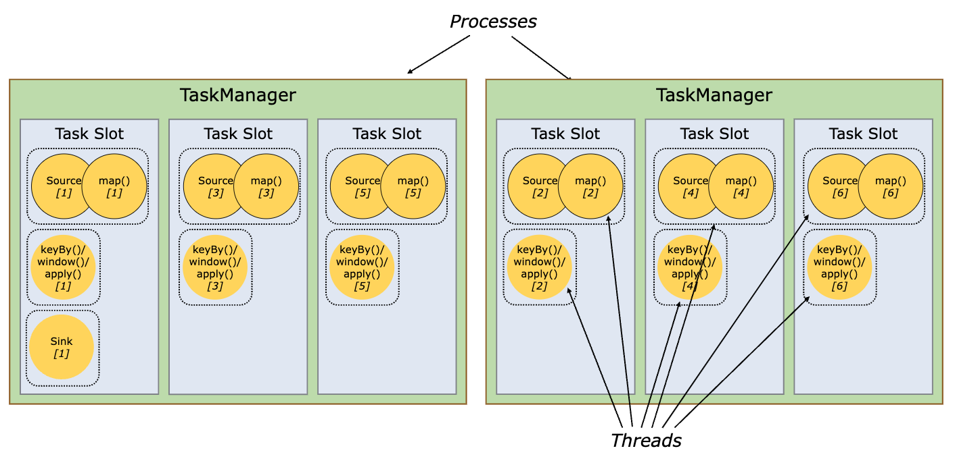
Flink Architecture
Task Slots and Resources

Slide 36
Examples
https://github.com/apache/flink/tree/master
https://nightlies.apache.org/flink/flink-docs-release-1.18/docs/flinkdev/ide_setup/
WordCount
public class WordCountData { public static final String[] WORDS = new String[] { "To be, or not to be,--that is the question:--", "Whether 'tis nobler in the mind to suffer", "The slings and arrows of outrageous fortune", "Or to take arms against a sea of troubles,", "And by opposing end them?--To die,--to sleep,--", "No more; and by a sleep to say we end",
……
}
}

Slide 37
Examples
public class WordCount { public static void main(String[] args) throws Exception { final CLI params = CLI.fromArgs(args); final StreamExecutionEnvironment env = StreamExecutionEnvironment.getExecutionEnvironment(); env.setRuntimeMode(params.getExecutionMode());
env.getConfig().setGlobalJobParameters(params); DataStream<String> text; if (params.getInputs().isPresent()) { FileSource.FileSourceBuilder<String> builder = FileSource.forRecordStreamFormat( new TextLineInputFormat(), params.getInputs().get()); params.getDiscoveryInterval().ifPresent(builder::monitorContinuously); text = env.fromSource(builder.build(), WatermarkStrategy.noWatermarks(), "file-input"); } else { text = env.fromData(WordCountData.WORDS).name("in-memory-input"); }

Slide 38
Examples
DataStream<Tuple2<String, Integer>> counts = text.flatMap(new Tokenizer()) .name("tokenizer") .keyBy(value -> value.f0) .sum(1) .name("counter"); if (params.getOutput().isPresent()) { counts.sinkTo( FileSink.<Tuple2<String, Integer>>forRowFormat( params.getOutput().get(), new SimpleStringEncoder<>()) .withRollingPolicy( DefaultRollingPolicy.builder() .withMaxPartSize(MemorySize.ofMebiBytes(1)) .withRolloverInterval(Duration.ofSeconds(10)) .build()) .build()) .name("file-sink");

Slide 39
Examples
counts.print().name("print-sink"); } env.execute("WordCount"); } public static final class Tokenizer implements FlatMapFunction<String, Tuple2<String, Integer>> { @Override public void flatMap(String value, Collector<Tuple2<String, Integer>> out) { String[] tokens = value.toLowerCase().split("\\W+"); for (String token : tokens) { if (token.length() > 0) { out.collect(new Tuple2<>(token, 1)); } } } } }

Slide 40
Examples
public class CLI extends ExecutionConfig.GlobalJobParameters { public static final String INPUT_KEY = "input"; public static final String OUTPUT_KEY = "output"; public static final String DISCOVERY_INTERVAL = "discovery-interval"; public static final String EXECUTION_MODE = "execution-mode"; public static CLI fromArgs(String[] args) throws Exception { MultipleParameterTool params = MultipleParameterTool.fromArgs(args); Path[] inputs = null; if (params.has(INPUT_KEY)) { inputs = params.getMultiParameterRequired(INPUT_KEY).stream() .map(Path::new) .toArray(Path[]::new); } else { System.out.println("Executing example with default input data."); System.out.println("Use --input to specify file input."); }

Slide 41
Examples
Path output = null; if (params.has(OUTPUT_KEY)) { output = new Path(params.get(OUTPUT_KEY)); } else { System.out.println("Printing result to stdout. Use --output to specify output path."); } Duration watchInterval = null; if (params.has(DISCOVERY_INTERVAL)) { watchInterval = TimeUtils.parseDuration(params.get(DISCOVERY_INTERVAL)); } RuntimeExecutionMode executionMode = ExecutionOptions.RUNTIME_MODE.defaultValue(); if (params.has(EXECUTION_MODE)) { executionMode = RuntimeExecutionMode.valueOf(params.get(EXECUTION_MODE).toUpperCase()); } return new CLI(inputs, output, watchInterval, executionMode, params); }

Slide 42
Examples
private final Path[] inputs; private final Path output; private final Duration discoveryInterval; private final RuntimeExecutionMode executionMode; private final MultipleParameterTool params; private CLI( Path[] inputs, Path output, Duration discoveryInterval, RuntimeExecutionMode executionMode, MultipleParameterTool params) { this.inputs = inputs; this.output = output; this.discoveryInterval = discoveryInterval; this.executionMode = executionMode; this.params = params; }
public Optional<Path[]> getInputs() { return Optional.ofNullable(inputs); } public Optional<Duration> getDiscoveryInterval() { return Optional.ofNullable(discoveryInterval); } public Optional<Path> getOutput() { return Optional.ofNullable(output); } public RuntimeExecutionMode getExecutionMode() { return executionMode; }

Slide 43
Examples
if (o == null || getClass() != o.getClass()) { return false; } if (!super.equals(o)) { return false; } CLI cli = (CLI) o; return Arrays.equals(inputs, cli.inputs) && Objects.equals(output, cli.output) && Objects.equals(discoveryInterval, cli.discoveryInterval); } @Override public int hashCode() { int result = Objects.hash(output, discoveryInterval); result = 31 * result + Arrays.hashCode(inputs); return result; } }
public OptionalInt getInt(String key) { if (params.has(key)) { return OptionalInt.of(params.getInt(key)); } return OptionalInt.empty(); } @Override public Map<String, String> toMap() { return params.toMap(); } @Override public boolean equals(Object o) { if (this == o) { return true; }

Slide 44

Thank You!

