Slide 1


Distributed file system (DFS): NFS & GFS
SE3331-1 (2024 Fall)
Yubin Xia/Xingda Wei
IPADS, Shanghai Jiao Tong University
https://www.sjtu.edu.cn
Credits: Rong Chen@IPADS

Slide 2
Large-scale website so-far
Large-scale websites are composed of different distributed systems
Request processing, data storage
Caching server
Caching server
Caching server
…
Caching
Caching
Caching
Distributed caching
Database server
Database server
CDN
Users
Application #1
generate the page
Database
user, price
…
Database
user, price
Application server
Distributed database
Internet
Load
Balance
Application #2
add the order
File server
File server
File server
File:
image
File:
image
…
File:
image
Application server
…
…
Message queue
Distributed file system

Slide 3
Large-scale website so-far
Large-scale websites are composed of different distributed systems
Request processing, data storage
How each system communicates?
Caching server
Caching server
Caching server
…
Caching
Caching
Caching
Distributed caching
Database server
Database server
CDN
Users
Application #1
generate the page
Database
user, price
…
Database
user, price
Application server
Distributed database
Internet
Load
Balance
Application #2
add the order
File server
File server
File server
File:
image
File:
image
…
File:
image
Application server
…
…
Message queue
Distributed file system

Slide 4


Last lecture: Remote Procedure Call (RPC)
Allow a procedure to execute in another address space without coding the details for the remote interaction
RPC History
Idea goes back in 1976
RPC uses stubs to avoid handling argument encoding/decoding and send/receiving messages, message transports, etc.
How RPC handles failures?
Depends on the semantic: at-most-once, at-least-once & exactly-once
What makes failure handling simpler? Idempotence

Slide 5
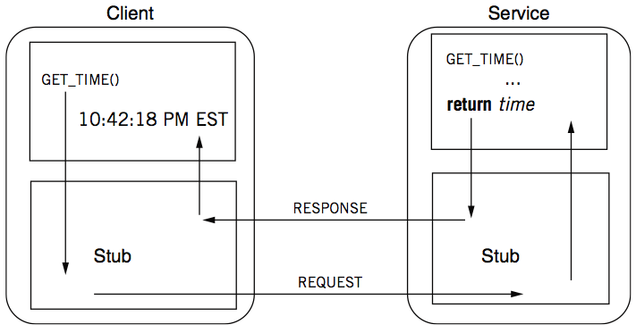
Review: RPC -- a complete calling process

Slide 6
This lecture
Distributed file system!

Slide 7

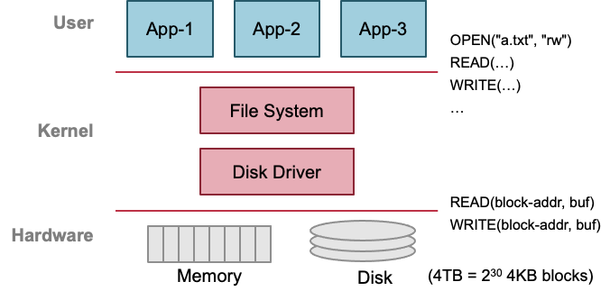
Previous lecture: single-machine file system
Storage as files
Caching server
Caching server
…
Caching server
Caching
Caching
Caching
Distributed caching
Database server
Database server
CDN
Users
Application #1
generate the page
Database
user, price
…
Database
user, price
Application server
Distributed database
Internet
Load
Balance
Application #2
add the order
File server
File server
File server
File:
image
File:
image
…
File:
image
Application server
…
…
Message queue
Distributed file system

Slide 8
Distributed file system
Key components in distributed systems
Stores large blob of data, intermediate results, database/KV backends, etc.
Caching server
Caching server
Caching server
…
Caching
Caching
Caching
Distributed caching
Database server
Database server
CDN
Users
Application #1
generate the page
Database
user, price
…
Database
user, price
Application server
Distributed database
Internet
Load
Balance
Application #2
add the order
File server
File server
File server
File:
image
File:
image
…
File:
image
Application server
…
…
Message queue
Distributed file system

Slide 9
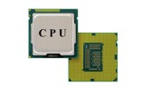

Why? Recall: for computation & storage disaggregation
Scale
Application: handles application logic
Can be scaled with more CPUs
Database: requires reading/writing disk & cache
Can be scaled with faster disks & larger memory
File system: store large bulks of data
E.g., images, videos
Can be scaled with faster disks
Application
generate the web page
Application server
Local area network
File server
Database server
Scale
Scale
File:
image
Database
user, price
Database
user, price

Slide 10
With the help of RPC
We can now build distributed file system!

Slide 11
Ways for accessing remote files
Many familiar ways, FTP, telnet, 网盘…
Explicit access (knowing it is a distributed file system)
User-directed connection to access remote resource
There is also transparent approach
E.g., NFS, GFS, etc.
Applications access the remote files like a local file

Slide 12
Distributed File Service Types
Upload/Download model (E.g., FTP)
Read file: copy file from server to client
Write file: copy file from client to server
Advantage
Simple
Problems
Wasteful “what if client needs small pieces?”
Problematic “what if client does not have enough space?”
Consistency “what if others modify the same file?”

Slide 13
Distributed File Service Types
Remote access model
File service provide functional interface with RPC (create, delete, read, write, etc.)
Advantage
Client gets only what’s needed
Server can manage a consistent view of file system
Problem
Possible server and network problem (e.g., congestion)
Servers are accessed for duration of file access
Same data may be requested repeatedly

Slide 14
NFS with RPC

Slide 15
NFS: Network File System
Design Goals (by Sun, 1980s, designed for workstations)
Any machine can be a client or a server
Support diskless workstations
Support Heterogeneous deployment
Different HW, OS, underlying file system
Access transparency
Use remote access model
Recovery from failure
Stateless, UDP, client retries
High performance
Use caching and read-ahead
Notes:
Support disk-less workstations: 避免反复存OS镜像

Slide 16
Question: can we simply replace the APIs (e.g., open, read/write, etc) in the inode filesystem to the RPC part for DFS?

Slide 17
Recall: the file system API
API
CHDIR, MKDIR
CREAT, LINK, UNLINK, RENAME
SYMLINK
MOUNT, UNMOUNT
OPEN, READ, WRITE, APPEND, CLOSE
SYNC
Implemented as system calls to user applications
Remote procedure call

Slide 18
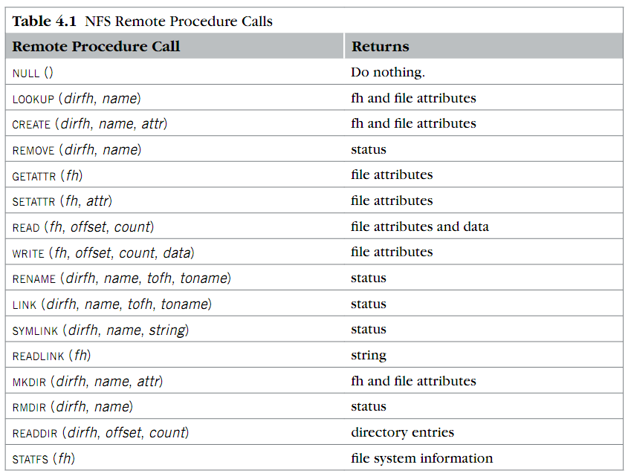
RPC implemented in NFS
Where is OPEN and CLOSE?
why offset?
What is fh?

Slide 19
NFS Protocols step-by-step: Mount
Static mounting
mount request contacts server
Server:
add list of shared directories to /etc/exports
Client:
mount 192.168.1.100:/users/paul /home/paul

Slide 20
NFS Protocols step-by-step: Mount
Protocol:
Request access to exported directory tree
Requests permission to access contents
Server returns file handle (fh), the name of the remote file
Client: parses pathname
contacts server for file handle
Server: a standard inode filesystem that implements the NFS RPC callbacks
Client: create in-memory VFS inode (vnode) at mount point internally points to remote files
Executes full file system APIs described in the last lectures using NFS RPCs

Slide 21
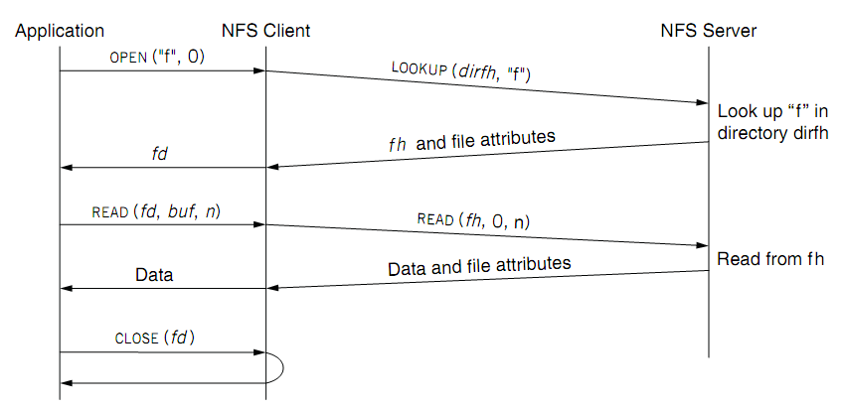
NFS Protocols: read a file
fd <--> fh (file handler)

Slide 22
Design choice: No open RPC in NFS
The NFS client library executes the open locally
By issuing lookup API instead, why?
To answer this, we need to recall what does open do

Slide 23
Review: open
Check user's permission
Update last access time
Return a short name for a file
File descriptor (fd)
fd is used by READ, WRITE, CLOSE, etc.
The FD is stored in an FD_table
Stores other things like cursor

Slide 24
What if we faithfully implement the open w/ RPC?
For each client, we need to store its opened file information in the table
So the RPC is stateful
Stateful RPC is generally less performant/scalable than stateless one
What if the server crashes, and then reboot?
What if many clients connected to the server?
NFS chooses a simple design: no open and the RPCs are stateless
For better fault tolerance & scalability

Slide 25
Stateless on NFS server
Stateless on NFS server
Each RPC contains all the information
Q: What about states like file cursor?
Client maintains the states, including the file cursor
Stateless simplifies failure handling
Client can repeat a request until it receives a reply (at least once)
But, naïve retry stateless operations are not always good
Server may execute the same request twice
Solution: each RPC is tagged with a transaction number, and server maintains some "soft" state: reply cache (recall, at-most-once RPC)
Q: What if the server fails between two same requests?

Slide 26
NFS Protocols: read a file
What is a file handler?

Slide 27
What is a file handler?
Basically, it is used to name the remote file
i.e., identifying which file to access on the server
Question: how to implement it?
We cannot use FD, because the server has no file table ☺
What are the other options?
Path name
Inode number
Q: Can we use path name in the handle?

Slide 28
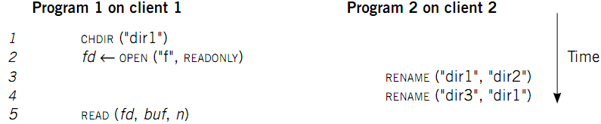
Case 1: Rename After Open
UNIX Spec:
Program 1 should read "dir2/f"
NFS should keep the spec

Slide 29
What is a file handler?
Basically, it is a naming
i.e., which file to access on the server
We cannot use FD, because the server has no file table ☺
What are the other options?
Path name
Inode number
Q: Can we directly use the inode number ?

Slide 30
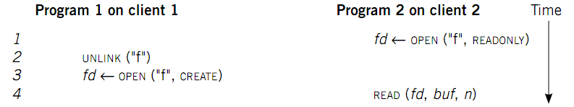
Case 2: Delete After Open
Remedy: let program 2 read the previous file, or return error
Cannot read the wrong file!
How to avoid program 2 reading the wrong file?
Generation number: a number incremented upon assigning an inode number to a new file
The fh contains both inode number & generation number
If read’s fh does not match the current generation, then abort

Slide 31
Case 2: Delete After Open
How to avoid program 2 reading new file?
Generation number: a number incremented upon assigning an inode number to a new file
UNIX spec:
On local FS, program 2 will read the old file
Not the same as UNIX spec! It's a tradeoff...

Slide 32
Put it all together: file handler
File handler contains two main parts
inode number: for server to locate the file
Generation number: for server to maintain consistency of a file
Some other less important information, e.g., file system type

Slide 33
NFS Protocols: read a file
fd <--> fh (file handler)
Question: why the READ of NFS is different from the inode file system?

Slide 34
Problem: performance overheads
Usually slower than local, but not always
Question: depends on what?
Optimization: caching at client
Goal: reduce number of remote ops
Caching: read, readlink, getattr, lookup, readdir
Cache file data at client (buffer cache)
Cache file attribute information at client
Cache pathname bindings for faster lookup
Server side
Caching is “automatic” via buffer cache
File server performance & network speed

Slide 35
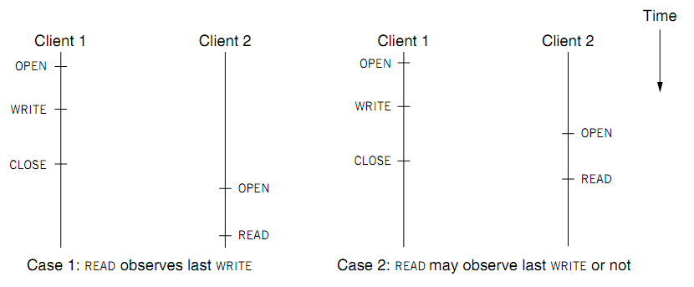
Challenge of caching: cache coherence

Slide 36
Challenge of caching: cache coherence
Type-1: Close-to-open consistency
Higher data rate
GETATTR when OPEN, to get last modification time
Compare the time with its cache
When CLOSE, send cached writes to the server
Type-2: Read/write coherence
On local file system, READ gets newest data
On NFS, client has cache
NFS could guarantee read/write coherence for every operation, or just for certain operation
Notes:
Mixed blocks, old and new

Slide 37
Handling inconsistency
Inconsistencies may arise in NFS
For close-to-open consistency
Flush the cache upon close
If data block is modified, it is:
Marked dirty, then flushed on file close
For read/write coherence
Resolve inconsistencies with validation
Both server and client save timestamp of files
When file opened or server contacted for new
Compare last modification time
If remote is more recent, invalidate cached data
Always invalidate data after some time
open files (3 sec), directories (30 sec)

Slide 38
Improving Read Performance
Transfer data in large chunks
8KB default
Read-ahead
Optimize for sequential file access
Send requests to read disk blocks before they are requested by the applications

Slide 39
Not an ending story: NFS is continuously improving
Version 3
Version 4
User-level lock manager
NVRAM support
Adjust RPC retries dynamically
Client-side disk caching
Support 64-bit file sizes
TCP support and large-block transfers
Commit operation
…
More state: control of caching, notify of file changes
Server export a single name space (pseudo file system)
Compound RPC support
Extended attribute and ACL
Negotiate security mechanism on mount
…

Slide 40
Reference Materials
RFC 1831: RPC Specification
http://www.ietf.org/rfc/rfc1831.txt?number=1831
RFC 1832: XDR Specification
http://www.ietf.org/rfc/rfc1832.txt?number=1832

Slide 41
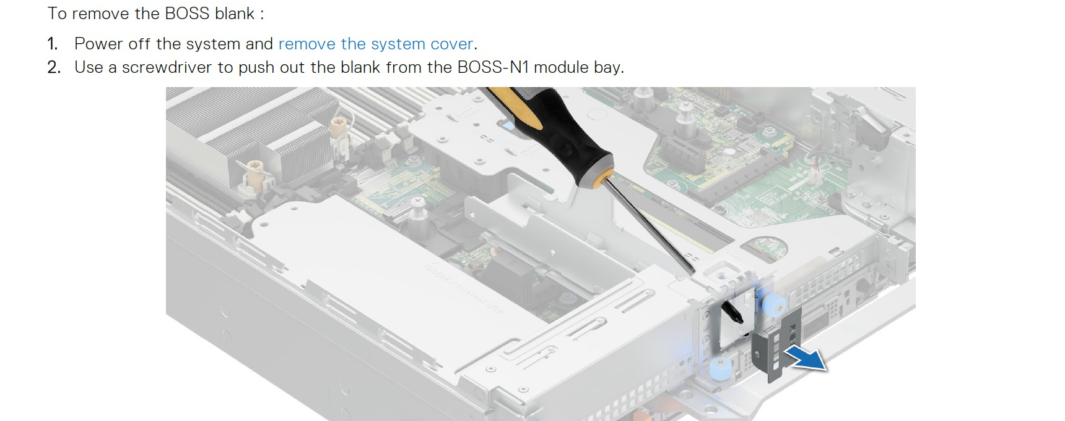
Drawback of NFS
Capacity
Can only disks on a single server, which has a limited capacity to insert disks

Slide 42
Drawback of NFS
Capacity
Can only disks on a single server, which has a limited capacity
2. Reliability
If the server crashes, the remote files are unavailable
3. Performance
The file performance is limited to a single file (and a single network bandwidth)

Slide 43
Observation: plenty of available servers in a datacenter
Plenty of machines in a datacenter
E.g., much cheaper than a high-end server
Idea: utilis multiple machines to form a single, large distributed file system
We can leverage the aggregated capacity of all the machines!
Naïve solution: do manual partitioning & replication
User decides which files / directories are stored on which server
Not so good: dates back to the FTP case ☺

Slide 44
Design goal: transparent remote file accesses
We don’t want the developers to manage which file store on which server
It is difficult to the developers
Also, does not support existing applications
But, it means that we cannot simply reuse the inode-based filesystem implementations
Nevertheless, the overall principles are the same, e.g., we still needs things like block layer, inode layer, etc.
We will see many challenges faced by distributed systems during our journal ☺

Slide 45

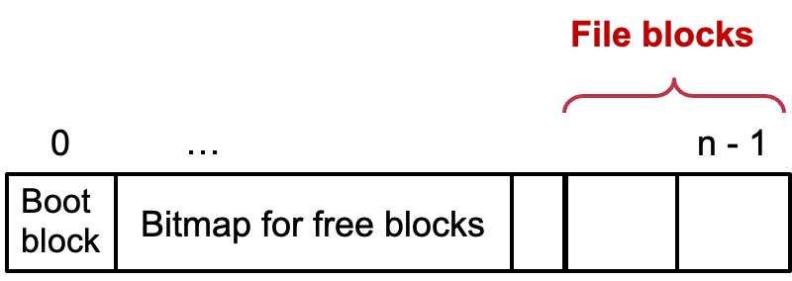
Step #1: Distributed block layer
File blocks
0
1
…
n - 1
Boot
block
Super
block
Bitmap for free blocks
…
File blocks
0
…
n - 1
Boot
block
Bitmap for free blocks

Slide 46
Step #1: Distributed block layer
Block num
Disk
Block
Q1. How to access the block in a distributed setting?
Simple, we can extend the block_id to <mac_id, block_id>
Q2. Second, how can a client know which machine has a free block?
Sol#1. select a random server; if it has free block, then we are done; if not, retry until we can find one.
Sol#2. use a master server to record the free blocks at each machine, and all the block allocation & deallocation go to the master
Master
…
File system metadata: free blocks
Notes:
Sol#1 is not so good: what if we want allocate many blocks? Multiple RTTs

Slide 47
L2: File Layer: do we need a redesign?
File
(inode)
Block num
Disk
Block
Recall: Given an inode, can map a block index number (of a file) to a block number (of a disk)
Index number: e.g., the 3rd block of a file is number 78
No need for now for now for functionality, since we can access the blocks
With our previous designed distributed layer
There are some other issues, e.g., performance, reliability, consistency, etc.
We will back to these example later

Slide 48
L3: Distributed inode Number Layer
Inode num
File
(inode)
Block num
Disk
Block
Mapping: inode number -> inode
inode table: at a fixed location on storage
inode number is the index of inode table
Track which inode number are in use, e.g. free list, a field in inode
Distributed inode number layer: store the inode table at the master!
Inode table
Master
…
File system metadata: free blocks + inode table

Slide 49
L4: File Name Layer
File
name
Inode num
File
(inode)
Block num
Disk
Block
File name
Hide metadata of file management
Files and I/O devices
Mapping
Mapping table is saved in directory
Default context: current working directory
Context reference is an inode number
The current working directory is also a file
Question
Do we need to extend it to a distributed setup? So far, so good!
struct inode
integer block_nums[N]
integer size
integer type
Overview of inode content
File name | inode num
helloworld.txt | 12
cse2021.md | 73

Slide 50

Put the distributed file layers so far together
Example: lookup (simplified)
Local lookup
<1,64>
<0,12>
Read
File system metadata: free blocks + inode table
Filename,
directory inode
<0,12>
Master
Read
<1,64>

Slide 51
L5: Path Name Layer
File
name
Inode num
File
(inode)
Block num
Disk
Block
Path name
Hierarchy of directories and files
Structured naming: E.g. "projects/paper"
Context: the working directory dir
If we have the lookup, then we can also do the path lookup ☺
procedure PATH_TO_INODE_NUMBER(string path, integer dir)-> integer
if PLAIN_NAME(path)return NAME_TO_INODE_NUMBER(path,dir)
else
dir <- LOOKUP(FIRST(path), dir)
path <- REST(path)
return PATH_TO_INODE_NUMBER(path,dir)

Slide 52
Does naïve DFS address the drawback of NFS?
Capacity: Yes
Can only disks on a single server, which has a limited capacity
2. Reliability
If the server crashes, the remote files are unavailable
3. Performance
The file performance is limited to a single file (and a single network bandwidth)

Slide 53
Issues of our naïve design so far
Performance
E.g., path lookup is slow due to multiple RTTs
Though we can use cache, like we have done in NFS ☺
Reliability
E.g., what if the master fails?
E.g., what if some servers that store the blocks fail?
Correctness
If a failure happens, the overall system states will be corrupted!

Slide 54
Failure is a subtle issue & can even happens under in inode-base filesystem
We will talk about the issues in later lectures

Slide 55
We need more “weapons” to cope w/ the above issues
Performance
E.g., path lookup is slow due to multiple RTTs
Though we can use cache, like we have done in NFS ☺
But what if there is a cache miss? What if a server has become the bottleneck?
Reliability => we need data replication
E.g., what if the master fails?
E.g., what if some servers that store the blocks fail?
Correctness => we need to define what is correct & how to achieve so ☺
If a failure happens, the overall system states will be corrupted!

Slide 56
Case study: GFS
The Google File System
Sanjay Ghemawat, “The Google File System”. SOSP, 2003
Notes:
Based on our previous illustration, but make some extension based on Google’s internal need, or made some trade-offs

Slide 57
Design Assumptions: environments
Assumptions for conventional file systems don’t work
E.g., “most files are small”, “short lifetimes”
Files are huge: n-GB/TB files are the norm, e.g., large web index
I/O ops and block size choices are affected
Component failures are the norm, not an exception
File system = thousands of storage machines
Some % not working at any given time (recall from lecture2)

Slide 58
More Design Assumptions: File Access
Most files are appended, not overwritten (why? E.g., add new web pages to the Google’s global store)
Random writes within a file are rare
Means we need to provide efficient appends
Workload is mostly:
mostly reads: large streaming reads;
Once created, files are mostly read; often sequential (e.g., read a previous archived page)
We should
designing the FS API with the design of apps benefits the system

Slide 59
GFS design goals
Scalable distributed file system
E.g., Can NFS stores a very large file?
Designed for large data-intensive applications
Essential for distributed computing frameworks, e.g., MapReduce
Fault-tolerant; runs on commodity hardware
E.g., what if a server crashes, in the case of NFS?
Delivers high performance to a large number of clients

Slide 60
GFS interface
GFS does not have a standard OS-level API
No full POSIX API
It provides user-level API
Operations
Basic ops: create/delete/open/close/read/write
Additional ops: snapshot/append
Not supported ops: link, symlink, rename
Why not rename? As I illustrated before, hard to ensure consistency under failures (no mature distributed TX---see later lectures---at that time)
Notes:
The assumptions are just listed in the paper, lack a detailed descriptions

Slide 61
GFS architecture
A GFS cluster = 1 Master (Distributed inode layer) + N Chunkservers (Distributed blocks layer + replication)
chunk server
chunk server
chunk server
Master
. . .
chunk server
File system metadata
Maps files to chunks
chunk server
Data Storage: fixed-size chunks
Chunks replicated on several system

Slide 62
GFS files
A File is made of 64MB chunks, possibly spawn multiple machines
That are replicated for fault-tolerance
Chunks live on chunkservers
chunkserver
chunkserver
chunkserver
Used for fault tolerance, talked later
checkpoint image
operation log
The master manages the file system namespace
master
In-memory FS metadata

Slide 63
Why Large Chunks?
Default chunks size = 64MB
Compare to Linux ext4 block size: 4KB~1MB
Benefits:
Reduce the need for frequent communication with master for chunk location info
Makes it feasible to keep a TCP connection open for an extended time
Establishing a TCP connect can be costly (two-way handshake, see later lectures)
Master can store all metadata in memory
Notes:
Why frequent communication? Reduce communicate to the master for append, which is common in GFS
What does TCP mean? Reduce #communications

Slide 64
Chunks (Blocks) and Chunkservers
Chunk size = 64 MB (default)
32-bit checksum with each chunk
Chunk handle
Globally unique 64-bit number
Assigned by the master when creation
Chunks are stored on local disk as Linux files (aka. file system overlay)
Each chunk is replicated on multiple nodes
Three replicas (default)
More replicas for popular files to avoid hotspots

Slide 65
Short summary: GFS vs. naïve filesystem?
Master stores current locations of chunks (blocks)
Unlike naïve distributed file, which store the locations in the inode block
Why? For performance & simplified correctness management
Data are stored in large chunks
Chunks are replicated for fault tolerance & high performance
Our previous design does not replicate the data

Slide 66
GFS uses one master, why? Make the design simple
All metadata stored in master’s memory
Super-fast access
Name-to-chunk maps (e.g., using an in-memory tree)
Stored in memory
Also persist in an operation log on the disk (talk about in later chapters)
Stores chunk ID-to-chunk location maps in memory (and no need for log)
This is queried from all the chunkservers at startup
Can keep up-to-date: maste`r controls all the management
Benefits: simpler for consistency management

Slide 67
Client-GFS interaction model
GFS client code linked into each app
No OS-level API
Interacts with master for metadata-related ops
Interacts directly with chunkservers for data
Master is not a point of congestion
No caching: neither clients nor chunkservers cache data
Except for the system buffer cache
Why? Large files offer little opportunity for caching
Clients cache metadata
e.g., location of a file’s chunks
Notes:
Why no caching? “Client caches offer little benefit because most applications stream through huge files or have working sets too large to be cached.”

Slide 68
Reading a file in GFS (very similar to the naïve DFS)
Reading a file is simple in GFS
1. Contact the master
2. Get file’s metadata: chunk handles
3. Get the location of each of the chunk handles
Multiple replicated chunkservers per chunk
4. Contact any available chunkserver for chunk
Can be omitted if cached

Slide 69
Writing a File in GFS (More complicated due to replication)
Less frequent than reading
But is more complex, because we need to deal with the consistency issues
GFS adopts a relaxed consistency model (see later lectures)
Benefits: simple & efficient to implement
Design goals
Each replica eventually have the same data
Reduced communication with the master

Slide 70
Writing a File in GFS (More complicated due to replication)
To ensure convergence, we need a single primary for coordinating the writes
Why we need the coordination? Think about concurrent writes
How to choose the primary?
Can we designate one? No. Because the primary can fail
Master grants a chunk lease to one of the replicas
This replica will be the primary chunkserver
The only one that can modify the chunk
Primary can request extensions (of lease), if needed
Master increases the chunk version number and informs replicas

Slide 71
Writing a File in GFS: Two-phases
Phase 1: send data
Deliver data but don’t write to the file
A client is given a list of replicas
Identifying the primary and secondaries
Client writes to the closest replica
Pipeline forwarding
Chunkservers store this data in a cache (in memory)
Client App
chunkserver
1
chunkserver
2
chunkserver
3
Notes:
Why two phases? Primary should guarantee the same order for applying chunks.

Slide 72
Writing a File in GFS: Two-phases
Phase 2: write data
Add the data to the file (commit)
Client waits for replicas’ ack of receiving data
Send a write request to the primary
The primary is responsible for serialization of writes (applying then forwarding)
Once all acks have been received → The primary sends ack the client
secondary chunkserver
Client App
Primary chunkserver
secondary chunkserver

Slide 73
Writing a File in GFS: Two-phases
Data flow (phase 1) is different from control flow (phase 2)
Data flow
Client → chunkserver → chunkserver → ...
Order does not matter
Control flow
Client → primary → all secondaries
Order maintained (also for concurrent writes from multiple clients)
Chunk version numbers are used to detect if any replica has stale data
Is maintained by the primary chunkserver
If a replica has stale data, it shall be replaced

Slide 74
Naming in GFS: simple flat naming
No per-directory data structure like most file systems
E.g., directory file contains names of all files in the directory
No aliases (i.e., no hard or symbolic links)
Namespace is a single lookup table
Maps pathnames to metadata

Slide 75
Summary: GFS in Google cluster
Google cluster environment
Core services: GFS + cluster scheduling system
Typically, 100s to 1000s of active jobs
200+ clusters, many with 1000s of machines
Pools of 1000s of clients
4+ PB filesystems, 40GB/s read/write loads
Job-1
Job-2
Job-3
Chunk Server
Scheduling Slave
GFS Master
File system Master
. . .
Linux
Scheduling Master
Job Scheduler
Commodity Hardware

Slide 76











HDFS: another popular (open-source) DFS
Hadoop Distributed FS
Primary storage system for Hadoop apps
A framework that allows for the distributed processing of large data sets across clusters of computers

Slide 77
Design Goals & Assumptions of HDFS
HDFS is an open source (Apache) implementation inspired by GFS design
Similar goals as GFS
Run on commodity hardware
Highly fault tolerant
High throughput & large-scale deployments
…

Slide 78
Recall GFS files
A File is made of 64MB chunks, possibly spawn multiple machines
That are replicated for fault-tolerance
Chunks live on chunkservers
chunkserver
chunkserver
chunkserver
checkpoint image
operation log
The master manages the file system metadata
master
In-memory FS metadata

Slide 79
HDFS files
A File is made of 64MB blocks, possibly spawn multiple machines
That are replicated for fault-tolerance
Blocks live on DataNodes
DataNode
DataNode
DataNode
FSImage
EditLog
NameNode
The NameNode manages the file system metadata
In-memory FS metadata

Slide 80
Summary
Designing distributed file system (DFS) is not simply
Single-node file system + RPC
Many design choices for performance, consistency model & failure handling
Interface
Caching
Access model
Two case studies
NFS: transparent access files on a remote server
GFS: highly-scalable & fault-tolerant DFS optimized for Google’s workload

Slide 81
GFS or NFS are not Perfect
NFS
Can not scale
Is not fault-tolerant
But is well-enough for many workloads, e.g., sharing the data for experiments in our lab ☺
GFS
Relaxed consistency model: the results of concurrent mutations are undefined
Single-node master: single point of failures (though next-generation of GFS refines this, with more advanced techniques developed later)
Work well in Google’s datacenter workloads

Slide 82
GFS or NFS are not Perfect
NFS
Can not scale
Is not fault-tolerant
But is well-enough for many workloads, e.g., sharing the data for experiments in the lab
GFS
Relaxed consistency model: the results of concurrent mutations are undefined
Single-node master: single point of failures (though next-generation of GFS refines this)
Work well in Google’s datacenter workloads
We will see system principles to cope with them in future lectures.
For other workloads (e.g., Database) may not sufficient.

