Slide 1


Consistency under crash: All-or-nothing atomicity
SE3331-1 (2023 Fall)
Xingda Wei, Yubin Xia
IPADS, Shanghai Jiao Tong University
https://www.sjtu.edu.cn
Credits: Rong Chen@IPADS

Slide 2
Review: eventual consistency
A specific weak consistency model, informally:
All servers eventually receives all writes, and servers holding the same set of writes will have the same data contents
Thus, if no new updates are made to the data, eventually all accesses will return the last update value

Slide 3
Review: basic execution of eventual consistency
Client
Setup: replicated KVS
Each device has a full copy of the KVS
Read
Return the latest copy of the local KVS
Write
Write to the local KVS and broadcast to the others
May be rollbacked to ensure all the KVS copies are the same
SRV
iPhone
SRV
SRV
iPhone

Slide 4
Review: basic ordered update log for single-copy value
Ordered list of updates at each node (updates are expressed as a function)
Record the updates in a log, and sort it according to some order
Delay the updates, until we are sure that it can be ordered
Syncing: ensure both nodes have the same updates in log
X
Y
Client
SRV1
SRV2
iPhone
Add X to chat w/ uid
Add Y to chat w/ uid
sync
Add X
Add Y
Add Y
Time
Add X
Log
Log
Notes:
不能直接apply；要delay
sync：保证大家的write都一样了；然后再apply
讲动画

Slide 5
Review: basic ordered update log for single-copy value
Ordered list of updates at each node (updates are expressed as a function)
Record the updates in a log, and sort it according to some order
Delay the updates, until we are sure that it can be ordered
Syncing: ensure both nodes have the same updates in log
X
Y
Client
SRV1
SRV2
iPhone
Add X to album w/ uid
Add Y to album w/ uid
Sort
sync
Sort
Add X
Add X
Add Y
Time
Add Y
Log
Log

Slide 6
Review: basic ordered update log for single-copy value
Ordered list of updates at each node (updates are expressed as a function)
Record the updates in a log, and sort it according to some order
Delay the updates, until we are sure that it can be ordered
Syncing: ensure both nodes have the same updates in log
X
Y
Client
SRV1
SRV2
iPhone
Add X to album w/ aid
Add Y to album w/ aid
sync
Add X
X (sid=10)
X (sid=10)
Add X
Add Y
Y (sid=11)
Time
Y (sid=11)
Add Y
Log
Log

Slide 7
Review: Lamport clock
We use lamport clock to sort the log entries
Causality-preserving timestamp
Lamport logical clock
Each server keeps a clock T
Increments T as real time passes, e.g., one second per second
Modify T = Max(T, T’+1) if sees T’ from another server (e.g., from a message)

Slide 8
Quiz on Lamport clock
If TS(event #1) < TS(event #2), what does it say about event #1 (create on node #1) and event #2 (created on node #2)?
Event #1 occurred at a physical time earlier than event #2
Node #1 must have communicated with Node #2
If event #1 has been synced to node #2, then event #1 must have occurred at a physical time earlier than event #2
No.
No.
No.

Slide 9
Review: Rollback and Replay
Allow immediate update the storage for better read
Rollback all the updates before the sync
Essentially clean the storage to an empty state
Re-run all update functions, starting from empty storage state
After syncing, Srv1 and Srv2 have same set of updates (ordered logs)
Srv1 and Srv2 arrive at same final state
Problems
Slow sync process
Large log size (If some device is out of the sync)
How to avoid storing all the logs?

Slide 10
Idea: distinguish tentative writes from stable ones
Each server’s log consists of 2 portions:
Stable writes, followed by
Tentative writes
Stable writes are not rolled backup upon sync
Tentative writes can be possibly been rolled back
Question
How to determine which writes are stable? (hint: using the lamport clock!)
Answer
An update (W) is stable iff no entries will have a lamport timestamp < W

Slide 11
De-centralized approach
Commit (write) scheme
Each machine maintains the last seen lamport clock from the others
Thus, we can calculate a global minimum
If a log entry’s write < global minimum, then it can be seemed as stable
Problem: If any node is offline, the stable portion of all logs stops growing

Slide 12
Centralized approach
Commit scheme
One server designated “primary”
Assign a total commit order: CSN to each write
Complete timestamp: <CSN, local-TS, SrvID>
Any write with a known CSN is stable
All stable writes are ordered before tentative writes
CSNs are exchanged between servers
CSNs define a total order for committed update
CSN: Commit-Seq-No
Advantage: as long as the primary is up, writes can be committed and stabilized
Notes:
Any write with a known CSN is stable
Why? Because later writes will have a larger CSN
中央服务器怎么容错？可以放数据中心，网络连接比较稳定

Slide 13
Does CSN order preserve causality?
Complete timestamp: <CSN, local-TS, SrvID>
Should do some works
A server asks the primary to assign CSN for all tentative writes (include those received from others)
i.e., the primary can assign a larger CSN for a dependent write
Question
Does complete timestamp always match the tentative order?

Slide 14
Will CSN matches update order?
Not always. The primary can see newer updates before the old ones, as long as they don’t have casualty relationship
<-, 10, Srv1>
Time
Primary
Server
Server
<-, 10, Srv1>
Server

Slide 15
Will CSN matches update order?
Not always. The primary can see newer updates before the old ones, as long as they don’t have casualty relationship
<-, 10, Srv1>
Time
<-, 20, Srv2>
Primary
Server
Server
<-, 10, Srv1>
<-, 20, Srv2>
Server

Slide 16
Will CSN matches update order?
Not always. The primary can see newer updates before the old ones, as long as they don’t have casualty relationship
<-, 10, Srv1>
sync
Time
<-, 20, Srv2>
Primary
Server
Server
<-, 10, Srv1>
sync
<-, 20, Srv2>
Server
<-, 10, Srv1>

Slide 17
Will CSN matches update order?
Not always. The primary can see newer updates before the old ones, as long as they don’t have casualty relationship
<-, 10, Srv1>
sync
Time
<-, 20, Srv2>
sync
Primary
Server
Server
sync
<-, 10, Srv1>
sync
<-, 20, Srv2>
Server
<-, 10, Srv1>
<-, 20, Srv2>

Slide 18
Will CSN matches update order?
Not always. The primary can see newer updates before the old ones, as long as they don’t have casualty relationship
<-, 10, Srv1>
sync
Time
<-, 20, Srv2>
sync
sync primary
Primary
<5, 20, Srv2>
sync
Server
Server
sync
<-, 10, Srv1>
sync
<-, 20, Srv2>
Server
<-, 10, Srv1>
<-, 20, Srv2>

Slide 19
Will CSN matches update order?
Not always. The primary can see newer updates before the old ones, as long as they don’t have casualty relationship
<-, 10, Srv1>
sync
sync primary
Time
<-, 20, Srv2>
sync
sync primary
Primary
<5, 20, Srv2>
<6, 10, Srv1>
sync
sync
Server
Server
sync
<-, 10, Srv1>
sync
<-, 20, Srv2>
Server
<-, 10, Srv1>
<-, 20, Srv2>

Slide 20
Will CSN matches update order?
Not always. The primary can see newer updates before the old ones, as long as they don’t have casualty relationship
<-, 10, Srv1>
sync
sync primary
sync
Time
<-, 20, Srv2>
sync
sync primary
Primary
<5, 20, Srv2>
<6, 10, Srv1>
sync
sync
Server
sync
Server
sync
<-, 10, Srv1>
sync
<-, 20, Srv2>
Server
<-, 10, Srv1>
Commit order unmatch tentative order
<-, 20, Srv2>

Slide 21
Will CSN matches update order?
Not always. The primary can see newer updates before the old ones, as long as they don’t have casualty relationship
<-, 10, Srv1>
sync
sync primary
sync
Time
<-, 20, Srv2>
sync
sync primary
Primary
<5, 20, Srv2>
<6, 10, Srv1>
sync
sync
Server
sync
Server
sync
<-, 10, Srv1>
sync
<-, 20, Srv2>
Server
<5, 20, Srv2>
Re-order the updates
<6-, 20, Srv1>

Slide 22
Trimming the log
Logs can be kept long without trimming
When nodes receives new CSNs, can discard all committed log entries seen up to this point
Result: No need to keep years of log data

Slide 23
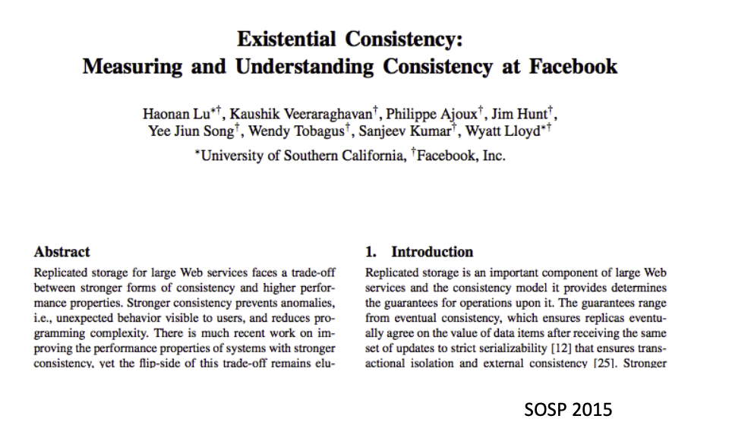
Does eventual consistency anomalies matter?
It depends on the application scenarios
Frequencies of the anomalies
Importance of the anomalies
Facebook has conducted a research to measure the frequencies of anomalies under eventual consistency. Some highlights are:
Per-Object Results: 1 anomaly per million reads (user should see their writes)
A social networking website can tolerate many anomalies
However, many scenarios (e.g., Bank) require stronger models (even linearizability is insufficient)

Slide 24
Consistency under single-machine faults

Slide 25
Recall: what is a strong consistency model
It's easy for users to reason about correctness assuming
Everything has only one-copy
The overall behavior is equivalent to some serial behavior
What about failure? Can it cause consistency issues?

Slide 26
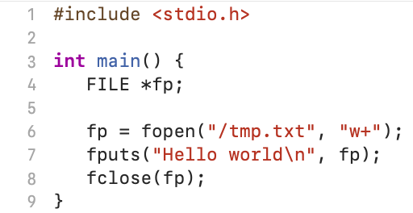
Example: failure leaves operations in a partial state
e.g., writing to a file
Question: what happen to fputs under crash?
What happens to fputs?
Not started (in OS’s in-memory cache)
Doing (writing a large data, not finished yet)
Done (fine)
Application should deal with the fact that a single write could fail.
Otherwise, may affect the correctness of the applications!

Slide 27

Example: bank transfer
Suppose bank accounts are stored in a single file
The transfer is executed on a single machine with a single thread
So it follows linearizability by default
transfer(bank, a, b, amt):
bank[a] = bank[a] – amt
bank[b] = bank[b] + amt
Application invariant (consistency) that must preserve:
bank(a) + bank(b) never changes

Slide 28
Example: bank transfer
Implementation (Simplified)
transfer(bank, a, b, amt):
records = mmap(bank, ...)
records[a] = records[a] – amt records[b] = records[b] + amt
fsync(bank, ...)
What if an error happens during the execution of fsync?

Slide 29
Deconstructing fsync (SYNC)
transfer(bank, a, b, amt): // amt=10
records = mmap(bank, ...)
records[a] = records[a] – amt records[b] = records[b] + amt
fsync(bank, ...)
a:
10
b:
10
Page cache
Disk

Slide 30
Deconstructing fsync (SYNC)
transfer(bank, a, b, amt): // amt=10
records = mmap(bank, ...)
records[a] = records[a] – amt records[b] = records[b] + amt
fsync(bank, ...)
a:
10
b:
10
a:
10
B:
10
records
Page cache
Disk

Slide 31
Deconstructing fsync (SYNC)
transfer(bank, a, b, amt): // amt=10
records = mmap(bank, ...)
records[a] = records[a] – amt records[b] = records[b] + amt
fsync(bank, ...)
a:
10
b:
10
a:
0
B:
10
records
Page cache
Disk

Slide 32
Deconstructing fsync (SYNC)
transfer(bank, a, b, amt): // amt=10
records = mmap(bank, ...)
records[a] = records[a] – amt records[b] = records[b] + amt
fsync(bank, ...)
a:
10
b:
10
a:
0
B:
20
records
Page cache
Disk

Slide 33
Deconstructing fsync (SYNC)
transfer(bank, a, b, amt): // amt=10
records = mmap(bank, ...)
records[a] = records[a] – amt records[b] = records[b] + amt
fsync(bank, ...)
Write(A)
Write(B)
a:
10
b:
10
a:
0
B:
20
records
Page cache
Disk

Slide 34
Deconstructing fsync (SYNC)
transfer(bank, a, b, amt): // amt=10
records = mmap(bank, ...)
records[a] = records[a] – amt records[b] = records[b] + amt
fsync(bank, ...)
Write(A)
Write(B)
a:
0
b:
10
B:
20
records
Page cache
Disk
Pages are flushed to disk one-by-one

Slide 35

Deconstructing fsync (SYNC)
transfer(bank, a, b, amt): // amt=10
records = mmap(bank, ...)
records[a] = records[a] – amt records[b] = records[b] + amt
fsync(bank, ...)
Write(A)
Write(B)
a:
0
b:
10
B:
20
records
Page cache
Consistency is broken after the machine failure!
Disk
Application invariant that must preserve:
bank(a) + bank(b) never changes

Slide 36
What is a strong consistency model (continued)
It's easy for users to reason about correctness assuming
Everything has only one-copy
The overall behavior is equivalent to some serial behavior
The operations that need to be executed in an atomic unit (usually called operations belonging to a transaction) are executed on a machine that happens completely or not at all (all-or-nothing atomicity)
All-or-nothing atomicity makes it much easier to reason about failures
Need to think about the consequences of the action happening or not happening, but not about the action partially happening

Slide 37
Achieving atomicity: shadow copy
Ensure a set of operations written to a file is all-or-nothing
E.g., writes records a & b to the bank file
High-level idea (copy-on-write):
Do not modify the old copy (there is always a consistent copy)
Replace the origin file with the updates only if all the writes to are successful
Original
Shadow copy
transfer(bank, a, b, amt):
records = mmap(bank, ...)
records[a] = records[a] – amt records[b] = records[b] + amt
fsync(bank, ...)
transfer(bank, a, b, amt):
fcopy(bank, bank_temp)
records = mmap(bank_temp, ...)
records[a] = records[a] – amt records[b] = records[b] + amt
fsync(bank_temp, ...)
rename(bank_temp,bank)

Slide 38
Shadow copy: analysis
Shadow copy
transfer(bank, a, b, amt):
fcopy(bank, bank_temp)
records = mmap(bank_temp, ...)
records[a] = records[a] – amt records[b] = records[b] + amt
fsync(bank_temp, ...)
rename(bank_temp,bank)
Question: what happen if a crash happens during fcopy or fsync?
The origin bank file is always consistent
We can just remove the bank_temp, so the transfer not happens

Slide 39
Shadow copy: analysis
Shadow copy
transfer(bank, a, b, amt):
fcopy(bank, bank_temp)
records = mmap(bank_temp, ...)
records[a] = records[a] – amt records[b] = records[b] + amt
fsync(bank_temp, ...)
rename(bank_temp,bank)
Question: what happen if a crash happens during rename?
For the bank transfer, it is consistent
What about the filesystem state?
Depends on the internal implementation of the filesystem!

Slide 40
rename(temp_bank, bank)
Directory data blocks:
filename "bank" → inode 12
filename " temp_bank " → inode 13
inode 12:
data blocks: 3, 4, 5
refcount: 1
inode 13:
data blocks: 6, 7, 8
refcount: 1

Slide 41
rename(temp_bank, bank)
Directory data blocks:
filename "bank" → inode 13
filename " temp_bank " → inode 13
inode 12:
data blocks: 3, 4, 5
refcount: 1
inode 13:
data blocks: 6, 7, 8
refcount: 1
Time

Slide 42
rename(temp_bank, bank)
Directory data blocks:
filename "bank" → inode 13
filename " temp_bank " → inode 13
inode 12:
data blocks: 3, 4, 5
refcount: 1
inode 13:
data blocks: 6, 7, 8
refcount: 2
Time

Slide 43
rename(temp_bank, bank)
Directory data blocks:
filename "bank" → inode 13
filename " temp_bank " → inode 13
inode 12:
data blocks: 3, 4, 5
refcount: 0
inode 13:
data blocks: 6, 7, 8
refcount: 2
Time

Slide 44
rename(temp_bank, bank)
Directory data blocks:
filename "bank" → inode 13
filename " temp_bank " → inode 13
inode 12:
data blocks: 3, 4, 5
refcount: 0
inode 13:
data blocks: 6, 7, 8
refcount: 2
Time

Slide 45
rename(temp_bank, bank)
Directory data blocks:
filename "bank" → inode 13
filename " temp_bank " → inode 13
inode 12:
data blocks: 3, 4, 5
refcount: 0
inode 13:
data blocks: 6, 7, 8
refcount: 1
Time

Slide 46
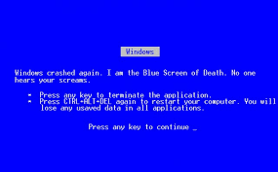
If crash, what step will cause problem?

Slide 47

Problem
Directory data blocks:
filename "bank" → inode 13
filename ”temp_bank" → inode 13
inode 12:
data blocks: 3, 4, 5
refcount: 1
inode 13:
data blocks: 6, 7, 8
refcount: 1
Time
Two names point to fnew’s inode, but refcount is 1
which reference is the correct one?

Slide 48
Naïve solution
Ask application to remove the unnecessary inodes
i.e., the application knows that "bank_temp" should be removed
Typically, not a good idea
Problem #1. The filesystem consistency depends on the application. What if the application is buggy or malicious?
Problem #2. What about more complex applications?
Ideal semantic: the application’s recovery method should be decoupled from the filesystem recovery method

Slide 49
Goal: file system ensures the rename is atomic
To decouple the atomicity of shadow copy from the application
Key idea: journaling

Slide 50
Journaling overview
Logging
A concept from database (and will talk about more details in this lecture)
Record before update
Record changes in journal
Commit journal
Update
Crash before commit:
- No data is changed
- Discard journal
Crash after commit:
- Journal is complete
- Redo changes in journal

Slide 51
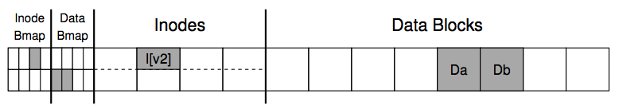
Rename via journaling
Directory data blocks:
filename "bank" → inode 12 -> 13
filename " temp_bank " → inode 13
Inside of 12
data blocks: 3, 4, 5
refcount: 1 -> 0
Inside of 13
data blocks: 6, 7, 8
refcount: 1
Directory data blocks:
“bank” -> inode 13
Delete ”temp_bank”
Inode 12: refcount = 0
Inode 13: refcount = 1
COMMITTED
12
13

Slide 52
Append a File via Journaling
Inside of Inode:
owner : yubin
permissions : read-write
size : 1
pointer : 4
pointer : null
pointer : null
lnode:
size: 1=>2
2nd pointer: null => 5
Db:
Old-data… => Appended-data…
COMMITTED
=> 2
=> 5
Journal

Slide 53

Journaling Drawbacks
Everything is written to the disk twice
Once in the journal
The other at the home location
Become problematic when the files are large

Slide 54
Mitigating Journaling Drawbacks
Observation:
Not everything in file system has equal importance
Usually, the metadata is more important
E.g., which blocks belong to the inode
Mitigation:
Only protect metadata via Journaling
Data is written only once
What if data is also important?
Ext4 options: data=journal/ordered/writeback
Application can also handle the write itself, e.g., wait for fsync to flush the data synchronously before proceed to the next
Notes:
Ordered: file data is written before the metadata is changed

Slide 55
What if crash during commit journal?
Assume that writing to one sector on disk is all-or-nothing
Disk saves enough energy to complete one sector write
Small capacitor suffices to power disk for a few microsecond
Assumption: time spent writing a sector is small
If write did not start, no need to complete it
Still all-or-nothing
So write to the journal is always all-or-nothing
But wait, what if the logged data is larger than the sector?
We need a generalized method than journaling ☺

Slide 56
Back to shadow copy
Write to a copy of data, atomically switch to new copy
Switching can be done with one all-or-nothing operation
Rename with journaling
Only requires a simple recovery procedure of the file system
i.e., remove the temporal file after the recovery
The filesystem itself is kept consistent via journaling
i.e., the filesystem itself has a recovery process

Slide 57
Drawbacks of shadow copy
Question: what would happen if multiple clients share the same file?
Example:
Client 0
Client 1
transfer(bank, a, b, amt):
fcopy(bank, bank_temp)
records = mmap(bank_temp, ...)
records[a] = records[a] – amt records[b] = records[b] + amt
fsync(bank_temp, ...)
rename(bank_temp,bank)
transfer(bank, c, d, amt):
fcopy(bank, bank_temp)
records = mmap(bank_temp, ...)
records[a] = records[c] – amt records[b] = records[d] + amt
fsync(bank_temp, ...)
rename(bank_temp,bank)

Slide 58
Drawbacks of shadow copy
Question: what would happen if multiple clients share the same file?
Client 0 transfers 100 from a to b
a = 100
b = 100
c = 100
d = 100
a = 100
b = 100
c = 100
d = 100
Bank
Bank_temp
Time
Create shadow file
Update a

Slide 59
Drawbacks of shadow copy
Question: what would happen if multiple clients share the same file?
Client 0 transfers 100 from a to b
a = 100
b = 100
c = 100
d = 100
a = 100
b = 100
c = 100
d = 100
a = 0
b = 100
c = 100
d = 100
Bank
Bank_temp
Cache
Time
Create shadow file
Update a

Slide 60
Drawbacks of shadow copy
Question: what would happen if multiple clients share the same file?
Client 0 transfers 100 from a to b
Client 1 transfers 100 from c to d
a = 100
b = 100
c = 100
d = 100
a = 100
b = 100
c = 100
d = 100
a = 0
b = 100
c = 100
d = 100
Bank
Bank_temp
Cache
Question: can client 1 directly create a new bank_temp?
Time
Create shadow file
Update a

Slide 61
Drawbacks of shadow copy
Question: what would happen if multiple clients share the same file?
Client 0 transfers 100 from a to b
Client 1 transfers 100 from c to d
a = 100
b = 100
c = 100
d = 100
a = 100
b = 100
c = 100
d = 100
a = 0
b = 100
c = 100
d = 100
Bank
Bank_temp
Cache
No. Because it will overwrite client 0’s results.
We can only reuse existing file
Time
Create shadow file
Update a

Slide 62
Drawbacks of shadow copy
Question: what would happen if multiple clients share the same file?
Client 0 transfers 100 from a to b
Client 1 transfers 100 from c to d
a = 100
b = 100
c = 100
d = 100
a = 100
b = 100
c = 100
d = 100
a = 0
b = 100
c = 0
d = 200
Bank
Bank_temp
Cache
Client 0 stuck, e.g., due to interrupts
Time
Create shadow file
Update a
Update c,d

Slide 63
Drawbacks of shadow copy
Question: what would happen if multiple clients share the same file?
Client 0 transfers 100 from a to b
Client 1 transfers 100 from c to d
a = 100
b = 100
c = 100
d = 100
a = 0
b = 100
c = 0
d = 200
a = 0
b = 100
c = 0
d = 200
Bank
Bank_temp
Cache
Time
Create shadow file
Update a
Update c,d
fsync

Slide 64
Drawbacks of shadow copy
Question: what would happen if multiple clients share the same file?
Client 0 transfers 100 from a to b
Client 1 transfers 100 from c to d
a = 0
b = 100
c = 0
d = 200
Bank
Client 1 writes client 0’s intermediate
results. So it must wait…
Time
Create shadow file
Update a
Update c,d
fsync
Client 1 done

Slide 65
Drawbacks of shadow copy
Only one operation can happen at a time
Naively executing concurrent transfer can cause consistency issue
Even these operations in principle can run concurrently
Hard to generalize to multiple files or directories
Have to place all files in a single directory, or rename subdirs
Requires copying the entire file for any (small) change

Slide 66
Logging for atomicity

Slide 67
Logging
Log entry
Append
Log file
Key idea (very similar to journaling)
Avoid updating the disk states until we can recovery it after failure
How to achieve so in shadow copy or journaling?
Shadow copy buffers the updates in a copy of the origin file
Journaling buffers the updates in a sector (can be viewed as a small log)
We can generalize journaling by storing all the updates in a log
Log file: a file only contains the updated results
Log entries: contain the updated values of an atomic unit (e.g., transfer)

Slide 68
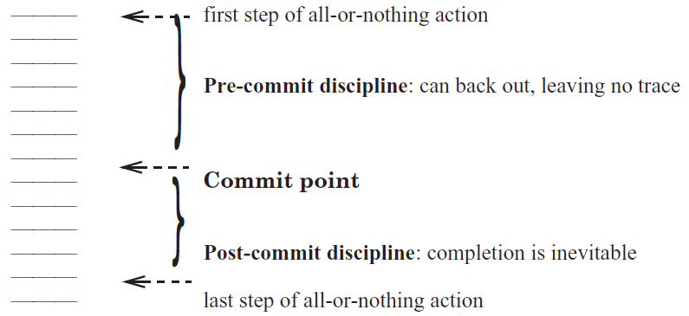
Transaction and Commit Point: marking atomic units

Slide 69
Transaction and Commit Point
Log entry
Append
Log file
We call a set of operations that needs to be atomic "transaction”
Transaction typically provides interfaces for applications to mark the atomicity granularity of operations
TX.begin()
TX.commit()
Each update between a begin() & commit() are stored in a log entry
Can be replayed via replaying each entry of the log
Commit point
The time when we are sure the operation is “all”

Slide 70
First try: commit logging
Log entry
Append
Log file
transfer(bank, a, b, amt, log): // amt=10
records = mmap(bank, ...)
new_a = records[a] – amt
new_b = records[b] + amt
commit_log = "log start: a:" + new_a + "\b:" + new_b
log.append(commit_log).sync()
record[a] = new_a
record[b] = new_b
Updates are buffered in the memory
To prevent writing a temporal value to the disk

Slide 71
First try: commit logging
Log entry
Append
Log file
transfer(bank, a, b, amt, log): // amt=10
records = mmap(bank, ...)
new_a = records[a] – amt
new_b = records[b] + amt
commit_log = "log start: a:" + new_a + "\b:" + new_b
log.append(commit_log).sync()
record[a] = new_a
record[b] = new_b
Before we write the disk, write the log to the disk synchronously
Question: do we need these two steps to be atomic? How to achieve so?

Slide 72
First try: commit logging
Log entry
Append
Log file
transfer(bank, a, b, amt, log): // amt=10
records = mmap(bank, ...)
new_a = records[a] – amt
new_b = records[b] + amt
commit_log = "log start: a:" + new_a + "\b:" + new_b
log.append(commit_log).sync()
record[a] = new_a
record[b] = new_b
Before we write the disk, write the log to the disk synchronously
Question: how to ensure the logged entry is complete?
Simple: we can use a checksum

Slide 73
First try: commit logging
Log entry
Append
Log file
transfer(bank, a, b, amt, log): // amt=10
records = mmap(bank, ...)
new_a = records[a] – amt
new_b = records[b] + amt
commit_log = "log start: a:" + new_a + "\b:" + new_b
log.append(commit_log).sync()
record[a] = new_a
record[b] = new_b
After the logging succeed, we can update the disk states

Slide 74
First try: commit logging
Log entry
Append
Log file
transfer(bank, a, b, amt, log): // amt=10
records = mmap(bank, ...)
new_a = records[a] – amt
new_b = records[b] + amt
commit_log = "log start: a:" + new_a + "\b:" + new_b
log.append(commit_log).sync()
record[a] = new_a
record[b] = new_b
fsync(bank) // ?
Question: do we need to add fsync to flush the modifications to the bank file?
Not necessary, because we can do the recovery

Slide 75
Crash recovery of commit log
Log entry
Append
Log file
After reboot, we need to recover the systems to a consistent state
Based on the log entries stored in the log file
Rules
Travel from start to end
Re-apply the updates recorded in a complete log entry

Slide 76
First try: commit logging
Log entry
Append
Log file
transfer(bank, a, b, amt, log): // amt=10
records = mmap(bank, ...)
new_a = records[a] – amt
new_b = records[b] + amt
commit_log = "log start: a:" + new_a + "\b:" + new_b
log.append(commit_log).sync()
record[a] = new_a
record[b] = new_b
Question: What is the commit point of this transaction? (transfer)
The line after log.append(commit_log).sync()

Slide 77
Quick summary: commit logging (redo-only logging)
Keep a log of all update actions
Redo all the updates upon recovery
Log
Old
State
DO
New
State
Log
Old
State
REDO
New
State
Log

Slide 78
Journaling can be viewed as a special case of commit logging

Slide 79
Pros & Cons of redo-only logging so far
Pros
The commit is extremely efficient: only one file append operations (w/ updated data)
Other methods, e.g., shadow copy copies the entire file
Cons
Wastes of disk I/O: all disk operations must happen at the commit point
All updates must be buffered in the memory until the transaction commits
What if there is insufficient memory?
The log file is continuously growing while most its updates are already flushed to the disk (unless the machine is rebooted or crashed, and we do the recovery)

Slide 80
Pros & Cons of redo-only logging so far
Pros
The commit is extremely efficient: only one file append operations (w/ updated data)
Other methods, e.g., shadow copy copies the entire file
Cons
Wastes of disk I/O: all disk operations must happen at the commit point
All updates must be buffered in the memory until the transaction commits
What if there is insufficient memory?
The log file is continuously growing while most its updates are already flushed to the disk
Unlike filesystem journaling, the user can commit a lot of entries in a transaction
Notes:
我们先讲怎么解决前两个问题

Slide 81
Basic solution
We allow the transaction directly writing uncommitted values to the disk
Before the commit point to free-up memory space & utilize disk I/O
transfer(bank, a, b, amt, log): // amt=10
records = mmap(bank, ...)
records[a] = records[a] – amt
records[b] = records[b] + amt
The OS will flush the page back if
out of the memory
Problem
How to prevent a partial updates from uncommitted transactions?
Idea: use log to undo updates of uncommitted transactions!

Slide 82
Undo logging
Keep a log of all update actions
The log can undo the (partial) updates of a DO operation
Log
Old
State
DO
New
State
Log
New
State
UNDO
Old
State
Log
Old
State
REDO
New
State
Log

Slide 83
Logging w/ undo
Before updates, write an undo log record to the log file
Should contain sufficient information to undo uncommitted transactions
E.g., old values
Question: do we need the redo entry?
transfer(bank, a, b, amt, log): // amt=10
records = mmap(bank, ...)
log.append(...).sync()
records[a] = records[a] – amt
log.append(...).sync()
records[b] = records[b] + amt
Action (file name, offset, old value)

Slide 84
Logging w/ undo-redo logging
Question: do we need the redo entry?
Depends on whether we wait for records[a] to be written to the disk (e.g., sync)
Typically, yes: waiting two disk syncs are slow!
Especially for non-logging writes: log is a fast sequential disk write
transfer(bank, a, b, amt, log): // amt=10
records = mmap(bank, ...)
log.append(...).sync()
records[a] = records[a] – amt
log.append(...).sync()
records[b] = records[b] + amt
log.append("TX {id} commit”).sync()
Action (file name, offset, old & new values)

Slide 85
Log entry vs. log record
Redo-only logging appends log entry to the log file
Containing all the updates of the transaction
Und—redo logging appends log records to the log file
Containing the updates of a single operation
Log records from different transaction (TX) may possibly interleave
E.g., the OS schedules the transaction out
Therefore, we further need pointer to trace operations from the same TX
Record
Entry
Append
Append
Log file
Log file

Slide 86
Put it all together: log record in undo-do logging
Each log record consists of
Transaction ID
Operation ID
Pointer to previous record in this transaction
Value (file name, offset, old & new value)
…
Log
TID=1, OID=2, PTR=80, ACT={A, 23, 3000, 2000}

Slide 87
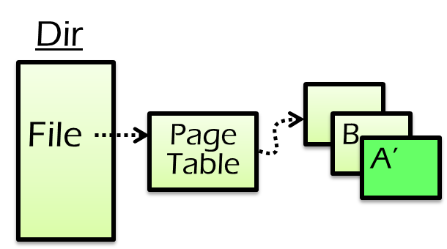
Put it all together: logging rules
transfer(bank, a, b, amt, log): // amt=10
records = mmap(bank, ...)
log.append(...).sync()
records[a] = records[a] – amt
log.append(...).sync()
records[b] = records[b] + amt
log.append("TX {id} commit”).sync()
Write log record to disk before modifying persistent state
(e.g., replace A’s value)
Write Ahead Log (WAL) protocol
Log

Slide 88
Put it all together: logging rules
transfer(bank, a, b, amt, log): // amt=10
records = mmap(bank, ...)
log.append(...).sync()
records[a] = records[a] – amt
log.append(...).sync()
records[b] = records[b] + amt
log.append("TX {id} commit”).sync()
Write log record to disk before modifying persistent state
(e.g., replace A’s value)
Write Ahead Log (WAL) protocol
At commit point, append a commit record to the log last
E.g., when user calls commit
Commit
Log

Slide 89
Recovery rules
How to recovery from crash?
Read the log and recover states according to its content
Rules:
Travel from end to start
Log

Slide 90

Recovery rules
How to recovery from crash?
Read the log and recover states according to its content
Rules:
Travel from end to start
Mark all transaction’s log record w/o CMT log and append ABORT log
Log

Slide 91
Recovery rules
How to recovery from crash?
Read the log and recover states according to its content
Rules:
Travel from end to start
Mark all transaction’s log record w/o CMT log and append ABORT log
UNDO ABORT logs from end to start
UNDO
Log

Slide 92
Recovery rules
How to recovery from crash?
Read the log and recover states according to its content
Rules:
Travel from end to start
Mark all transaction’s log record w/o CMT log and append ABORT log
UNDO ABORT logs from end to start
REDO CMT logs from start to end
REDO
Log

Slide 93
Problem: continuously growing of the log file
Both redo-only logging & undo-redo logging append to the log file
The log file is continuously growing while most its updates are already flushed to the disk
A large log file also makes recovery slow
Typically, a machine fails less frequent
E.g., one per day
We need checkpoint the log file to reduce the log file size!
Checkpoint: Determining which parts of the log can be discarded, then discarded them

Slide 94
Checkpoint the log
Naïve solution
Run the recovery process. If it is done, then we can discard all the log file
Problem: too slow
Observation
Uncommitted updates are only in the page cache
If we can flush all the page cache to the disk, then the committed TX’s log can be discarded
Problem
What if a TX is ongoing? We need to reserve its log

Slide 95
How to checkpoint?
Basic approach
Wait till no transactions are in progress
Flush the page cache
Discard all the logs of committed TXs
Question
What if a TX is doing a long time? Can we allow ongoing TXs?
Idea: can we wait till no operations are in progress?
We need to reserve the log for ongoing TXs !

Slide 96
How to checkpoint?
actions
How to checkpoint?
Wait till no transactions are in progress
Write a CKPT record to log
Contains a list of all transaction in process and their logs
Flush the page cache
Discard all the log records except the CKPT record

Slide 97

Recovery with checkpoint
Checkpoint
T1
Crash
T2
T3
T4
T5
Read the latest checkpoint → T2, T4 are ongoing transactions
Read log → T2, T3 are committed, T5 are ongoing
Undo ongoing TXs & redo committed TXs

Slide 98
Undo-redo logging vs. redo-only logging
Question:
Which one is faster during execution?
Which one is faster during recovery?
Redo-only logging
Less disk operations compared with undo-redo logging
Only need one scan of the entire log file
Redo-only logging is typically preferred except for TXs with large in-memory states

Slide 99
UNDO-only Logging
Logging rules
Append UNDO log record before flushing state modification
State modification must be flushed before transaction committed
w/o REDO
Rarely used
Much slower than UNDO-REDO logging during execution
Though the recovery speed is faster

Slide 100
Summary
Systematic methods to support all-or-nothing atomicity
Shadow copy
Logging (including journaling)
Logging
REDO logging
UNDO-REDO logging
UNDO-only logging

Slide 101
Question
Do log necessary be stored in a log file?
No. It can be any mechanisms that supports atomic append & fault tolerant
E.g., in-memory logs replicated on many servers(see later lectures)

Slide 102

Logging: widely used in large-scale websites
Caching server
Caching server
…
Caching server
All can use logging to ensure
atomicity!
Caching
Caching
Caching
Distributed caching
Database server
Database server
CDN
Users
Application #1
generate the page
Database
user, price
…
Database
user, price
Application server
Distributed database
Internet
Load
Balance
Application #2
add the order
File server
File server
File server
File:
image
File:
image
…
File:
image
Application server
…
…
Message queue
Distributed file system

