Slide 1


Before-or-after atomicity and Serializability
SE3331-1 (2024 Fall)
Xingda Wei, Yubin Xia
IPADS, Shanghai Jiao Tong University
https://www.sjtu.edu.cn

Slide 2
Review: what is a strong consistency model
It's easy for users to reason about correctness assuming
Everything has only one-copy
The overall behavior is equivalent to some serial behavior
The operations that need to be executed in an atomic unit (usually called operations belonging to a transaction) are executed on a machine that happens completely or not at all (all-or-nothing atomicity)
All-or-nothing atomicity makes it much easier to reason about failures
Need to think about the consequences of the action happening or not happening, but not about the action partially happening

Slide 3
Review: techniques to support all-or-nothing
Systematic methods to support all-or-nothing atomicity
Shadow copy (Single-file updates are atomic)
Journaling (Filesystem API executions are atomic)
Logging
REDO logging (A general-purpose approach for any read and write )

Slide 4
Review: redo-only logging
Log entry
Append
Log file
transfer(bank, a, b, amt, log): // amt=10
records = mmap(bank, ...)
new_a = records[a] – amt
new_b = records[b] + amt
commit_log = "log start: a:" + new_a + "\b:" + new_b
log.append(commit_log).sync()
record[a] = new_a
record[b] = new_b
log.append(commit_log).sync()’s return is the commit point
After it returns, the transfer’s updates must be all
The whole all-or-nothing unit is usually called transaction (TX)

Slide 5
Crash recovery of commit log
Log entry
Append
Log file
After reboot, we need to recover the systems to a consistent state
Based on the log entries stored in the log file
Rules
Travel from start to end
Re-apply the updates recorded in a complete log entry

Slide 6
Review: Pros & Cons of redo-only logging so far
Pros
The commit is extremely efficient: only one file append operations (w/ updated data)
Other methods, e.g., shadow copy copies the entire file
Cons
Wastes of disk I/O: all disk operations must happen at the commit point
All updates must be buffered in the memory until the transaction commits
What if there is insufficient memory?
The log file is continuously growing while most its updates are already flushed to the disk (unless the machine is rebooted or crashed, and we do the recovery)

Slide 7
Pros & Cons of redo-only logging so far
Pros
The commit is extremely efficient: only one file append operations (w/ updated data)
Other methods, e.g., shadow copy copies the entire file
Cons
Wastes of disk I/O: all disk operations must happen at the commit point
All updates must be buffered in the memory until the transaction commits
What if there is insufficient memory?
The log file is continuously growing while most its updates are already flushed to the disk
Unlike filesystem journaling, the user can commit a lot of entries in a transaction
Notes:
我们先讲怎么解决前两个问题

Slide 8
Review: undo logging
Before updates, write an undo log record to the log file
Should contain sufficient information to undo uncommitted transactions
E.g., old values
Question: do we need the redo entry?
transfer(bank, a, b, amt, log): // amt=10
records = mmap(bank, ...)
log.append(...).sync()
records[a] = records[a] – amt
log.append(...).sync()
records[b] = records[b] + amt
Action (file name, offset, old value)

Slide 9
Logging w/ undo-redo logging
Question: do we need the redo entry?
Depends on whether we wait for records[a] to be written to the disk (e.g., sync)
Typically, yes: waiting two disk syncs are slow!
Especially for non-logging writes: log is a fast sequential disk write
transfer(bank, a, b, amt, log): // amt=10
records = mmap(bank, ...)
log.append(...).sync()
records[a] = records[a] – amt
log.append(...).sync()
records[b] = records[b] + amt
log.append("TX {id} commit”).sync()
Action (file name, offset, old & new values)

Slide 10

Recovery rules
How to recovery from crash?
Read the log and recover states according to its content
Rules:
Travel from end to start
Mark all TX’s log record w/o CMT ABORT log
UNDO ABORT logs from end to start
REDO CMT logs from start to end
REDO
Log
Notes:
为什么redo在undo之后？因为undo可能会擦除redo的修改，即一个uncommitted的TX把一个committed的TX回滚了
为什么undo要从end to start？因为后续的TX可能会depend on 前序的TX

Slide 11
Problem: continuously growing of the log file
Both redo-only logging & undo-redo logging append to the log file
The log file is continuously growing while most its updates are already flushed to the disk
The log is only deleted if there is a single machine failure
Typically, a machine fails less frequent
E.g., one per day
We need checkpoint the log file to reduce the log file size!
Checkpoint: Determining which parts of the log can be discarded, then discarded them

Slide 12
Checkpoint the log
Naïve solution
Run the recovery process. If it is done, then we can discard all the log file
Problem: too slow
Observation
For redo logging, we only need to flush the page caches so we can discard all the logs of committed TXs
For undo logging, we only need to wait for TXs to finish to discard all its log entries

Slide 13
How to checkpoint? (For both undo + redo logging)
Basic approach
Wait till no TXs are in progress
Flush the page cache
Discard all the logs
Question
What if a TX is doing a long time? Can we allow ongoing TXs?
We need to reserve the log for ongoing TXs !

Slide 14
How to checkpoint?
actions
How to checkpoint?
Wait till no transactions are in progress
Write a CKPT record to log
Contains a list of all transaction in process and their logs
Flush the page cache
Discard all the log records except the CKPT record

Slide 15

Recovery with checkpoint
Checkpoint
T1
Crash
T2
T3
T4
T5
T1: do nothing
T2: redo its update based on the log in its checkpoint
T3: redo its updates based on the log entries
T4: undo its updates based on the log in both CKP & log entries
T5: undo its updates based on the log entries

Slide 16
Undo-redo logging vs. redo-only logging
Question:
Which one is faster during execution?
Which one is faster during recovery?
Redo-only logging
Less disk operations compared with undo-redo logging
Only need one scan of the entire log file
Redo-only logging is typically preferred except for TXs with large in-memory states

Slide 17
UNDO-only Logging
Logging rules
Append UNDO log record before flushing state modification
State modification must be flushed before transaction committed
w/o REDO
Rarely used
Much slower than UNDO-REDO logging during execution
Though the recovery speed is faster

Slide 18
Summary & durability
Systematic methods to support all-or-nothing atomicity
Shadow copy (Single-file updates)
Journaling (Filesystem API)
Logging (General-purpose approaches)
REDO-only logging (commit logging)
UNDO-REDO logging (write-ahead logging)
UNDO-only logging
Durability: Committed Action’s data on durable storage
Logging is also a method to ensure durability

Slide 19
Before-or-after atomicity
We will evolve from single-threaded to multi-threaded setting

Slide 20
What is a strong consistency model
It's easy for users to reason about correctness assuming
Everything has only one-copy
The overall behavior is equivalent to some serial behavior
The operations that need to be executed in an atomic unit (usually called operations belonging to a transaction) are executed on a machine that happens completely or not at all (all-or-nothing atomicity)

Slide 21



Review: serial execution of reads/writes
Time
The system
Reads/writes are executed concurrently
Replicated KVSes
Time
One logical KVS
Reads/writes are executed logically in a serial manner.

Slide 22
One step further: serial execution of actions
Time
The system
Actions
Reads/writes are executed concurrently
Replicated KVSes
Time
One logical KVS
Reads/writes are executed logically in a serial manner.
Actions

Slide 23
Motivating example
Example: consider two threads access the same account concurrently
We have a in-memory array to store all the accounts w/o losing generality
T0
T1
Action
Action implementation
Deposit(bank,"alice”,10)
Deposit(bank, acct, amt):
bank[acct] += amt
Time
Question: What are the expected behavior?

Slide 24

Motivating example
Example: consider two threads access the same account concurrently
We have a in-memory array to store all the accounts w/o losing generality
T0
T1
Action
Action implementation
Deposit(bank,"alice”,10)
Deposit(bank, acct, amt):
bank[acct] += amt
Time
Question: What are the expected behavior?
Alice: 0¥
Alice: 10¥? (Expected result: 20¥)

Slide 25
Atomicity of the + operator
Example: consider two threads access the same account concurrently
Even a simple + operator is non-atomic
Why would this happen?
The deposit function is not atomic, even assuming each mov is linearizable!
CPU can only guarantee the atomicity of one memory op, but it has two
mov acct, %eax
add $amt, %eax
mov %eax, acct
Deposit(bank, acct, amt):
bank[acct] += amt
Developer’s written code
Compiler’s generated code

Slide 26
Atomicity of the + operator
mov acct, %eax
add $amt, %eax
mov %eax, acct
Deposit(bank, acct, amt):
bank[acct] += amt
Developer’s written code
Compiler’s generated code
Thread 0
Thread 1
Bank[Alice]
0
T0
T1
Deposit(
bank,"alice”,10)
Time

Slide 27
Atomicity of the + operator
mov acct, %eax
add $amt, %eax
mov %eax, acct
Deposit(bank, acct, amt):
bank[acct] += amt
Developer’s written code
Compiler’s generated code
Thread 0
Thread 1
Bank[Alice]
0
Read acct
0
T0
T1
Deposit(
bank,"alice”,10)
Time

Slide 28
Atomicity of the + operator
mov acct, %eax
add $amt, %eax
mov %eax, acct
Deposit(bank, acct, amt):
bank[acct] += amt
Developer’s written code
Compiler’s generated code
Thread 0
Thread 1
Bank[Alice]
0
Read acct
0
T0
T1
Read acct
0
Deposit(
bank,"alice”,10)
Time

Slide 29
Atomicity of the + operator
mov acct, %eax
add $amt, %eax
mov %eax, acct
Deposit(bank, acct, amt):
bank[acct] += amt
Developer’s written code
Compiler’s generated code
Thread 0
Thread 1
Bank[Alice]
0
Read acct
0
T0
T1
Read acct
0
Deposit(
bank,"alice”,10)
0
Increase
Time

Slide 30
Atomicity of the + operator
mov acct, %eax
add $amt, %eax
mov %eax, acct
Deposit(bank, acct, amt):
bank[acct] += amt
Developer’s written code
Compiler’s generated code
Thread 0
Thread 1
Bank[Alice]
0
Read acct
0
T0
T1
Read acct
0
Deposit(
bank,"alice”,10)
0
Increase
Increase
0
Time

Slide 31
Atomicity of the + operator
mov acct, %eax
add $amt, %eax
mov %eax, acct
Deposit(bank, acct, amt):
bank[acct] += amt
Developer’s written code
Compiler’s generated code
Thread 0
Thread 1
Bank[Alice]
0
Read acct
0
T0
T1
Read acct
0
Deposit(
bank,"alice”,10)
0
Increase
Increase
0
Write acct
10
Time

Slide 32
Atomicity of the + operator
mov acct, %eax
add $amt, %eax
mov %eax, acct
Deposit(bank, acct, amt):
bank[acct] += amt
Developer’s written code
Compiler’s generated code
Thread 0
Thread 1
Bank[Alice]
0
Read acct
0
T0
T1
Read acct
0
Deposit(
bank,"alice”,10)
0
Increase
Increase
0
Write acct
10
Time
Write acct
10

Slide 33
The race condition problem
When two or more threads access shared data and at least one is write
Timing dependent error involving shared state
i.e., whether the scheduling will cause reading a non-atomic update state
Thread 0
Thread 1
Bank[Alice]
Thread 0
Thread 1
Bank[Alice]
0
0
Read acct
0
Read acct
0
Read acct
0
Increase
0
Increase
0
Write acct
10
Increase
0
Read acct
10
Write acct
10
Increase
10
Write acct
10
Write acct
20

Slide 34
Race condition is hard to control
Must make sure all possible schedules are safe
Number of possible schedules permutations is huge
Bad schedules that will and will not work sometimes
They are intermittent
Small timing changes between invocations might result in different behavior which can hide bug (e.g., Therac-25)
Also known as Heisenbugs (Heisenberg uncertainty)
Possible system solution-1: DMT (Deterministic Multi-Threading)
Possible system solution-2: Record and Replay
Both are hard in either correctness or cost, or both
Notes:
Intermittent: 间断的

Slide 35


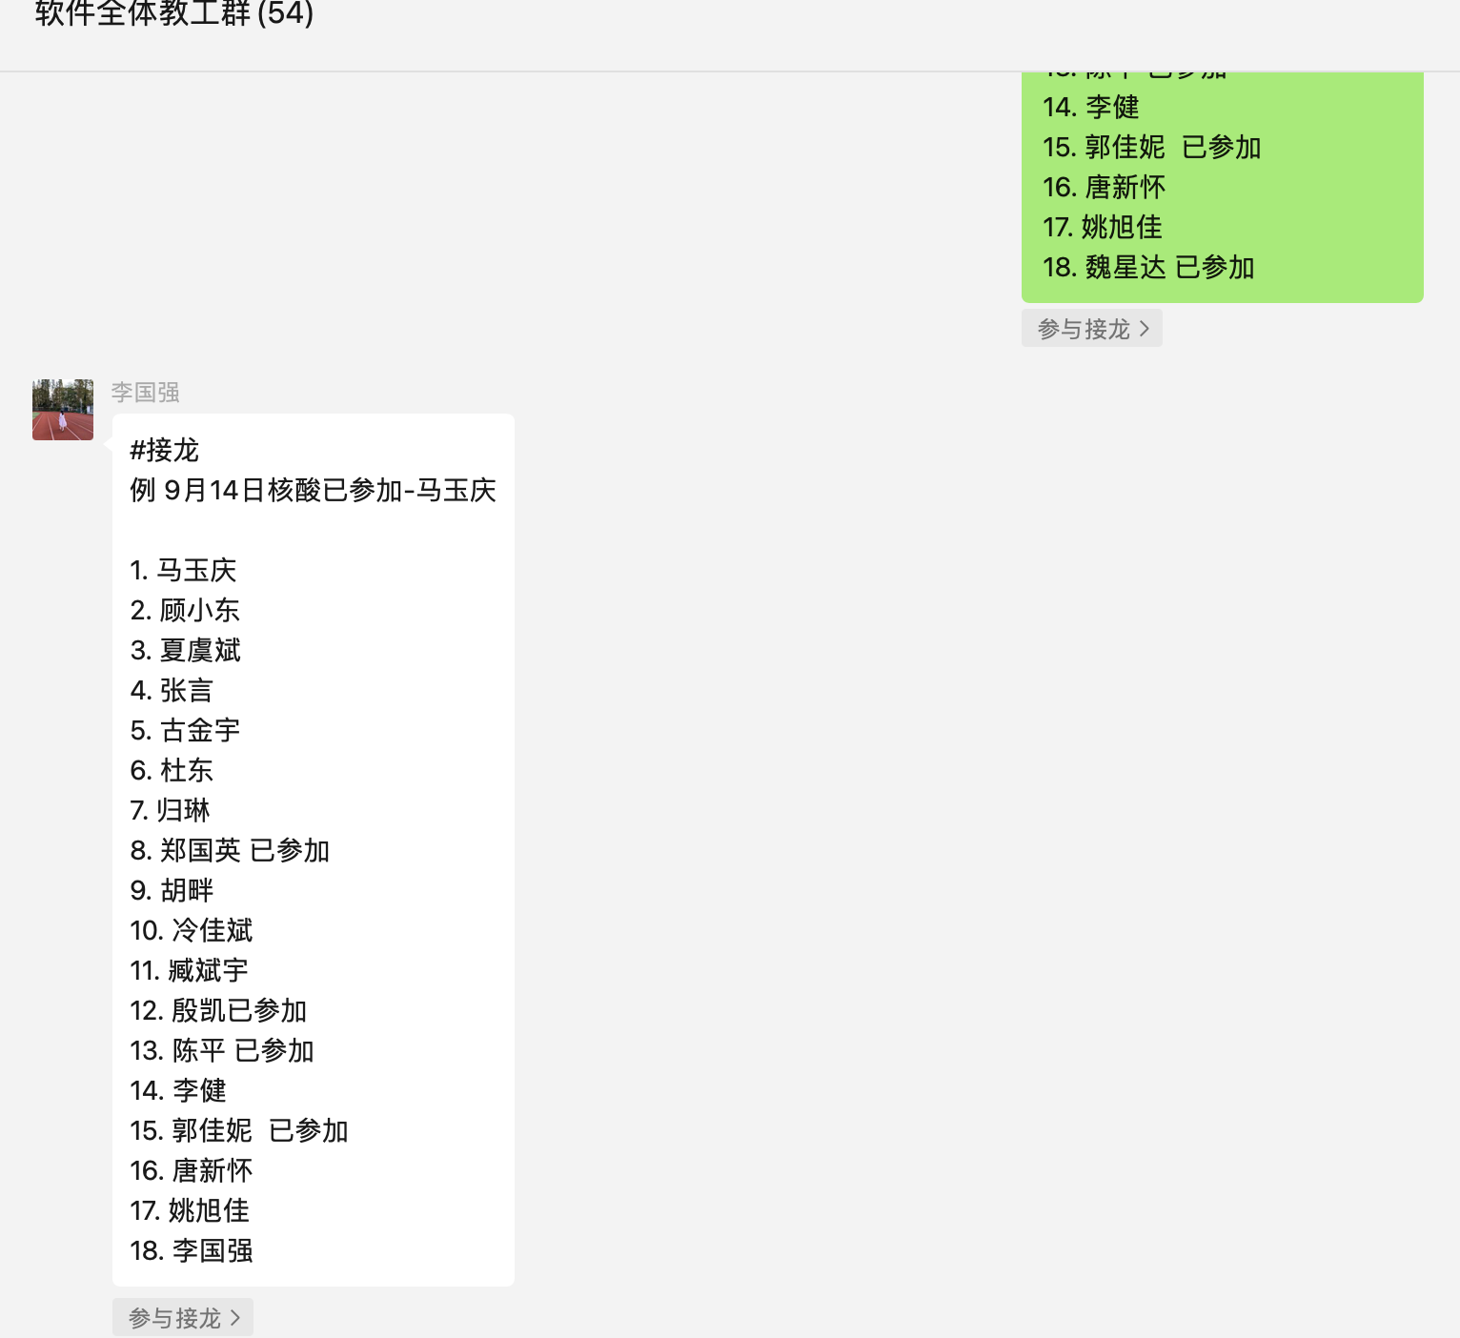
Race condition is common (benign case)
Real-world computing systems embrace concurrency
E.g., embrace the design of distributed systems
Bad: race condition brings unsatisfactory to the customers
E.g., the comment system in
Show 5 comments;
But only 3 presented on the app

Slide 36
Race condition may be dangerous (e.g., in Therac-25)
The equipment control task did not properly synchronize with the operator interface task, so that race conditions occurred if the operator changed the setup too quickly. In three cases, the injured patients later died as a result of the overdose.

Slide 37
Before-or-After Atomicity

Slide 38
Goal: before-or-after atomicity
To prevent hazard produced by race condition, we need a group of reads/writes to be atomic
E.g., cannot see/overwrites the intermediate states of a concurrent action
Thread 1 should not see the intermediate states of thread 0
Thread 0
Thread 1
Bank[Alice]
0
Read acct
0
Read acct
0
Increase
0
Increase
0
Write acct
10
Write acct
10

Slide 39
Goal: before-or-after atomicity (a.k.a, Isolation)
To prevent hazard produced by race condition, we need a group of reads/writes to be atomic
E.g., cannot see/overwrites the intermediate states of a concurrent action
A concurrent action may have multiple linearizable reads/writes
Before or after atomicity
Concurrent actions have the before-or-after property if their effect from the point of view of their invokers is as if the actions occurred either completely before or completely after one another

Slide 40


Before-or-after vs. Linearizability
Put(X,1)
Done
Put(Y,1)
Done
P0
Get(Y)
0
Get(X)
1
P1
Put(X,1)
Done
Put(Y,1)
Done
Get(Y)
0
Get(X)
1
The above schedule is allowed in Linearizability, but not before-or-after atomicity

Slide 41
How to know which operations should be atomic?
Review: Transaction!
We call a set of operations that needs to be atomic "transaction”
Transaction typically provides interfaces for applications to mark the atomicity granularity of operations
TX.begin()
TX.commit()
So typically, transactions must provide both all-or-nothing & before-or-after, a.k.a., ACID

Slide 42
Use locking to achieve before-or-after
Locks: a data structure that allows only one CPU acquire at a given time
Programs can acquire and release the lock
If the acquisition fails, then the CPU will wait until it is succeed
Example: pthread_mutex
Implementing the locks efficiently is a broad topic
And is non-trivial: out of the scope of this lecture

Slide 43
Use locking to achieve before-or-after: global lock
Locks: a data structure that allows only one CPU acquire at a given time
Programs can acquire and release the lock
If the acquisition fails, then the CPU will wait until it is succeed
Example: pthread_mutex
Global lock:
The action must acquire the global lock before executing, and release it after it commits
Deposit(bank, lock, acct, amt):
acquire(lock)
bank[acct] += amt
release(lock)
Deposit(bank, acct, amt):
bank[acct] += amt

Slide 44
Use locking to achieve before-or-after: global lock
Deposit(bank, lock, acct, amt):
acquire(lock)
bank[acct] += amt
release(lock)
Deposit(bank, acct, amt):
bank[acct] += amt
Thread 0
Thread 1
Bank[Alice]
Thread 0
Thread 1
Bank[Alice]
0
0
Read acct
0
Read acct
0
Increase
0
Increase
0
Write acct
10
Write acct
10
Notes:
假设同样的scheduling（即出错会发生）；然后进行调度

Slide 45
Use locking to achieve before-or-after: global lock
Deposit(bank, lock, acct, amt):
acquire(lock)
bank[acct] += amt
release(lock)
Deposit(bank, acct, amt):
bank[acct] += amt
Thread 0
Thread 1
Bank[Alice]
Thread 0
Thread 1
Bank[Alice]
0
0
Read acct
0
Acquire(lock)
0
Read acct
0
Increase
0
Increase
0
Write acct
10
Write acct
10
Notes:
Can global lock prevent our previous race condition?

Slide 46
Use locking to achieve before-or-after: global lock
Deposit(bank, lock, acct, amt):
acquire(lock)
bank[acct] += amt
release(lock)
Deposit(bank, acct, amt):
bank[acct] += amt
Thread 0
Thread 1
Bank[Alice]
Thread 0
Thread 1
Bank[Alice]
0
0
Read acct
0
Acquire(lock)
0
Read acct
0
Read acct
0
Increase
0
Increase
0
Write acct
10
Write acct
10
Notes:
Can global lock prevent our previous race condition?

Slide 47
Use locking to achieve before-or-after: global lock
Deposit(bank, lock, acct, amt):
acquire(lock)
bank[acct] += amt
release(lock)
Deposit(bank, acct, amt):
bank[acct] += amt
Thread 0
Thread 1
Bank[Alice]
Thread 0
Thread 1
Bank[Alice]
0
0
Read acct
0
Acquire(lock)
0
Read acct
0
Read acct
0
Increase
0
Acquire(lock)
0
Increase
0
Write acct
10
Write acct
10
Notes:
Can global lock prevent our previous race condition?

Slide 48
Use locking to achieve before-or-after: global lock
Deposit(bank, lock, acct, amt):
acquire(lock)
bank[acct] += amt
release(lock)
Deposit(bank, acct, amt):
bank[acct] += amt
Thread 0
Thread 1
Bank[Alice]
Thread 0
Thread 1
Bank[Alice]
0
0
Read acct
0
Acquire(lock)
0
Read acct
0
Read acct
0
Increase
0
Acquire(lock)
0
Increase
0
Read acct
0
Write acct
10
Write acct
10
Can this happen?
Notes:
Can global lock prevent our previous race condition?

Slide 49
Use locking to achieve before-or-after: global lock
Deposit(bank, lock, acct, amt):
acquire(lock)
bank[acct] += amt
release(lock)
Deposit(bank, acct, amt):
bank[acct] += amt
Thread 0
Thread 1
Bank[Alice]
Thread 0
Thread 1
Bank[Alice]
0
0
Read acct
0
Acquire(lock)
0
Read acct
0
Read acct
0
Increase
0
Acquire(lock)
0
Increase
0
Write acct
10
Write acct
10
Notes:
Can global lock prevent our previous race condition?

Slide 50
Use locking to achieve before-or-after: global lock
Deposit(bank, lock, acct, amt):
acquire(lock)
bank[acct] += amt
release(lock)
Deposit(bank, acct, amt):
bank[acct] += amt
Thread 0
Thread 1
Bank[Alice]
Thread 0
Thread 1
Bank[Alice]
0
0
Read acct
0
Acquire(lock)
0
Read acct
0
Read acct
0
Increase
0
Acquire(lock)
0
Increase
0
Increase
Acquire(lock)
0
Write acct
10
Write acct
10
Thread is stuck at the acquiring the lock
Notes:
Can global lock prevent our previous race condition?

Slide 51
Use locking to achieve before-or-after: global lock
Deposit(bank, lock, acct, amt):
acquire(lock)
bank[acct] += amt
release(lock)
Deposit(bank, acct, amt):
bank[acct] += amt
Thread 0
Thread 1
Bank[Alice]
Thread 0
Thread 1
Bank[Alice]
0
0
Read acct
0
Acquire(lock)
0
Read acct
0
Read acct
0
Increase
0
Acquire(lock)
0
Increase
0
Increase
Acquire(lock)
0
Write acct
10
Write back
Acquire(lock)
10
Write acct
10
Notes:
Can global lock prevent our previous race condition?

Slide 52
Use locking to achieve before-or-after: global lock
Deposit(bank, lock, acct, amt):
acquire(lock)
bank[acct] += amt
release(lock)
Deposit(bank, acct, amt):
bank[acct] += amt
Thread 0
Thread 1
Bank[Alice]
Thread 0
Thread 1
Bank[Alice]
0
0
Read acct
0
Acquire(lock)
0
Read acct
0
Read acct
0
Increase
0
Acquire(lock)
0
Increase
0
Increase
Acquire(lock)
0
Write acct
10
Write back
Acquire(lock)
10
Write acct
10
Release(lock)
Acquire(lock)
10
Notes:
Can global lock prevent our previous race condition?

Slide 53
Use locking to achieve before-or-after: global lock
Deposit(bank, lock, acct, amt):
acquire(lock)
bank[acct] += amt
release(lock)
Deposit(bank, acct, amt):
bank[acct] += amt
Thread 0
Thread 1
Bank[Alice]
Thread 0
Thread 1
Bank[Alice]
0
0
Read acct
0
Acquire(lock)
0
Read acct
0
Read acct
0
Increase
0
Acquire(lock)
0
Increase
0
Increase
Acquire(lock)
0
Write acct
10
Write back
Acquire(lock)
10
Write acct
10
Release(lock)
Acquire(lock)
10
Increase
10
Notes:
Can global lock prevent our previous race condition?

Slide 54
Use locking to achieve before-or-after: global lock
Deposit(bank, lock, acct, amt):
acquire(lock)
bank[acct] += amt
release(lock)
Deposit(bank, acct, amt):
bank[acct] += amt
Thread 0
Thread 1
Bank[Alice]
Thread 0
Thread 1
Bank[Alice]
0
0
Read acct
0
Acquire(lock)
0
Read acct
0
Read acct
0
Increase
0
Acquire(lock)
0
Increase
0
Increase
Acquire(lock)
0
Write acct
10
Write back
Acquire(lock)
10
Write acct
10
Release(lock)
Acquire(lock)
10
Increase
10
Write back
20
Notes:
Can global lock prevent our previous race condition?

Slide 55
Use locking to achieve before-or-after: global lock
Deposit(bank, lock, acct, amt):
acquire(lock)
bank[acct] += amt
release(lock)
Deposit(bank, acct, amt):
bank[acct] += amt
Thread 0
Thread 1
Bank[Alice]
Thread 0
Thread 1
Bank[Alice]
0
0
Read acct
0
Acquire(lock)
0
Read acct
0
Read acct
0
Increase
0
Acquire(lock)
0
Increase
0
Increase
Acquire(lock)
0
Write acct
10
Write back
Acquire(lock)
10
Write acct
10
Release(lock)
Acquire(lock)
10
Increase
10
Write back
20
Release(lock)
20
Notes:
Can global lock prevent our previous race condition?

Slide 56
Use locking to achieve before-or-after: global lock
Locks: a data structure that allows only one CPU acquire at a given time
Programs can acquire and release the lock
Global lock:
The action must acquire the global lock before executing, and release it after it commits
Drawback: too coarse-grained
Only allow one action to run at a time
Even they don’t read/write each other
+ global lock
T0
T1
T0
T1
Requiring Lock
Deposit(Alice)
Deposit(bob)
Time

Slide 57


Use locking to achieve before-or-after: fine-grained locking
…
Fine-grained locking:
Each shared data has one lock
E.g., a lock for Alice & a lock for Bob
Locking rule:
The action must acquire the shared data’s lock before access it, and releases it after the data access finishes
Bank = [
Alice: 0¥
Bob: 0¥
Lock = [
Deposit(bank, lock, acct, amt):
acquire(lock)
bank[acct] += amt
release(lock)
Deposit(bank, lock, acct, amt):
acquire(lock[acct])
bank[acct] += amt
release(lock[acct])

Slide 58
Use locking to achieve before-or-after: fine-grained locking
Global
Fine-grained
Deposit(bank, lock, acct, amt):
acquire(lock)
bank[acct] += amt
release(lock)
Deposit(bank, lock, acct, amt):
acquire(lock[acct])
bank[acct] += amt
release(lock[acct])
Thread 0
Thread 1
Bank[Alice]
Thread 0
Thread 1
Bank[Alice]
0
0
Acquire(lock)
0
Acquire(lock[alice])
0
Read acct
0
Read acct
0
Acquire(lock)
0
Acquire(lock[alice])
0
Increase
Acquire(lock)
0
Increase
Acquire(lock[alice])
0
Write back
Acquire(lock)
10
Write back
Acquire(lock[alice])
10
Release(lock)
Acquire(lock)
10
Release(
lock[alice])
Acquire(lock[alice])
10
Increase
10
Increase
10
Write back
20
Write back
20
Release(lock)
20
Release(lock[alice])
20
Notes:
Correctness: in our deposit operation, since there is only one object, so it fallback to global locking

Slide 59
Use locking to achieve before-or-after: fine-grained locking
Fine-grained locking allows more concurrency
If the deposits operate on different accounts, they can run concurrently
Thread 0
Thread 1
Bank[Alice]
Bank[Bob]
T0
T1
Acquire(lock[alice])
Acquire(lock[bob])
0
0
Read acct
Read acct
0
0
Increase
Increase
0
0
Write back
Write back
10
10
Release(lock[alice])
Release(lock[bob])
10
10
Time
Two deposits can run concurrently!
👍
Deposit(Alice)
Deposit(bob)
Notes:
Performance

Slide 60
Use locking to achieve before-or-after: fine-grained locking
…
Fine-grained locking:
Each data record has one lock
E.g., a lock for Alice & a lock for Bob
Lock acquire rule:
The action must acquire the account lock before access it, and releases it after the data access finishes
Bank = [
Alice: 0¥
Bob: 0¥
Lock = [
Question: can fine-grained locking avoids any the race conditions?

Slide 61
More example: multiple records
…
Alice: 10¥
Bob: 10¥
Transfer + Audit for the bank application
Transfer(bank, locks, a, b, amt):
Acquire(lock[b])
bank[b] += amt
Release(lock[b])
Acquire(lock[a])
bank[a] -= amt
Release(lock[a])
Audit(bank):
sum = 0
for acct in bank:
Acquire(locks[acct])
sum += bank[acct]
Release(locks[acct])
print(sum)
Question: what is the ideal output of Audit?

Slide 62
Accessing multiple records
Transfer
(alice, bob, 10)
Audit()
Thread 0 (Transfer) | Thread 1 (Audit) | Bank[Alice] | Bank[bob] | Sum
 |  | 10 | 10 | 0
Time

Slide 63
Accessing multiple records
Transfer
(alice, bob, 10)
Audit()
Thread 0 (Transfer) | Thread 1 (Audit) | Bank[Alice] | Bank[bob] | Sum
 |  | 10 | 10 | 0
Acquire(lock[b]) | Acquire(lock[b]) | 10 | 10 | 0
Time

Slide 64
Accessing multiple records
Transfer
(alice, bob, 10)
Audit()
Thread 0 (Transfer) | Thread 1 (Audit) | Bank[Alice] | Bank[bob] | Sum
 |  | 10 | 10 | 0
Acquire(lock[b]) | Acquire(lock[b]) | 10 | 10 | 0
Read(b) = 10 | Acquire(lock[b]) | 10 | 10 | 0
Time

Slide 65
Accessing multiple records
Transfer
(alice, bob, 10)
Audit()
Thread 0 (Transfer) | Thread 1 (Audit) | Bank[Alice] | Bank[bob] | Sum
 |  | 10 | 10 | 0
Acquire(lock[b]) | Acquire(lock[b]) | 10 | 10 | 0
Read(b) = 10 | Acquire(lock[b]) | 10 | 10 | 0
Write(b) = 20 | Acquire(lock[b]) | 10 | 20 | 0
Time

Slide 66
Accessing multiple records
Transfer
(alice, bob, 10)
Audit()
Thread 0 (Transfer) | Thread 1 (Audit) | Bank[Alice] | Bank[bob] | Sum
 |  | 10 | 10 | 0
Acquire(lock[b]) | Acquire(lock[b]) | 10 | 10 | 0
Read(b) = 10 | Acquire(lock[b]) | 10 | 10 | 0
Write(b) = 20 | Acquire(lock[b]) | 10 | 20 | 0
Release(lock[b]) | Acquire(lock[b]) | 10 | 20 | 0
Time

Slide 67
Accessing multiple records
Transfer
(alice, bob, 10)
Audit()
Thread 0 (Transfer) | Thread 1 (Audit) | Bank[Alice] | Bank[bob] | Sum
 |  | 10 | 10 | 0
Acquire(lock[b]) | Acquire(lock[b]) | 10 | 10 | 0
Read(b) = 10 | Acquire(lock[b]) | 10 | 10 | 0
Write(b) = 20 | Acquire(lock[b]) | 10 | 20 | 0
Release(lock[b]) | Acquire(lock[b]) | 10 | 20 | 0
 | Read(b) = 20 | 10 | 20 | 20
Time

Slide 68
Accessing multiple records
Transfer
(alice, bob, 10)
Audit()
Thread 0 (Transfer) | Thread 1 (Audit) | Bank[Alice] | Bank[bob] | Sum
 |  | 10 | 10 | 0
Acquire(lock[b]) | Acquire(lock[b]) | 10 | 10 | 0
Read(b) = 10 | Acquire(lock[b]) | 10 | 10 | 0
Write(b) = 20 | Acquire(lock[b]) | 10 | 20 | 0
Release(lock[b]) | Acquire(lock[b]) | 10 | 20 | 0
 | Read(b) = 20 | 10 | 20 | 20
 | Release(lock[b]) | 10 | 20 | 20
Time

Slide 69
Accessing multiple records
Transfer
(alice, bob, 10)
Audit()
Thread 0 (Transfer) | Thread 1 (Audit) | Bank[Alice] | Bank[bob] | Sum
 |  | 10 | 10 | 0
Acquire(lock[b]) | Acquire(lock[b]) | 10 | 10 | 0
Read(b) = 10 | Acquire(lock[b]) | 10 | 10 | 0
Write(b) = 20 | Acquire(lock[b]) | 10 | 20 | 0
Release(lock[b]) | Acquire(lock[b]) | 10 | 20 | 0
 | Read(b) = 20 | 10 | 20 | 20
 | Release(lock[b]) | 10 | 20 | 20
 | Acquire(lock[a]) | 10 | 20 | 20
Time

Slide 70
Accessing multiple records
Transfer
(alice, bob, 10)
Audit()
Thread 0 (Transfer) | Thread 1 (Audit) | Bank[Alice] | Bank[bob] | Sum
 |  | 10 | 10 | 0
Acquire(lock[b]) | Acquire(lock[b]) | 10 | 10 | 0
Read(b) = 10 | Acquire(lock[b]) | 10 | 10 | 0
Write(b) = 20 | Acquire(lock[b]) | 10 | 20 | 0
Release(lock[b]) | Acquire(lock[b]) | 10 | 20 | 0
 | Read(b) = 20 | 10 | 20 | 20
 | Release(lock[b]) | 10 | 20 | 20
 | Acquire(lock[a]) Read(a) = 10 | 10 10 | 20 20 | 20 30
Time

Slide 71
Accessing multiple records
Transfer
(alice, bob, 10)
Audit()
Thread 0 (Transfer) | Thread 1 (Audit) | Bank[Alice] | Bank[bob] | Sum
 |  | 10 | 10 | 0
Acquire(lock[b]) | Acquire(lock[b]) | 10 | 10 | 0
Read(b) = 10 | Acquire(lock[b]) | 10 | 10 | 0
Write(b) = 20 | Acquire(lock[b]) | 10 | 20 | 0
Release(lock[b]) | Acquire(lock[b]) | 10 | 20 | 0
 | Read(b) = 20 | 10 | 20 | 20
 | Release(lock[b]) | 10 | 20 | 20
 | Acquire(lock[a]) Read(a) = 10 | 10 10 | 20 20 | 20 30
 | Release(lock[a]) | 10 | 20 | 30
Time

Slide 72
Accessing multiple records
Transfer
(alice, bob, 10)
Audit()
Thread 0 (Transfer) | Thread 1 (Audit) | Bank[Alice] | Bank[bob] | Sum
 |  | 10 | 10 | 0
Acquire(lock[b]) | Acquire(lock[b]) | 10 | 10 | 0
Read(b) = 10 | Acquire(lock[b]) | 10 | 10 | 0
Write(b) = 20 | Acquire(lock[b]) | 10 | 20 | 0
Release(lock[b]) | Acquire(lock[b]) | 10 | 20 | 0
 | Read(b) = 20 | 10 | 20 | 20
 | Release(lock[b]) | 10 | 20 | 20
 | Acquire(lock[a]) Read(a) = 10 | 10 10 | 20 20 | 20 30
 | Release(lock[a]) | 10 | 20 | 30
Acquire(lock[a]) |  | 10 | 20 | 30
Time

Slide 73
Accessing multiple records
Transfer
(alice, bob, 10)
Audit()
Thread 0 (Transfer) | Thread 1 (Audit) | Bank[Alice] | Bank[bob] | Sum
 |  | 10 | 10 | 0
Acquire(lock[b]) | Acquire(lock[b]) | 10 | 10 | 0
Read(b) = 10 | Acquire(lock[b]) | 10 | 10 | 0
Write(b) = 20 | Acquire(lock[b]) | 10 | 20 | 0
Release(lock[b]) | Acquire(lock[b]) | 10 | 20 | 0
 | Read(b) = 20 | 10 | 20 | 20
 | Release(lock[b]) | 10 | 20 | 20
 | Acquire(lock[a]) Read(a) = 10 | 10 10 | 20 20 | 20 30
 | Release(lock[a]) | 10 | 20 | 30
Acquire(lock[a]) Read(a) = 10 |  | 10 10 | 20 20 | 30 30
Time

Slide 74
Accessing multiple records
Transfer
(alice, bob, 10)
Audit()
Thread 0 (Transfer) | Thread 1 (Audit) | Bank[Alice] | Bank[bob] | Sum
 |  | 10 | 10 | 0
Acquire(lock[b]) | Acquire(lock[b]) | 10 | 10 | 0
Read(b) = 10 | Acquire(lock[b]) | 10 | 10 | 0
Write(b) = 20 | Acquire(lock[b]) | 10 | 20 | 0
Release(lock[b]) | Acquire(lock[b]) | 10 | 20 | 0
 | Read(b) = 20 | 10 | 20 | 20
 | Release(lock[b]) | 10 | 20 | 20
 | Acquire(lock[a]) Read(a) = 10 | 10 10 | 20 20 | 20 30
 | Release(lock[a]) | 10 | 20 | 30
Acquire(lock[a]) Read(a) = 10 |  | 10 10 | 20 20 | 30 30
Write(a) = 0 |  | 0 | 20 | 30
Time

Slide 75
Accessing multiple records
Transfer
(alice, bob, 10)
Audit()
Thread 0 (Transfer) | Thread 1 (Audit) | Bank[Alice] | Bank[bob] | Sum
 |  | 10 | 10 | 0
Acquire(lock[b]) | Acquire(lock[b]) | 10 | 10 | 0
Read(b) = 10 | Acquire(lock[b]) | 10 | 10 | 0
Write(b) = 20 | Acquire(lock[b]) | 10 | 20 | 0
Release(lock[b]) | Acquire(lock[b]) | 10 | 20 | 0
 | Read(b) = 20 | 10 | 20 | 20
 | Release(lock[b]) | 10 | 20 | 20
 | Acquire(lock[a]) Read(a) = 10 | 10 10 | 20 20 | 20 20
 | Release(lock[a]) | 10 | 20 | 30
Acquire(lock[a]) Read(a) = 10 |  | 10 10 | 20 20 | 30 30
Write(a) = 0 |  | 0 | 20 | 30
Release(lock[a]) |  | 0 | 20 | 30
Time

Slide 76
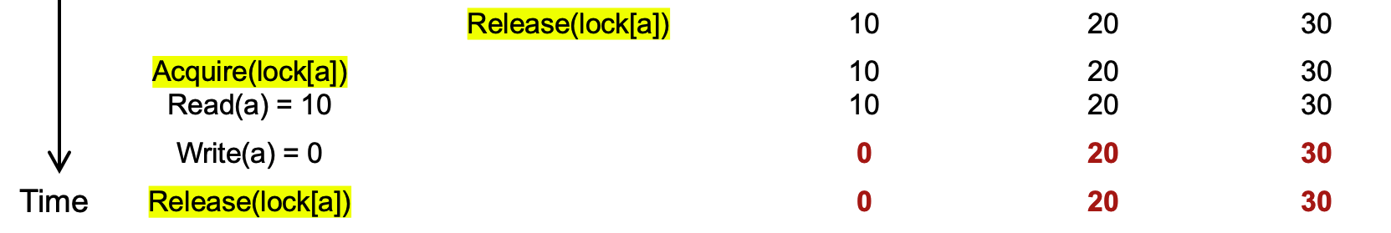
Problem: accessing multiple records
Question #1:
Is the final state of the program correct (i.e., bank accounts) ?
Question #2:
Is the sum of the audit correct?
Notes:
Q1: yes
Q2: no

Slide 77
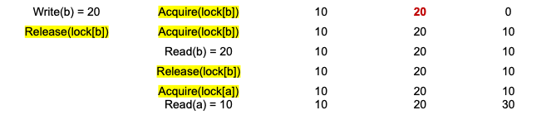
Problem: accessing multiple records
Core problem
Simple fine-grained locking does not prevent the exposure of intermediate result
Insight
we need to delay the lock release time for each shared data
Until all the transaction’s updates finish

Slide 78
Solution: acquire all locks first, and release them at last
Lock Point
Lock
Acquire lock-D
Release lock-D
Acquire lock-C
Release lock-C
Acquire lock-B
Release lock-B
Acquire lock-A
Release lock-A
Time

Slide 79
What are the drawbacks?
Notes:
Long lock held time
Must known the lock set

Slide 80
Two-phase locking (2PL)
…
Fine-grained locking:
Each shared data has one lock
E.g., a lock for Alice & a lock for Bob
2PL locking rule:
The action must acquire the shared data’s lock before access it, and releases it after the data access finishes and release it until the action finishes (on-demand, like fine-grained locking)
Bank = [
Alice: 0¥
Bob: 0¥
Lock = [

Slide 81
Two-phase locking (2PL)
2PL Lock acquire rule:
The action must acquire the shared data’s lock before access it, and release it until all the action finishes
Fine-grained locking
Fine-grained locking + 2PL
Transfer(bank, locks, a, b, amt):
Acquire(lock[b]
bank[b] += amt
Release(lock[b])
Acquire(lock[a])
bank[a] -= amt
Release(lock[a])
Transfer(bank, locks, a, b, amt):
Acquire(lock[b]
bank[b] += amt
Acquire(lock[a])
bank[a] -= amt
Release(lock[a])
Release(lock[b])

Slide 82
Two-phase locking (2PL)
Transfer
(alice, bob, 10)
Transfer
(alice, bob, 10)
Audit()
Audit()
Thread 0 (Transfer) | Thread 1 (Audit) | Bank[Alice] | Bank[bob] | Sum
 |  | 10 | 10 | 0
Acquire(lock[b]) | Acquire(lock[b]) | 10 | 10 | 0
Read(b) = 10 | Acquire(lock[b]) | 10 | 10 | 0
Write(b) = 20 | Acquire(lock[b]) | 10 | 20 | 0
Release(lock[b]) | Acquire(lock[b]) | 10 | 20 | 0
Time
Time

Slide 83
Two-phase locking (2PL)
Transfer
(alice, bob, 10)
Transfer
(alice, bob, 10)
Audit()
Audit()
Thread 0 (Transfer) | Thread 1 (Audit) | Bank[Alice] | Bank[bob] | Sum
 |  | 10 | 10 | 0
Acquire(lock[b]) | Acquire(lock[b]) | 10 | 10 | 0
Read(b) = 10 | Acquire(lock[b]) | 10 | 10 | 0
Write(b) = 20 | Acquire(lock[b]) | 10 | 20 | 0
Acquire(lock[a]) | Acquire(lock[b]) | 10 | 20 | 0
Time
Time

Slide 84
Two-phase locking (2PL)
Transfer
(alice, bob, 10)
Transfer
(alice, bob, 10)
Audit()
Audit()
Thread 0 (Transfer) | Thread 1 (Audit) | Bank[Alice] | Bank[bob] | Sum
 |  | 10 | 10 | 0
Acquire(lock[b]) | Acquire(lock[b]) | 10 | 10 | 0
Read(b) = 10 | Acquire(lock[b]) | 10 | 10 | 0
Write(b) = 20 | Acquire(lock[b]) | 10 | 20 | 0
Acquire(lock[a]) | Acquire(lock[b]) | 10 | 20 | 0
Read(a) = 10 | Acquire(lock[b]) | 10 | 10 | 0
Time
Time

Slide 85
Two-phase locking (2PL)
Transfer
(alice, bob, 10)
Transfer
(alice, bob, 10)
Audit()
Audit()
Thread 0 (Transfer) | Thread 1 (Audit) | Bank[Alice] | Bank[bob] | Sum
 |  | 10 | 10 | 0
Acquire(lock[b]) | Acquire(lock[b]) | 10 | 10 | 0
Read(b) = 10 | Acquire(lock[b]) | 10 | 10 | 0
Write(b) = 20 | Acquire(lock[b]) | 10 | 20 | 0
Acquire(lock[a]) | Acquire(lock[b]) | 10 | 20 | 0
Read(a) = 10 | Acquire(lock[b]) | 10 | 10 | 0
Write(a) = 0 | Acquire(lock[b]) | 0 | 20 | 0
Time
Time

Slide 86
Two-phase locking (2PL)
Transfer
(alice, bob, 10)
Transfer
(alice, bob, 10)
Audit()
Audit()
Thread 0 (Transfer) | Thread 1 (Audit) | Bank[Alice] | Bank[bob] | Sum
 |  | 10 | 10 | 0
Acquire(lock[b]) | Acquire(lock[b]) | 10 | 10 | 0
Read(b) = 10 | Acquire(lock[b]) | 10 | 10 | 0
Write(b) = 20 | Acquire(lock[b]) | 10 | 20 | 0
Acquire(lock[a]) | Acquire(lock[b]) | 10 | 20 | 0
Read(a) = 10 | Acquire(lock[b]) | 10 | 10 | 0
Write(a) = 0 | Acquire(lock[b]) | 0 | 20 | 0
Release(lock[b]) | Acquire(lock[b]) | 0 | 20 | 0
Time
Time

Slide 87
Two-phase locking (2PL)
Transfer
(alice, bob, 10)
Transfer
(alice, bob, 10)
Audit()
Audit()
Thread 0 (Transfer) | Thread 1 (Audit) | Bank[Alice] | Bank[bob] | Sum
 |  | 10 | 10 | 0
Acquire(lock[b]) | Acquire(lock[b]) | 10 | 10 | 0
Read(b) = 10 | Acquire(lock[b]) | 10 | 10 | 0
Write(b) = 20 | Acquire(lock[b]) | 10 | 20 | 0
Acquire(lock[a]) | Acquire(lock[b]) | 10 | 20 | 0
Read(a) = 10 | Acquire(lock[b]) | 10 | 10 | 0
Write(a) = 0 | Acquire(lock[b]) | 0 | 20 | 0
Release(lock[b]) Release(lock[a]) | Acquire(lock[b]) | 0 | 20 | 0
 | Read(b) = 20 | 0 | 20 | 20
Time
Time

Slide 88
Two-phase locking (2PL)
Transfer
(alice, bob, 10)
Transfer
(alice, bob, 10)
Audit()
Audit()
Thread 0 (Transfer) | Thread 1 (Audit) | Bank[Alice] | Bank[bob] | Sum
 |  | 10 | 10 | 0
Acquire(lock[b]) | Acquire(lock[b]) | 10 | 10 | 0
Read(b) = 10 | Acquire(lock[b]) | 10 | 10 | 0
Write(b) = 20 | Acquire(lock[b]) | 10 | 20 | 0
Acquire(lock[a]) | Acquire(lock[b]) | 10 | 20 | 0
Read(a) = 10 | Acquire(lock[b]) | 10 | 10 | 0
Write(a) = 0 | Acquire(lock[b]) | 0 | 20 | 0
Release(lock[b]) Release(lock[a]) | Acquire(lock[b]) | 0 | 20 | 0
 | Read(b) = 20 Acquire(lock[a]) | 0 0 | 20 20 | 20 20
Time
Time

Slide 89
Two-phase locking (2PL)
Transfer
(alice, bob, 10)
Transfer
(alice, bob, 10)
Audit()
Audit()
Thread 0 (Transfer) | Thread 1 (Audit) | Bank[Alice] | Bank[bob] | Sum
 |  | 10 | 10 | 0
Acquire(lock[b]) | Acquire(lock[b]) | 10 | 10 | 0
Read(b) = 10 | Acquire(lock[b]) | 10 | 10 | 0
Write(b) = 20 | Acquire(lock[b]) | 10 | 20 | 0
Acquire(lock[a]) | Acquire(lock[b]) | 10 | 20 | 0
Read(a) = 10 | Acquire(lock[b]) | 10 | 10 | 0
Write(a) = 0 | Acquire(lock[b]) | 0 | 20 | 0
Release(lock[b]) Release(lock[a]) | Acquire(lock[b]) | 0 | 20 | 0
 | Read(b) = 20 Acquire(lock[a]) Read(a) = 0 | 0 0 0 | 20 20 20 | 20 20 20
Time
Time

Slide 90
Two-phase locking (2PL)
Transfer
(alice, bob, 10)
Transfer
(alice, bob, 10)
Audit()
Audit()
Thread 0 (Transfer) | Thread 1 (Audit) | Bank[Alice] | Bank[bob] | Sum
 |  | 10 | 10 | 0
Acquire(lock[b]) | Acquire(lock[b]) | 10 | 10 | 0
Read(b) = 10 | Acquire(lock[b]) | 10 | 10 | 0
Write(b) = 20 | Acquire(lock[b]) | 10 | 20 | 0
Acquire(lock[a]) | Acquire(lock[b]) | 10 | 20 | 0
Read(a) = 10 | Acquire(lock[b]) | 10 | 10 | 0
Write(a) = 0 | Acquire(lock[b]) | 0 | 20 | 0
Release(lock[b]) Release(lock[a]) | Acquire(lock[b]) | 0 | 20 | 0
 | Read(b) = 20 Acquire(lock[a]) Read(a) = 0 Release(lock[a]) | 0 0 0 0 | 20 20 20 20 | 20 20 20 20
Time
Audit appears to run after the transfer
Time

Slide 91
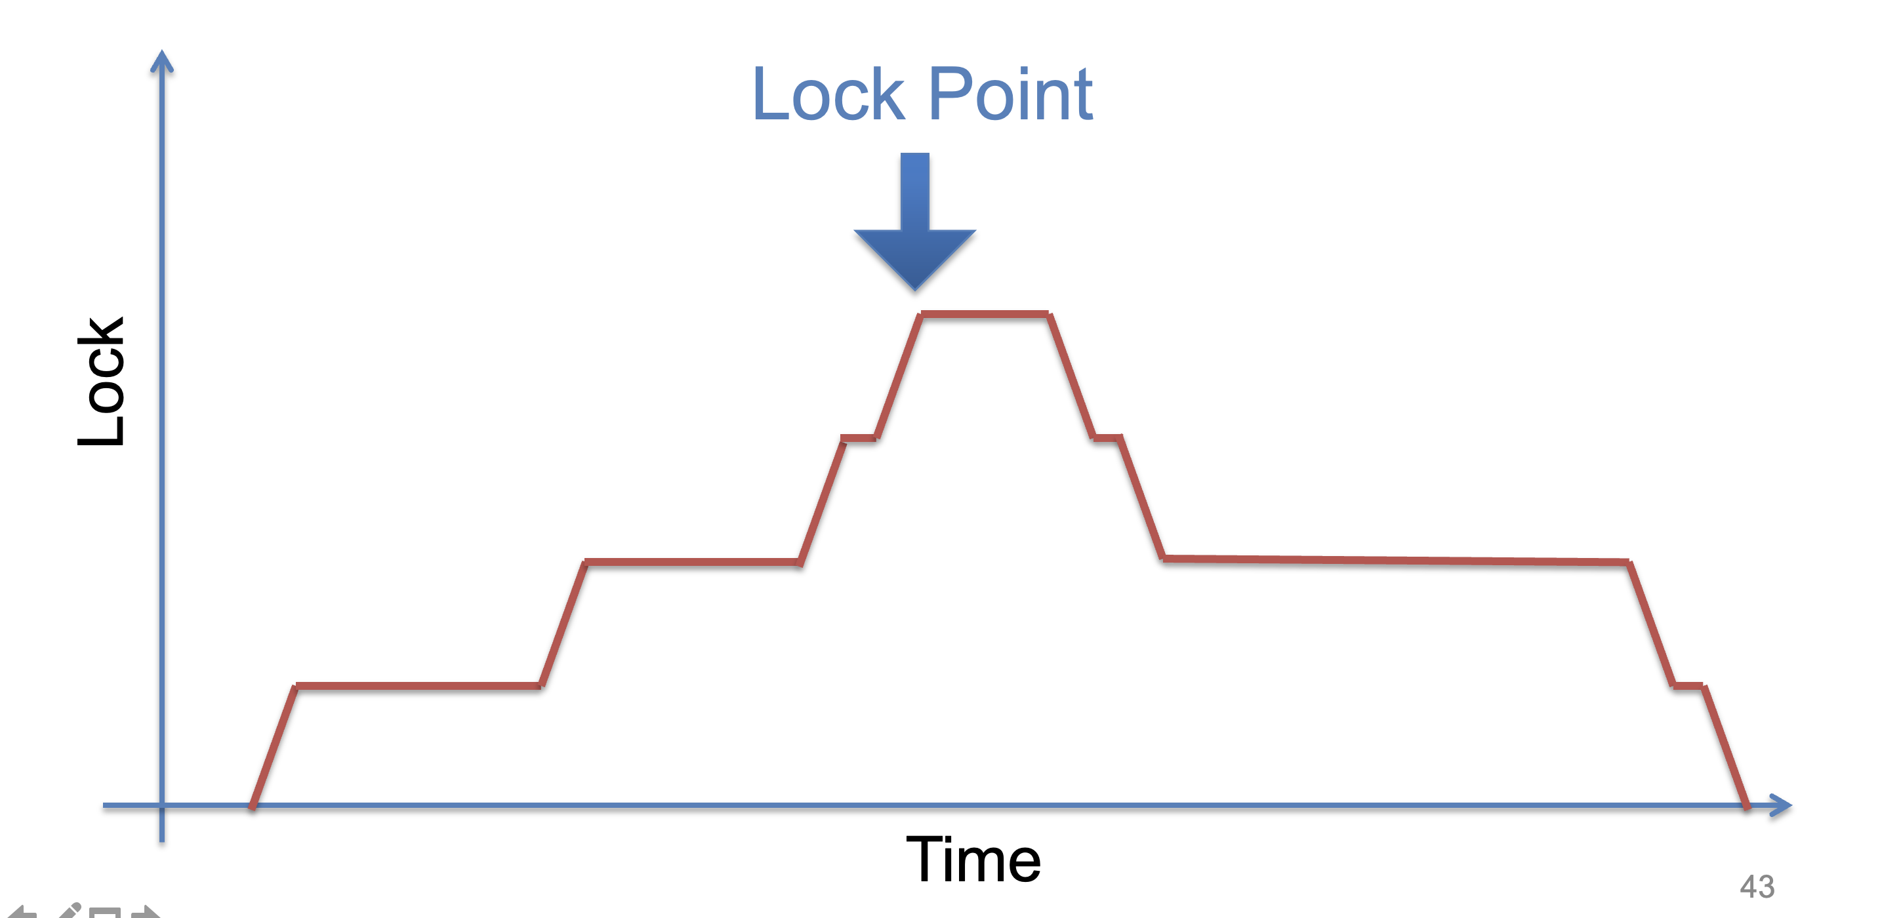
Two-phase locking (2PL)

Slide 92
A note on fine-grained locking
The number of locks used is made explicit in our previous examples
Global lock: only 1 lock
2PL (ideal): one per record
One lock per record record may waste many memory
Especially when there are many records (e.g., records in files)
The number of locks can be configured on demand
We can set a constant number of locks for the system
Only need to ensure the access to the same record will acquire the same lock
Question: what are the trade-offs?

Slide 93
Use locking to achieve before-or-after: 2PL
2PL can guarantee before or after atomicity with serializability
Run actions T1, T2, .., TN concurrently, and have it "appears" as if they ran sequentially (we will prove it later)
Before or after atomicity also is usually termed as serializability
Before or after atomicity
Concurrent actions have the before-or-after property if their effect from the point of view of their invokers is as if the actions occurred either completely before or completely after one another

Slide 94
Serializability
2PL can guarantee before or after atomicity with serializability
Run actions T1, T2, .., TN concurrently, and have it "appears" as if they ran sequentially (we will prove it later)
What does this mean?

Slide 95
Serializability
2PL can guarantee before or after atomicity with serializability
Run actions T1, T2, .., TN concurrently, and have it "appears" as if they ran sequentially (we will prove it later)
What does this mean?
T1
begin
read(x)
tmp = read(y)
write(y, tmp+10)
commit
T2
begin
write(x, 20)
write(y, 30)
commit
Action start
Action end

Slide 96
Init: x=0, y=0
T1
begin
read(x)
tmp = read(y)
write(y, tmp+10)
commit
T2
begin
write(x, 20)
write(y, 30)
commit
Possible sequential schedules
T1 -> T2: x=20, y=30
T2 -> T1: x=20, y=40
T2: write(x, 20)
T1: read(x)
T2: write(y, 30)
T1: tmp = read(y)
T1: write(y, tmp+10)
At end: x=20, y=40
T1: read(x)
T2: write(x, 20)
T1: tmp = read(y)
T2: write(y, 30)
T1: write(y, tmp+10)
At end: x=20, y=10

Slide 97
Init: x=0, y=0
T1
begin
read(x)
tmp = read(y)
write(y, tmp+10)
commit
T2
begin
write(x, 20)
write(y, 30)
commit
Possible sequential schedules
T1 -> T2: x=20, y=30
T2 -> T1: x=20, y=40
T2: write(x, 20)
T1: read(x)
T2: write(y, 30)
T1: tmp = read(y)
T1: write(y, tmp+10)
At end: x=20, y=40
x=0
T1: read(x)
T2: write(x, 20)
T2: write(y, 30)
T1: tmp = read(y)
T1: write(y, tmp+10)
At end: x=20, y=40
y=30
In the second schedule, the results are correct. But T1 reads x=0 and y=30; those reads are not possible in a sequential schedule. Is that ok?

Slide 98
Init: x=0, y=0
Whether OK depends:
There are many ways for multiple transactions to "appear" to have been run in sequence; there are different notions of serializability
Chose a type of serializability depends on applications
T1
begin
read(x)
tmp = read(y)
write(y, tmp+10)
commit
T2
begin
write(x, 20)
write(y, 30)
commit
Possible sequential schedules
T1 -> T2: x=20, y=30
T2 -> T1: x=20, y=40
T2: write(x, 20)
T1: read(x)
T2: write(y, 30)
T1: tmp = read(y)
T1: write(y, tmp+10)
At end: x=20, y=40
x=0
T1: read(x)
T2: write(x, 20)
T2: write(y, 30)
T1: tmp = read(y)
T1: write(y, tmp+10)
At end: x=20, y=40
y=30
In the second schedule, the results are correct. But T1 reads x=0 and y=30; those reads are not possible in a sequential schedule. Is that ok?

Slide 99
Serializability has many types
Final-state serializability
A schedule is final-state serializable if its final written state is equivalent to that of some serial schedule
Conflict serializability
View serializability
Final-state serializability
Most widely used
x=0
T1: read(x)
T2: write(x, 20)
T2: write(y, 30)
T1: tmp = read(y)
T1: write(y, tmp+10)
At end: x=20, y=40
y=30

Slide 100
Conflict Serializability

Slide 101
Conflict Serializability
Two operations conflict if:
they operate on the same data object, and
at least one of them is write, and
they belong to different transactions
Conflict serializability
A schedule is conflict serializable if the order of its conflicts (the order in which the conflicting operations occur) is the same as the order of conflicts in some sequential schedule

Slide 102
Init: x=0, y=0
T1
begin
read(x)
tmp = read(y)
write(y, tmp+10)
commit
T2
begin
write(x, 20)
write(y, 30)
commit
Possible sequential schedules
T1 -> T2: x=20, y=30
T2 -> T1: x=20, y=40
T1.1
T2.1
T1.2
T2.2
T1.3
Conflicts
T1.1 read(x) and T2.1 write(x,20) on x
T1.2 tmp = read(y) and T2.2 write(y,30) on y
T1.3 write(y, tmp+10) and T2.2 write(y,30) on y

Slide 103
Conflict Graph
Conflict Graph
Nodes are transactions, edges are directed
Edge between T_{i} and T_{j} if and only if:
T_{i} and T_{j} have a conflict between them, and
the first step in the conflict occurs in T_{i}
A schedule is conflict serializable if and only if:
It has an acyclic conflict graph

Slide 104
T1
begin
read(x)
tmp = read(y)
write(y, tmp+10)
commit
T2
begin
write(x, 20)
write(y, 30)
commit
Possible sequential schedules
T1 -> T2: x=20, y=30
T2 -> T1: x=20, y=40
Conflicts
T1.1 read(x) -> T2.1 write(x,20)
T1.2 tmp = read(y) -> T2.2 write(y,30)
T1.3 write(y, tmp+10) -> T2.2 write(y,30)
(T1 -> T2)

Slide 105
T1
begin
read(x)
tmp = read(y)
write(y, tmp+10)
commit
T2
begin
write(x, 20)
write(y, 30)
commit
Possible sequential schedules
T1 -> T2: x=20, y=30
T2 -> T1: x=20, y=40
Conflicts
T2.1 write(x,20) -> T1.1 read(x)
T2.2 write(y,30) -> T1.2 tmp = read(y)
T2.2 write(y,30) -> T1.3 write(y, tmp+10)
(T2 -> T1)

Slide 106
Conflicts
T2.1, T1.1
T2.2, T1.2
T2.2, T1.3
Conflict order for sequential schedules
T1.1 -> T2.1 T2.1 -> T1.1
T1.2 -> T2.2 or T2.2 -> T1.2
T1.3 -> T2.2 T2.2 -> T1.3
(T1 -> T2) (T2 -> T1)
T2: write(x, 20)
T1: read(x)
T2: write(y, 30)
T1: tmp = read(y)
T1: write(y, tmp+10)
T1: read(x)
T2: write(x, 20)
T2: write(y, 30)
T1: tmp = read(y)
T1: write(y, tmp+10)
T2.1 -> T1.1
T2.2 -> T1.2
T2.2 -> T1.3
T1.1 -> T2.1
T2.2 -> T1.2
T2.2 -> T1.3

Slide 107
Conflicts
T2.1, T1.1
T2.2, T1.2
T2.2, T1.3
Conflict order for sequential schedules
T1.1 -> T2.1 T2.1 -> T1.1
T1.2 -> T2.2 or T2.2 -> T1.2
T1.3 -> T2.2 T2.2 -> T1.3
(T1 -> T2) (T2 -> T1)
T2: write(x, 20)
T1: read(x)
T2: write(y, 30)
T1: tmp = read(y)
T1: write(y, tmp+10)
T2 -> T1
T1: read(x)
T2: write(x, 20)
T2: write(y, 30)
T1: tmp = read(y)
T1: write(y, tmp+10)
-->
<--
T2 T1
It's final-state serializable,
not conflict serializable
Both at end: x=20, y=40

Slide 108



Conflict Equivalence
=
conflict-equal
Schedule A
if
Schedule B
T1 → T2
T4 → T3
=
equal
Conflicts order A
Conflicts order B
If conflicts-order-A equals to conflicts-order-B,
then schedule-A conflict-equals to schedule-B

Slide 109
View Serializability
T1 T2 T3
read(x)
write(x)
write(x)
write(x)
Conflict graph
T3
T2 T1
Cyclic -> Not conflict serializable
But compare it to running T1 then T2 then T3 (serially)
Final-state is fine
Intermediate reads are fine
Question: why shouldn't we allow this schedule?

Slide 110
View Serializability
Informal definition
A schedule is view serializable if the final written state as well as intermediate reads are the same as in some serial schedule
Formally, for those interested
Two schedules S and S' are view equivalent if:
If T_{i} in S reads an initial value for X, so does T_{i} in S'
If T_{i} in S reads the value written by T_{j} in S for some X, so does T_{i} in S'
If T_{i} in S does the final write to X, so does T_{i} in S'
A schedule is view serializable if it is view equivalent to some serial schedule

Slide 111
Question
Why conflict serializability when it seems too strict?
Why not focus on view serializability?
Final-state Serializability
View
Serializability
Conflict
Serializability
⊃
⊃
Care the final state only
Care the final state as well as intermediate read
Care the final state as well as all the data dependency

Slide 112
Conflict Serializability VS. View Serializability
Conflict serializability is easy to test (& enforce)
i.e., check whether a graph is acyclic
View serializability is hard to test (likely NP-hard)
Conflict serializable schedules are easy to generate
Using concurrency control protocols. E.g., 2PL (two-phase-locking)
Conflict serializable schedules are also view serializable
No easy way to generate view schedules that allows for ones like the previous example

Slide 113
Use locking to achieve before-or-after: 2PL
2PL can guarantee before or after atomicity
Run actions T1, T2, .., TN concurrently, and have it "appears" as if they ran sequentially
2PL locking rule:
The action must acquire the shared data’s lock before access it and release it until the action finishes
Question
Which serializability does 2PL guarantee?
Conflict serializability!

Slide 114
Proof of 2PL
T1 and T2 conflict on x1
T2 and T3 conflict on x2
...
Tk and T1 conflict on x_k
Suppose 2PL does not generate conflict serializable schedule
Suppose the conflict graph produced by an execution of 2PL has a cycle, which without loss of generality, is:
T1 --> T2 --> ... --> Tk --> T1
Let the shared variable (the one that causes the conflict) between T_i and T_{i+1} be represented by x_i.
T1 acquires x1.lock
T2 acquires x1.lock and x2.lock
T3 acquires x2.lock and x3.lock
...
Tk acquires x_{k-1}.lock and x_k.lock
T1 acquires x_k.lock
T1 violates 2PL!
T1 acquires x1.lock
T1 releases x1.lock
...
...
...
T1 acquires x_k.lock
T1 acquires x1.lock
T1 releases x1.lock
T2 acquires x1.lock and x2.lock
...
Tk acquires x_{k-1}.lock and x_k.lock
T1 acquires x_k.lock

Slide 115
Serializability simplifies enforcing concurrent correctness / data consistency

Slide 116
Correctness (app-semantic consistency)
Correctness is hard for computer system to enforce
It is at the application level, with application specific semantic
E.g., developer can write a buggy program, even no concurrency (single-threaded)
To ensure concurrent correctness, we need assumptions
i.e., The single-threaded implementation of actions must be correct
Buggy
Transfer(bank, a, b, amt):
bank[b] += amt
bank[a] -= amt
Transfer(bank, a, b, amt):
bank[b] += amt * 2
bank[a] -= amt

Slide 117
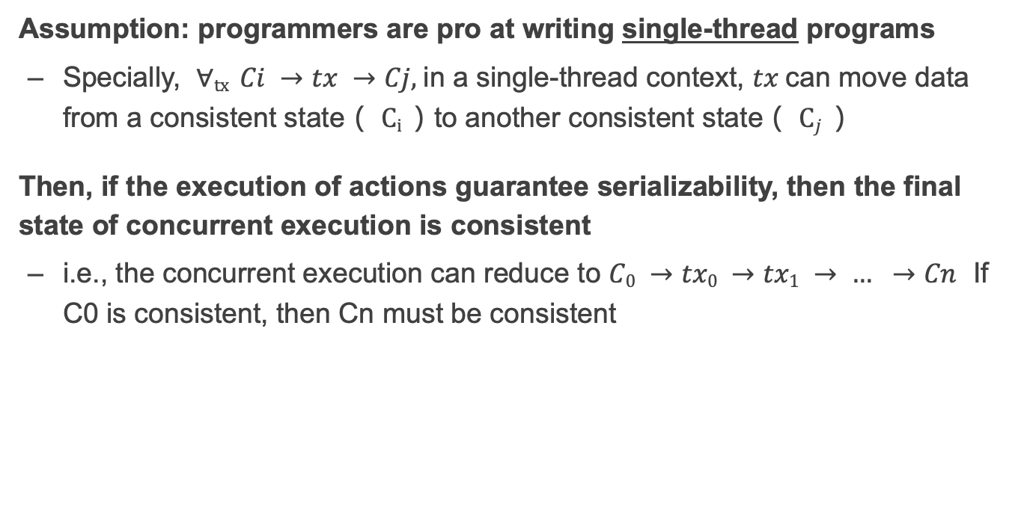
Correctness and serializability
Assumption: programmers are pro at writing single-thread programs
Specially, $∀tx Ci →tx →Cj,$in a single-thread context, $tx$can move data from a consistent state（ $Ci$）to another consistent state（ $Cj$）
Then, if the execution of actions guarantee serializability, then the final state of concurrent execution is consistent
i.e., the concurrent execution can reduce to $C0 →tx0 →tx1 → … →Cn$ If C0 is consistent, then Cn must be consistent

Slide 118
The deadlock issues of 2PL

Slide 119
Deadlock
Two-phase lock is pessimistic:
Before proceed, each TX must wait for conflicting TX to release the lock
What can happen if two TX are waiting for each other?

Slide 120
Deadlock: what if Thread 1 first acquires lock[a]?
Thread 0 (Transfer) | Thread 1 (Audit) | Bank[Alice] | Bank[bob] | Sum
 |  | 10 | 10 | 0
Acquire(lock[b]) | Acquire(lock[b]) | 10 | 10 | 0
Read(b) = 10 | Acquire(lock[b]) | 10 | 10 | 0
Write(b) = 20 | Acquire(lock[b]) | 10 | 20 | 0
Acquire(lock[a]) | Acquire(lock[b]) | 10 | 20 | 0
Read(a) = 10 | Acquire(lock[b]) | 10 | 10 | 0
Write(a) = 0 | Acquire(lock[b]) | 0 | 20 | 0
Release(lock[b]) | Acquire(lock[b]) | 0 | 20 | 0
 | Read(b) = 20 Acquire(lock[a]) Read(a) = 0 Release(lock[a]) | 0 0 0 0 | 20 20 20 20 | 20 20 20 20

Slide 121
Deadlock: what if Thread 1 first acquires lock[a]?
Thread 0 (Transfer) | Thread 1 (Audit) | Bank[Alice] | Bank[bob] | Sum
 |  | 10 | 10 | 0
Acquire(lock[b]) | Acquire(lock[a]) | 10 | 10 | 0

Slide 122
Deadlock: what if Thread 1 first acquires lock[a]?
Thread 0 (Transfer) | Thread 1 (Audit) | Bank[Alice] | Bank[bob] | Sum
 |  | 10 | 10 | 0
Acquire(lock[b]) | Acquire(lock[a]) | 10 | 10 | 0
Read(b) = 10 | Read(a) = 10 | 10 | 10 | 10

Slide 123
Deadlock: what if Thread 1 first acquires lock[a]?
Thread 0 (Transfer) | Thread 1 (Audit) | Bank[Alice] | Bank[bob] | Sum
 |  | 10 | 10 | 0
Acquire(lock[b]) | Acquire(lock[a]) | 10 | 10 | 0
Read(b) = 10 Acquire(lock[a]) | Read(a) = 10 Acquire(lock[b]) | 10 | 10 | 10

Slide 124
Deadlock: what if Thread 1 first acquires lock[a]?
Thread 0 (Transfer) | Thread 1 (Audit) | Bank[Alice] | Bank[bob] | Sum
 |  | 10 | 10 | 0
Acquire(lock[b]) | Acquire(lock[a]) | 10 | 10 | 0
Read(b) = 10 Acquire(lock[a]) Acquire(lock[a]) | Read(a) = 10 Acquire(lock[b]) Acquire(lock[b]) | 10 | 10 | 10
Question: can thread 0 or thread 1 finishes the execution?

Slide 125
Resolving deadlock
1. Acquire locks in a pre-defined order
Not support general TX: TX must know the read/write sets before execution
2. Detect deadlock by calculating the conflict graph
If there is a cycle, then there must be a deadlock
Abort one TX to break the cycle
High cost for detection
3. Using heuristics (e.g., timestamp) to pre-abort the TXs
May have false positive, or live locks

