Slide 1


OCC, MVCC, TX & Multi-site atomicity
SE3331-1 (2024 Fall)
IPADS, Shanghai Jiao Tong University
https://www.sjtu.edu.cn

Slide 2



Optimistic concurrency control (OCC)
Problem of 2PL for before-or-after: locking overhead + deadlock
Pessimistically execute the TX to avoid race conditions
Executing TXs optimistically w/o acquiring the lock
Checks the results of TX before it commits
If violate serializability, then aborts & retries
First proposed in 1981, widely used today (even in hardware impl. !)

Slide 3
Review: Optimistic Concurrency Control
Phase 1: Concurrent local processing
Reads data into a read set
Buffers writes into a write set
Phase 2: Validation serializability in critical section
Validates whether serializability is guaranteed:
Has any data in the read set been modified?
Phase 3: Commit the results in critical section or abort
Aborts: aborts the transaction if validation fails
Commits: installs the write set and commits the transaction

Slide 4
Review: OCC Executes a Transaction in 3 Phases
Phase 1:
Reads data into a read set
Buffers writes into a write set
...
tx.begin();
...
tx.read(A)
...
tx.commit();
...
val_a = read(A)
read_set.add(val_a)

Slide 5
Review: OCC Executes a Transaction in 3 Phases
Phase 1:
Reads data into a read set
Buffers writes into a write set
What about a second read?
Read from the read-set!
Why? Need to provided repeated read!
...
tx.begin();
...
tx.read(A)
tx.read(A)
tx.commit();
...
if A in read_set:
return read_set[A]

Slide 6
Review: OCC Executes a Transaction in 3 Phases
Phase 1:
Reads data into a read set
Buffers writes into a write set
Question
Why do we need to update the readset? Is It necessary?
...
tx.begin();
...
tx.read(A)
tx.write(A)
tx.commit();
...
write_set[A] = ..
if A in read_set:
read_set[A] = ..
Notes:
假设A之前没有被TX写过，即A只写一次

Slide 7
Review: OCC Executes a Transaction in 3 Phases
Phase 1:
Reads data into a read set
Buffers writes into a write set
Question
Why do we need to update the readset? Is It necessary?
Goal: we need to ensure later read will see my write
We can avoid updating the readset by checking the writeset during reads
...
tx.begin();
...
tx.read(A)
tx.write(A)
tx.read(A)
tx.commit();
...
Write_set[A] = ..
if A in write_set:
return write_set[A]
if A in read_set:
return read_set[A]
...
Notes:
假设A之前没有被TX写过，即A只写一次

Slide 8
Review: OCC Executes a Transaction in 3 Phases
Phase 2:
Validates whether serializability is guaranteed:
Has any data in the read set been modified?
...
tx.begin();
...
tx.read(A)
...
tx.commit();
...
for d in read_set:
if d has changed:
abort()

Slide 9
Review: OCC Executes a Transaction in 3 Phases
Phase 3:
Aborts: aborts the transaction if validation fails
Commits: installs the write set and commits the transaction
...
tx.begin();
...
tx.read(A)
...
tx.commit();
...
for d in read-set:
if d has changed:
abort()
for d in write_set:
write(d)

Slide 10
Review: implement 2 & 3
Use two-phase locking + read validation
Only lock the write set, after that,
Check the read set has not changed & locked
def validate_and_commit() // phase 2 & 3 with before-or-after
for d in sorted(write-set):
d.lock()
for d in read-set:
if d has changed or d has been locked:
abort()
for d in write-set:
write(d)
// release the locks
...
Notes:
check完相当于放锁

Slide 11
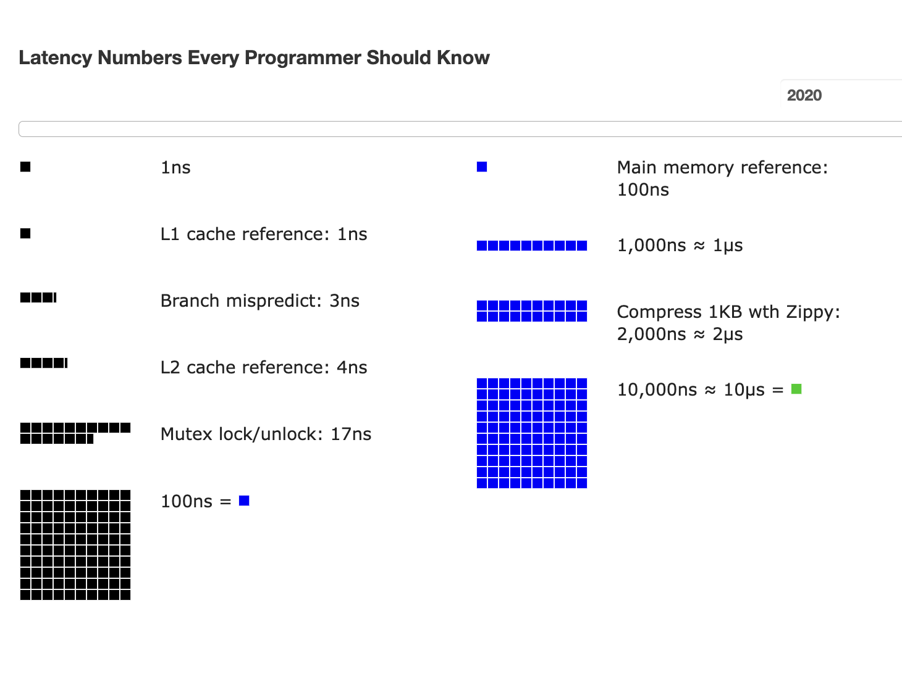
Review: why reducing locks? Atomic for lock is costly

Slide 12
Put it all together: OCC in an example
Tuple A in T1's read set has been changed by T2, thus T1 must be aborted.
Thread1
Thread2
T1:
B = A + B;
T2:
A = A * 1.1;
T2's read set remains unchanged, thus T2 is allowed to commit
BEGIN
BEGIN
T1's read set:
A (100)
B (100)
R(A);
R(A);
T2's read set:
A (100)
B (200)
R(B);
W(A);
T1's write set:
T2's write set:
A (110)
W(B);
Commit
Validation
Thread-local memory
Abort
Validation
Thread-local memory
Time
Database
storage
ID | Value
A | 110
B | 100
ID | Value
A | 100
B | 100

Slide 13
OCC's Problem: False Aborts
Some transactions aborted by OCC could have been allowed to commit without causing an unserializable schedule
Thread1
Thread2
T1:
B = A + B;
T2:
A = A * 1.1;
No cycle is formed
OCC only allows serialized execution of T2, T1, but is not able to recognize serialized execution of T1, T2.
T1 is falsely aborted
BEGIN
BEGIN
R(A);
rw
R(A);
R(B);
W(A);
W(B);
Commit
Abort

Slide 14
OCC's Problem: False Aborts
Some transactions aborted by OCC could have been allowed to commit without causing an unserializable schedule
Especially for TXs with a lot of reads
E.g., read a lot of items → large read set → easier to abort
May abort even under low-contention
Notes:
因为执行的时间很长，所以会abort

Slide 15
OCC’s Problem: livelock
Under high contention, OCC may continuously abort
Especially with large read/write sets, or long execution time
Transaction is executing, but no progress!

Slide 16
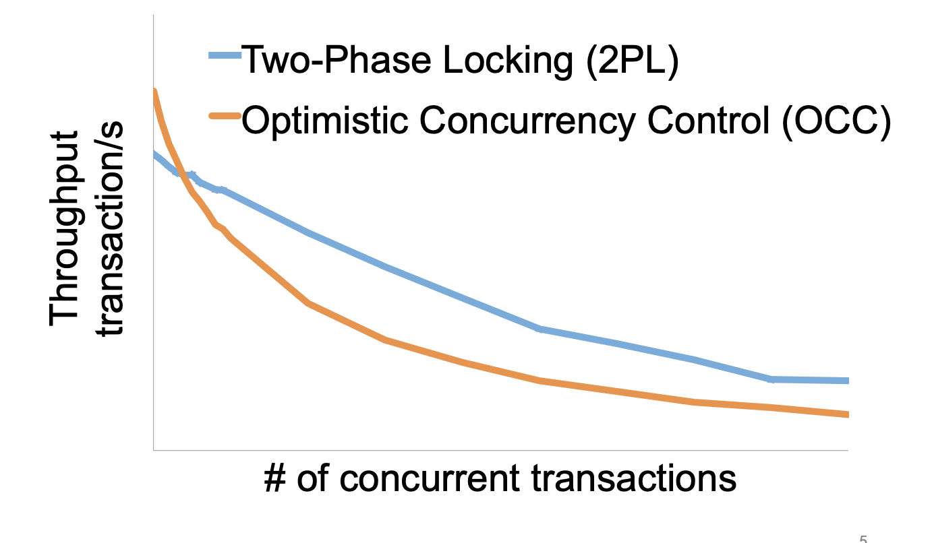
2PL vs. OCC: in a nutshell
OCC reduced locking overhead
OCC has false aborts due to validation fails
Source: Extracting More Concurrency from Distributed Transactions [OSDI'14]

Slide 17
OCC & hardware transactional memory

Slide 18

Hardware Transactional Memory
A CPU feature for writing concurrent programs
CPU guarantees the before-or-after atomicity of memory reads/writes
i.e., no race conditions & no need for 2PL & (Software-implemented) OCC!
Intel’s HTM named as RTM
Restricted Transactional Memory
First released in Haswell processor
Other implementations also exist
E.g., ARM Transactional Memory Extension (TME)

Slide 19
Let’s look at how to use HTM (RTM)
ISA support for transactional memory
The ISA is very similar to what we have been described for TXs
Recall: Writing with TX in software
Use TX.begin to mark when a TX starts
Use TX.commit to commit the TX
In RTM, the concept is similar (new assemble code)
Use xbegin to mark an RTM execution start
Use xend to mark an RTM end

Slide 20
Programming with RTM
If transaction starts successfully
Do work protected by RTM, and then try to commit
CPU detects race condition & aborts if necessary
If abort, CPU rollbacks to line xbegin, return an abort code
Manually abort inside a transaction
if _xbegin() == _XBEGIN_STARTED:
if conditions:
_xabort()
critical code
_xend()
else
fallback routine

Slide 21
Programming with RTM
If transaction starts successfully
Do work protected by RTM, and then try to commit
CPU detects race condition & aborts if necessary
If abort, CPU rollbacks to line xbegin, return an abort code
Manually abort inside a transaction
if _xbegin() == _XBEGIN_STARTED:
if conditions:
_xabort()
critical code (access x)
_xend()
else
abort case
Another process
x = 1

Slide 22
Programming with RTM
If transaction starts successfully
Do work protected by RTM, and then try to commit
CPU detects race condition & aborts if necessary
If abort, CPU rollbacks to line xbegin, return an abort code
Manually abort inside a transaction
if _xbegin() == _XBEGIN_STARTED:
if conditions:
_xabort()
critical code
_xend()
else
abort case

Slide 23
RTM: pros & cons
The benefits of RTM
Memory operations between xbegin() & xend()satisfy before-of-after
Much easier to program than 2PL or OCC (in most cases)
In some cases, the performance is better
Drawbacks
Cannot guarantee success
extern std::vector<u64> data; // shared by multiple threads
if _(xbegin() == _XBEGIN_STARTED)
data.push(12);
else
?

Slide 24
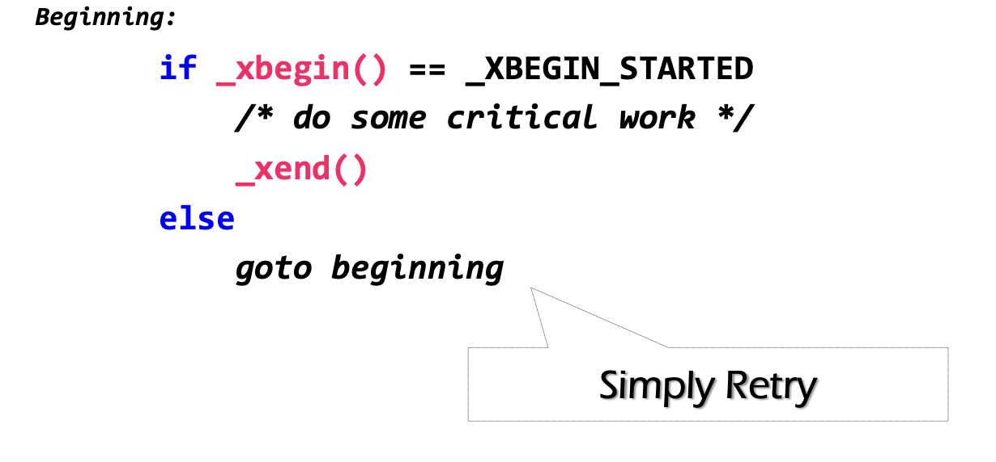
Problem: RTM cannot guarantee success
No guaranteed success. So handling the abort case is more complex
E.g., we cannot use a simple retry-base strategy
Otherwise, we may encounter livelock
Why RTM cannot guarantee success?

Slide 25
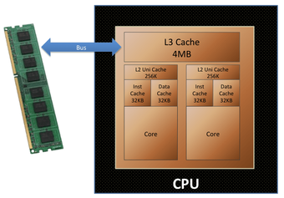
Fun facts about the implementation of RTM
Intel implements RTM using optimistic concurrency control
OCC itself does not guarantee success
RTM’s OCC is implemented on the CPU hardware, which has restrictions
Use CPU cache to track the read/write sets of CPU reads/writes
Use cache coherence protocols to detect conflicts

Slide 26
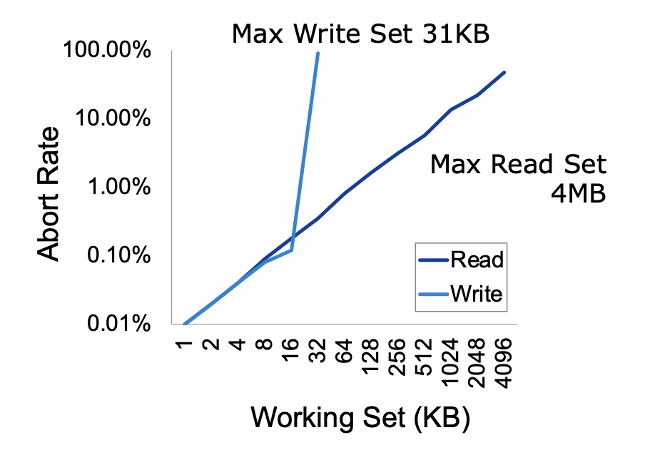
RTM: limited working set
CPU has limited cache capacity
If the read/write sets exceed the cache size, the RTM will unconditionally abort
How big is the RTM read/write sets?
Depends on various factors
Hardware setup (e.g., CPU cache size)
Access pattern: read or write
L1 cache tracks all the writes
L2 or L3 to tracks all the reads
Why not using L2 or L3 to track reads/writes?

Slide 27
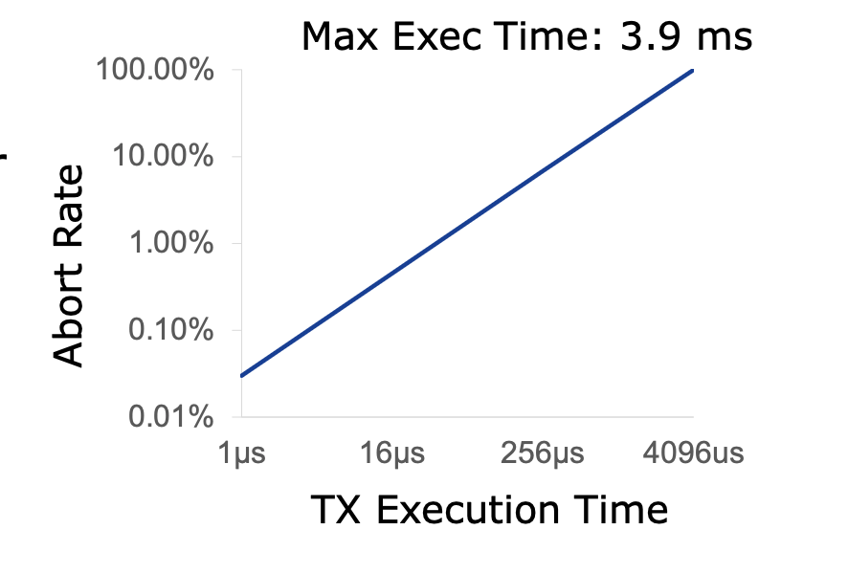
RTM: limited execution time
The longer the execution, the higher the probability a TX aborts
Root cause: CPU interrupts will also unconditionally abort the TX
Why will interrupt cause an RTM to abort? Context switch will pollute the cache

Slide 28
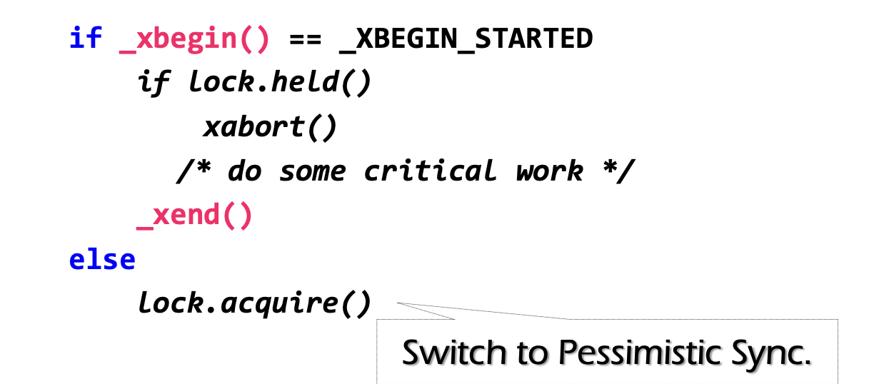
Fallback path: make RTM finally commits
Problem: RTM cannot guarantee success
Similar to OCC, code in RTM can be frequently aborted due to conflicts
It can also be aborted due to hardware restrictions described above
Must switch to a fallback path after some retries (e.g., using a counter)
E.g., fallback to locking; if fallbacks frequently, no performance benefits
check lock status to avoid conflict with fallback handlers on other CPU

Slide 29
HTM on database workloads
Naïve: using HTM to execute the in-memory transaction
Smallbank: transfer &. Audit
TPC-C: much complex, insert 10+ orders and update 10+ stocks
Silo@SOSP’13: the fastest in-memory OCC implementation so far

Slide 30
Short summary of OCC & RTM
OCC is yet another classic protocol for before-or-after atomicity
Whose idea has even been adopted by hardware designers
Hardware support for transactional memory
Easy programming model for the programmer (no need for locking)
As long as the programmer do the in-memory computations, e.g., in-memory database
Good performance if using properly
No need for locking & atomic operations
However, the programmer should handle its pitfalls

Slide 31

OCC & 2PL are bad when TXs are long running w/ many reads
OCC: abort due to read validation fails
2PL: read will hold the lock and block others
Yet, reads are common in applications
e.g., for Taobao, we rarely add items, but extensively read the items
Scenario: long-running read-only or read-mostly transactions
run analytics on a companion data, while update a piece of data
long running read-only transaction
Notes:
因为执行的时间很长，所以会abort

Slide 32
Can we avoid validation for reads?

Slide 33

Abort in OCC
T1:
Print(A+B)
T2:
B = 2
A = 3
Time
T1
T2
Read(A_{T0})
Read(B_{T0})
Write(A_{T2})
Write(B_{T2})
Validate(A)
Abort!

Slide 34
Abort in OCC
T1:
Print(A+B)
T2:
B = 2
A = 3
Time
T1
T2
Read(A_{T0})
Read(B_{T0})
Do we necessarily need to abort T1?
Write(A_{T0})
Write(B_{T2})
Validate(A)
Abort!

Slide 35
Abort in OCC case (2)
T1:
Print(A+B)
T2:
B = 2
A = 3
Time
T1
T2
Read(A_{T0})
Write(A_{T2})
Write(B_{T2})
Read(B_{T2})
Validate(A)
Question: can we avoid aborting T1?
Abort!

Slide 36
Abort in OCC case (2)
T1:
Print(A+B)
T2:
B = 2
A = 3
Time
T1
T2
Read(A_{T0})
Write(A_{T2})
Write(B_{T2})
Read(B_{T0})
Read(B_{T2})
Overwrite

Slide 37
Idea: multi-versioning concurrency control
Each data has multiple-versions instead of a single version
A set of version represents a snapshot of the database
E.g., A_{T0} + B_{T0}
The version ~= the time a TX makes the updates
Data
VersionedData
X₀
X₁
X
Struct Data {
value : u8[…]
lock : lock_t
}
Struct Data {
value: List<VersionedData>
lock : lock_t
}
Struct VersionedData {
value: u8[…]
version: u64
}

Slide 38
Idea: multi-versioning concurrency control
Read
Only read from a consistent snapshot at a start time
Write
Install a new version of the data instead of overwriting the existing one
Version ~= the commit time of the TX
Goal: avoid race conditions on reading a snapshot
Data
VersionedData
X₀
X₁
X
Struct Data {
value : u8[…]
lock : lock_t
}
Struct Data {
value: List<VersionedData>
lock : lock_t
}
Struct VersionedData {
value: u8[…]
version: u64
}

Slide 39
Get the start and commit time
Requirement: the counter reflects TX’s serial execution order
E.g., if T1 finishes before T2, it will have a smaller start & commit timestamp
Not necessary for read-only TX, but is critical for the write
Simplest (& most widely used) solution: global counter
Using atomic fetch and add (FAA) to get at the TX’s begin & commit time
TX Begin: use FAA to get the start time
TX Commit: use FAA to get the commit time
We will introduce more advanced timestamps in later lectures
Not using a global counter is challenging because de-centralized time (e.g., physical time) is unsynchronized

Slide 40
Try #1: Optimize OCC w/ MV (incomplete)
Acquire the start time
Phase 1: Concurrent local processing
Reads data belongs to the snapshot closest to the start time
Buffers writes into a write set
Acquire the commit time
Phase 2: Commit the results in critical section
Commits: installs the write set with the commit time
Compared to the OCC, no validation is need!

Slide 41
Try #1: Optimize OCC w/ MV (incomplete)
Commit(tx):
for record in tx.write_set:
lock(record)
let commit_ts = FAA(global_counter)
for record in tx.write_set:
record.insert_new_version(commit_ts, ...)
unlock(record)
Get(tx, record):
while record.is_locked():
pass
for version,value in record.sort_version_in_decreasing():
if version <= tx.start_time:
return value

Slide 42
Partial snapshot
T2:
B = 2
A = 3
T1:
Print(A+B)
Global counter g (initial 0)
T1
T2
1
Start_time = FAA(g)
A: A₀
B: B₀
Read(A) = A₀
2
Commit_time = FAA(g)
Write(B, B₂)
A: A₀
Read(B) = B₀
B: B₂ B₀
Write(A, A₂)
A: A₂ A₀
B: B₂ B₀
No validation needs here (for T1) !
Problem: partial updated snapshot

Slide 43
Partial snapshot example
T1:
Print(A+B)
T2:
B = 2
A = 3
Global counter (initial 0)
T1
T2
Needs to be atomic
A: A₀
1
Commit_time = FAA(g)
B: B₀
Write(B, B₁)
A: A₀
2
start_time = FAA(g)
B: B₁ B₀
Read(A) = A₀
Read(B) = B₁
A: A₁ A₀
Write(A, A₁)
B: B₁ B₀
Missing the updates! We need T2’s write being before-or-after atomic!

Slide 44
Enforcing the write atomicity of snapshot w/ locking
Commit(tx):
for record in tx.write_set:
lock(record)
let commit_ts = FAA(global_counter)
for record in tx.write_set:
record.insert_new_version(commit_ts, ...)
unlock(record)
Get(tx, record):
while record.is_locked():
pass
for version,value in record.sort_version_in_decreasing():
if version <= tx.start_time:
return value

Slide 45
Example revisit
T1:
Print(A+B)
T2:
B = 2
A = 3
Question: can we reorder get commit time and locking?
Global counter (initial 0)
T1
T2
Lock A, B
A: A₀
1
Commit_time = FAA(g)
B: B₀
Write(B, B₁)
Unlock B
A: A₀
2
start_time = FAA(g)
B: B₁ B₀
Read(A) = ?
A: A₀
Cannot read! Because A is locked!
B: B₁ B₀
A: A₁ A₀
Write(A, A₁)
B: B₁ B₀
Unlock A
Read(A) = A₁
Read(B) = B₁

Slide 46
What about writes?
T1:
A += 1
T2:
A += 1
Global counter (initial 0)
T1
T2
1
Start_time = FAA(g)
Read(A₀) = 0
2
Start_time = FAA(g)
Read(A₀) = 0
3
Commit_time = FAA(g)
Write (A_{3,} 1)
4
Commit_time = FAA(g)
Write (A_{4,} 1)

Slide 47
MVCC ensures no race for reads, but not writes
Race conditions of reads are isolated via snapshots
But we still needs to rule out race conditions between reads + writes
We do so by validating the writes at the commit time
The validation is simple:
During commit time, check whether another TX has installed a new snapshot after the committing TX’s start time

Slide 48
Put it together, MVCC so far
T is assigned a commit timestamp T.cts
System checks all data within T.wset, if T.sts < X.cts, then abort T
Update all data within T.wset with T.cts
T is assigned a start timestamp T.sts
T
START
READ(X)
WRITE(X)
COMMIT
Time
T reads the biggest version of X(i), such that X(i).cts <= T.sts
T buffers writes to X and adds X to its write-set, T.wset += {X}

Slide 49
Question: do our current MVCC method guarantee before-or-after?

Slide 50
Write skew anomaly
Our MVCC differs from serializability due to one anomaly
Describe the anomaly and also give a concrete application for which the anomaly is undesirable.
T1
S
R(X)
W(Y)
C
R(X) = X₀
W(Y) = Y₂
T2
S
R(Y)
W(X)
C
R(Y) = Y₀
W(X) = X₁
Possible Conflict Serial Order
X₀
X₁
T1
T2
Y₀
Y₂
T2
T1

Slide 51
Fixing the anomaly
The simplest way is to validate the read-set in read-write TX
Essentially fallbacks to OCC for read-write TX
But read-only TX can still enjoy the benefits from MVCC
Never aborts & no validations
Usually being ignored in practice (Snapshot isolation)
The MVCC without the read validation is also called snapshot isolation (SI)
Though the idea of MVCC is first proposed in SI, its usage is not restricted to it, e.g., we can have MV-2PL and MV-OCC; & we will see it later

Slide 52
A short summary of consistency so far with transactions

Slide 53

Widely used transaction (TX)s
Caching server
Caching server
…
Caching server
All can use TX to manager data!
e.g., FS meta data
Caching
Caching
Caching
Distributed caching
Database server
Database server
CDN
Users
Application #1
generate the page
Database
user, price
…
Database
user, price
Application server
Distributed database
Internet
Load
Balance
Application #2
add the order
File server
File server
File server
File:
image
File:
image
…
File:
image
Application server
…
…
Message queue
Distributed file system

Slide 54

Widely used transaction (TX)s
if item.count > 0:
item.count -= 1
Cart.add(item)

Slide 55
What is TX?
An abstraction to manage the data
Data is also an abstract concept, can be arbitrary computing data. Concrete examples including:
Key-value store entries
File system metadata (e.g., directory,, inode, etc)
Processor’s metadata (e.g., child processors)
Look like similar program, with data managed by the TX system, and extra mark to denote the start/end of a TX

Slide 56

What a TX typically provide? ACID
The program btw { tx.begin() & tx.commit() } has the following properties:
A：Atomicity
C：Consistency
I：Isolation
D：Durability
...
tx.begin();
...
...
tx.commit();
...
ACID
Application program

Slide 57
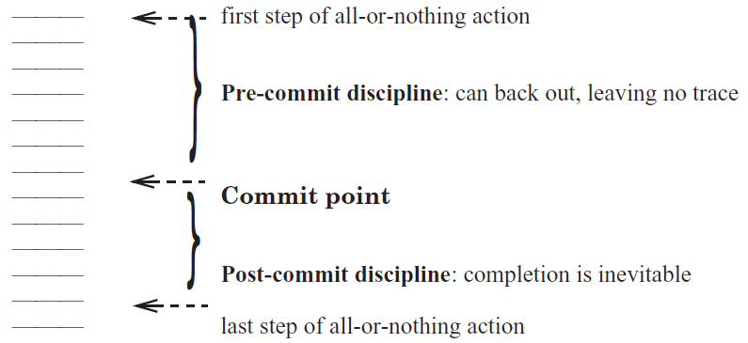
Atomicity: All-or-nothing

Slide 58
Isolation & Durability
Isolation: Two concurrently transactions are isolated (Before-or-after)
E.g., not viewing the intermediate results of another TX
Avoid the race conditions
Durability
Once a transaction is committed, its changes (e.g., writes) must durably stored to a persistent storage

Slide 59
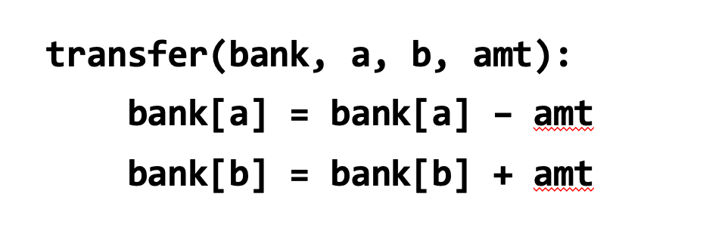
Consistency
Transaction must change the data from a consistent state to another
What is consistent is defined by the applications
E.g., transfer should leave the sum(bank[a] + bank[b]) unchanged
Transaction alone is not sufficient for application consistency
E.g., If the programmer writes the incorrect program.
bank[a] = bank[a] - amt * 2

Slide 60
Enforcing ACID properties (in the single-machine case)
Enforcing A & D:
Logging and recovery (see the last last lecture)
Enforcing C:
Database constraint system (not covered in this class)
Enforcing I:
Concurrency control methods (last & this lecture)

Slide 61
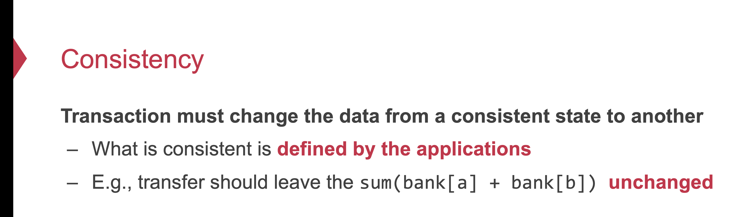
Why is isolation typically related to consistency?
Because it simplifies the programmer to enforce consistency
Recall: consistency depends on how the programmer writes the program

Slide 62
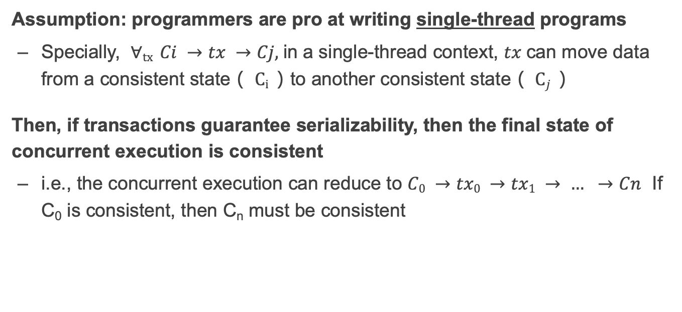
Why serializability is ideal?
Assumption: programmers are pro at writing single-thread programs
Specially, $∀tx Ci →tx →Cj,$in a single-thread context, $tx$can move data from a consistent state（ $Ci$）to another consistent state（ $Cj$）
Then, if transactions guarantee serializability, then the final state of concurrent execution is consistent
i.e., the concurrent execution can reduce to $C0 →tx0 →tx1 → … →Cn$ If C₀ is consistent, then C_{n} must be consistent

Slide 63
Why we need to use a TX?
Programmers can manually add logging & locking to their program
Can guarantee all-or-nothing and before-of-after
However, this is a typically bad idea
Question: what if the programmer falsely releases the lock (like the fine-grained lock example in our previous lecture?)
What if the programmer write the wrong logging & recovery mechanism?

Slide 64
Review of TX: an abstraction to ease data management
Handle failure atomicity (all-or-nothing) & race conditions (before-or-after)
Writing with TX is straightforward, the atomicity is left to the system
Use TX.begin to mark when a TX starts
Use TX.commit to commit the TX
Rewrite the data read/write with TX’s interface
E.g., bank[a] = bank[a] – amt
tx.write(a, tx.read(a) – amt);
transfer(bank, a, b, amt, tx):
tx.begin()
tx.write(b, tx.read(b) + amt);
tx.write(a, tx.read(a) – amt);
tx.commit()
transfer(bank, a, b, amt):
bank[b] = bank[b] + amt
bank[a] = bank[a] - amt
Program
Transaction

Slide 65
Summary
Transactions provide ACID properties
OCC & 2PL are basic protocols to provide serializability
Problem of 2PL: locking overhead & deadlock
Problem of OCC: False abort & livelock
Hardware transactional memory (HTM)
Advanced CPU features inspired by ACID properties of TXs
Commercial implementation of HTM uses OCC
Leads to several drawbacks
The cost of concurrency control can be reduced w/ relaxed isolation level
Snapshot Isolation (require global counter, not serializable)

Slide 66
Multi-site transaction &
Multi-site atomicity

Slide 67



Multi-site transaction: what if the data is distributed?
The data accessed by TXs are stored on multiple machines
i.e., a single site cannot store all the bank accounts
The setup
Client + coordinator + two servers
One server handles bank accounts A-M
The other server handles bank accounts N-Z
Coordinator and servers all have logs to ensure single transaction atomicity
Coordinators
e.g., frontend servers
Storage servers
e.g., key-value stores
Clients,
e.g., iPhone
A - M
N - Z

Slide 68

Deposit(bank, a, amt):
bank[a] += amt
Multi-site transaction
e.g., coordinator sends multiple deposit to different servers
They use RPCs to send requests to the server to execute transaction
发工资(bank, accts, amt):
for acct in accts:
deposit(bank, acct, amt)
发工资
Coordinator
Server 0
deposit(“Alice”)
Audit(“Zack”)
Server 1
Time

Slide 69
Multi-site transaction
Coordinator sends multiple deposit to different servers
They use RPCs to send requests to the server to execute transaction
发工资(bank, accts, amt):
for acct in accts:
deposit(bank, acct, amt)
发工资
Coordinator
Server 0
deposit(“Alice”)
deposit(“Zack”)
Server 1
Time
What if one server commits and the other aborts?

Slide 70
Goal: all sites either all commits or all aborts

Slide 71
Two-phase Commit: a way to ensure multi-site atomicity
High-layer TX
The high-level view of the TX
Low-layer TX
Specific reads and writes that executed on a single machine
Higher-layer transaction coordinates the execution of lower-layer TXs
All low-layer TX either all commits or all aborts
发工资(bank, accts, amt):
tx.high_begin()
for acct in accts:
deposit(bank, acct, amt)
tx.high_commit()
High-layer TX
Deposit(bank, a, amt):
tx.low_begin()
bank[a] += amt
tx.low_commit()
Low-layer TX

Slide 72
We also aggregate scattered accesses as low-layer TX
The coordinator can send scattered reads/writes to a site
The reads and writes on that site also form a low-layer TX
Coordinator
Storage server
A - M
Storage server
N - Z
accts[“alice"] -= amt
accts[“zack"] += amt
accts[“bob”] += amt
Low-layer TX:
READ(A)
WRITE(A)
READ(B)
WRITE(B)
A - amt
ok
Z + amt
ok
B + amt
ok

Slide 73
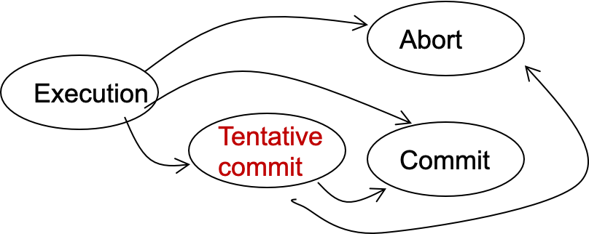
Two-phase Commit: a way to ensure multi-site atomicity
Phase-1: preparation / voting
Delay the commitment of low-layer TXs
Lower-layer transactions either abort or tentatively committed
Higher-layer transaction evaluate lower situation
Phase-2: commitment
The high-layer decides whether low-layer TXs will commit or abort
It will also coordinate the commitment of lower-layer TXs
State transitions of a TX
Notes:
Why 2 phase? Delay the commitment of TX

Slide 74
Two-phase Commit: a way to ensure multi-site atomicity
High-layer TX
发工资(bank, accts, amt):
tx.high_begin()
for acct in accts:
deposit(bank, acct, amt)
tx.high_commit()
High_begin
Mark itself as a high-level transaction
High_commit
Send prepare messages to the low-level transactions to check whether it can commit
tx.high_begin()
tx.high_commit()
for each deposit:
if deposit.abort: abort()
for each deposit:
deposit.commit()
Deposit(…)
Deposit(…)
Time

Slide 75
We need extension to the low-layer TX’s log
Low-layer TX
Deposit(bank, a, amt):
tx.begin()
bank[a] += amt
tx.commit()
Recall: the WAL logging in the previous lecture
At commit point, append a commit record to the log
Question
Can we directly append the commit record to the lower-level transaction log?
...
log.append("TX {id} commit”).sync()
...
Commit
No! The high-level transaction can abort
Log

Slide 76
Logging rule of WAL under 2PC
Low-layer transaction
REDO-UNDO log entries: like normal
Commit log entry -> Tentative commit log entry (PREPARED)
Contains a reference to the high-layer TX
In case of failure: ask the high-layer TX’s coordinator to see if I can commit
High-layer transaction （Responsible for commit of low-layer TXs)
Log the prepare log as a commitment of a high-layer TX

Slide 77
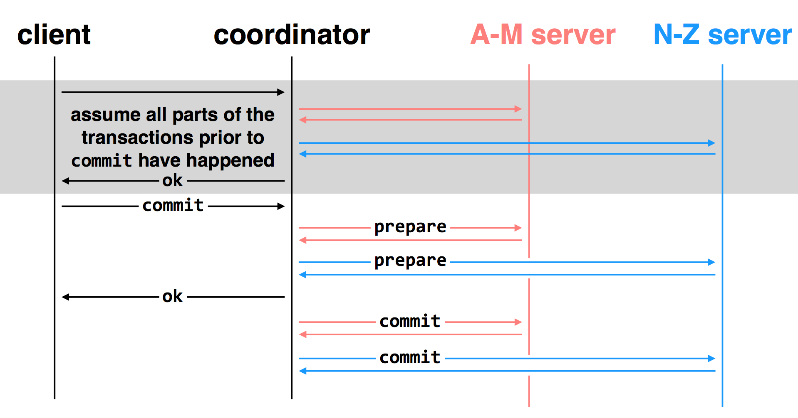
Multi-site transactions under two-phase commit
Idea: the coordinator is responsible for committing all the TXs
How? By sending RPCs or Messages to all the other servers

Slide 78
Challenge: unreliable communications, coordinator & worker

Slide 79
Multiple-site Atomicity
Principles:
Following the coordinator’s decision
Log sufficient state to tolerate failures (e.g., the coordinator’s decision)
Coordinator (do the decision & maintain the state)
Collect some ABORT or nothing: ABORT or retry
Collect all COMMIT: then COMMIT
Worker passively react to the coordinator’s actions
If no message is sent from the coordinator, just wait
When receive COMMIT: then COMMIT

Slide 80
client
coordinator
A-M server
N-Z server
assume all parts of the transactions prior to
commit have happened
OK
commit
prepare
prepare
OK
commit
commit
two-phase commit: nodes agree that they are ready to commit before committing

Slide 81
client
coordinator
A-M server
N-Z server
OK
commit
X
prepare
timeout; resend
prepare
prepare
OK
commit
commit
failure: lost prepare

Slide 82
client
coordinator
A-M server
N-Z server
OK
commit
prepare
X
timeout; resend
prepare
prepare
OK
failure: lost ACK for prepare

Slide 83

client
coordinator
A-M server
N-Z server
OK
commit
prepare
prepare
abort
abort
failure: worker failure during prepare
coordinator can safely abort transaction, will send explicit abort messages to live workers

Slide 84
client
coordinator
A-M server
N-Z server
OK
commit
prepare
prepare
OK
commit
X
Why? Just wait..
tx?
timeout; resend
commit
commit
failure: lost commit message

Slide 85
client
coordinator
A-M server
N-Z server
OK
commit
prepare
prepare
OK
commit
X
timeout; resend
commit
commit
failure: lost ACK of commit message

Slide 86

client
coordinator
A-M server
N-Z server
OK
commit
prepare
prepare
OK
commit
commit
failure: worker failure during commit
Notes:
workers write PREPARE records once prepared. the recovery process — reading through the log — will indicate which transactions are prepared but not committed

Slide 87

client
coordinator
A-M server
N-Z server
OK
commit
prepare
prepare
OK
commit
commit
tx?
restart
commit
failure: worker failure during commit

Slide 88

client
coordinator
A-M server
N-Z server
OK
commit
prepare
coordinator recovers
abort
abort
failure: coordinator failure during prepare

Slide 89
client
coordinator
A-M server
N-Z server
OK
commit
prepare
prepare
OK
commit
coordinator recovers
commit
commit
failure: coordinator failure during commit
Must log the decision before sending the commit messages

Slide 90
What about 2PL or OCC in 2PC?
Nearly identical
2PL: each low-layer TX cannot release its lock until the high-layer TX decides to commit
OCC: the validation & commit phases are done by the coordinator

Slide 91
Summary of 2-phase Commit
Two-phase commit allows us to achieve multi-site atomicity: transaction remains atomic even when they require communication with multiple machines
In two-phase commit, failures prior to the commit point can be aborted. If workers (or the coordinator) fail after the commit point, they recover into the PREPARED state, and complete the transaction
Remaining challenge: availability under coordinator failures
Follow the coordinator’s decision simplifies achieving multi-site atomicity, but what if the coordinator crashes for a long time?
We will see how to make the coordinator available in the next lecture

