Slide 1


Multi-site atomicity & Primary-backup replication
SE3331-1 (2024 Fall)
IPADS, Shanghai Jiao Tong University
https://www.sjtu.edu.cn

Slide 2

Review: OCC & 2PL are bad when TXs are long running w/ many reads
OCC: abort due to read validation fails
2PL: read will hold the lock and block others
Yet, reads are common in applications
e.g., for Taobao, we rarely add items, but extensively read the items
Scenario: long-running read-only or read-mostly transactions
run analytics on a companion data, while update a piece of data
long running read-only transaction
Notes:
因为执行的时间很长，所以会abort

Slide 3
Review: multi-versioning concurrency control
Read
Only read from a consistent snapshot at a start time
Write
Install a new version of the data instead of overwriting the existing one
Version ~= the commit time of the TX
Goal: avoid race conditions on reading a snapshot
Data
VersionedData
X₀
X₁
X
Struct Data {
value : u8[…]
lock : lock_t
}
Struct Data {
value: List<VersionedData>
lock : lock_t
}
Struct VersionedData {
value: u8[…]
version: u64
}

Slide 4
Review: MVCC (Snapshot isolation)
T is assigned a commit timestamp T.cts
System checks all data within T.wset, if T.sts < X.cts, then abort T
Update all data within T.wset with T.cts
T is assigned a start timestamp T.sts
T
START
READ(X)
WRITE(X)
COMMIT
Time
T reads the biggest version of X(i), such that X(i).cts <= T.sts
T buffers writes to X and adds X to its write-set, T.wset += {X}

Slide 5
Review: partial snapshot example
T1:
Print(A+B)
T2:
B = 2
A = 3
Global counter (initial 0)
T1
T2
Needs to be atomic
A: A₀
1
Commit_time = FAA(g)
B: B₀
Write(B, B₁)
A: A₀
2
start_time = FAA(g)
B: B₁ B₀
Read(A) = A₀
Read(B) = B₁
A: A₁ A₀
Write(A, A₁)
B: B₁ B₀
Missing the updates! We need T2’s write being before-or-after atomic!

Slide 6
Review: partial snapshot example
T1:
Print(A+B)
T2:
B = 2
A = 3
Global counter (initial 0)
T1
T2
A: A₀
1
Commit_time = FAA(g)
B: B₀
Write(B, B₁)
A: A₀
2
start_time = FAA(g)
B: B₁ B₀
Read(A) = A₀
Read(B) = B₁
A: A₁ A₀
Write(A, A₁)
B: B₁ B₀
Note that the write is at the commit phase

Slide 7
Multi-site transaction &
Multi-site atomicity

Slide 8



Multi-site transaction: what if the data is distributed?
The data accessed by TXs are stored on multiple machines
i.e., a single site cannot store all the bank accounts
The setup
Client + coordinator + two servers
One server handles bank accounts A-M
The other server handles bank accounts N-Z
Servers have logs to ensure single transaction atomicity (on a single site)
Coordinators
e.g., frontend servers
Storage servers
e.g., key-value stores
Clients,
e.g., iPhone
A - M
N - Z

Slide 9

Deposit(bank, a, amt):
bank[a] += amt
Multi-site transaction
e.g., coordinator sends multiple deposit to different servers
They use RPCs to send requests to the server to execute transaction
发工资(bank, accts, amt):
for acct in accts:
deposit(bank, acct, amt)
发工资
Coordinator
Server 0
deposit(“Alice”)
Audit(“Zack”)
Server 1
Time

Slide 10
Multi-site transaction
e.g., coordinator sends multiple deposit to different servers
They use RPCs to send requests to the server to execute transaction
发工资(bank, accts, amt):
for acct in accts:
deposit(bank, acct, amt)
发工资
Coordinator
Server 0
deposit(“Alice”)
deposit(“Zack”)
Server 1
Time
What if one server commits and the other aborts?

Slide 11
Goal: all sites either all commits or all aborts
w/ two-phase commit

Slide 12
Multi-site case #1: compose multiple single-site TXs
High-layer TX
The high-level view of the TX
Low-layer TX
Specific reads and writes that executed on a single machine
Higher-layer transaction coordinates the execution of lower-layer TXs
All low-layer TX either all commits or all aborts
发工资(bank, accts, amt):
tx.high_begin()
for acct in accts:
deposit(bank, acct, amt)
tx.high_commit()
High-layer TX
Deposit(bank, a, amt):
tx.low_begin()
bank[a] += amt
tx.low_commit()
Low-layer TX

Slide 13
Multi-site case #2: a TX access data across sites
The coordinator can send scattered reads/writes to a site
The reads and writes on that site also form a low-layer TX
Coordinator
Storage server
A - M
Storage server
N - Z
accts[“alice"] -= amt
accts[“zack"] += amt
accts[“bob”] += amt
Low-layer TX:
READ(A)
WRITE(A)
READ(B)
WRITE(B)
A - amt
ok
Z + amt
ok
B + amt
ok

Slide 14
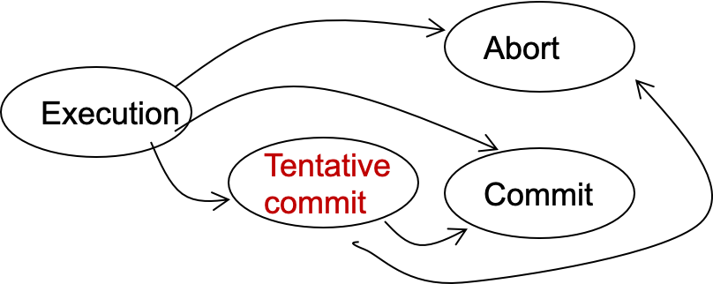
Two-phase Commit: a way to ensure multi-site atomicity
Phase-1: preparation / voting
Delay the commitment of low-layer TXs
Lower-layer transactions either abort or tentatively committed
Higher-layer transaction evaluate lower situation
Phase-2: commitment
The high-layer decides whether low-layer TXs will commit or abort
It will also coordinate the commitment of lower-layer TXs
State transitions of a TX
Notes:
Why 2 phase? Delay the commitment of TX

Slide 15
Two-phase Commit: a way to ensure multi-site atomicity
High-layer TX
发工资(bank, accts, amt):
tx.high_begin()
for acct in accts:
deposit(bank, acct, amt)
tx.high_commit()
High_begin
Mark itself as a high-level transaction
High_commit
Send prepare messages to the low-level transactions to check whether it can commit
tx.high_begin()
tx.high_commit()
for each deposit:
if deposit.abort: abort()
for each deposit:
deposit.commit()
Deposit(…)
Deposit(…)
Time

Slide 16
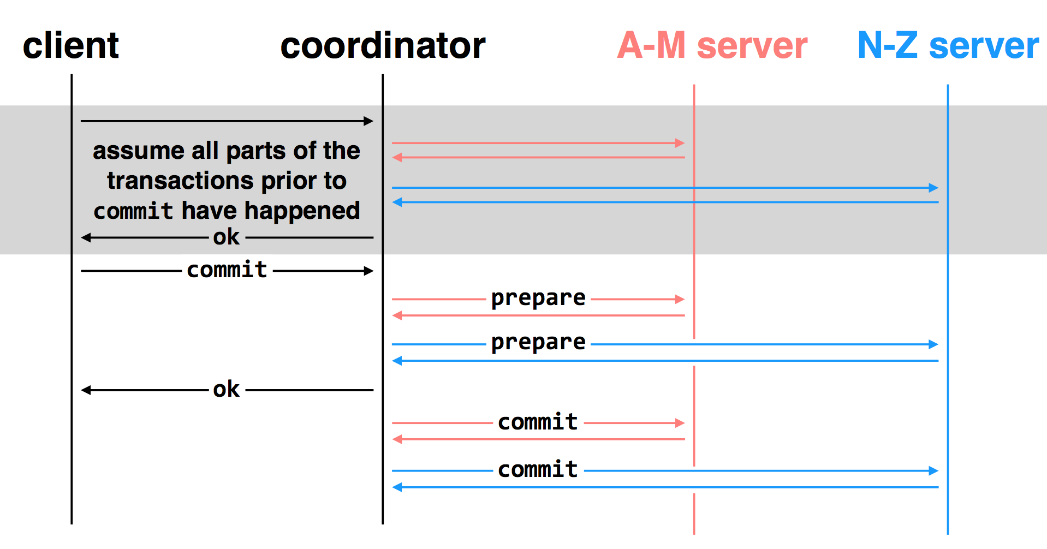
Multi-site transactions under two-phase commit
Idea: the coordinator is responsible for committing all the TXs
How? By sending RPCs or Messages to all the other servers

Slide 17
Challenge: unreliable communications, coordinator & worker

Slide 18
Can we directly use the logging in low TX?
Low-layer TX
Deposit(bank, a, amt):
tx.begin()
bank[a] += amt
tx.commit()
Recall: logging in the previous lecture (e.g., redo-only)
At commit point, append a commit record to the log
Question
Can we directly append the commit record to the lower-level transaction log?
...
log.append("TX {id} commit, ...”).sync()
...
No! The high-level transaction can abort

Slide 19
Logging rule under 2PC
Low-layer transaction
REDO-UNDO log entries: like normal
Commit log entry -> Tentative commit log entry (PREPARED)
Contains a reference to the high-layer TX
In case of failure: ask the high-layer TX’s coordinator to see if I can commit (described later)
High-layer transaction （Responsible for commit of low-layer TXs)
Log the prepare log as a commitment of a high-layer TX
Challenge: the log can become partial
E.g., two workers tentatively committed, can the TX become committed?

Slide 20
Commit decision based on (possibly) partial log
Goal: multi-site atomicity
Principles:
Following the coordinator’s decision
Log sufficient state to tolerate failures (e.g., the coordinator’s decision)
Coordinator (do the decision & maintain the state)
Collect some ABORT or nothing: ABORT or retry
Collect all COMMIT: then COMMIT
Worker passively react to the coordinator’s actions
If no message is sent from the coordinator, just wait
When receive COMMIT: then COMMIT

Slide 21
client
coordinator
A-M server
N-Z server
assume all parts of the transactions prior to
commit have happened
OK
commit
prepare
prepare
OK
commit
commit
two-phase commit: nodes agree that they are ready to commit before committing

Slide 22
client
coordinator
A-M server
N-Z server
OK
commit
X
prepare
timeout; resend
prepare
prepare
OK
commit
commit
failure: lost prepare

Slide 23
client
coordinator
A-M server
N-Z server
OK
commit
prepare
X
timeout; resend
prepare
prepare
OK
failure: lost ACK for prepare

Slide 24

client
coordinator
A-M server
N-Z server
OK
commit
prepare
prepare
abort
abort
failure: worker failure during prepare
coordinator can safely abort transaction, will send explicit abort messages to live workers

Slide 25
client
coordinator
A-M server
N-Z server
OK
commit
prepare
prepare
OK
commit
X
Why? Just wait..
tx?
timeout; resend
commit
commit
failure: lost commit message

Slide 26
client
coordinator
A-M server
N-Z server
OK
commit
prepare
prepare
OK
commit
X
timeout; resend
commit
commit
failure: lost ACK of commit message

Slide 27

client
coordinator
A-M server
N-Z server
OK
commit
prepare
prepare
OK
commit
commit
failure: worker failure during commit
Notes:
workers write PREPARE records once prepared. the recovery process — reading through the log — will indicate which transactions are prepared but not committed

Slide 28

client
coordinator
A-M server
N-Z server
OK
commit
prepare
prepare
OK
commit
commit
tx?
restart
commit
failure: worker failure during commit

Slide 29

client
coordinator
A-M server
N-Z server
OK
commit
prepare
coordinator recovers
abort
abort
failure: coordinator failure during prepare

Slide 30
client
coordinator
A-M server
N-Z server
OK
commit
prepare
prepare
OK
commit
coordinator recovers
commit
commit
failure: coordinator failure during commit
Must log the decision before sending the commit messages

Slide 31
Summary: the logging strategy of high TX
What must be logged?
Whether a TX is committed (or aborted)
Do we have to log the prepare? E.g., whether a TX has acked the prepare
Not necessary. We can just abort upon recovery
Recall: minimize logging is critical to performance
E.g., redo vs. undo-redo logging
Remaining question: what about checkpoint?
Easy to do with the low TX, but needs some additional work on the high TX

Slide 32
What about 2PL or OCC in 2PC?
Nearly identical
2PL: each low-layer TX cannot release its lock until the high-layer TX decides to commit
OCC: the validation & commit phases are done by the coordinator

Slide 33
Summary of 2-phase Commit
Two-phase commit allows us to achieve multi-site atomicity: transaction remains atomic even when they require communication with multiple machines
In two-phase commit, failures prior to the commit point can be aborted. If workers (or the coordinator) fail after the commit point, they recover into the PREPARED state, and complete the transaction
Remaining challenge: availability under coordinator failures
Follow the coordinator’s decision simplifies achieving multi-site atomicity, but what if the coordinator crashes for a long time?
We will see how to make the coordinator available in the next lecture

Slide 34
2PC and CAP

Slide 35
Review of The CAP theorem: 2 out of 3
It is impossible for a distributed computer system to simultaneously provide all three of the following guarantees
Consistency (all nodes see the same data at the same time, e.g., linearizability)
Availability (a guarantee that every request receives a response about whether it succeeded or failed)
Partition tolerance (the system continues to operate despite arbitrary message loss or failure of part of the system)

Slide 36
Review of The CAP theorem: 2 out of 3
It is impossible for a distributed computer system to simultaneously provide all three of the following guarantees
Consistency (all nodes see the same data at the same time)
Availability (a guarantee that every request receives a response about whether it succeeded or failed)
Partition tolerance (the system continues to operate despite arbitrary message loss or failure of part of the system)
Question: which property does 2PC achieve?

Slide 37
2PC only guarantees consistency!
If the coordinator fails before sending the commit
All other transaction must wait until it wakes up
The coordinator logs its decisions to recovery & resume after the failure
If one site fails during the transaction’s execution
All TX requiring this site’s involvement must wait until it wakes up
Only some corner cases can ensure availability or partition tolerant of a TX
By aborting TXs. But it doesn’t help much.
We need replication to achieve high availability!

Slide 38
Review: Two-phase Commit
Two-phase commit allows us to achieve multi-site atomicity: transaction remains atomic even when they require communication with multiple machines
In two-phase commit, failures prior to the commit point can be aborted. If workers (or the coordinator) fail after the commit point, they recover into the PREPARED state, and complete the transaction
Our remaining issue deals with availability and replication: we will replicate data across sites to improve availability, we may also replicate the coordinator, but must deal with keeping multiple copies of the data consistent
We focus on replicating the data. Replicating the coordinator is similar

Slide 39
Replication is everywhere
Recall: GFS in distributed file system
For performance
Higher throughput: replicas can serve concurrently
Lower latency: cache is also a form of replication
For fault tolerance
Maintain availability even if some replicas fail

Slide 40
Replication Consistency
Optimistic Replication (e.g., eventual consistency)
Tolerate inconsistency, and fix things up later
Works well when out-of-sync replicas are acceptable
Pessimistic Replication (e.g., linearizability)
Ensure strong consistency between replicas
Needed when out-of-sync replicas can cause serious problems

Slide 41
Pessimistic replication

Slide 42
Pessimistic Replication
Some applications may prefer not to tolerate inconsistency
E.g., a replicated lock server, or replicated coordinator for 2PC
Better not give out the same lock twice
E.g., Better have a consistent decision about whether transaction commits
Trade-off: stronger consistency with pessimistic replication means:
Lower availability than what you might get with optimistic replication
Performance overhead for waiting syncing w/ other replicas

Slide 43
Goal: Single-copy Consistency (Linearizability)
Problem of optimistic way: replicas get out of sync
One replica writes data, another doesn't see the changes
This behavior was impossible with a single server
Ideal goal: single-copy consistency
Property of the externally-visible behavior of a replicated system
Operations appear to execute as if there's only a single copy of the data
Internally, there may be failures or disagreement, which we have to mask

Slide 44
Replicated State Machines (RSM)

Slide 45
RSM: Replicated State Machines
A general model to simplify consistent replicas of a server:
Start with the same initial state on each server
Provide each replica with the same input operations, in the same order
Ensure all operations are deterministic
E.g., no randomness, no reading of current time, etc.
An RSM with the above three assumptions will ensure single-copy consistency

Slide 46
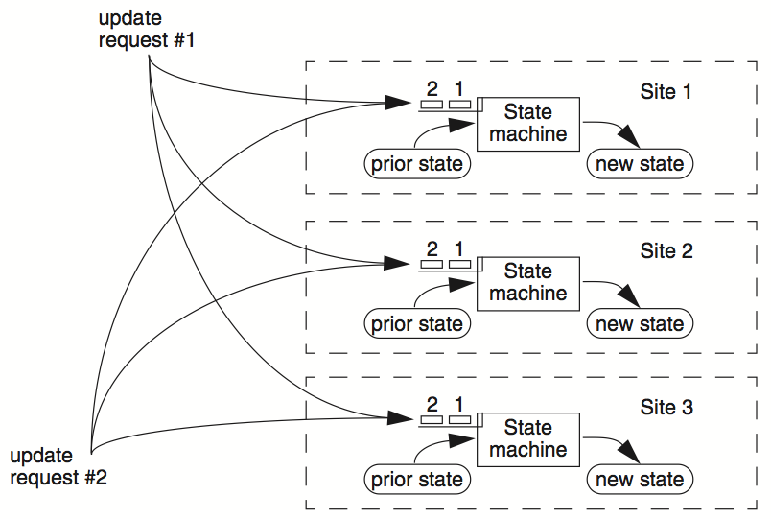
RSM

Slide 47
Inconsistency of Replicas
Problem: replicas can become inconsistent
Issue: clients' requests to different servers can arrive in different order
How do we ensure the servers remain consistent?
Unlike optimistic replication (e.g., eventual consistency), we cannot re-order events later, we must order it right now

Slide 48
Clients
Servers
C₁
S₁
write₁(x)
C₂
S₂
write₂(x)
(replica of S₁)

Slide 49
Clients
Servers
C₁
S₁
write₁(x)
write₂(x)
C₂
S₂
write₁(x)
write₂(x)
(replica of S₁)

Slide 50
Clients
Servers
C₁
S₁
write₂(x)
write₁(x)
C₂
S₂
write₁(x)
write₂(x)
(replica of S₁)
problem: How to ensure the order of operations?

Slide 51
Implementing RSM w/ Primary Backup model
RSMs can use a primary-backup mechanism for replication
Ensure only one server for ordering inputs received from clients
Primary does important stuff
Ensures that it sends all inputs to the backup before ACKing the ops
Chooses an ordering for all operations, so that the primary and backup agree (i.e., one writer)
Decides all non-deterministic values (e.g., random(), time())
It can also recruit new backups after servers fail, but needs to take care (see later)
Primary-backup can trivially support single-copy, like what we did in linearizability, but what is the problem of our previous protocol ?

Slide 52
What if Primary Fails? We want availability
Idea 1: Have human decide when to switch from primary to backup
Not unreasonable for small web services
Idea 2: Coordinator (a computer problem) knows about both primary and backup, and decides which to use automatically
Won't work if using multiple coordinators: the "split brain" syndrome
Multiple coordinators come to independent, and different, conclusions about who is primary when there are network partitions
Idea 3: we have some black magic to select the primary after a previous primary fails ☺ (Will talk about in the later part of this course)

Slide 53
Primary/Backup Model
(primary)
Clients
Coordinator
S₁
C
S₂
if primary fails, C knows about S₂, and switches
(backup)
attempt: coordinators communicate with primary servers, who communicate with backup servers

Slide 54
Primary/Backup Model
(primary)
X
Clients
Coordinator
S₁
C
S₂
if primary fails, C knows about S₂, and switches
(backup)
attempt: coordinators communicate with primary servers, who communicate with backup servers

Slide 55
Multiple Coordinators + the Network = ?
X
Clients
Coordinator
S₁
C
S₂
if primary fails, C knows about S₂, and switches
(primary)
attempt: coordinators communicate with primary servers, who communicate with backup servers

Slide 56
Multiple Coordinators + the Network = Problems
(primary)
C₁
S₁
network partition
C₂
S₂
(backup)
attempt: coordinators communicate with primary servers, who communicate with backup servers

Slide 57
Multiple Coordinators + the Network = Problems
(primary)
C₁
S₁
network partition
C₂
S₂
(backup, but primary for C₂)
C₁ and C₂ are using different primaries;
S₁ and S₂ are no longer consistent

Slide 58
View Server
The view server keeps a table that maintains a sequence of "view"
Each view contains view number, primary server, and backup servers
The view server alerts each server as to whether it's the primary or the backup
Upon receiving any updates, the primary will receive an ACK from the backup before responding to the view server (just as before)
Coordinators make requests to the view server asking who is primary in the background & cache the primary status locally
Coordinators then contact the primary

Slide 59

View Server
(primary)
S₁
S₁
primary
C
primary?
VS
S₁
backup
1: S₁, S₂
S₂
(backup)
Use a view server, which determines which replica is the primary

Slide 60
View Server
To discover failures via heartbeats
Replicas ping to the view server
If view server misses N pings in a row, it deems a server to be dead
Basic failure (actual worker crash):
1. Primary fails; pings cease
2. View server lets S2 know it's primary, and it handles any client requests
Before S2 knowing it's the primary, it will simply reject requests that come directly from the coordinator
3. View server will eventually recruit a new idle server to act as backup

Slide 61
Failure of Primary
(dead)
X
S₁
C
VS
lack of pings indicates to VS that S₁ is down
1: S₁, S₂
S₂
(backup)
Use a view server, which determines which replica is the primary

Slide 62
Failure of Primary
(dead)
X
S₁
C
primary?
VS
S₂
primary
1: S₁, S₂
2: S₂, --
S₂
S₂
(primary)

Slide 63
Network Partitions
Network Partition between VS and S₁
(primary)
S₁
lack of pings indicates to VS that S₁ is down
S₁
C
VS
1: S₁, S₂
S₂
(backup)
But: S₁ is still functioning as a primary, how to prevent split brain?

Slide 64
Rules when Facing Network Partitions
Primary must wait for backups to accept each request
A backup accepts a request if it is in the same view of the primary
Non-primary must reject direct coordinator requests
That's what happened in the earlier failure, in the interim between the failure and S2 hearing that it was primary
Primary must reject forwarded requests
i.e., it won't accept an update from the backup
Primary in view i must have been primary or backup in view i-1
Otherwise, the backup’s data may not catch up

Slide 65
Network Partitions
Network Partition between VS and S₁
(primary)
S₁
S₁
VS makes S₂ primary
C
VS
primary
1: S₁, S₂
2: S₂, --
S₂
rejected by S₂
(backup)
it's okay! S2 will act as backup
(accept updates from S1, reject coordinator's requests)
problem: what happens before S₂ knows it's the primary?

Slide 66
Network Partitions
Network Partition between VS and S₁
rejected by S₁
(Cannot get ACK from S₂)
(primary)
S₁
S₁
C
VS
1: S₁, S₂
2: S₂, --
S₂
(primary)
also okay! S1 won't be able to act as primary
(can't accept client requests because it won't get ACKs from S2)
problem: what happens after S2 knows it's the primary,
but S1 also thinks it is?

Slide 67
Consider S₁ being Partitioned from the VS
Before S2 hears about View #2:
S1 can process operations from coordinators, S2 will accept forwarded requests (because they are all on view #1)
S2 will reject operations from coordinators who have heard about view #2
After S2 hears about View #2:
If S1 receives coordinator requests, it will forward. S2 will reject (not ACK), so S1 can no longer act as primary
S1 will send error to coordinator, coordinator will ask VS for new view, learn about view #2, and coordinator will re-send to S2
The commit point of switch-over:
When S2 hears about View #2

Slide 68
What if view server fails?
(primary)
S₁
S₁
C
X
VS
1: S₁, S₂
S₂
(backup)
problem: what if view server fails?
Now, we need Paxos

