Slide 1


RSM & PAXOS Consistency across multiple machines
SE3331-1 (2024 Fall)
IPADS, Shanghai Jiao Tong University
https://www.sjtu.edu.cn
Credits: Rong Chen@IPADS & Jinyang Li@NYU & John Ousterhout & MIT PDOS

Slide 2
Review: Two-phase Commit
Phase-1: preparation / voting
Lower-layer transactions either aborts or tentatively committed
Higher-layer transaction evaluate lower situation
Phase-2: commitment
If top-layer, then COMMIT or ABORT
If nested itself, then become tentatively committed

Slide 3
Review of The CAP theorem: 2 out of 3
It is impossible for a distributed computer system to simultaneously provide all three of the following guarantees
Consistency (all nodes see the same data at the same time)
Availability (a guarantee that every request receives a response about whether it succeeded or failed)
Partition tolerance (the system continues to operate despite arbitrary message loss or failure of part of the system)

Slide 4
Review: Two-phase Commit
Two-phase commit allows us to achieve multi-site atomicity: transaction remains atomic even when they require communication with multiple machines
In two-phase commit, failures prior to the commit point can be aborted. If workers (or the coordinator) fail after the commit point, they recover into the PREPARED state, and complete the transaction
Our remaining issue deals with availability and replication: we will replicate data across sites to improve availability, we may also replicate the coordinator, but must deal with keeping multiple copies of the data consistent
We focus on replicating the data. Replicating the coordinator is similar

Slide 5
Review: Why Replication?
For performance
Higher throughput: replicas can serve concurrently
Lower latency: cache is also a form of replication
For fault tolerance
Maintain availability even if some replicas fail

Slide 6
Replicated State Machines (RSM)

Slide 7
RSM: Replicated State Machines
A general approach to making consistent replicas of a server:
Start with the same initial state on each server
Provide each replica with the same input operations, in same order
Ensure all operations are deterministic
E.g., no randomness, no reading of current time, etc.
These rules ensure each server will end up in the same final state

Slide 8
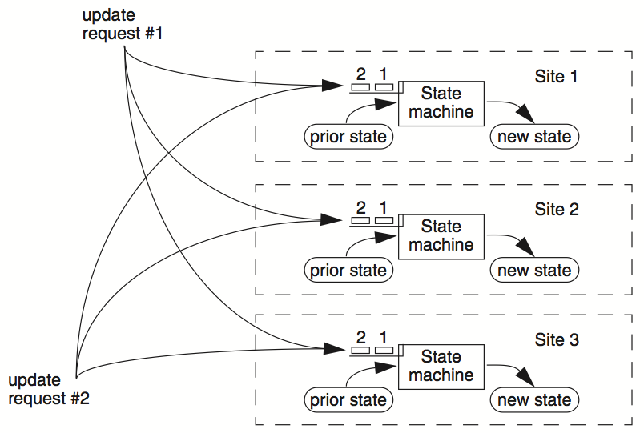
RSM

Slide 9
Clients
Servers
C₁
S₁
write₁(x)
C₂
S₂
write₂(x)
(replica of S₁)

Slide 10
Clients
Servers
C₁
S₁
write₁(x)
write₂(x)
C₂
S₂
write₁(x)
write₂(x)
(replica of S₁)
problem: How to ensure the order of operations?

Slide 11
RSM: Replicated State Machines
RSMs provide single-copy consistency
Operations complete as if there is a single copy of the data
Though internally there are replicas
RSMs can use a primary-backup mechanism for replication
Using view server to ensure only one replica acts as the primary
It can also recruit new backups after servers fail

Slide 12
Primary/Backup Model
Primary does important stuff
Ensures that it sends all updates to the backup before ACKing the coordinator
Chooses an ordering for all operations, so that the primary and backup agree (i.e., one writer)
Decides all non-deterministic values (e.g., random(), time())

Slide 13
What if Primary Fails?
Idea 1: Coordinator knows about both primary and backup, and decides which to use
Won't work: the "split brain" syndrome
Multiple coordinators come to independent, and different, conclusions about who is primary when there are network partitions
Idea 2: Have human decide when to switch from primary to backup
Not unreasonable for small web services

Slide 14
Primary/Backup Model
(primary)
Clients
Coordinator
S₁
C
S₂
if primary fails, C knows about S₂, and switches
(backup)
attempt: coordinators communicate with primary servers, who communicate with backup servers

Slide 15
Primary/Backup Model
(primary)
X
Clients
Coordinator
S₁
C
S₂
if primary fails, C knows about S₂, and switches
(backup)
attempt: coordinators communicate with primary servers, who communicate with backup servers

Slide 16
Multiple Coordinators + the Network = Problems
X
Clients
Coordinator
S₁
C
S₂
if primary fails, C knows about S₂, and switches
(primary)
attempt: coordinators communicate with primary servers, who communicate with backup servers

Slide 17
Multiple Coordinators + the Network = Problems
(primary)
C₁
S₁
network partition
C₂
S₂
(backup)
attempt: coordinators communicate with primary servers, who communicate with backup servers

Slide 18
Multiple Coordinators + the Network = Problems
(primary)
C₁
S₁
network partition
C₂
S₂
(backup, but primary for C₂)
C₁ and C₂ are using different primaries;
S₁ and S₂ are no longer consistent

Slide 19
View Server
The view server keeps a table that maintains a sequence of "view"
Each view contains view number, primary server, and backup servers
The view server alerts each server as to whether it's the primary or the backup
Upon receiving any updates, the primary will receive an ACK from the backup before responding to the view server (just as before)
Coordinators make requests to the view server asking who is primary
Coordinators then contact the primary

Slide 20

View Server
(primary)
S₁
S₁
primary
C
primary?
VS
S₁
backup
1: S₁, S₂
S₂
(backup)
Use a view server, which determines which replica is the primary

Slide 21
View Server
To discover failures
Replicas ping to the view server
If view server misses N pings in a row, it deems a server to be dead
Basic failure (actual worker crash):
1. Primary fails; pings cease
2. View server lets S2 know it's primary, and it handles any client requests
Before S2 knowing it's the primary, it will simply reject requests that come directly from the coordinator
3. View server will eventually recruit a new idle server to act as backup

Slide 22
Failure of Primary
(dead)
X
S₁
C
VS
lack of pings indicates to VS that S₁ is down
1: S₁, S₂
S₂
(backup)
Use a view server, which determines which replica is the primary

Slide 23
Failure of Primary
(dead)
X
S₁
C
primary?
VS
S₂
primary
1: S₁, S₂
2: S₂, --
S₂
S₂
(primary)
before S₂ knows it's primary, it will reject any requests from clients

Slide 24
Rules when Facing Network Partitions
Primary must wait for backup to accept each request
Non-primary must reject direct coordinator requests
That's what happened in the earlier failure, in the interim between the failure and S2 hearing that it was primary
Primary must reject forwarded requests
i.e., it won't accept an update from the backup
Primary in view i must have been primary or backup in view i-1

Slide 25
Network Partitions
Network Partition between VS and S₁
(primary)
S₁
lack of pings indicates to VS that S₁ is down
S₁
C
VS
1: S₁, S₂
S₂
(backup)

Slide 26
Network Partitions
Network Partition between VS and S₁
(primary)
S₁
S₁
VS makes S₂ primary
C
VS
primary
1: S₁, S₂
2: S₂, --
S₂
rejected by S₂
(backup)
it's okay! S2 will act as backup
(accept updates from S1, reject coordinator's requests)
problem: what happens before S₂ knows it's the primary?

Slide 27
Network Partitions
Network Partition between VS and S₁
rejected by S₁
(Cannot get ACK from S₂)
(primary)
S₁
S₁
C
VS
1: S₁, S₂
2: S₂, --
S₂
(primary)
also okay! S1 won't be able to act as primary
(can't accept client requests because it won't get ACKs from S2)
problem: what happens after S2 knows it's the primary,
but S1 also thinks it is?

Slide 28
Consider S₁ being Partitioned from the VS
Before S2 hears about View #2:
S1 can process operations from coordinators, S2 will accept forwarded requests
S2 will reject operations from coordinators who have heard about view #2
After S2 hears about View #2:
If S1 receives coordinator requests, it will forward. S2 will reject (not ACK), so S1 can no longer act as primary
S1 will send error to coordinator, coordinator will ask VS for new view, learn about view #2, and coordinator will re-send to S2
The commit point of switch-over:
When S2 hears about View #2

Slide 29
What if view server fails?
(primary)
S₁
S₁
C
X
VS
1: S₁, S₂
S₂
(backup)
problem: what if view server fails?
Now, we need Paxos

Slide 30
Paxos
Distributed consensus mechanism

Slide 31

Leslie Lamport
http://ipads.se.sjtu.edu.cn/courses/cse-g/2012f/Schedule_files/paxos-simple.pdf

Slide 32
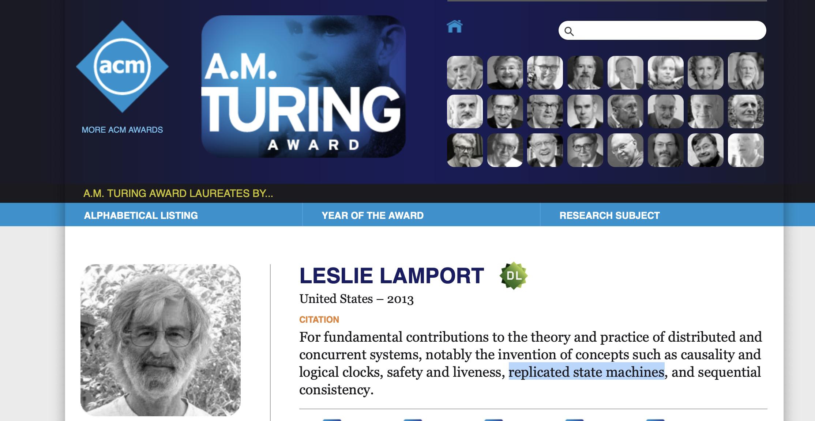
Paxos solves the consensus problem

Slide 33
Single-decree Paxos
Agree on a single value

Slide 34
Paxos' properties: correct + fault-tolerance
No guaranteed termination (i.e., lack of availability guarantee)
Goal: have all acceptors agree to a value V associated with a proposal
Proposer
Proposer
Proposer
E.g., a view
Acceptor
Client
Network
Acceptor
Acceptor
leader
Learner
Learner
quorum
Learner
Paxos: one machine may serve several roles

Slide 35
Paxos Players
Client
makes a request
Proposer
Get a request and run the protocol
Leader = elected Coordinator
Acceptor
Remember the state of the protocol
Quorum = any majority of Acceptors
Learner
When agreement has been reached, a Learner executes the request and/or sends a response back to the Client

Slide 36
General Approach
One proposer decides to be the leader (optional)
Leader proposes a value and solicits acceptance from acceptors (majority)
Leader announces result or try again
What if >1 proposers become leaders simultaneously?
What if there is a network partition?
What if a leader crashes in the middle of solicitation?
What if a leader crashes after deciding but before announcing results?
. . .

Slide 37
Political Science 101
Paxos has rounds; each round has a unique ID (N)
Rounds are asynchronous
Time synchronization not required
If you are in round j and hear a message from round j+1, abort everything and move over to round j+1
Use timeouts; may be pessimistic
Each round itself broken into phases
Phases are also asynchronous

Slide 38
Paxos in Action: Phase 0
Client sends a request to a proposer
Proposer
request
Acceptor
Client
Network
Acceptor
Acceptor
quorum
Learner

Slide 39
Paxos in Action: Phase 1a (Prepare)
Leader creates a proposal N and send to quorum
N is greater than any previous proposal number seen by this proposer
Leader
proposal N
Acceptor
Client
Network
Acceptor
Acceptor
quorum
Learner

Slide 40
Paxos in Action: Phase 1b (Prepare)
Acceptor: if proposal ID > any previous proposal
reply with the highest past proposal number and value
promise to ignore all IDs < N
else ignore (proposal is rejected)
Leader
promise N
Acceptor
Client
Network
Acceptor
Acceptor
quorum
Learner

Slide 41
Paxos in Action: Phase 2a (Accept)
Leader: if receive enough promise
set a value V to the proposal V, if any accepted value returned, replace V with the returned one
send accept request to quorum with the chosen value V
Leader
accept request(N, V)
Acceptor
Client
Network
Acceptor
Acceptor
quorum
Learner
Ignore all proposals < N

Slide 42
Paxos in Action: Phase 2b (Accept)
Acceptor: if the promise still holds
register the value V
send accepted message to Proposer/Learners
else ignore the message
Leader
accepted
Acceptor
Client
Network
Acceptor
Acceptor
accepted
quorum
Learner
Learner
Ignore all proposals < N

Slide 43
Paxos in Action: Phase 3 (Learn)
Learner: responds to Client and/or take action on the request
Leader
Acceptor
Client
Network
Acceptor
Acceptor
quorum
Learner
Learner
Ignore all proposals < N

Slide 44
Paxos Setup
Client
Client
Paxos Node
Paxos Node
Paxos Node
Proposer
Proposer
Proposer
Acceptor
Acceptor
Acceptor
. . .
Learner
Learner
Learner
N_{a}: highest proposal number accepted
V_{a}: accepted value of N_{a}
N_{h}: highest proposal number seen
M_{n}: my proposal number
each round of Paxos, each Node

Slide 45
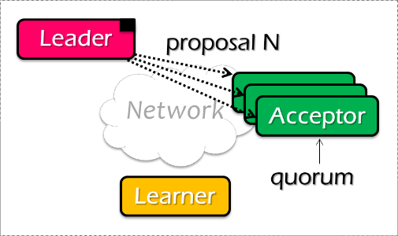
Paxos Pseudo-code
N_{a}: highest proposal number accepted
V_{a}: accepted value of N_{a}
N_{h}: highest proposal number seen
M_{n}: my proposal number
A node decides to be Leader
Leader chooses M_{n} > N_{h}
Leader sends <proposal, M_{n} > to all nodes
Acceptor receives <proposal, N>
if N < N_{h}
reply <promise-reject>
else
N_{h} = N
reply <promise-ok, N_{a}, V_{a}>
Ignore all proposals < N_{h}

Slide 46

Paxos Pseudo-code
N_{a}: highest proposal number accepted
V_{a}: accepted value of N_{a}
N_{h}: highest proposal number seen
M_{n}: my proposal number
If Leader gets promise-ok from a majority
If Leader fails to get majority promise-ok
Upon receiving <accept, N, V>
if V != null, V = the value of the highest N_{a} received
if V = null, then Leader can pick any V
send <accept, M_{n}, V> to all nodes
delay and restart Paxos
if N < N_{h}
reply <accept-reject>
else
N_{a} = N; V_{a} = V; N_{h} = N;
reply <accept-ok>

Slide 47
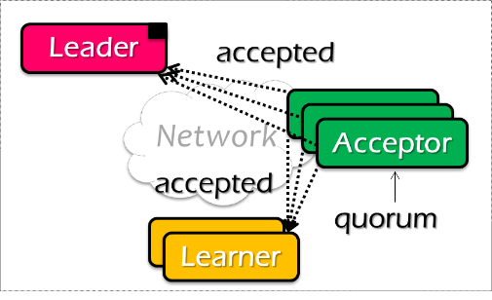
Paxos Pseudo-code
N_{a}: highest proposal number accepted
V_{a}: accepted value of N_{a}
N_{h}: highest proposal number seen
M_{n}: my proposal number
If Leader gets accept-ok from a majority
If Leader fails to get majority accept-ok
send <decide, V_{a}> to all nodes
delay and restart Paxos

Slide 48
Paxos Pseudo-code
N_{a}: highest proposal number accepted
V_{a}: accepted value of N_{a}
N_{h}: highest proposal number seen
M_{n}: my proposal number
N_{a} = V_{a} = null
N_{h} = N0:0
N_{a} = V_{a} = null
N_{h} = N1:0
N_{a} = V_{a} = null
N_{h} = N2:0
M_{n} = N1:1
<proposal, N1:1>
<proposal, N1:1>
N_{h} = N1:1
N_{a} = null
V_{h} = null
N_{h} = N1:1
N_{a} = null
V_{h} = null
<promise, null, null>
<promise, null, null>
<accept, N1:1, V1>
<accept, N1:1, V1>
N_{h} = N1:1
N_{a} = N1:1
V_{h} = V1
N_{h} = N1:1
N_{a} = N1:1
V_{h} = V1
<accept-ok>
<accept-ok>
<decide, V1>
<decide, V1>
Time

Slide 49
Inside of Paxos
N_{a}: highest proposal number accepted
V_{a}: accepted value of N_{a}
N_{h}: highest proposal number seen
M_{n}: my proposal number
Why setups multiple acceptors?
Failure of the single acceptor halts decision
Why not accepts the first proposal and rejects the rest?
Multiple leaders result in no majority accepting
Leader dies
What if more than one leader is active?
Can both leaders see a majority of promises?

Slide 50
Inside of Paxos
N_{a}: highest proposal number accepted
V_{a}: accepted value of N_{a}
N_{h}: highest proposal number seen
M_{n}: my proposal number
When is the value V chosen?
Leader receives a majority <promise, …>
A majority acceptors receive <accept, N, V>
Leader receives a majority <accepted, …>
What if acceptor fails after sending promise?
Must remember N_{h}
What if acceptor fails after receiving accept?
Must remember N_{h} and N_{a} V_{a}
What if leader fails while sending accept?
Propose M_{n} again
Notes:
When is the value V chosen?
- As long as majority send <accepted>, even if the leader has not received that much.
Why not the second case?
- The acceptor may receive the request, than fail
If not remember Nh, than another leader may get the same promise

Slide 51
Question
N_{a}: highest proposal number accepted
V_{a}: accepted value of N_{a}
N_{h}: highest proposal number seen
M_{n}: my proposal number
Suppose that the acceptors are A, B, and C. A and B are also proposers. How does Paxos ensure that the following sequence of events can't happen? What actually happens, and which value is ultimately chosen?
A sends <prepare, 1> requests with proposal number 1, and gets responses from A, C
A sends <accept,1, "foo"> to A and C and gets responses from both. Because a majority accepted, A thinks that "foo" has been chosen. However, A crashes before sending an <accept, 1, "foo"> to B
B sends <prepare, 2> messages with proposal number 2, and gets responses from B and C
B sends <accept, 2, "bar"> messages to B and C and gets responses from both, so B thinks that "bar" has been chosen

Slide 52

Question
N_{a}: highest proposal number accepted
V_{a}: accepted value of N_{a}
N_{h}: highest proposal number seen
M_{n}: my proposal number
A
C
M_{n} = 1
<proposal, 1>
<promise, …>
B
<accept, 1, foo>
M_{n} = 2
<proposal, 2>
<promise, …>
<accept, 2, bar>
Time

Slide 53
Question
N_{a}: highest proposal number accepted
V_{a}: accepted value of N_{a}
N_{h}: highest proposal number seen
M_{n}: my proposal number
A
C
M_{n} = 1
<proposal, 1>
<promise, …>
B
<accept, 1, foo>
M_{n} = 2
<proposal, 2>
<promise, 1, foo>
<accept, 2, foo>
Time

Slide 54
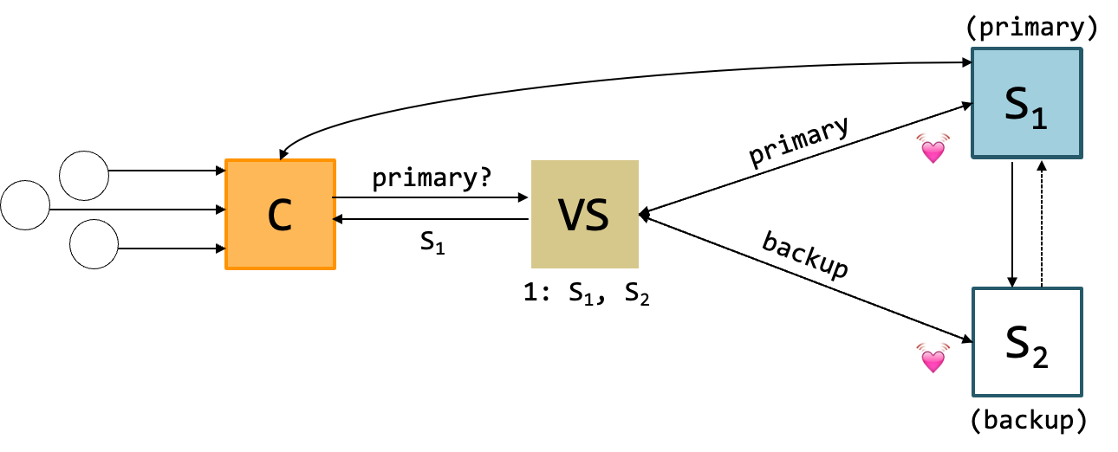
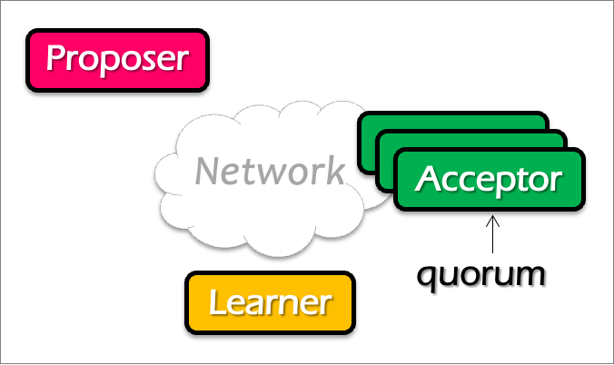
Question
Does single-decree Paxos works fine for our view server example?
When can it go wrong? Accepting a single value is not enough (because view can change)
Notes:
No. What about configuration updates?

Slide 55
Paxos Summary
Paxos allows us to ensure consistent (total) ordering over a set of events in a group of nodes
Events = commands / actions / state updates
Each machine will have the latest state or a previous version of the state

Slide 56
Paxos Summary
To make a change to the system
Tell the proposer(leader) the event
(NOTE: these requests may occur concurrently)
The leader picks its next highest ID and asks proposal to all the acceptors with that ID
When the majority of acceptors accept the proposal, accepted event are sent to learners
The learners do event (e.g., update system state)

Slide 57
Multi-Paxos
Agree on a sequence of values

Slide 58
Multi-Paxos builds on top of the basic Paxos
Useful when agreeing on a sequences of values, examples including:
Views in primary-backup replication
Logs in a replicated state machine
i.e., use Multi-Paxos to implement RSM
The basic approach
Run a separate instance of Paxos to agree on the value of each index
Each instance of Paxos has its own copy of state
highest proposal seen
accepted proposal number
accepted proposal value

Slide 59

Basic Multi-Paxos
Question: what could happen if instance 3 has already gotten a value?
Server simultaneously acts as proposer, acceptor & learner
After receiving a value, the server:
Decides where to place the value (e.g., the latest)
Start Paxos at the decided position
x
0
1
2
Select 3
S1
S1
S2
S2
S3
S3
Prepare
Accept
Notes:
初始状态： 每个server都确认了0，1，2的value

Slide 60
Basic Multi-Paxos is inefficient
With multiple concurrent proposers, conflicts and restarts are likely
higher load → more conflicts
Will be slow (but still correct!)
2 rounds of RPCs for each value chosen
Prepare, Accept
Solution
Select a leader: most of the time, only one server can propose
Batch prepare requests from multiple instances sent from a leader

Slide 61
Multi-paxos uses a distinguished proposer (leader)
Distinguished proposer (aka. leader)
The only one that issues proposals
i.e., reduce proposer conflicts
Client sends the commands only to the leader
Decides the value position
Note, single leader is not necessary for Multi-paxos
E.g., if two or more servers act as proposers at the same time, the protocol still works correctly

Slide 62
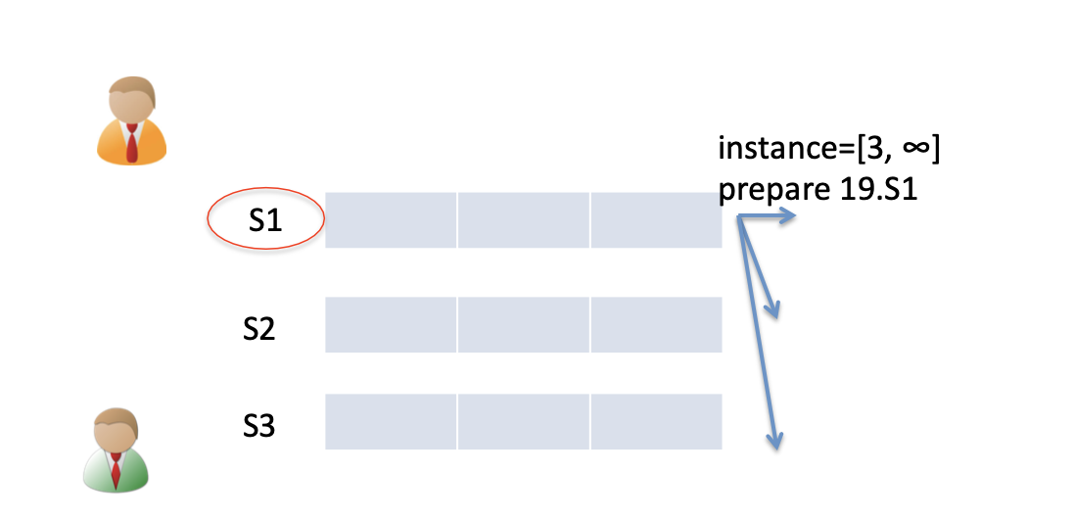
Prepare message batching
All instances of the leader share the same state
i.e., highest proposal number seen
Can use one message to prepare for a batch of instances

Slide 63
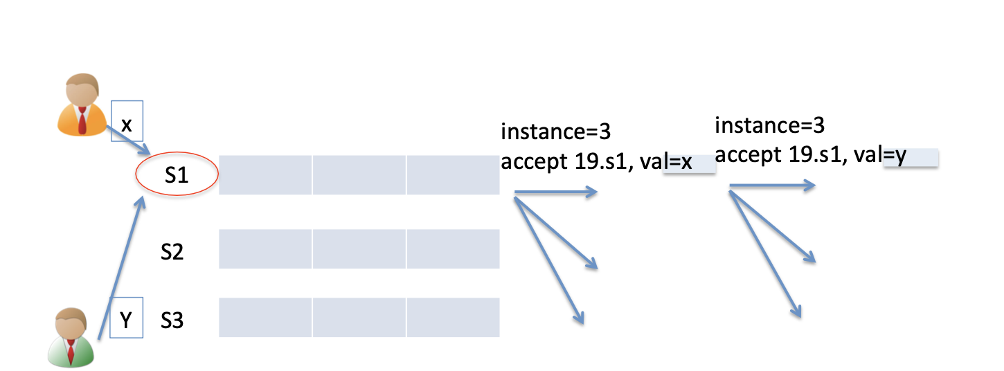
Benefits of batched prepare message
Leader only needs to run the accept phase to replicate an operation during normal time
Notes:
1次prepare，多次accept

Slide 64
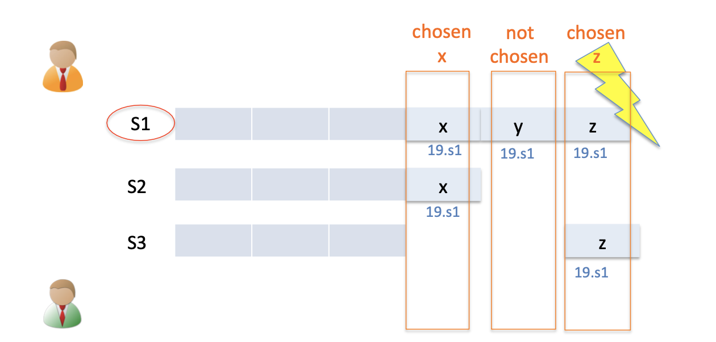
Multi-Paxos can run multiple instances concurrently
i.e., the prefix of chosen values are not contiguous
Need to re-run Paxos after an old leader crashes to fill the holes
If there is no value chosen, use a no-op to fill the hole

Slide 65
Paxos for RSM
Fault-tolerant RSM requires consistent replica view
View: <primary, backups> (e.g., <node1, node2>)
All active nodes must agree on the sequence of view changes
<vid-1, primary, backups>, . . .
Use Paxos to agree on the <primary, backups>
Each Paxos instance agree to a single view
(e.g., <2, Node1, Node2>)
Paxos itself can also be used to implement RSM
E.g., agree on multiple states
Usually inefficient: e.g., two RTTs to agree on a value
Multi-Paxos can batch prepares to improve the performance

