Slide 1


Multi-Paxos, Raft & NewSQL Consistency across replicas
SE3331-1 (2024 Fall)
IPADS, Shanghai Jiao Tong University
https://www.sjtu.edu.cn
Credits: Rong Chen@IPADS & Jinyang Li@NYU & John Ousterhout

Slide 2
Paxos Summary
Paxos allows us to ensure consistent (total) ordering over a set of events in a group of nodes
Events = commands / actions / state updates
Each machine will have the latest state or a previous version of the state

Slide 3
Paxos Setup
Client
Client
Paxos Node
Paxos Node
Paxos Node
Proposer
Proposer
Proposer
Acceptor
Acceptor
Acceptor
. . .
Learner
Learner
Learner
N_{a}: highest proposal number accepted
V_{a}: accepted value of N_{a}
N_{h}: highest proposal number seen
M_{n}: my proposal number
each round of Paxos, each Node

Slide 4
Paxos in Action: Phase 0
Client sends a request to a proposer
Proposer
request
Acceptor
Client
Network
Acceptor
Acceptor
quorum
Learner

Slide 5
Paxos in Action: Phase 1a (Prepare)
Leader creates a proposal N and send to quorum
N is greater than any previous proposal number seen by this proposer
Leader
proposal N
Acceptor
Client
Network
Acceptor
Acceptor
quorum
Learner

Slide 6
Paxos in Action: Phase 1b (Prepare)
Acceptor: if proposal ID > any previous proposal
reply with the highest past proposal number and value
promise to ignore all IDs < N
else ignore (proposal is rejected)
Leader
promise N
Acceptor
Client
Network
Acceptor
Acceptor
quorum
Learner

Slide 7
Paxos in Action: Phase 2a (Accept)
Leader: if receive enough promise
set a value V to the proposal V, if any accepted value returned, replace V with the returned one
send accept request to quorum with the chosen value V
Leader
accept request(N, V)
Acceptor
Client
Network
Acceptor
Acceptor
quorum
Learner
Ignore all proposals < N

Slide 8
Paxos in Action: Phase 2b (Accept)
Acceptor: if the promise still holds
register the value V
send accepted message to Proposer/Learners
else ignore the message
Leader
accepted
Acceptor
Client
Network
Acceptor
Acceptor
accepted
quorum
Learner
Learner
Ignore all proposals < N

Slide 9
Paxos in Action: Phase 3 (Learn)
Learner: responds to Client and/or take action on the request
Leader
Acceptor
Client
Network
Acceptor
Acceptor
quorum
Learner
Learner
Ignore all proposals < N

Slide 10
Multi-Paxos
Agree on a sequence of values

Slide 11
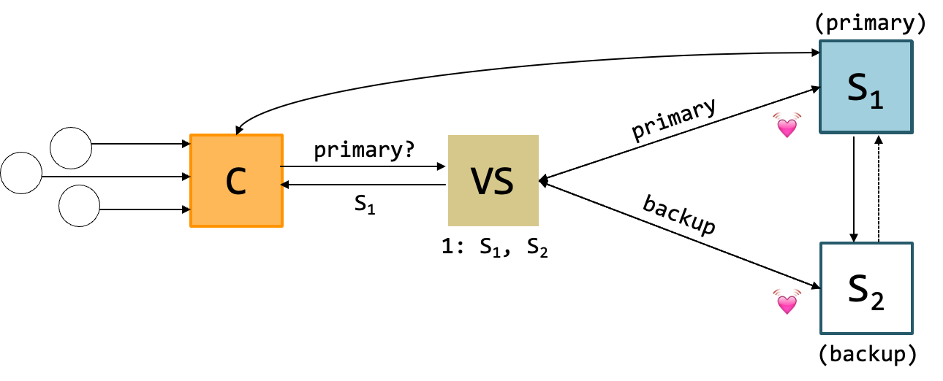
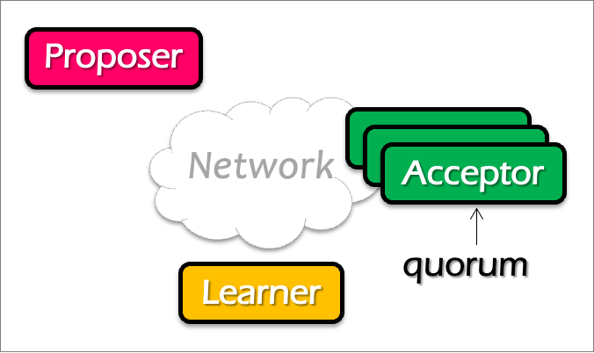
Question
Does single-decree Paxos works fine for our view server example?
When can it go wrong? Accepting a single value is not enough (because view can change)
Notes:
No. What about configuration updates?

Slide 12
Multi-Paxos builds on top of the basic Paxos
Useful when agreeing on a sequences of values, examples including:
Views in primary-backup replication
Logs in a replicated state machine
i.e., use Multi-Paxos to implement RSM
The basic approach
Run a separate instance of Paxos to agree on the value of each index
Each instance of Paxos has its own copy of state
highest proposal seen
accepted proposal number
accepted proposal value

Slide 13
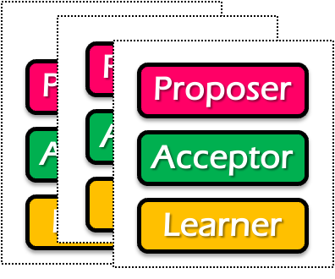
Single-decree Paxos vs. Multi-Paxos
0
1
2
Log
add
cmp
xxx
Client
Client
Proposer
Proposer
Proposer
Acceptor
Acceptor
Acceptor
Learner
Learner
Learner
Single-decree Paxos
Single-decree
instance for 0
Single-decree
instance for 1
Single-decree
instance for 2
Multi-Paxos

Slide 14
Note
The proposers/acceptors can of different instances can be on the same machine

Slide 15
Basic Multi-Paxos
Server simultaneously acts as proposer, acceptor & learner
Example
Suppose we want to append an entry to the log
Client
0
1
2
S1
add
cmp
xxx
S1
S2
add
cmp
xxx
S2
S3
add
cmp
xxx
S3
Notes:
初始状态： 每个server都确认了0，1，2的value

Slide 16
Basic Multi-Paxos
Question: what could happen if instance 3 has already gotten a value?
After receiving the request from a client, the server will
Decide the number of the instance to append (3 in our example)
Do the single-decree paxos to append the log entry to the instance 3
Prepare + Accept
Client
0
1
2
3
Prepare
Accept
S1
add
cmp
xxx
yyy
S1
Select 3
yyy
S2
add
cmp
xxx
yyy
S2
yyy
S3
add
cmp
xxx
yyy
S3

Slide 17
Basic Multi-Paxos
Question: what could happen if instance 3 has already gotten a value?
Example: S1 receives the request, but S2 and S3 has already accepted the value (zzz)
Our single-decree paxos will not choose the value client sent
Client
0
1
2
3
Prepare
Accept
S1
add
cmp
xxx
zzz
S1
Select 3
zzz
add
cmp
xxx
xxx
S2
zzz
S2
zzz
add
cmp
xxx
xxx
S3
zzz
S3
Notes:
初始状态： 每个server都确认了0，1，2的value

Slide 18
Basic Multi-Paxos
In case of conflict, S1 will choose a larger instance (e.g., 4)
And re-run the instance until find the largest available instance
May possible try many times until find an available slot
Client
0
1
2
3
4
Prepare
Accept
Prepare
S1
add
cmp
xxx
zzz
yyy
S1
Select 3
Select 4
zzz
add
cmp
xxx
xxx
yyy
S2
zzz
S2
zzz
add
cmp
xxx
xxx
yyy
S3
zzz
S3

Slide 19
Question
How many RTTs are required for appending a single log entry?

Slide 20
Basic Multi-Paxos is correct but inefficient
2 rounds of RPCs for each value chosen in the optimal case
Prepare, Accept
With multiple concurrent proposers, conflicts and restarts are likely
1. The server may conflict on the position of the new log entry to insert
(our previous example)
2. Even in the same Paxos instance, different proposer may conflict
Only the proposers with the highest number can win
Solution
Select a leader: most of the time, only one server can propose
Batch the prepare requests from multiple instances sent from a leader

Slide 21
Multi-paxos uses a distinguished proposer (leader)
Distinguished proposer (aka. leader)
The only one that issues proposals
i.e., no proposer conflicts in the optimal case
Client only sends the commands to the leader
Decides the value position
Question: is single leader necessary for multi-paxos?
No: if two or more servers act as proposers at the same time, the protocol still works correctly

Slide 22
Not relying a single leader simplifies user implementation
i.e., the user can choose the leader in an arbitrary way
i.e., all the server don't need to agree on the same leader
Performance degradations if multiple leaders exist
We can also use multi-paxos for the leader election ☺
Similar to implementing a view server

Slide 23
Benefits of leader election: prepare message batching
Suppose S1 is the leader (w/o batching)
Paxos 0
Paxos 1
Paxos 2
Paxos 3
N_{a} : S1.19
V_{a} : add
N_{h} : S1.19
M_{h} : S1.19
N_{a} : S1.19
V_{a} : cmp
N_{h} : S1.19
M_{h} : S1.19
N_{a} :
V_{a} :
N_{h} :
M_{h} :
N_{a} :
V_{a} :
N_{h} :
M_{h} :
S1.19
S1.19
xxx
yyy
S1.19
S1.19
S1.19
S1.19
Client
0
1
2
3
xxx, yyy
Prepare
Accept
Prepare
Accept
S1
add
cmp
xxx
yyy
S1
Select
2
Select
3
xxx
yyy
S2
add
cmp
xxx
yyy
S2
xxx
yyy
S3
add
cmp
xxx
yyy
S3

Slide 24
Benefits of leader election: prepare message batching
Suppose S1 is the leader (+ batching)
Paxos 0
Paxos 1
Paxos 2
Paxos 3
N_{a} : S1.19
V_{a} : add
N_{h} : S1.19
M_{h} : S1.19
N_{a} : S1.19
V_{a} : cmp
N_{h} : S1.19
M_{h} : S1.19
N_{a} :
V_{a} :
N_{h} :
M_{h} :
N_{a} :
V_{a} :
N_{h} :
M_{h} :
S1.19
S1.19
xxx
xxx
S1.19
S1.19
S1.19
S1.19
Client
0
1
2
3
xxx, yyy
Prepare 2 + 3
Accept
Accept
Select
3
S1
add
cmp
xxx
yyy
S1
Select
2
xxx
yyy
S2
add
cmp
xxx
yyy
S2
xxx
yyy
S3
add
cmp
xxx
yyy
S3

Slide 25
Problem: hole in the log
0
1
2
3
Suppose S1 is the leader (with batching)
What happens after S1 crashes w/ unfinished entry?
Entry 2 will be empty
Application should fill the gap itself, e.g., w/ no-op
S1
add
cmp
yyy
S2
add
cmp
add
yyy

Slide 26
Summary of Multi-Paxos
Based on single-decree Paxos, realizing RSM
i.e., agree on a sequence of values
Needs non-trivial application efforts to make it work
E.g., should use a leader for better performance
Should fill the holes of the log entries
Paxos itself is not friendly to the programmers

Slide 27
More: Raft replicated log
A different approach for consensus
Paxos’s approach (bottom-up)
solve single-decree consensus first
replicate a sequence of values using single-decree consensus
Raft’s approach (top-down)
directly solve log replication without first solving single-decree consensus

Slide 28






Why learn raft?
Raft is described in a concrete form that favors system design & impl.
Widely implemented and deployed nowadays
Especially for open-source projects

Slide 29

Abstraction of the operations: replicated log
Clients
shl
Consensus Module
State Machine
Consensus Module
State Machine
Consensus Module
State Machine
Servers
Log
Log
Log
add
jmp
mov
shl
add
jmp
mov
shl
add
jmp
mov
shl
Replicated log => replicated state machine
All servers execute same (deterministic) commands in same order
Consensus module ensures proper logs are the same!

Slide 30
Raft’s high-level approach: problem decomposition
Leader election
Select one server as the leader
Detect crashes, choose new leader
Log replication (normal operation)
Leader accepts commands from clients, append to its log
Leader replicates its log to other servers (overwrites inconsistencies)
Safety
Keep logs consistent
Only servers with up-to-date logs can become the leader
Notes:
Safety can violate if a replication happens partially

Slide 31
Raft server states
Server
Server
Network
At any time, each server is either:
Leader: handles all client interactions, log replication
Invariant achieved: At most 1 viable leader at a time
Follower: passive (only responds to incoming RPCs)
Candidate: used to elect a new leader
Normal workloads
1 server is the leader, others are the followers
Server
Servers communicates
w/ RPCs
Timeout, start election
Receive acks from majority of servers
Start
Follower
Candidate
Leader
Discover current server or
w/ high term
Discover server w/ high term

Slide 32
Raft server states
Leader is active
Receive client requests, replicate logs to the followers
Followers are passive
Only respond to the requests from leaders or candidates
Passive
Activate
Follower
Candidate
Leader

Slide 33
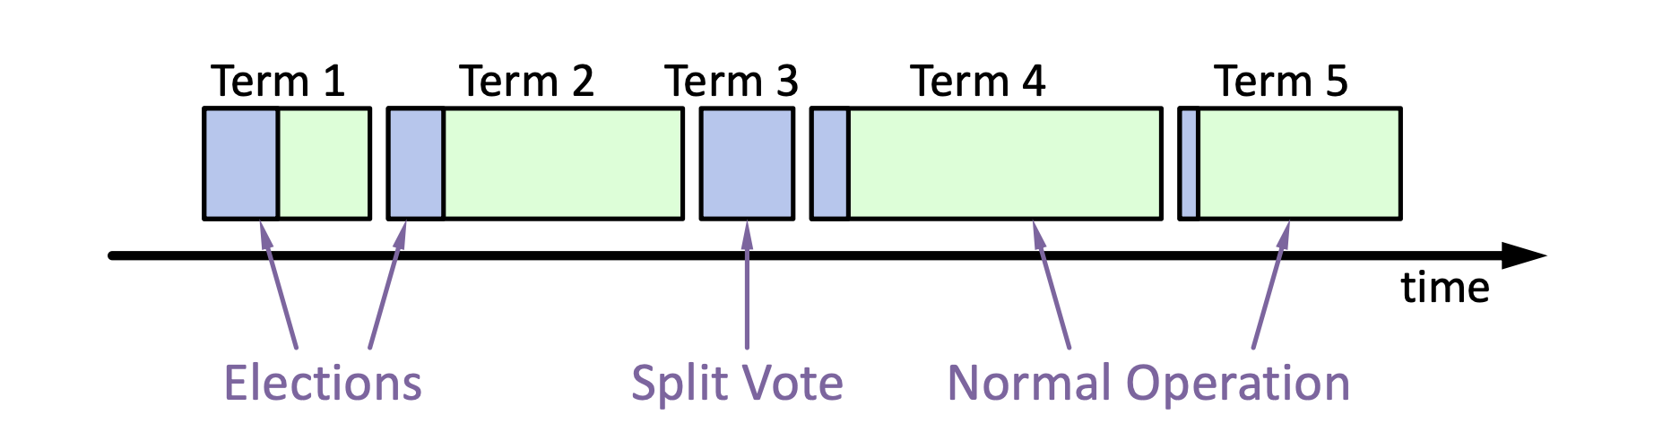
Raft basics: terms for one leader
Raft divides time into terms (with arbitrary length):
Each term starts with an election
Ends with one leader or no leader
At most one leader per term
Each leader is uniquely associated with a term
Key role: identify obsolete information
Notes:
obsolete information, e.g., as stale leaders
Servers exchange with others to build the global view of the terms

Slide 34
Raft server state switch: Heartbeats & Timeouts
Servers start as followers (except one server is assigned as the leader)
Followers expect to receive RPCs from leaders or candidates
Leaders must send heartbeats to maintain authority in a term
If election timeout elapses with no RPCs:
Follower assumes leader has crashed
Follower starts new election
Timeouts typically 100-500ms
Notes:
election timeout: a follower receives no communication over a period of time

Slide 35
Election Basics
Change its state to the candidate state
Increment current term
Vote for itself
Send RequestVote RPCs to all other servers, retry until either
Receive votes from majority of servers ➔ Become the leader!
Receiver RPC from a valid leader ➔ Return to the follower
Question: what is the condition for the follower to vote?
The leader’s term >= self’s term & never vote before
Notes:
Use heartbeat to announce the leadership.

Slide 36
Election Basics
Change its state to the candidate state
Increment current term
Vote for itself
Send RequestVote RPCs to all other servers, retry until either
Receive votes from majority of servers ➔ Become the leader!
Receiver RPC from a valid leader ➔ Return to the follower
No one wins election (timeouts on the election) ➔ Increase the term, start the new election

Slide 37
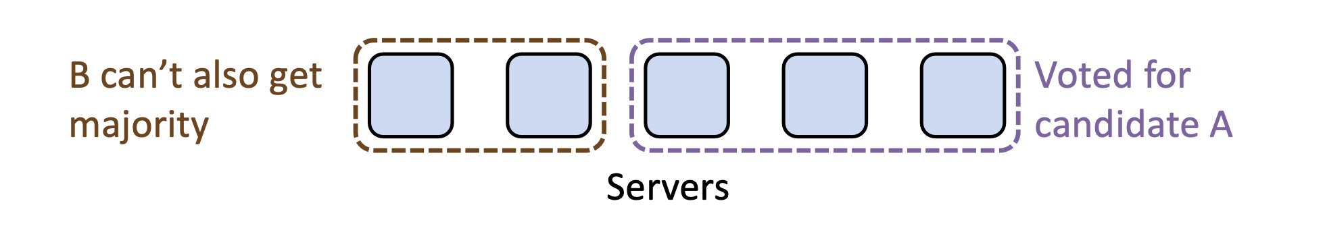
Election requirements: safety
At most one winner per term
How to achieve so? Each server only gives one vote per term (persist on disk)
Majority ensures at least one leader (similar to phase #1 of Paxos)
Question
Can different candidates exist in the same term?
Yes. Each server should keep a VotedFor variable to ensure it only gives vote to one candidate.

Slide 38
Election requirements: liveness
Some candidate must eventually win
If multiple candidates started, non will win
Raft’s key idea: use random timeout before the retry
So as to minimize the possibilities that two candidates retry at the same time
Typically, it randomly selects a time between [T, 2T]
T is the election timeout
Notes:
Liveness: something good happens

Slide 39
Persistent state of each server so far
currentTerm
Latest term server has seen (initialized to 0 on first boot)
votedFor
Candidate Id that received vote in current term (or null if none)

Slide 40
Basic request vote RPC so far
Invoked by candidates to gather votes.
Arguments:
candidateId candidate requesting vote
term candidate's term
Results:
term currentTerm, for candidate to update itself
voteGranted true means candidate received vote
Implementation:
If term > currentTerm, currentTerm ← term (step down if leader or candidate)
If term == currentTerm, votedFor is null or candidateId, grant vote and reset election timeout

Slide 41
Raft’s high-level approach: problem decomposition
Leader election
Select one server as the leader
Detect crashes, choose new leader
Log replication (normal operation)
Leader accepts commands from clients, append to its log
Leader replicates its log to other servers (overwrites inconsistencies)
Safety
Keep logs consistent
Only servers with up-to-date logs can become the leader
Notes:
Safety can violate if a replication happens partially

Slide 42
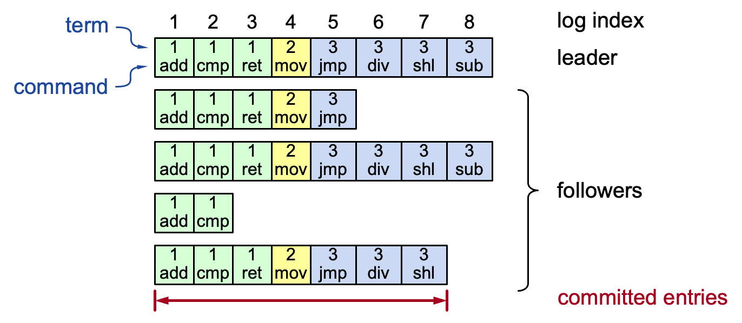
Log structure
Log entry = index, term, command
Stored on the disk to tolerate failures
A log is committed if it can be safely applied to the state machine
i.e., eventually stored on all the servers with the same value
Not all entries are committed (will talk about later)
Notes:
Interesting things:
Each log entry store an additional term
Commit: can safely execute on the state machine, no others will execute a different command

Slide 43
Persistent state of each server + log
currentTerm
Latest term server has seen (initialized to 0 on first boot)
votedFor
Candidate Id that received vote in current term (or null if none)
Log[]
Log entries

Slide 44
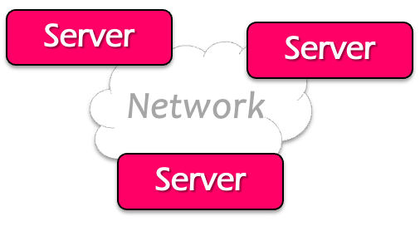

Normal operations to update the log
Command
Client
Send command to the leader
Leader appends command to its log
Leader sends AppendEntries RPCs to followers
Once a new entry (of log) committed:
Leader passes command to its state machine, returns results to client
Notifies followers of committed entries, Follower pass committed commands to their state machines

Slide 45
Normal operations to update the log
Command
Client
Crashed/slow followers?
Leader retries RPCs until they succeed (at least once)
Performance is optimal in the common case (like Multi-Paxos w/ batching)
One successful RPC to any majority of servers

Slide 46

Challenge: crash can cause log to inconsistencies
Case: an old leader is unaware of the new leader due to network partition
Yet, it can still get commands from the clients
Leader
Leader
Leader (stale)
S1
1
add
1
cmp
S1
1
add
1
cmp
S1
1
add
1
cmp
1
xxx
S2
1
add
1
cmp
S2
1
add
1
cmp
S2
1
add
1
cmp
2
shi
S3
1
add
1
cmp
S3
1
add
1
cmp
S3
1
add
1
cmp
2
shi
2
ret
Leader (term2)
Term 1
Term 2

Slide 47
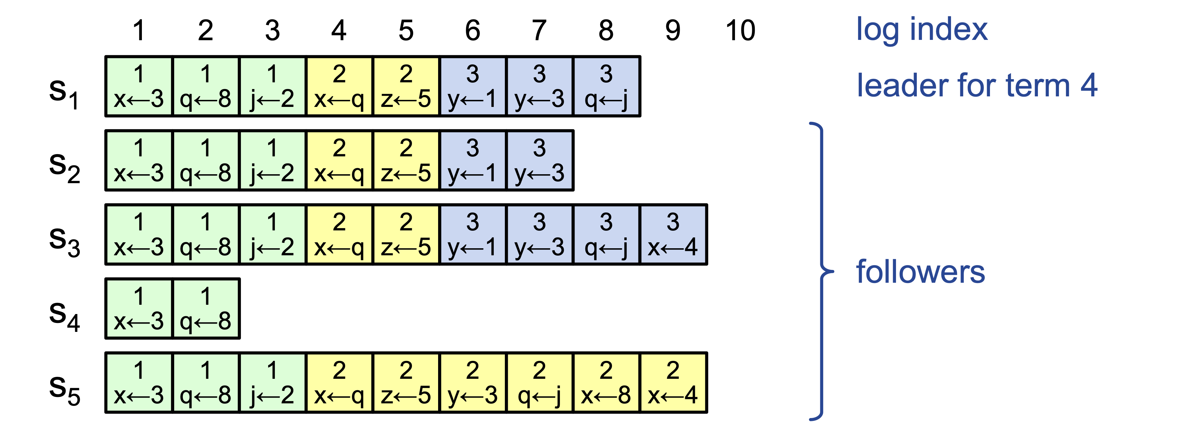
Challenge: crash can cause log to inconsistencies
Raft minimizes special code for repairing inconsistencies
Leaders assume its log is correct
Normal operation will repair all inconsistencies
Notes:
Case in the example: server 4 crashes
Server 5 becomes the leader for 2, and keeps appending the logs from the clients

Slide 48
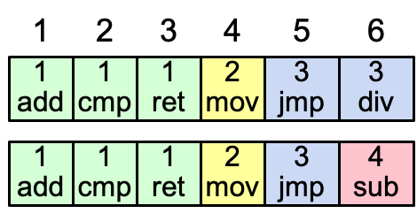
Consistency of the log
Question: how to achieve this property?
High level of coherency between logs maintained by the raft:
If log entries on different servers have the same index & term
They store the same command
The logs are identical in all preceding entries
If a given entry is committed, all preceding entries are also committed
Note that not all log entries are committed
Notes:
Commands must be equal: issued by the same leader

Slide 49
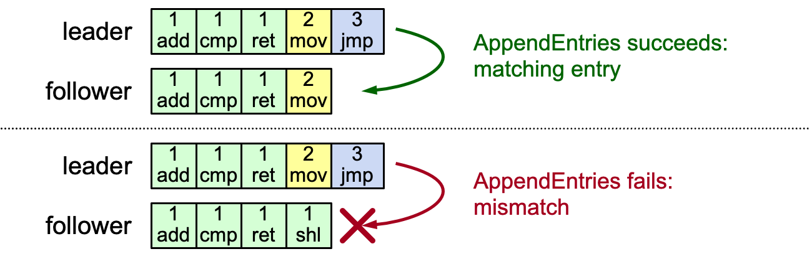
AppendEntries consistency checks
Implements an induction step, ensures coherency
Each RPC argument contains
Append index, term, term of entry preceding new ones
Follower checks whether it has the matching entry
Otherwise, it rejects the request

Slide 50
Why can rejection happens? Leader changes
At beginning of new leader’s term:
Old leader may have left entries partially replicated
No special steps by new leader: just start normal operation, w/ different position
Leader’s log is “the truth”
Will eventually make follower’s logs identical to leader’s (overwrite the divergent log entries with the leader’s ones)
The rejected entries will be overwritten by the leader’s log entry

Slide 51
Handle rejections
Implements an induction step, ensures coherency
In this example, the leader will
Overwrite index 4 with [2 mov] with AppendEntries
Then append entry [3 jmp] to the end of the follower
Fail to append case
Overwrite mismatched entry
L
1
add
1
cmp
1
ret
2
mov
3
jmp
L
1
add
1
cmp
1
ret
2
mov
3
jmp
1
ret
2
mov
F
1
add
1
cmp
1
ret
1
shi
F
1
add
1
cmp
1
shi
L
1
add
1
cmp
1
ret
2
mov
3
jmp
Append the new entry
1
ret
2
mov
3
jmp
F
1
add
1
cmp
1
shi

Slide 52
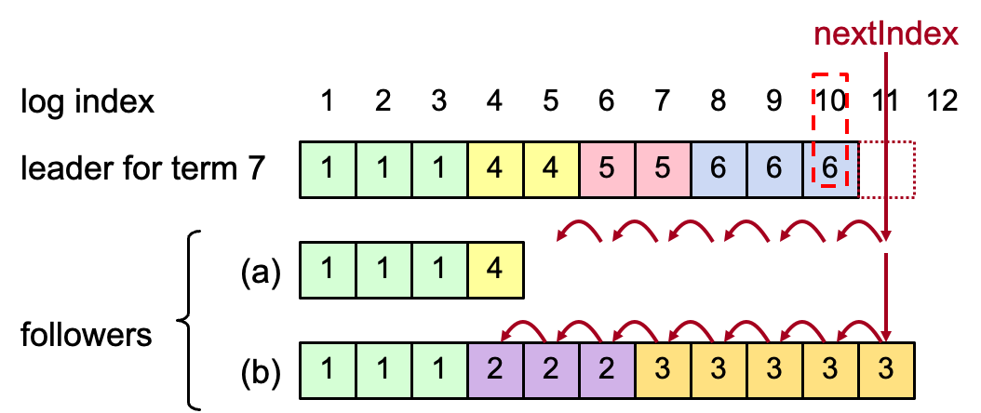
More on Repairing Follower Logs
New leader must make follower logs consistent with its own
Delete extraneous entries
Fill in missing entries
Leader keeps nextIndex for each follower:
Index of next log entry to send to that follower
Initialized to (1 + leader’s last index)

Slide 53
AppendEntries RPC (Simplified)
Invoked by leader to replicate log entries and discover inconsistencies
Arguments:
term leader's term
prevLogIndex index of log entry immediately preceding new ones
prevLogTerm term of prevLogIndex entry
entries[] log entries to store (empty for heartbeat)
Results:
success true if follower contained entry matching prevLogIndex and prevLogTerm
Notes:
省去了heartbeat和commmit

Slide 54
AppendEntries RPC (Simplified)
Implementation:
Return false if term < currentTerm
If term > currentTerm, currentTerm ← term
If candidate or leader, step down
Reset election timeout
Return failure if log doesn’t contain an entry at prevLogIndex whose term matches prevLogTerm
If existing entries conflict with new entries, delete all existing entries starting with first conflicting entry
Append any new entries not already in the log
Notes:
Step down: 一个旧的leader变回follower

Slide 55
Overwrite can ensure consistency.
But it makes a subtle issue:
When can we commit a log entry? (Since an appended log entry may be overwritten)

Slide 56
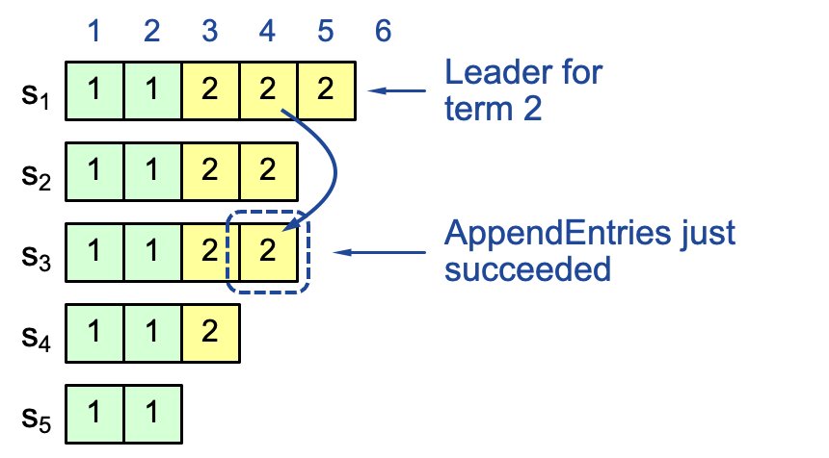
Intuitive result: replicating on a majority
If the log is replicated on a majority of servers, it can be applied on the state machine
Not always true on raft so far
Question: can index 4 be overwritten after appending to S3?

Slide 57
Case study: raft overwriting
Question: can index 4
be overwritten?
Leader S1
Leader ?
Leader S3
1
2
3
4
1
2
3
4
1
2
3
4
s₁
1
1
2
2
2
s₁
1
1
2
2
2
1
1
2
2
s₂
1
1
2
2
s₂
1
1
2
2
s₂
1
1
2
2
s₃
1
1
2
2
s₃
1
1
2
2
3
s₃
1
1
2
s₄
1
1
2
s₄
1
1
2
s₄
1
1
s₅
1
1
s₅
1
1
s₅
Term 2
S1 crashes
Term 3

Slide 58
Case study: raft overwriting
Question: can index 4
be overwritten?
Leader S1
Leader ?
Leader S5
1
2
3
4
1
2
3
4
1
2
3
4
s₁
1
1
2
2
2
s₁
1
1
2
2
2
1
1
2
2
1
1
2
2
s₂
1
1
2
2
s₂
3
s₂
1
1
2
2
1
1
2
2
s₃
1
1
2
2
s₃
3
s₃
1
1
3
1
1
2
s₄
1
1
2
s₄
2
s₄
1
1
s₅
1
1
s₅
1
1
3
3
s₅
Term 2
S1 crashes
Term 3

Slide 59
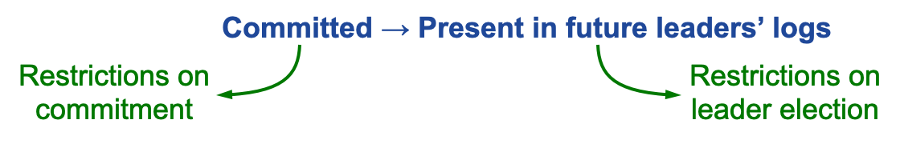
Safety requirement of the commit entry
Once a log entry has been applied to a state machine, no other state machine must apply a different value for that log entry
Raft safety property:
If a leader has decided that a log entry is committed, that entry will be present in the logs of all future leaders (no overwritten)
This guarantees the safety requirement
Leaders never overwrite entries in their logs
Only entries in the leader’s log can be committed
Entries must be committed before applying to state machine
Notes:
1. Delay the commitment of an entry until we know it is committed

Slide 60
Goal: if a log entry has been replicated to majority followers, it is likely to commit, i.e., be in the log of future leaders

Slide 61
Committing Entry from the Current Term
Case #1/2: Leader decides entry in current term is committed
Question: how to prevent index 4 from being overwritten? Prevent S4 or S5 from becoming the leader

Slide 62
Picking the Best Leader
During elections, choose candidate with log most likely to contain all committed entries
Candidates include log info in RequestVote RPCs (index & term of last log entry)
Voting server V denies vote if its log is “more complete”: (lastTermV > lastTermC) || (lastTermV == lastTermC) && (lastIndexV > lastIndexC)
Leader will have “most complete” log among electing majority

Slide 63
Comparing the best leader
(lastTermV > lastTermC) || (lastTermV == lastTermC) && (lastIndexV > lastIndexC)
s₁
1
1
2
2
2
s₁
1
1
2
2
2
s₂
1
1
2
2
s₂
1
1
2
3
Question: which log is longer?
S1 & S2, respectively

Slide 64
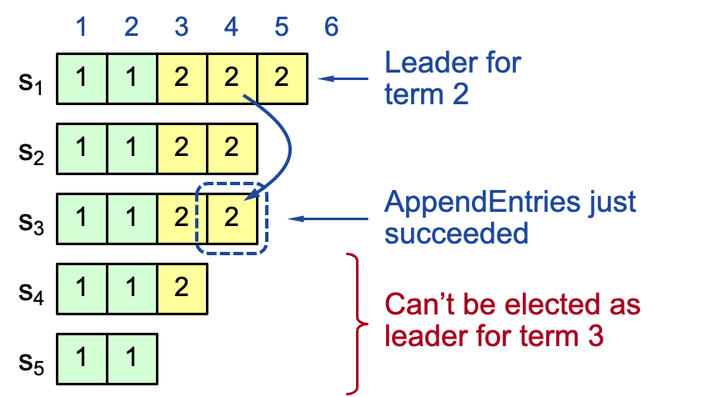
Committing Entry from the Current Term
Leader decides entry in current term is committed
Safe: leader for term 3 must contain entry 4

Slide 65
Complete picture of request vote RPC
Invoked by candidates to gather votes.
Arguments:
candidateId candidate requesting vote
term candidate's term
lastLogIndex index of candidate's last log entry
lastLogTerm term of candidate's last log entry
Results:
term currentTerm, for candidate to update itself
voteGranted true means candidate received vote
Implementation:
If term > currentTerm, currentTerm ← term (step down if leader or candidate)
If term == currentTerm, votedFor is null or candidateId, and candidate's log is at least as complete as local log, grant vote and reset election timeout

Slide 66
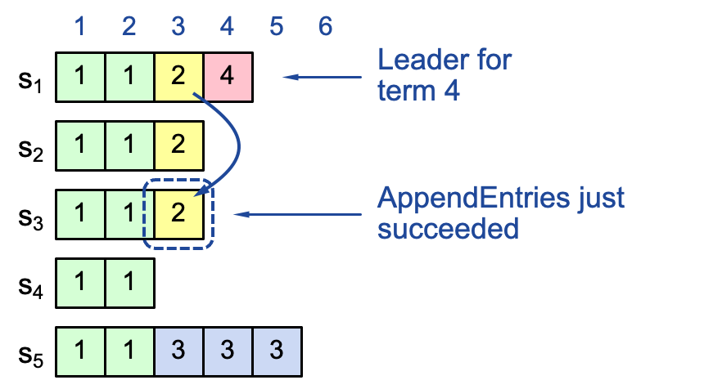
Commit rule for raft so far
If the log entry from the leader term is replicated to a majority of followers
Then we can treat it as committed
The later leader must contain the entry
But, what about replicating log entry from a previous term?
The previous term’s entry may fail to reach a majority

Slide 67
Case study: a majority replicated entry can be overwritten
Leader S1
Leader S5
Question: who can become the leader for term 3?
1
2
3
1
2
1
2
3
4
s₁
1
1
2
s₁
1
1
2
1
1
2
s₂
1
1
2
s₂
1
1
2
1
1
2
s₃
1
1
s₃
1
1
1
1
s₄
1
1
s₄
1
1
1
1
s₅
1
1
s₅
1
1
1
1
3
3
Partition again!!!
Term 2
Partition!!!
Term 3

Slide 68
Case study: a majority replicated entry can be overwritten
Leader S5
Leader S1
Leader S5
Leader S5
1
2
3
4
1
2
3
4
5
1
2
3
4
1
1
2
1
1
2
4
1
1
2
1
1
2
1
1
2
1
1
2
3
1
1
1
1
2
1
1
2
1
1
3
1
1
1
1
1
1
1
1
3
1
1
3
3
1
1
3
3
3
1
1
3
3
3
1
1
3
3
3
Partition on term 3!!
Term 4
S1 crashes
Term 5

Slide 69
Committing Entry from Earlier Term
Case #2/2: Leader is trying to finish committing entry from an earlier term
Entry 3 not safely committed:
S5 can still be elected as leader for term 5
If elected, it will overwrite entry 3 on S1, S2 and S3 (recall our previous example)

Slide 70
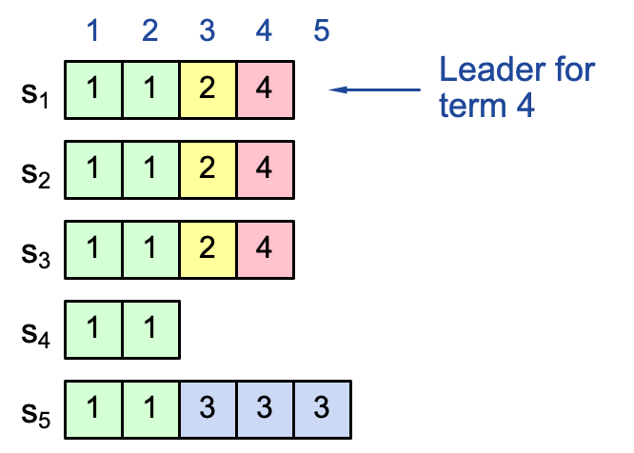
Commit rules
For a leader to decide an (previous) entry is committed:
Must be stored on a majority of servers
At least one new entry from leader’s term must also be stored on majority of servers
This is because once entry 4 committed:
s₅ cannot be elected leader for term 5
Entries 3 and 4 both safe
Combination of election rules & commitment rules makes Raft safe

Slide 71
Neutralizing Old Leaders
Deposed leader may not be dead:
Temporarily disconnected from network
Other servers elect a new leader
Old leader becomes reconnected, attempts to commit log entries
Terms used to detect stale leaders (and candidates)
Every RPC contains term of the sender
If sender’s term is older, RPC is rejected, sender reverts to follower and updates its term
If receiver’s term is older, it reverts to follower, updates its term, then processes RPC normally

Slide 72
Case study:
Google Spanner

Slide 73








Problems faced by large-scale company
Large-scale dataset
Facebook has more than 1 billion of images uploaded weekly, Baidu stores tens of billions of web pages
Question: how to store such a large dataset?
Solution: sharding
Each shard is stored in an LSM storage
Server0
User data
Data center
Server1

Slide 74
How to shard?
A topic orthogonal to the design of Spanner
Possible way:
Hashing, node id = hash(key) % num_of_nodes
Range partitioning
E.g., coordinators record that 0-100 keys are at shard 0, etc.
A good partition need to consider many factors, e.g.,
Reduce cross shard transaction (no 2PC for multi-site transactions)
Why? Shards are likely to span across two machines, which needs two-phase-commit for execution
We will not focus sharding in this lecture

Slide 75
Problems faced by large-scale company
Fault tolerance
Large-scale companies are built over large-scale datacenters (>10K servers)
Machine failures are particular common in large-scale datacenters
“Suppose a cluster has ultra-reliable server nodes with a stellar mean time between failures (MTBF) of 30 years (10,000 days)—a cluster of 10,000 servers will see an average of one server failure per day. ”

Slide 76
Problems faced by large-scale company
Fault tolerance
Large-scale companies are built over large-scale datacenters (>10K servers)
Machine failures are particular common in large-scale datacenters
Solution: replication
Each shard is replicated on multiple servers
Server0
Data center
Replication factor = 2
Server1

Slide 77
Question: is a replication factor of 2 ok?
Ok means can achieve single-copy consistency
Whether OK depends on the scenarios (& setup)
Under primary-backup replication, it is ok
We have a view server
Under Paxos & Raft, it’s not! (no majority)
Server0
Data center
Replication factor = 2
Server1
77

Slide 78

Replications causes consistency problem
Could not achieve single-copy consistency if allow client arbitrary reads/writes
E.g., consistency among replicas
?
Request 1
Request 2
Bob.acct = 100$
Print(bob.acct)
Rep 0
Bob.acct=0$
Bob.acct=100$
Bob.acct=100$
Time
Rep1
Bob.acct=0$
Bob.acct=0$
Bob.acct=0$

Slide 79
Solution: Paxos for single-copy consistency
Spanner uses Multi-Paxos w/ leaders to abstract the replicated shard
On the developer’s perspective, a shard w/ replication can be viewed as a single-shard (single-copy consistency)
Physical view
Logical view
+Paxos

Slide 80

Geo-replicated datacenters
e.g., The locations of Alibaba datacenters
What can go wrong if we only replicate the data only within one datacenter?
Source: https://www.alibabacloud.com/zh/global-locations

Slide 81
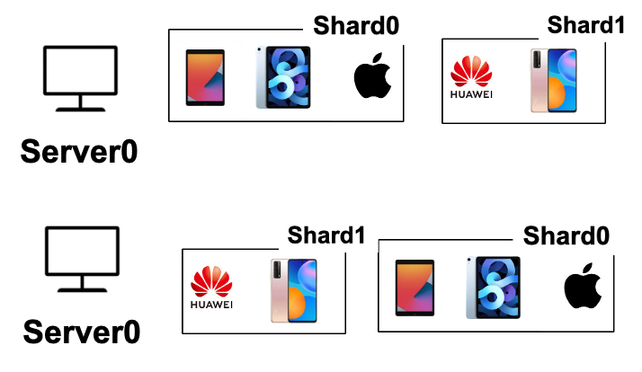


Replication within a DC is insufficient
A single datacenter (DC) can fail due to natural disasters
A DC cannot serve requests well (in low latency) across the planet
DC1
Users from china will suffer from long latency
DC in the US

Slide 82
Spanner further replicates the data across datacenters
Data sharded & replicated over many machines & datacenters
Tolerate machine failures across datacenters & lower request latency
User data
Server1
Server1
DC0
DC1
Data centers
Users from china can query DC at china for lower latency
Notes:
How to shard? Range or hash

Slide 83
2-phase commit + 2-phase locking
With Paxos, multiple replicas of a shard can be viewed as one
E.g., the developer sees an X, but X is actually replicated multiple times
However, Paxos is insufficient
A user request (TX) can touch multiple shards
How to coordinate these accesses?
Using two-phase locking for before-or-after atomicity & two-phase commit for multi-site atomicity
x
tx.begin()
x = x + 1
y = y + 1
tx.end()
Y

Slide 84
Big picture of Spanner
How to scale to a larger dataset?
Shading
How to tolerate failures across machines & datacenters?
Replicated state machine w/ Paxos
Can also use raft (e.g., TiDB)
How to execute read-write transaction to ensure before-or-after atomicity and multi-site atomicity?
2PL + 2PC

Slide 85

Execution flow of read-write transaction(TX)
Read-write TX:
A TX that both reads and writes the data
tx.begin()
x = x + 1
y = y + 1
tx.end()
Client
Notes:
// what is a read-write TX
Execution flow

Slide 86
Execution flow of read-write transaction(TX)
Read-write TX:
A TX that both reads and writes the data
tx.begin()
x = x + 1
y = y + 1
tx.end()
DC0
DC1
x
X
Y
Y
Client
X,Y are sharded on two servers
Notes:
// what is a read-write TX
Execution flow

Slide 87
Execution flow of read-write transaction(TX)
Each shard is replicated
The run PAXOS to behavior as a single (logical) shard
tx.begin()
x = x + 1
y = y + 1
tx.end()
DC0
DC1
x
X
PAXOS
Y
Y
PAXOS
Client
Each shard is replicated on multiple DCs
Notes:
Omit local replication for simplicity

Slide 88
Execution flow of read-write transaction(TX)
Each shard is replicated w/ PAXOS
A replica is selected leader to simplify execution (no Raft introduced then)
tx.begin()
x = x + 1
y = y + 1
tx.end()
DC0
DC1
x
X
PAXOS
Y
Y
PAXOS
Leader will execute request
Start a PAXOS proposal accordingly
Client
Notes:
The leader is responsible for accepting client requests and managing the replication of the log to other servers. The data flows only in one direction: from leader to other servers.
Proposal & learned
Similar to the RAFT leader
Hold the latest value (w/o failure)

Slide 89
Execution flow of read-write transaction(TX)
Spanner uses standard 2PC & 2PL for executing read-write TX
Two-phase commit & two-phase locking
tx.begin()
x = x + 1
y = y + 1
tx.end()
DC0
DC1
x
X
PAXOS
Y
Y
PAXOS
Client

Slide 90

Execution flow of read-write transaction(TX)
Upon read, the leader will return the latest value of data
Also hold the lock on it (2PL)
tx.begin()
x = x + 1
y = y + 1
tx.end()
DC0
DC1
x
X
PAXOS
Rx
Y
Y
PAXOS
Client sends each read to Paxos leader of relevant shard, lock the record & do the latest value
Client
Notes:
Read locks are not replicated via Paxos, so leader failure -> abort.

Slide 91
Execution flow of read-write transaction(TX)
The write will be buffered at local client
They will be written back via 2PC at the TX’s commit time
tx.begin()
x = x + 1
y = y + 1
tx.end()
DC0
DC1
write
x
X
PAXOS
Rx
Y
Y
PAXOS
Client

Slide 92
Execution flow of read-write transaction(TX)
Commit will use 2PC to write all the updates back
It will choose a shard leader as the coordinator leader
tx.begin()
x = x + 1
y = y + 1
tx.end()
DC0
DC1
x
X
PAXOS
Rx
Y
Y
PAXOS
Client
Ry

Slide 93
Execution flow of read-write transaction(TX)
The coordinator uses its PAXOS group to replicate the TX states
Why? Otherwise, the 2PC may fail if the coordinator crashes!
tx.begin()
x = x + 1
y = y + 1
tx.end()
DC0
DC1
x
X
PAXOS
Rx
Y
Y
PAXOS
Select as coordinator leader
w/ the update values
Client
Ry
Notes:
为什么client单独没法做leader？

Slide 94
Execution flow of read-write transaction(TX)
The coordinator leader will send the update values to the host shard leader
And each shard leader execute the prepare with PAXOS (including locking the write-set, and replicates its locks to tolerate leader failure)
tx.begin()
x = x + 1
y = y + 1
tx.end()
DC0
DC1
x
X
PAXOS
Prepare
Rx
Y
Y
PAXOS
Prepare
Select as coordinator leader
w/ the update values
Client
Ry

Slide 95
Execution flow of read-write transaction(TX)
If all shard leader returns the Yes to the coordinator leader
The coordinator log the commit decision (via PAXOS) & commit others
tx.begin()
x = x + 1
y = y + 1
tx.end()
DC0
DC1
x
Commit
X
PAXOS
Commit
Rx
Y
Y
PAXOS
Commit
Select as coordinator leader
w/ the update values
Yes: logs a commit record through Paxos
Client
Ry
Commit: update & release the lock
Notes:
Lock is replicated only at the prepare phase to improve the performance

Slide 96
Read-write TX: put it all together
Multiple physical nodes
backed by PAXOS
$$2PL+2PC+Paxos$$
$$Client$$
$$read x$$
$$Shard0$$
$$Shard1$$
$$read y$$
Client Buffer:
$$x=x+1$$
$$y=y −1$$
$$Coordiantor$$
$$perpare$$
$$perpared$$
$$perpare$$
$$perpared$$
$$commit$$
$$applied$$
$$commit$$
$$applied$$
Note: we skip the network RTTs of Paxos
Notes:
Prepared: get the lock, record 2PC state and Paxos state
Applied: release the lock
Prepare + Commit both require Paxos

Slide 97
Read-write TX: put it together
Spanner’s read-write TX gives a strong abstraction to the user
A single-thread “machine” that never fails (even tolerate natural disasters)
The “machine” has “unlimited” storage capacity
As long as the machines in the datacenters have enough capacity to store the data
But, what are the costs?

Slide 98
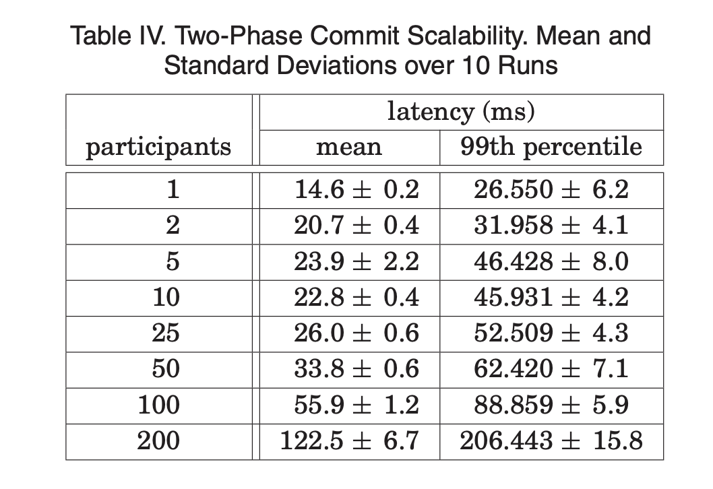
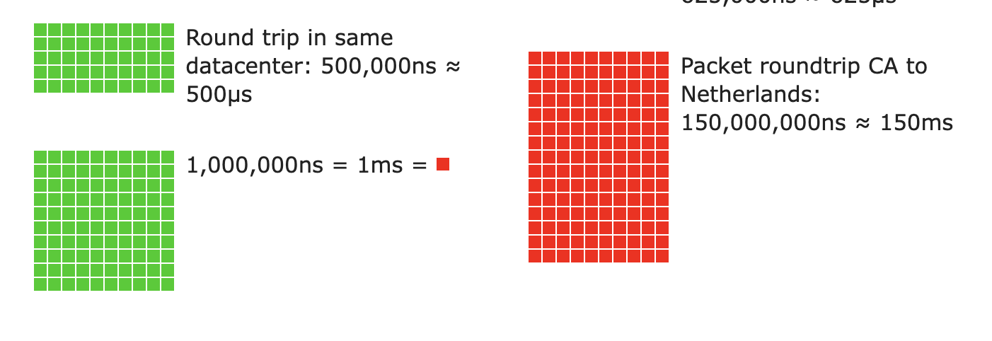
Read-write TX of Spanner so far
Techniques: 2PL & 2PC & Paxos
Not optimized– Spanner finds writes are infrequent at Google
Maybe slow: many messages sent between machines
Also, across datacenters!
Source: https://colin-scott.github.io/personal_website/research/interactive_latency.html
Notes:
Data: 2PC through three regions

Slide 99

What about read-only TX?
Problem: read-only TXs are massive faced by Google
Each read-only TX may touch many datasets
Drawbacks of 2PL (in read-only TX)
Acquire the read lock is costly (need Paxos!)
May possibly lock the items very long
Solution
Multi-version concurrency control

Slide 100
Review: Multi-version Concurrency Control
Each data item has multiple versions
When accessing different versions of data, probably no conflict!
Key (high-level) idea
Writes don’t overwrite the original data
Instead, writes install new versions of data
Reads read from a "snapshot" of data
Benefits: no lock or validation during TX’s execution
bankA: 100, ver: 12, pre:xx
bankA: 100
bankA: 200, ver: 10, pre:xx
Single-version
Multi-version

Slide 101
Review: Snapshot Isolation
A popular multi-version concurrency control (MVCC) scheme
Transactions will get start and commit timestamp
Use start timestamp to find the snapshot to read
Use commit timestamp to install new versions
Transactions:
WRITEs a local buffer (similar to OCC)
READs a “snapshot” of entire data image
COMMIT only if no write-write conflict
Install new versions of data
Drawback: no serializability guarantee !

Slide 102
Idea: use 2PL for read-write TX, MVCC for read-only TX
Still use 2PL for read-write TX
The execution of TXs is always serializable!
Use MVCC to execute the read-only TX
Read-only TX no-longer to acquire locks for the execution
Note that similar technique also applies to OCC
E.g., we can use OCC for read-write TX, and MVCC for read-only TX
Out of the scope of this course

Slide 103
MV-2PL: read-write TX (w/o 2PC & Paxos for simplicity)
Acquire all the write locks, T is assigned a commit timestamp T.cts
update all data within T.wset with T.cts
Release all the locks
T
START
READ(X)
WRITE(X)
COMMIT
Time
Acquire the read lock on X and then
read the latest
Writes locally

Slide 104
MV-2PL: read-only TX
T is assigned a start timestamp T.sts
T
START
READ(X)
Time
T reads the biggest version of X(i), such that X(i).cts <= T.sts

Slide 105
Question remains: how do we assign the time to TXs?
Timestamp of start & commit should be assigned in an increasing order
E.g., global counters with atomic increase
Note: read-only TX does not necessary increase the time
Example implementation: global counter (on a single machine)
u64 global_time; // initial 0
tx_begin(tx) { // read-only
tx.global_time = READ(global_time);
...
}
tx_commit(tx) { // read-write
tx.commit_time = FAA(global_time);
...
}
struct TX {
u64 start_time;
u64 commit_time;
set<...> write_set;
...
}

Slide 106
Question: is global counter suitable for Spanner’s use case?

Slide 107


Global time is inefficient for Spanner’s use case
Performance overhead
1. Extra latency overhead
2. Scalability bottleneck
Question: can we avoid reading the global counter?
Possible when considering the read-only TX
User data
Global counter
DC0
DC1
2
1

Slide 108
Cache the time locally to avoid querying the global counter
Observation: the read-only TX can read a stale timestamp
E.g., not reading from the latest global counter
Still correct
TX only reads from a (possible) stale snapshot

Slide 109
Cache global counter to avoid frequently reads
Cache start timestamp for the read-only TX
The read-only TX no longer needs to do the FAA all the time
Note: here FAA maybe implemented as a remote procedure call
To the server that stores the global counter
u64 global_time; // initial 0
tx_begin(tx) {
if cached_time.is_none():
tx.cached_time= Some(READ(global_time));
tx.start_time = tx.cached_time.unwrap()
...
}
struct TX {
u64 start_time;
u64 commit_time;
Option<u64> cached_time;
set<...> write_set;
...
}

Slide 110
Example revisit w/ cached time
T1:
Print(A+B)
T2:
B = 2
A = 3
Global counter
(initial 2)
T1 (cached_time = 0)
T2
A: A₁ A₀
B: B₁ B₀
3
Commit_time = FAA(G)
Write(B, B₃)
A: A₃ A₁ A₀
Write(A, A₃)
B: B₃ B₁ B₀
Start_time = 0 // cached
Read(A) = A₀
A: A₃ A₁ A₀
Read(B) = B₀
B: B₃ B₁ B₀

Slide 111


Drawbacks of cached time
No freshness guarantees
i.e., no external consistency
External consistency is the most desirable for the programmer
Simplified definition: If T1 completes before T2 starts, T2 must see T1's writes.
Should be 100!
T1
T2
Bob.acct = 100$
Print(bob.acct)
Time
John
Bob

Slide 112
Drawbacks of cached time
No freshness guarantees
i.e., no external consistency
Read-write TX still need to acquire the global counter
Extra latency to communicate with the server that stores the global time
Possible performance bottleneck

Slide 113
Challenge of the timing in MVCC so far
Time needs synchronization for external consistency (strict serializability)
If a read-write TX has decided to commit, then a read-only TX starts, then must ensure:
Time_{read-only} >= Time_{read-write}
Global counter trivially satisfies this requirement
But requires a centralized time server not suitable for geo-replicated databases
Can we use the physical clock of the machines?
No. Different machines’ time are different

Slide 114
Observation: we may not get the accurate physical time, but we can get an accurate bound

Slide 115
TrueTime API of Spanner
TrueTime returns a time interval instead of a single point of time
The interval is a bound. i.e., the time of the time server must be in this bound
The interval is the physical time. i.e., familiar to the user
struct timeval {
time_t tv_sec; suseconds_t tv_usec;
};
struct time_interval{
timeval Lower;
timeval Upper;
};
int gettimeofday(struct timeval *restrict tv, ...)
int get_truetime(time_interval *interval);
// Server timeval must be in [L,U]
Linux Time API
TrueTime API (Simplified)

Slide 116
Power of TrueTime API (return [L,U])
Used to implement external consistency
If a read-write TX has decided to commit, then:
Time_{read-only} >= Time_{read-write}
How to achieve this?
Commit wait for read-write TX: after acquire the commit timestamp, the coordinator wait until (U – L) and uses U as Time_{read-write}
Commit wait done, time server.time1 >= U1
Real time
Read-write TX
L1
U1
1
Get commit time-stamp

Slide 117
Power of TrueTime API (return [L,U])
Used to implement external consistency
If a read-write TX has decided to commit, then:
Time_{read-only} >= Time_{read-write}
How to achieve this?
Commit wait for read-write TX: after acquire the commit timestamp, the coordinator wait until (U – L) and U1 as Time_{read-write}
For read-only TX, simply uses U as the read timestamp
Commit wait done, server.time1 >= U1
Real time
Read-write TX
L1
U1
1
2
Read-only TX
L2
U2
Get read timestamp, U2 >= server.time2

Slide 118
Power of TrueTime API (return [L,U])
Used to implement external consistency
If a read-write TX has decided to commit, then:
Time_{read-only} >= Time_{read-write}
Correctness
Time_{read-write} (U1) < server.time1 < server.time2 < U2 (Time_{read-only})
Commit wait done, server.time1 >= U1
Real time
Read-write TX
L1
U1
1
2
Read-only TX
L2
U2
Get read timestamp, U2 >= server.time2

Slide 119
How to achieve the bound of TrueTime?

Slide 120
TrueTime: how to achieve the bound?
The bound is relative to the time servers as the ground truth
For simplicity, we first assume there is only one time server
Spanner adopts a variant of Marzullo’s algorithm^{[1]}
Similar to NTP, sync w/ the time server to calculate the bound
Even single time server will not become the bottleneck: syncing is not on the critical path of the TX’s execution
[1] Maintaining the Time in a Distributed System
Notes:
Ma zu luo

Slide 121
TrueTime: how to calculate the bound?
Problem statement
If the local clock of client is T, what is the time interval of the time server?
High-level idea: send RPC to the server for the query as the measurements!
But unlike NTP, we don’t adjust local time according to tsrv
We calculate the future time based on tsrv
Sync
What is the time?
tsrv
T_{s}
Time
Server
T
Client
tbegin
tend
get_truetime()

Slide 122
TrueTime: how to calculate the bound?
Simplification: first assuming server advances in the same speed as clients
Since we know the tsrv, the key question is how to calculate the interval
Question
How do we calculate the interval based on tsrv, tbegin & tend?
Sync
tsrv
T_{s}
Time
Server
Interval
T
Client
tbegin
tend
get_truetime()

Slide 123
TrueTime: how to calculate the bound?
Since we know the tsrv, the key question is how to calculate the interval
Interval >= T – tend
Interval <= T – tbegin
T_{s} = tsrv + Interval
T – tend + tsrv <= T_{s} <= T – tbegin + tsrv (based on our simplification)
Question: what if there is a drift between client & server?
Sync
tsrv
T_{s}
Time
Server
Interval
T
Client
tbegin
tend

Slide 124
TrueTime: how to calculate the bound?
Simplification: assuming server advances in the same speed as clients
T – tend + tsrv <= T_{s} <= T – tbegin + tsrv (based on our simplification)
Assume a fixed ε drift rate between client & server
After t time, the drift between client & server is (1 + ε) or (1 - ε)
Spanner assumes a fixed as 200us / second
Then the interval is regulated as
(T – tend) * (1 - ε) + tsrv <= T_{s} <= (T – tbegin) * (1 + ε) + tsrv
Done
Solution: regulate with the drift rate
L
U
Notes:
Time server 挂了怎么办

Slide 125
Commit wait revisited
Used to implement external consistency
If a read-write TX has decided to commit, then:
Time_{read-only} >= Time_{read-write}
How to achieve this?
Commit wait for read-write TX: after acquire the commit timestamp, the coordinator wait until (U – L)(1 + ε) and uses U as Time_{read-write}
Commit wait done, server.time1 >= U1
Real time
Read-write TX
L1
U1
1
Note! During the interval, the TX is not committed
Get commit time-stamp

Slide 126
TrueTime adopts multiple time servers
timemaster
timemaster
timemaster
Question: how to keep different timemasters sync?
timemaster
timemaster
timemaster
Client
Datacenter 1
Datacenter 2
…
Datacenter n
Called timemaster (☺) in Spanner
Notes:
Marzullo’s algorithm also considers the case of multiple time servers

Slide 127
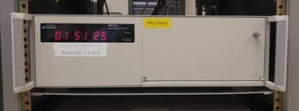
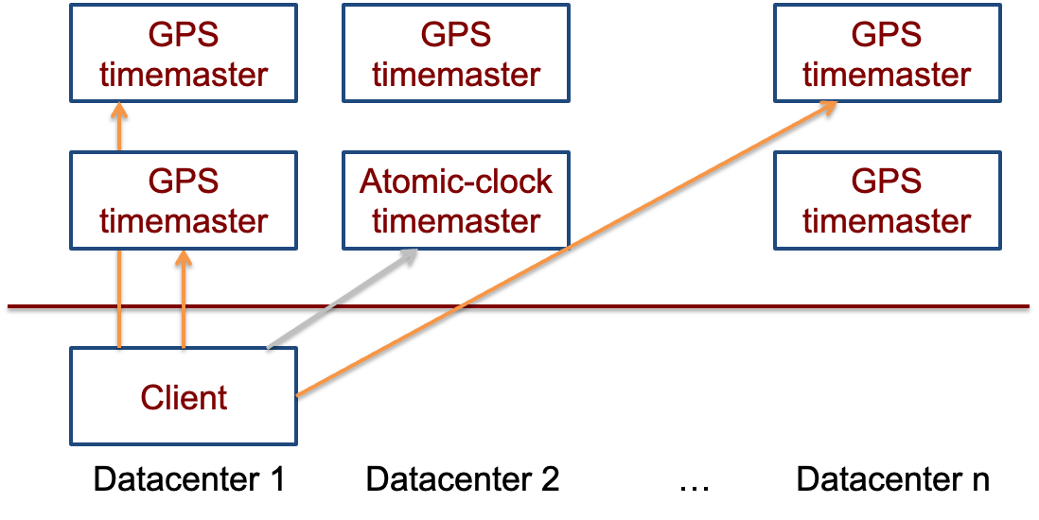
TrueTime adopts multiple time servers
Time servers are backed by GPS & atomic clocks
High-precision clocks
E.g., 1 second drift after 20,000,000 year (vs. 200us per second of CPU)
Atomic clocks are synchronized with each other

Slide 128
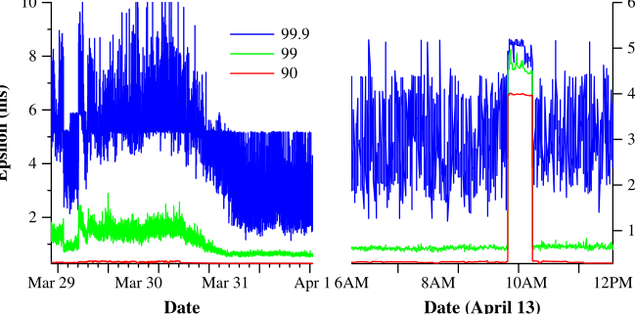
Final takeaway of TrueTime: Network-Induced Uncertainty
Interval of T
[ (T – tend) * (1 - ε) + tsrv, (T – tbegin) * (1 + ε) + tsrv]
tsrv – tbegin is rougly estimated as the network delay
Can have spikes if timemasters are out of services
Maintain 2 timemasters
tsrv
Server
delay
Client
tbegin
tend

Slide 129
Summary
Reify clock uncertainty in time APIs
Known unknowns are better than unknown unknowns
Rethink algorithms (TX’s concurrency control) to make use of uncertainty
Stronger semantics are achievable
Greater scale != weaker semantics

