Slide 1

Internship Presentation
AI Chatbot Development
Neural Network-Based Conversational Agent
Presented by: Nour Yaakoub

Slide 2
1 . Company Overview
2 . Project Overview
Agenda:
3 . Technical Implementation
4 . Technical Demonstration

Slide 3

1 . Company Overview
Belmont Web, established in 2018, is a leading digital agency in Tunisia specializing in web development and digital solutions. During my internship, I worked in their IT department, which is responsible for developing and maintaining web applications and implementing digital solutions for clients.

Slide 4
2 . Project Overview
The main objective of my internship was to develop an intelligent chatbot system that could understand and respond to customer queries naturally. This project aimed to automate customer service while maintaining a personal touch in communications.

Slide 5
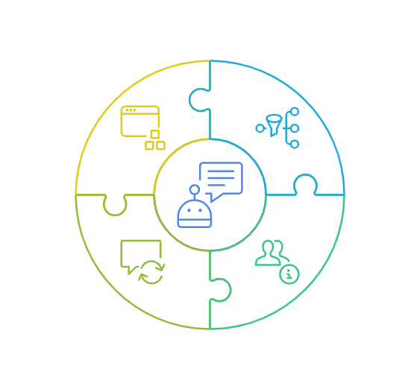
The technical requirements were challenging: we needed a system that could:
Integrate with
Web Interfaces
Understand Natural Language Input
Generate Real-time Responses
Classify User Intentions

Slide 6



3 . Technical Implementation
Neural Network Model
Backend Development
Frontend Integration
Our chatbot uses a PyTorch neural network with three layer. It converts user messages into vectors, processes them, and identifies intents to select a relevant response.
I implemented a Flask server that handles frontend requests, communicates with the neural network, processes responses, and manages API endpoints.
The frontend, built with HTML, CSS, and JavaScript, features a responsive chat interface that updates in real-time, maintains chat history,

Slide 7
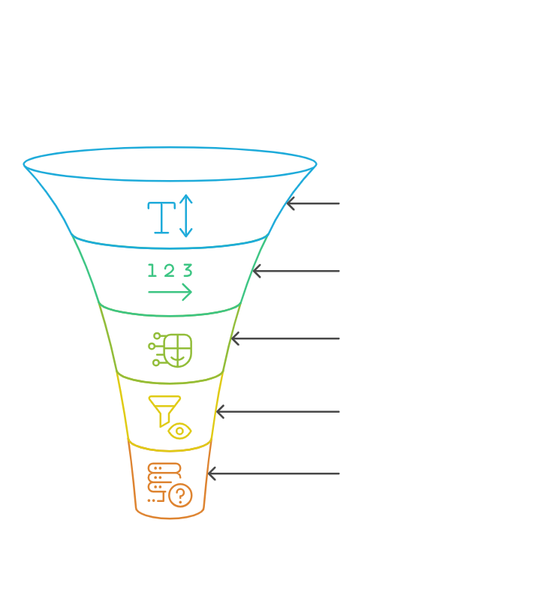
Neural Network Model
Incoming Message
The model consists of three main layers:
Tokenization
An input layer that processes text using bag-of-words vectorization
A hidden layer with 8 neurons for pattern recognition
An output layer that classifies user intents
Vectorization
Neural Processing
The model works by converting user messages into numerical vectors, which are then processed to identify the user's intent.
Intent Identification
Response Selection

Slide 8
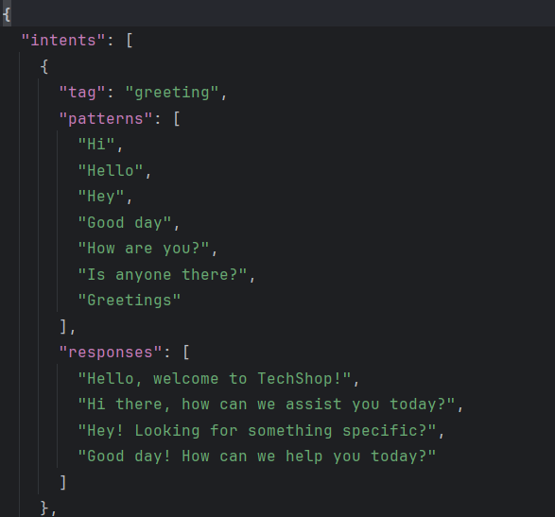
1.aDatabase:
A chatbot framework needs a structure in which conversational intents are defined. One clean way to do this is with a JSON file.
Each conversational intent contains:
a tag (a unique name)
patterns (sentence patterns for our neural network text classifier)
responses (one will be used as a response)

Slide 9
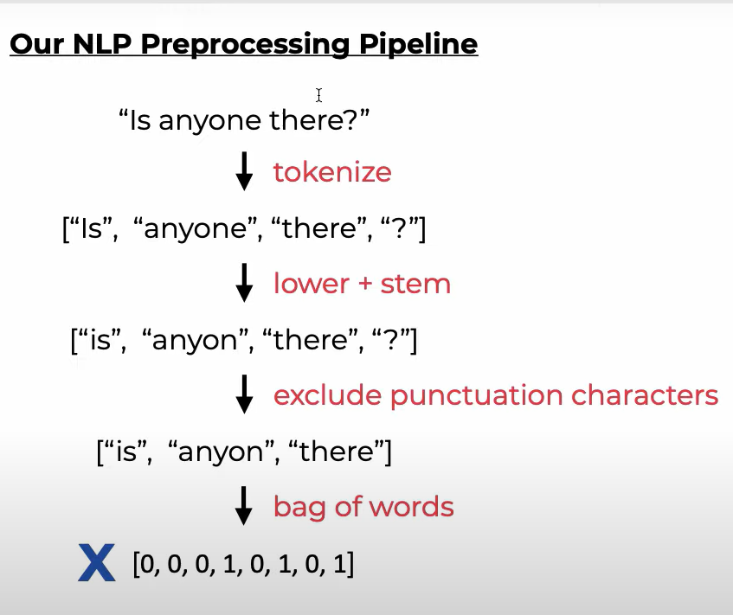
2. Data Handling:
a- Tokenization:
the process of breaking text into smaller units, such as words or sentences.
b- Lowering + stemming:
the process of converting all text to lowercase and reducing words to their root form by removing suffixes.
c- Excluding punctuation:
the process of removing punctuation marks from text.
d-Bag of words:
a text representation technique that converts a document into a set of word frequencies, ignoring grammar and word order.

Slide 10
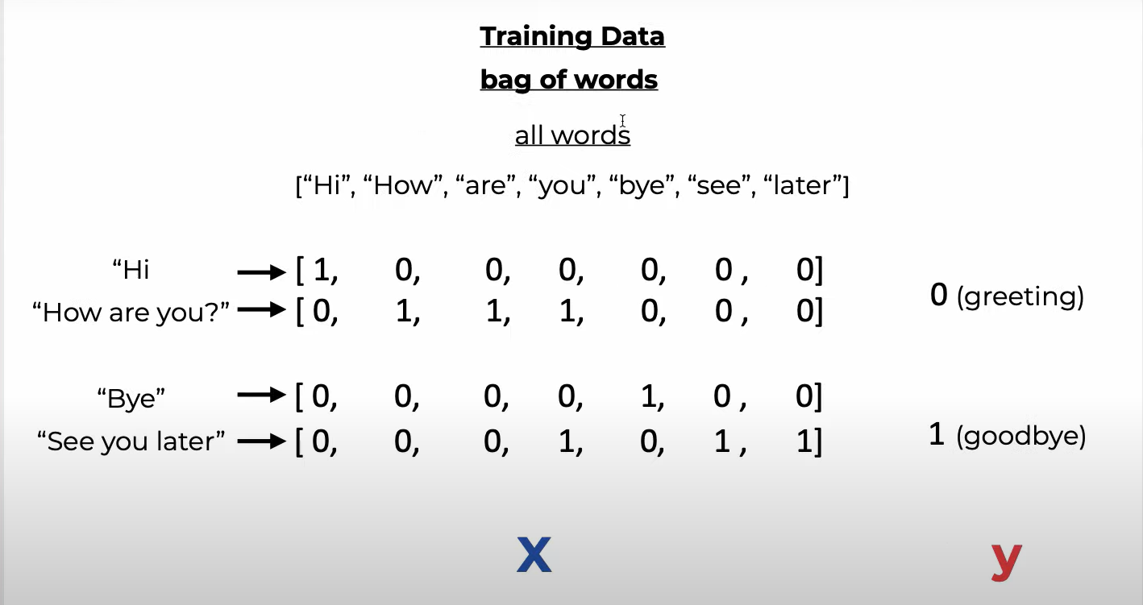

Slide 11
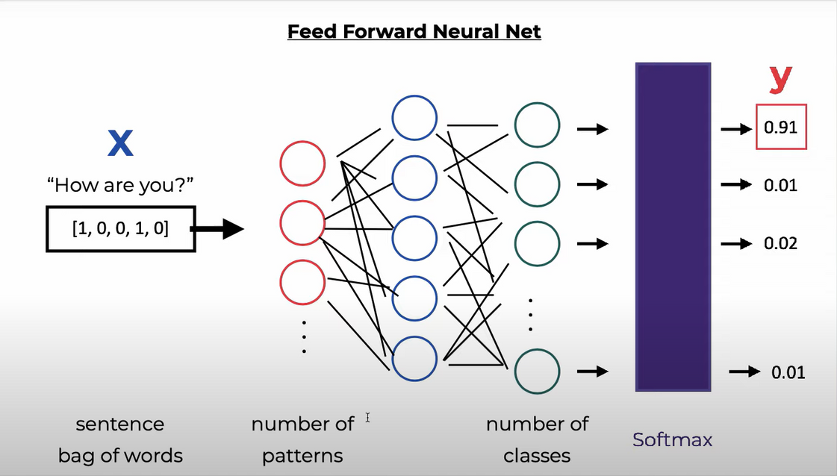
2. Neural network layers:
At this stage, I built the neural network with its 3 layers,.
I used ReLU (Rectified Linear Unit) in my NLP chatbot because it’s a widely-used activation function in neural networks, including those for NLP tasks.
I used DataLoader, which helped you efficiently load data in mini-batches, shuffle it, and optimize training.
I faced challenges with Model Training Optimization, so I tried finding the optimal hyperparameters by changing learning rate, batch size, number of hidden units to find values that lead to the best performance.
The metric used to calculate the error during training is Cross-Entropy Loss, since this is a multi-class classification problem

Slide 12
Backend Development
I implemented a Flask server that:
-Handles incoming requests from the frontend
-Communicates with our neural network model
-Processes responses
-Manages the API endpoints
The server processes each message through two main endpoints:
-A GET route for serving the chat interface
-A POST route for handling message exchanges

Slide 13
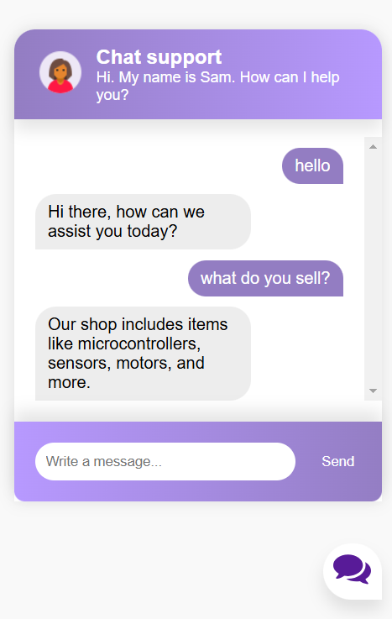
Frontend Integration
The frontend was developed using HTML, CSS, and JavaScript, creating a responsive chat interface that:
Updates in real-time
Maintains chat history
Provides a smooth user experience
Adapts to different screen sizes

Slide 14
4 . Technical Demonstration

Slide 15
Thank you

