Slide 1
Assessing the effects of climate change on U.S. West Coast sablefish productivity and on the performance of alternative management strategies
Melissa A. Haltuch¹, Z. Teresa A’mar², Nicholas A. Bond³, Juan L. Valero⁴
¹NOAA-Fisheries, NWFSC, Seattle, WA, USA.
² NOAA-Fisheries, AFSC, Seattle, WA, USA
³ University of Washington, JISAO, Seattle, WA, USA
⁴ CAPAM, La Jolla, CA, USA
PFMC
Notes:
Hope for this to be the beginning of an iterative dialogue.

Slide 2
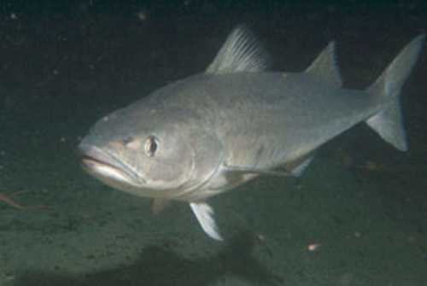
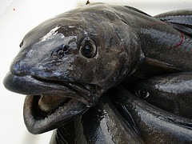

Sablefish
Widely distributed across the NE Pacific
Winter deep water spawners
Pelagic larvae offshore, migrate inshore to settle as demersal juveniles
Rapid growth, reaching full size and maturity within a decade, long lived
Commercially valuable target fishery
Photo: Wade D. Smith

Slide 3
Sablefish
Understanding climate drivers of recruitment and the interaction between climate and fishing is a priority
Subject of previous research and lengthy debates during scientific review of assessment products for management.
Forecast and/or hindcast stock productivity.
Testing the robustness of management strategies to climate variability and change.
Photo: Wade D. Smith

Slide 4
Motivation
Why Should We Care About Uncertainty in Future Climate and Management Strategy Evaluation?
2011 Assessment
PFMC: Uncertainty in future environmental conditions of the California current ecosystem should be considered a significant source of uncertainty in all projections of stock status.
IPCC GCMs can provide relevant projections of future long term environmental conditions.
MSE is a STRATEGIC planning tool can be used to:
evaluate the robustness of control rules to potential long term trends in recruitment-climate relationships.
understand and evaluate trade-offs of a range of management policies.
Multi-decadal forecasts of sablefish productivity could provide long term strategic advice to allow fishers and managers to plan for and respond to shifts in productivity.
Notes:
Decision support tool for managers
Also: Short-term environmental forecasts may inform projections beyond assumptions of average recruitment (but outside the scope of this talk)
Utility in understanding long term implications of climate on control rule performance and stock productivity.
Incentive to Identify climate adaptation strategies
From 2007 assessment - concept of a static “virgin” biomass is challenged by one in which an unfished sablefish population
would exhibit substantial variability in response to long-term oscillation in environmental conditions.
Estimate h? this has been done in some assessments and not others…
Current bias adjustment
Last yr no bias 1945
First yr full bias 1955
Investigate the utility of short term seasonal to annual forecasting with climate model products – maybe we don’t need to down scale products for the long term large scale impacts but we certainly will need to for short term prediction – what about parties gaming the system if they know who both the long and short term winners will be.
Next Set of MSEs Projections
Resampled tide gauge data (baseline)
Bootstrap population dynamics model and project with a subset of GCMs
GFDL GCM downscaled with ROMs
Evaluate alternative control rules and reference points
Longer Term
Engage with industry and managers to solicit feedback on alternative control rule and performance metrics.
Investigate the utility and skill of short term seasonal to annual forecasting
Main caveat - Assume stable sea level-recruitment relationship, as well as other potentially important ecological relationships
-Punt et al. -risk of wrong managmenet choice given climate information outweights inclusion in assessments
-problem – past observations may not be representative of future -
We have quantified what the King et al paper suggested – qualitative sablefish scenario
King et al. 2011. ICES Journal of Marine Science, 68(6), 1199–1216.
Loss of southern range with warm-water impacts on larvae
In the north, decreased year-class success with reduced spring
productivity and copepod production for larvae
Longevity with periodic strong year classes maintains biomass
King et al. (2000), King and McFarlane (2003), and Schirripa and Colbert (2006)
The statistical downscaling approach, based on
a moderate greenhouse-gas-emission scenario (A1B), suggests
only moderate oceanographic changes: mild surface warming
accompanied by relatively minor increases in upwelling-favourable
winds in northern portions of the CCS. Natural variability overshadows
climate signals for many important metrics (Overland
and Wang, 2007; Wang et al., 2010). Our downscaling results
agree with the basic findings of Mote and Mantua (2002) that
drastic changes in upwelling are unlikely over the next few
decades. They are at odds with Bakun (1990) and Snyder et al.
(2003), who posited that upwelling was liable to strengthen.
Under a scenario based on the statistical downscaling outlined
above, resource managers might anticipate relatively minor
changes rooted in mild warming and small, localized increases
in upwelling long-lived, highly fecund species
(periodic strategists), such as Dover sole, sablefish, and rockfish
(Table 2), can withstand many years of poor recruitment by
taking the substantial advantage of interannual variability that
periodically favours good recruitment.
Adaptation strategies (W5)
farm raised all female sablefish.
Evaluate the resilience of the Sablefish supply chain to potential declines in catch…in a scenario of declining stock how to add value to product and ensure a resilient supply chain for sablefish? Lisa? Plaganyi talk from W5
Goal to build community reliance to potential change, particularly where the weight of the current evidence suggests that change may be negative.
Have a look at the implications of 20-30 year projections versus 50 year projections. How long does it take to move outside of the historical (say 1970-present) observed data.
Next step is to investigate the utility of short term seasonal to annual forecasting with climate model products – maybe we don’t need to down scale products for the long term large scale impacts but we certainly will need to for short term prediction – what about parties gaming the system if they know who both the long and short term winners will be.
-maintaining monitoring programs – need to track non-stationary – reduction of uncertainty via more monitoring
This is a straddling stock managed by PFMC, DFO-BC, and NPFMC – non of which have a routine mechanism for exchange of information - not a closed stock, should be tracking what is happening in waters of British Columbia and Alaska
-many of these examples are rapid change – but more insidious and harder to track will be slower long term change.
This kind of study may be refined/improved via Process oriented fisheries studies that investigate env drivers of recruitment
Engage with the council bodies to solicit feedback on alternative control rule and performance metrics.
Estimate h? this has been done in some assessments and not others…
Current bias adjustment
Last yr no bias 1945
First yr full bias 1955
Consider adaptation strategies
Resilience of supply chain / communities (Plaganyi W5)
Aquaculture
Maintain monitoring programs
Straddling stock – need for collaboration between regions

Slide 5
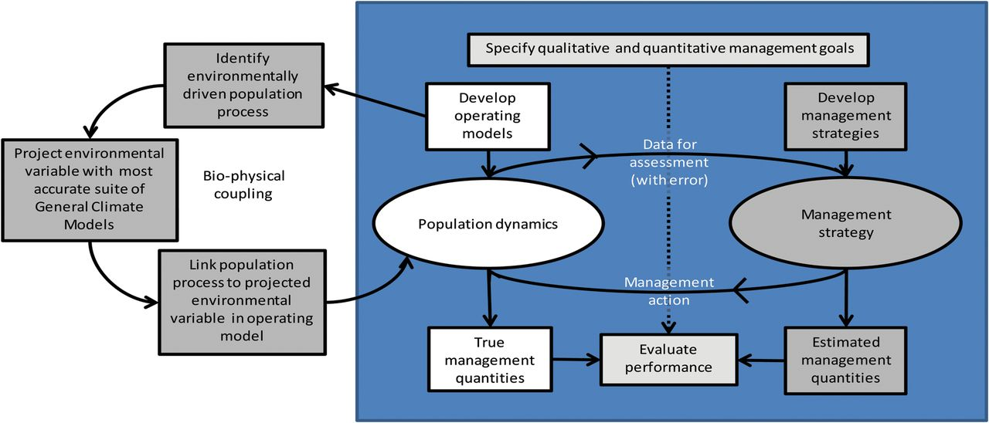
Goals
MSE assess the robustness of harvest control rules to decadal scale climate driven changes in recruitment.
Evaluate future decadal scale trends in sablefish productivity.
© Crown copyright 2013.
André E. Punt et al. ICES J. Mar. Sci. 2014;71:2208-2220
Notes:
This analysis focuses on using multi-decadal SSH forecasts to allow management to better respond to shifts in productivity before they occur, rather than refining our ‘hindsight’ further.
Figure: The MSE approach and how climate-induced factors can be used to drive the population dynamics of the operating model.
The MSE approach and how climate-induced factors can be used to drive the population dynamics of the operating model. The standard MSE framework is summarized in the box, and the links to environmental variables are indicated in the flowchart on the left side of the plot for the case in which the mechanistic approach is used. Note that the management strategy might make use of environmental data.

Slide 6
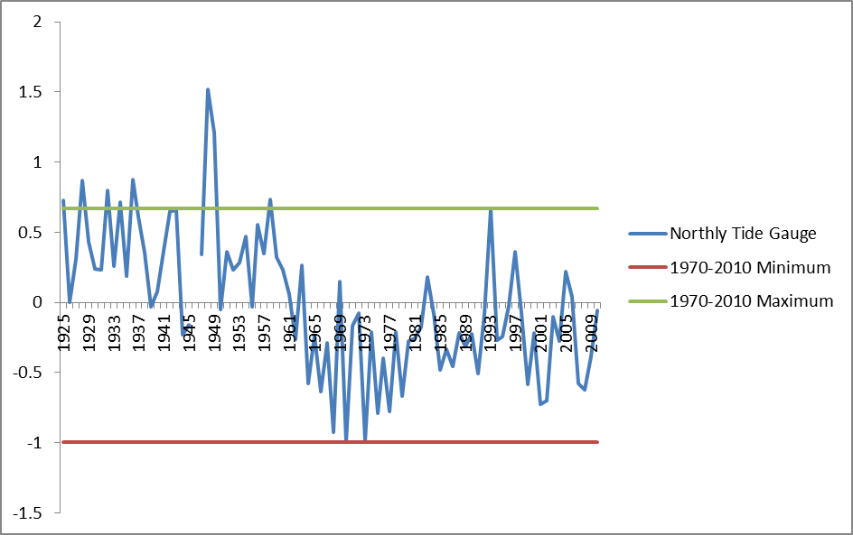
Physical Processes
Recruitment is driven by pelagic life stage feeding conditions.
Feeding conditions are driven by horizontal transport.
Sea level indexes horizontal transport.
April-June Mean
40-49 ºN
Tide Gauge Data: 1925 - 2011
Notes:
Not corrected for atmospheric pressure
-previous assessments suggest that this is fine b/c sea level will integrate larger scale atmospheric forcing with actual sea level data from tide gauge.

Slide 7
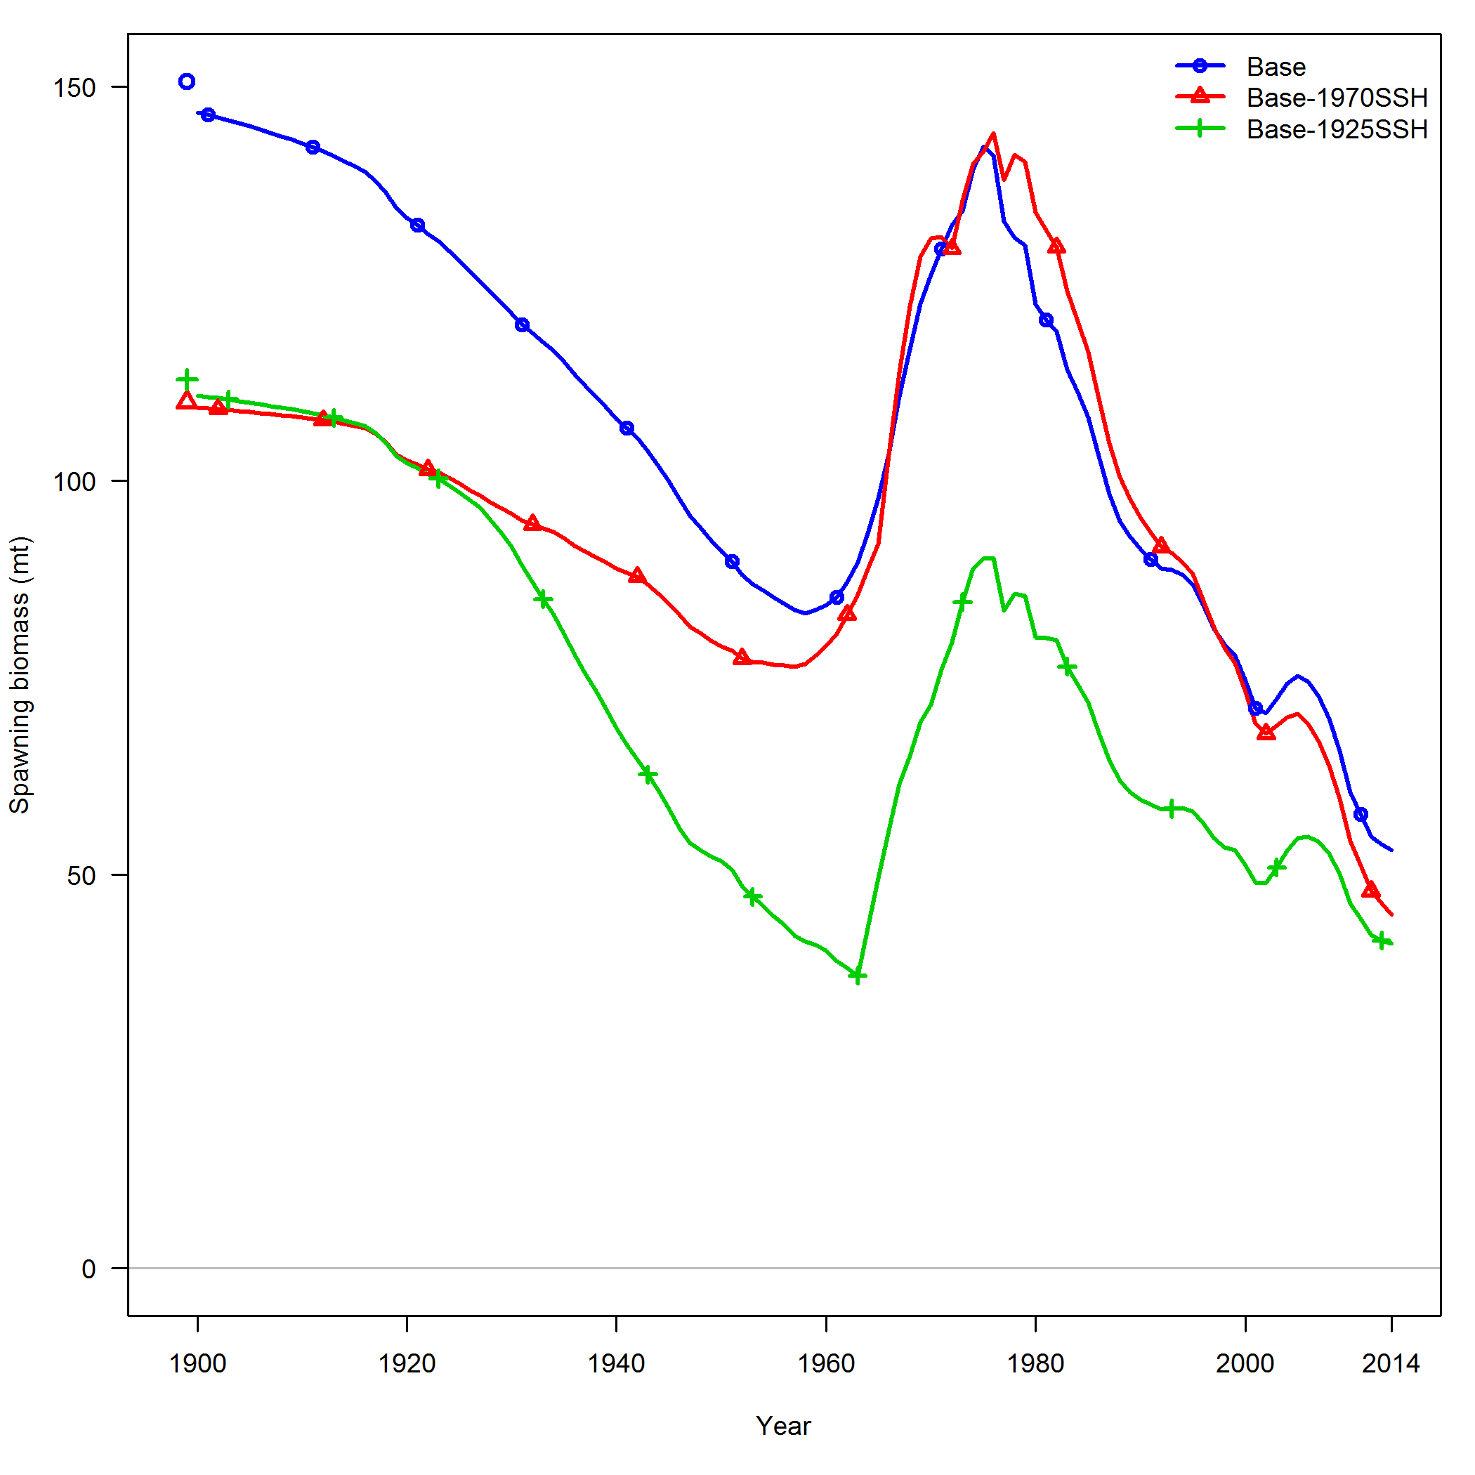
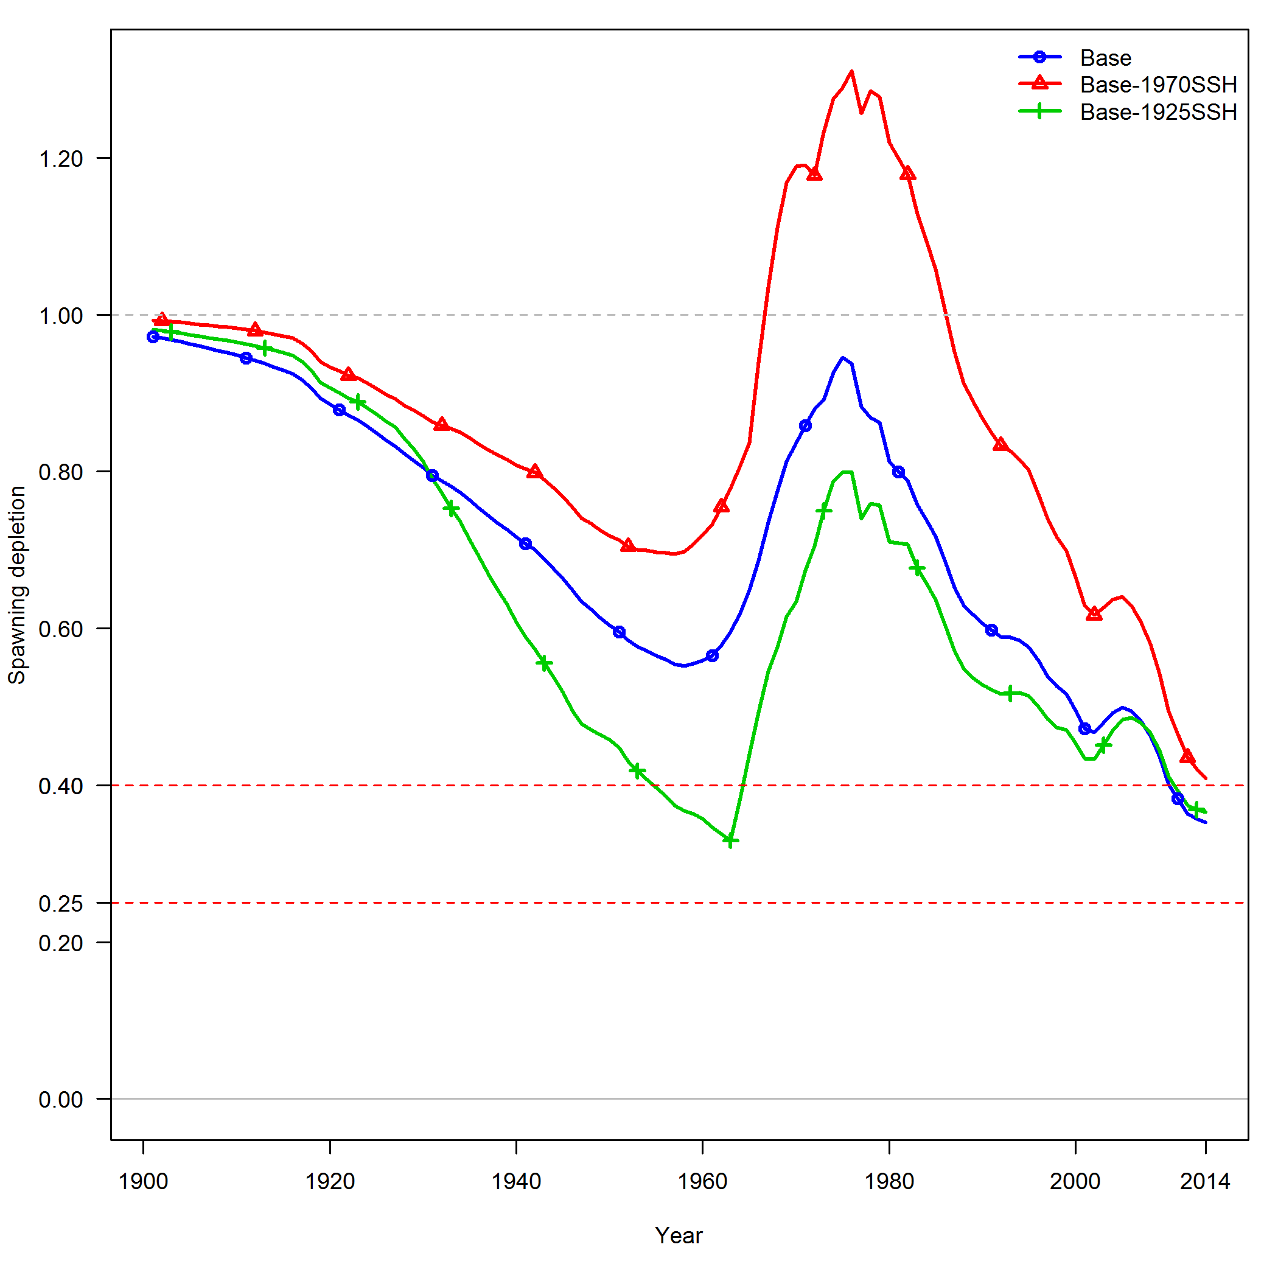
2015 Stock Assessment Sensitivity:
Conditioning the Operating Model
Spawning Biomass
Spawning Depletion
Year
Year
Base – No SSH
Base – SSH 1970, No estimated additional SD
Base – SSH 1925, No estimated additional SD
Notes:
Green model run has been used to condition the OM for these simulations
Note that in the green run the estimate of M declines to 0.058, from 0.068 in the blue model run
Note the reference points for models using the SSH data are now conditioned on recruitment deviations that are either more closely driven by SSH (red) or consider a much longer time series of SSH that encompasses a low productivity/recruitment period for the stock.
Sensitivity of 2015 model to use of SSH time series 1970 to 2014 versus including all available SSH observations 1925-2014. Note that bias correction has been modified from base model in the models that have SSH from 1925 forward.

Slide 8
Management Strategy Evaluation Framework
Operating Model – Representation of the ‘True’ System
SL - northern California Current
SL recruitment index beginning during 1925
11 CMIP 5 GCMs (initially CMIP3 GCMs) from 2015 forward
SL-recruitment relationship explains 36% of the variability in recruitment deviations in the OM
Estimation Model
Annual Management period: 2015-2060
2015 update stock assessment
SL used as a survey index of recruitment beginning 1925
IPCC SL 2015 forward
Notes:
Use SS3
Need: Evaluate how resilient current fishery control rules are to climate change, consider alternatives
Both operating models and estimation models are in SS
Estimation model uses SL from 1925 forward with no estimation of added SD for the recruitment index and bias correction ramp up from 1930-1970.

Slide 9
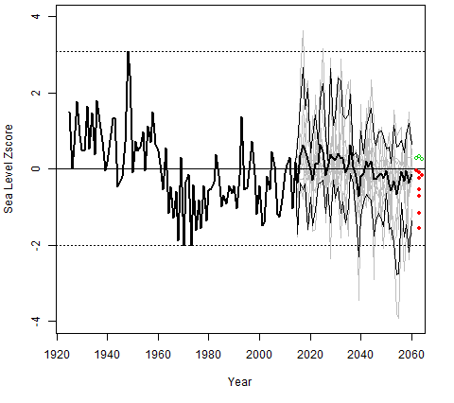
SSH Tide Gauge and GCM Outputs
Notes:
Figure 2. Mean normalized sea level data from the historical period (1925-2014) and the projection period (2015-2060) where the historical values are the spatio-temporal mean SL calculated as used in past stock assessments and the projected values are the ensemble mean SLs across the 11 GCMs (bold black line). Also plotted are the sea level from each individual GCM (grey lines), the minimum and maximum SLs from the historical period (horizontal dashed lines), the lower and upper 5% and 95% quantiles from the ensemble of 11 GCMs (light black lines), and the mean SL over the last 10 years of the projection period for each of the 11 GCMs (open circles are above the zero line, closed circles are below the zero line).

Slide 10
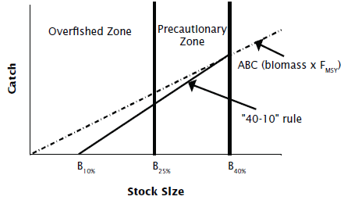
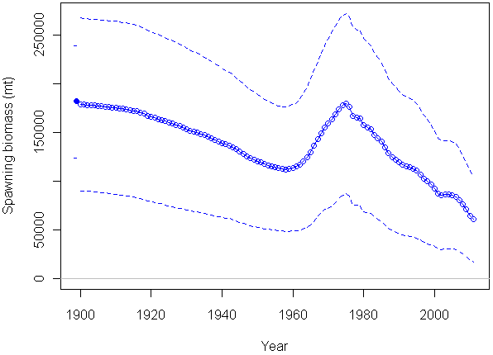
Management strategy: Harvest Control Rules
No fishing
40-10 rule
Static reference points
Dynamic Bo 40-10 rule
35 year moving window
Notes:
The “dynamic B0” approach (MacCall et al., 1985;Field et al., 2010) involves setting the unfished biomass, B0, usedwhen applying harvest control rules, to the average spawning stockbiomass calculated by projecting the population through the yearsfor which data are available, but without fishing. The values for allmodel parameters, including the deviations in recruitment aboutthe stock–recruitment relationship, are set at the values estimatedin the stock assessment when making this projection.
How to define dynamic B0
Annual values
Moving window average
end of time series
start of time series
how long
mean generation time
N modeled data age classes
What about feedback into the stock-recruitment relationship?

Slide 11
Performance Metrics
Projected time series: spawning biomass, stock depletion, catches
Distributions: estimated unfished biomass and unfished recruitment, and historical (1925 to 2014) and projected (2015-2060) spawning biomass and recruitment
Proportion of the time that historical (1925 to 2014) and projected (2015-2060) spawning biomass is below the true (OM) 25% and 10% levels of B₀ (reference run).

Slide 12
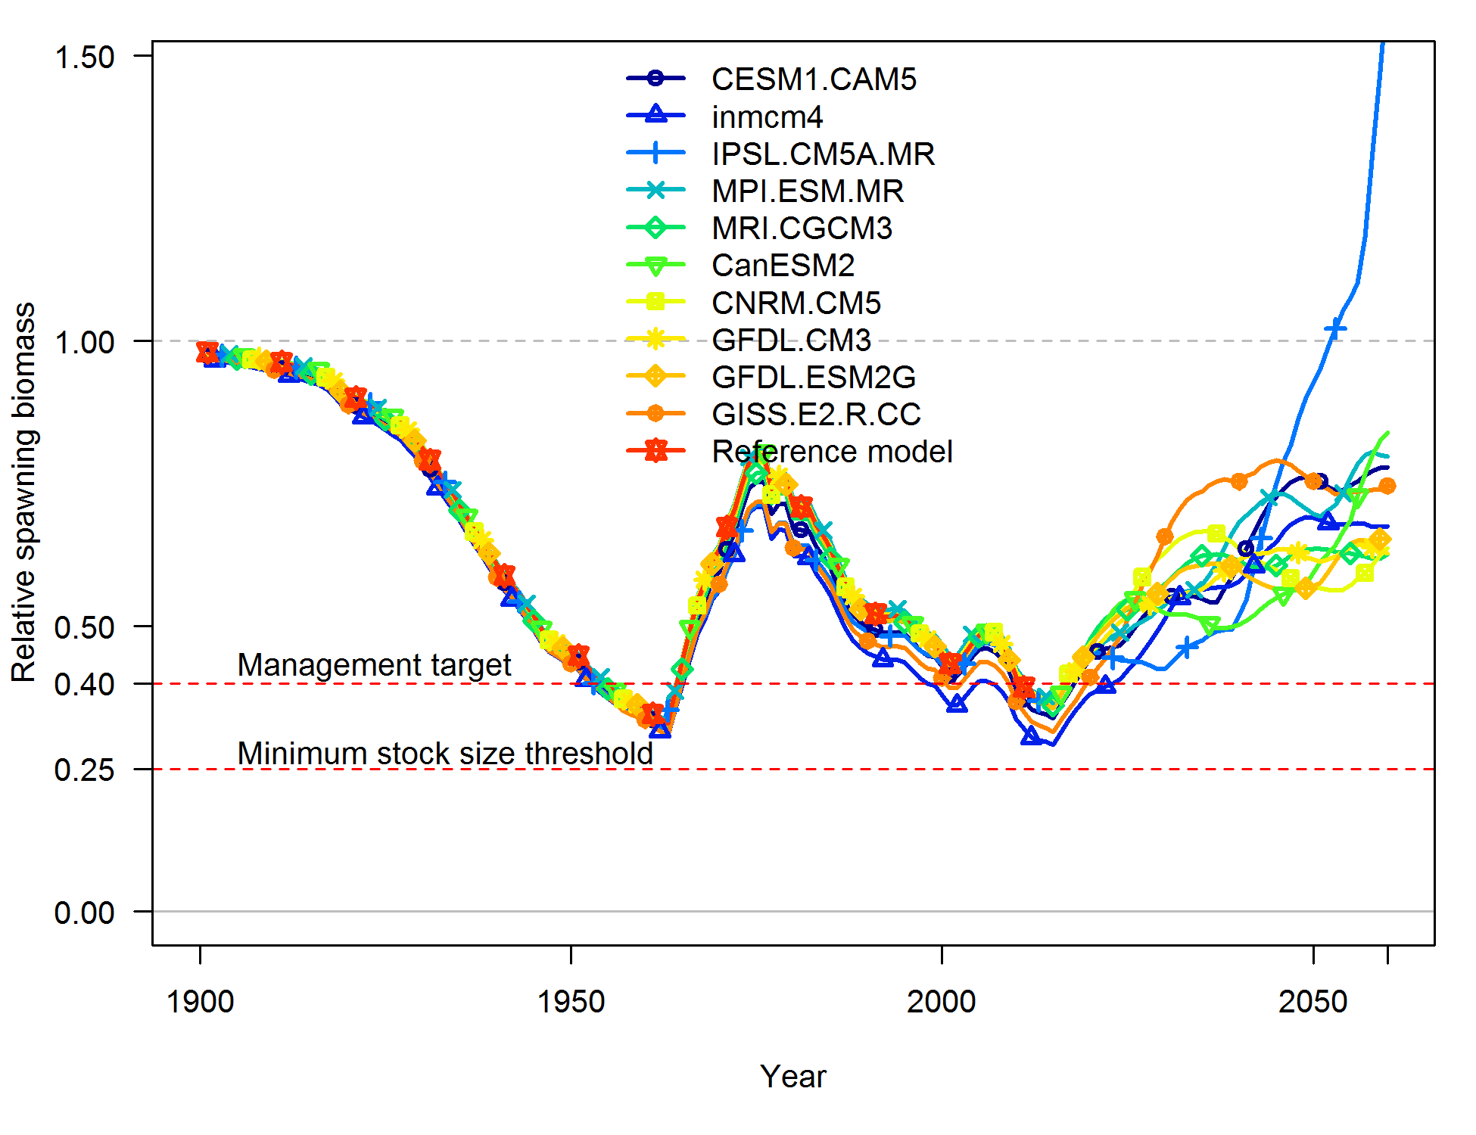
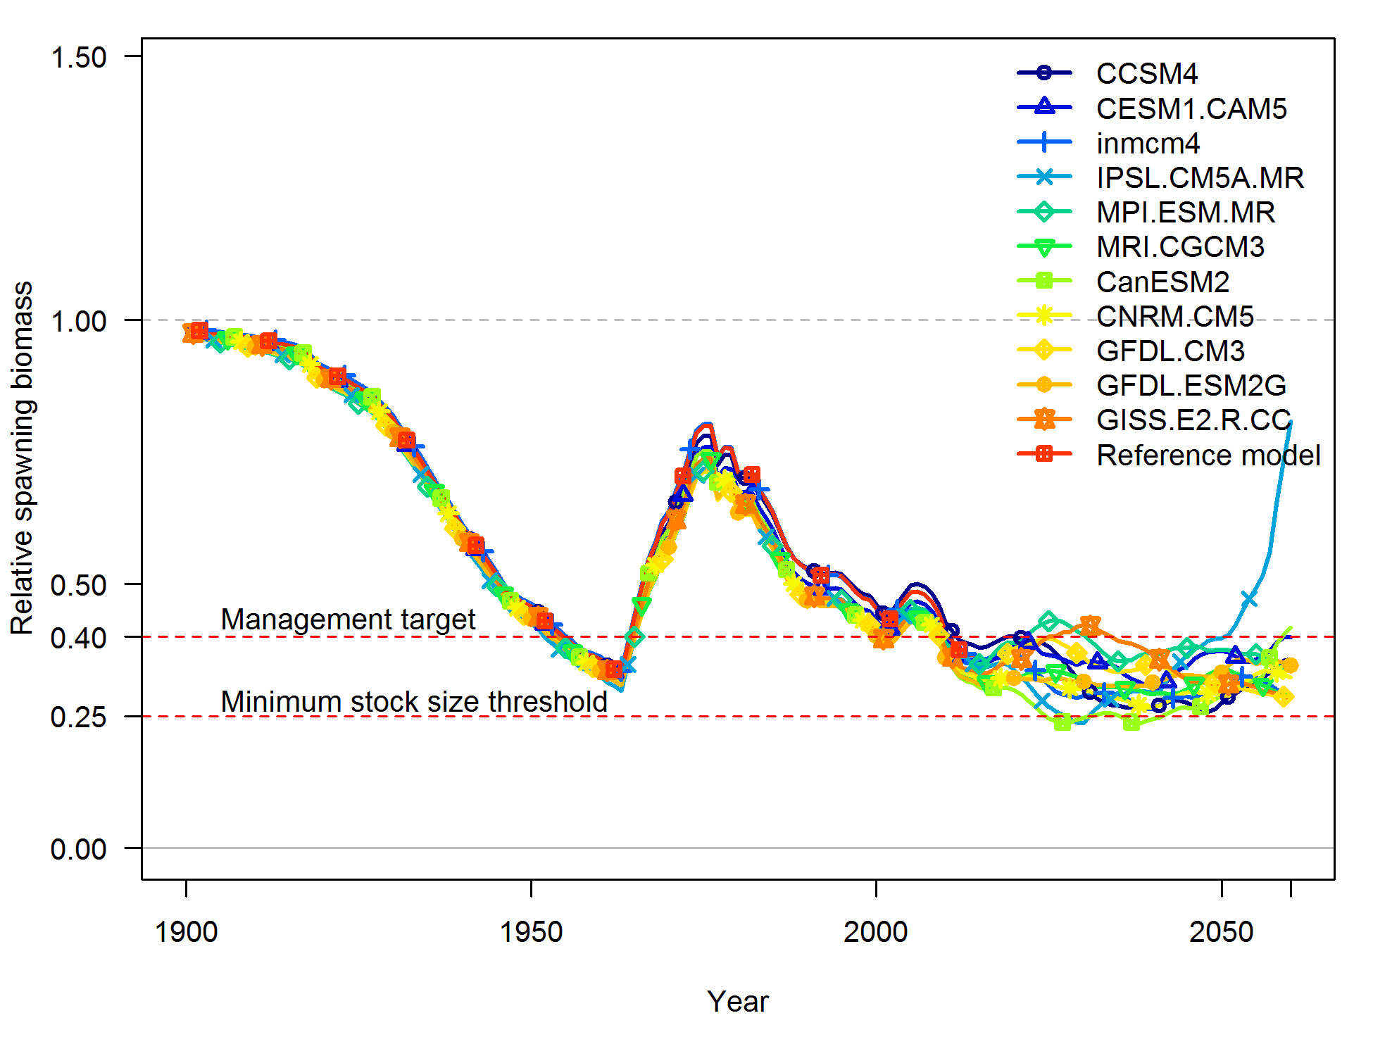
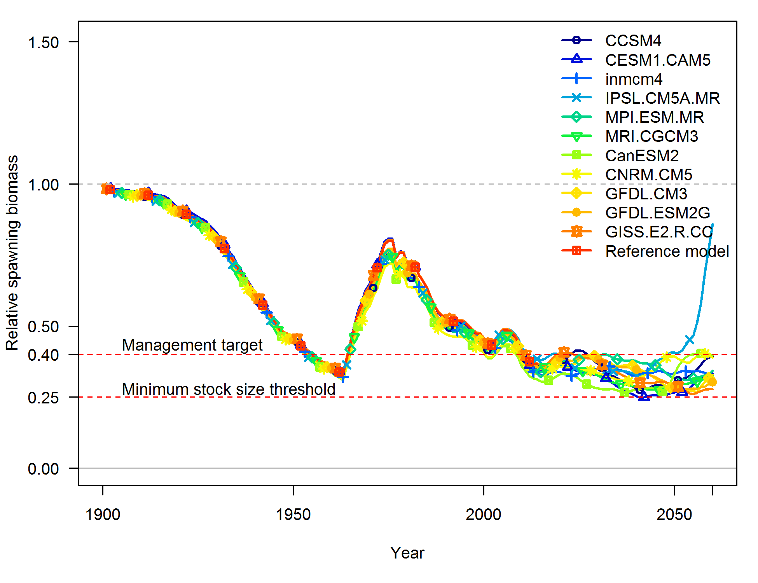
MSE Results: Time Series of Stock Depletion
No Fishing
40-10 HCR
Dynamic 40-10 HCR
Notes:
Time series of stock depletion from the no catch, 40-10 HCR, and dynamic unfished biomass 40-10 HCR.
Note that the 40-10 rule keeps the stock firmly in the precautionary zone. This is because the fixed value of stock-recruitment steepness (0.6) and the SPR rate of 0.45 are inconsistent with the stock being maintained at 40 percent of unfished biomass.
Note that the value for steepness increased between 2007 and 2011 from 0.43 to 0.6 while M was changed from fixed at 0.07 to estimated.

Slide 13
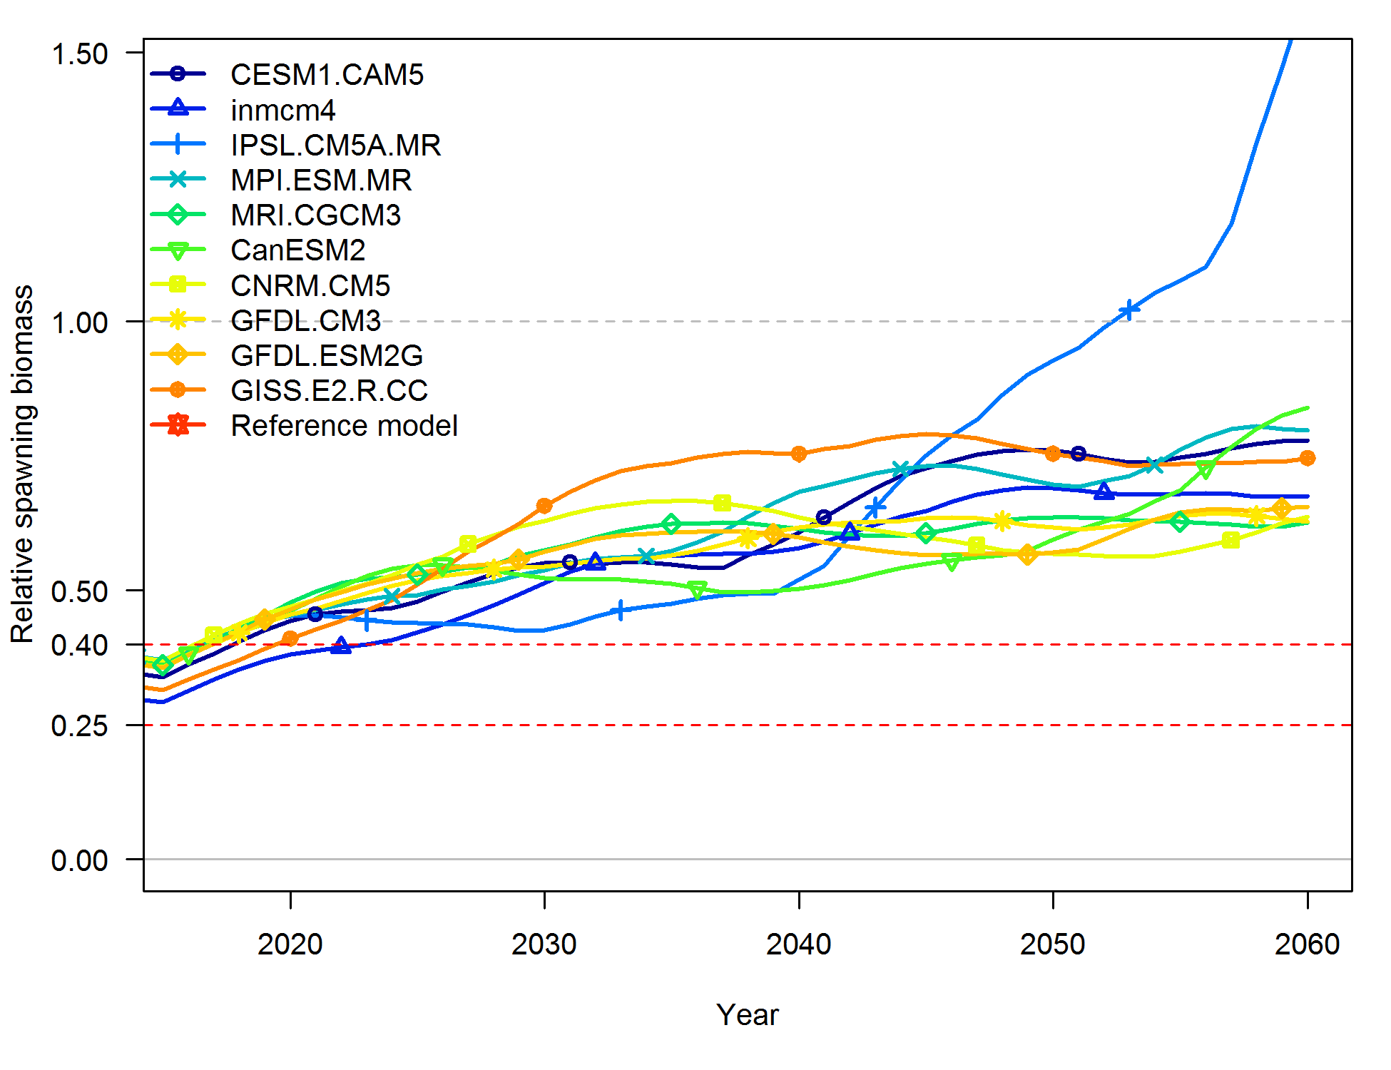
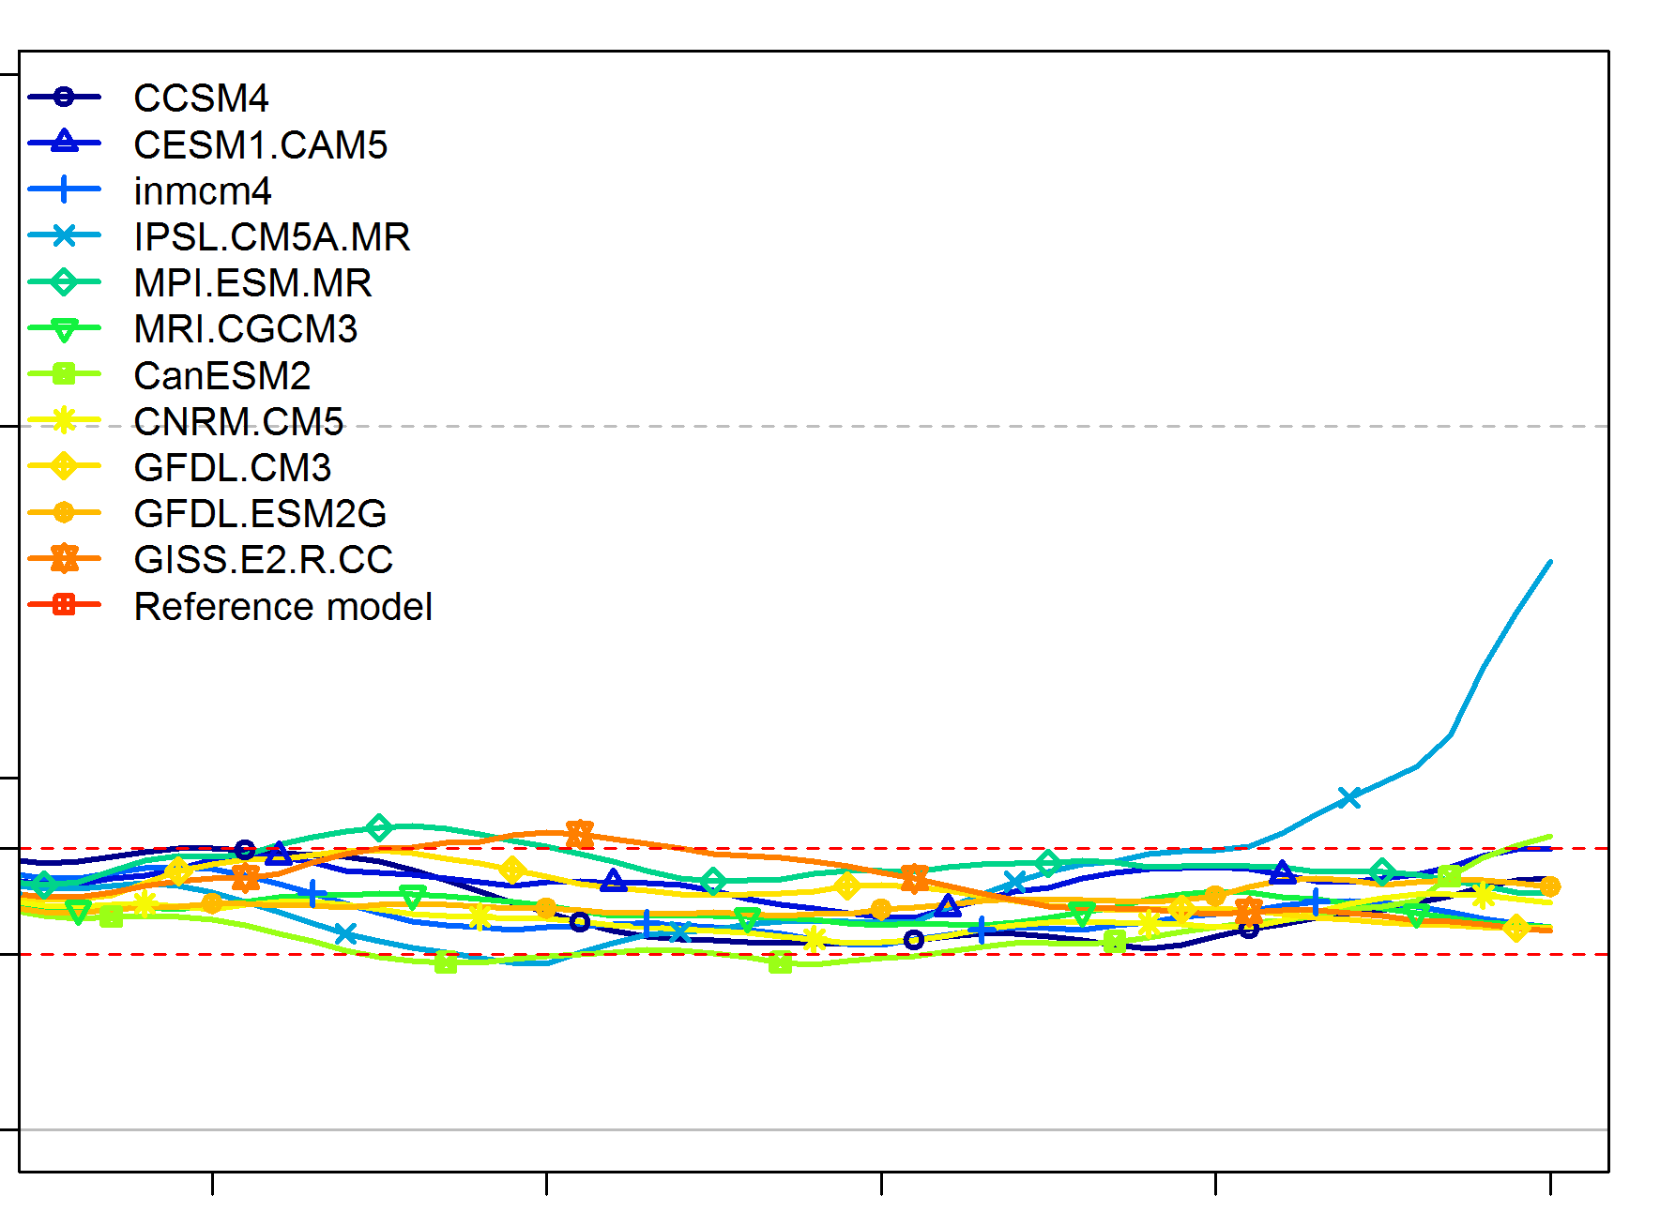
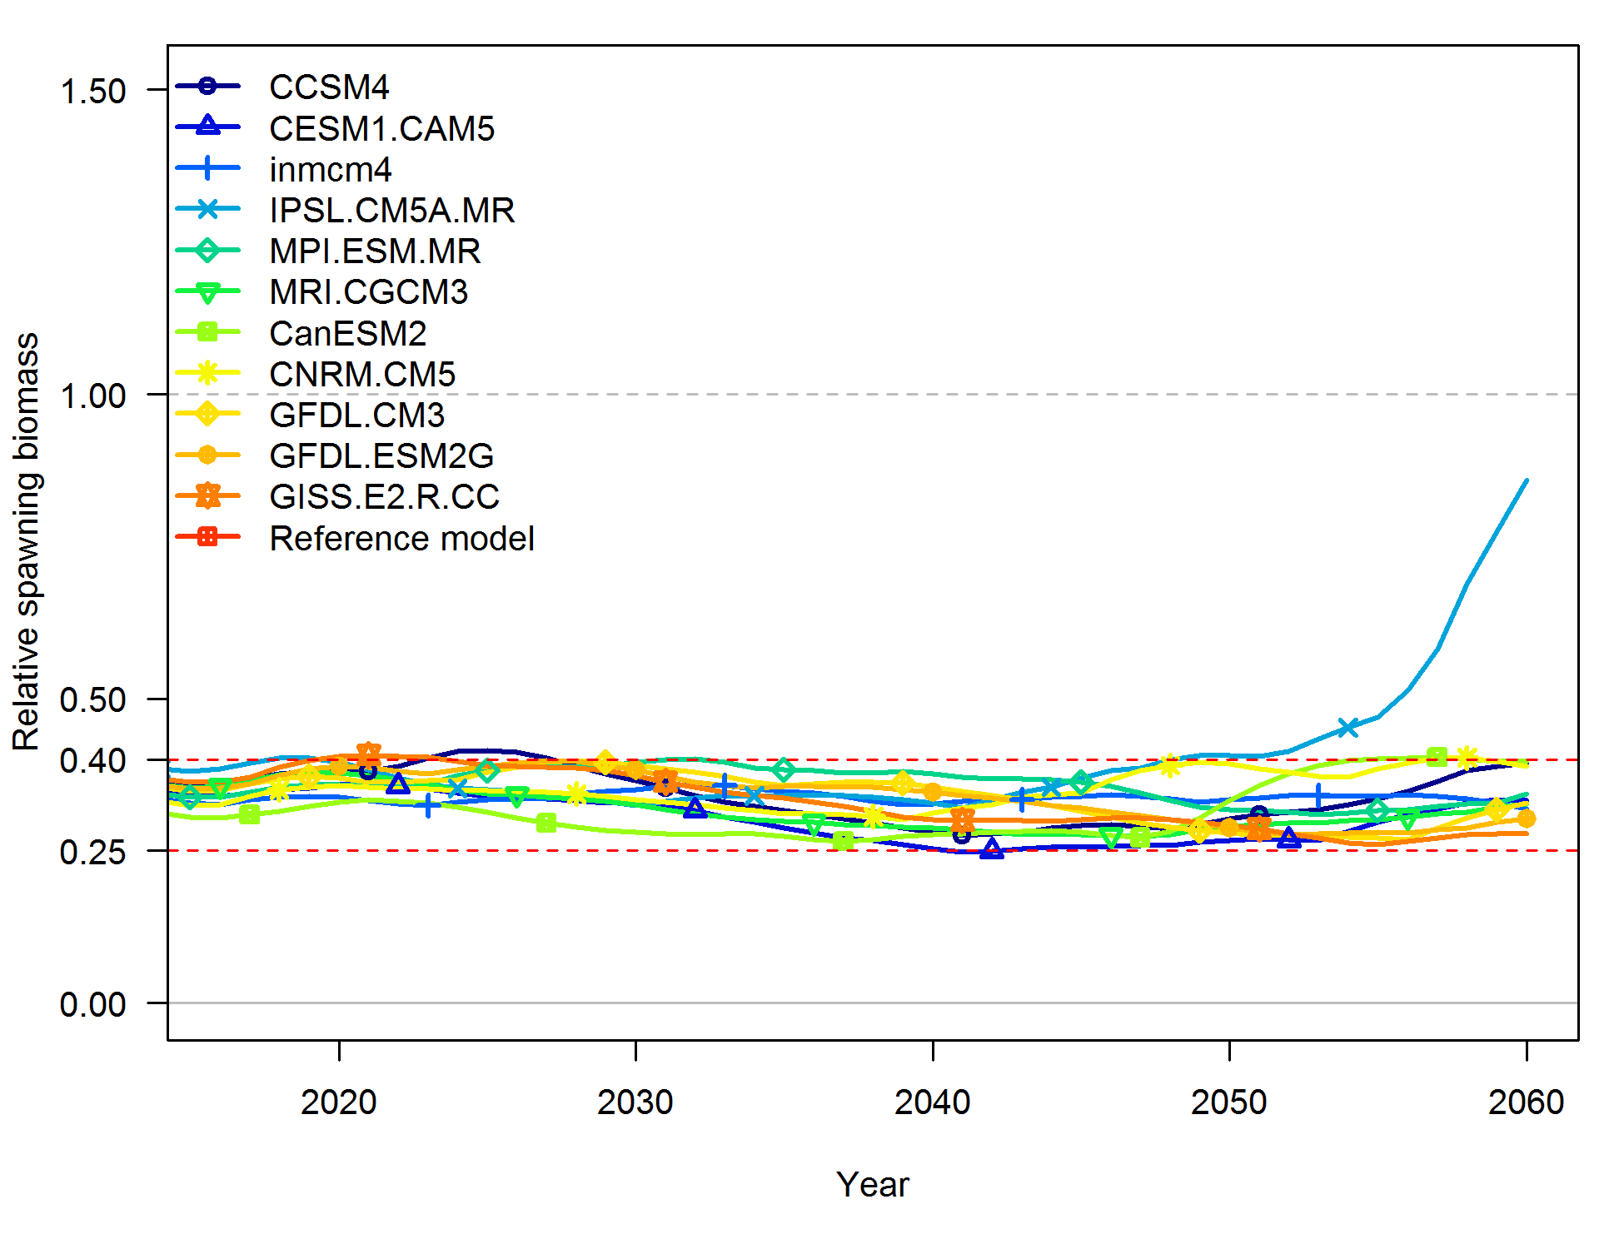
MSE Results: Time Series of Stock Depletion
No Fishing
40-10 HCR
Dynamic 40-10 HCR
Notes:
Time series of stock depletion from the no catch, 40-10 HCR, and dynamic unfished biomass 40-10 HCR.

Slide 14
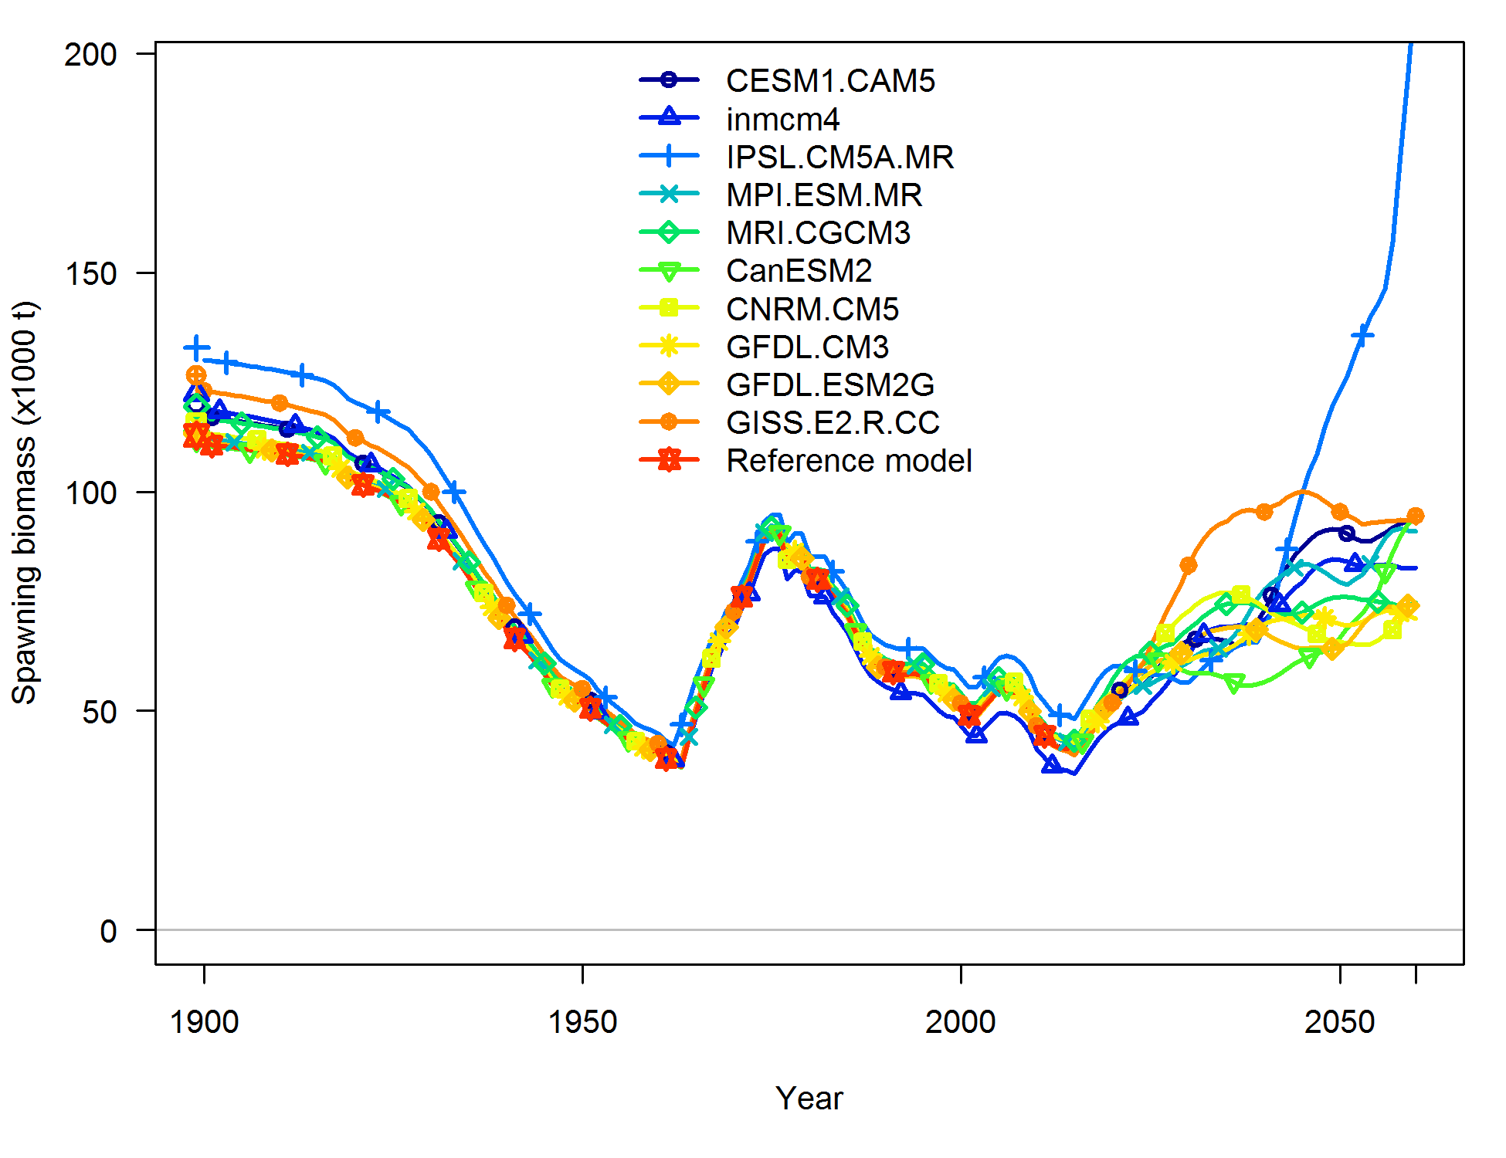
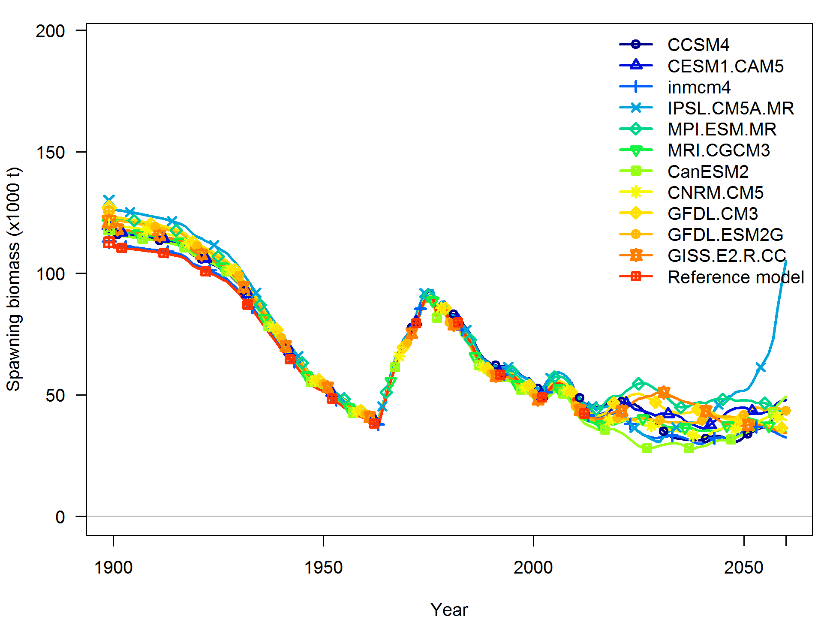
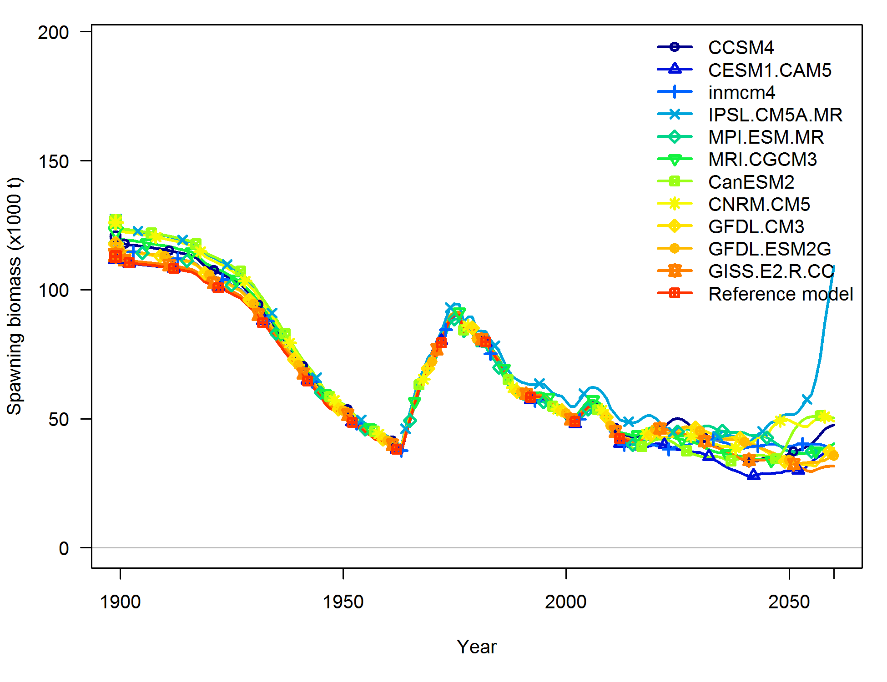
MSE Results: Time Series of Spawning Biomass
No Fishing
40-10 HCR
Dynamic 40-10 HCR
Notes:
Time series of spawning biomass from the no catch, 40-10 HCR, and dynamic unfished biomass 40-10 HCR.

Slide 15
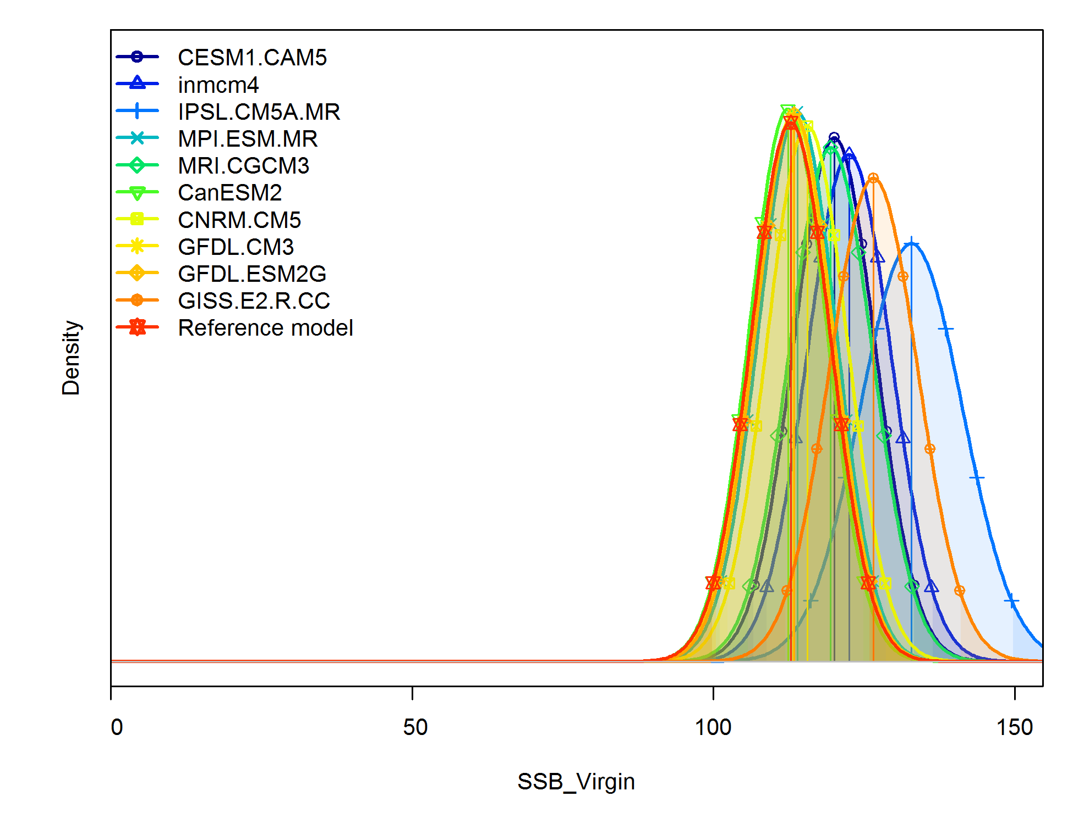
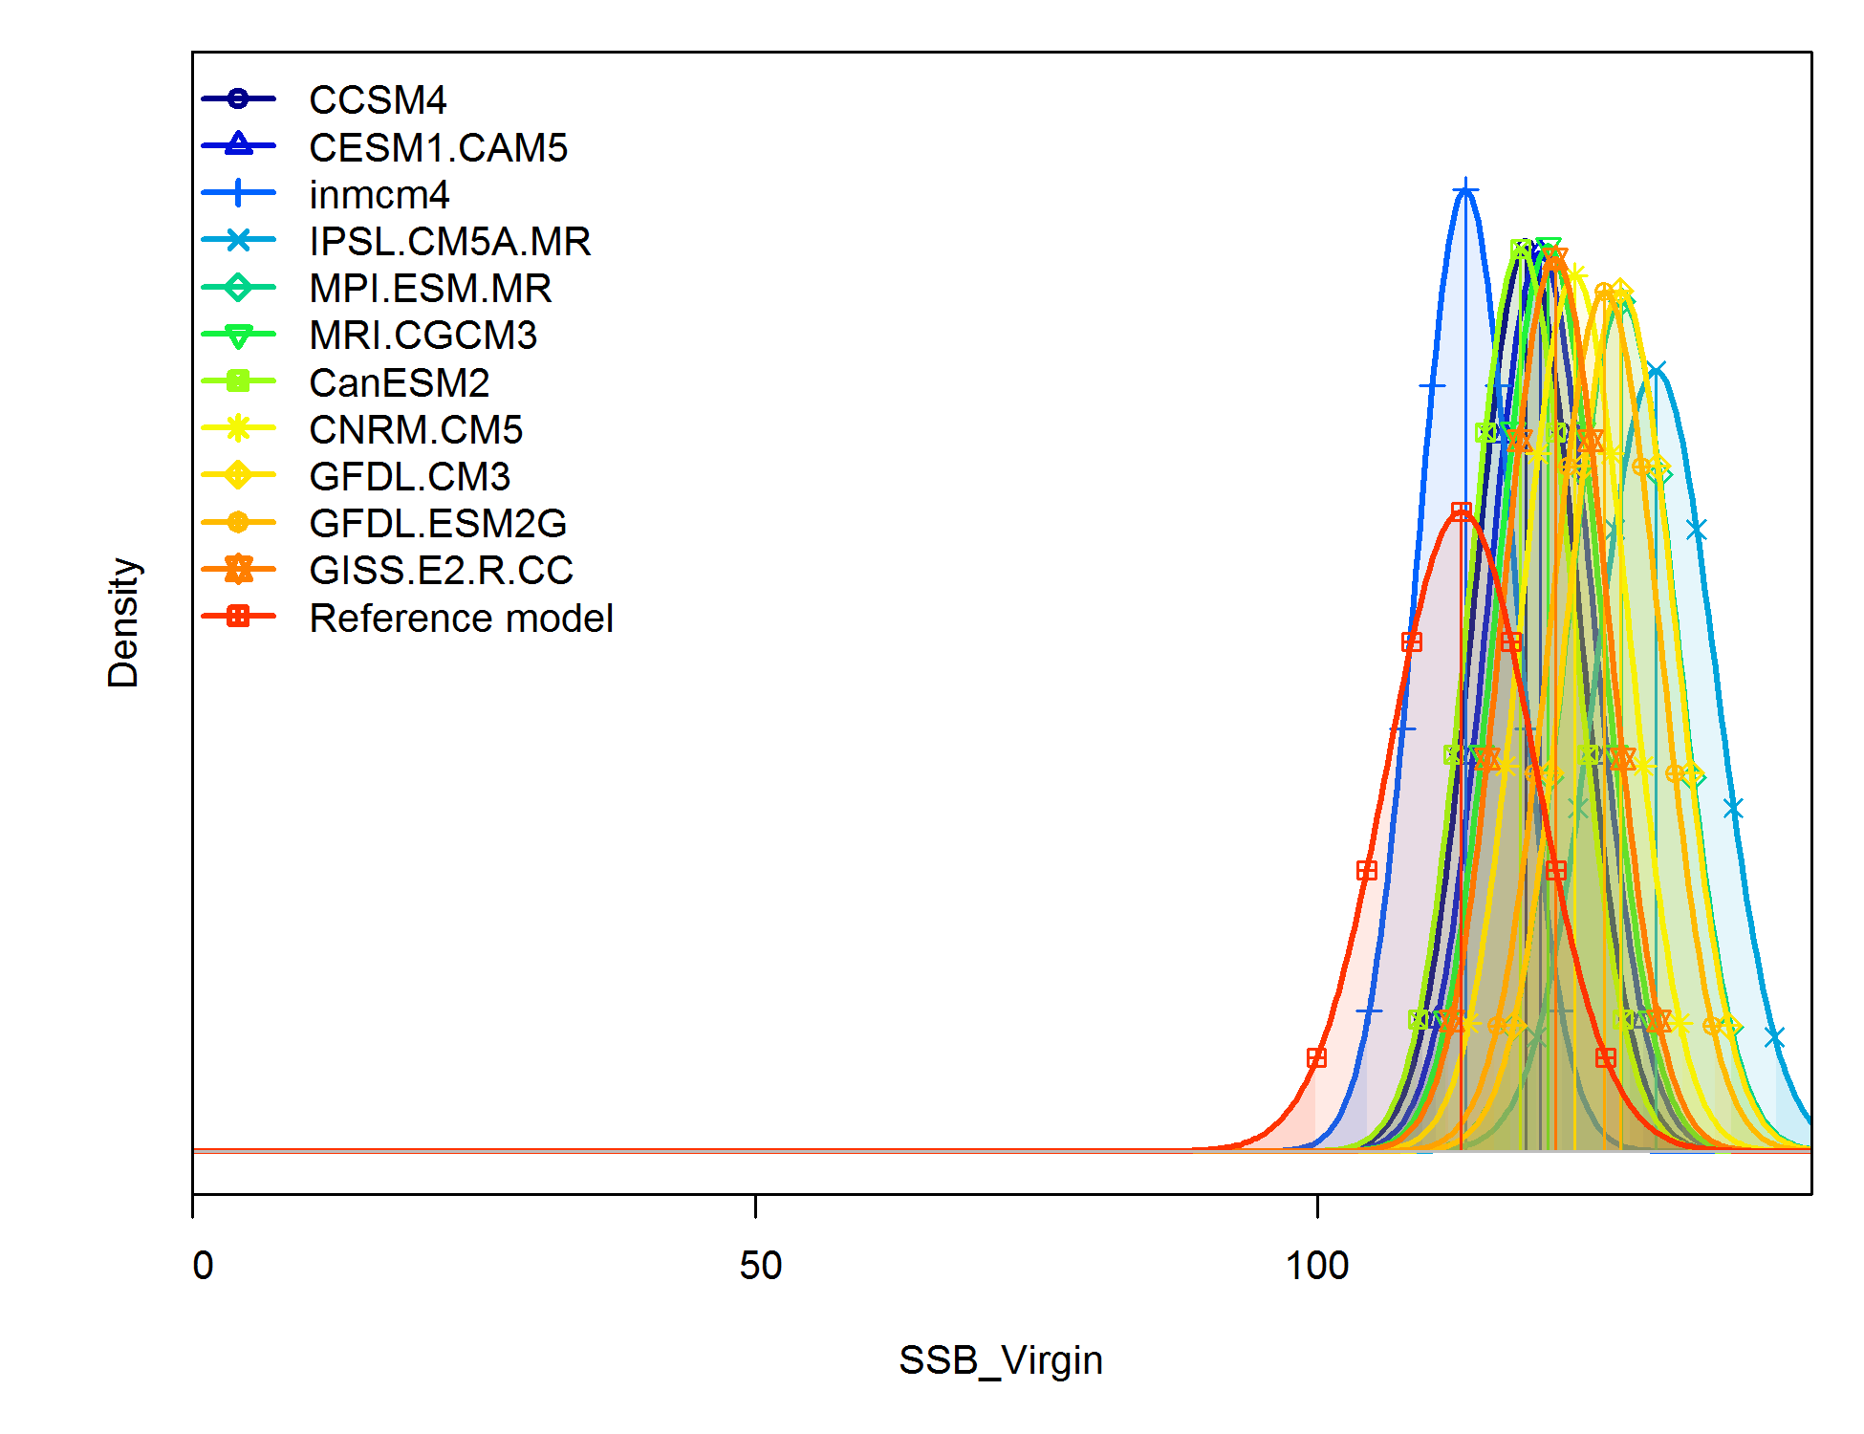
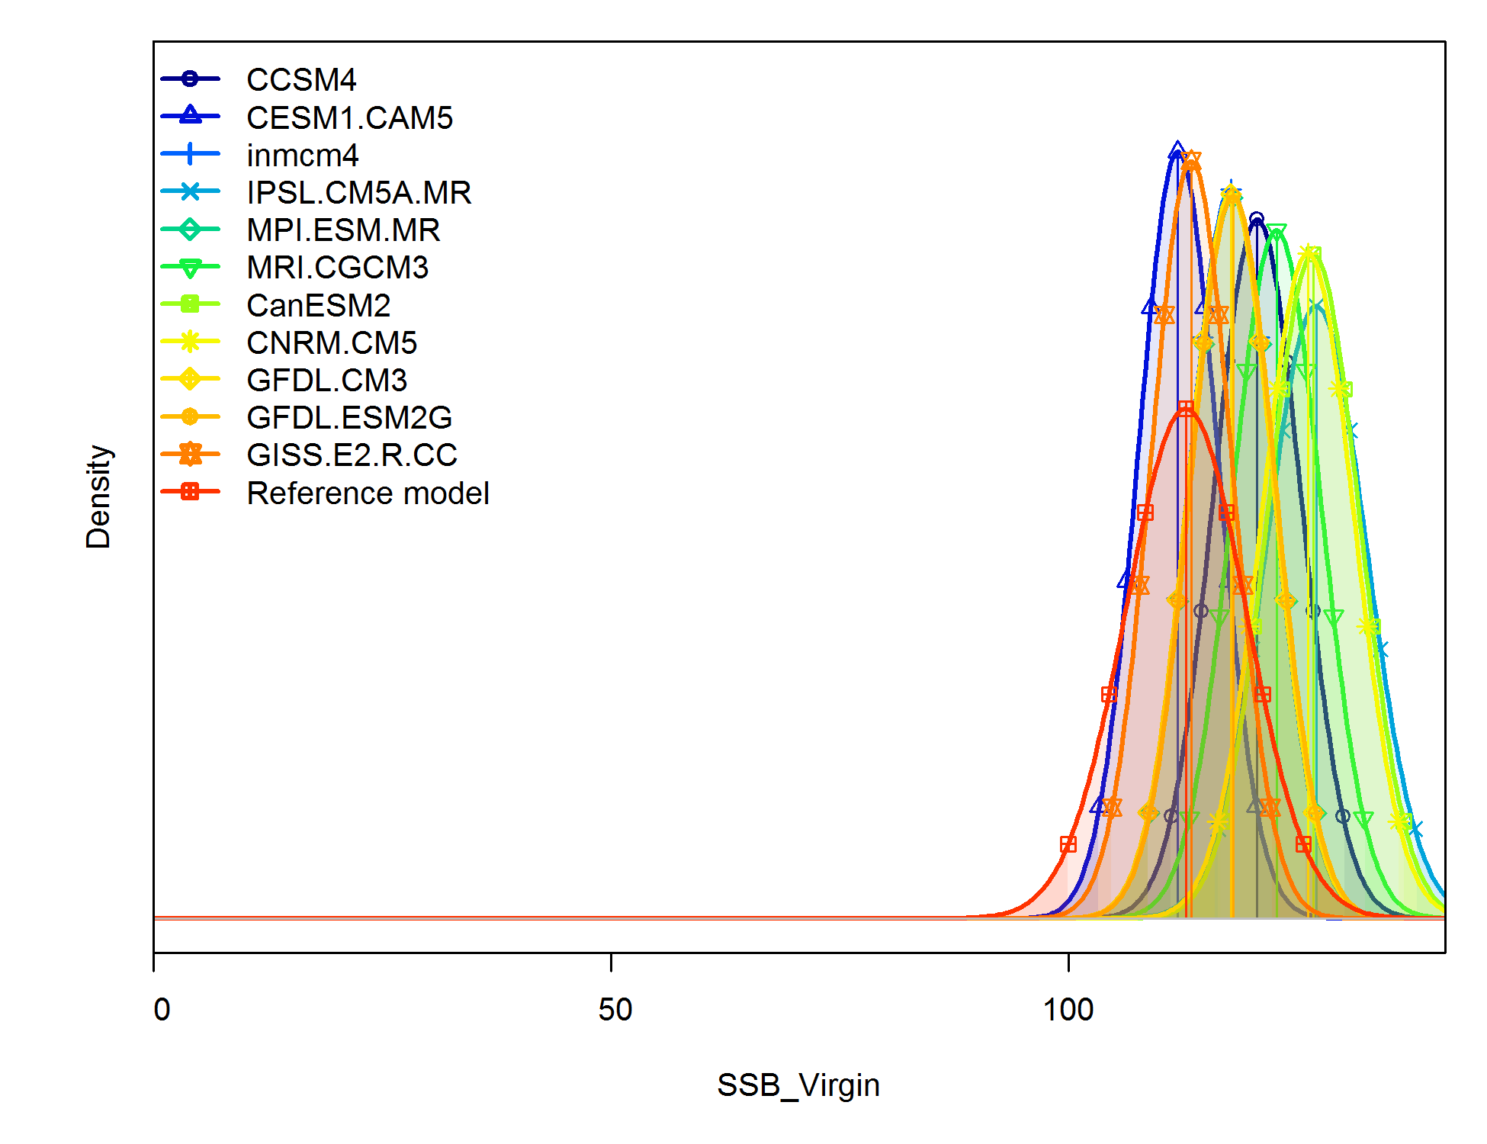
MSE Results: Distribution of Unfished Spawning Biomass
No Fishing
40-10 HCR
Dynamic 40-10 HCR
Notes:
Figure 7. Distribution of unfished spawning biomass from the no catch, 40-10 HCR, and dynamic unfished biomass 40-10 HCR.

Slide 16
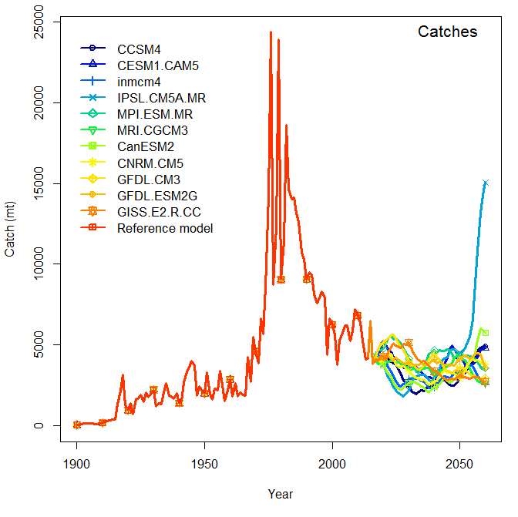
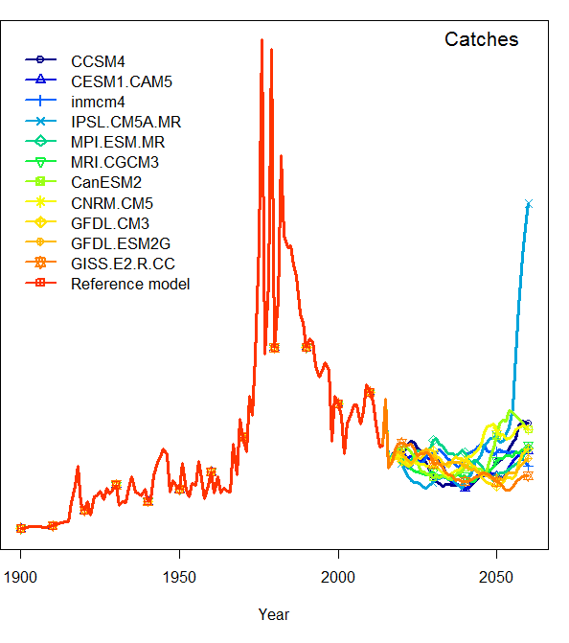
MSE Results: Catches
40-10 HCR
Dynamic 40-10 HCR
Notes:
Catches resulting from application of the current 40-10 HCR (top panel) and the dynamic unfished biomass HCR (bottom panel).
Note two model groups appear in CMIP5, those that suggest an overall decrease in wind forcing, upwelling strength, and boreal copepod community leading to lower catches and those that suggest in increase in deep water upwelling (see Ryan’s paper) leading to and increase in productivity due to ….see the MS
CMIP5 – catch projections are more pessimistic, with just over half of the GCMs suggesting that future catches will drop below the minimum landings caught
during the previous 20 years and very few suggesting that catches will increase. Projections suggest that catches will decline below the previous minimum anywhere between the early 2020s and 2050s.

Slide 17
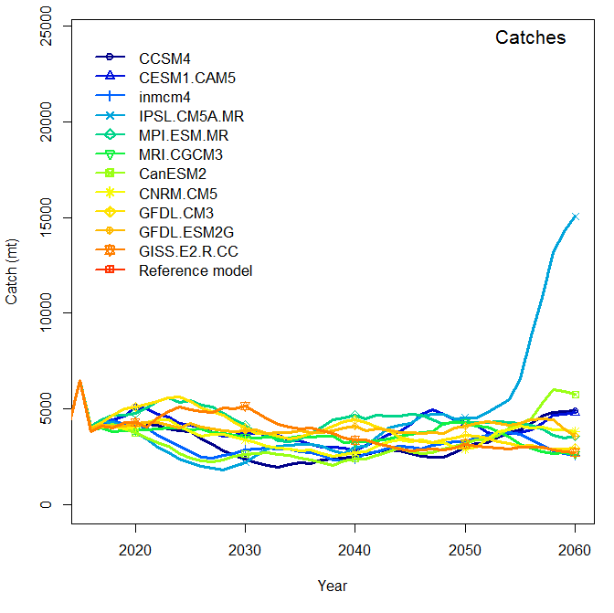
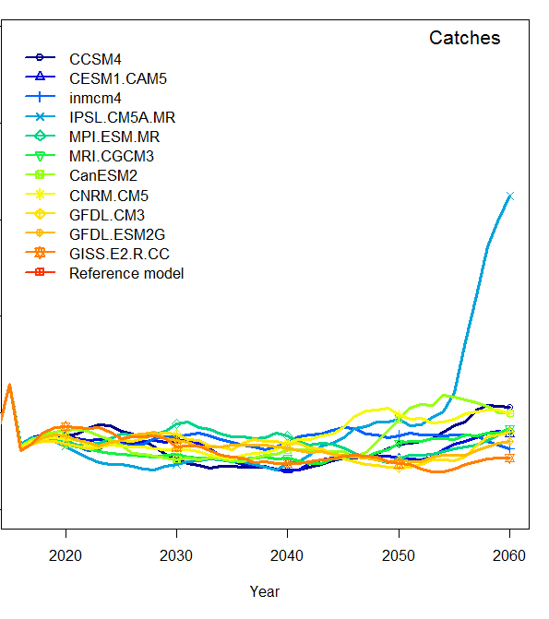
MSE Results: Catches
40-10 HCR
Dynamic 40-10 HCR
Notes:
Catches resulting from application of the current 40-10 HCR (top panel) and the dynamic unfished biomass HCR (bottom panel).
Note two model groups appear in CMIP5, those that suggest an overall decrease in wind forcing, upwelling strength, and boreal copepod community leading to lower catches and those that suggest in increase in deep water upwelling (see Ryan’s paper) leading to and increase in productivity due to ….see the MS
CMIP5 – catch projections are more pessimistic, with just over half of the GCMs suggesting that future catches will drop below the minimum landings caught
during the previous 20 years and very few suggesting that catches will increase. Projections suggest that catches will decline below the previous minimum anywhere between the early 2020s and 2050s.

Slide 18
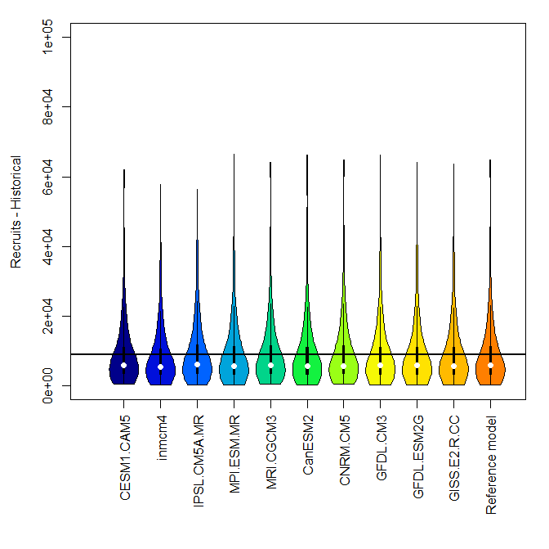
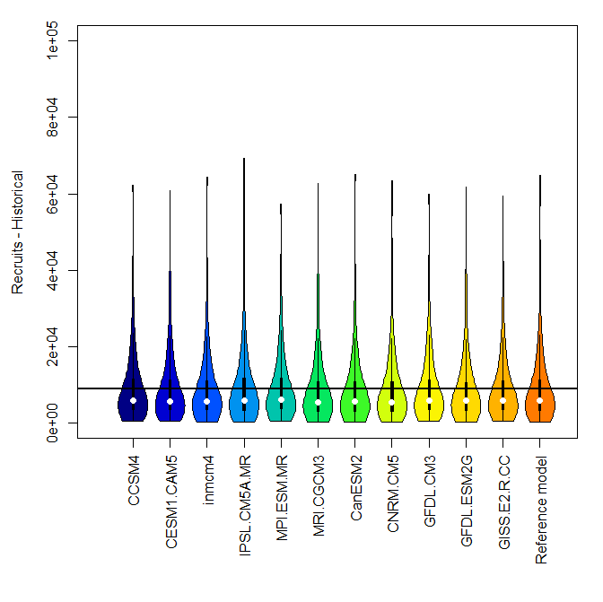

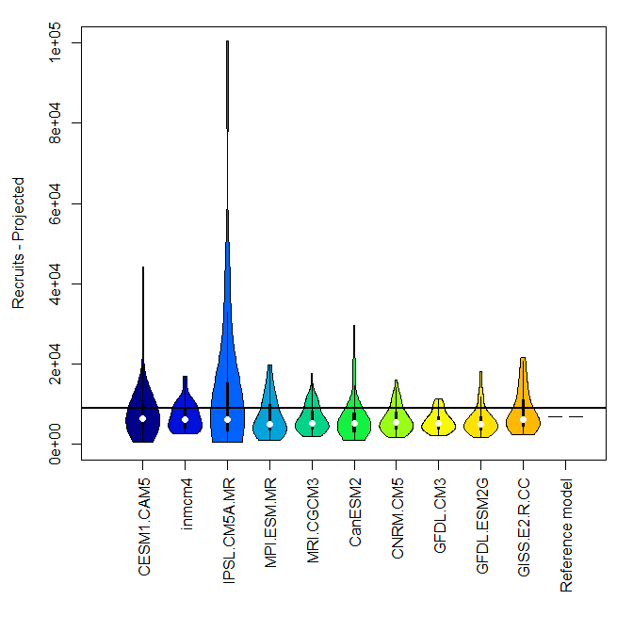
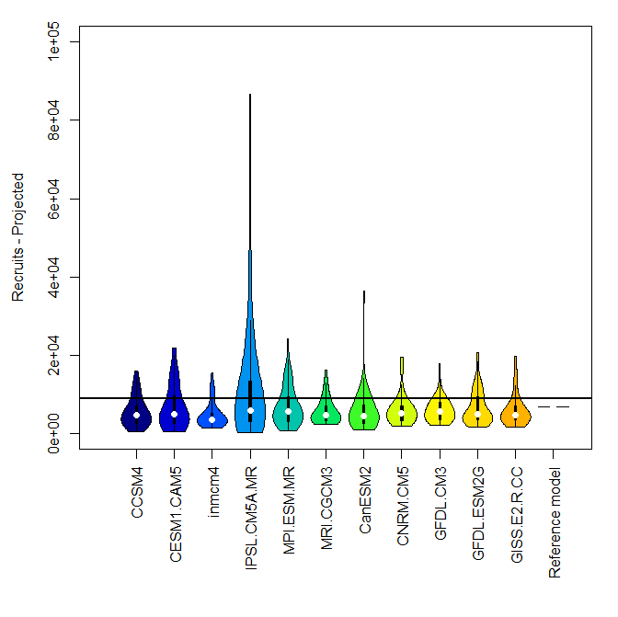
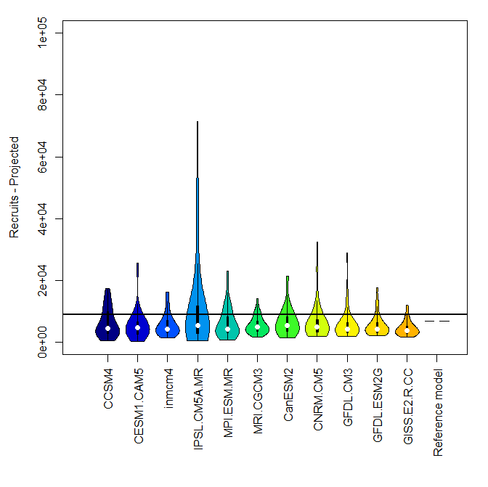
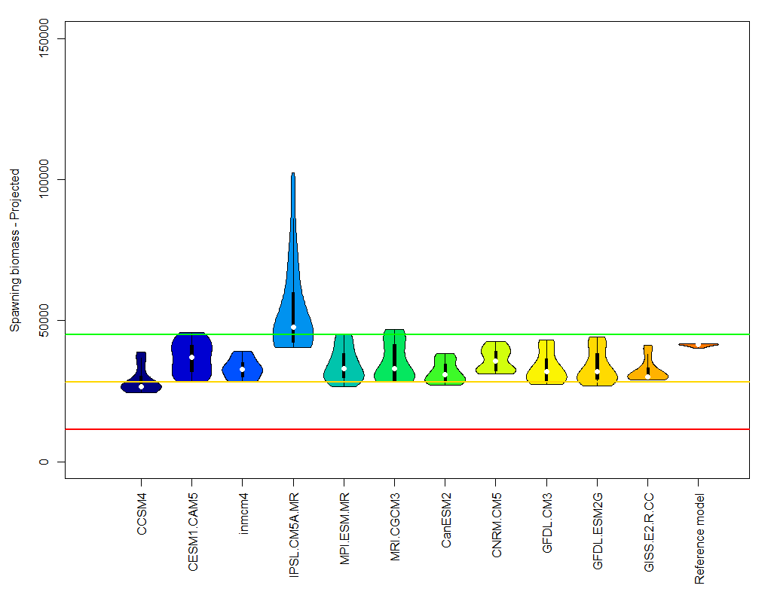
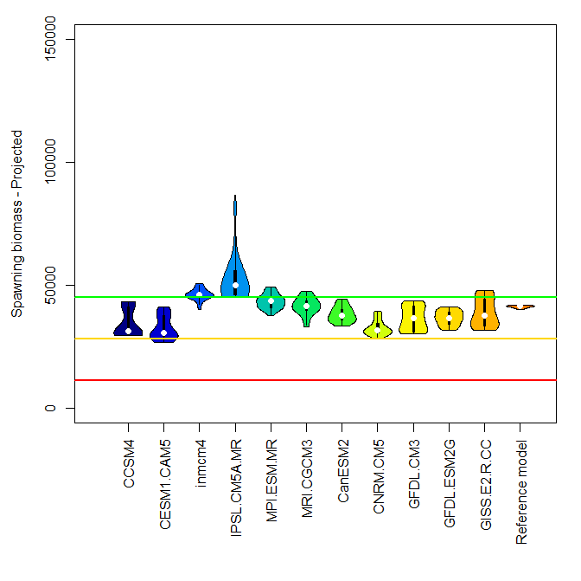
MSE Results: Recruitment distribution versus management target
No Fishing
40-10 HCR
Dynamic 40-10 HCR
Historical
Projected

Slide 19
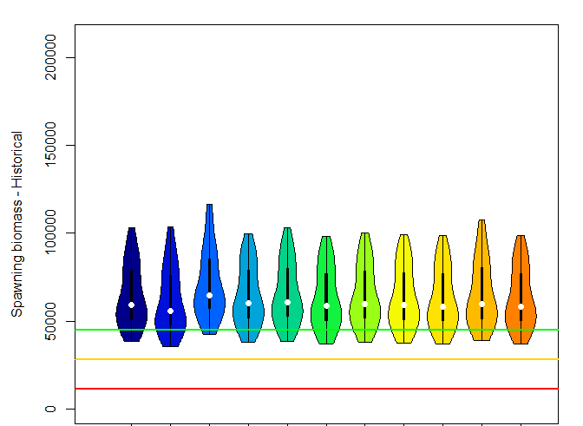
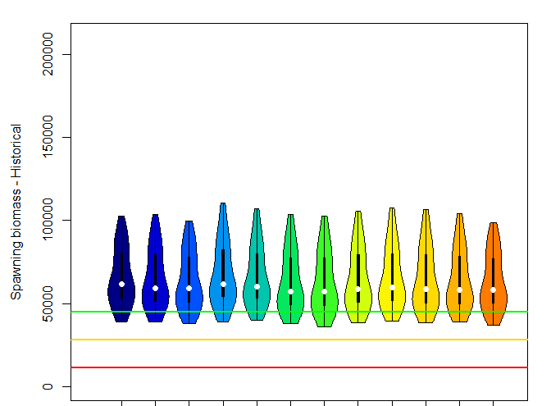
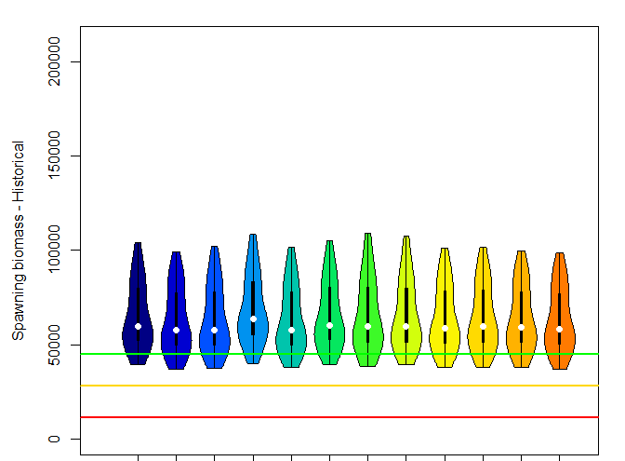
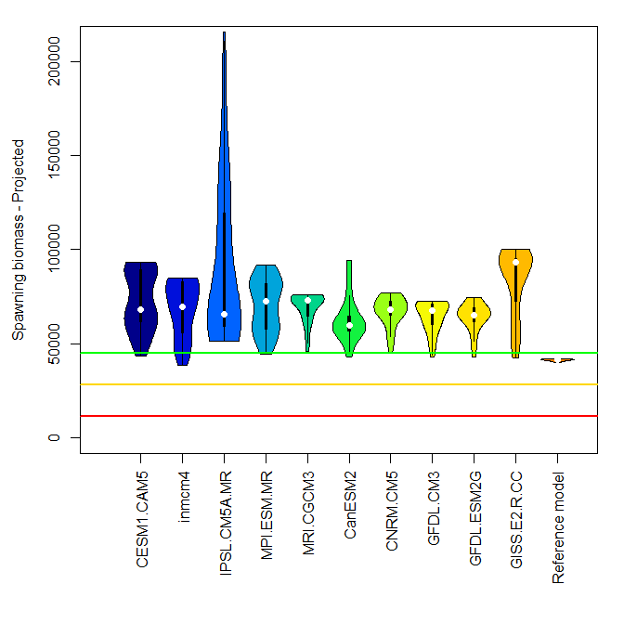
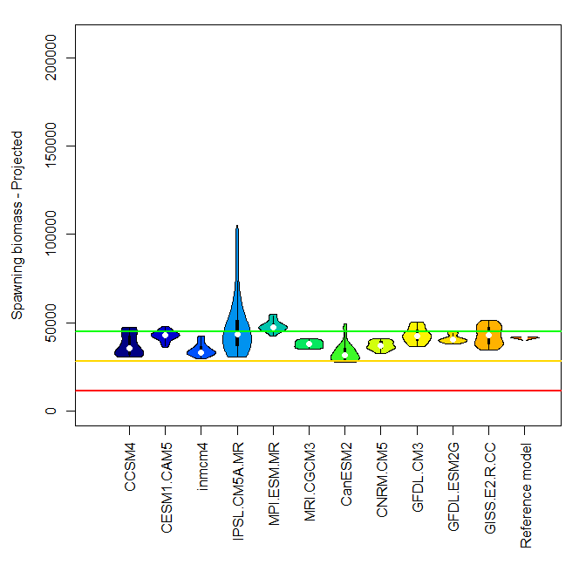
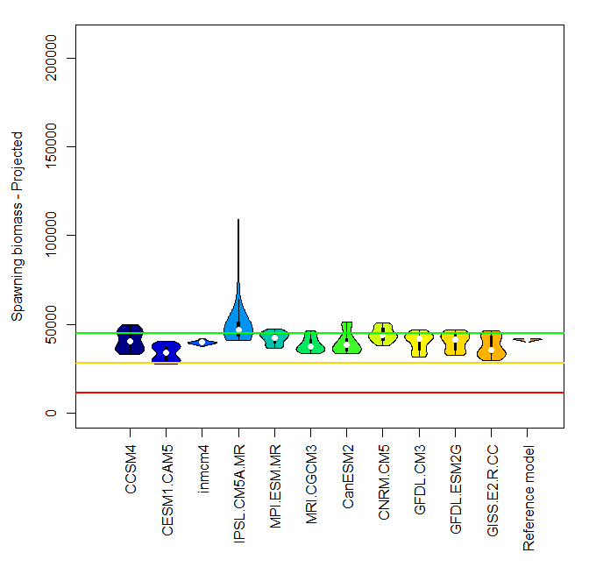
MSE Results: Spawning biomass (mt) distribution versus management target
No Fishing
40-10 HCR
Dynamic 40-10 HCR
Historical
Projected
Notes:
Figure 9. Spawning biomass distributions versus management targets including, the target sock size (40% of unfished spawning biomass, the green line), stock size at which a rebuilding plan would be required (25% of unfished spawning biomass, the yellow line), and stock size at which the fishery would be closed (10% of unfished spawning biomass, the red line). Panels show the historical distributions (upper row), projected distributions (lower row), and the three HCRs, no fishing (left column), 40-10 HCR (middle column), and dynamic unfished biomass HCR (right column). The GCMs are given across the x axis.

Slide 20
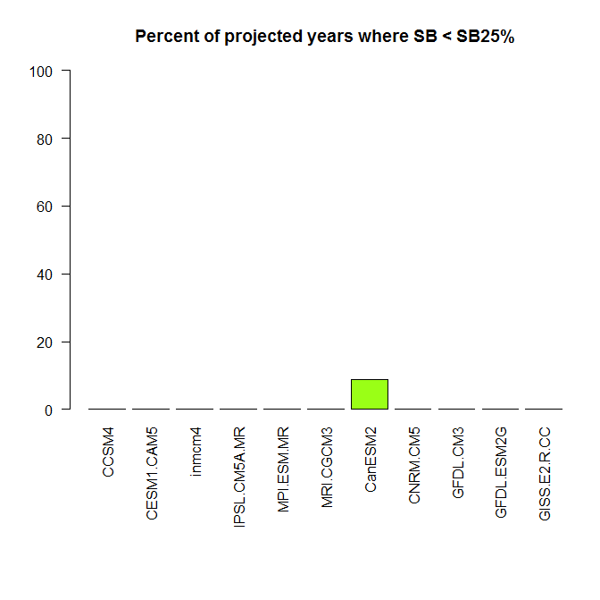
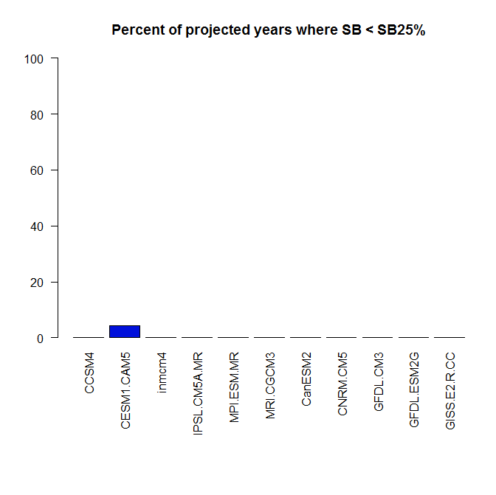
MSE Results: Proportion of years below management limit and fishery closure
40-10 HCR
Dynamic 40-10 HCR
Notes:
Figure 11. Proportion of years below the limit reference point of 25% of the estimated unfished spawning biomass for the 40-10 HCR (left panel) and the dynamic unfished biomass 40-10 HCR

Slide 21
Reference Points
 | No Catch |  | 40-10 HCR |  | Dynamic Unfished Biomass 40-10 HCR
 | Average | Standard Deviation | Average | Standard Deviation | Average | Standard Deviation
Unfished recruitment (millions) | 9.262 | 0.492 | 9.408 | 0.405 | 9.247 | 0.400
Unfished spawning biomass (mt) | 118,958 | 6,738 | 122,154 | 4,921 | 119,966 | 5,173
Spawning biomass at 40% Unfished spawning biomass (mt) | 47,584 | 2,695 | 48,862 | 1,968 | 47,986 | 2,069
Catch at 40% Unfished spawning biomass (mt) | 4,417 | 242 | 4,505 | 193 | 4,426 | 197
Spawning Biomass at MSY (mt) | 34,823 | 1,993 | 35,811 | 1,434 | 35,149 | 1,526
Catch at MSY (mt) | 4,630 | 252 | 4,721 | 203 | 4,639 | 206
Spawing biomass 2015-2024 (mt) | 51,122 | 3,488 | 42,214 | 4,523 | 43,145 | 3,084
Spawning biomass 2051-2060 (mt) | 87,741 | 26,051 | 42,795 | 10,580 | 41,696 | 11,919
Ratio of biomass 2015-2024 to Unfished spawning biomass | 43.1% | 3.2% | 34.6% | 3.5% | 36.0% | 2.4%
Ratio of biomass 2051-2060 to Unfished spawning biomass | 73.1% | 17.2% | 34.9% | 7.5% | 34.5% | 8.5%

Slide 22
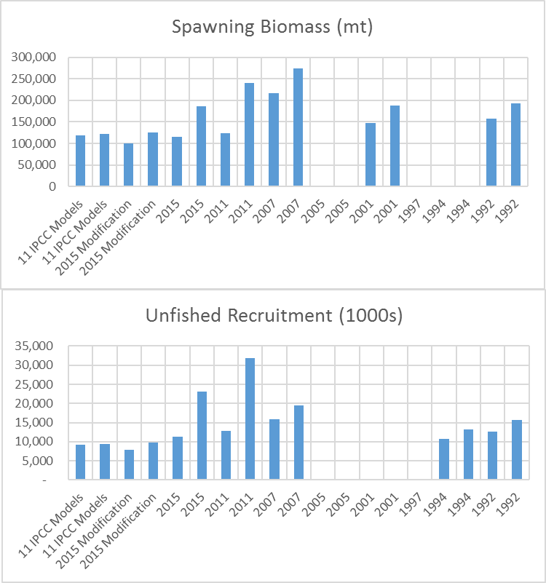
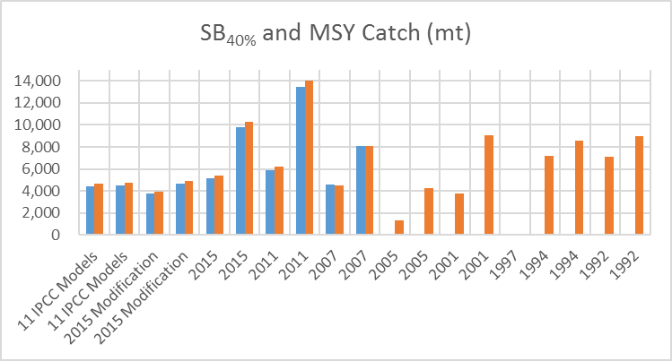
Past and Projected Reference Point Ranges
Unfished Spawning Biomass (mt)
SB_{40%} and MSY Catch (mt)
Unfished Recruitment (1000s)
The two sets of bars for each model provide the lower and upper range of uncertainty presented for each assessment.
Circles represent point estimates from assessments that did not present uncertainty.
Shaded boxes are values from this study.
Notes:
Range

Slide 23
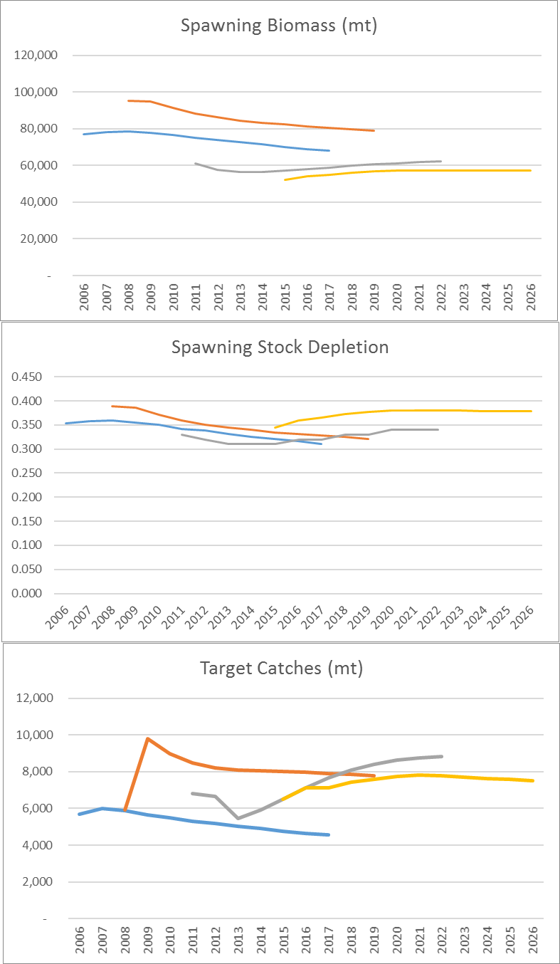
Past and Projected Management Advice
2005 Assessment
2007 Assessment
2011 Assessment
2015 Assessment
2015-2024 40-10 Mean Projected Value, IPCC
2051-2060 40-10 Mean Projected Value, IPCC
Catch 40% Unfished spawning biomass (mt)
Notes:
Points show the 40-10 rule and control rule catches

Slide 24
Conclusions
Future sablefish recruitment is likely to:
fall within the range of past observations
exhibit decadal trends that result in recruitment levels that persist at lower levels (~ 2040) followed by higher levels (~2040 - 2060)
GCMs capture long term sea level trends but less natural variability
Both HCRs:
Prevent fishery closures
Project declining, then stabilizing or slightly increasing spawning biomass and catch trends
Maintain the stock in the precautionary zone
SPR rate and target biomass are inconsistent policies
Future MSY Catches ~4100-5100 mt
Notes:
Projected SLs from the CMIP5 GCMs suggest that future sablefish recruitment is likely to fall within the range of past observations but may be less variable (this will likely change in revised model runs) and is likely to exhibit decadal trends that result in recruitment levels that persist at lower levels (through about 2040) followed somewhat higher levels (from about 2040 through 2060).
The current GCMs seem to capture long-term trends in SL but suggest less natural variability. Decreased variability in SL could be partially related to a weaker ENSO, but warrants further investigation. The lower variance in the GCM SL projections, in comparison to historical values, suggests a lack of occasional large recruitments during the projection period that could sustain the population at higher levels due to the decreased variability in sea level.
Two model groups appear, out of the 11 GCMs. The first group suggests an overall decrease in productivity due to decreases in wind forcing, upwelling strength, and boreal copepod community leading to lower catches (higher SL resulting in lower recruitment). The second group suggests increases in productivity, likely due to increasing in deep water, nitrogen rich, upwelling (Rykaczewski and Dunne 2010) leading to an increase in productivity (lower sea level resulting in higher recruitment). A majority of the GCMs suggest that after about 2040 there will be a slight trend towards generally lower SLs, with an increasing frequency of low SLs outside of the range of the historical observations. Lower sea levels suggest more favorable conditions for sablefish in the northern California Current. Analyses of potential oceanographic changes in the CC due to climate change suggest only moderate oceanographic changes
natural variability overshadows climate signals for many important metrics (Overland and Wang, 2007; Wang et al., 2010)
This MSE suggests that although spawning biomass and catches decline, and then stabilize, into the future under both the current 40-10 HCR, with static reference points, and the alternative dynamic B0 40-10 HCR, that both HCRs maintain the sablefish stock above the stock size that causes a fishery closure, as intended. However, using the 40-10 HCR triggers stock rebuilding plans more frequently that the dynamic B0 40-10 HCR, suggesting that the dynamic B0 HCR is more robust to potential future climate change due to the ability to track decadal scale changes in productivity.
While the dynamic B₀ HCR appears favorable given long-term shifts in productivity due to environment, it could be risk prone in cases where fishing pressure is causing biomass declines, allowing higher catches at low stock sizes due to reference points shifting lower through time. In practice, presenting a combination of both static and dynamic B₀ reference points to fishery managers is recommended.
This MSE is based solely on a modification of the current PFMC stock assessment model implemented for management in the CC.
Main caveat - Assume stable sea level-recruitment relationship, as well as other potentially important ecological relationships
-Punt et al. -risk of wrong managmenet choice given climate information outweights inclusion in assessments
-problem – past observations may not be representative of future -
We have quantified what the King et al paper suggested – qualitative sablefish scenario
King et al. 2011. ICES Journal of Marine Science, 68(6), 1199–1216.
Loss of southern range with warm-water impacts on larvae
In the north, decreased year-class success with reduced spring
productivity and copepod production for larvae
Longevity with periodic strong year classes maintains biomass
King et al. (2000), King and McFarlane (2003), and Schirripa and Colbert (2006)
The statistical downscaling approach, based on
a moderate greenhouse-gas-emission scenario (A1B), suggests
only moderate oceanographic changes: mild surface warming
accompanied by relatively minor increases in upwelling-favourable
winds in northern portions of the CCS. Natural variability overshadows
climate signals for many important metrics (Overland
and Wang, 2007; Wang et al., 2010). Our downscaling results
agree with the basic findings of Mote and Mantua (2002) that
drastic changes in upwelling are unlikely over the next few
decades. They are at odds with Bakun (1990) and Snyder et al.
(2003), who posited that upwelling was liable to strengthen.
Under a scenario based on the statistical downscaling outlined
above, resource managers might anticipate relatively minor
changes rooted in mild warming and small, localized increases
in upwelling long-lived, highly fecund species
(periodic strategists), such as Dover sole, sablefish, and rockfish
(Table 2), can withstand many years of poor recruitment by
taking the substantial advantage of interannual variability that
periodically favors good recruitment.
Adaptation strategies: farm raised all female sablefish.
Evaluate the resilience of the Sablefish supply chain to potential declines in catch…in a scenario of declining stock how to add value to product and ensure a resilient supply chain for sablefish?
Goal to build community reliance to potential change, particularly where the weight of the current evidence suggests that change may be negative.
This kind of study may be refined/improved via Process oriented fisheries studies

Slide 25
Conclusions
Both 40-10 and Dynamic B0 HCRs trigger stock rebuilding plans occasionally
Dynamic B0 HCR:
May be more robust to potential future climate change due to the ability to track decadal scale changes in productivity
But performs similarly to the 40-10 HCR given the implementation of a long moving window
Could be risk prone in cases where fishing pressure is causing biomass declines, allowing higher catches at low stock sizes due to reference points shifting lower through time.
Recommend presenting a combination of both static and dynamic B₀ reference points to fishery managers
Notes:
Projected SLs from the CMIP5 GCMs suggest that future sablefish recruitment is likely to fall within the range of past observations but may be less variable (this will likely change in revised model runs) and is likely to exhibit decadal trends that result in recruitment levels that persist at lower levels (through about 2040) followed somewhat higher levels (from about 2040 through 2060).
The current GCMs seem to capture long-term trends in SL but suggest less natural variability. Decreased variability in SL could be partially related to a weaker ENSO, but warrants further investigation. The lower variance in the GCM SL projections, in comparison to historical values, suggests a lack of occasional large recruitments during the projection period that could sustain the population at higher levels due to the decreased variability in sea level.
Two model groups appear, out of the 11 GCMs. The first group suggests an overall decrease in productivity due to decreases in wind forcing, upwelling strength, and boreal copepod community leading to lower catches (higher SL resulting in lower recruitment). The second group suggests increases in productivity, likely due to increasing in deep water, nitrogen rich, upwelling (Rykaczewski and Dunne 2010) leading to an increase in productivity (lower sea level resulting in higher recruitment). A majority of the GCMs suggest that after about 2040 there will be a slight trend towards generally lower SLs, with an increasing frequency of low SLs outside of the range of the historical observations. Lower sea levels suggest more favorable conditions for sablefish in the northern California Current. Analyses of potential oceanographic changes in the CC due to climate change suggest only moderate oceanographic changes
natural variability overshadows climate signals for many important metrics (Overland and Wang, 2007; Wang et al., 2010)
This MSE suggests that although spawning biomass and catches decline, and then stabilize, into the future under both the current 40-10 HCR, with static reference points, and the alternative dynamic B0 40-10 HCR, that both HCRs maintain the sablefish stock above the stock size that causes a fishery closure, as intended. However, using the 40-10 HCR triggers stock rebuilding plans more frequently that the dynamic B0 40-10 HCR, suggesting that the dynamic B0 HCR is more robust to potential future climate change due to the ability to track decadal scale changes in productivity.
While the dynamic B₀ HCR appears favorable given long-term shifts in productivity due to environment, it could be risk prone in cases where fishing pressure is causing biomass declines, allowing higher catches at low stock sizes due to reference points shifting lower through time. In practice, presenting a combination of both static and dynamic B₀ reference points to fishery managers is recommended.
This MSE is based solely on a modification of the current PFMC stock assessment model implemented for management in the CC.
Main caveat - Assume stable sea level-recruitment relationship, as well as other potentially important ecological relationships
-Punt et al. -risk of wrong managmenet choice given climate information outweights inclusion in assessments
-problem – past observations may not be representative of future -
We have quantified what the King et al paper suggested – qualitative sablefish scenario
King et al. 2011. ICES Journal of Marine Science, 68(6), 1199–1216.
Loss of southern range with warm-water impacts on larvae
In the north, decreased year-class success with reduced spring
productivity and copepod production for larvae
Longevity with periodic strong year classes maintains biomass
King et al. (2000), King and McFarlane (2003), and Schirripa and Colbert (2006)
The statistical downscaling approach, based on
a moderate greenhouse-gas-emission scenario (A1B), suggests
only moderate oceanographic changes: mild surface warming
accompanied by relatively minor increases in upwelling-favourable
winds in northern portions of the CCS. Natural variability overshadows
climate signals for many important metrics (Overland
and Wang, 2007; Wang et al., 2010). Our downscaling results
agree with the basic findings of Mote and Mantua (2002) that
drastic changes in upwelling are unlikely over the next few
decades. They are at odds with Bakun (1990) and Snyder et al.
(2003), who posited that upwelling was liable to strengthen.
Under a scenario based on the statistical downscaling outlined
above, resource managers might anticipate relatively minor
changes rooted in mild warming and small, localized increases
in upwelling long-lived, highly fecund species
(periodic strategists), such as Dover sole, sablefish, and rockfish
(Table 2), can withstand many years of poor recruitment by
taking the substantial advantage of interannual variability that
periodically favors good recruitment.
Adaptation strategies: farm raised all female sablefish.
Evaluate the resilience of the Sablefish supply chain to potential declines in catch…in a scenario of declining stock how to add value to product and ensure a resilient supply chain for sablefish?
Goal to build community reliance to potential change, particularly where the weight of the current evidence suggests that change may be negative.
This kind of study may be refined/improved via Process oriented fisheries studies

Slide 26
Future Directions
Funding
NMFS-Sea Grant fellow in population dynamics, pending
DFO 2 year post-doc or researcher, awarded
Stakeholder input is fundamental to define and evaluate alternative MSE frameworks that are viable and possible to implement
Input regarding alternative:
Management objectives
Management strategies
Performance Metrics
Operating models: fishery and population dynamics
Notes:
Possible management objectives, e.g.:
Restore to within a prescribed period of time or maintain at Bmsy
The risk of failure to meet the Bmsy target and interim biomass targets within a prescribed period of time should be kept moderately low
Low risk of exceeding Fmsy
Very low risk of going below an established threshold (e.g. Blim or Blim proxy)
Maximize yield in the short, medium and long term
The risk of steep decline of stock biomass should be kept moderately low
Keep inter annual TAC variation below established thresholds
All management objectives cannot be maximized simultaneously, therefore seek a HCR that strikes the best balance between objectives.
E.g. provide a high probability of reaching target stock size and a very low risk of going below Blim. At the same time catches should remain relatively stable.
Alternative performance indicators, e.g.
Fish size in the catch
CPUE

Slide 27
Future Directions
Maintain monitoring programs
Engage with industry and managers to solicit feedback on alternative control rules and performance metrics
Collaborate with NE Pacific sablefish scientists
Straddling stock data and assessment issues
Consider community adaptation strategies
Investigate the utility and skill of short term seasonal to annual forecasting using regional environmental indices at spatio-temporal scales relevant to the sablefish life history.
Research technical aspects of recruitment hindcasting and bias correction.
Notes:
A separate MSE for British Columbia sablefish also assumed a closed stock in spite of the contrary evidence (Cox and Kronlund 2008). Future MSEs for sablefish should encompass the whole NE Pacific stock. In fact, the PFMC passed a motion during 2015 requesting that federal scientists “initiate a comprehensive review of the status of the sablefish stock throughout its range, including Canada and Alaska”
Currently, near-term sablefish forecasts rely upon average recruitment from the stock recruitment curve. However, recruitment is often far above or below the average, with large annual deviations around that curve. Using even the weak SL-recruitment relationship to inform whether near term recruitment is likely to be above or below the average would be informative for fishery managers.
Regional sea level, as used in this study, reflects the integrated effects of a variety of processes and represents a single overall measure of physical oceanographic conditions. Using specific regional environmental indices at spatio-temporal scales relevant to the sablefish life history results in greater ability to explain the variation around the stock-recruitment curve, 57% in the case of CC sablefish (Tolimieri et al. 2018). Indices with greater explanatory power are more likely to be useful in near term recruitment projections from stock assessment models and may be less likely to break down over time. The indices identified by Tolimieri et al. (2018) could inform future MSE development for sablefish both in the CC and the NE Pacific as well as for short term forecasting of recruitment.
maintaining monitoring programs – need to track non-stationary – reduction of uncertainty via more monitoring
This is a straddling stock managed by PFMC, DFO-BC, and NPFMC – non of which have a routine mechanism for exchange of information - not a closed stock, should be tracking what is happening in waters of British Columbia and Alaska
Finally, research that can provide advice on technical stock assessment modeling issues such as how best to specify the stock-recruitment bias correction during model periods with environmental data (where, in this example, SL informs a recruitment estimate a single time) but without length and age composition data (where multiple observations through time inform recruitment estimates) would be beneficial to future studies. While the current implementation of the stock-recruitment bias correction in SS is implemented as a simple ramp (Methot and Taylor 2011), a more complex shape would most likely be an improvement when environmental data is used to hind-cast recruitment in the absence of age- and length-composition data.

Slide 28
Contact Information
Dr. Melissa A. Haltuch
melissa.haltuch@noaa.gov
Phone: 206.860.3480
Research Fishery Biologist, NOAA Fisheries
Affiliate Faculty, University of Washington, School of Aquatic and Fishery Science

Slide 30
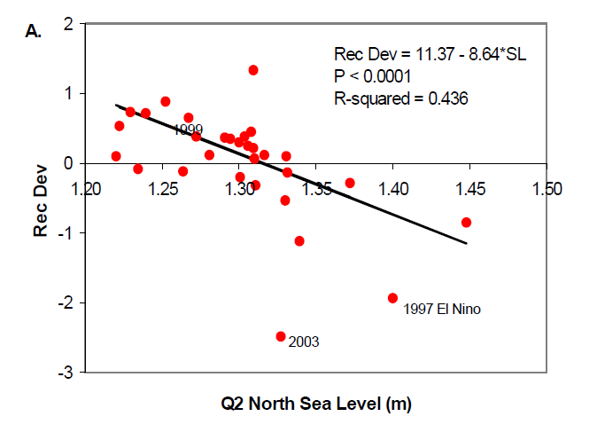
SSH z-score used to model recruitment deviations from 1925-2005.
SSH Spatio-temporal average: April-June and 44-48 degrees N.
Sigma-R = ~half of the model without the environmental covariate.
STAR Panel concurred.
PFMC SSC took issue with reducing sigma-R b/c of reduced bias correction on Bo and resulting underestimation of Bo.
2005
Stock Assessment
Estimated relationship outside of the stock assessment uses recruitment deviations from 1974-2003
Notes:
A significant relation was observed between
second quarter (April, May, and June) sea level in
the northern coast (44-48 degrees latitude) and
age-0 sablefish survivorship, as depicted by
deviations from the estimated spawner-recruit
function. If this relationship also existed
historically back to 1925, then the following
additional inferences can be drawn with regard to
survivorship and recruitment: (1) since 1925
sablefish survivorship has experienced two
stanzas, a lower survivorship period from 1925 to
1961 when sea levels were on average higher, and
a higher survivorship period from 1961 to 2000,
when sea levels were on average lower; (2) since
the late 1960's. recruitment in sablefish has shown
a gradual decline, with the exception of the strong
1999 and 2000 year classes.
A significant relationship between recruitment and sea-level recorded at Crescent City, California was used
to strength the previous theory that environmental factors were indeed critical to the recruitment process.
Sea level data was used as a proxy to describe oceanographic conditions which were used to augment estimates of recruitment deviations starting in 1925.
sea level was used as a covariate for recruitment deviations from the fitted stock-recruit
relation. The stock-recruit function used the to modify the recruitments coming
off the stock-recruit function (Maunder and Watters, 2003; Sinclair and Crawford, 2005). The variance of
the stock-recruit function (sigma-R) was estimated through iteration and matching the assumed variance to
the resulting residual mean square error. Because sea level was accounting for a portion of the variance in
recruitment, sigma-R of the stock-recruit function was somewhat lower (sigma-R = 0.278) than that from the
model without the environmental covariate (sigma-R = 0.68). Recruitment deviations were estimated from
1925 to 2005.
Environmental determination of variation in sablefish recruitment
Sablefish recruitment is assumed to follow a Beverton-Holt type spawner-recruit function. We regressed the
estimated variation about the curve on potential explanatory variables (Schirripa and Colbert, 2005). We
partitioned the range of sablefish in the California Current domain into two regions. We chose these two
regions because history of surveys suggests this area is where the majority of recruits are produced.
We considered the northern region to be the coastal ocean between 44/ N to 50/ N Latitude and the central
region to be between 38/ N. to 44/ N Latitude. We created coastal averages for north-south and east-west
Ekman transport, sea level pressure, and sea surface temperature by averaging monthly means for coastal 1/
x 1/ Latitude-Longitude cells from each region. We found seven sites; Neah Bay and Willapa Bay
Washington, Astoria, Newport and Coos Bay Oregon, Crescent City and San Francisco California had
consistent long-term historical monthly mean sea level readings. We averaged the first four of these to form
the northern region and the last three to form the central region, providing monthly coastal averages. We next
considered historical measures of Pacific basin-wide variation that could influence sablefish recruitment.
Here we chose the multivariate ENSO index (MEI), Southern Oscillation Index (SOI), Northern Oscillation
Index (NOI), and the North Pacific Index (NPI). MEI is a by-monthly average variable while all others were
available as monthly averages for each year.
From the monthly average variables we created seasonal variables for winter, spring, summer and fall, as well
as quarterly variables for each year where historical data were available. Winter is defined as the last two
month of the prior year and the first two months of the current year (November-February), spring is the
following two months (March-April), summer is the following four months (May-August), and fall is the
following two months (September-October).
Independently, we tested these eight temporal summaries of the four coastal variables and four basin-wide
indexes of ocean conditions, looking for significant relationships between these environmental variables and
sablefish recruitment. Stepwise regression was used to screen the list of environmental variables with the
acceptance and removal levels set at 0.05. All regressions were weighted, using the reciprocal of standard
error of estimates for deviations from the assumed Beverton-Holt model as weights. From these initial
screening procedures we obtained two variables that can be used to explain variation in the deviations of
sablefish recruitment about the assumed spawner-recruit model. Environmental conditions in the second
quarter (April-June) were consistently found to provide for highest explanatory power (Figure 26).
North-coast (44/ to 50/ N) sea level can explain 43.6 % of the variation (F = 21.66, P < 0.0001) and the North
Pacific Index can explain 31.4 % of the variation (F = 12.82, P = 0.0013). We examined these data for more
complex multiple regression models and general additive spline alternatives but found no significant
improvement in explaining variation in sablefish recruitment from these environmental variables.
Young-of-year sablefish have matured out of the larval stage, are free swimming and free feeding in late
spring and early summer. At this stage they are searching for zooplankton and other food while moving
onshore to nursery grounds. Low sea level and low values of the North Pacific Index suggest higher than
expected recruitment. The tide gauge sea level data we use are not adjusted for barometric pressure, so they
integrate both the atmospheric effects and the large-scale ocean conditions. That is, they integrate both the
large-scale northeastern Pacific Ocean conditions with local upwelling and pressure. Sea level is also a good
predictor of near-bottom ocean temperature along the shelf. Lower sea level is associated with colder than
average water, more upwelling, stronger southward currents and lower salinity. All these factors provide
better habitat conditions for young sablefish, as they inhabit the shelf at this time of year. Higher values of
NPI are associated with cool regimes or La Niña conditions which have been shown to produce more
favorable conditions for northern copepod species and richer food sources for feeding juveniles in the mixed
layer over the shelf.
To make use of these results in the 2005 projection, we need an estimate of average sea level for April-June
2005. Given the data available for sea level, we have developed the prediction of this quarterly mean from
just the April data that is now available. The April mean sea level for 2005 is 1.39175; using the historical
relationship between April and Q2 sea level, the predicted Q2 Mean sea level is 1.3678. While sea level has
been quite erratic so far this year, April can be used to provide our best estimate for sablefish recruitment for
the current year.
The stock recruitment parameter relating sea level to recruitment deviations was, as expected, indicative of
a satisfactory agreement between the two variables (-0.359). Figure 34 shows the relation between the sea
level index and recruitment deviations. Recruitment deviations from 1925 to 1973 were driven nearly entirely
by sea level data. This is because there was no other data within the model with a strong enough signal to
alter the fit. If we assume the same relation observed from 1974 to 2003 held true previous to this period,
we can see that perhaps two periods of productivity took place. Our sea level index showed an approximate
30 year cycle of high sea level from 1925-1960 (low sablefish productivity) and lower sea level from 1961
more recent (high sablefish productivity). This leads to two possible conclusions: (1) that steepness for
sablefish has changed over the last 100 years and is specific to the current environmental conditions, or (2)
that a stock can indeed persist with fishing mortality if environmental conditions are such as to increase
survivorship with enough frequency and magnitude.
Recommendations
5. Develop a study to examine the adequacy and accuracy of incorporating environmental factors into an
assessment. Attempt to define the most appropriate methods for examining environmental factors that are
external to but may have pronounced influences on the population dynamics (internal feedbacks) of the
species and its fishery. How best do we accurately incorporate these external influences into the
assessment process?
STAR
1.4) The STAT’s proposed base model estimates a relationship between sea level and recruitment deviations for the period 1973-2003 and extrapolates that relationship to the remainder of the time series. To test the sensitivity of model results to this extrapolation, the STAR Panel requested the STAT to conduct an alternative run with this relationship “turned off” for the years outside the period within which the environment-recruitment relationship was estimated.
Run STAR4e (responding to Request 1.4, with the environmental component of the stock-recruitment relationship “turned off” during years outside the range within which
3
the environmental effect was actually estimated) gives a much lower initial biomass than Model 4 in the early portion of the time series, but the biomass levels are similar in later years. In terms of depletion, run STAR4e is much higher than Model 4 in the middle portion of the time series, but only slightly higher than Model 4 in later years. Run STAR4e gives an intermediate case between inclusion of all years of environmental data and only the later portion of the environmental time series. Overall, the STAR Panel was supportive of the STAT’s efforts to include an environmental component to the stock-recruitment relationship.
The STAR Panel concurred with the STAT’s use of an environmental covariate to model recruitment deviations.
Recommendation -
4) Simulation testing of methods for estimating environmental, as well as stock, effects on recruitment in the context of stock assessment modeling
Bridge from 2005 to 2007
Model configuration #0, the “bridge model” between the 2005 and current assessment, produced results that
were essentially identical to those presented in the 2005 assessment. However, it was not chosen as the baserun
because of the issues associated with the manner in which the stock-recruitment function was constructed.
In this model the deviations in survival caused by the environmental effects were modeled as variation within
the variation accounted for in sigma-r. Consequently, including as environmental effect meant that the sigmar
had to be reduced to reflect the remaining variation not accounted for by the environmental effects.
However, reducing sigma-r in this manner has the undesirable consequence of reducing the bias correction on
B-zero as well. Simulation work confirmed that indeed B-zero will be under-estimated using this approach.

Slide 31
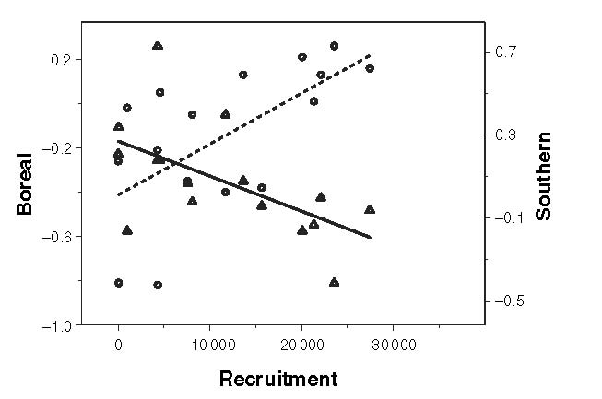
Schirripa and Colbert, 2006
Boreal copepods
Anomalies
---- Trend
Southern copepods
Anomalies
Trend
Explains ~35-40% of recruitment variability
Notes:
Figure 7. Boreal copepod anomalies (circles) and trend line (dashed) and the southern copepod anomalies (triangles) and trend line (solid) plotted against sablefish recruitment using 1985–99 data from Mackas et al. (2001).
SSH appears to have been selected, in part, as a replacement for the copepod index on the basis of the correlation between the two and the more complete time series of the former.
Lower sea level is associated with colder-than-average water, more upwelling, stronger southward currents and lower salinity. All these factors provide better habitat conditions for young sablefish, as they inhabit the shelf at this time of year.
Grover and Olla (1987) found that the size of copepods found in the stomachs of sablefish larvae differed during El Nin˜o years. Specifically, a smaller (<1 mm),
‘southern’ warm-water species of copepods, Paracalanus parvus, contributed significantly more to the diets of larval sablefish in 1983 (El Nin˜o) than in 1980 (a non-
El Nin˜o year).
For sablefish, the correlation between productivity in the California current and recruitment success is well-documented (Schirripa and Colbert 2006, Schirripa et al. 2009) and has been included in recent stock assessments (Schirripa 2002, Schirripa and Colbert 2005, Schirripa 2007).
SSH integrates, regional wind forcing, temperature anomolies, Coastally trapped phenomena

Slide 32
2007 Stock Assessment
Sea surface height and zooplankton data were used to index recruitment deviations from the estimated stock recruitment function.
SSH data, 1972-2006
SSH Anomalies calculated using a standard z-score from 1924 to 2006.
Zooplankton data, 1979-2001
Notes:
Discussion of this but not clear what was actually used…
1925 to 1992 tide gauge
1993-2006, data from the satellites JASON and TOPEX?
Model files show
Estimation of simple deviations around Ro based on ‘regime’ change 1972 2006 -5 4 2 #_recr_devs ENV OFF
As survey index of recruitment 1972-2006
sea surface height (SSH) data, 1925-2006; and zooplankton abundance data, 1979-2001. Seasurface
height and zooplankton data were used to index recruitment deviations from the estimated stockrecruitment
function.
A significant relation was observed between second quarter (April, May,
and June) sea surface height in the northern coast (44-48 degrees latitude) and age-0 sablefish
survivorship. A weaker, yet still significant, relationship was found between recruitment deviations and
zooplankton species composition. While SSH is thought to affect sablefish recruitment at the physical
oceanographic level, zooplankton species composition is thought to affect survival at a more basic
biological level. The SSH and zooplankton index were significantly related, suggesting they are acting in
concert on overall survivorship.
SSH Index
Sea-Surface Height (survey #4). From 1925 to 1992 data on monthly average coastal sea surface height
(SSH) was obtained from the NOAA Center for Operational Oceanographic Products and Services
10
http://tidesandcurrents.noaa.gov/). We used data from Neah Bay and Toke Point, Washington and Astoria and
Newport, Oregon and averaged the monthly SSH over April, May, and June to arrive at a coastal SSH
between 44° N to 50° N Latitude (Figure 13). From 1993-2006, data from the satellites JASON and TOPEX
were used in lieu of the tide-stage data. A polygon was drawn over the area from 44° N to 50° N Latitude to a
depth of 1650 meters (Figure 14). Anomalies were calculated using a standard z-score from 1924 to 2006.
Hereafter, this vector of SSH anomalies for the second calendar quarter of the year will be referred to as the
SSH Index.
Recruitment Model Spex/Justification
Recruitment deviations were estimated either from 1971-2005, or from 1925 to 2006, depending on whether
the long-term SSH data was used. The variance of the stock-recruit function (sigma-R) was estimated
through iteration and matching the assumed variance to the resulting residual mean square error. The final
sigma-R used was 0.60.
In late spring and early summer young-of-year sablefish have matured out of the larval stage, are free
swimming and free feeding. At this stage they are searching for zooplankton and other food while moving
onshore to nursery grounds. Low sea level and low values of the North Pacific Index suggest higher than
expected recruitment. The tide gauge sea level data we use are not adjusted for barometric pressure, so they
integrate both the atmospheric effects and the large-scale ocean conditions. That is, they integrate both the
large-scale northeastern Pacific Ocean conditions with local upwelling and pressure. Sea level is also a good
predictor of near-bottom ocean temperature along the shelf. Lower sea level is associated with colder than
average water, more upwelling, stronger southward currents and lower salinity. All these factors provide
better habitat conditions for young sablefish, as they inhabit the shelf at this time of year.
Research and Data Needs
While the significant relation between the SSH index and sablefish age-0 survival demonstrates
that this should be a reliable (at least near term) index, the zooplankton index may support the
underlying biological mechanism as to exactly WHY this relationship is being observed.
Investigations into the food habits of age-0 fish, especially during the spring months, could help
with this understanding. The date of the Spring Transition also shows promise as an early
indicator of recruitment strength and should be investigated further. Also, further research
should be conducted to evaluate alternative methods for incorporating ecosystem metrics into the
assessment. For example, should the two current indices be combined into one index by way of a
principal component analysis or should the current (or similar) multivariate method be used. The
simulation work conducted for the recent Groundfish Harvest Policy Evaluation Workshop
should be continued and should address issues of this nature.
Sea surface height data going back to 1925
suggests that there may have been a fundamental shift in the mean SSH around the year 1961. If this is
the case, it is difficult to estimate how or even if, this shift may have affected the productivity of the
stock. Furthermore, the variability of productivity of the CCS prior to 1925 are unknown. Consequently,
the concept of a static “virgin” biomass is challenged by one in which an unfished sablefish population
would exhibit substantial variability in response to long-term oscillation in environmental conditions.
Without a longer time series of environmental data, it is not possible to determine if environmental
conditions near 1925 represent a reasonable long-term average state, relative to the productivity for the
sablefish stock.
Overall Perspectives. A unification of sablefish recruitment, climate change, and the factors that affect
the California Current System is suggested: as goes climate change, so goes sablefish recruitment. If
future climate change results in a more erratic California Current System, as predicted by some models,
the results may be more erratic sablefish recruitment. Should this happen, the fishery may end up being
supported by fewer, less frequent, strong year classes rather than by a greater number of “average”
strength year classes.
At present, the strong 1999 and 2000 years classes are fully within the fishery. Whether these two year
classes are due to past management actions or merely favorable oceanographic conditions is not clear.
Caution should be exercised when using the apparent high abundance of these two year classes as an
index of overall stock health. Although the two year classes are estimated to be the strongest in recent
history, adjacent year classes do not appear to be as strong.
STAT Response to STAR Panel
The STAT found many of the concerns raised in the report to be either totally unfounded or too general to
be of any help to the process. The STAT made written mention of these generalities and inaccuracies
during the report writing process, but the final report failed to address many of the STAT concerns and
maintained many of its original criticisms and extremely ambiguous tone. As a result, the STAT feels
compelled to address several Panel comments in this document.
As catch estimates are made further into the future, the use of environmental indicators to help forecast
recruitment strength will become more important. The environmental indices used are and exactly the
same as those used in the previous assessment and extremely similar to those published in Schirripa and
Colbert (2004). Despite statements made in the STAR Panel report, this publication does indeed do a
type of validation that was fully accepted by the peer reviewers of the documents. Given the low p-values
of the regression (p = 0.00004191) and the biology supporting the index, it is highly unlikely that the
relationship is spurious. There was an obvious difference of philosophy between the STAR Panel and the
STAT as to the importance of including these data. While the report terms the use of such indices as
“fashionable”, the STAT challenges this characterization by pointing out that no other assessment on the
west coast is currently using environmental data to help determine and/or forecast recruitment.
The STAR Panel’s conclusion that the complexity of the model was not justified given the likely
information content of the data was not supported by any specific details or examples of consequence. In
fact, the STAT made large strides to decrease the complexity of previous model configurations
SSC
The sablefish assessment continues to use sea surface height (SSH) as a predictor of recruitment. These environmental data are incorporated in a technically superior way compared to the previous assessment. One result of these changes and the addition of the most recent data is that the model now provides a plausible estimate for steepness.
There were two unresolved areas of disagreement between the STAT and the STAR Panel as noted in the STAR Panel report. The SSC worked with the STAR chair and the STAT to resolve these issues. There was considerable discussion among the SSC, STAR Chair and STAT about the use of SSH in the assessment. The SSC concurs with the STAT and endorses the use of SSH in the current assessment but notes that much more work needs to be done toward evaluating the selection and validation of environmental signals in stock assessments as was recommended following the Groundfish Harvest Policy Evaluation Workshop in December, 2006. The inclusion of SSH had only a small influence on estimated depletion levels (in 2009: 38.6% with vs. 36.9% without the SSH data).
STAR
Environmental variables were used as recruitment indices which is technically superior to the previous approach (where they modified the stock recruitment relationship).
Many of the data sets have not been scrutinized and analyzed nearly enough to justify their inclusion in base model runs.
The link between the environmental indices and recruitment remains to be validated (although current results are encouraging).
The first issue concerned the use of sea surface height (SSH) in the base model. The STAR Panel recommended that it only be used in a sensitivity run. However, the STAT decided to keep it in the base model. As there is very little difference in stock status and projections whether SSH is included or not the dispute is somewhat academic (at least for this assessment). However, the STAR Panel maintain that SSH should not be used as an index of recruitment until a full cross validation study is undertaken and the apparent link between SSH and sablefish recruitment is shown to be robust.
The use of environmental variables as recruitment indices is currently fashionable and results do look encouraging. However, the priority for this work is to conduct a full cross validation study on the existing candidates rather than to further refine the candidate environmental indices.

Slide 33
2007 Stock Assessment
Conflict between STAT and STAR
Use of such indices as “fashionable”
Model complexity not justified given the likely information content of the data
Need for model validation
SSC Decision
Environmental data are incorporated in a technically superior way compared to the previous assessment agreed with STATs inclusion in the base model but note need for further work.
Index made little difference in assessment outcomes
Notes:
Model files show
Estimation of simple deviations around Ro based on ‘regime’ change 1972 2006 -5 4 2 #_recr_devs ENV OFF
As survey index of recruitment 1972-2006
sea surface height (SSH) data, 1925-2006; and zooplankton abundance data, 1979-2001. Seasurface
height and zooplankton data were used to index recruitment deviations from the estimated stockrecruitment
function.
A significant relation was observed between second quarter (April, May,
and June) sea surface height in the northern coast (44-48 degrees latitude) and age-0 sablefish
survivorship. A weaker, yet still significant, relationship was found between recruitment deviations and
zooplankton species composition. While SSH is thought to affect sablefish recruitment at the physical
oceanographic level, zooplankton species composition is thought to affect survival at a more basic
biological level. The SSH and zooplankton index were significantly related, suggesting they are acting in
concert on overall survivorship.
SSH Index
Sea-Surface Height (survey #4). From 1925 to 1992 data on monthly average coastal sea surface height
(SSH) was obtained from the NOAA Center for Operational Oceanographic Products and Services
10
http://tidesandcurrents.noaa.gov/). We used data from Neah Bay and Toke Point, Washington and Astoria and
Newport, Oregon and averaged the monthly SSH over April, May, and June to arrive at a coastal SSH
between 44° N to 50° N Latitude (Figure 13). From 1993-2006, data from the satellites JASON and TOPEX
were used in lieu of the tide-stage data. A polygon was drawn over the area from 44° N to 50° N Latitude to a
depth of 1650 meters (Figure 14). Anomalies were calculated using a standard z-score from 1924 to 2006.
Hereafter, this vector of SSH anomalies for the second calendar quarter of the year will be referred to as the
SSH Index.
Recruitment Model Spex/Justification
Recruitment deviations were estimated either from 1971-2005, or from 1925 to 2006, depending on whether
the long-term SSH data was used. The variance of the stock-recruit function (sigma-R) was estimated
through iteration and matching the assumed variance to the resulting residual mean square error. The final
sigma-R used was 0.60.
In late spring and early summer young-of-year sablefish have matured out of the larval stage, are free
swimming and free feeding. At this stage they are searching for zooplankton and other food while moving
onshore to nursery grounds. Low sea level and low values of the North Pacific Index suggest higher than
expected recruitment. The tide gauge sea level data we use are not adjusted for barometric pressure, so they
integrate both the atmospheric effects and the large-scale ocean conditions. That is, they integrate both the
large-scale northeastern Pacific Ocean conditions with local upwelling and pressure. Sea level is also a good
predictor of near-bottom ocean temperature along the shelf. Lower sea level is associated with colder than
average water, more upwelling, stronger southward currents and lower salinity. All these factors provide
better habitat conditions for young sablefish, as they inhabit the shelf at this time of year.
Research and Data Needs
While the significant relation between the SSH index and sablefish age-0 survival demonstrates
that this should be a reliable (at least near term) index, the zooplankton index may support the
underlying biological mechanism as to exactly WHY this relationship is being observed.
Investigations into the food habits of age-0 fish, especially during the spring months, could help
with this understanding. The date of the Spring Transition also shows promise as an early
indicator of recruitment strength and should be investigated further. Also, further research
should be conducted to evaluate alternative methods for incorporating ecosystem metrics into the
assessment. For example, should the two current indices be combined into one index by way of a
principal component analysis or should the current (or similar) multivariate method be used. The
simulation work conducted for the recent Groundfish Harvest Policy Evaluation Workshop
should be continued and should address issues of this nature.
Sea surface height data going back to 1925
suggests that there may have been a fundamental shift in the mean SSH around the year 1961. If this is
the case, it is difficult to estimate how or even if, this shift may have affected the productivity of the
stock. Furthermore, the variability of productivity of the CCS prior to 1925 are unknown. Consequently,
the concept of a static “virgin” biomass is challenged by one in which an unfished sablefish population
would exhibit substantial variability in response to long-term oscillation in environmental conditions.
Without a longer time series of environmental data, it is not possible to determine if environmental
conditions near 1925 represent a reasonable long-term average state, relative to the productivity for the
sablefish stock.
Overall Perspectives. A unification of sablefish recruitment, climate change, and the factors that affect
the California Current System is suggested: as goes climate change, so goes sablefish recruitment. If
future climate change results in a more erratic California Current System, as predicted by some models,
the results may be more erratic sablefish recruitment. Should this happen, the fishery may end up being
supported by fewer, less frequent, strong year classes rather than by a greater number of “average”
strength year classes.
At present, the strong 1999 and 2000 years classes are fully within the fishery. Whether these two year
classes are due to past management actions or merely favorable oceanographic conditions is not clear.
Caution should be exercised when using the apparent high abundance of these two year classes as an
index of overall stock health. Although the two year classes are estimated to be the strongest in recent
history, adjacent year classes do not appear to be as strong.
STAT Response to STAR Panel
The STAT found many of the concerns raised in the report to be either totally unfounded or too general to
be of any help to the process. The STAT made written mention of these generalities and inaccuracies
during the report writing process, but the final report failed to address many of the STAT concerns and
maintained many of its original criticisms and extremely ambiguous tone. As a result, the STAT feels
compelled to address several Panel comments in this document.
As catch estimates are made further into the future, the use of environmental indicators to help forecast
recruitment strength will become more important. The environmental indices used are and exactly the
same as those used in the previous assessment and extremely similar to those published in Schirripa and
Colbert (2004). Despite statements made in the STAR Panel report, this publication does indeed do a
type of validation that was fully accepted by the peer reviewers of the documents. Given the low p-values
of the regression (p = 0.00004191) and the biology supporting the index, it is highly unlikely that the
relationship is spurious. There was an obvious difference of philosophy between the STAR Panel and the
STAT as to the importance of including these data. While the report terms the use of such indices as
“fashionable”, the STAT challenges this characterization by pointing out that no other assessment on the
west coast is currently using environmental data to help determine and/or forecast recruitment.
The STAR Panel’s conclusion that the complexity of the model was not justified given the likely
information content of the data was not supported by any specific details or examples of consequence. In
fact, the STAT made large strides to decrease the complexity of previous model configurations
SSC
The sablefish assessment continues to use sea surface height (SSH) as a predictor of recruitment. These environmental data are incorporated in a technically superior way compared to the previous assessment. One result of these changes and the addition of the most recent data is that the model now provides a plausible estimate for steepness.
There were two unresolved areas of disagreement between the STAT and the STAR Panel as noted in the STAR Panel report. The SSC worked with the STAR chair and the STAT to resolve these issues. There was considerable discussion among the SSC, STAR Chair and STAT about the use of SSH in the assessment. The SSC concurs with the STAT and endorses the use of SSH in the current assessment but notes that much more work needs to be done toward evaluating the selection and validation of environmental signals in stock assessments as was recommended following the Groundfish Harvest Policy Evaluation Workshop in December, 2006. The inclusion of SSH had only a small influence on estimated depletion levels (in 2009: 38.6% with vs. 36.9% without the SSH data).
STAR
Environmental variables were used as recruitment indices which is technically superior to the previous approach (where they modified the stock recruitment relationship).
Many of the data sets have not been scrutinized and analyzed nearly enough to justify their inclusion in base model runs.
The link between the environmental indices and recruitment remains to be validated (although current results are encouraging).
The first issue concerned the use of sea surface height (SSH) in the base model. The STAR Panel recommended that it only be used in a sensitivity run. However, the STAT decided to keep it in the base model. As there is very little difference in stock status and projections whether SSH is included or not the dispute is somewhat academic (at least for this assessment). However, the STAR Panel maintain that SSH should not be used as an index of recruitment until a full cross validation study is undertaken and the apparent link between SSH and sablefish recruitment is shown to be robust.
The use of environmental variables as recruitment indices is currently fashionable and results do look encouraging. However, the priority for this work is to conduct a full cross validation study on the existing candidates rather than to further refine the candidate environmental indices.

Slide 34
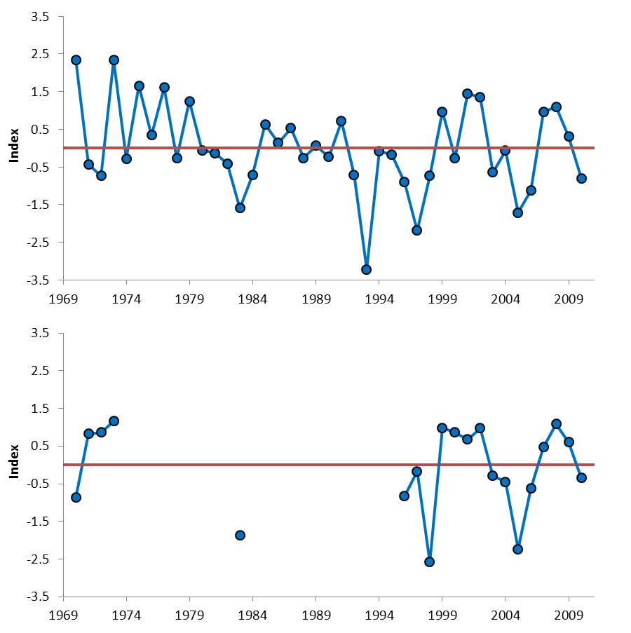
SSH - Sablefish recruitment: 2011 Stock Assessment
Continuing validation: Bootstrap, jackknife, removal of recent values, and randomization tests
(Schirripa and Colbert 2006, Schirripa 2007, Stewart et al., 2011)
~35-40% of the variance in recruitment explained
Survey index of recruitment
~ 1970 - present
Uncertainty
Missing years of data
Inverse Sea Level
Zooplankton Index
Notes:
The relationship has been modeled both via a direct offset to the expected value for recruitment (Maunder and Watters 2003, Schirripa and Colbert 2005), and as an index of recruitment deviations (Schirripa 2007). The former method makes it difficult to determine the appropriate degree of recruitment variability for the deviations themselves, and also requires that the environmental series be treated as if it is known without error. The latter method allows for observation error in the environmental series, as well as for tuning of the uncertainty so that forecast uncertainty is consistent with the degree of correspondence observed within the time-series. Although it has received much attention in recent assessments and reviews, the link between recruitment strength and environmental conditions has generally been contentious, and ultimately has not greatly influenced model results or predictions (Schirripa 2007).
The topic of model-selection, robustness and validation for the sablefish recruitment-environment relationship has been a recurrent theme in STAR panels and with the SSC since its use in the stock assessment began in 2002. The 2007 SSC statement reflects this issue: “There was considerable discussion among the SSC, STAR Chair and STAT about the use of SSH [sea-surface height] in the assessment. The SSC concurs with the STAT and endorses the use of SSH in the current assessment but notes that much more work needs to be done toward evaluating the selection and validation of environmental signals in stock assessments as was recommended following the Groundfish Harvest Policy Evaluation Workshop in December, 2006.” Previous validation the environmental index utilized three basic methods: a bootstrap of the observed data, a jackknife of each data point and the sequential removal of recent values (Schirripa and Colbert 2006, Schirripa 2007). One aspect of model validation that is difficult to quantify is the a priori vs. post-hoc nature of the final selected covariate(s). The concern here was that if a large number of covariates are evaluated, then a small number of seemingly large, but entirely random, correlations would be expected. To explore this issue, it is necessary to determine exactly how many potential covariates were evaluated during the original variable selection process, ultimately leading to the covariate included in recent stock assessment. The covariate used in recent assessments has been an annual series of average sea surface heights over the spring months.
The 2001 assessment (Schirripa and Methot 2001) focused on evaluating the sensitivity of the results to treatment of the survey data and trade-offs among pot survey and logbook indices of abundance. This assessment was the first to introduce the possibility that sablefish recruitment may be linked to environmental factors. The 2002 assessment (Schirripa 2002) was an update to the 2001 analysis, and therefore focused mainly on newly available data from existing sources. It was the first to detect the relatively strong incoming cohorts from 1999 and 2000 present in the 2001 data following ten years of below average recruitment. A significant relationship between recruitment and sea surface height was identified.
In 2005 (Schirripa and Colbert 2005) several important changes were made to the sablefish assessment. Landings (and the modeled time-period) were extended back to the year 1900. Trawl surveys were allowed to have separate selectivity curves and slope survey years of limited geographic coverage were removed from the model. Discard data from the relatively new observer program was included and discard mortality investigated (as described above). Sea surface height was used as an explicit offset to expected recruitment.
The 2007 assessment extended available data series, and adjusted the treatment of the environmental index of recruitment to be an index, and therefore subject to observation error, rather than an offset to recruitment.
Note that ssh index sign is changed.
The relationship has been modeled both via a direct offset to the expected value for recruitment (Maunder and Watters 2003, Schirripa and Colbert 2005), and as an index of recruitment deviations (Schirripa 2007). The former method makes it difficult to determine the appropriate degree of recruitment variability for the deviations themselves, and also requires that the environmental series be treated as if it is known without error. The latter method allows for observation error in the environmental series, as well as for tuning of the uncertainty so that forecast uncertainty is consistent with the degree of correspondence observed within the time-series.
Validation: The results of this exercise indicated that it is highly unlikely that a spurious correlation would be maintained for very long, hence the common observation that many purported recruitment-environment relationships break-down within several years of their initial ‘discovery’. After the first year is added (2001; recent years were added first), the observed correlation was only marginally significant. However, when all eight years of additional recruitment are added to the relationship based on random time-series, there was little chance of the observed correlation remaining as high as the observed value (p-value < 0.02).
Figure 1. Environmental indices derived from sea-surface height (upper panel; M. Schirripa, personal communication) and zooplankton abundance (lower panel; B. Black and W. Peterson, personal communication).

Slide 35
2011 Stock Assessment Results: Sea level as a Survey Index of Recruitment
2011 Stock Assessment: SSH 1972 - 2011
Notes:
Used the std dev of data plus extra estiamted sd
The 2011 assessment found that although the SSH-sablefish recruitment relationship has been the subject of considerable discussion, and it is compelling from an ecological standpoint, the use of the environmental index has not had a large effect on model results and it continues to have little impact on model results in the 2011 assessment (Figures 3 and 4). The model run with the SSH index of recruitment is presented in the sablefish stock assessment as a model sensitivity (Stewart et al. 2011). The small effect of the SSH recruitment index on the sablefish stock assessment is due to the reasonably consistent signals from fishery and survey data sources regarding year-class strengths. There is little added by the environmental series with a relatively low (but still significant) predictive capability.
Note that the NWFSC survey catches age-0 fish so the survey provides a recruitment signal that is likely swamping the use of the SSH/zooplankton index (these environmental data only explain ~35% of the variability in recruitment).
Figure 3. Results of a sensitivity analysis to the inclusion of environmental indices as indices of recruitment deviations.
Figure 4. Results of a sensitivity analysis to the inclusion of environmental indices as indices of recruitment deviations.
ity analysis to the inclusion of environmental indices as indices of recruitment deviations.

Slide 36
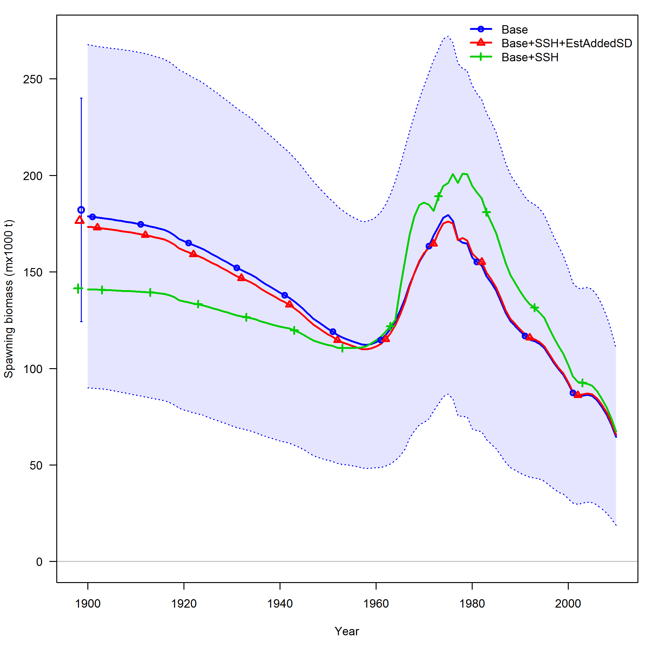
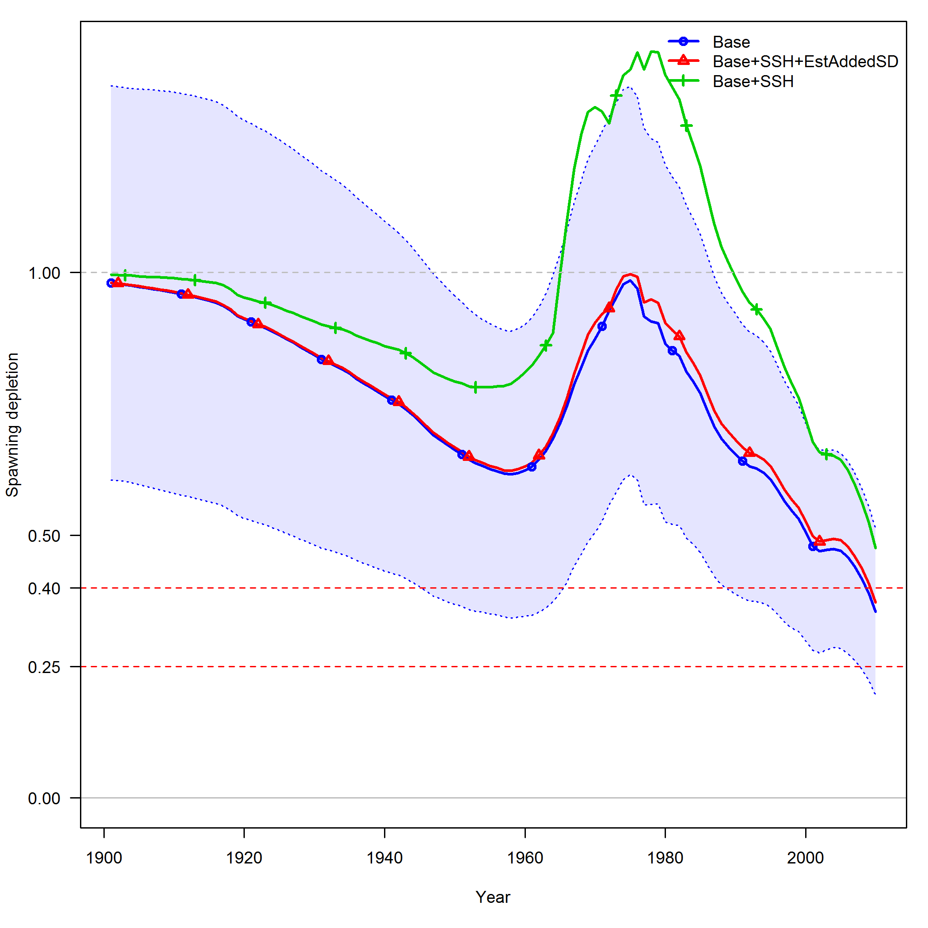
SSH - Sablefish recruitment: 2011 Stock Assessment
Spawning Biomass
Stock Depletion
Base – No SSH
Base – SSH with estimated additional SD
Base – SSH without estimated additional SD
Notes:
Based on the relatively small effect the use of the environmental covariate had had on stock assessment model results in the 2007 assessment, it was not included in the base-case model for 2011.
Sensitivity to tuning 1970-2010 SSH index in the assessment model.

Slide 37
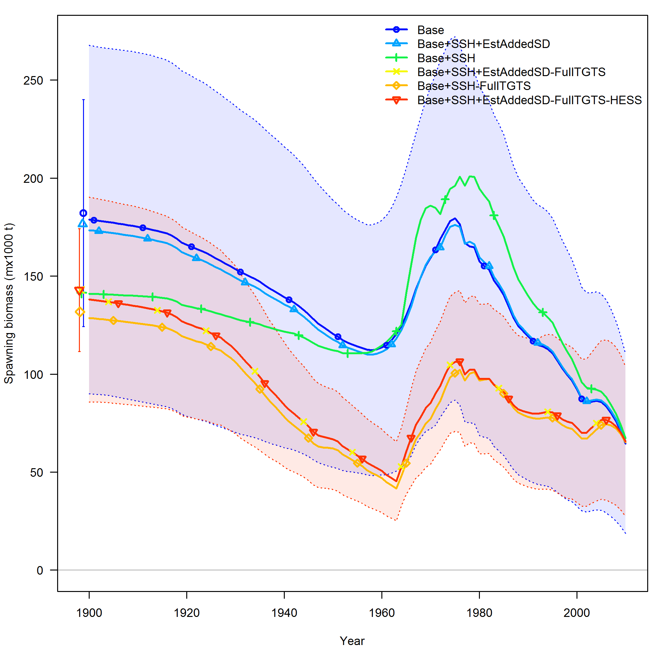
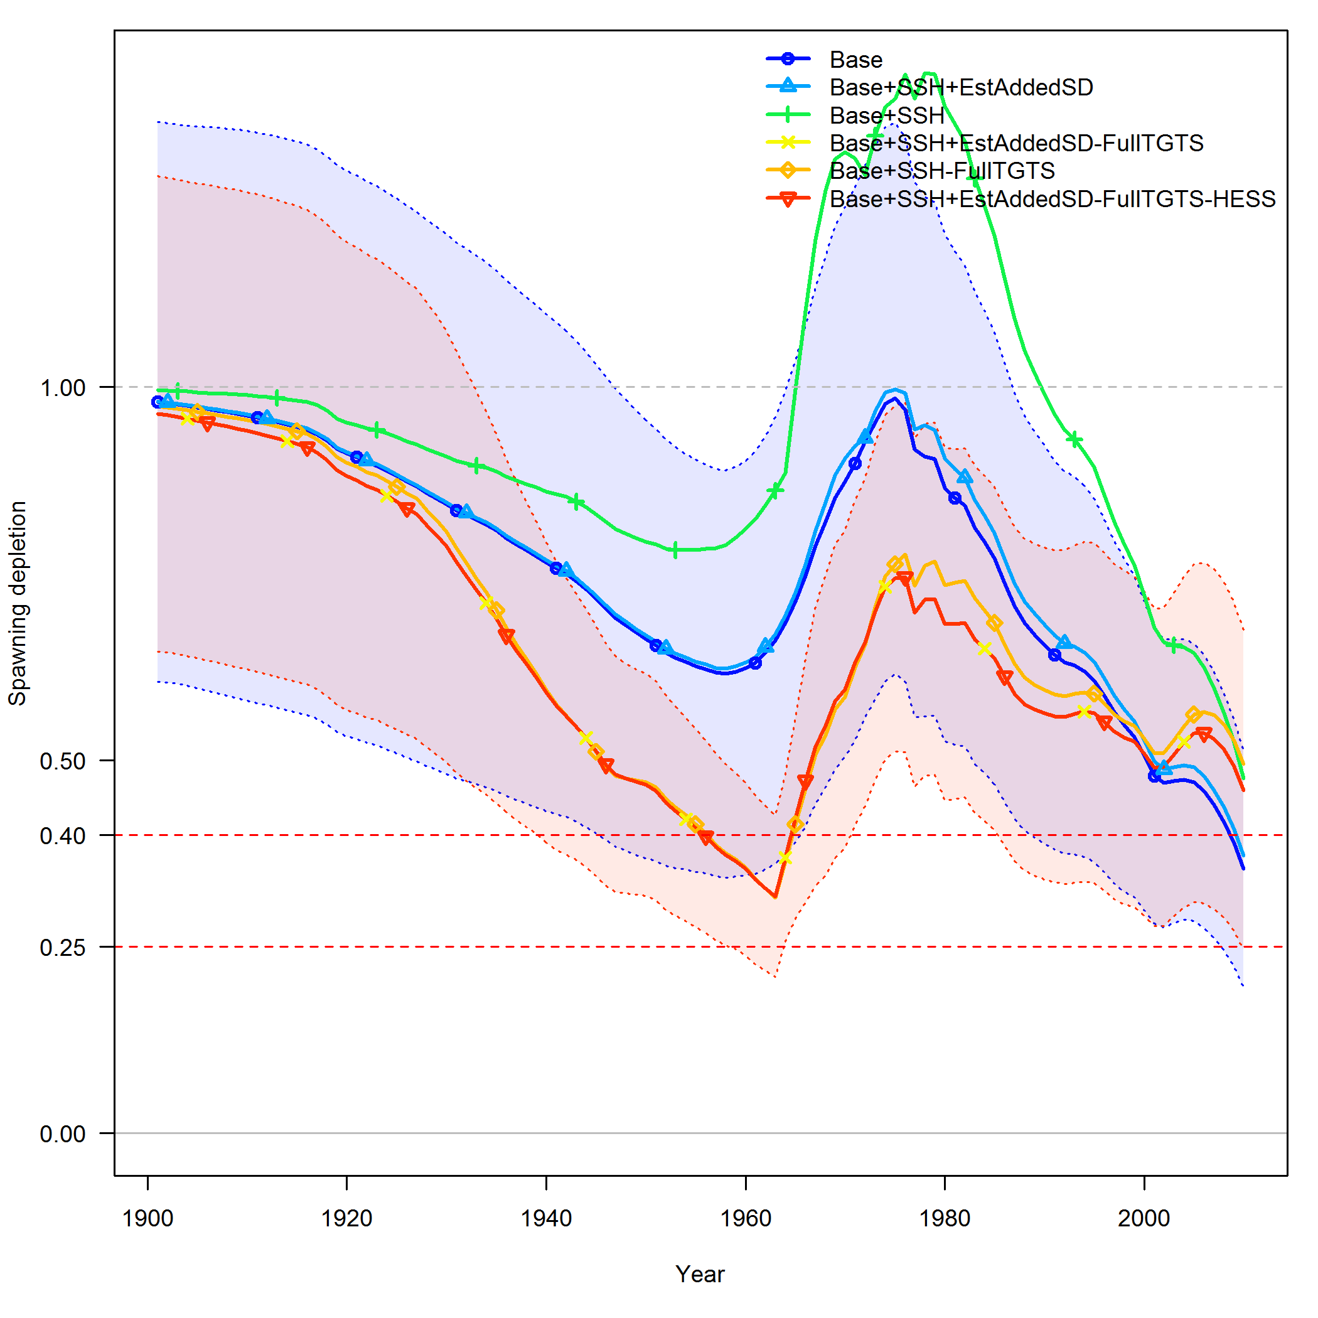
2011 Stock Assessment: SSH ~1920-present
Spawning Biomass
Spawning Depletion
SSH 1970-2011 Tuned
SSH 1970-2011 Not Tuned
SSH 1925-2011
SSH 1970-2011 Tuned
SSH 1970-2011 Not Tuned
SSH 1925-2011
Year
Year
Notes:
Based on the relatively small effect the use of the environmental covariate had had on stock assessment model results in the 2007 assessment, it was not included in the base-case model for 2011. However, when either the newly available zooplankton index or the sea-surface height index were added (and iteratively tuned so that the mean input SD was consistent with the RMSE) the influence on stock trajectory (Table 23, Figure 132), and on the recruitment time-series itself (Figure 133) was relatively small. This was largely due to the substantial inflation of the input variance for both series.
Continue to evaluate methods to capture information regarding environmental and ecosystem variability in stock assessments. Further, historical records of particularly large year classes (e.g., 1947 reported by sport fishermen in central California) could be investigated to better inform the historical period.

Slide 38
Progress and Challenges: Sablefish 2005 - Present
Peer review publication is not enough
Total N indices evaluated is often not clear, the significant ones get published
General skepticism regarding the validity of climate-recruitment relationships
Best methods remains a research topic
Population dynamics versus survey index?
Recruitment hindcasting in absence of age/length composition data
Need recruitment bias correction research
Suggest the need for two time periods for recruitment bias correction
Difficult to re-create analyses completed independent of stock assessment
Operationalizing research to operations.
Staff changes can result in loss of code for analyses, etc.
Review and management decisions can be influenced by variable scientific opinions and personal interactions.
2011 Assessment
Notes:
When it is not clear how may indices were evaluated it leads to skepticism regarding the validity of the relationship, regardless of peer review publication…peer review publication is not enough to ensure success in review processes used by council.
Best methods for including env. Drivers of recruitment into assessment model still a research topic. 1. dynamics, 2. survey index.
Difficult to re-create analyses, particularly when the person who complete the analyses is not longer working for the agency.
Results in potentially slightly different analyses being used in each assessment round.
Issue of how to deal with hindcast period, particularly when modeling s-r deviations as explained by an environmental index
This raises issues with bias correction ramp up. Essentially need two time periods for bias correction, one for comps and one for time period with env. Covariate.
Review and management decision highly subject to the politics of personalities and variable scientific views.

Slide 39

US GLOBEC: The horizontal-advection bottom-up forcing paradigm
Large-scale climate forcing drives regional changes in alongshore and cross-shelf ocean transport, directly impacting the transport of nutrients, water masses, and organisms.
Di Lorenzo, et al. 2013. Oceanography 26(4):22–33.
Notes:
Figure 7. Conceptual advances of GLOBEC. GLOBEC expanded the classical bottom-up forcing
paradigm (1) by recognizing that horizontal advection bottom-up forcing paradigm (2)
is an equally important mechanism by which marine ecosystems respond to climate forcing.
GLOBEC studies identified ocean horizontal transport processes as an equally important
driver of marine ecosystem dynamics.
Cross-shore transport variability in the California Current: Ekman upwelling
vs. eddy dynamics
V. Combes a,⇑, F. Chenillat b,c, E. Di Lorenzo d, P. Rivière b, M.D. Ohmane, S.J. Bograd f

Slide 40

US GLOBEC: The horizontal-advection bottom-up forcing paradigm
Large-scale climate forcing drives regional changes in alongshore and cross-shelf ocean transport, directly impacting the transport of nutrients, water masses, and organisms.
A mechanistic framework through which climate variability and change alter sea surface height (SSH), zooplankton community structure, and sablefish recruitment, all of which are regionally correlated.
Di Lorenzo, et al. 2013. Oceanography 26(4):22–33.
Notes:
Impact of shifting copepod communities Discussed in Nature world news online article Mar 17, 2015
Figure 3. Observed ecosystem response to changes in Oregon Shelf transport. (a) Correlation between alongshore wind data from the National Centers for Environmental Prediction and satellite AVISO alongshore transport data. (b) Correlation between Newport zooplankton biweekly data and alongshore transport. (c) Correlation between coho salmon survival rate and Newport zooplankton. Figure redrafted from Bi et al. (2011); see paper for details on data sources
Cross-shore transport variability in the California Current: Ekman upwelling vs. eddy dynamics
V. Combes a,⇑, F. Chenillat b,c, E. Di Lorenzo d, P. Rivière b, M.D. Ohmane, S.J. Bograd f

Slide 41
GCMs
CMIP5-RCP8.5 (11)
CCSM4
CanESM2
GFDL.CM3
GFDL.ESM2G
Inmcm4
IPSL.CM5A.MR
MPI.ESM.MR
MRI.CGCM3
CNRM.CM5
GISS.E2.R.CC
CESM1.CAM5
CMIP3
Overland and Wang 2007
CMIP5
Rupp et al 2013
Notes:
The CMIP3 models that were run for the AR4 of the IPCC were evaluated by Overland and Wang (EOS, 2007) in terms of their replication of the PDO. Based on that evaluation, the CCSM3, CCCMA-T47, GFDL2.0, GFDL2.1,Miroc-H, MRI, and UKHADCM3 models also seem suitable for getting crude estimates of changes in SSH along the coast.
Previously MRI-discarded, resolution to coarse
Eliminated the following from CMIP 5 due to unrealistic futures for SSH such as 1) unrealistic disconnect between historical and projection period, a flat line mean SSH in the projection with a huge variance suggesting that we know nothing about future ssh for the CC region, 3) MSE projections crashed due to population going extinct.
MIROC5
Bcc.csm1.1
cmcc.cm
Ec.earh
Hadley
Noresm1.m
RCP8.5 is the more extreme carbon emmissions scenario but seems to be the track that we are on

Slide 42
What has worked?
Empirical MPs are easier to understand
Informal dialogues – jointly “owned” by scientists and managers - noting that language barriers make that impossible in some settings.
Formalized and clearly tasked small groups: technical and manager/stakeholders
Where trust was built, the managers were happier to trust process outputs
Taking time, listening, creating two way discussion rather than lecture/decision.
Focus communication on key “vectors”/opinion leaders: stakeholders who will bring others along.

Slide 43
Key COMMS issues:
How does an overall communications strategy look?
Building stakeholder engagement
What information must be communicated (ie minimum essential points to facilitate decision making)
How to communicate confidence in the science
How and when to communicate critical information
How much dialogue to have on management objectives before have prelim results
How to measure effectiveness of communications?

Slide 44
“The perfect is the enemy of the good”
Voltaire, Dictionnaire philosophique, 1770
Notes:
quoted this Italian proverb
Discussed in W5
Danish proverb
This is the relatively low lying fruit- action that can be implemented in the current management framework relatively quickly…compared to some formalized EBFM (which we functionally already do to some degree event though most of the quantitative fishery advice stems from single species models…let’s think evolution rather than revolution…these actions are more likely to move management systems that are resistant to change towards considering climate informed management alternatives. We need to rethink equilibrium based reference points in a changing climate – we don’t know what the new ‘equilibrium’ will be…or there is not a new equilibrium. –both single species and in the development of ‘ecosystem’ or multispecies reference points. How do we avoid shifting the burden of proof from do no harm/sustainable exploitation to allowing too much flexibility (i.e. higher (too) Fs)

Slide 45
“The perfect is the enemy of the good”
Voltaire, Dictionnaire philosophique, 1770
“It is difficult (dangerous) to make forecasts,
especially about the future.”
Danish Proverb
Notes:
quoted this Italian proverb
Discussed in W5
Danish proverb
This is the relatively low lying fruit- action that can be implemented in the current management framework relatively quickly…compared to some formalized EBFM (which we functionally already do to some degree event though most of the quantitative fishery advice stems from single species models…let’s think evolution rather than revolution…these actions are more likely to move management systems that are resistant to change towards considering climate informed management alternatives. We need to rethink equilibrium based reference points in a changing climate – we don’t know what the new ‘equilibrium’ will be…or there is not a new equilibrium. –both single species and in the development of ‘ecosystem’ or multispecies reference points. How do we avoid shifting the burden of proof from do no harm/sustainable exploitation to allowing too much flexibility (i.e. higher (too) Fs)

