Slide 1


























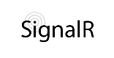




















event index & profiler
UI
& i18n
Logging & BI
Endpoints & RESTful APIs
app
Data Persistence
Scalability & High Availability
Domain & Building Blocks
raft-based HA cluster
application security
user accounts
actor & data grid
CRM
SaaS
report builder
basket
point of sale
payment gateways
shipping
accounting
billing
booking
inventory
marketing
?
CAD
stock exchange
forex
software ALM
?

Slide 2
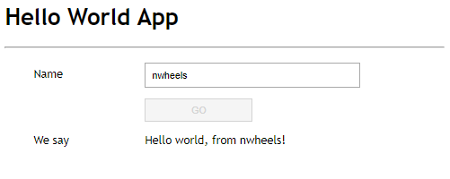
POST http://localhost:5000/tx/HelloWorld/Hello HTTP/1.1
Host: localhost:5000
{"name": "nwheels"}
Hello World App
Name
microservice
public async Task<string> Hello(string name)
{
return $"Hello world, from {name}!";
}
nwheels
Go
We say:
Hello world, from nwheels!
HTTP/1.1 200 OK
Content-Type: application/json
Server: Kestrel
{"result":"Hello world, from nwheels!"}

Slide 3
technology stack adapters
programming models
app
domain building blocks

