Slide 1

SQL Chess Game
The SchackMatt Team:
Vicky Lym, Lauren Vagts, Nathanael Whitney, and Dan Zapfel

Slide 2
Starting Off
Three competing designs
Option 1: A character generator for the Pathfinder 2 open beta test
Option 2: A chess game
Option 3: Coding a RDBMS using Prolog and a high level language

Slide 3
Starting Off
Why we chose Chess
We thought it would translate well to SQL
We wanted to do a game
Takes full advantage of SQL tools and things we learned in this class
Advanced ERD models
Triggers
Why we picked the name “SchackMatt”
It’s “Check Mate” in Swedish.

Slide 4

PRODUCT DESCRIPTION

Slide 5
Steps We Took
We began by creating a Github page for our project
We continued by brainstorming business rules and requirements, mostly by referencing Chess rules
Once we started to create the ERD, we realized it was more complex than we had originally thought
We had to completely overhaul our business rules and ERD once we thought more in depth about how we were going to accomplish our goal
We had to really simplify the game of Chess in order for this project to not get out of control

Slide 6
Tools We Used
Vertabelo for our ERD
PostgreSQL (originally)
Changed to SQL Server
MySQL workbench
DataGrip for our IDE
GitHub to help us all collaborate
Slack

Slide 7
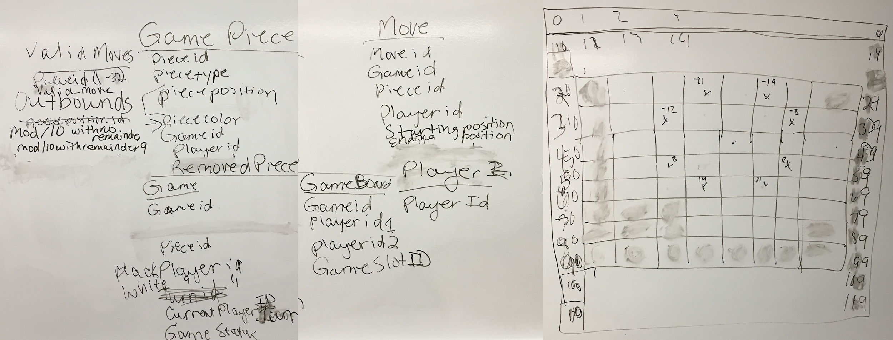
Early Brainstorming In Action

Slide 8

CHESS RULES

Slide 9
Just the Basics
Chess is played on an 8 x 8 grid
Two players (black and white) who take turns
White gets to go first
Each turn a player can move 1 piece
There are 8 kinds of game pieces
Each player gets 8 Pawns, 2 Rooks, 2 Knights, 2 Bishops, 1 Queen and 1 King
Each piece has a different set of valid moves (Move Set)
Pieces cannot move through other pieces
Pieces can attack (capture) other pieces
The game is won or lost when one player’s king has nowhere to stay or go without being captured on the other player’s next turn

Slide 10
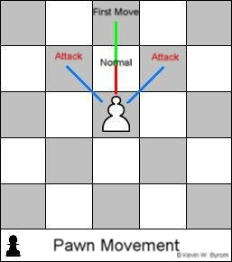
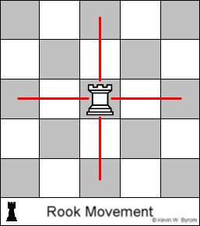
Chess Piece Moves
The Pawn
2 simple moves
2 advanced moves
The Rook (Castle)
Moves in straight directions as far as the player wants

Slide 11
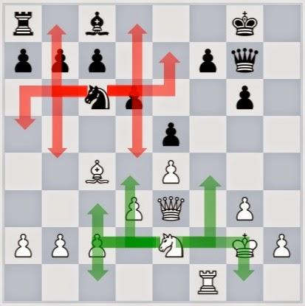
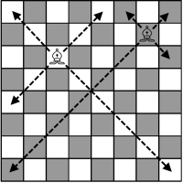
Chess Piece Moves 2
The Knight
Moves in “L” shapes 3 squares long
Can skip over other pieces
The Bishop
Moves in straight directions, diagonally as far as the player wants

Slide 12
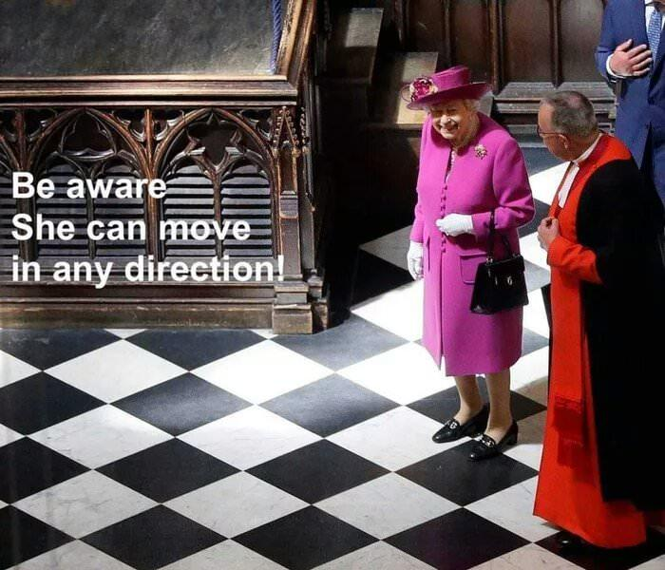
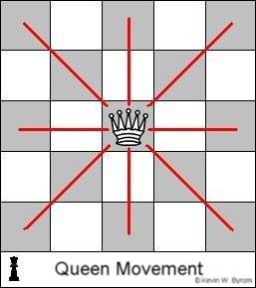
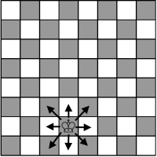
Chess Piece Moves 3
The King
The most important piece
Moves in straight lines and/or diagonally but only one square at a time
Has one advanced combo move with the Rook
The Queen
Moves in straight lines and/or diagonally

Slide 13
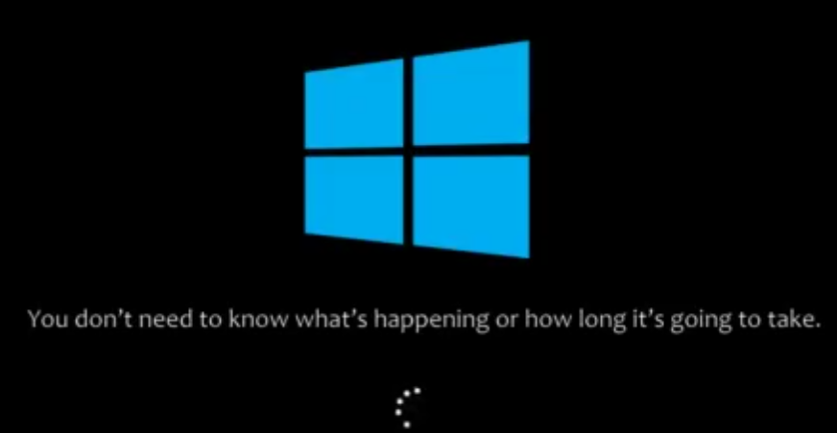
CHESS TO BUSINESS RULES

Slide 14
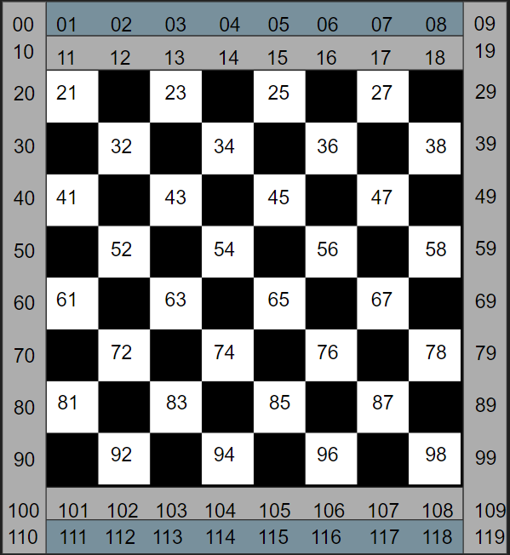
Business Rules
Each game is played by two players
Each player can play many games
A player must be white or black
A board has many squares
A square is contained on many boards
A piece occupies only one square at a time
A game can have only one board
One board is reflective of only one game
A player has many turns
One turn for each player
A player has many pieces
A piece can only have one player

Slide 15
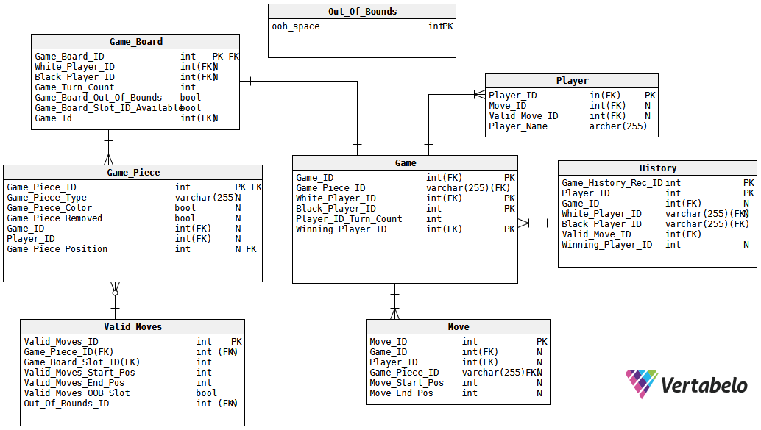

Slide 16
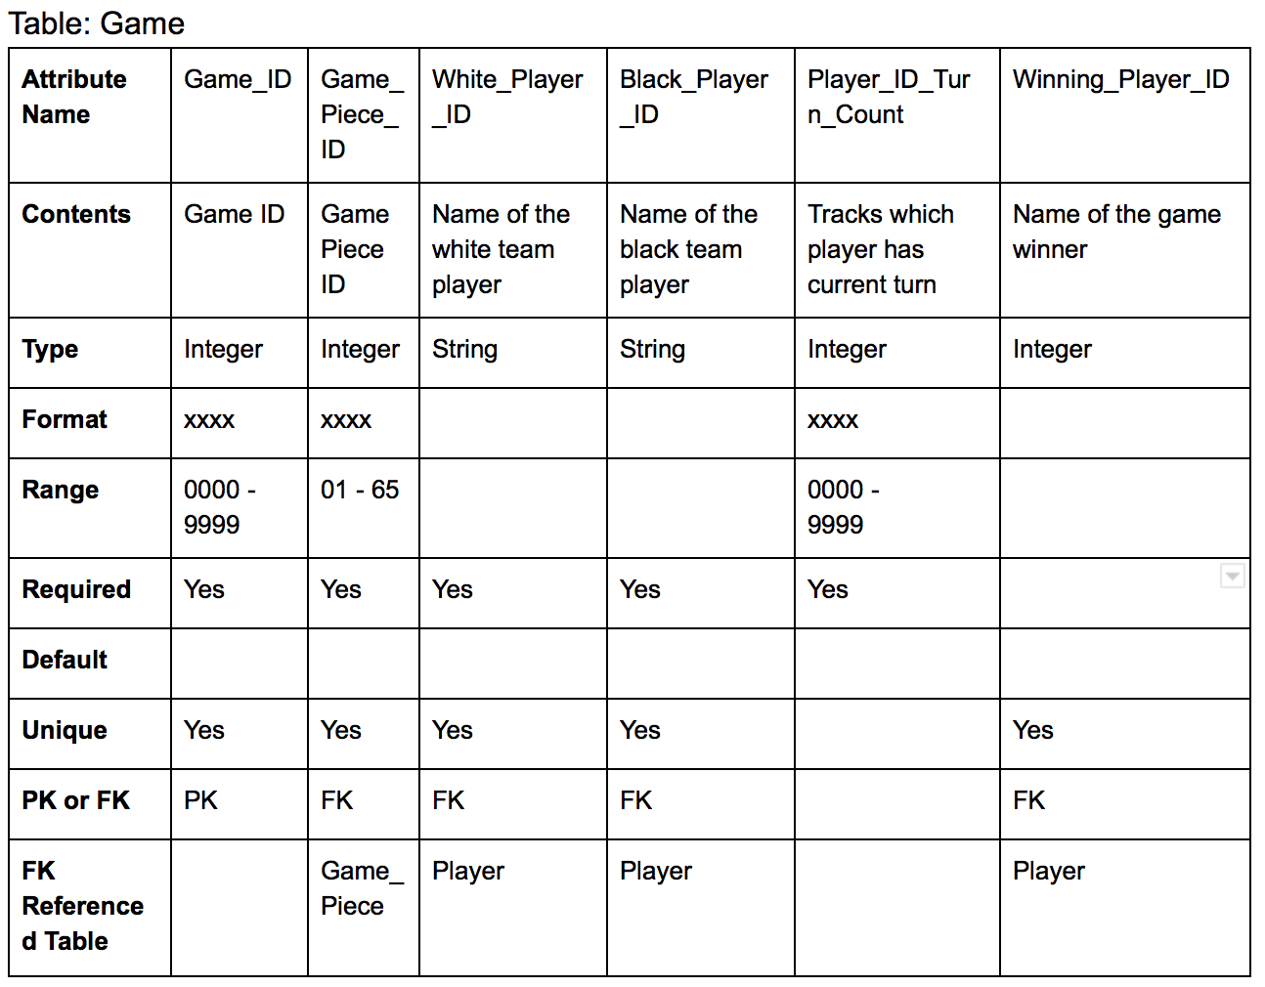

Slide 17
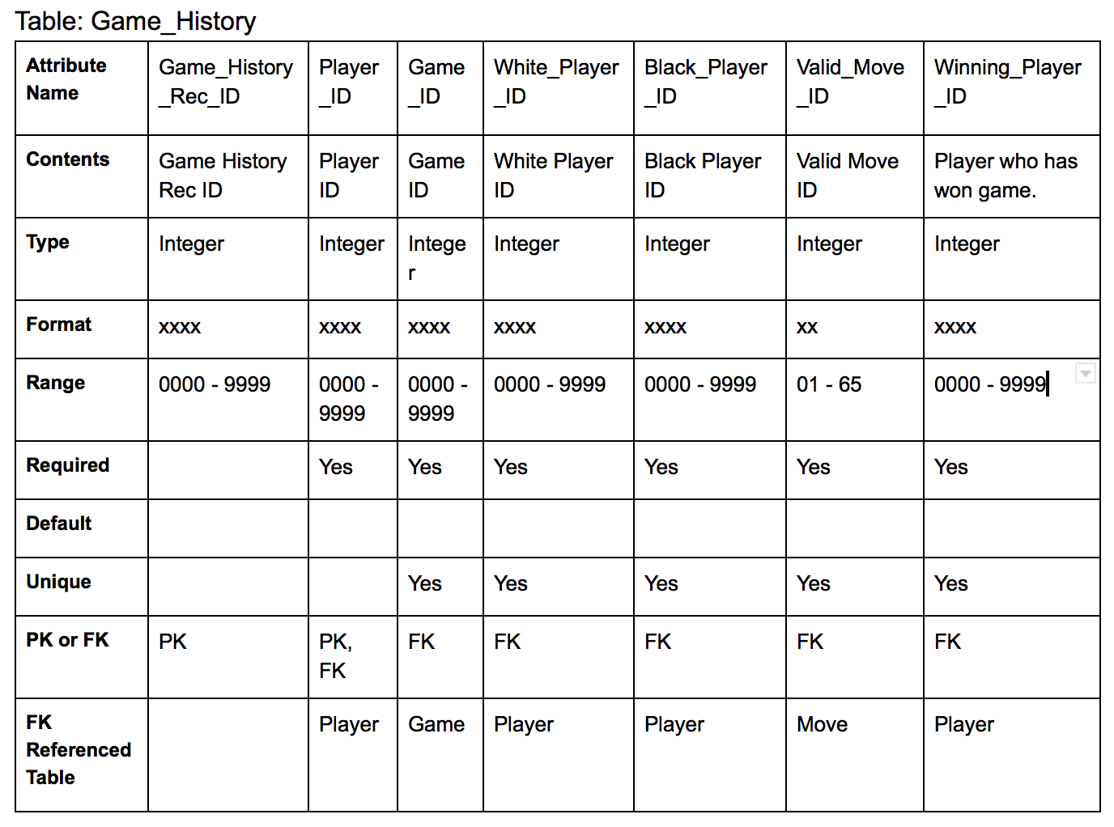

Slide 18
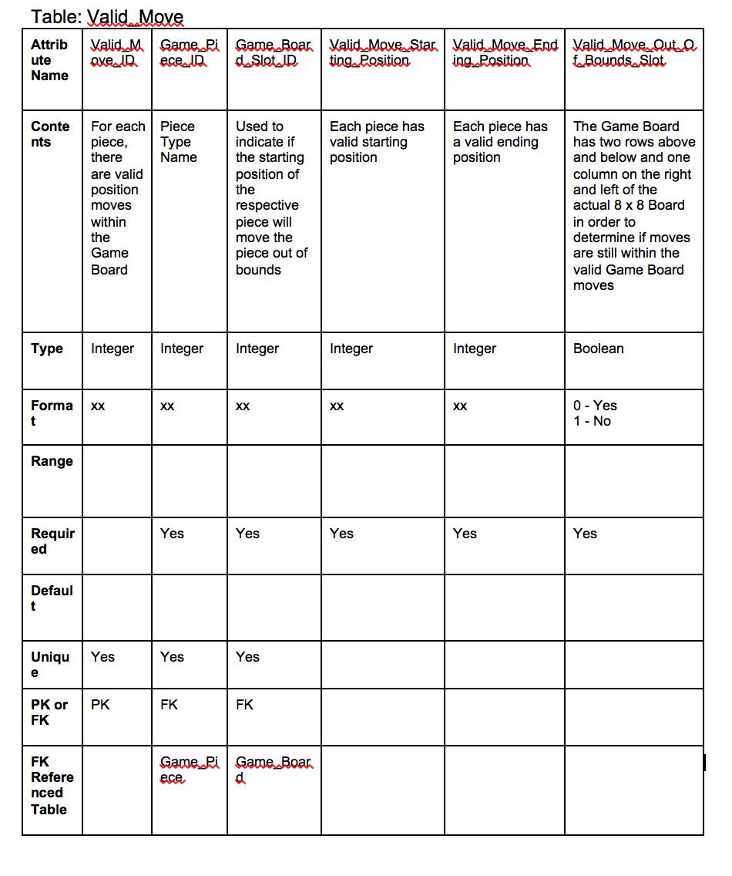

Slide 19

TURNING CHESS INTO MYSQL

Slide 20
SQL DEMO

Slide 21
Works Cited 1
Title page logo image: http://iotakt.se/wp-content/uploads/2017/02/schack-matt.jpg
Image of the British queen: https://i.imgur.com/EH1WEmX.jpg
Sebesta, Robert W., Concepts of Programming Languages, 11th edition (Global Edition), 2016. Pearson Education. pg 743
www.vertabelo.com for modeling
Our Github page https://github.com/SchackMatt/ChessGame
Pawn moveset https://farm5.staticflickr.com/4153/5023239218_2261f61dcf_z.jpg
Knight moveset https://2.bp.blogspot.com/-_KOceAcdM3w/VIc0PNgXBnI/AAAAAAAAA0U/M70ipuyhtwM/s1600/Knights.jpg
King moveset http://www.family-games-treasurehouse.com/images/Chess_Moves_King.gif
Rook moveset https://c1.staticflickr.com/5/4124/5023239348_44653ec607.jpg
Queen moveset https://c1.staticflickr.com/5/4104/5022629271_826d2b74b7.jpg
Bishop moveset https://www.family-games-treasurehouse.com/images/xChess_Moves_Bishop.gif.pagespeed.ic.udMo9S4RIc.png
Beach image: http://teampwnicorn.com/wp-content/uploads/2013/07/Beach-ball-of-death.png
Beach ball image: https://twotasks.files.wordpress.com/2011/09/spinning_beach_ball_of_death_1_13512_5315_image_7479.gif
Luke Smith for Q&A.

Slide 22
Works Cited 2
Windows loading circle http://www.istartedsomething.com/wp-content/uploads/2009/08/winvista_cursor.gif
Windows loading screen https://media.giphy.com/media/hJaQNVrOPC4Ja/giphy.gif
Dinosaur drawing image https://i.redd.it/8uyhobf4jnt11.png
Cactuar (Cactus) image http://marcoleonardi1991.files.wordpress.com/2007/12/kyactus1785.gif
Celko, Joe. Joe Celko’s SQL For Smarties – Advanced SQL Programming – Fourth Edition. Elsevier, 2011.
Robb Hill for Q&A.

Slide 23
Any Questions ?
Thank you!
Team SchackMatt - Vicky Lym, Lauren Vagts, Nathanael Whitney, and Dan Zapfel

Slide 24
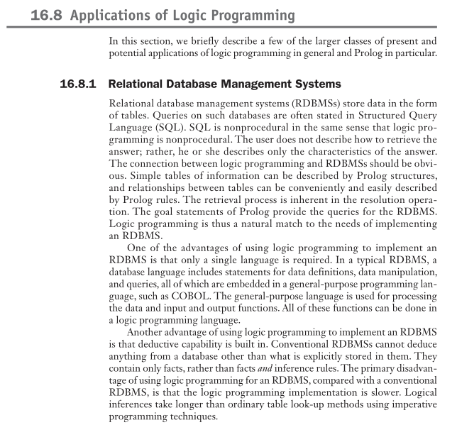
Appendix
The proposed requirements for our original proposal.
Just in case anyone is curious.
Source: Sebesta, Robert W., Concepts of Programming Languages, 11th edition (Global Edition), 2016. Pearson Education. pg 743.

