Slide 1
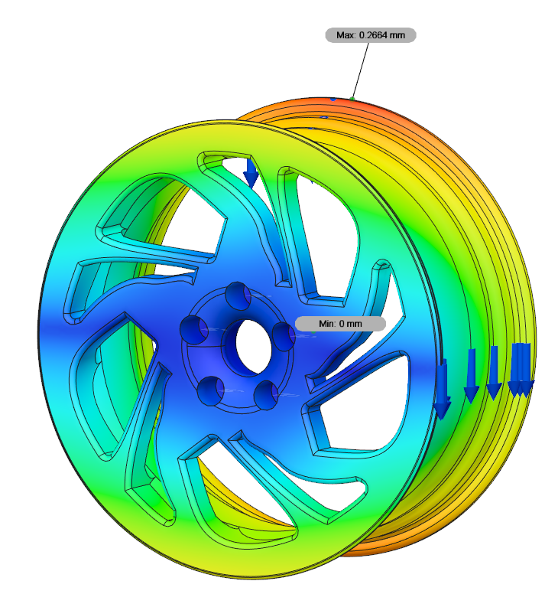
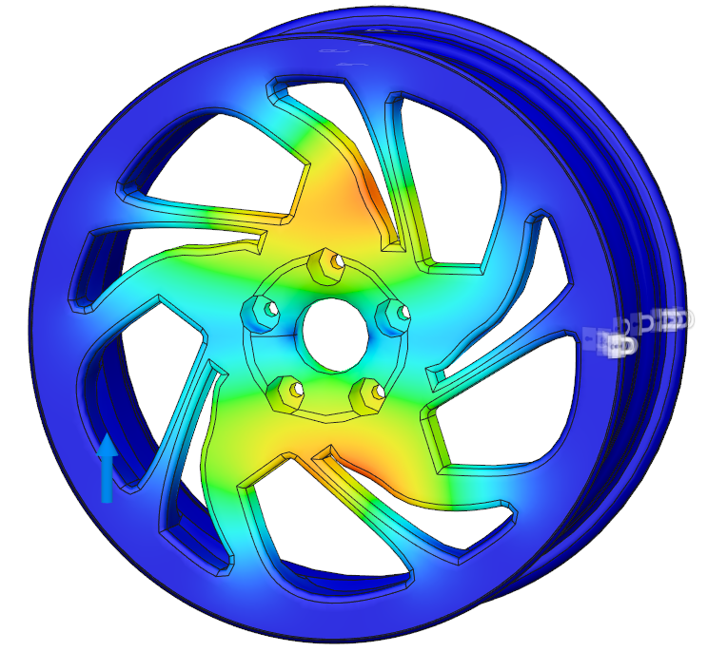
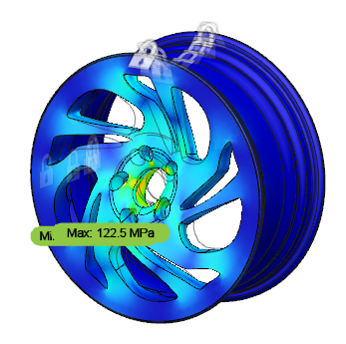
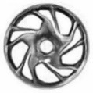


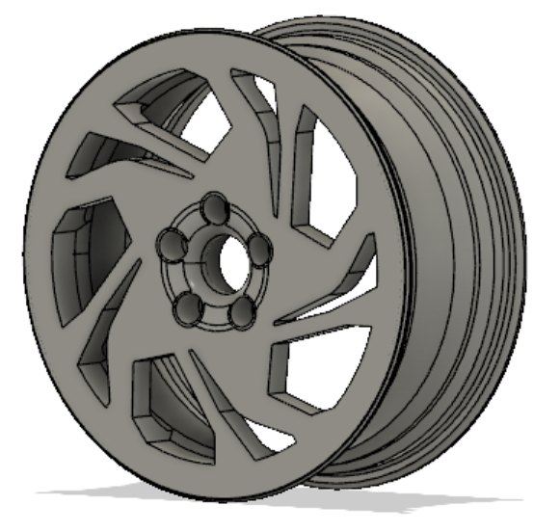

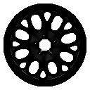
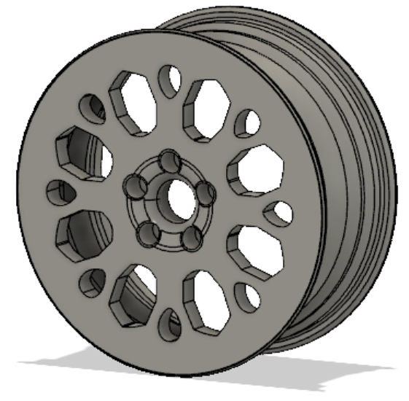
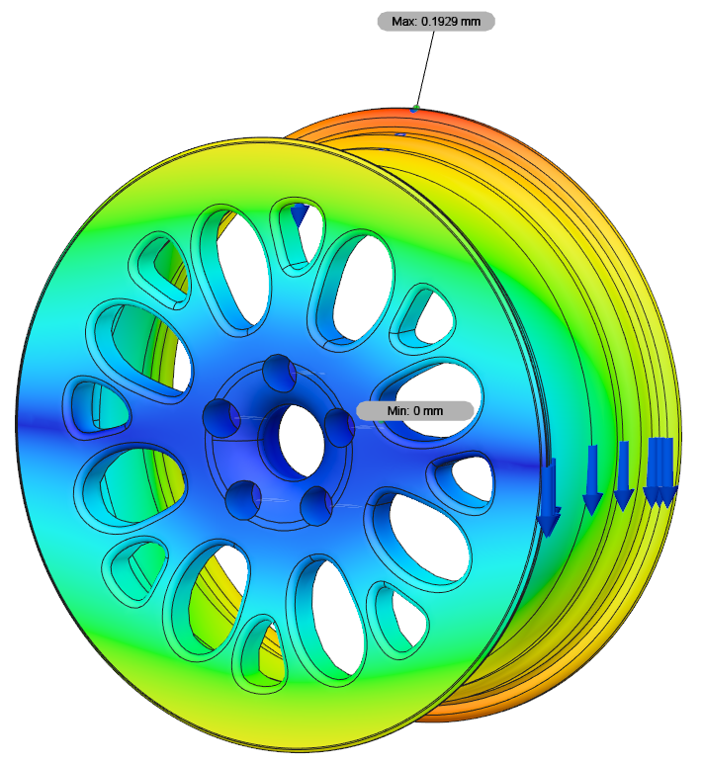
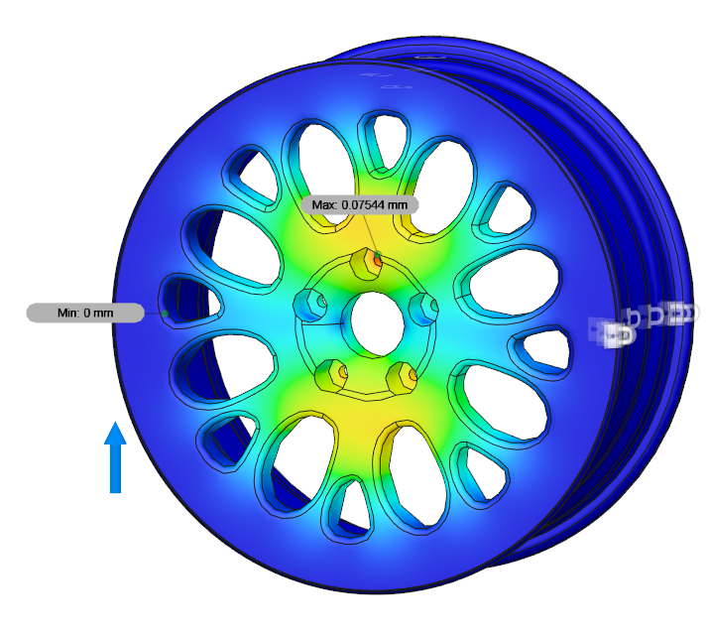
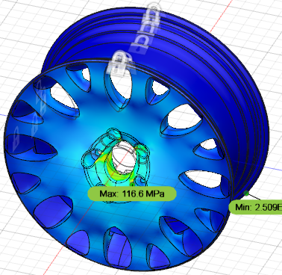
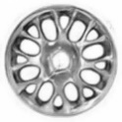
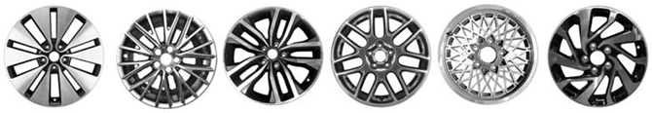



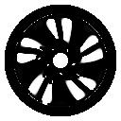


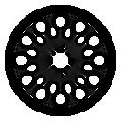





[ AI-BASED GENERATIVE DESIGN ]
① Design Generation
② Design
Evaluation
③ Design Recommendation
CAE/
CAM
CAD
HCI
…
…
…
Engineering Performance & Manufacturability Prediction
Data
Users’
Preference
Prediction
Design
Exploration
Notes:
This is my proposed AI-based Vehicle Design process.
The process consist of three stages. Design generation, design evaluation, and design recommendation.
(클릭)First, Design Generation stage integrates CAD and AI, to generate aesthetic and novel designs based on the past design data.
(클릭)Second, Design evaluation stage integrates CAE/CAM and AI, to evaluate and predict various engineering performance and manufacturability of generated designs.
(클릭)Lastly, Design Recommendation stage integrates HCI and AI, to predict customer’s design preferences and recommend marketable designs.

Slide 2

















[ COLLABORATORS ]

Slide 3
[ COLLABORATORS ]
COLLABORATORS

Slide 4
COLLABORATORS

