Slide 1
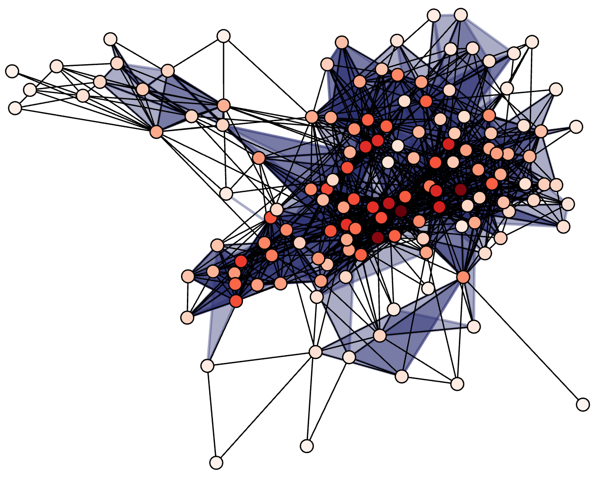


A Practical Guide to Modeling with Higher-order Networks
Nicholas W. Landry
University of Virginia

Slide 2



The relevant links for today
https://github.com/nwlandry/software-demos
https://github.com/xgi-org/xgi
https://xgi.readthedocs.io

Slide 3
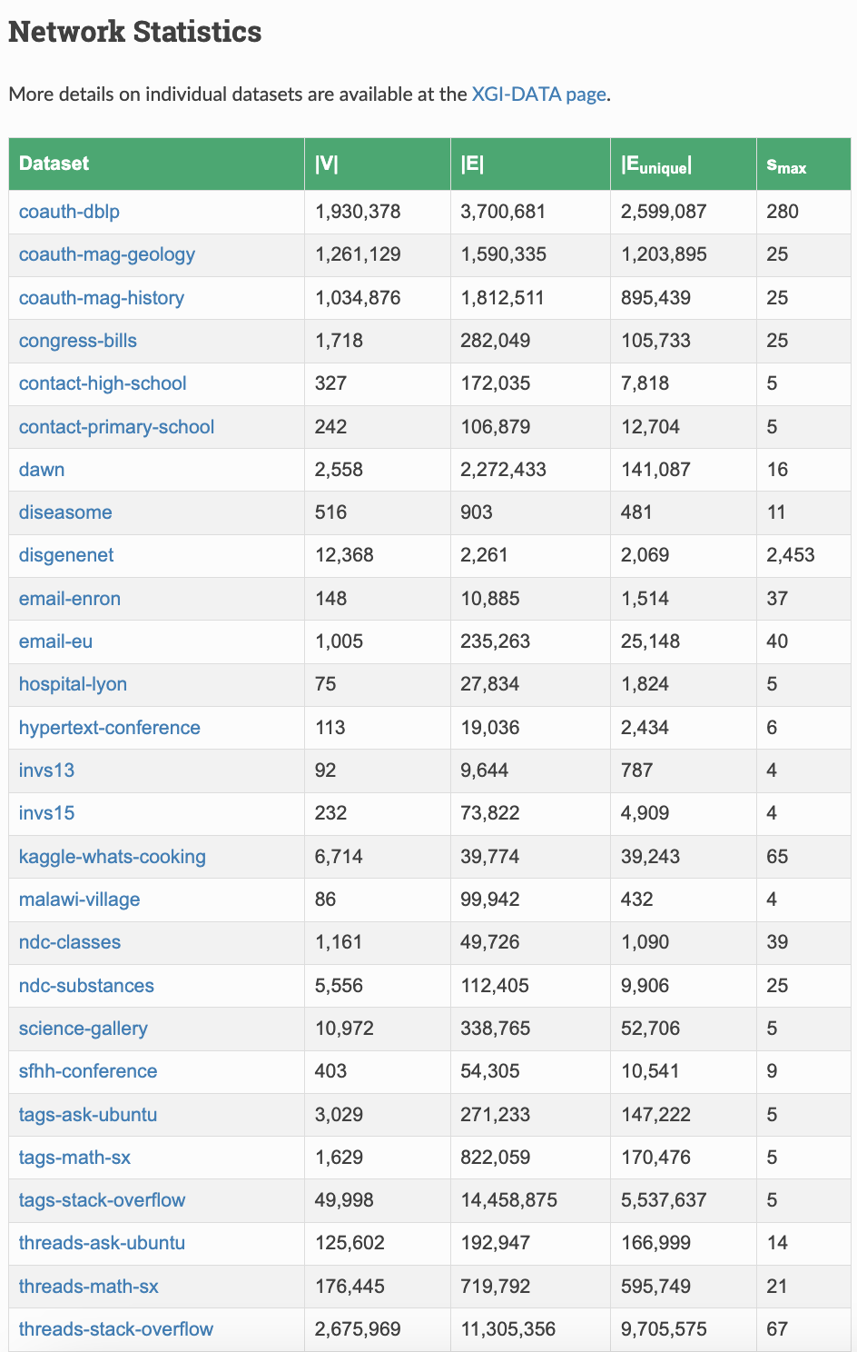

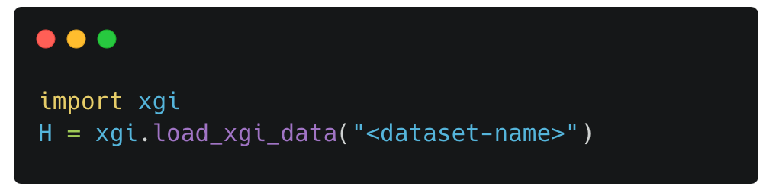
XGI-DATA
Hosted on Zenodo
Standardized format
Corresponding datasheets
45 datasets and counting!
Integrated with XGI
Load data through an HTTP request:

