Slide 1

GSNP Short Course on Higher Order Network Science
Nicholas W. Landry

Slide 2



The relevant links for today
https://github.com/nwlandry/software-demos
https://github.com/xgi-org/xgi
https://xgi.readthedocs.io

Slide 3
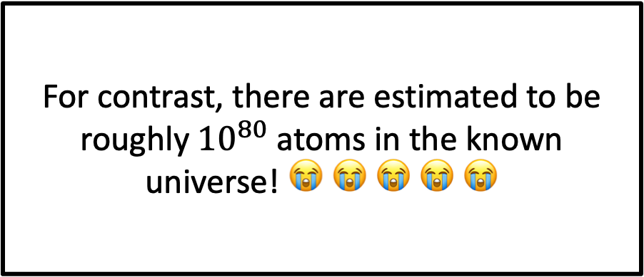
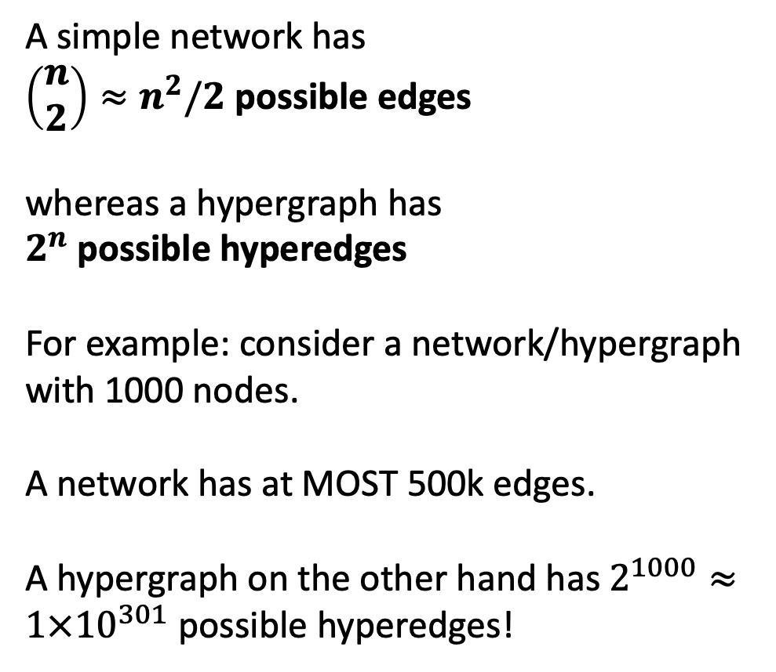
Higher-order poses computational difficulties
A simple network has
$\left(\begin{matrix}n \\ 2\end{matrix}\right)≈n^{2}/2$ possible edges
whereas a hypergraph has
$2^{n}$ possible hyperedges
For example: consider a network/hypergraph with 1000 nodes.
A network has at MOST 500k edges.
A hypergraph on the other hand has $2^{1000}≈1×{10}^{301}$ possible hyperedges!
For contrast, there are estimated to be roughly ${10}^{80}$ atoms in the known universe! 😭 😭 😭 😭 😭

Slide 4
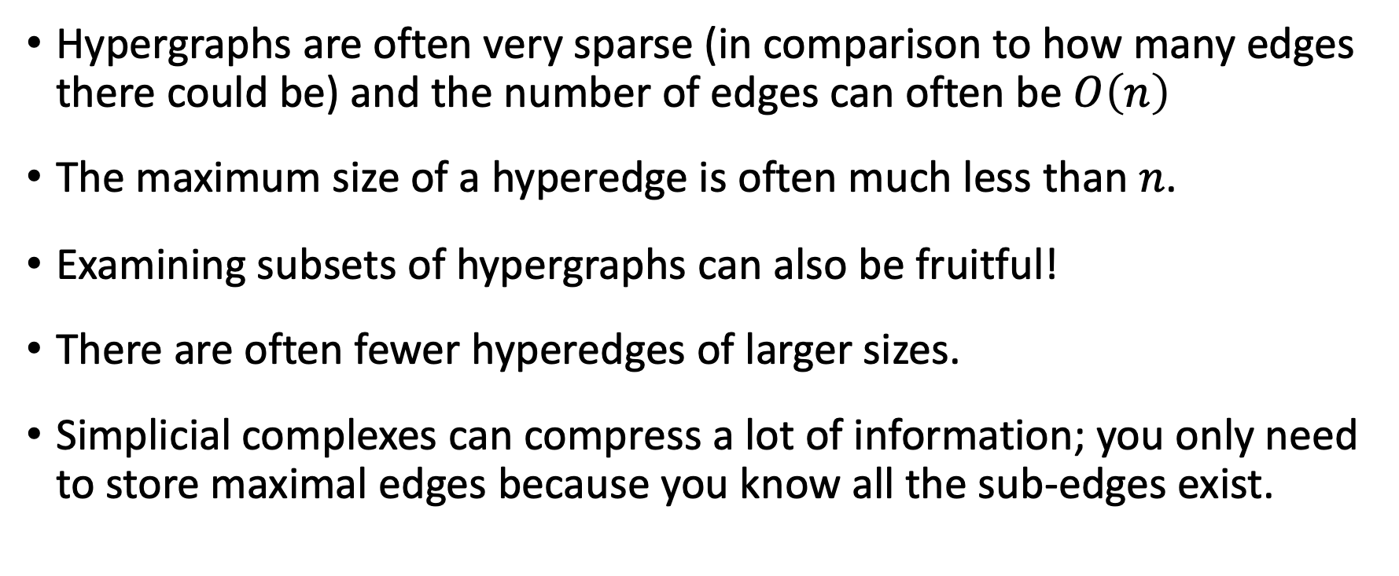
Good news!
Hypergraphs are often very sparse (in comparison to how many edges there could be) and the number of edges can often be $O\left(n\right)$
The maximum size of a hyperedge is often much less than $n$.
Examining subsets of hypergraphs can also be fruitful!
There are often fewer hyperedges of larger sizes.
Simplicial complexes can compress a lot of information; you only need to store maximal edges because you know all the sub-edges exist.

Slide 5
Representations of hypergraphs
Exact
Bipartite data structures
Bipartite edge list
Incidence matrix
Adjacency list
Other
Hyperedge list
Sets of tensors
Lossy
Adjacency matrix
Line graph

Slide 6
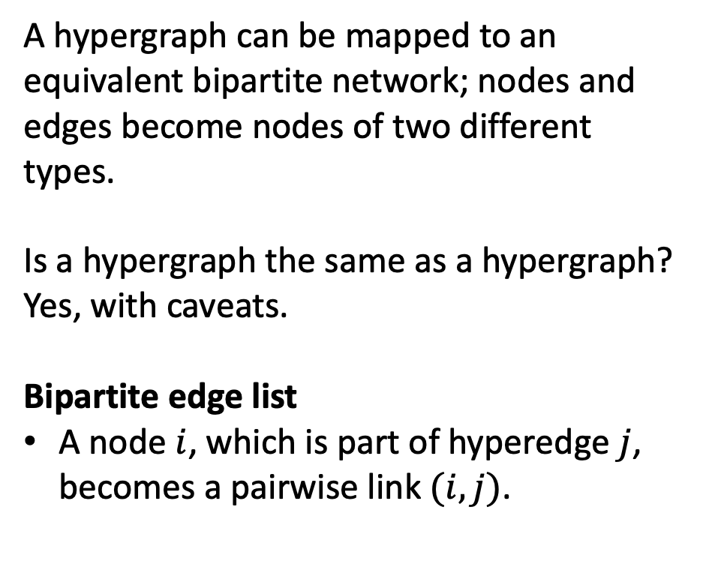
Bipartite network
A hypergraph can be mapped to an equivalent bipartite network; nodes and edges become nodes of two different types.
Is a hypergraph the same as a hypergraph? Yes, with caveats.
Bipartite edge list
A node $i$, which is part of hyperedge $j$, becomes a pairwise link $(i, j)$.

Slide 7
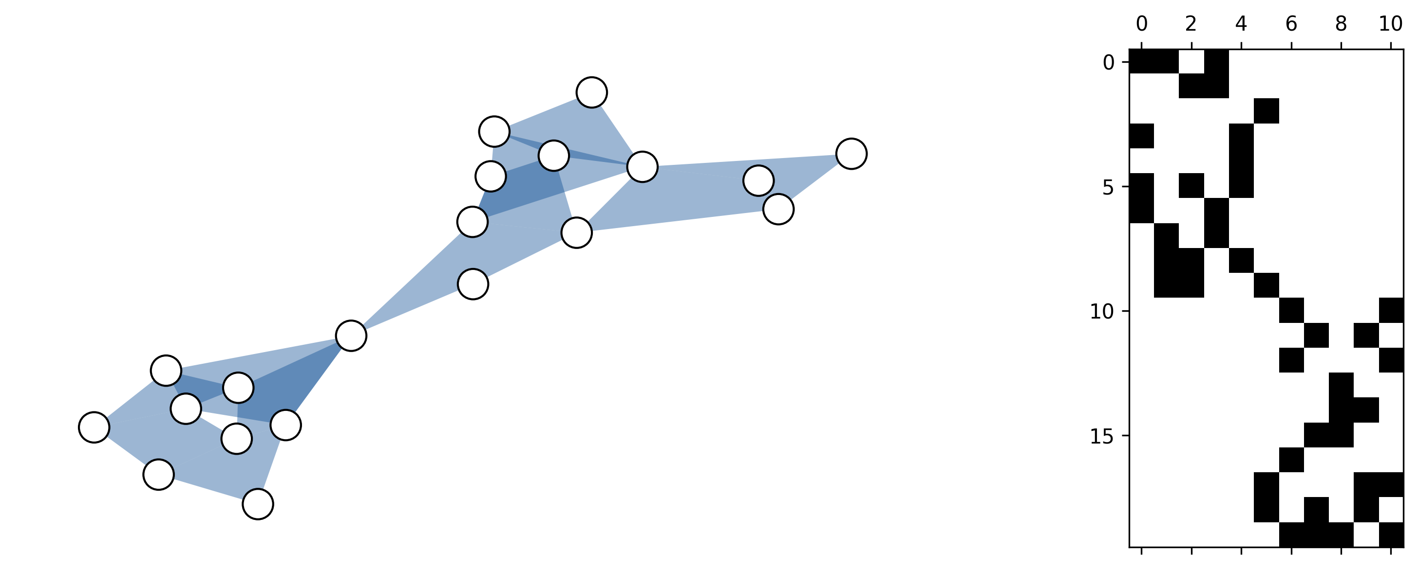
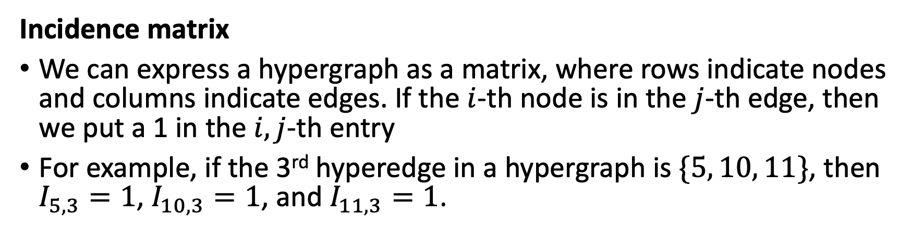
Bipartite cont.
Edges
Nodes
Incidence matrix
We can express a hypergraph as a matrix, where rows indicate nodes and columns indicate edges. If the $i$-th node is in the $j$-th edge, then we put a 1 in the $i,j$-th entry
For example, if the 3rd hyperedge in a hypergraph is $\{5, 10, 11\}$, then $I_{5, 3}=1$, $I_{10, 3}=1$, and $I_{11, 3}=1$.

Slide 8
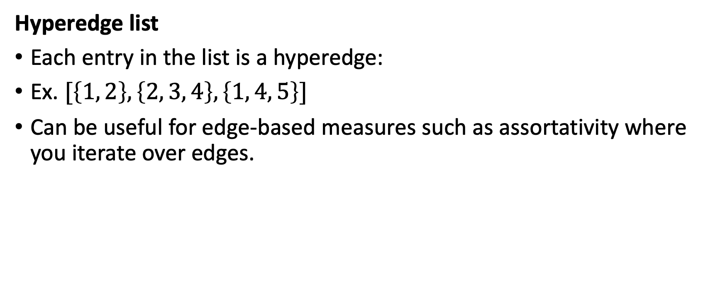
Other
Hyperedge list
Each entry in the list is a hyperedge:
Ex. $[\left\{1, 2\right\}, \left\{2, 3, 4\right\}, \left\{1, 4, 5\right\}]$
Can be useful for edge-based measures such as assortativity where you iterate over edges.

Slide 9
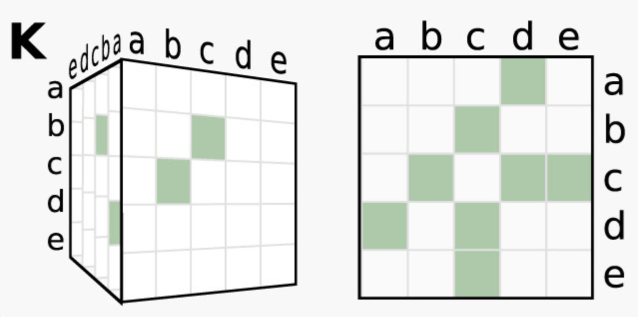
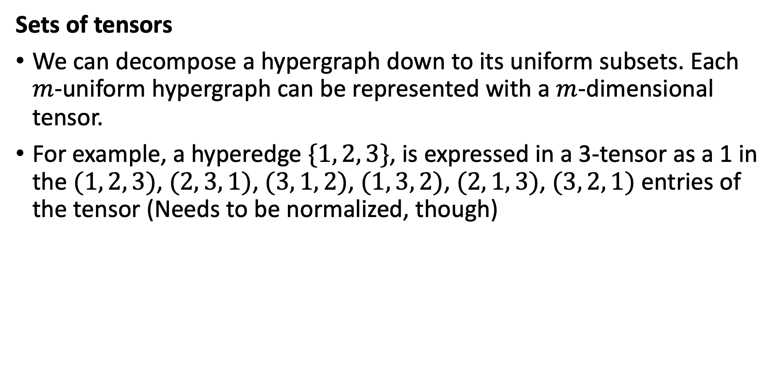
Other cont.
Sets of tensors
We can decompose a hypergraph down to its uniform subsets. Each $m$-uniform hypergraph can be represented with a $m$-dimensional tensor.
For example, a hyperedge $\{1, 2, 3\}$, is expressed in a 3-tensor as a 1 in the $(1, 2, 3)$, $(2, 3, 1)$, $(3, 1, 2)$, $(1, 3, 2)$, $(2, 1, 3)$, $(3, 2, 1)$ entries of the tensor (Needs to be normalized, though)

Slide 10
Lossy representations
Adjacency matrix
There is a pairwise link between nodes if the nodes are connected by at least one hyperedge
More than one hypergraph can make the same adjacency matrix
Line graph
The adjacency matrix but for edges, i.e., there is a pairwise link between two edges if they share at least one node in common
Other matrices
Other matrices (Laplacian, clique motif matrix, etc.) are often just different variations or combinations of these matrices.

Slide 11
Considerations: application
Simplicial complexes: maximal faces
Matrices
Pros: quick computations of edge size/degree and linear algebra stuff
Cons: Edge/node relations, depending on matrix representation
Bipartite network
Pros: good for local relations such as neighbors, degree, edge size
Cons: construct the incidence matrix from scratch when you need it
You can use a cache approach (as you need), BUT it will always be space vs. time efficiency. Every time the hypergraph changes, you will need to recompute.
It depends on the application!

Slide 12
Challenges
Computational feasibility is a big concern
There are cases where pairwise projections do just as well
A lot of metrics are defined on the pairwise projection of the hypergraph
A lot of work has already been done for bipartite networks
Are dynamics and structure qualitatively different from pairwise networks?

