Slide 1
Mut
Nathan Longnecker

Slide 2

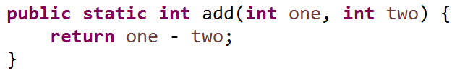
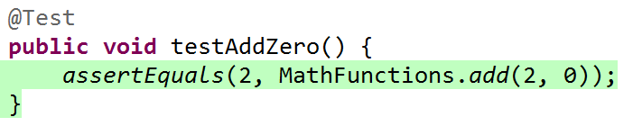
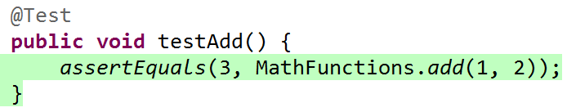
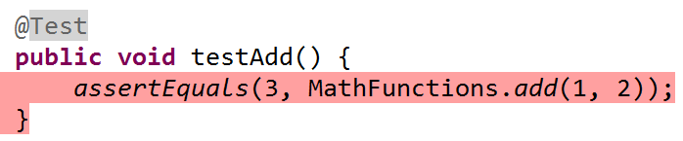
Mutation Testing!

Slide 3
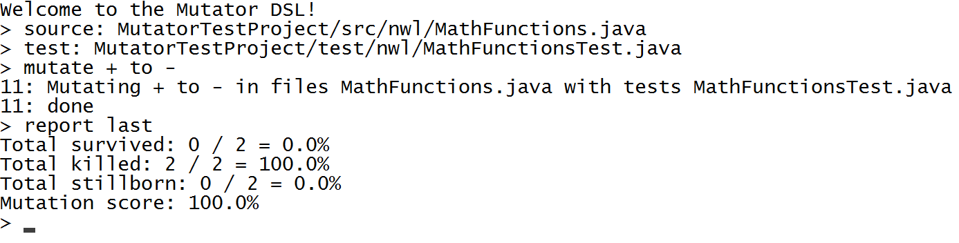
How do?

Slide 4
How does Mut work?
Read files
Compile & Test
In memory file system
JavaCompiler in JDK
Survived
Killed
Stillborn
Report
Change Source
Regex pattern matching
JUnit
Custom ClassLoader

Slide 5
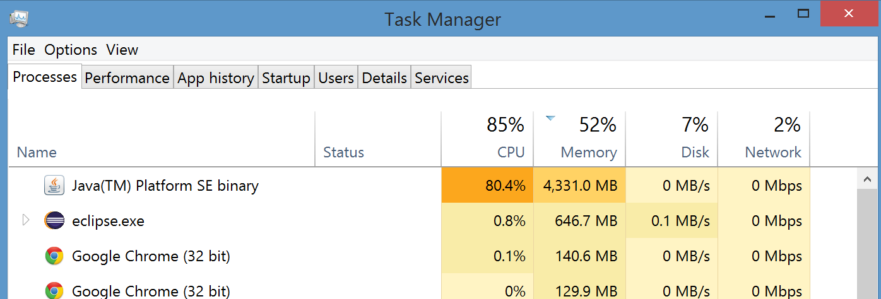
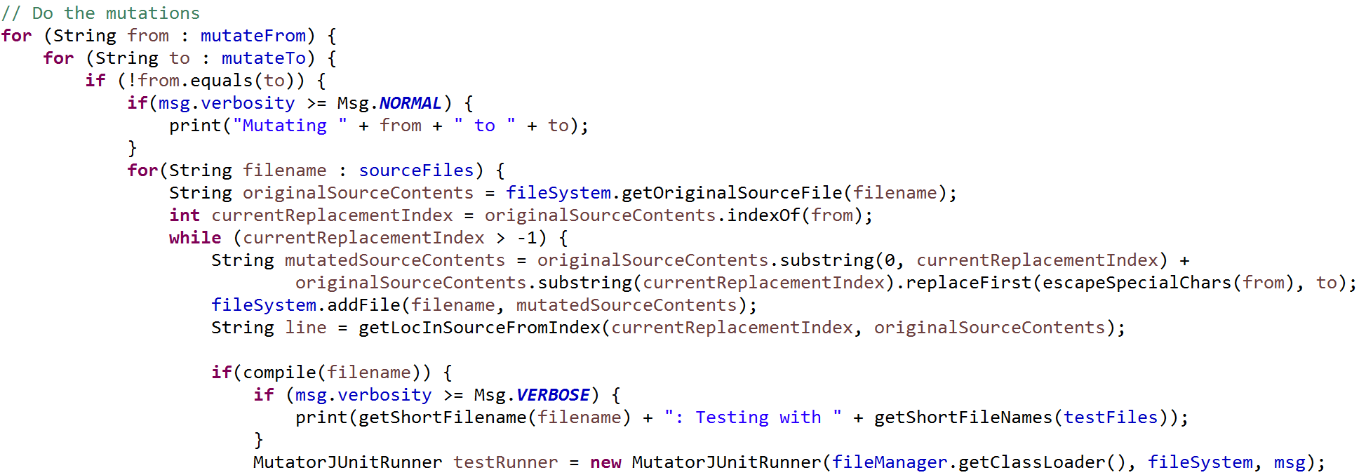

It’s quite simple…

Slide 6
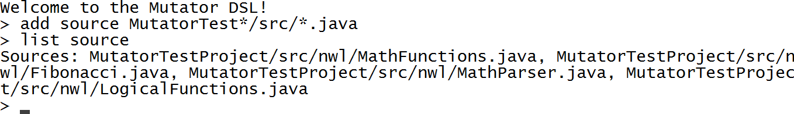
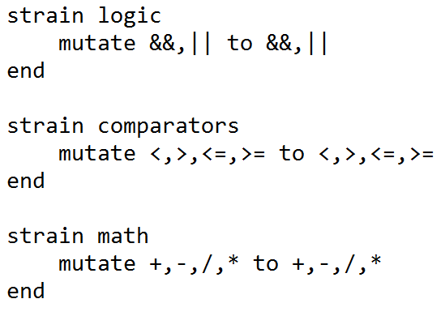
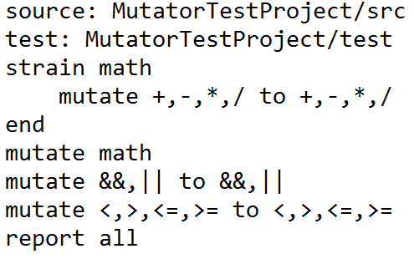
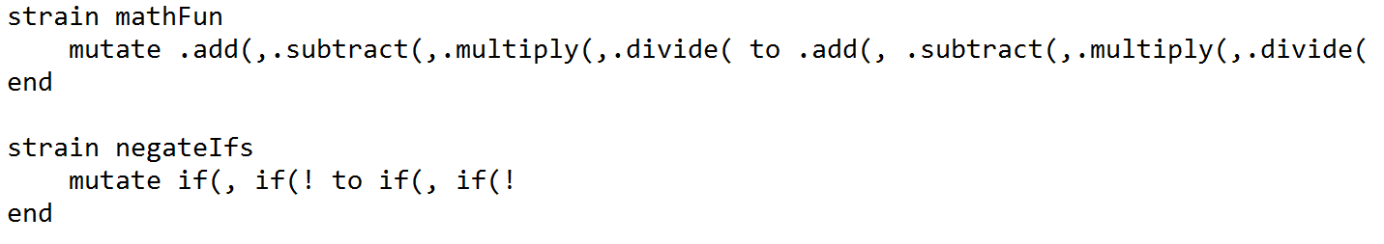
Features
Add multiple files with regex
Mutation ‘strains’
Powerful matching
Multithreading
Run with script or REPL
Result reporting

