Slide 1
Indian Student Association - NWMSU
Team - 04

Slide 2
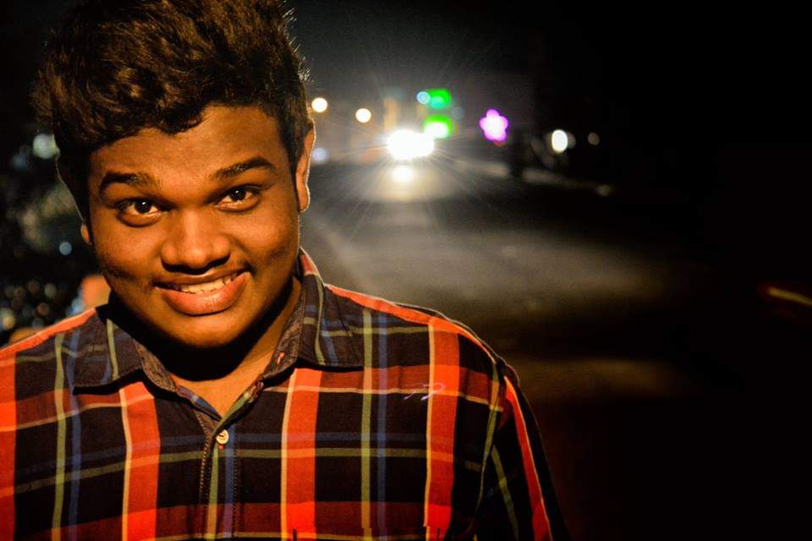
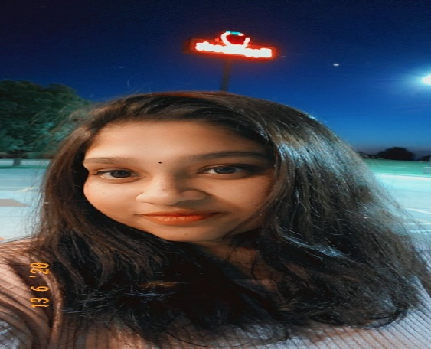
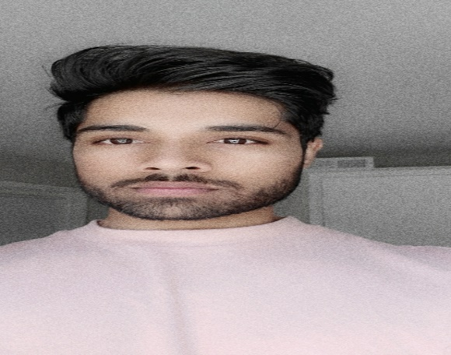
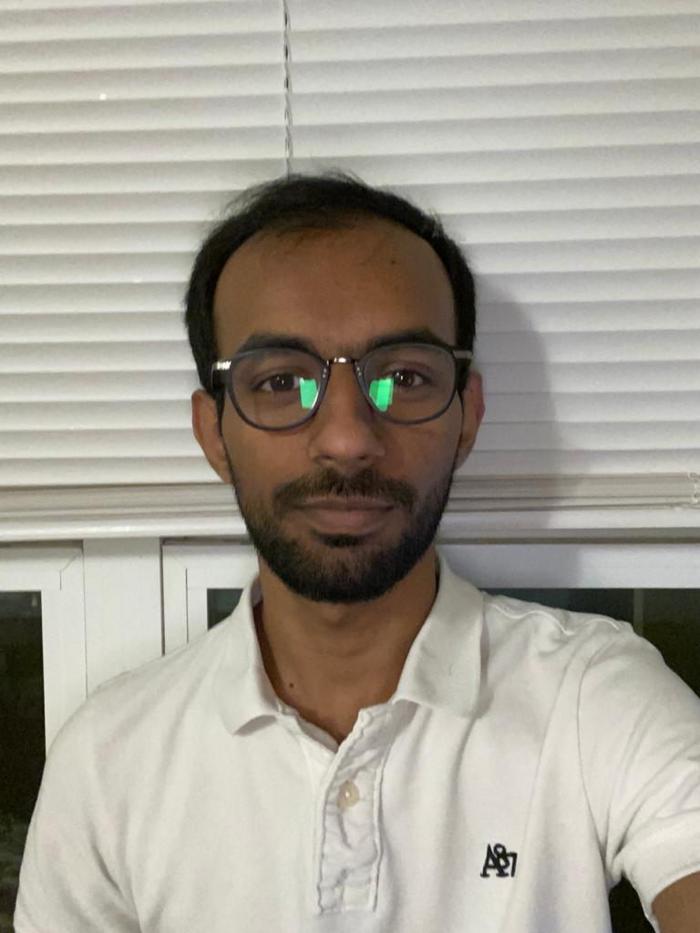
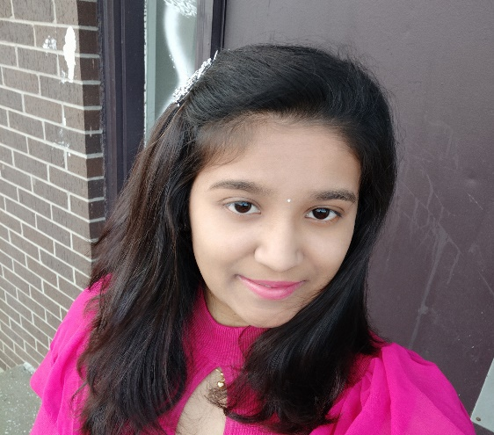
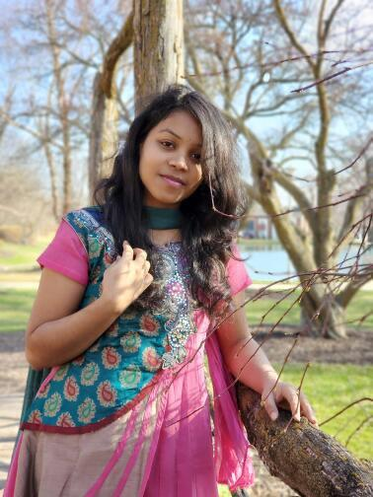
Team
Dheeraj
Sai Jyothsna
Jeevan Reddy
Bharat Reddy
Bhavya Deepthi
Mahalakshmi

Slide 3
Agenda
About the project
Intended use of the project
Tools and Technologies used
Demo - Bharat
Demo – Bhavya
Demo – Dheeraj
Demo – Mahalakshmi
Demo – Jyothsna
Demo – Jeevan
Summary
Bharat

Slide 4
About the project
Web based application intended to be used on browsers.
Authentication in place.
Email functionality.
Available online at https://isanwmsu.herokuapp.com/

Slide 5
Intended use of the project
The project is targeted on the Indian community that attend Northwest Missouri State University.
Helps Team – ISA to manage their responsibilities more efficiently.
One stop shop for managing all requests are answering queries.

Slide 6
Tools and technologies used
Software:
React JS
Express
Node
Mongo DB
Semantic UI React
Bootstrap
Hardware:
Computers
Server
IDE:
Visual Studio Code

Slide 7
Demo - Bharat
Bharat

Slide 8
Responsibilities for GDP - 2
CRUD functionality for events(UI)
Live Chat
Navbar/Admin Navbar
Home page

Slide 9
Demo - Bhavya
Bhavya

Slide 10
Responsibilities for GDP - 2
Backend for Help Module
Backend for Events Module
Pickup function user functionality
Pickup function admin functionality

Slide 11
Demo - Dheeraj
Dheeraj

Slide 12
Responsibilities for GDP - 2
Forum UI
Individual forum view
Volunteer pickup user functionality
Volunteer pickup admin functionality

Slide 13
Demo - Mahalakshmi
Mahalakshmi

Slide 14
Responsibilities for GDP - 2
Contact Us
Temporary accommodation user functionality
Temporary accommodation admin functionality
Membership user functionality
Membership admin functionality

Slide 15
Demo – Jyothsna
Jyothsna

Slide 16
Responsibilities for GDP - 2
FAQ UI user functionality
FAQ UI admin functionality
CRUD views for FAQ functionality
Past events UI
Post arrival checklist

Slide 17
Demo – Jeevan
Jeevan

Slide 18
Responsibilities for GDP - 2
Alumni UI
Upcoming events UI
Individual user UI (cancel request)

Slide 19
Summary
Our main intention for developing this project is to help the Indian community at Northwest.
Team – ISA has a better and easy way to manage their services.
No more Google forms.
Ready to use on the internet.
Register with Team ISA at https://isanwmsu.herokuapp.com/register
Jeevan

Slide 20
Questions?
Jeevan

Slide 21
Team
Dheeraj
Sai Jyothsna
Jeevan Reddy
Bharat Reddy
Bhavya Deepthi
Mahalakshmi

Slide 22
Thank You..!!

