Slide 1
Project presentation
Agenda : introduction to our application (TAT)
By
Nanda kishore Mandadapu [574822478]
Sai Jyothi Bhumireddy[361648962]
Rishitha Reddy Kasireddy[012419648]

Slide 2
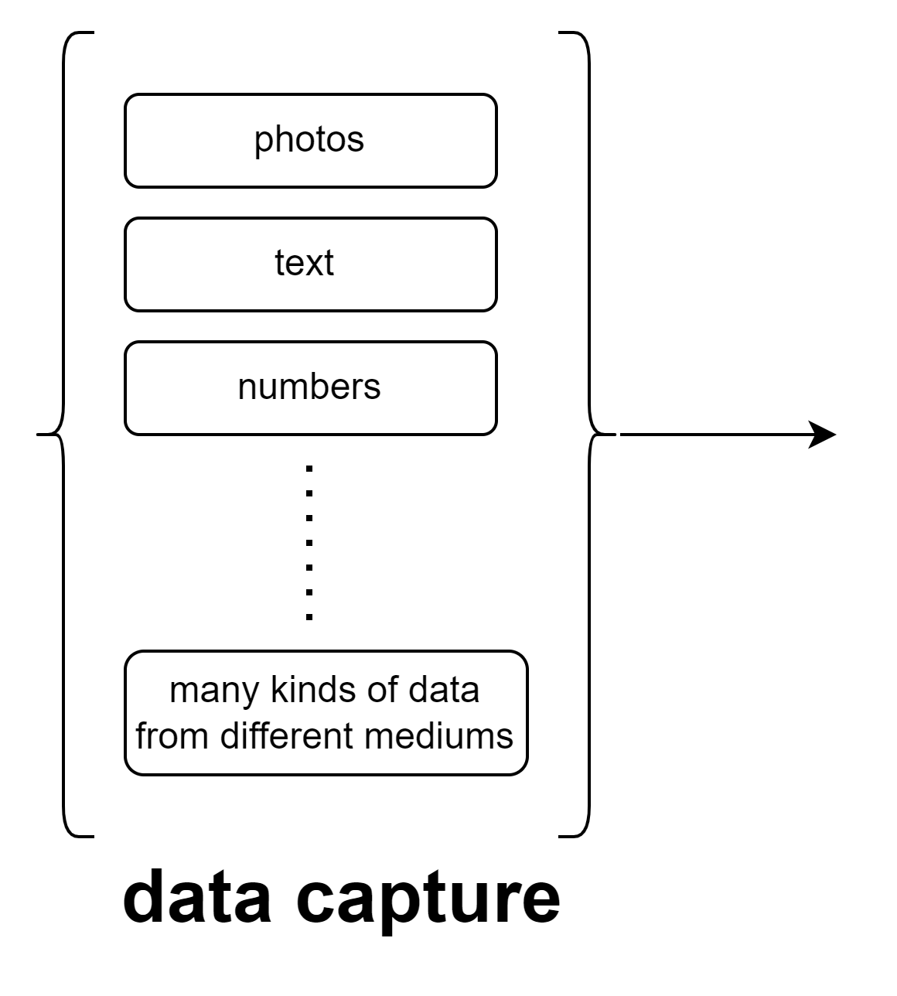
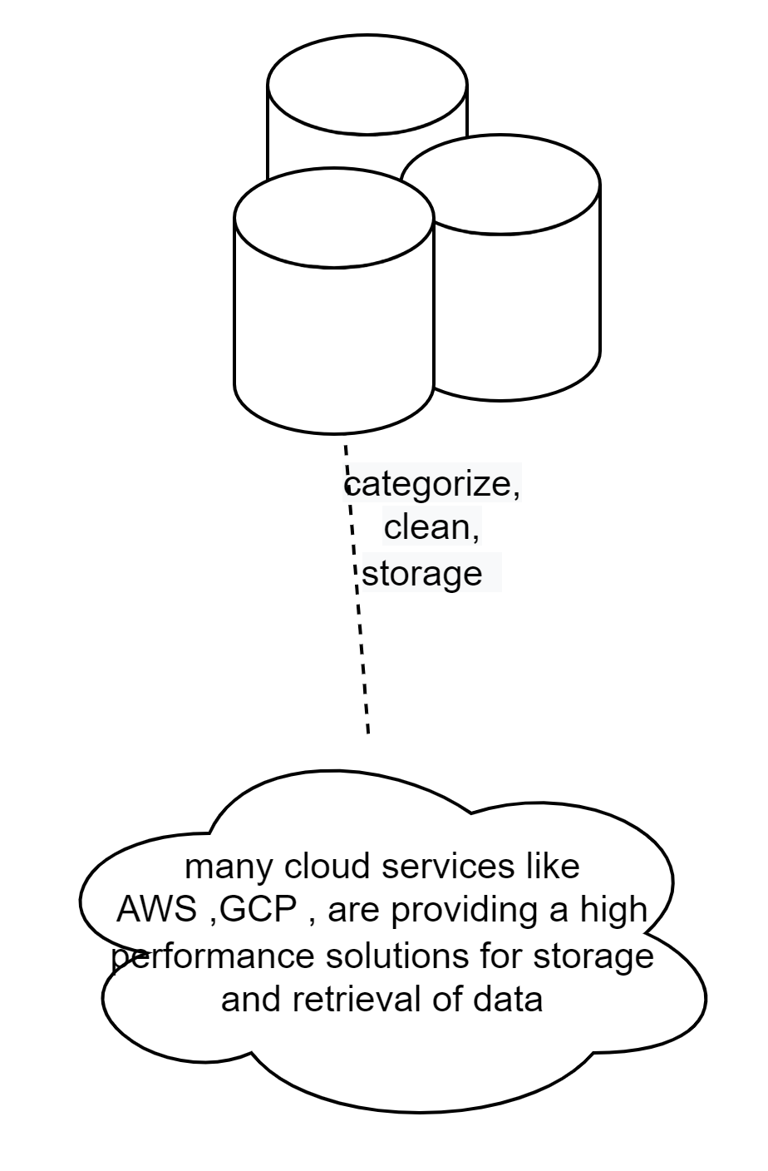
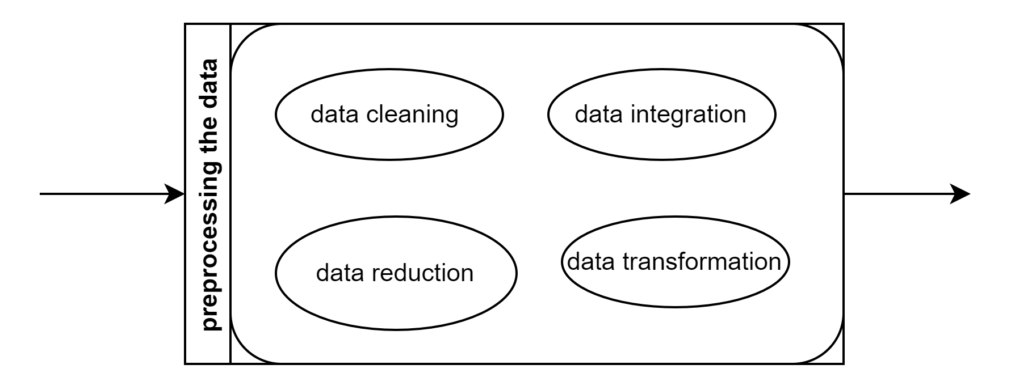
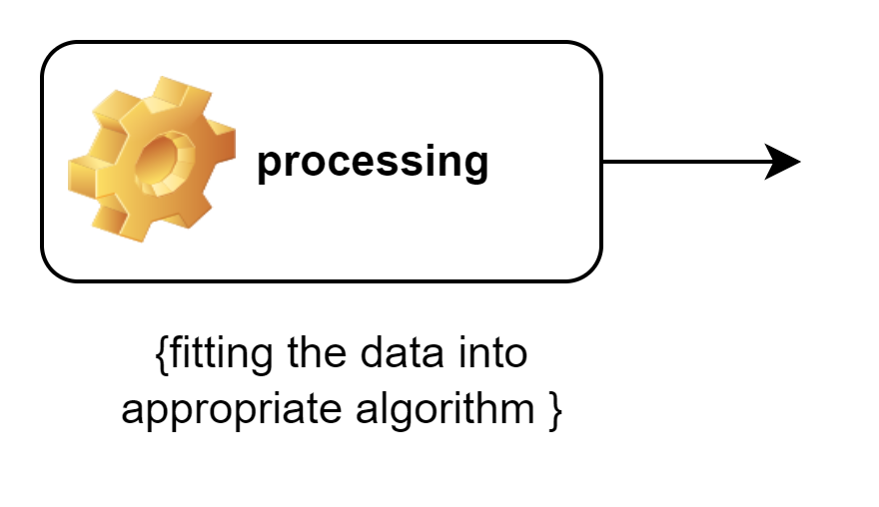
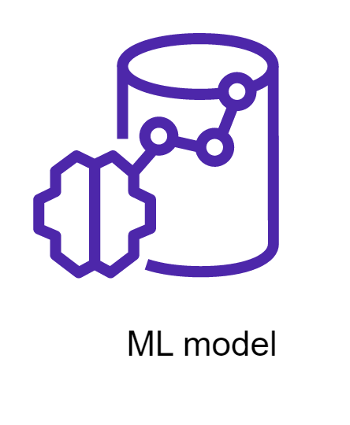
Life cycle

Slide 3
Big data and its application
Security
Manage risks
Improve decision-making
Predicting the future trends
Fraud detection
Prediction
Analyze
suggesting
clustering
Classifying
advertisement

Slide 4
Choosing Best Algorithm for your Data
?

Slide 5
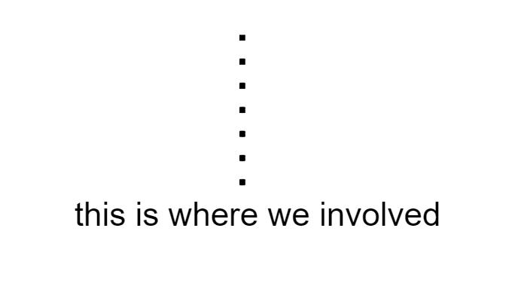
This is where we involve

Slide 6
Statistical measure
Measure to central tendency , correlations , variance
Accuracy
Precision
Sensitivity
Etc…

Slide 7
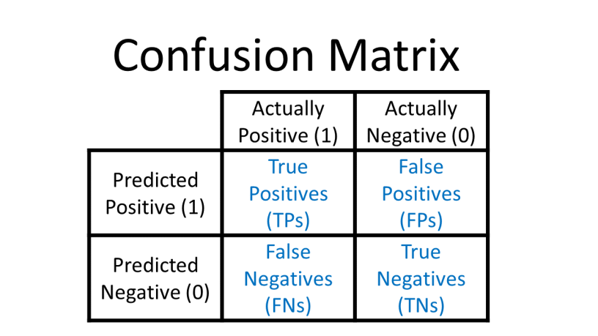
Confusion matrix

Slide 8
Advertising suggestions /classifications
Accuracy
Accuracy measures how often the model is correct.
(True Positive + True Negative) / Total Predictions

Slide 9
Fraud detection
Sensitivity (Recall)
Of all the positive cases, what percentage are predicted positive?
Sensitivity (sometimes called Recall) measures how good the model is at predicting positives.
This means it looks at true positives and false negatives (which are positives that have been incorrectly predicted as negative).
How to Calculate
True Positive / (True Positive + False Negative)

Slide 10
Weather prediction
Precision
Of the positives predicted, what percentage is truly positive?
True Positive / (True Positive + False Positive)
Precision does not evaluate the correctly predicted negative cases:

Slide 11
Health care- cancer detection
Specificity
How well the model is at predicting negative results
Specificity is similar to sensitivity, but looks at it from the perspective of negative results.
How to Calculate
True Negative / (True Negative + False Positive)

Slide 12
Sorting the search engine results
F-score
F-score is the "harmonic mean" of precision and sensitivity.
It considers both false positive and false negative cases and is good for imbalanced datasets.
How to Calculate
2 * ((Precision * Sensitivity) / (Precision + Sensitivity))

Slide 13
T A T
TEST & TRAIL
How to choose

Slide 14
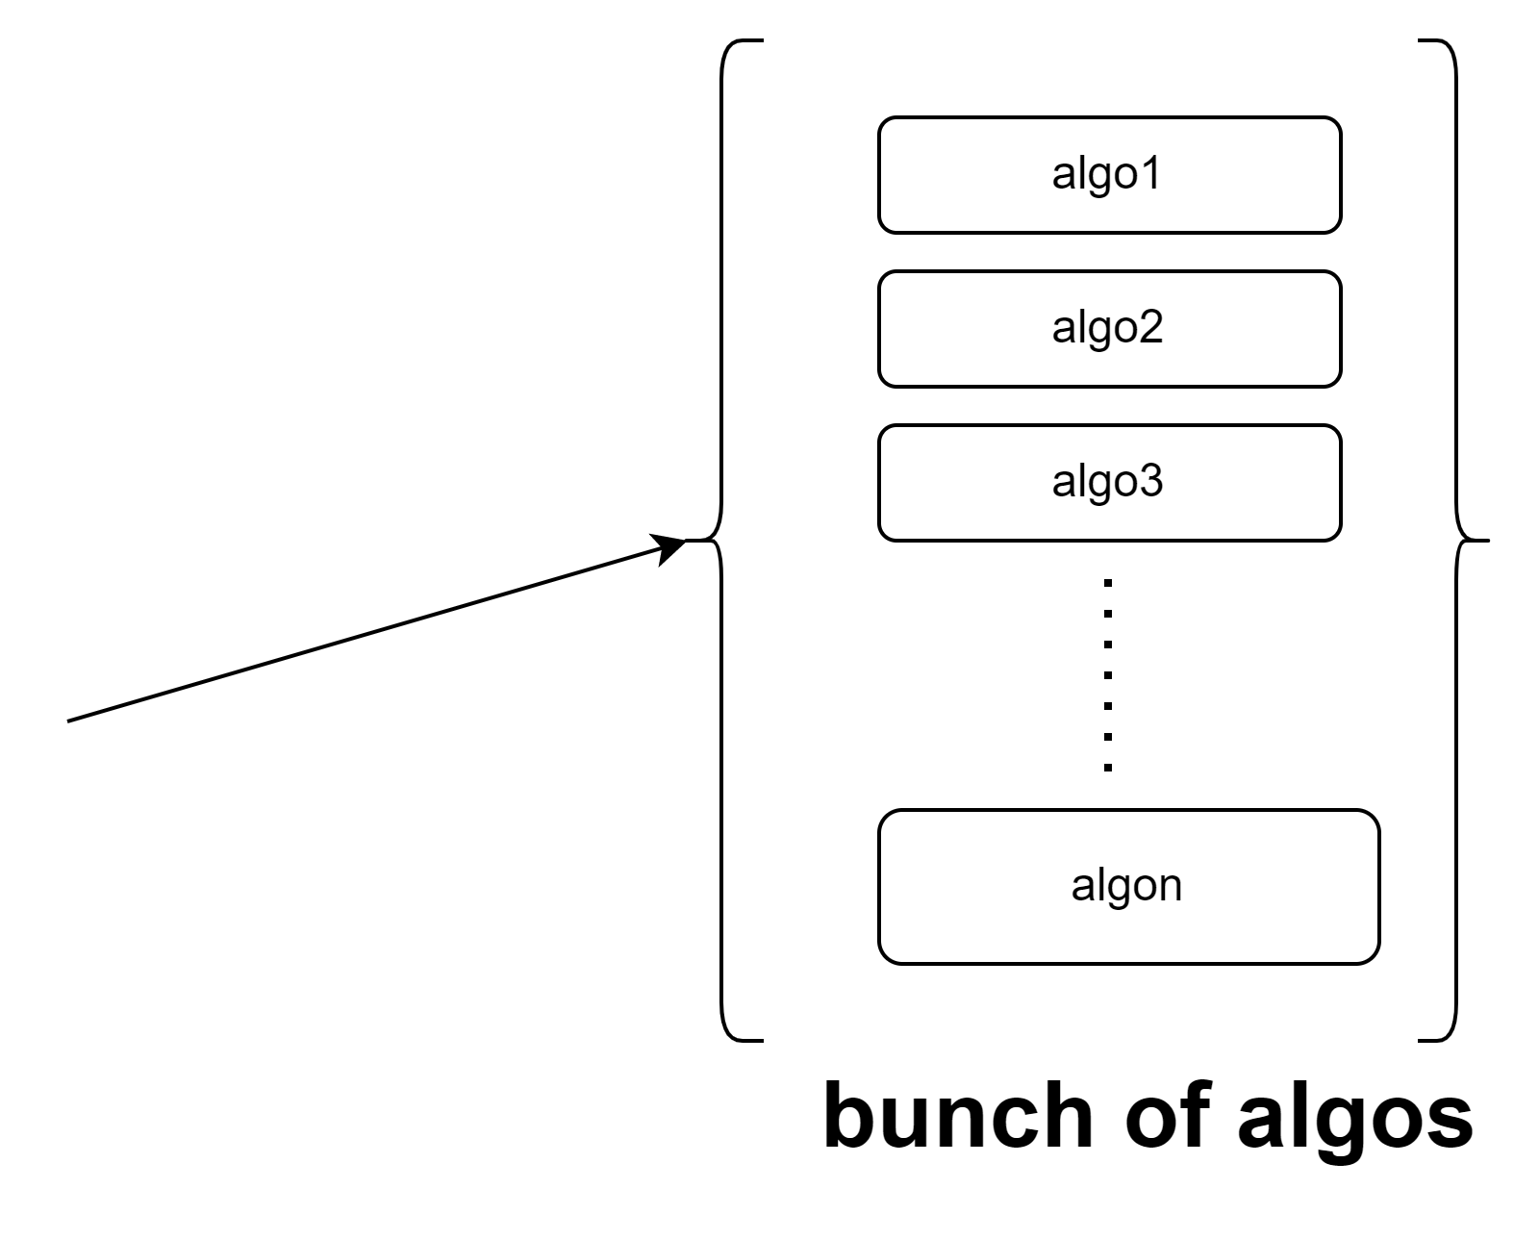
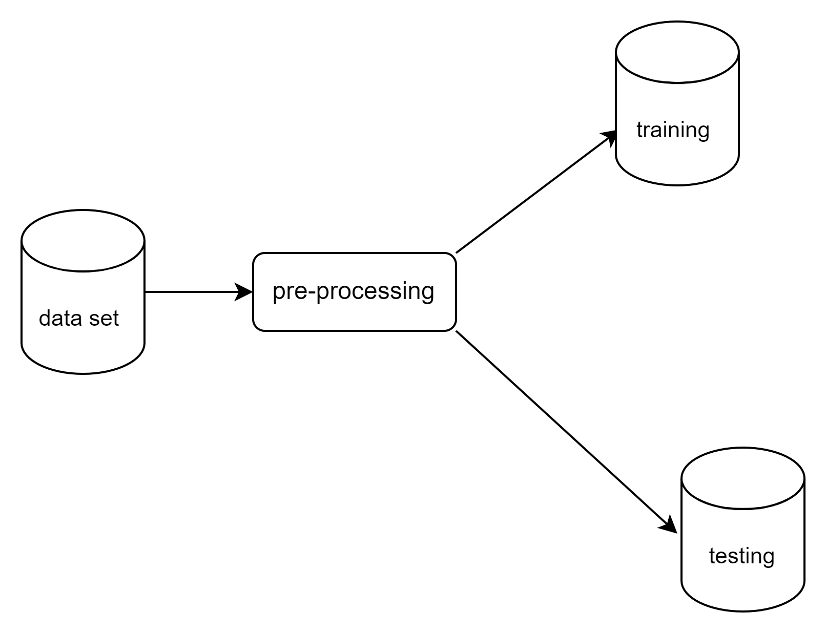
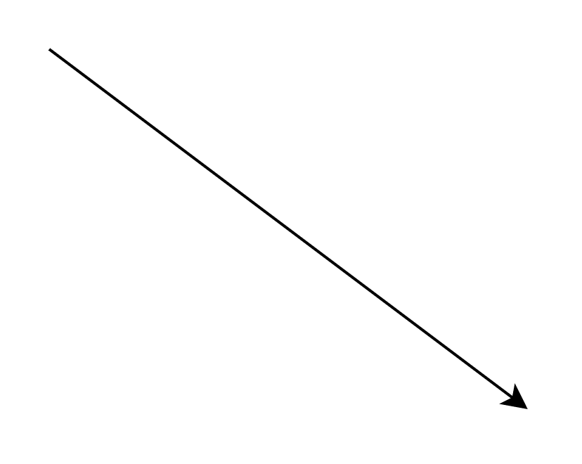
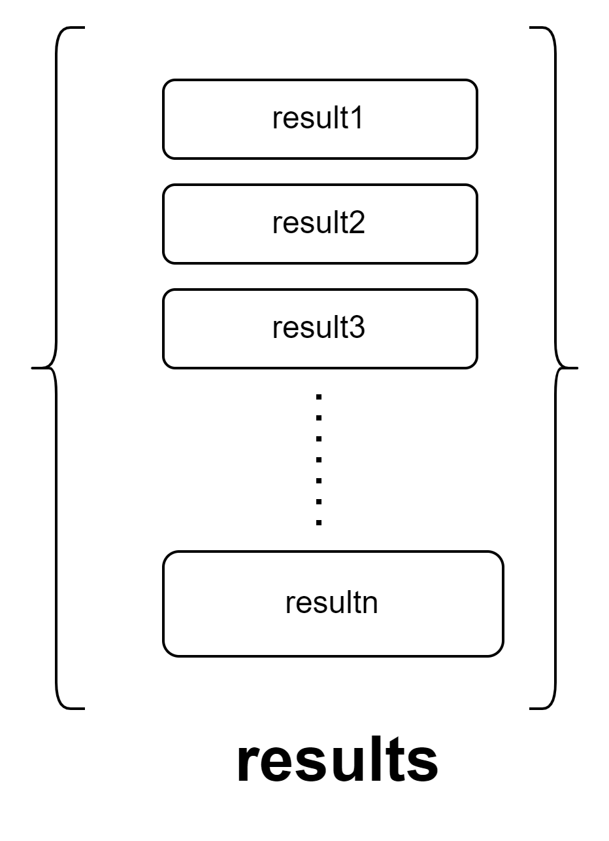
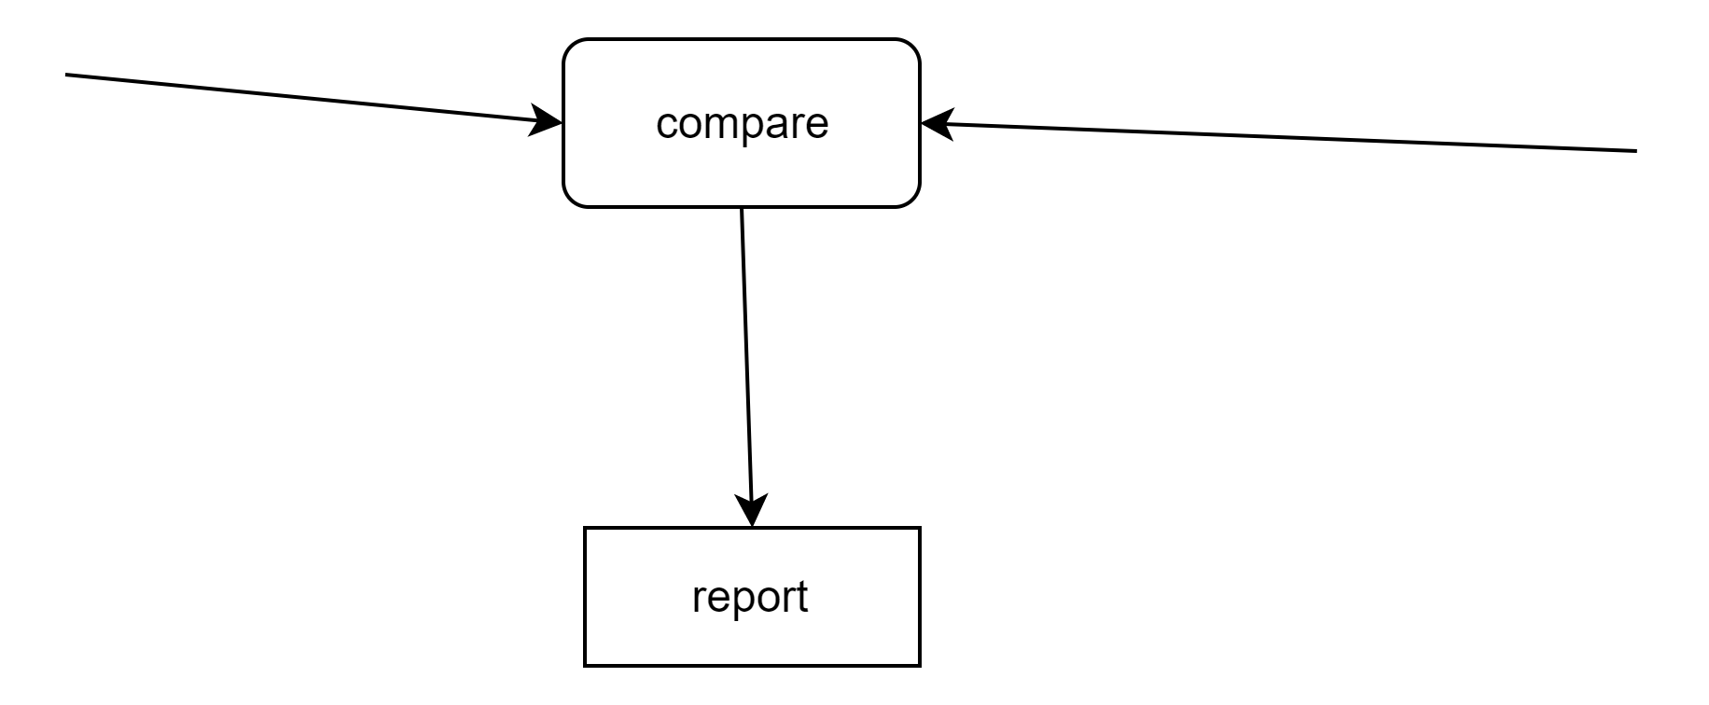
Our application helps you there

Slide 15
Piece of data
Why ?
Constraints
How?
Rows with null values
Duplicate rows
PCA

Slide 16
Future works
Time series
Image data

Slide 17
References
https://www.w3schools.com/python (definitions , code snipes )
https://scikit-learn.org/stable/modules/generated/sklearn.html
https://www.kaggle.com/datasets/uciml/breast-cancer-wisconsin-data

Slide 18
questions

