Slide 1


Rate the Rating:
Reliability of Teammates Rating Scores
Alex Xue

Slide 2
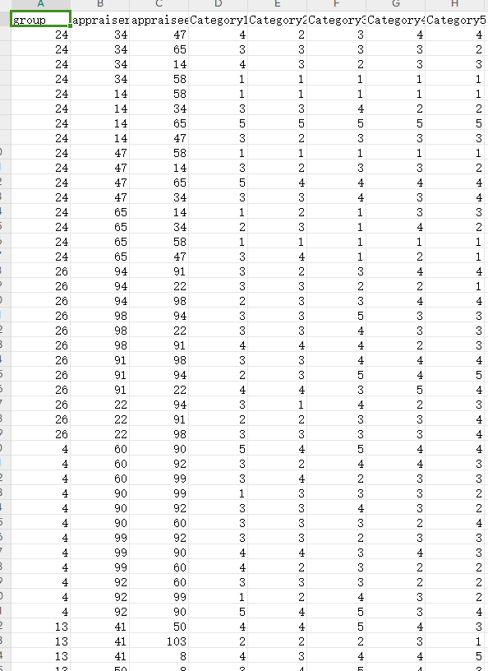

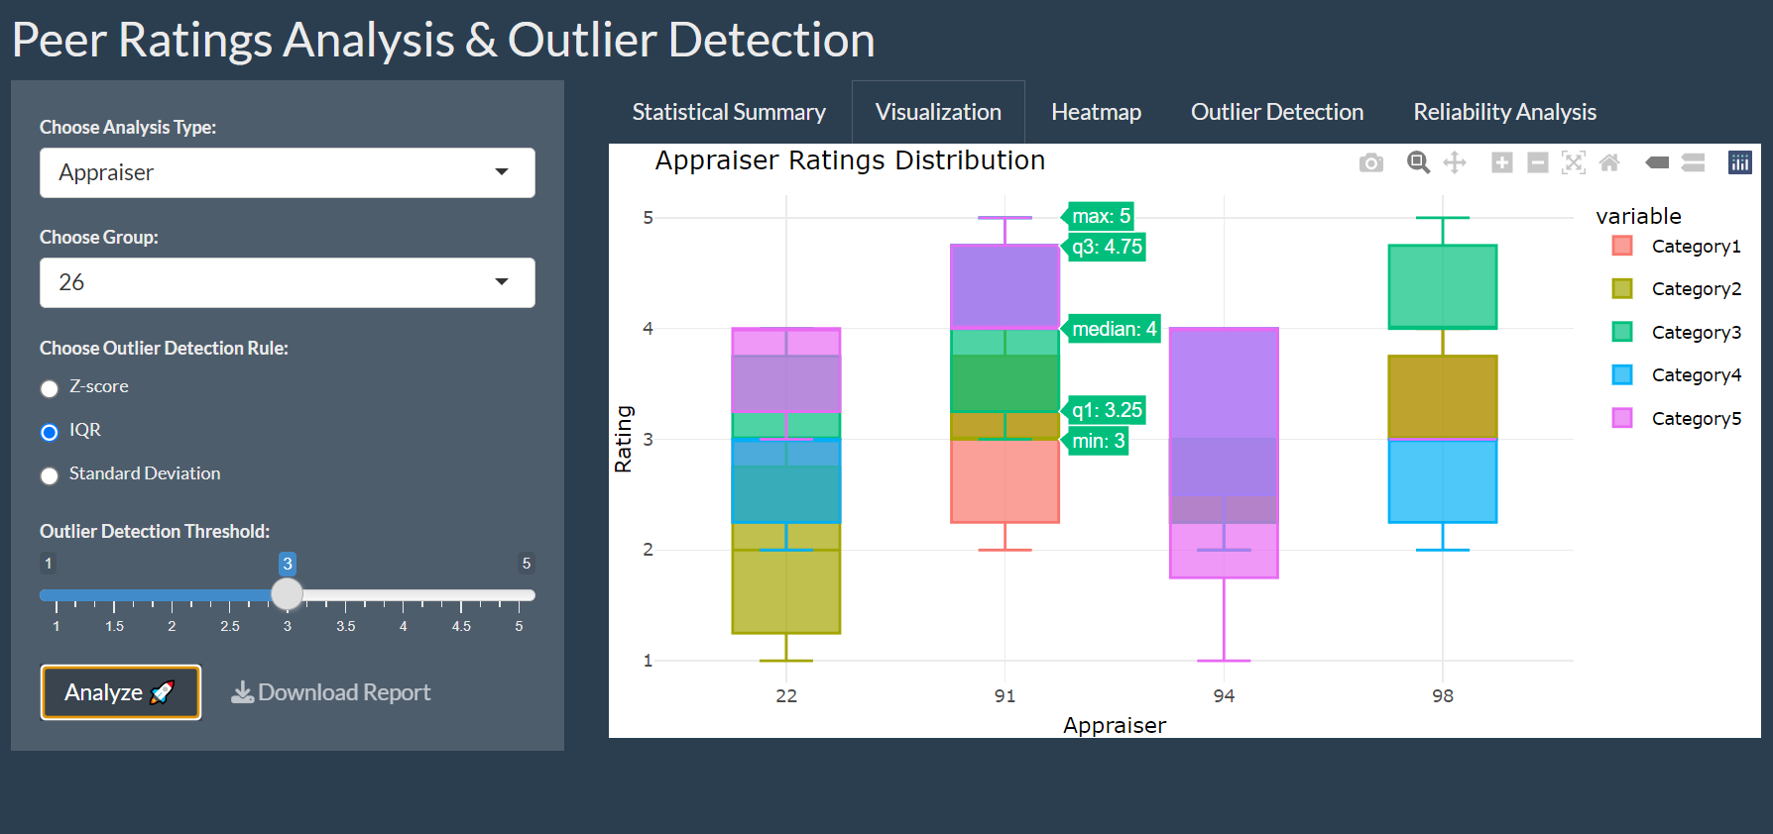
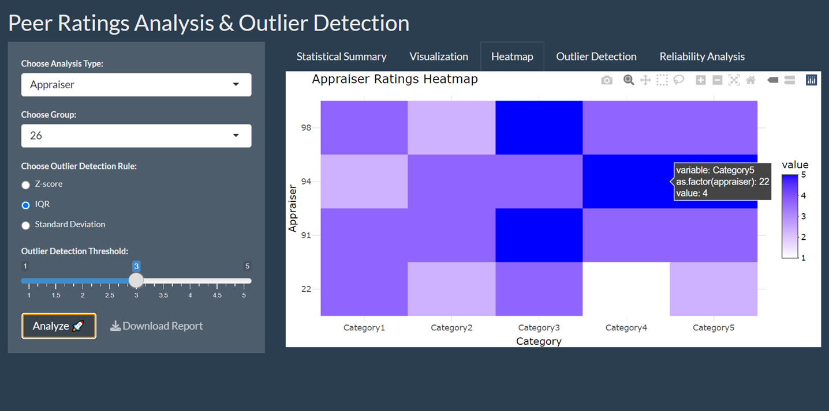

Yes, wanna take a look at team scores
But… lost in tons of numbers?
I got u!(with CLEAR VISUALIZATIONS)

Slide 3
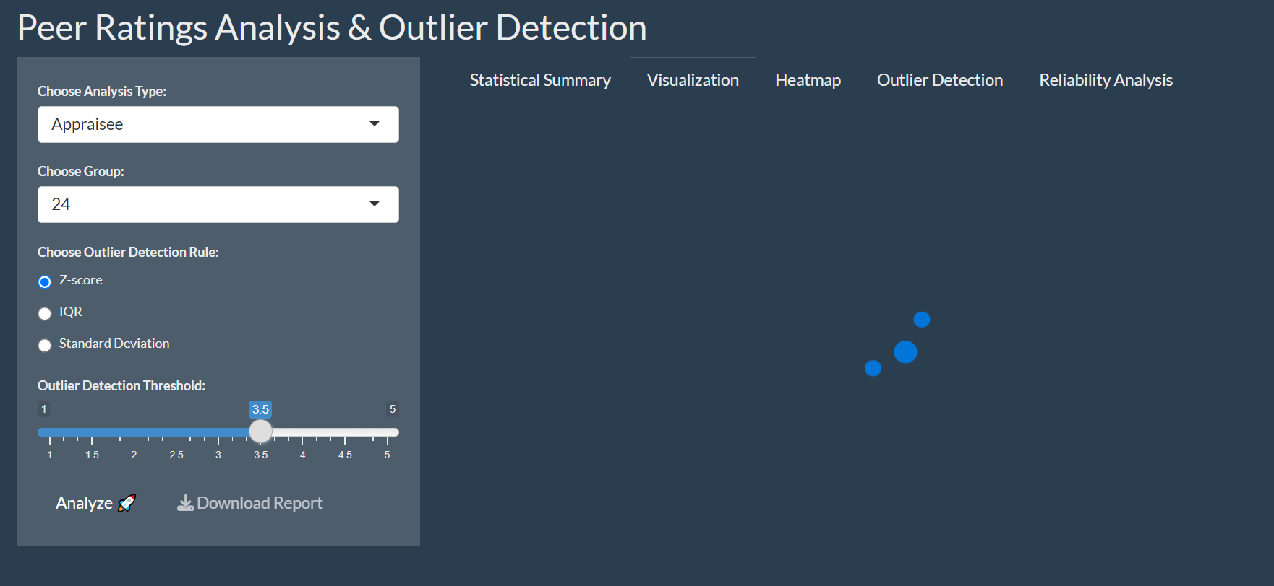
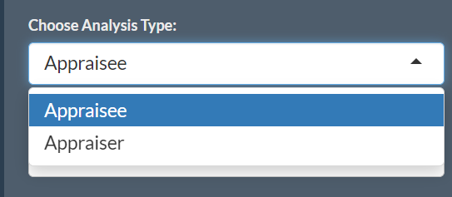
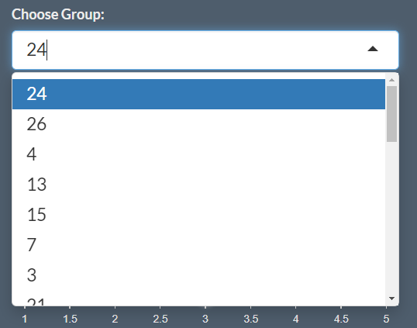
Words got u sleepy?
I got u!(with EASY ACCESS INTERACTIONS APP)
CAN DOWNLOAD REPORT IF NEEDED☺

Slide 4
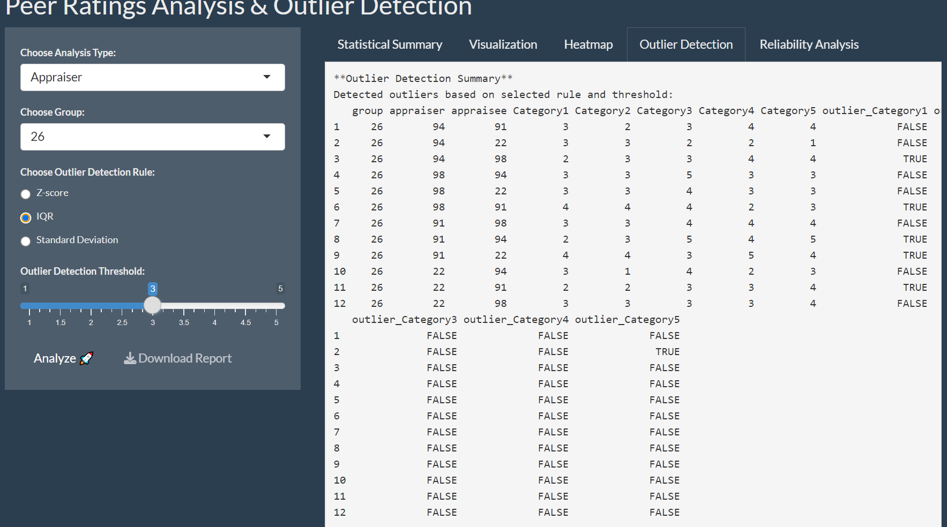
Suspicious unfair rating?
I got u!(with OUTLIER DETECTION IN 3 RULES)
(and threshold scroll)
Z-score: Detects outliers based on how far they are from the average, using standard deviations.
IQR: Looks for outliers that are significantly higher or lower than the typical range (25th-75th percentile).
Standard Deviation: Measures how far data points are from the average, flagging those that deviate by a set number of standard deviations.
Adjust the threshold to control how strictly outliers are detected. Lower values flag more outliers, while higher values only flag extreme cases."

Slide 5

Don’t wanna check this? Got u! Wait for summary☺

Slide 6
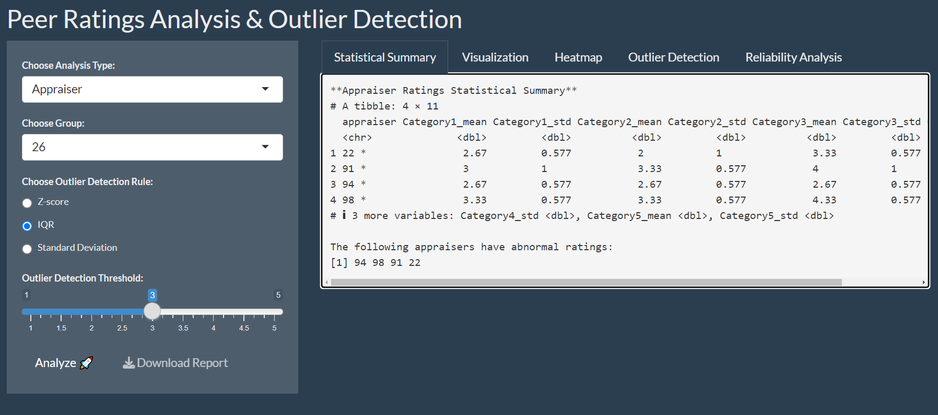

And…We found the mole!
(MARK THEM IN SUMMARY)
The outcome may be different using different rules and thersholds…I found IQR marks more anomalies

Slide 7
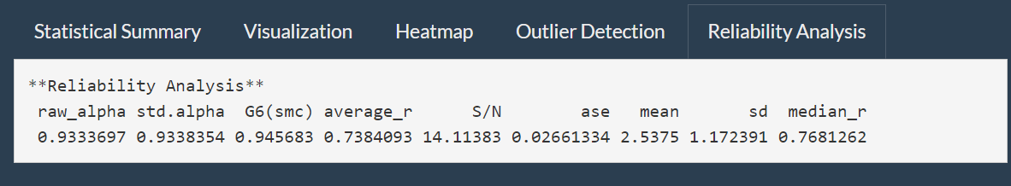
So…Do we trust the ratings?
(Cronbach's Alpha)
(Only showed one group of data as example, we can see other groups in the app)
Alpha = 0.933: Indicates high consistency and reliability in the ratings (values close to 1 mean better reliability).
Average correlation = 0.738: Shows a strong average correlation between the ratings.
Signal-to-Noise Ratio (S/N = 14.11): Suggests the ratings contain much more useful information than random noise.
Conclusion: The ratings are highly reliable and can be trusted.

Slide 8
THANK YOU
FOR
LISTENNING!!!

