Slide 1
Progressive Web Apps
Norbert Wolff

Slide 2
Some facts
Around 90% people on the world use Native Apps, only 10% use Web Apps
Around 85% of the time spent in Native Apps is in user’s TOP 3 apps (like YouTube, Facebook, Messanger)
Avarage of new Native Apps installed per month by users is close to 0
Web Apps have 3 Times bigger audience reach than Native Apps (because of Native Apps user’s TOP 3)
Conclusion? Web Apps have much better audience reach but they lack all the cool features that provides Native Apps.

Slide 3
What is Progressive Web App?
Progressively enhance web apps to look and feel like native apps:
Accessing device camera or location
Fully working offline mode
Displaying push notifications
Installing app on your devices and adding home screen icon and splash screen
Synchronizing data in the background
Progressive Web App should be:
Reliable: load fast and provide offline functionality
Fast: respond quickly to user actions
Engaging: feel like a native app on mobile device
PWA Compability:
https://www.goodbarber.com/blog/progressive-web-apps-browser-support-compatibility-a883/

Slide 4
Differences between PWA and Native App
Installation
Cross platform availability
- Updates
Discovery
Push notifications
Security
Device Features
Cost
https://www.mobiloud.com/blog/progressive-web-apps-vs-native-apps/

Slide 5
Main requirements for the Web App to be PWA
App served over https
Has included manifest.json
Has registered service worker script

Slide 6
PWA vs SPA
SPA:
Powered by JavaScript
Only one HTML file
PWA:
Uses a lot of JavaScript but also works without it
Works with multiple HTML files

Slide 7
Progressive Enhancement
Progressive Web App delivers a lot of features, but you don’t need to use all of them at once.
You might want to just add a manifest file so the users can add your app to the home screen.
Later on you can implement caching techniques to your service worker or any other PWA features like using camera device etc.

Slide 8
Manifest file in depth
{
”name”: ”Full app name”,
”short_name”: ”app name”,
”start_url”: ”/index.html”,
”scope”: ”.”,
”display”: ”standalone”,
”background_color”: ”#fff”,
”theme_color”: ”#fff”,
”description”: ”App description”,
”dir”: ”ltr”,
”lang”: ”en-US”,
”orientation”: ”portrait-primary”,
”icons”: [{
”src”: ”/icon.png”,
”type”: ”image/png”,
”size”: ”48x48”
}]
}
- Name visible on splashscreen
- Short name visible below icon
- Which page to load on startup
- Which page includes as PWA
- Should it be headless browser
- Background color of splashscreen
- Color of top bar in task switcher
- Description of your app
- Read direction of your app
- Main language
- Set and enforce default orientation
- Icons used for the splashscreen loading
-- Path to your icon
-- Type of file
-- Icon size, browser chooses best one for given device

Slide 9
PWA install banner requirements
https://developers.google.com/web/fundamentals/app-install-banners

Slide 10
Service worker
Allows caching and running app offline
Allows background synchronisation
Allows to handle Push notifications
Runs on separate thread
Listening to the events
Lives on after page is closed (background process)
Manages all pages of given scope

Slide 11
Service worker events
Service Worker lifecycle – Service worker phase changes
Fetch - Browser or Page-related JS initiates a Fetch request
Push Notifications – Service worker receives Web Push Notification (from Server)
Notification interaction – User interacts with displayed Notification
Background Sync – Service worker receives Background sync event when connection is restored and is able to perform stored actions

Slide 12
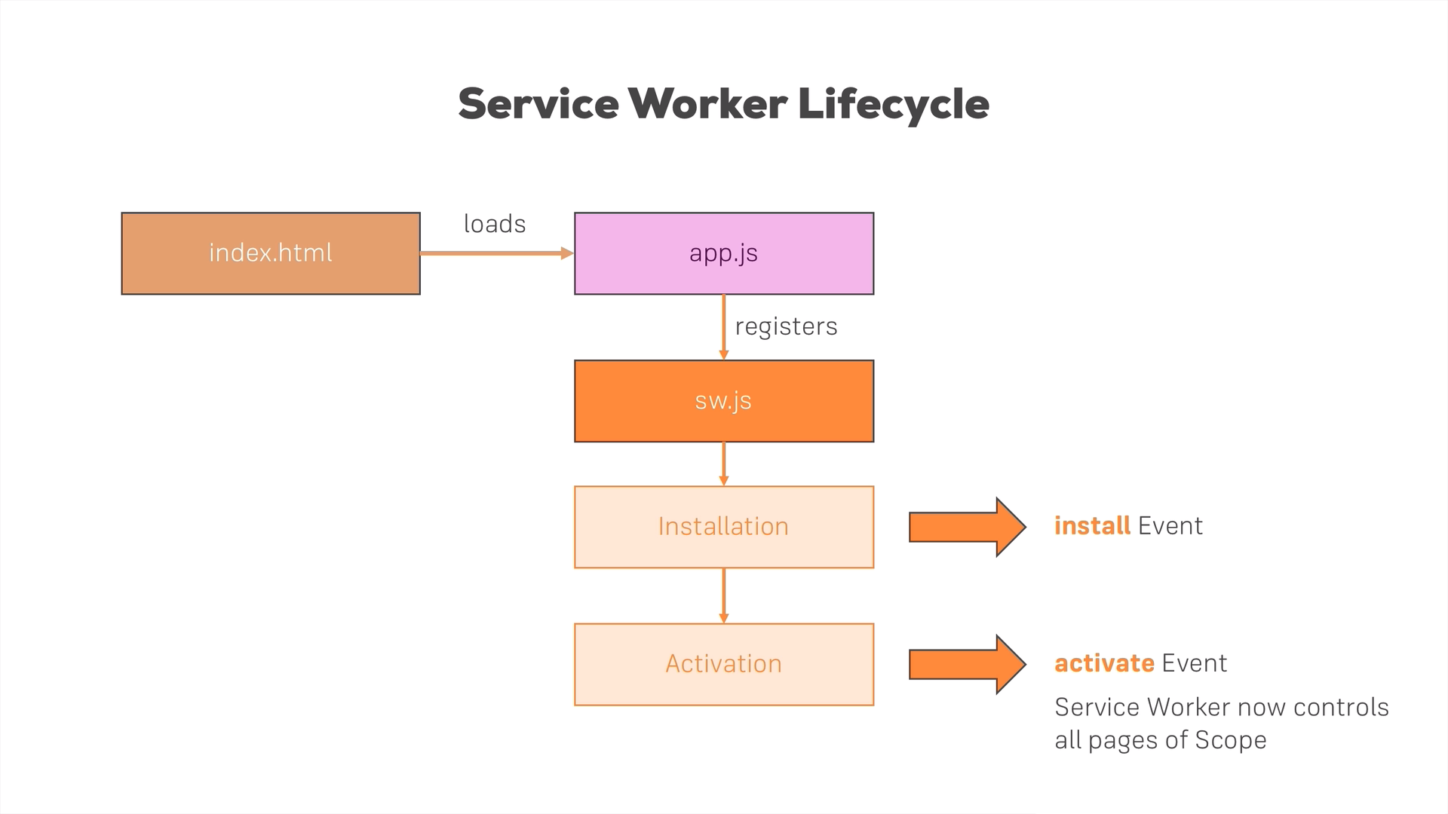

Slide 13
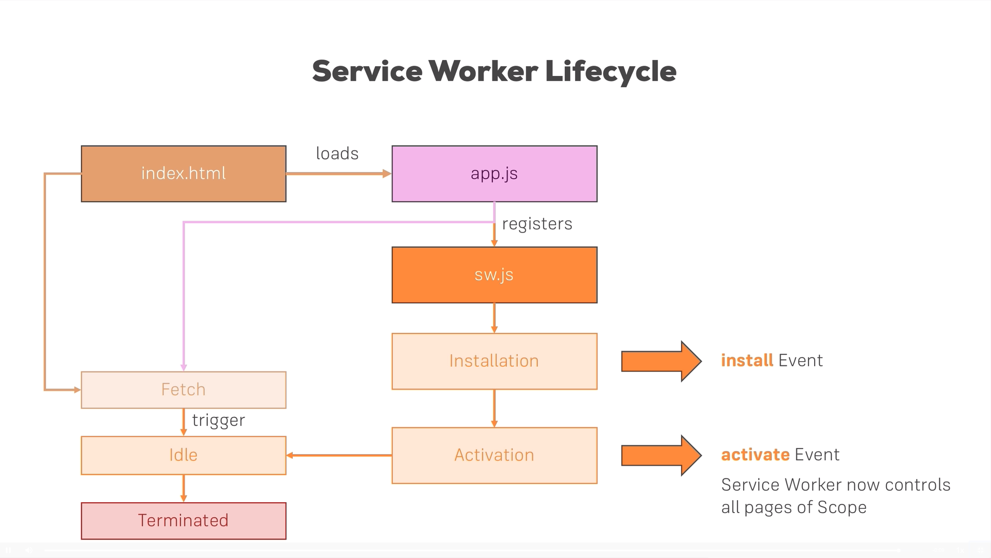

Slide 14
Types of caching
Static caching – caching app shell files, that don’t change that often
Dynamic caching – caching files like pictures that are not required for the app to launch but might change more frequently
Dynamic content caching – for example caching JSON data returned from API

Slide 15
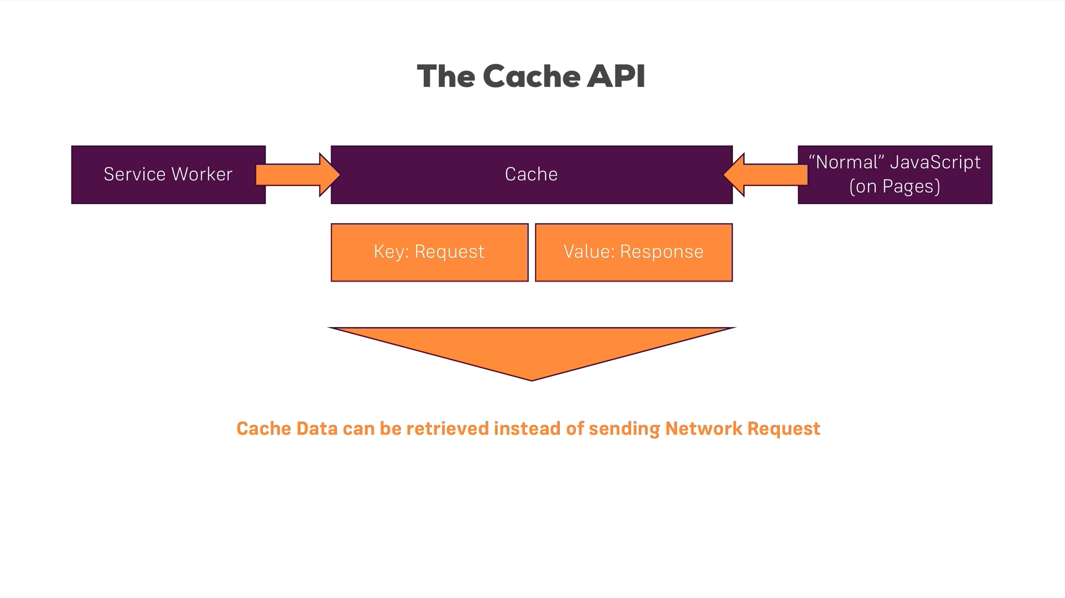

Slide 16
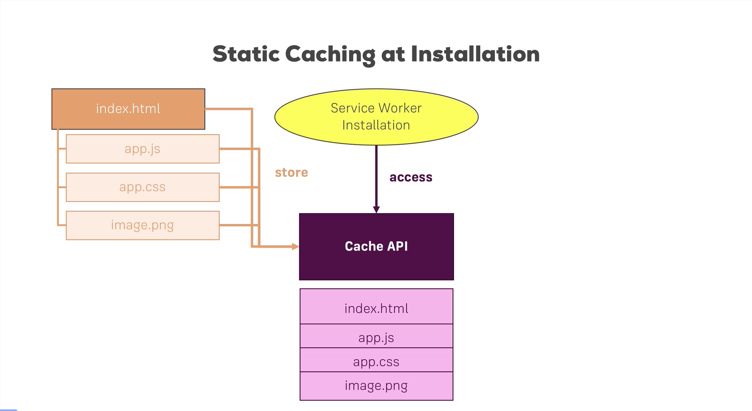

Slide 17
Caching strategies – cache on demand
Cache on demand allows to cache resources as user interacts with our page.
New files are added to the cache through the front-end application.

Slide 18
Caching strategies – cache with network fallback
Caching every request, if something is not stored in our cache, then make a network request.
Pros:
- we can instantly load assets even if we have a network connection
Cons:
- assets never get an update!

Slide 19
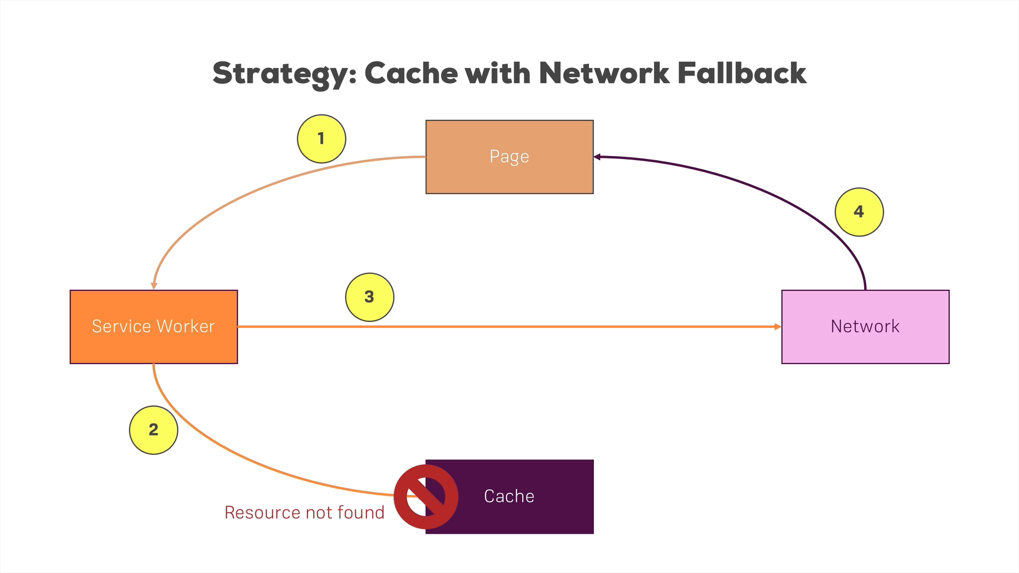

Slide 20
Caching strategies – network with cache fallback
Reaching to cache only as a fallback
Pros:
we get always latest files
we use cached files in case of offline mode or any error
Cons:
we don’t get an advantage of cached files when network is available
if request is getting 60 seconds timeout, user don’t see anything

Slide 21
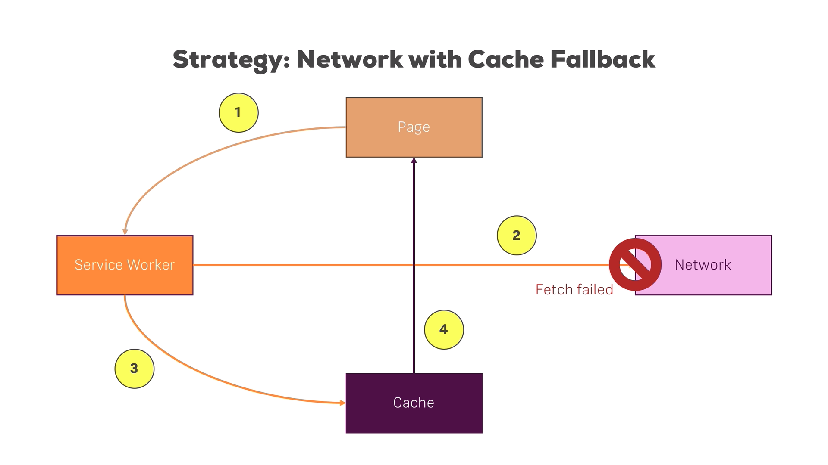

Slide 22
Caching strategies – cache, then network
Serving content from the cache until assets gets fetched from the network.
Pros:
user sees the content very quickly from the cache, then gets updated version asap from the network
Cons:
- needs to be combined with CACHE WITH NETWORK FALLBACK or CACHE ONLY strategies for offline support

Slide 23
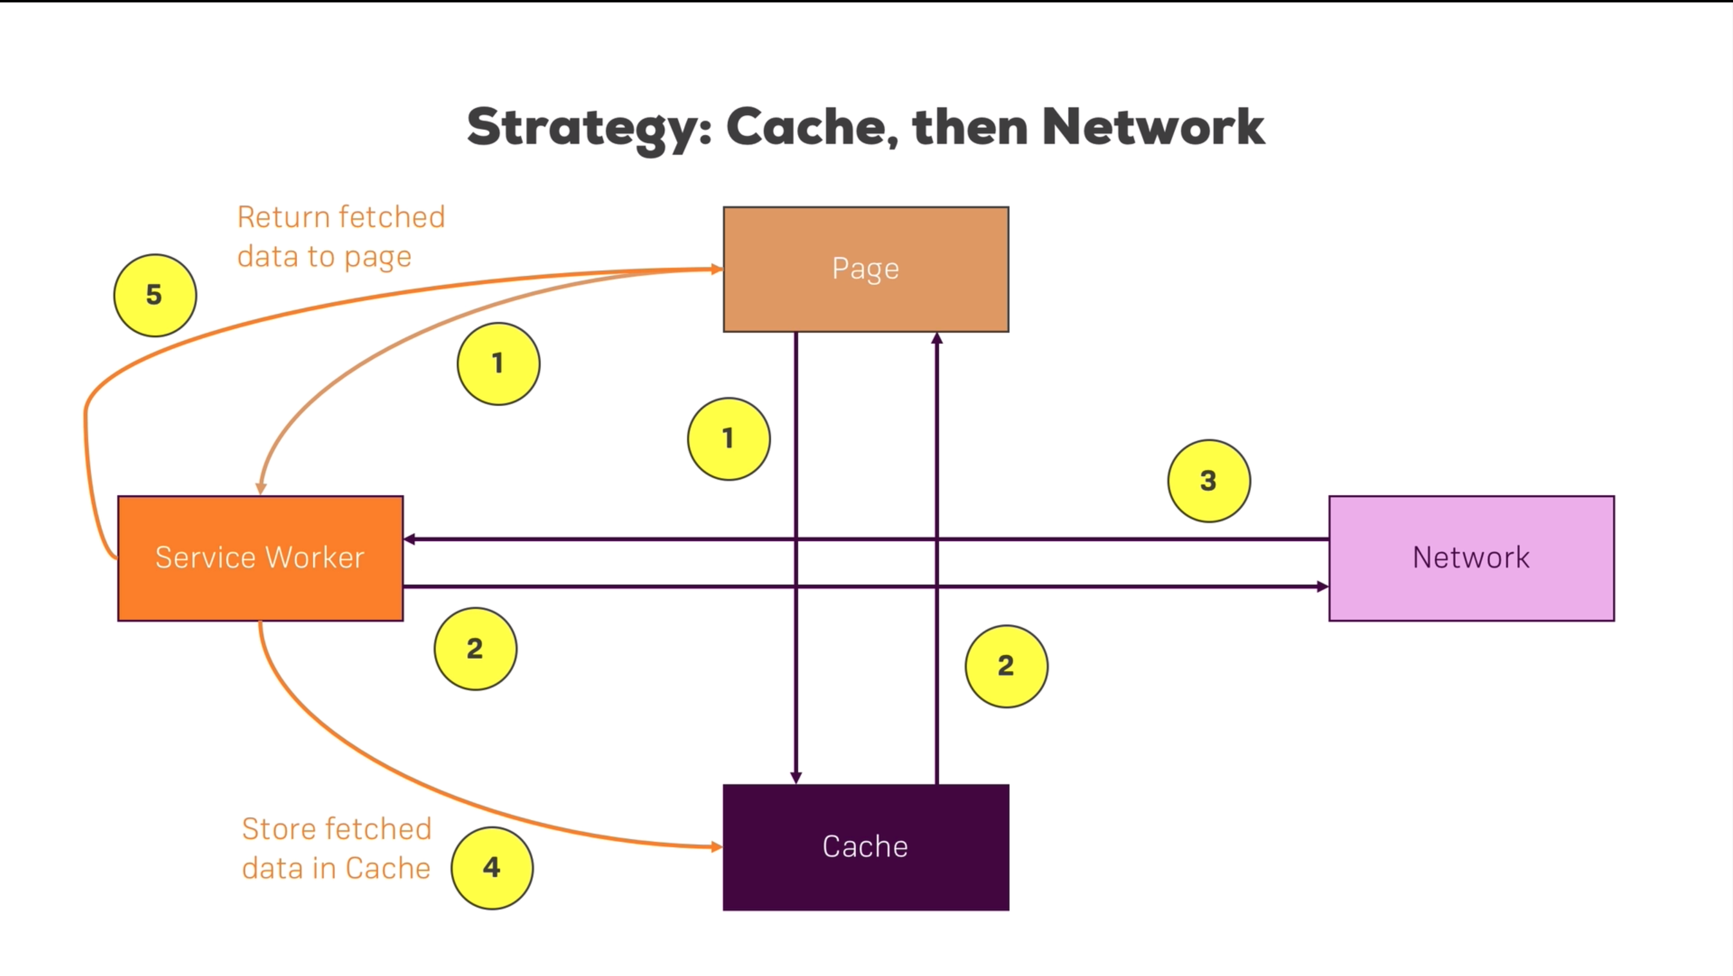

Slide 24
Caching dynamic content vs Dynamic cache
What’s the difference between caching dynamic content and dynamic caching?
dynamic caching – we use it for file assets like scripts, images, css, html etc.
caching dynamic content – dynamic content is coming from our backend server, mostly in JSON or XML format

Slide 25
IndexedDB for caching dynamic content
IndexedDB is a low-level API for client-side storage of significant amounts of structured data, including files/blobs. This API uses indexes to enable high-performance searches of this data.
IndexedDB is a transactional database system, like an SQL-based RDBMS. However, unlike SQL-based RDBMSes, which use fixed-column tables, IndexedDB is a JavaScript-based object-oriented database. IndexedDB lets you store and retrieve objects that are indexed with a key; any objects supported by the structured clone algorithm can be stored. You need to specify the database schema, open a connection to your database, and then retrieve and update data within a series of transactions.
Source:
https://developer.mozilla.org/en-US/docs/Web/API/IndexedDB_API

