Slide 1

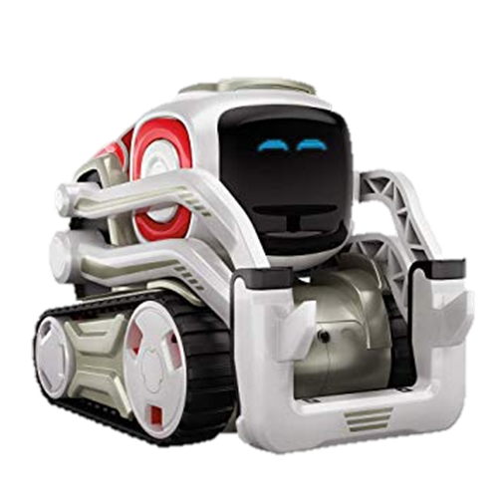
Color Combination Game
Team Leftovers

Slide 2
Team Leftovers Members and Roles
Andrew Audrain (Team Lead)
Nick Wooldridge (Documentation)
Eric Goodwin (Coder)
RJ Liceralde (Coder)
Jorge Jones (QA)

Slide 3
Topics
The idea
Original idea versus improved idea
Interesting piece of code
Demo
Design issues and setbacks
Future development

Slide 4
The idea
Original idea
Kids know colors
Two games
Complimentary color game
Secondary color game

Slide 5
Complications
The color_finder.py limitations
Modify existing sdk
Added colors we needed

Slide 6
Interesting

Slide 7
Demo

