Slide 1

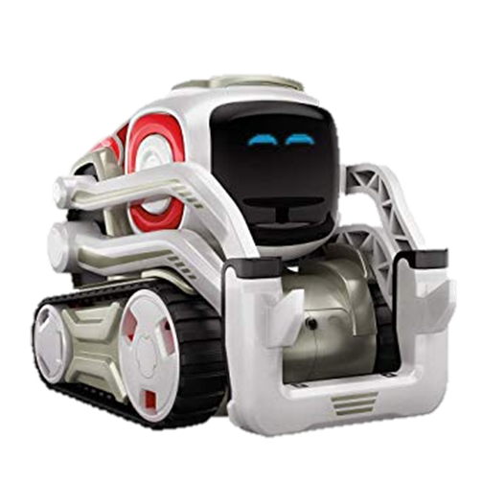
Color Combination Game
Team Leftovers

Slide 2
Team Leftovers Members and Roles
Andrew Audrain (Team Lead)
Nick Wooldridge (Documentation)
Eric Goodwin (Coder)
RJ Liceralde (Coder)
Jorge Jones (QA)

Slide 3
Topics
The idea
Original idea versus improved idea
Complications
Interesting Implementation
Demo
Known issues
Future development

Slide 4
The Idea
Original idea
Kids know colors
Two games
Complimentary color game
Secondary color game

Slide 5
Complications
The color_finder.py limitations
Modify existing sdk
Added colors we needed
Difficulties creating multiple colorfinder objects
Difficulties with terminating and restarting

Slide 6
Interesting Implementation
Insertion of HSV values to color_finder.py
Addition of colors to blocks
Development of termination condition
Two games in one

Slide 7
Demo

Slide 8
Known Issues

Slide 9
Future Development

