Slide 1
Office Object Detection
Lobos Solitarios v2.0
Quim Sanchez
Waldemar Franczak
Abraham Ayala
Supervisor : Dr. Zeyn Saigol

Slide 2
Overview
Introduction:
  Project aim
  Project time line
Tools selection and evaluation
Project Branches
  Registration
  Plane segmentation
  Geometric primitive fitting
  Primitive based object recognition
Future work

Slide 3
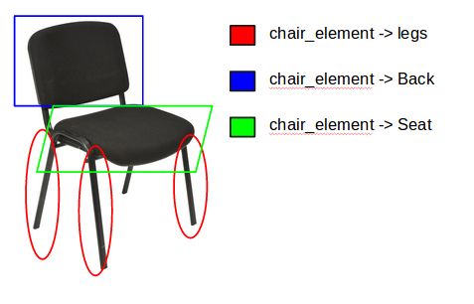
Introduction: Project Aim
Perform a starting approach to the problem of identifying objects that are usually present in an office environment
Perform recognition by detecting one or several parts of the same object

Slide 4
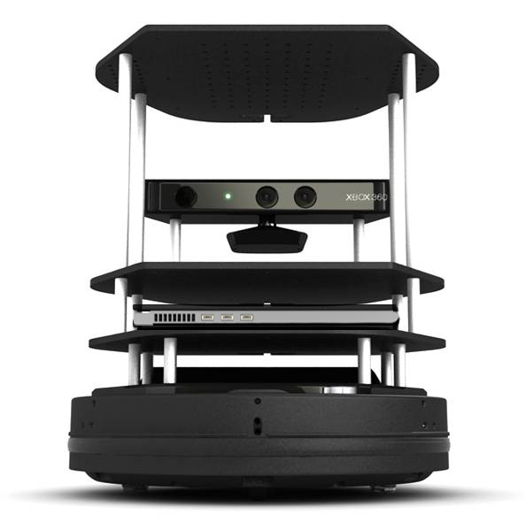


Introduction : Project Aim
Available hardware :
Preferable software to use:

Slide 5
Project Time Line
Milestone / week # | 3 | 4 | 5 | 6 | 7 | 8 | 9 | 10 | 11 | 12 | 13
Explore ORK functions
Research and develop algorithms
Implement algorithms in turtlebot
Write Report

Slide 6
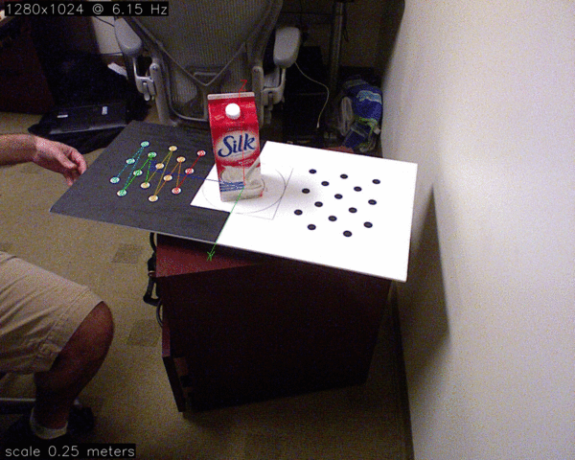
Tools evaluation and selection: ORK
C++ node
C++ node
OpenCV recognition
algorithms
Database
Python Connection
Python Connection
C++ node
Data capture and
training

Slide 7
Tools evaluation and selection: ORK
Object Recognition Kitchen (ORK) with OpenCV:
PROS | CONS
Off the shelf object recognition algorithms | Template base matching (Not suitable for object elements recognition)
Solves non vision problems like database management. Integration with ROS can be done. | For the aim of the project probably a database is not needed
Offers template registration and training methods for new templates | Very poor documentation

Slide 8


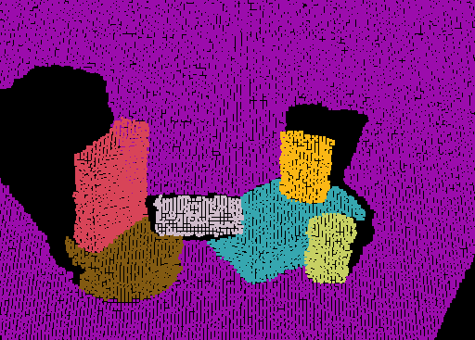


Tools evaluation and selection : PCL
Due to poor documentation and that the off- the-shelf algorithms are template matching based, other framework was needed. The Point Cloud Library (PCL) was selected

Slide 9
Project Branches using PCL
Registration
Plane segmentation
Geometric primitive fitting
Primitive based object recognition

Slide 10
New Time Line of the project
Milestone / week # | 3 | 4 | 5 | 6 | 7 | 8 | 9 | 10 | 11 | 12 | 13
Explore ORK functions
Research and develop algorithms
Implement algorithms in turtlebot with PCL
Write Report
Develop PC registration

Slide 11
Project Branch: Registration
New milestone set by supervisor:
  Registering Pointclouds to build a 3D map
Methods available:
  PCL functions for registration
  RGB-D visual odometry (CCNY RGB-D tools for ROS)
  Octomap probabilistic 3D mapping

Slide 12
Registration
New milestone set by supervisor:
  Registering Pointclouds to build a 3D map
Methods available:
  PCL functions for registration
  RGB-D visual odometry (CCNY RGB-D tools for ROS)
  Octomap probabilistic 3D mapping

Slide 13
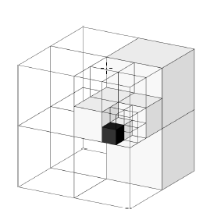
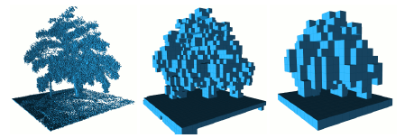
Registration
Octomap Framework:
Based in octrees, several depths or resolutions can be queried
Each node saves the probability to be occupied or free (helps to handle noise)
Map build incrementally , known and unknown areas available

Slide 14
Registration
ROS integration for the project:
SLAM mapping
/map
/tf
octomap_server
/centroids
Registered Map
Kinect
/depth_points

Slide 15
Registration
ROS integration for the project:
SLAM mapping
/map
/tf
octomap_server
/centroids
3D map
Kinect
/depth_points

Slide 16
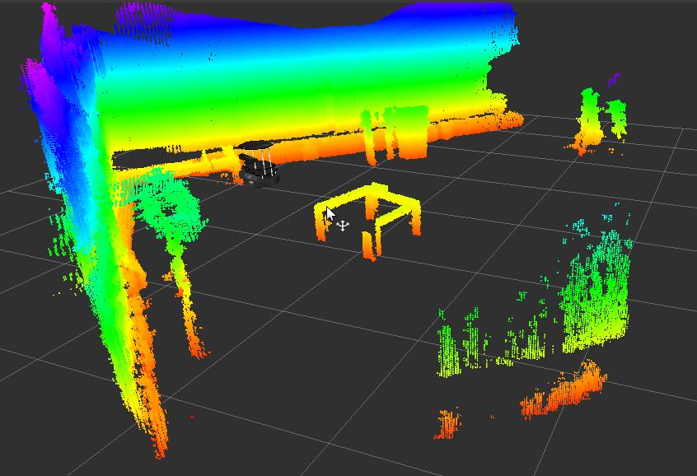
Registration

Slide 17
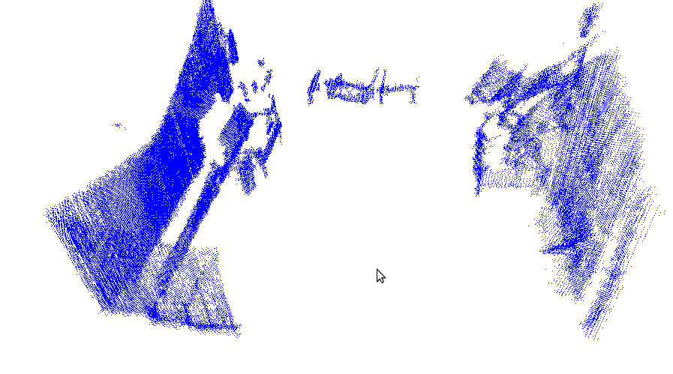
Registration

Slide 18
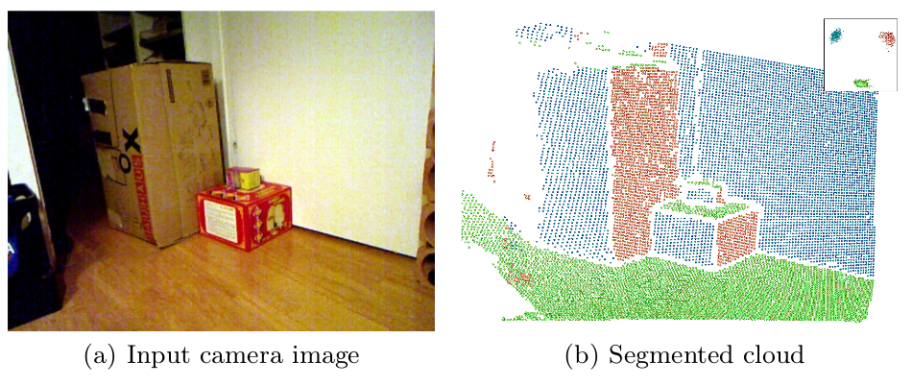
Project Branch:Fast Plane Extraction
Real-Time Plane Segmentation using RGB-D Cameras (Dirk Holz, Stefan Holzer, Radu Bogdan Rusu and Sven Behnke)
  Plane segmentation algorithm for RGB-R images
  Takes advantage of the “image” organization
  Octree segmentation

Slide 19
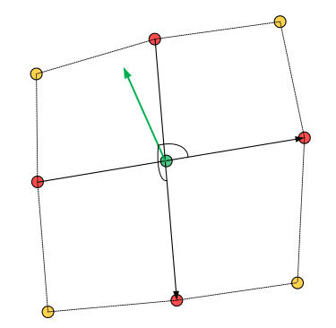
Fast Plane Extraction: Tangential Vectors
Approximate neighbor with range image
Tangential vectors using difference of neighbors

Slide 20
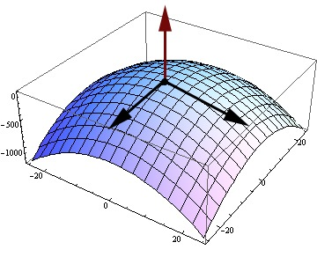
Fast Plane Extraction: Normal Vector
The normal vector is computed using the cross product of two tangential vectors

Slide 21
Fast Plane Extraction:Noise filtering
Separate vectors into “component images”
Apply Gaussian filter to images to smooth normals
cv::GaussianBlur(*hori, *hori, cv::Size(3,3), 0);
cv::GaussianBlur(*vert, *vert, cv::Size(3,3), 0);

Slide 22
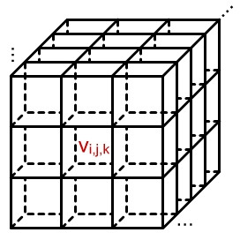
Fast Plane Extraction: Plane clustering
Feed octree with the normal vectors as points.
All normals in one voxel initially represents on plane

Slide 23
Fast Plane Extraction: pcl::octree and trick
Good:
  Fit out problem, we used a pcl::PointXYZNormal to encode the normal in XYZ and the point in the Normal to get it back after the computation
    pcl::PointXYZNormal.xyz = Norm
    pcl::PointXYZNormal.Norm = xyz
Bad:
  Little and outdated documentation
  C++ implementation using template of a template of an other template

Slide 24
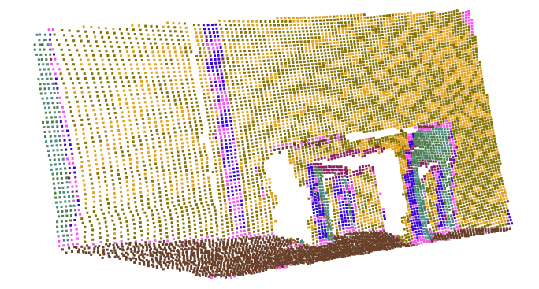
Fast plane extraction: First result
Plane have been split into two different voxels

Slide 25
Fast Plane Extraction: Merge Similar Planes
Compute mean of each plane
Merge similar planes
Nested “for” through all planes

Slide 26
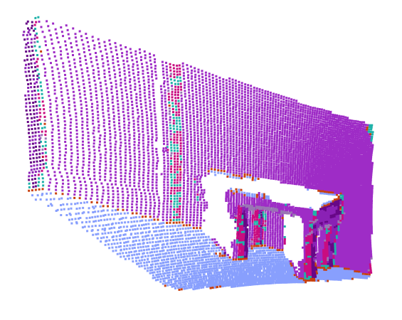
Fast Plane Extraction: Merge Result

Slide 27
Fast Plane Extraction: Parallel plane distinction
Same octree technique
In this case the location is going to be given by the distance of each point to the plane defined by the common Normal vector.
    pcl::PointXYZNormal.x = pointToPlaneDist()
    pcl::PointXYZ.y = 0
    pcl::PointXYZ.z = 0
    pcl::PointXYZNormal.Norm = xyz

Slide 28
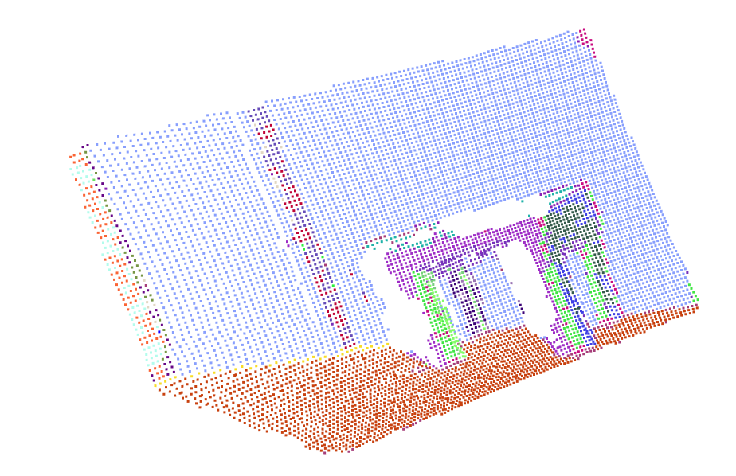
Fast Plane Extraction: Final Result

Slide 29
Project Branch: Geometric primitives fitting – related work
“Shape-Primitive Based Object Recognition and Grasping”
M. Nieuwenhuisen, J. Stückler, A. Berner, R. Klein, S. Behnke
- predefined CAD models of primitives
- very simple objects
“Learning the Compositional Structure of Man-Made Objects
for 3D Shape Retrieval”
R. Wessel and R. Klein
- high computation time
- evaluated on CAD models

Slide 30
Geometric primitives fitting – primitives extraction
Read PointCloud
Background
Planes extraction
Euclidean
clustering
Moving Least
Squars
smoothing
Primitives
fitting
Object
recognition

Slide 31
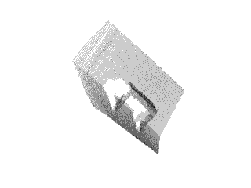
Geometric primitives fitting – input cloud

Slide 32
Geometric primitives fitting – plane extraction
Using implemented plane extraction algorithm we remove from the scene the least relevant for us elements – walls and ground floor. Extraction is based on a threshold determined with respect to number of points in the input point cloud.

Slide 33
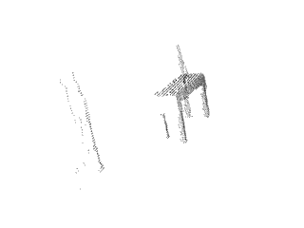
Geometric primitives fitting – plane extraction

Slide 34
Geometric primitives fitting – clustering
Next we perform euclidean distance based clustering in order to be able perform local based primitive shape fitting on local point clouds.

Slide 35
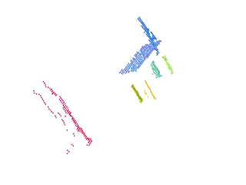
Geometric primitives fitting – clustering

Slide 36
Geometric primitives fitting – cluster grouping
Having the local clouds we follow the approach of euclidean distance clustering this time for the set of clusters.
Distance between point clouds is determined using FLANN version of KdTree improved by Marius Muja and David Lowe
Groups classification based on content and number of elements - minimum 1 plane and 3 cylinders,

Slide 37
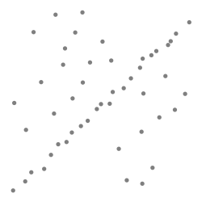
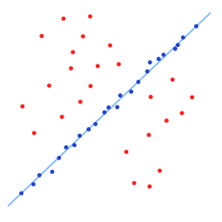
Geometric primitives fitting – fitting primitives
In order to describe the primitives using basic shapes we apply RANSAC using models for cylinders and planes.

Slide 38
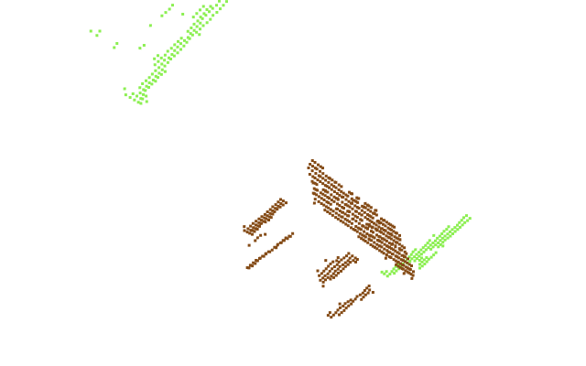
Project Branch :
Primitive based object recognition

Slide 39
Object Representation
An object is represented by its parts:
  A table is represented by four legs (cylinders) connected to a surface (plane)
Distance between clusters is computed leading to a graph where vertices are types (cylinder, plane, etc...) and edges are “connections” (closeness between clouds)

Slide 40
Object location in Graph
Plane
Cylinder
Table model

Slide 41
Graph Algorithm
Search is computed with a recursive algorithm
For every vertex in the graph it is recursively compared to the every vertex in the object graph
Compare every vertex neighbor to every object vertex neighbor

Slide 42
Future work
- Improve scene registration
- Investigate parameters configuration for more complete point clouds
- Apply ICP for scene registration
- Implement scene segmentation before registration and keep track of plane labels
- Implement probability based object recognition
- Combine all modules into ROS framework

Slide 43
Thank you for your attention!
  Questions?

Slide 44
References
A. Hornung, K.M. Wurm, M. Bennewitz, C. Stachniss, and W. Burgard: "OctoMap: An Efficient Probabilistic 3D Mapping Framework Based on Octrees"
Radu Bogdan Rusu and Steve Cousins. http://pointclouds.org/about/

