Slide 1
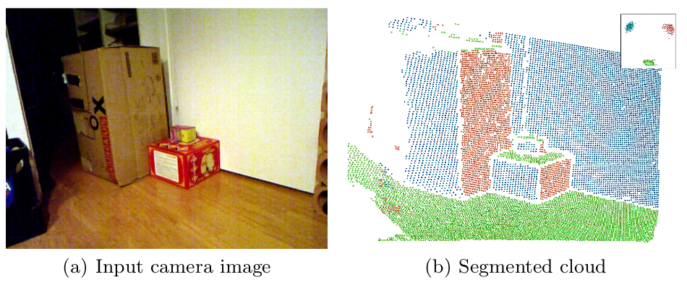
Fast Plane Extraction
Plane segmentation algorithm for RGB-R images
Takes advantage of the “image” organization
Octree segmentation

Slide 2
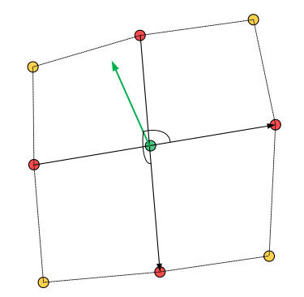
Tangential Vectors
Approximate neighbor with range image
Tangential vectors using difference of neighbors

Slide 3
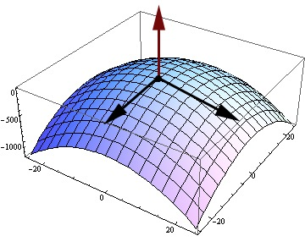
Normal Vector
The normal vector is computed using the cross product of two tangential vectors

Slide 4
Noise filtering
Separate vectors into “component images”
Apply Gaussian filter to images to smooth normals
cv::GaussianBlur(*hori, *hori, cv::Size(3,3), 0);
cv::GaussianBlur(*vert, *vert, cv::Size(3,3), 0);

Slide 5
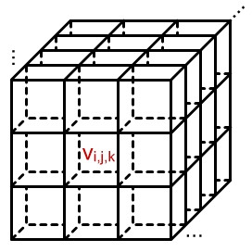
Plane clustering
Feed octree with the normal vectors as points.
All normals in one voxel initially represents on plane

Slide 6
pcl::octree and trick
Good:
  Fit out problem, we used a pcl::PointXYZNormal to encode the normal in XYZ and the point in the Normal to get it back after the computation
    pcl::PointXYZNormal.xyz = Norm
    pcl::PointXYZNormal.Norm = xyz
Bad:
  Little and outdated documentation
  C++ implementation using template of a template of an other template

Slide 7
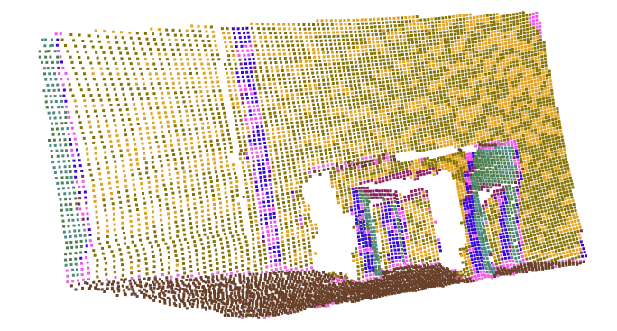
Fast plane extraction First result
Plane have been split into two different voxels

Slide 8
Merge Similar Planes
Compute mean of each plane
Merge similar planes
Nested “for” through all planes

Slide 9
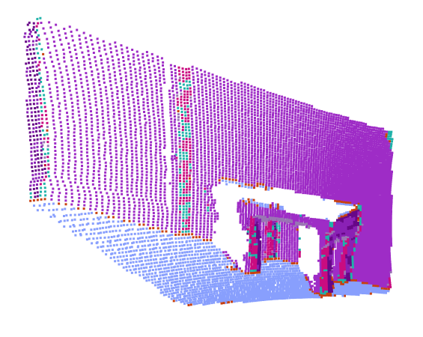
Merge Result

Slide 10
Parallel plane distinction
Same octree technique
In this case the location is going to be given by the distance of each point to the plane defined by the common Normal vector.
    pcl::PointXYZNormal.x = pointToPlaneDist()
    pcl::PointXYZ.y = 0
    pcl::PointXYZ.z = 0
    pcl::PointXYZNormal.Norm = xyz

Slide 11
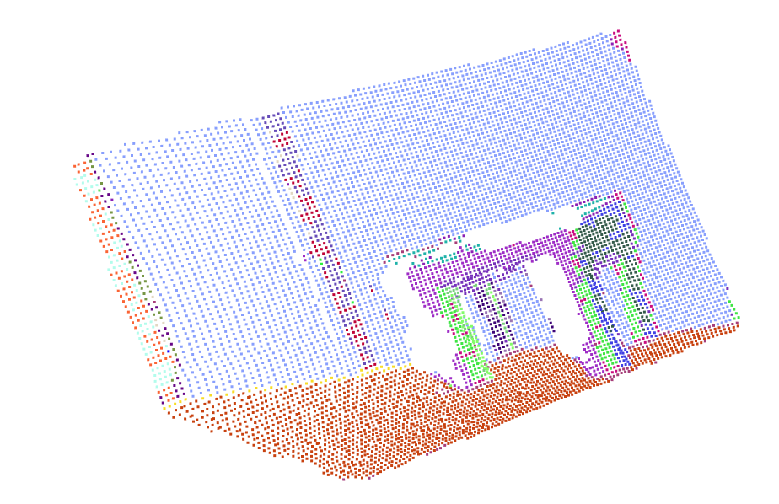
Final Result

Slide 12
Object Representation
An object is represented by its parts:
  A table is represented by four legs (cylinders) connected to a surface (plane)
Distance between clusters is computed leading to a graph where vertices are types (cylinder, plane, etc...) and edges are “connections” (closeness between clouds)

Slide 13
Object location in Graph
Plane
Cylinder
Table model

Slide 14
Graph Algorithm
Search is computed with a recursive algorithm
For every vertex in the graph it is recursively compared to the every vertex in the object graph
Compare every vertex neighbor to every object vertex neighbor

