Slide 1
Office Object Detection
Lobos Solitarios v2.0
Quim Sanchez
Waldemar Franczak
Abraham Ayala
Supervisor : Zeyn Saigol

Slide 2
Overview
Introduction:
  Project aim
  Project time line
Tools selection and evaluation
Division of main parts of the project
  Registration
  Plane segmentation
  Geometric primitive fitting
  Primitive based object recognition
Future work

Slide 3
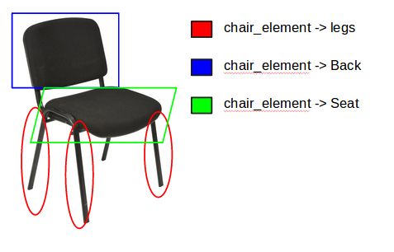
Introduction: Project Aim
Identify objects that are usually present in an office environment
Perform recognition identifying one or several parts of the same object

Slide 4
Introduction : Project aim

