Slide 1
Geometric primitives fitting – related work
“Shape-Primitive Based Object Recognition and Grasping”
M. Nieuwenhuisen, J. Stückler, A. Berner, R. Klein, S. Behnke
- predefined CAD models of primitives
- very simple objects
“Learning the Compositional Structure of Man-Made Objects
for 3D Shape Retrieval”
R. Wessel and R. Klein
- high computation time
- evaluated on CAD models

Slide 2
Geometric primitives fitting – primitives extraction
Read PointCloud
Background
Planes extraction
Euclidean
clustering
Moving Least
Squars
smoothing
Primitives
fitting
Object
recognition

Slide 3
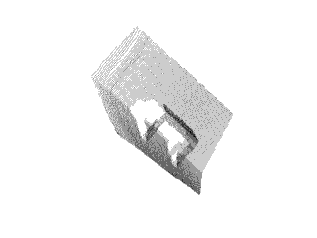
Geometric primitives fitting – input cloud

Slide 4
Geometric primitives fitting – plane extraction
Using implemented plane extraction algorithm we remove from the scene the least relevant for us elements – walls and ground floor. Extraction is based on a threshold determined with respect to number of points in the input point cloud.

Slide 5
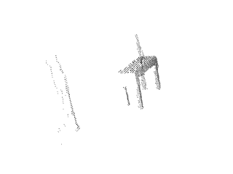
Geometric primitives fitting – plane extraction

Slide 6
Geometric primitives fitting – clustering
Next we perform euclidean distance based clustering in order to be able perform local based primitive shape fitting on local point clouds.

Slide 7
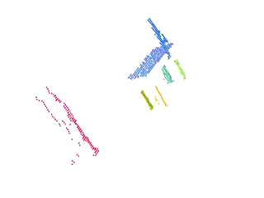
Geometric primitives fitting – clustering

Slide 8
Geometric primitives fitting – cluster grouping
Having the local clouds we follow the approach of euclidean distance clustering this time for the set of clusters.
Distance between point clouds is determined using FLANN version of KdTree improved by Marius Muja and David Lowe
Groups classification based on content and number of elements - minimum 1 plane and 3 cylinders,

Slide 9
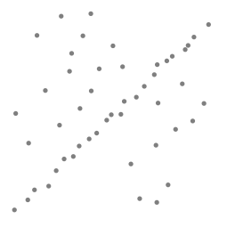
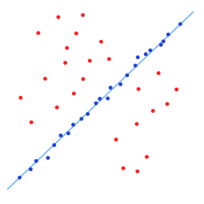
Geometric primitives fitting – fitting primitives
In order to describe the primitives using basic shapes we apply RANSAC using models for cylinders and planes.

Slide 10
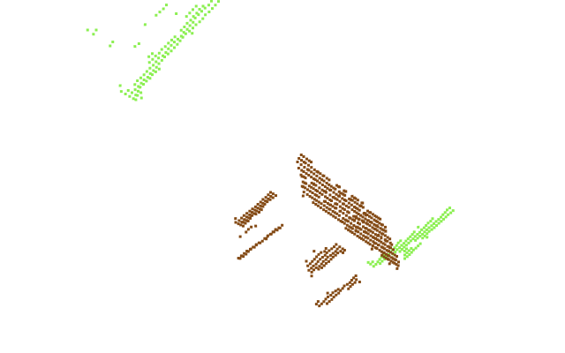
Primitive based object recognition

Slide 11
Future work
- improve scene registration
- investigate parameters configuration for more complete point clouds
- apply ICP for scene registration
- implement scene segmentation before registration and keep track of plane labels
- implement probability based object recognition
- combine all modules into ROS framework

Slide 12
Thank you for your attention!
  Questions?

