Slide 1
Example output

Slide 2
Text
This is an R Markdown presentation. Markdown is a simple formatting syntax for authoring HTML, PDF, and MS Word documents. For more details on using R Markdown see http://rmarkdown.rstudio.com.
When you click the Knit button a document will be generated that includes both content as well as the output of any embedded R code chunks within the document.

Slide 3
Bullets
Bullet 1
Bullet 2
Bullet 3

Slide 4
R Output
summary(cars)
## speed dist
## Min. : 4.0 Min. : 2.00
## 1st Qu.:12.0 1st Qu. : 26.00
## Median :15.0 Median : 36.00
## Mean :15.4 Mean : 42.98
## 3rd Qu.:19.0 3rd Qu. : 56.00
## Max. :25.0 Max. :120.00

Slide 5
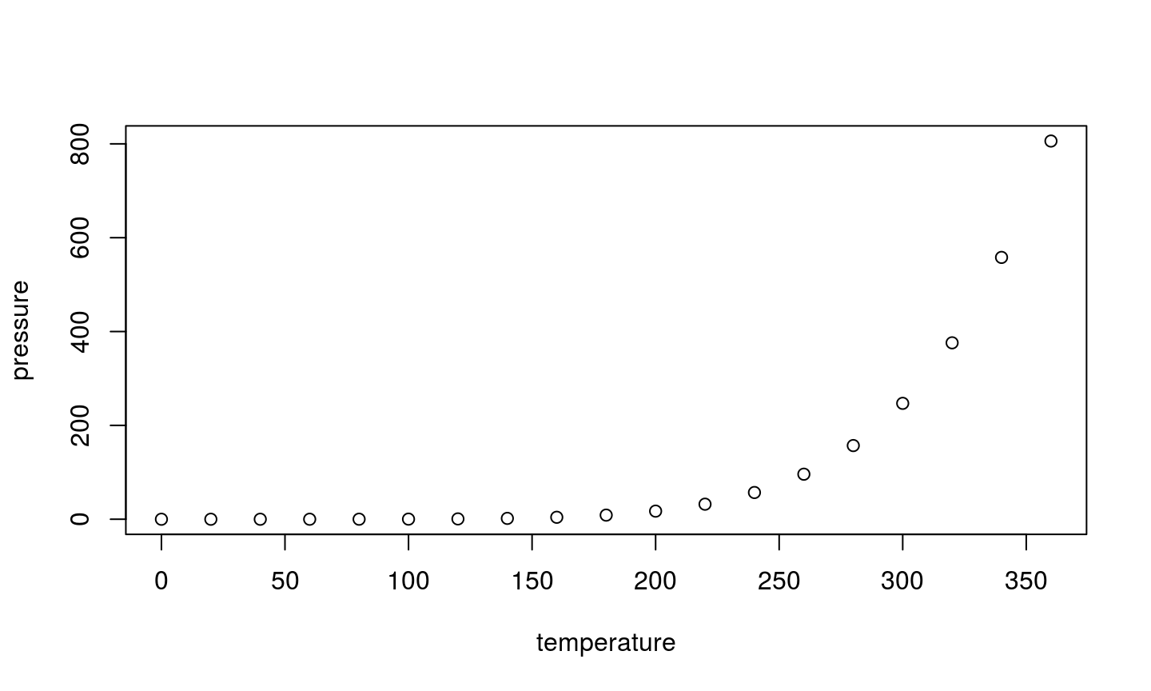
Plot
http://colorado.rstudio.com:3939/content/320/target.html

Slide 6
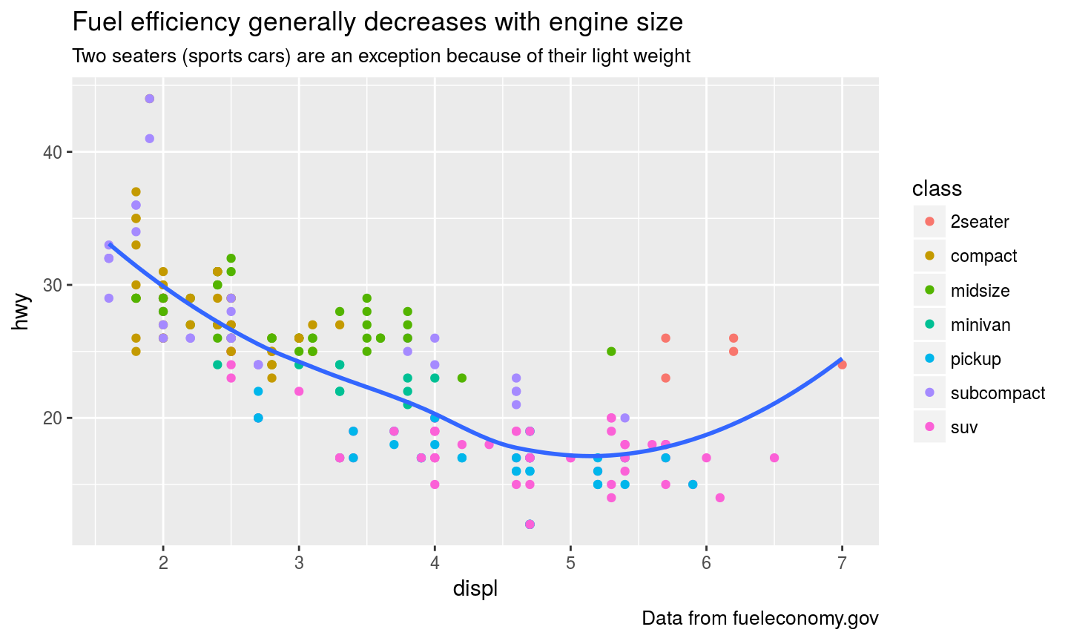
ggplot2: scatter
http://colorado.rstudio.com:3939/content/321/target.html

Slide 7
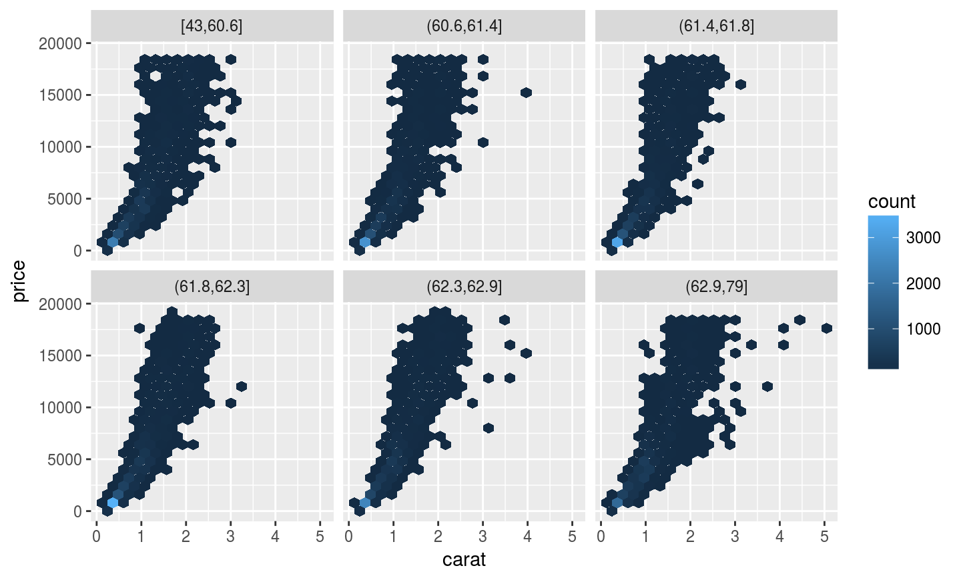
ggplot2: facets

Slide 8
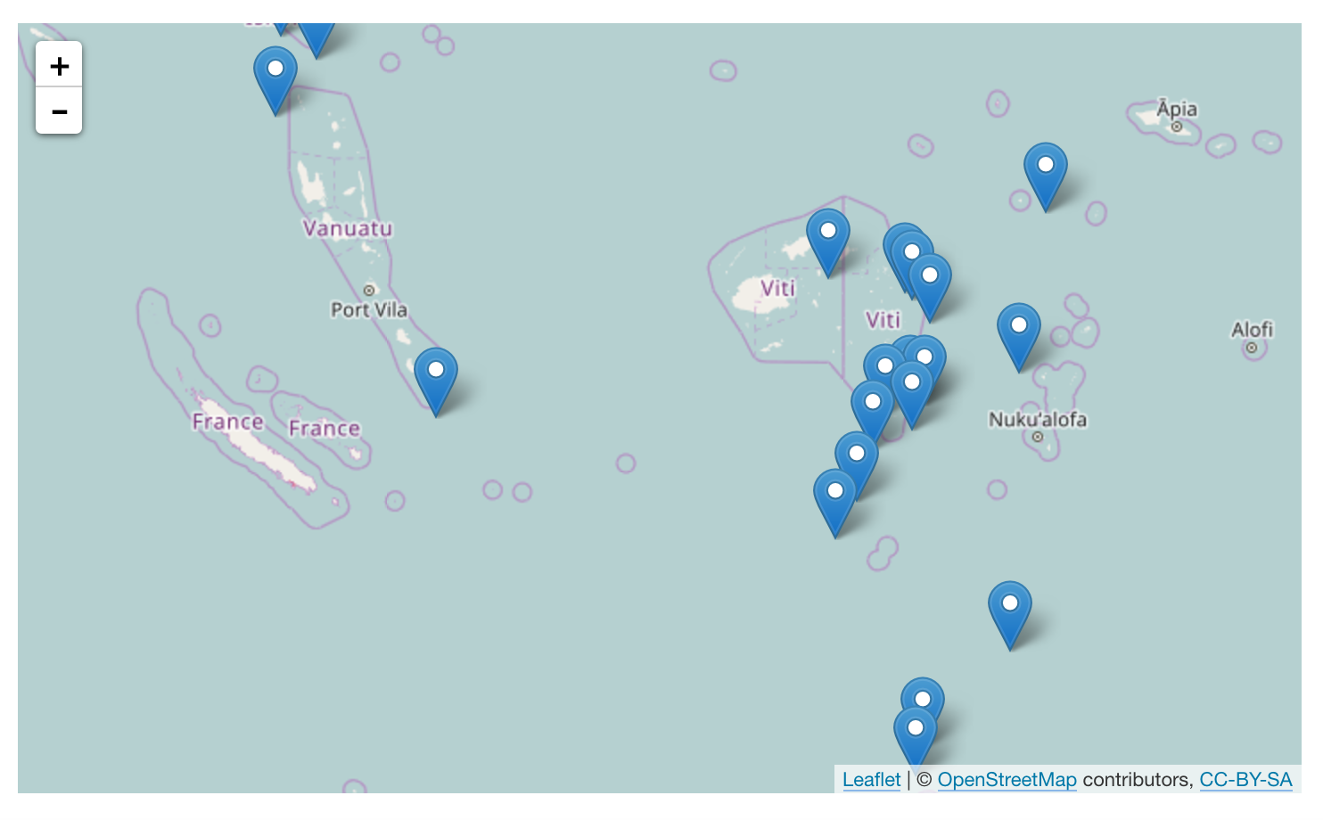
htmlwidgets: leaflet
http://colorado.rstudio.com:3939/content/315/viewer-rpubs-54d420f01991.html

Slide 9
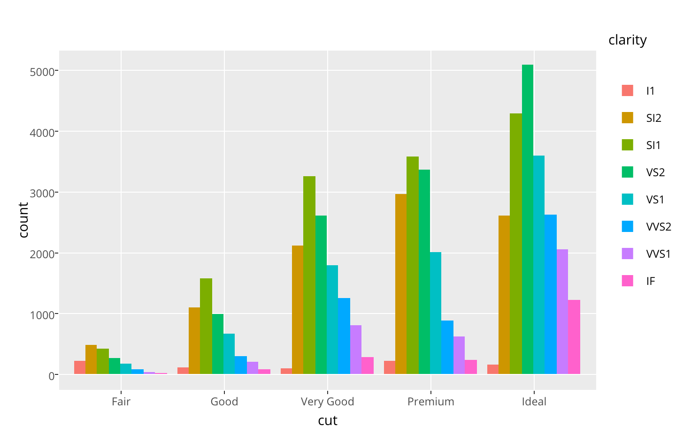
htmlwidgets: plotly
http://colorado.rstudio.com:3939/content/316/viewer-rpubs-54d41ce20168.html

Slide 10
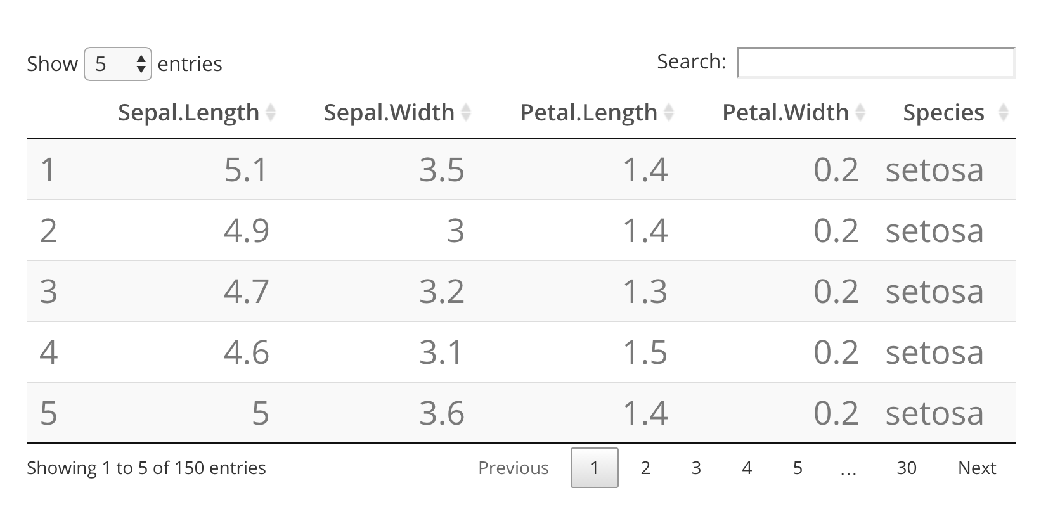
htmlwidgets: datatable
http://colorado.rstudio.com:3939/content/317/viewer-rpubs-54d4744ea5c6.html

Slide 11
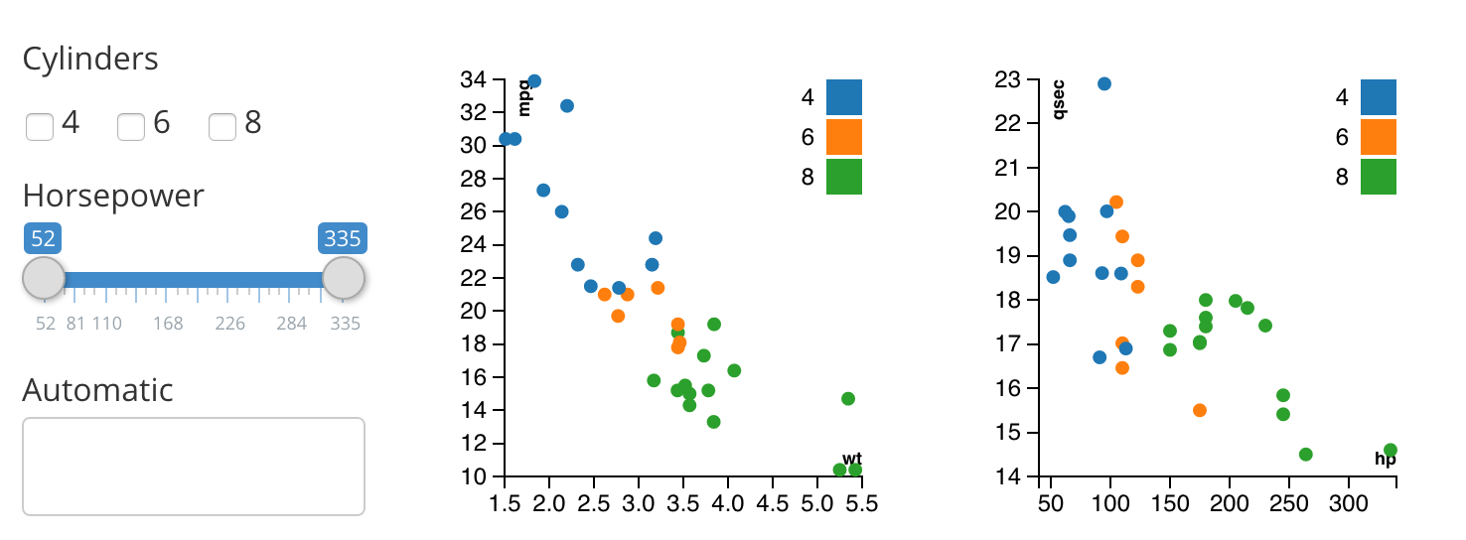
htmlwidgets: crosstalk
http://colorado.rstudio.com:3939/content/318/viewer-rpubs-54d45c74c35d.html

Slide 12
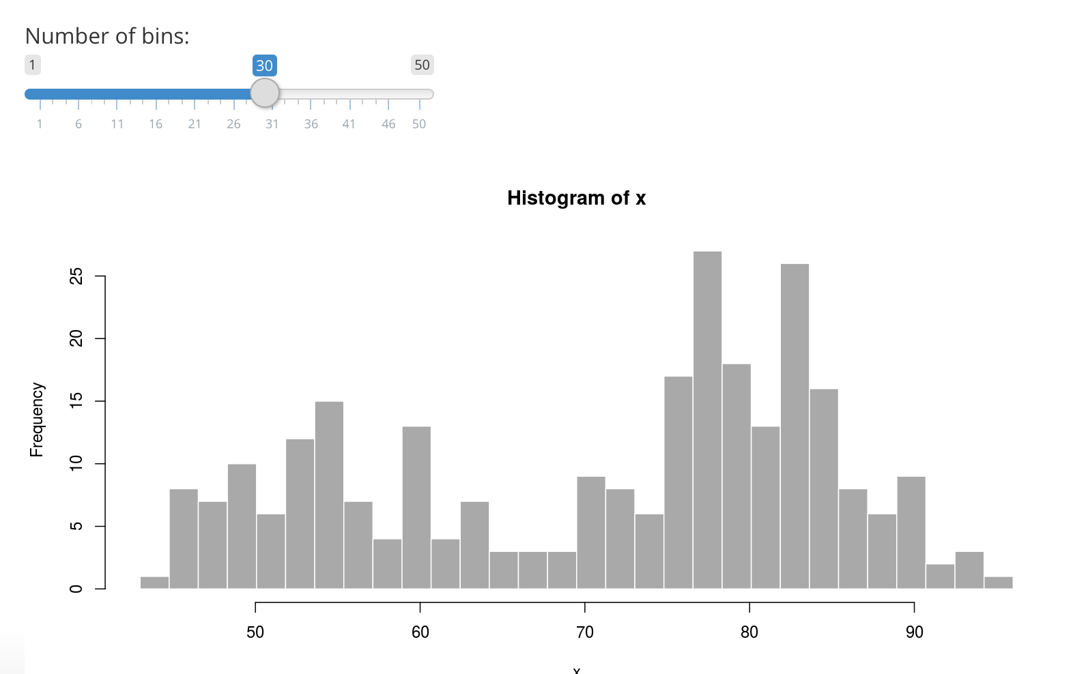
Shiny
http://colorado.rstudio.com:3939/content/319/

