Slide 1
RStudio Connect and PowerPoint

Slide 2
Overview
Your PowerPoint slides can point viewers to live content on RStudio Connect. You will need to install webshot and PhantomJS:
install.packages("webshot") webshot::install_phantomjs()
Then use knitr::include_app('<URL>') in an R code chunk. The render process will automatically take a screenshot of your app and link the image to your hosted app.

Slide 3
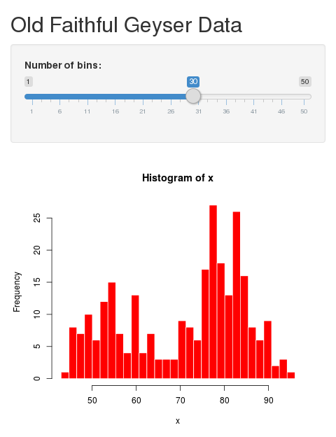
Example
Click to open

