Slide 1
A Demonstration File
From Pandoc Markdown to Powerpoint Jesse Rosenthal jrosenthal@jhu.edu

Slide 2
Table of Contents
A Toplevel Section Is A Title Slide
Images and Tables
Stuff left to do

Slide 3
A Toplevel Section Is A Title Slide

Slide 4
A Second-Level Section
This will make a header for a content slide.
See the --slide-level option for more information.¹

Slide 5
We can start a new slide without a section break, using a horizontal rule (usually a row of asterisks).
These features follow those described in the presentation section of the pandoc manual
Those were links, produced using one of the standard markdown formats.

Slide 6
Inline formatting
The standard inline formatting works here:
Here are examples of italics, bold, and bold italics.
Here is strook-three strike-through and small caps.
We can also do subscripts (H₂0) and super^{script}.
Here is a footnote.²

Slide 7
Math Equations
Equations can be written in LaTeX and can go either inline, $e^{iπ}+1=0$, or in display format:
$$∇⋅\overset{⃗}{E}=\frac{ρ}{ϵ_{0}}$$
or an array of equations:
$$\begin{matrix}∇⋅\overset{⃗}{B} & = & 0 \\ ∇×\overset{⃗}{E} & = & −\frac{∂B}{∂t}\end{matrix}$$

Slide 8
Lists
Bulleted bulleted lists.
And go to aribtrary depth.
Like this
Or this
Back to here.

Slide 9
Lists (continued)
Lists can also be numbered:
Tomatoes
Potatoes of various sorts
sweet potatoes
russet potates
Tornadoes, for the rhyme.

Slide 10
Some Code
At the moment, there is no syntax highliting for code, but that is forthcoming.
rCode <- putitHere doSomething(withit)

Slide 11
And a Blockquote:
Someone once said:
Maecenas ex quam, elementum vel augue in, dignissim pellentesque enim. Nunc sed dignissim sem, eget semper metus. Ut faucibus dolor ac nunc blandit, non egestas risus consequat. Quisque sodales erat sed nisi condimentum cursus. Maecenas egestas varius magna. Morbi at arcu at libero dictum facilisis ac nec tellus. Nam id dignissim est, vitae volutpat tellus. Quisque vitae lorem congue, interdum leo vitae, gravida tellus. Curabitur nulla neque, rhoncus eu erat sit amet, malesuada elementum nisl. Praesent pretium turpis in dignissim pretium.

Slide 12
Images and Tables

Slide 13
Some things to know
Images and tables always create new slides (there would be no way to place them properly with text boxes of arbtrary length.)
They can both have slide headers (made using second-level headers in markdown) and captions.
Captions may include links.
Images may be pulled from the local filesystem or the internet.
Images will be sized appropriately for the slide (and will make room for headers or captions, if they are there).

Slide 14

An Image with A Header and Caption
Frowning Lebron

Slide 15
An Image with No Caption

Slide 16
No Header

Slide 17
A linked Image With a Header
Frowning LeBron

Slide 18
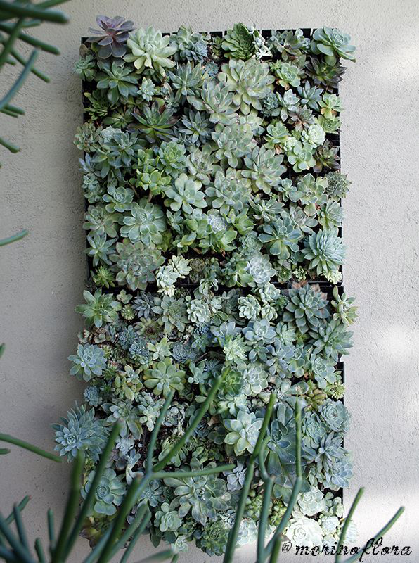
A Vertical image
Succulents

Slide 20
One more thing to know
Auto-sizing and placement of images from the internet will require a bit more work, but will be done very soon.

Slide 21

From the Internet (link in caption)
Go to Image source

Slide 22
A Table, with a caption
Right | Left | Center | Default
12 | 12 | 12 | 12
123 | 123 | 123 | 123
1 | 1 | 1 | 1
Demonstration of simple table syntax, with alignment

Slide 23
Two columns now work
One column of text.
More in the same column.
Another column of text.
Currently only two columns are supported, due to the static layouts in powerpoint.
read the pandoc manual for more information.

Slide 24
Stuff left to do

Slide 25
To-Do List
Immediate (this week)
Prepare to merge into pandoc development branch
Soon (next two weeks)
Merge into pandoc
Fix sizing of downloaded images, and placement of custom-sized images.
Add missing elements (footnotes, description lists)

Slide 26
To-Do List (continued)
Longish-term (by mid-January?)
Improve command-line templating
Syntax highlighting for code blocks

Slide 27
Notes
1. This slide was made with default --slide-level.
2. You came to find this.

