Slide 1
R Markdown to PowerPoint
Are you serious?! Nathan Stephens nathan@rstudio.com

Slide 2
Background

Slide 3
Engineering
Knitting from RStudio IDE
RMD > [knitr] > MD > [Pandoc] > PowerPoint
Pandoc now includes a PowerPoint translator
Work completed by third party
Supports general markdown capabilities (same things you would see in Beamer)
PPT feature to be included in RStudio version 1.2

Slide 4
Use cases
Create artifacts that will be customized (jumping off point)
Automate PowerPoint decks in RSC and send email to users (final product)

Slide 5
Example

Slide 6
What we do
Build and promote software that supports reproducible data analysis
Primary focus is the usability in our interfaces and API’s
Dedicated to R and open source software
70% of our engineering effort is towards open source

Slide 7
Who we are
Requires the top talent and minds to solve these problems
We created a structure to generate enough revenue to hire the them

Slide 8
My experiences on-boarding R
Engagement | Consumer Research | Ad Network | Client Services
R Users | Me | Team | Global
R Tools | Desktop | Server | Cluster
Relationship with IT | None | Support | Partnership
Groups Influenced | Department | Organization | Customers

Slide 9
Who is the R Admin?
A data scientist (who knows R) and works with IT/Ops to:
Establish R as an analytic standard
Promote R tooling
Integrate R into other systems.
R Views: Analytics Administration for R

Slide 10
That is why the r admin is rad!

Slide 11
References
Github: r-admin-2018
Analytics Administration for R
Make R a Legitimate Part of Your Organization
A Data Science Lab for R
The Unix Workbench

Slide 12
Demos

Slide 13
Bitcoin ETL
Extract
dat_json <- fromJSON("https://blockchain.info/ticker") dat_df <- map_dfr(dat_json, c, .id="name")
Transform
dat <- dat_df %>% mutate(timestamp = Sys.time()) %>% select(timestamp, name:symbol)
Load
con <- dbConnect(odbc::odbc(), "Postgres (DSN)") dbWriteTable(con, "bitcoin", dat, append = TRUE)

Slide 14
Bitcoin (ggplot)
## Loading required package: zoo
## ## Attaching package: 'zoo'
## The following objects are masked from 'package:base': ## ## as.Date, as.Date.numeric
## ## Attaching package: 'xts'
## The following objects are masked from 'package:dplyr': ## ## first, last

Slide 15
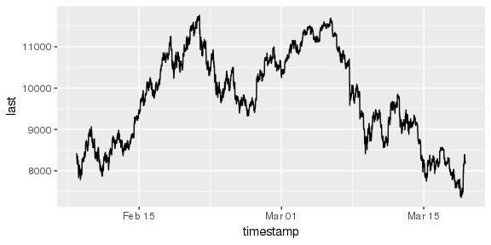

Slide 16
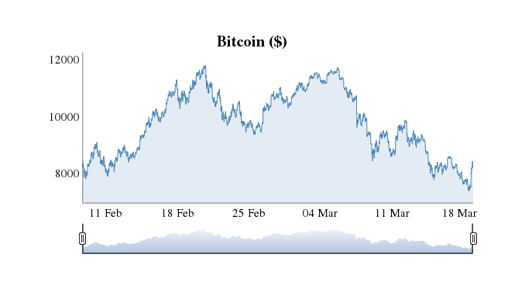
Bitcoin (dygraph)

Slide 17
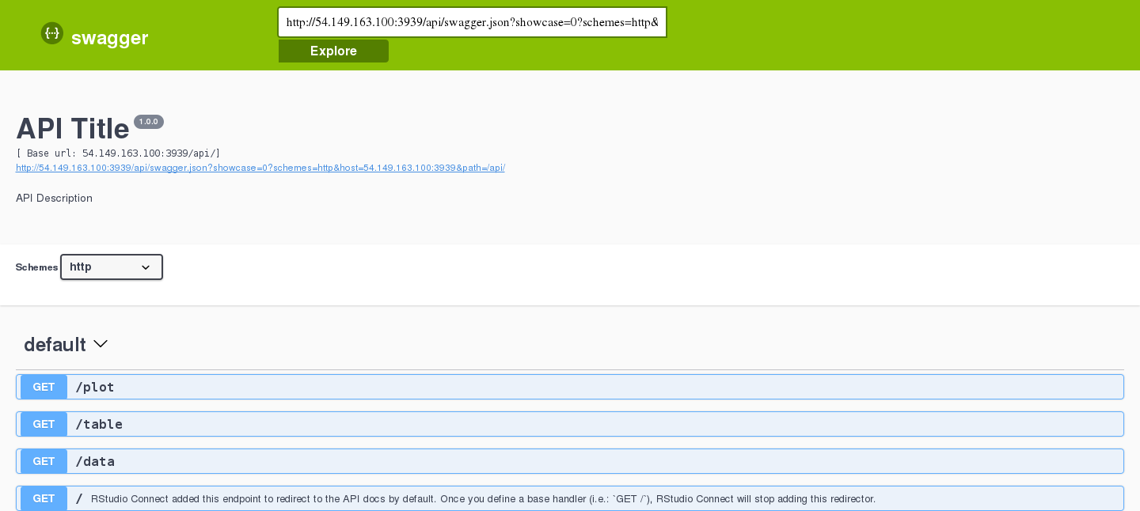
Bitcoin Exchange Rates (API)

Slide 18
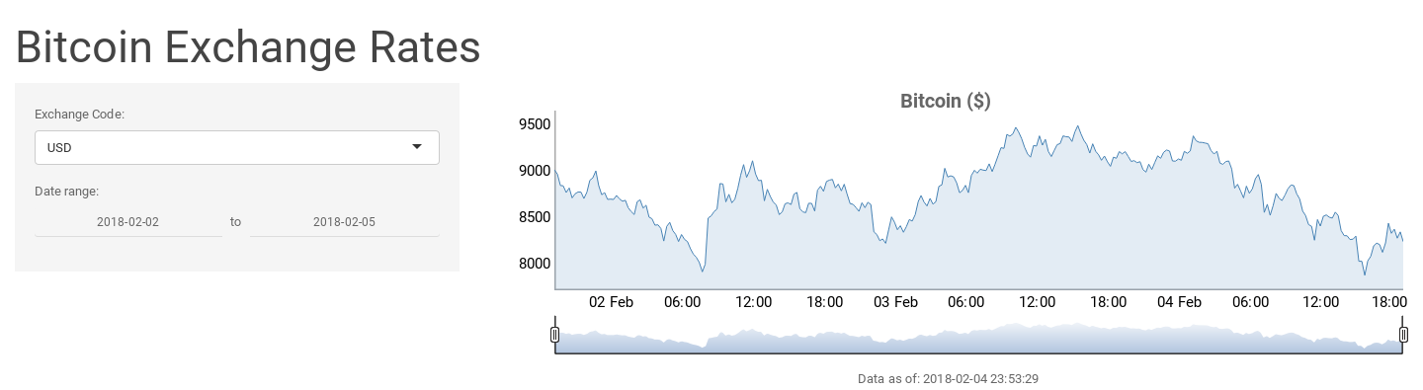
Bitcoin Exchange Rates (App)

