Slide 1
R for Data Science
Visualize, Model, Transform, Tidy, and Import Data RStudio Inc. info@rstudio.com

Slide 2
Introduction

Slide 3
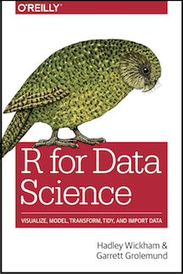
Data Science
Data science is an exciting discipline that allows you to turn raw data into understanding, insight, and knowledge. The goal of “R for Data Science” is to help you learn the most important tools in R that will allow you to do data science.
R for Data Science

Slide 4
What you will learn
First you must import your data into R. This typically means that you take data stored in a file, database, or web API, and load it into a data frame in R. If you can’t get your data into R, you can’t do data science on it!
Click to open

Slide 5
Topics
Our model of the tools needed in a typical data science project looks something like this:
Import
Tidy
Transform
Visualize
Model
Communicate
Notes:
here are my notes

Slide 6
Visualize

Slide 7
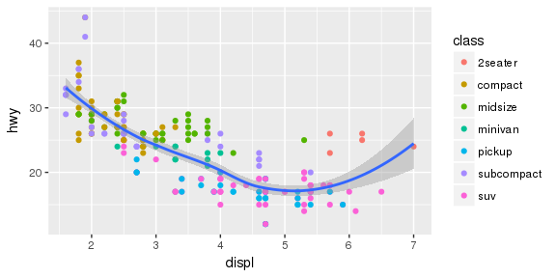
ggplot
Highway miles per gallon vs engine displacement

Slide 8
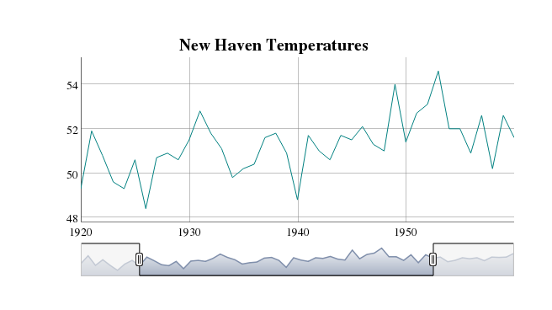
HTML Widgets
Screenshot of interactive dygraph

Slide 9
Tidy

Slide 10
Fuel economy data
manufacturer | displ | hwy | class
audi | 1.8 | 29 | compact
chevrolet | 5.3 | 20 | suv
dodge | 2.4 | 24 | minivan

Slide 11
Data (detail)
manufacturer | model | displ | year | cyl | trans | drv | cty | hwy | fl | class
audi | a4 | 1.8 | 1999 | 4 | auto(l5) | f | 18 | 29 | p | compact
audi | a4 | 1.8 | 1999 | 4 | manual(m5) | f | 21 | 29 | p | compact
audi | a4 | 2.0 | 2008 | 4 | manual(m6) | f | 20 | 31 | p | compact
audi | a4 | 2.0 | 2008 | 4 | auto(av) | f | 21 | 30 | p | compact

Slide 12
Communicate

Slide 13
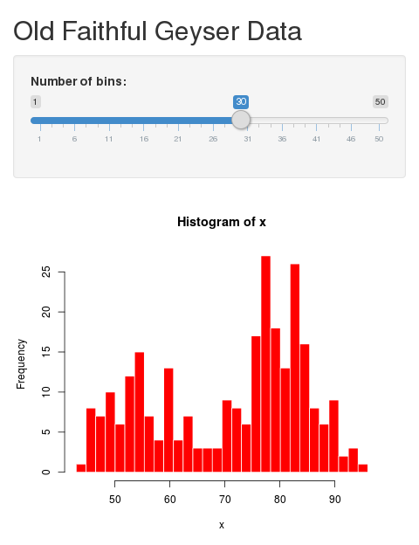
Shiny
Click to open

