Slide 1
Wrangling a Large Herd of Internet Clocks
DIMACS Workshop
27 October 1997
David L. Mills
University of Delaware
mills@udel.edu
HTML, PostScript and PowerPoint versions of
this presentation are available at
http://www.eecis.udel.edu/~mills

Slide 2
Introduction
S3
S3
S3
S2
S2
S2
S2
S1
S1
S1
S1
S1
S1
S4
S3
*
S3
*
S2
*
S2
*
S2
*
Workstation
Department
Servers
* to buddy (S2)
Campus
Servers
Network Time Protocol (NTP) synchronizes clocks of hosts and routers in the Internet
Provides submillisecond accuracy on LANs, low tens of milliseconds on WANs
Unix NTP daemon ported to almost every workstation and server platform available today - from PCs to Crays
Well over 100,000 NTP peers deployed in the Internet and its tributaries all over the world

Slide 3
Goals
Robustness to many and varied kinds of failure, including Byzantine disagreements, malicious attacks and implementation bugs.
  Our approach is based on diverse network paths, redundant servers and a suite of intricately crafted mitigation algorithms.
Autonomous server and client configuration to optimize performance under resource constraints.
  Our approach is based on Internet multicasting and manycasting, together with engineered drop-add heuristics.
Autonomous authentication using a combination of public-key and private-key cryptography.
  Our approach uses automatically generated and managed keys with controlled lifetimes and engineered algorithms designed to avoid loss of accuracy due to encryption delays.

Slide 4
NTP architecture
Peer 1
Filter 1
Intersection
and
Clustering
Algorithms
Peer 2
Filiter 2
Combining
Algorithm
Loop Filter
Peer 3
Filter 3
P/F-Lock Loop
LCO
NTP Messages
Timestamps
Multiple synchronization peers for redundancy and diversity
Clock filters select best from a window of eight clock offset samples
Intersection and clustering algorithms pick best subset of peers and discard outlyers
Combining algorithm computes weighted average of offsets for best accuracy
Loop filter and local clock oscillator (LCO) implement hybrid phase/frequency-lock feedback loop to minimize jitter and wander

Slide 5
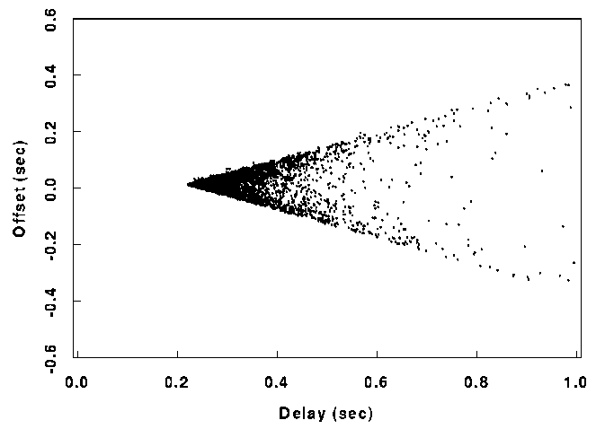


Clock filter algorithm
T₂
T₃
Server
Client
T₁
T₄
Most accurate clock offset θ is measured at the lowest delay δ (apex of the wedge diagram)
Phase dispersion ε_{r} is weighted average of offset differences over last eight samples - used as error estimator
Frequency dispersion ε_{f} represents clock reading and frequency tolerance errors - used in distance metric
Synchronization distance λ = ε_{f} + δ/2 - used as distance metric and maximum error bound, since correct time θ₀ must be in the range
θ − λ ≤ θ₀ ≤ θ + λ

Slide 6
Intersection algorithm
B
m = number of clocks
f = number of presumed falsetickers
A, B, C are truechimers
D is falseticker
A
D
C
Correct DTS
Time Offset
Correct NTP
Initially, set falsetickers f and counters c and d to zero
Scan from far left endpoint: add one to c for every lower endpoint, subtract one for every upper endpoint, add one to d for every midpoint
If c ≥ m − f and d ≥ m − f, declare success and exit procedure
Do the same starting from the far right endpoint
If success undeclared, increase f by one and try all over again
if f ≤ m/2, declare failure

Slide 7
Clustering algorithm
Sort survivors of intersction algorithm by increasing synchronization distance. Let n be the number of survivors and n_{min} a lower limit.
For each survivor s_{i}, compute the select dispersion (weighted sum of clock differences) between si and all others.
Let s_{max} be the survivor with maximum select dispersion (relative to all other survivors) and s_{min} the survivor with minimum sample dispersion (clock differences relative to past samples of the same survivor).
s_{max} ≤ s_{min} or n ≤ n_{min}?
yes
no
Delete the survivor s_{max}; reduce n by one
The resulting survivors are processed by the combining algorithm to produce a weighted average used as the final offset adjustment

Slide 8
NTP autonomous configuration - approach
Dynamic peer discovery schemes
  Primary discovery vehicle using NTP multicast and manycast modes
  Augmented by DNS, web and service location protocols
  Augmented by NTP subnet search using standard monitoring facilities
Automatic optimal configuration
  Distance metric designed to maximize accuracy and reliability
  Constraints due to fanout limitations and maximum distance
  Complexity issues require intelligent heuristic
Candidate optimization algorithms
  Multicast mode with or without initial propagation delay calibration
  Manycast mode with administrative and/or TTL delimited scope
  Distributed, hierarchical, greedy add/drop heuristic

Slide 9
NTP configuration scheme
Multicast scheme (moderate accuracy)
  Servers flood local area with periodic multicast response messages
  Clients use client/server unicast mode on initial contact to measure propagation delay, then continue in listen-only mode
Manycast scheme (highest accuracy)
  Initially, clients flood local area with a multicast request message
  Servers respond with multicast response messages
  Clients continue with servers as if in ordinary configured unicast client/server mode
Both schemes require effective implosion/explosion controls
  Expanding-ring search used with TTL and administrative scope
  Excess network traffic avoided using multicast responses and rumor diffusion
  Excess client/server population controlled using NTP clustering algorithm and timeout garbage collection

Slide 10
NTP autonomous authentication - approach
The circular dilemma:
  Cryptographic keys must not endure beyond enforced lifetimes
  Enforced lifetime requires secure timekeeping
  Secure timekeeping requires cryptographic authentication
Authentication and synchronization protocols work independently for each peer, with each allowed to reach a tentative outcome
When both authentication and synchronization are complete, the peer is admitted to the population used to synchronize the system clock
Complicating this scheme are requirements that the lifetimes of all public keys, including those used to sign certificates, must be enforced as well
However, the Achilles heel using public-key cryptography is that it is too slow for good timekeeping

Slide 11
Message propagation time budget
Cryptosum
and Protocol
Processing
Cryptosum
Output Wait
Network
Input Wait
Time
T_{3b}
Timestamp
T_{3a}
Timestamp
T₃
Timestamp
T₄
Timestamp
T_{4a}
Timestamp
We want T₃ and T₄ timestamps for accurate network calibration
  If output wait is small, T_{3a} is good approximation to T₃
  T_{3a} can’t be included in message after cryptosum is calculated, but can be sent in next message; use T_{3b} as best approximation to T₃
  T₄ captured by most network drivers at interrupt time; if not, use T_{4a} as best approximation to T₄
Largest error is usually output cryptosum
  Private-key algorithms (MD5, DES-CBC) running times range from 10 μs to 1 ms, depending on architecture, but can be predicted fairly well
  Public-key algorithms (RSA) running times range up to 100 ms, depending on architecture, but are highly variable and depend on message content

Slide 12
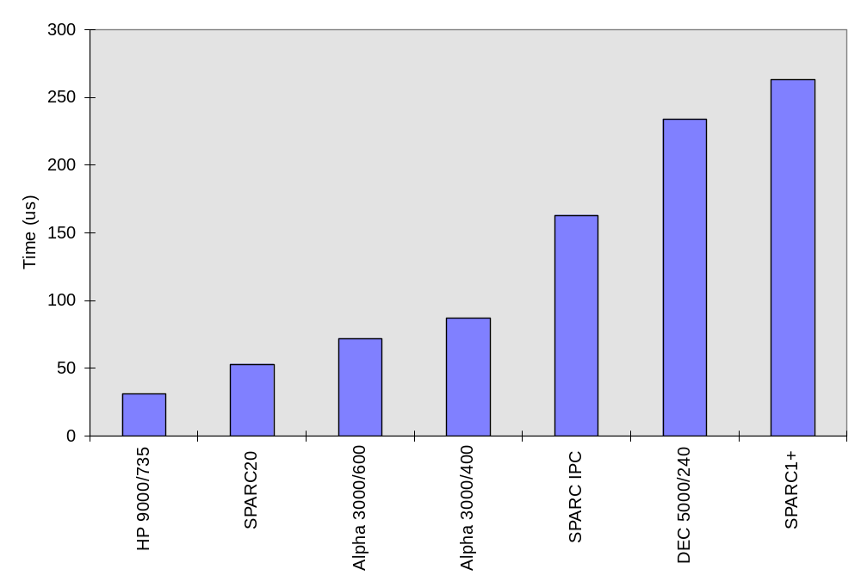
MD5 message digest
Measured times to construct 128-bit hash of 48-octet NTP header using MD5 algorithm in RSAREF

Slide 13
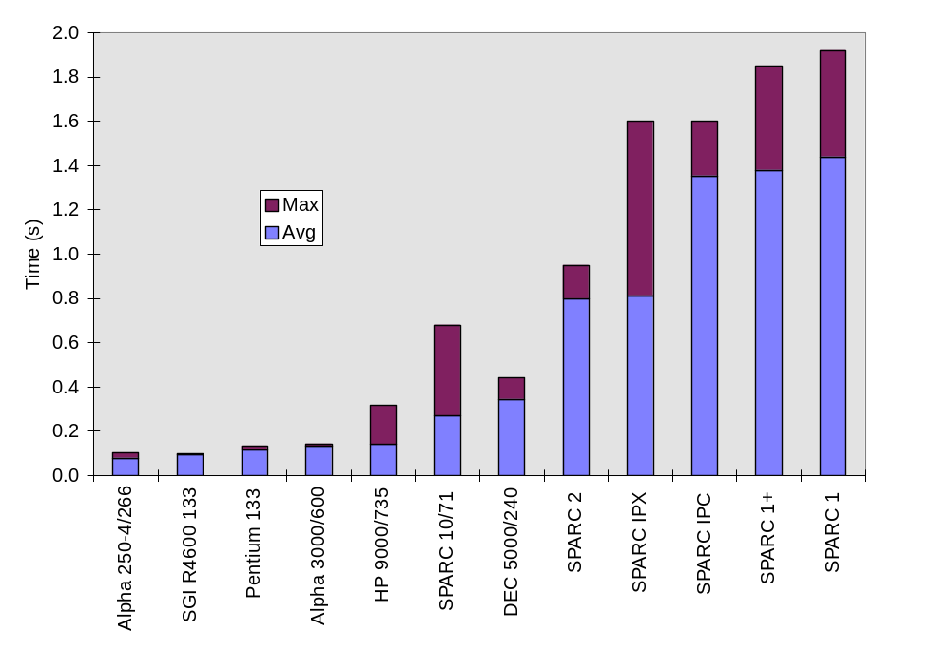
MD5/RSA digital signature
Measured times (s) to construct digital signature using RSAREF
Message authentication code constructed from 48-octet NTP header hashed with MD5, then encrypted with RSA 512-bit private key

Slide 14
NTP authentication scheme
Source
Address
Dest
Address
Key ID
Session
Key
List
Session
Key
Server Key
NTP
Header
MD5 Hash
MD5 Hash
Next
Key ID
MAC
Session keys are generated using IP addresses and key identifiers
Initial key identifier is random; each succeeding one is hashed from the previous one
Session key list is used in reverse order; clients verify hash of current session key matches most recent session key identifier
At intervals, a server generates a random server key and generates a public value by encrypting it with RSA
When the server key changes, clients obtain and decrypt the public value and verify it matches the server key

Slide 15
NTP Version 4 current progress and status
NTP Version 4 architecture and algorithms implemented and in test
  Simple NTP (SNTP) Version 4 specification now an Internet draft
  Improved local clock model now standard NTP feature
  Precision time kernel modifications now in Digital Unix 4.0 and Sun Solaris 2.6
Autonomous configuration
  Multicast server discovery now standard NTP feature
  Manycast server discovery implemented and in test
  Distributed add/drop greedy heuristic designed and simulated
  Span-limited, hierarchical multicast groups using NTP distributed mode and add/drop heuristics under study
Cryptographic authentication
  Autokey scheme implemented and in test
  Public-key certificate discovery and verification scheme expected to follow IETF model

Slide 16
Future plans
Complete NTP Version 4 protocol testing and validation project
  Deploy, test and evaluate NTP Version 4 daemon in local network
  Deploy and test in DARPA testbeds (DARTnet and CAIRN)
  Deploy and test at friendly sites in the US, Europe and Asia
Prosecute standards agendae in IETF, ANSI, ITU, POSIX
  Revise the NTP formal specification and launch on standards track
  Participate in deployment strategies with NIST, USNO, others
Develop scenarios for other applications such as web caching, DNS servers and other multicast services

Slide 17
NTP online resources
Internet (Draft) Standard RFC-1305 Version 3
  Simple NTP (SNTP) Version 4 specification RFC-2030
  Designated SAFEnet standard (Navy)
  Under consideration in ANSI, ITU, POSIX
NTP web page http://www.eecis.udel.edu/~ntp
  NTP Version 3 release notes and HTML documentation
  List of public NTP time servers (primary and secondary)
  NTP newsgroup and FAQ compendium
  Tutorials, hints and bibliographies
NTP Version 3 implementation and documentation for Unix, VMS and Windows
  Ported to over two dozen architectures and operating systems
  Utility programs for remote monitoring, control and performance evaluation

