Slide 1
The Nanokernel
David L. Mills
University of Delaware
http://www.eecis.udel.edu/~mills
mailto:mills@udel.edu

Slide 2
Going faster and faster
Observing that
  PC and workstation processor clock rates approaching and exceeding 1 GHz are becoming widely deployed
  10-Mb Ethernets have been replaced by 100-MHz Ethernets and these are now being replaced by 1-GHz Ethernets
  1.5-Mb Internet links have been replaced by 43-Mb links and these are being replaced by 155-Mb OC-3 links and soon 2.4-Gb OC-48 links
And further that
  Timekeeping expectations have been typically tens of milliseconds on a WAN and low milliseconds on a LAN
  Timekeeping ambitions for some applications are in the tens of microseconds on a modern workstation
We conclude that
  Accuracy expectations can be considerably improved by moving the clock discipline code from user space to the kernel and, where available, precision synchronization sources

Slide 3
Evolution to NTP Version 4
NTP Version 3 was first used in 1992 in a rambunctious Internet of congested links and 25-MHz workstations
NTP Version 4 architecture, protocol and algorithms have been evolved for gigabit networks and gigahertz computers
  Improved clock models which accurately predict the phase and frequency noise for each synchronization source and network path
  Engineered algorithms which reduce the impact of delay spikes and oscillator wander while speeding up initial convergence
  Redesigned clock discipline algorithm which can operate in frequency-lock, phase-lock and hybrid modes
But, the Unix time adjustment primitive prevents further improvement to the ambition of a few microseconds

Slide 4
Unix time adjustment primitive
θ
Adjustment Interval σ
C
+S
A
t
ε
−S
Adjustment Rate R − ϕ
Frequency Error ϕ
B
The discipline needs to steer the frequency over the range ±S, but the intrinsic clock frequency error is ϕ
Unix adjtime() slews frequency at rate R − ϕ PPM beginning at A
Slew continues to B, depending on the programmed frequency steer
Offset continues to C with frequency offset due to error ϕ
The net error with zero steering is ε, which can be several hundred μs

Slide 5
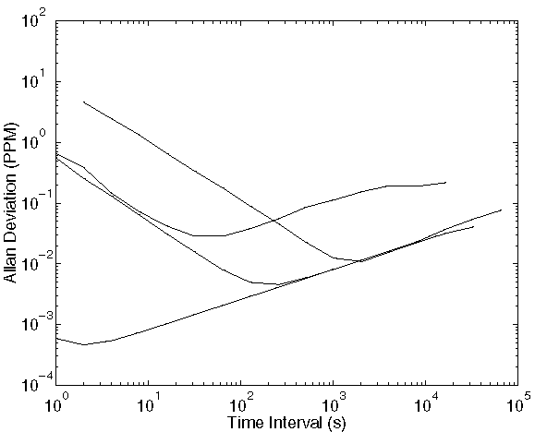
Computer clock modelling
SPARC IPC
Pentium 200
Alpha 433
Resolution limit

Slide 6
Allan intercepts compared
System | Resolution | Precision | Stability | x Intercept | y Intercept | Range *
SPARC IPC | 1000 ns | 1000 ns | good | 2000 s | .01 PPM | 600 - 5000 s
Pentium 200 | 1 ns | 5 ns | poor | 50 s | .03 PPM | 10 - 300 s
Alpha 433 | 1 ns | 2.3 ns | good | 200 s | .005 PPM | 50 - 2000 s
Resolution limit | 1 ns | 1 ns | good | 2 s | .0004 PPM | 1 - 10 s
* For stability no worse than twice y intercept

Slide 7
NTP kernel clock discipline
θ_{r}+
NTP
Phase
Detector
V_{d}
Clock
Filter
V_{s}
NTP
Daemon
θ_{c}−
VFO
Loop Filter
Kernel
x
V_{c}
Clock
Adjust
Phase/Freq
Prediction
y
Type II, adaptive-parameter, hybrid phase/frequency-lock loop disciplines variable frequency oscillator (VFO) phase and frequency
NTP daemon computes phase error V_{d} = θ_{r} − θ_{o} between source and VFO, then grooms samples to produce time update V_{s}
Loop filter computes phase x and frequency y corrections and provides new adjustments V_{c} at 1-s intervals
VFO frequency is adjusted at each hardware tick interrupt

Slide 8
FLL/PLL prediction functions
x
Phase
Correct
y_{FLL}
FLL
Predict
V_{s}
y
Σ
y_{PLL}
PLL
Predict
V_{s} is the phase offset produced by the clock filter algorithm
x is the phase correction computed as a fraction of V_{s}
y_{FLL} is the frequency adjustment computed as the average of past frequency offsets
y_{PLL} is the frequency adjustment computed as the integral of past phase offsets
y_{FLL} and y_{PLL} are combined according to weight factors determined by poll interval and Allan deviation characteristic

Slide 9
Nanokernel architecture
x
Phase
Prediction
PLL/FLL
Discipline
NTP
Update
Clock
Oscillator
Calculate
Adjustment
Frequency
Prediction
PPS
Discipline
PPS
Interrupt
Tick
Interrupt
Second
Overflow
y
PLL/FLL discipline predicts phase x and frequency y at measurement intervals from 1 s to over one day
PPS discipline predicts phase and frequency at averaging intervals from 4 s to 256 s, depending on nominal Allan intercept
On overflow of the clock second, a new value is calculated for the tick interrupt adjustment
Tick adjustment is added to the system clock at every tick interrupt
Process cycle counter (PCC) used to interpolate microseconds or nanoseconds between tick interrupts

Slide 10
PPS phase and frequency discipline
Second
Offset
Median
Filter
Range
Checks
Phase
Average
x
PPS
Interrupt
Frequency
Discrim
PCC
Counter
Ambiguity
Resolve
Range
Checks
Frequency
Average
y
Phase and frequency disciplined separately - phase from system clock offset relative to second, frequency from process cycle counter (PCC)
Frequency discriminator rejects noise and incorrect frequency sources
Median filter rejects sample outlyers and provides error statistic
Range checks reject popcorn spikes in phase and frequency
Phase offsets exponentially averaged with variable time constant
Frequency offsets averaged over variable interval

Slide 11
Experimental results with PPS discipline
Hepzibah is a 400-MHz Pentium workstation with a GPS receiver
  The PPS signal is connected via parallel port and modified driver
Rackety is a 25-MHz SPARC IPC dedicated NTP server with dual redundant GPS receivers and dual redundant WWVB receivers
  This machine has over 1000 clients causing a load of 15 packets/sec
  The PPS signal is connected via serial port and modified driver
Churchy is a 433-MHz Alpha workstation with a GPS receiver
  This machine uses a SAW oscillator presumed spectrally pure
  The PPS signal is connected via serial port and modified driver
All machines accessed the PPS signal from a GPS receiver and a level converter where necessary
Experiments lasted one day with data collected by the NTP daemon

Slide 12
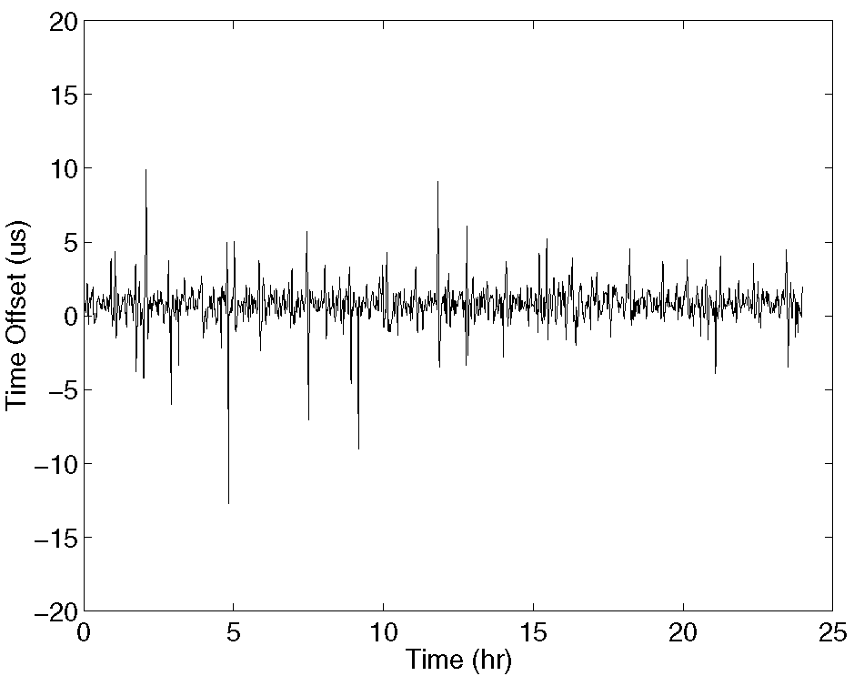
PPS time offset characteristic for Hepzibah
Jitter is presumed caused by interrupt latencies on the ISA bus
We need to explain why the spikes are both positive and negative

Slide 13
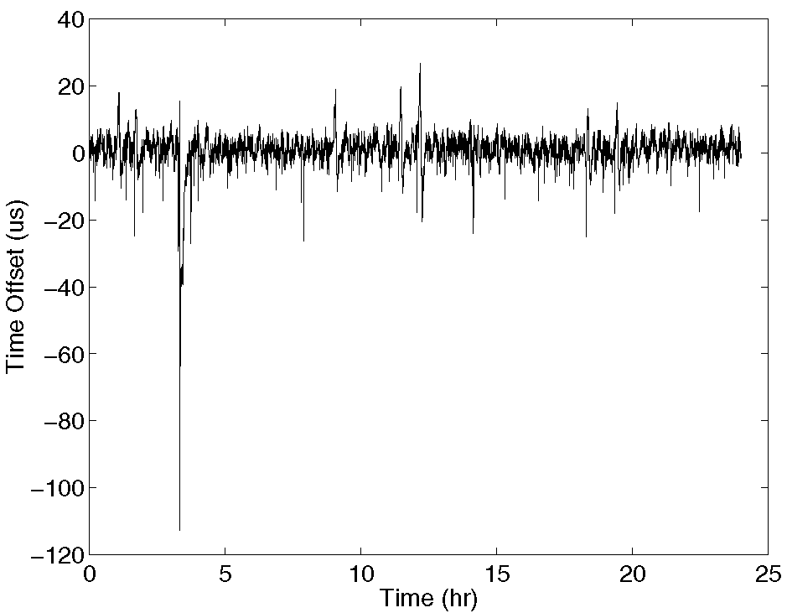
PPS time offset characteristic for Rackety
Jitter is presumed caused by interrupt latencies on the Sbus
Large negative spikes reflect contention by the radios and network

Slide 14
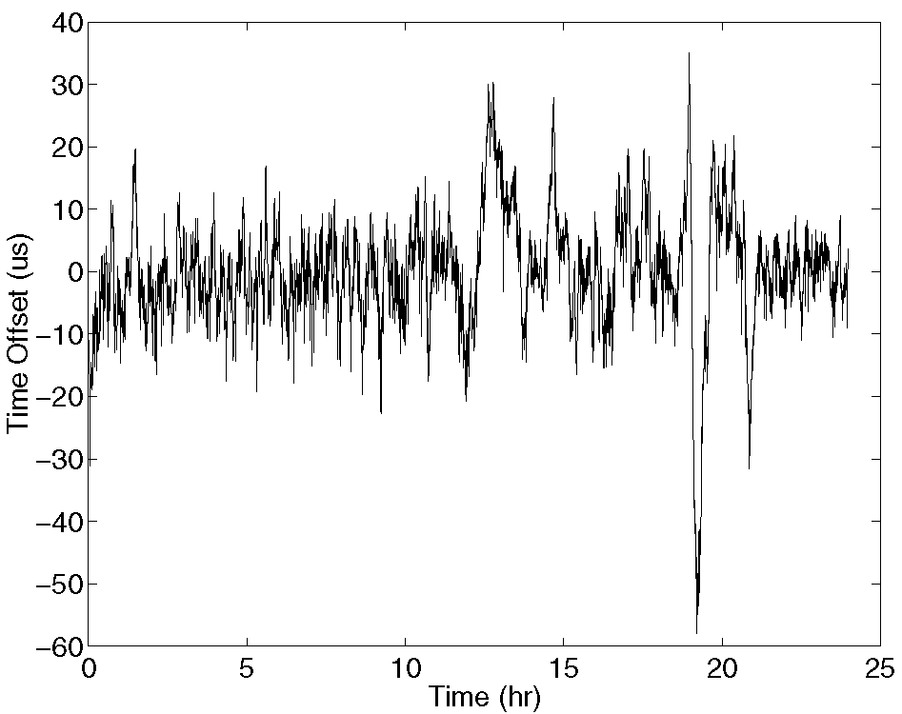
PPS time offset characteristic for Churchy
Jitter is presumed caused by interrupt latencies on the PCI bus
High flicker noise may be due to SAW phase noise and no PLL

Slide 15
Present status
The kernel modifications have been implemented for FreeBSD, Linux, Alpha and SunOS
The current version is in current FreeBSD and Linux public distributions
An older version, but with resolution only to the microsecond, is in current Alpha and Solaris licensed products
A standard PPS application program interface (PPSAPI) has been proposed to the IETF and supported in all kernels

Slide 16
Further information
Network Time Protocol (NTP): http://www.ntp.org/
  Current NTP Version 3 and 4 software and documentation
  FAQ and links to other sources and interesting places
David L. Mills: http://www.eecis.udel.edu/~mills
  Papers, reports and memoranda in PostScript and PDF formats
  Briefings in HTML, PostScript, PowerPoint and PDF formats
  Collaboration resources hardware, software and documentation
  Songs, photo galleries and after-dinner speech scripts
FTP server ftp.udel.edu (pub/ntp directory)
  Current NTP Version 3 and 4 software and documentation repository
  Collaboration resources repository
Related project descriptions and briefings
  See “Current Research Project Descriptions and Briefings” at http://www.eecis.udel.edu/~mills/status.htm

