Slide 1
Internet Timekeeping Around the Globe
David L. Mills, A. Thyagarajan, B. C. Huffman
University of Delaware
http://www.eecis.udel.edu/~mills
mills@udel.edu

Slide 2
Introduction
Network Time Protocol (NTP) synchronizes clocks of hosts and routers in the Internet
Provides submillisecond accuracy on LANs, low tens of milliseconds on WANs
Primary (stratum 1) servers synchronize to UTC via radio, satellite and modem; secondary (stratum 2, ...) servers and clients synchronize via hierarchical subnet
Reliability assured by redundant servers and diverse network paths
Engineered algorithms used to reduce jitter, mitigate multiple sources and avoid improperly operating servers
Unix NTP daemon ported to almost every workstation and server platform available today - from PCs to Crays
Well over 100,000 NTP peers deployed in the Internet and its tributaries all over the world

Slide 3
NTP configurations
S3
S3
S3
S2
S2
S2
S2
S4
S3
*
S3
*
Workstation
(a)
Clients
(b)
S1
S1
S1
S1
S1
S1
S2
*
S2
*
S2
*
Clients
(c)
* to buddy (S2)
(a) Workstations use multicast mode with multiple department servers
(b) Department servers use client/server modes with multiple campus servers and symmetric modes with each other
(c) Campus servers use client/server modes with up to six different external primary servers and symmetric modes with each other and external secondary (buddy) servers

Slide 4
NTP architecture
Server 1
Clock
Filter 1
Intersection
and
Clustering
Algorithms
Server 2
Clock
Filter 2
Combining
Algorithm
Loop Filter
Server 3
Clock
Filter 3
NTP Algorithms
P/F-Lock Loop
LCO
NTP Associations
Multiple synchronization peers provide redundancy and diversity
Clock filters select best from a window of eight clock offset samples
Intersection and clustering algorithms pick best subset of servers and discard outlyers
Combining algorithm computes weighted average of offsets for best accuracy
Loop filter and local clock oscillator (LCO) implement hybrid phase/frequency-lock feedback loop to minimize jitter and wander

Slide 5
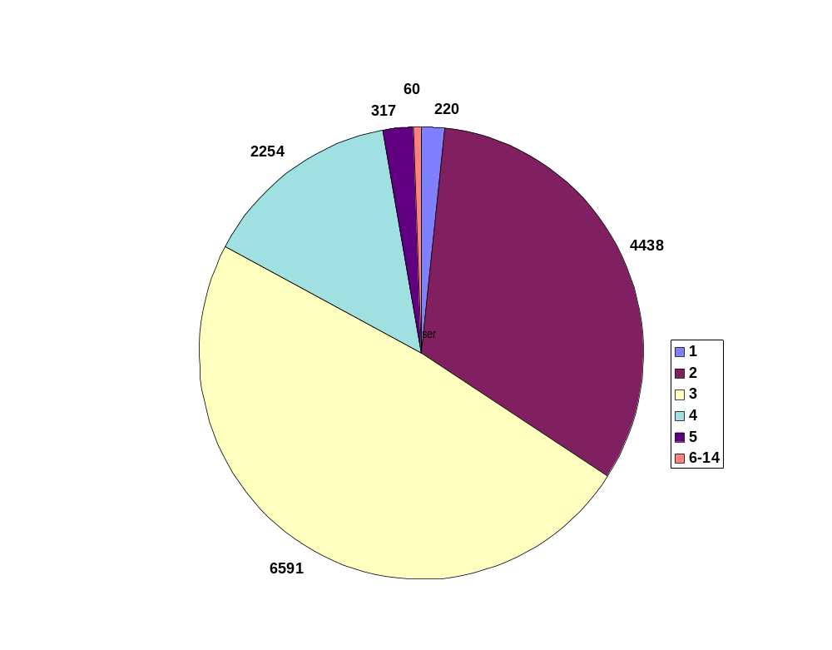
Server population by stratum

Slide 6
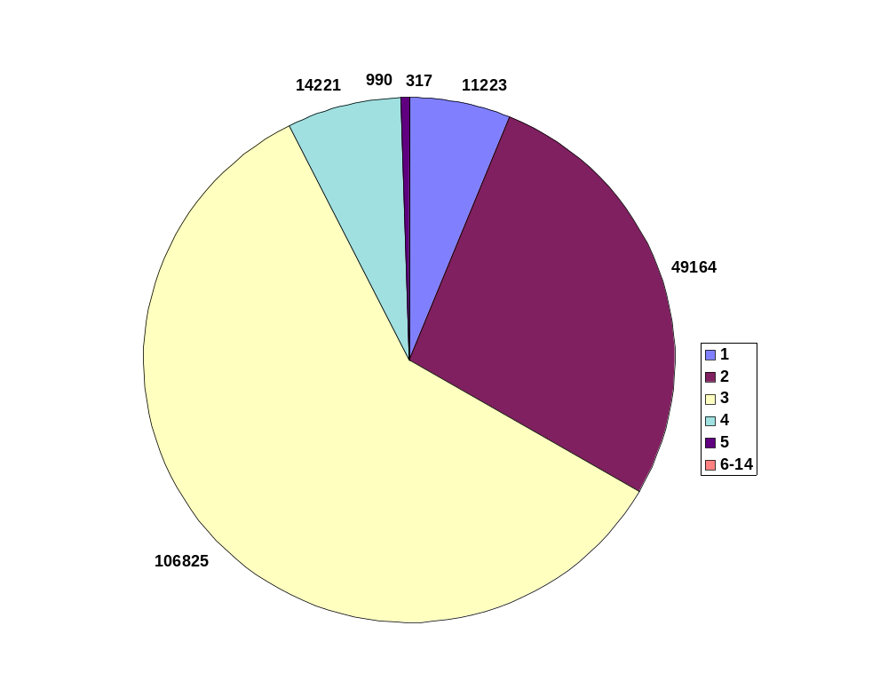
Association population by stratum

Slide 7
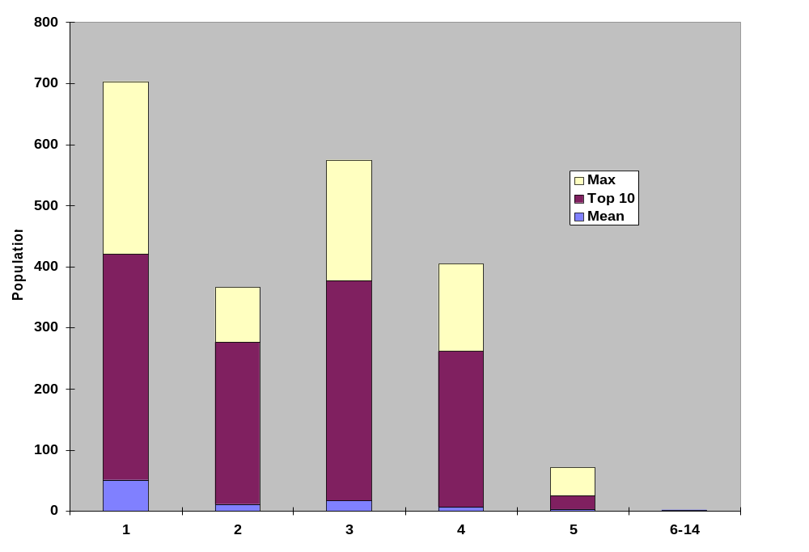
Associations per server population by stratum

Slide 8
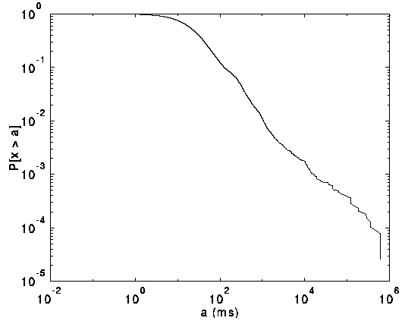
Time offsets
Cumulative distribution function of absolute time offsets
  38,722 Internet servers surveyed running NTP Version 2 and 3
  Offsets: median 23.3 ms, mean 234 ms, maximum 686 ms
  Offsets < 128 ms: median 20.1 ms, mean 28.7 ms

Slide 9
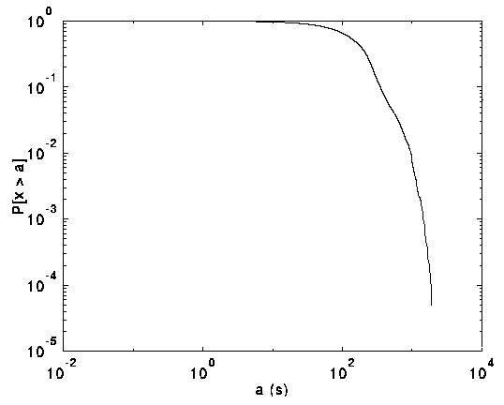
Roundtrip delays
Cumulative distribution function of absolute roundtrip delays
  38,722 Internet servers surveyed running NTP Version 2 and 3
  Delays: median 118 ms, mean 186 ms, maximum 1.9 s(!)
  Asymmetric delays can cause errors up to one-half the delay

Slide 10
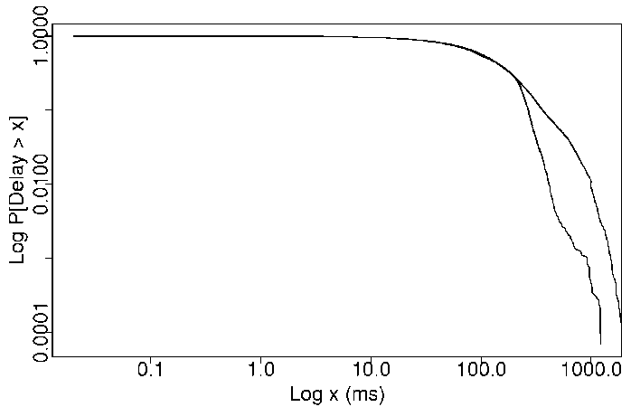
Peer roundtrip delays
Cumulative distribution of peer-peer absolute roundtrip delays
  182,538 samples excludes measurements where synchronization distance exceeds 1 s. since by specification these cannot synchronize the local clock
  Upper curve: different subnets (median 118 ms, mean 173 ms, max 1.91 s)
  Lower curve: same subnet (median 113 ms, mean 137 ms, max 1.40 s)

Slide 11
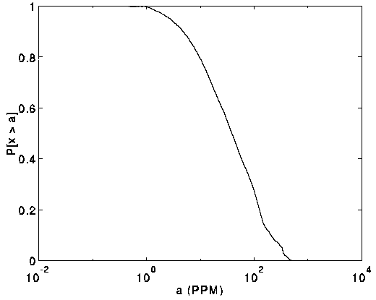
Systematic oscillator frequency offsets
Cumulative distribution function of absolute frequency offsets
  19,873 Internet servers surveyed running NTP Version 2 and 3
  593 outlyers greater than 500 PPM discarded as unsynchronized
  Remaining offsets: median 38.6 PPM, mean 78.1 PPM

Slide 12
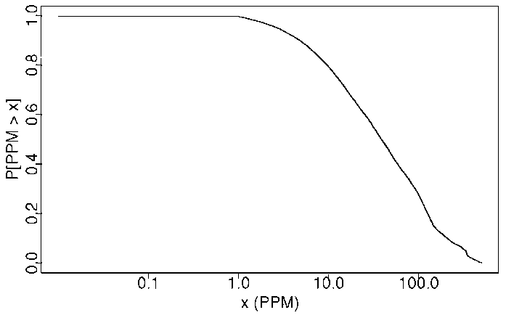
Local clock frequency offsets
Cumulative distribution of local clock absolute frequency offsets
  19,873 Internet peers surveyed running NTP Version 2 and 3
  396 offsets equal to zero deleted as probably spurious (self synchronized)
  593 offsets greater than 500 PPM deleted as probably unsynchronized
  Remaining 18,884 offsets: median 38.6 PPM, mean 78.1 PPM

Slide 13
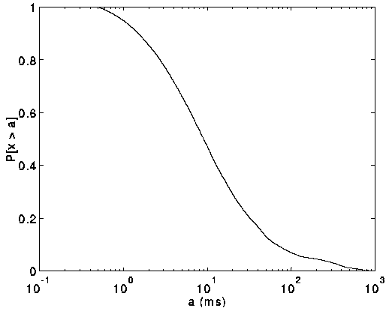
Clock oscillator phase errors
Cumulative distribution function of absolute phase errors
  19,873 Internet servers surveyed running NTP Version 2 and 3
  131 outlyers with errors over 1 s discarded as unsynchronized
  Remaining errors: median 9.1 ms, mean 37.0 ms

Slide 14
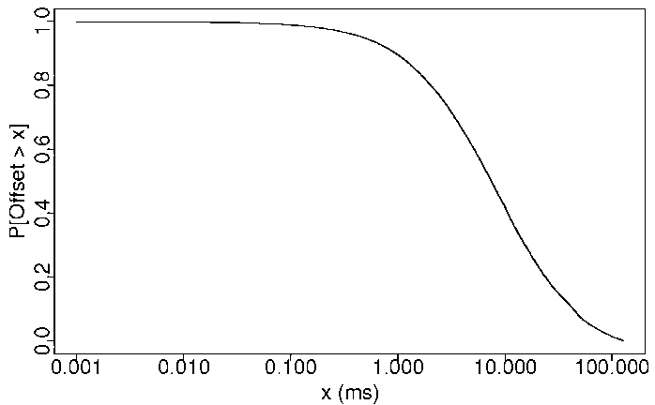
Local clock phase offsets
Cumulative distribution of local clock absolute phase offsets
  19,873 Internet peers surveyed running NTP Version 2 and 3
  530 offsets equal to zero deleted as probably unsynchronized
  664 offsets greater than 128 ms deleted as probably unsynchronized
  Remaining 18,679 offsets: median 7.45 ms, mean 15.87 ms

Slide 15
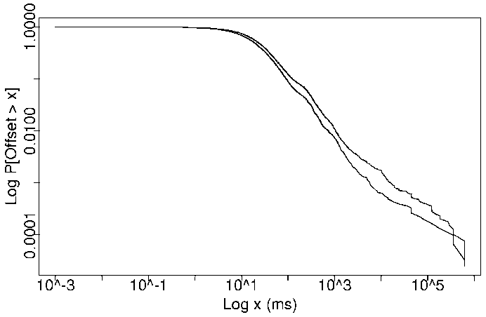
Peer clock offsets -same/different subnets
Cumulative distribution function of peer-peer absolute clock offsets
  182,538 peers used by 34,679 clients, 85,730 on the same subnet, 96,808 on a different subnet.
  Upper curve: different subnet (median 19 ms, mean 161 ms, max 621 s)
  Lower curve: same subnet (median 13 ms, mean 188 ms, max 686 s)

Slide 16
Reference clock sources
In a survey of 38,722 peers, found 1,733 primary and backup external reference sources
231 radio/satellite/modem primary sources
  47 GPS satellite (worldwide), GOES satellite (western hemisphere)
  57 WWVB radio (US)
  17 WWV radio (US)
  63 DCF77 radio (Europe)
  6 MSF radio (UK)
  5 CHU radio (Canada)
  7 modem (NIST and USNO (US), PTB (Germany), NPL (UK))
  25 other (cesium clock, precision PPS sources, etc.)
1,502 local clock backup sources (used only if all other sources fail)
For some reason or other, 88 of the 1,733 sources appeared down at the time of the survey

Slide 17
Timekeeping facilities at UDel - December 1997
WWVB
receivers (2)
GPS
receivers (2)
Cesium
clocks (2)
LORAN-C
receivers (2)
GPS, etc
receivers (3)
ASCII, IRIG
ASCII, IRIG
Cesium
clock
PPS
grundoon
NTP monitor
PPS
pogo
DCnet
rackety
public
barnstable
DARTnet
UDELnet
routers
ISDN
bridge
DCnet 128.4
10/100 Mb/s
DARTnet
1.5 Mb/s T1
UDELnet, Internet
1.5 Mb/s T1 (2)
Cesium oscillators are calibrated by U.S. Naval Observatory and checked continuously by Northeast US LORAN-C chain and GPS
NTP primary time servers synchronize to ASCII, PPS and IRIG-B, all with kernel modifications for precision timekeeping
NTP secondary servers (not shown) include SunOS 4/5, Ultrix 4, OSF/1, HP-UX, Cisco, Bancomm and Fuzzball (semi-retired)

Slide 18
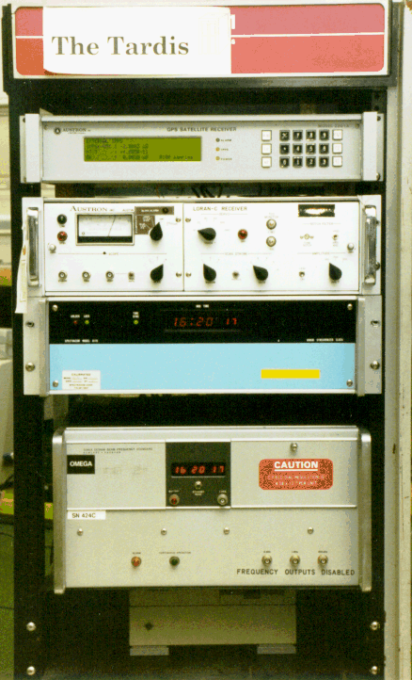
Precision Timekeeping Equipment
Austron 2200A GPS Receiver
Austron 2000 LORAN-C Receiver
Spectracom 8170 WWVB Reciver
Hewlett Packard 5061A Cesium Beam
Frequency Standard

Slide 19
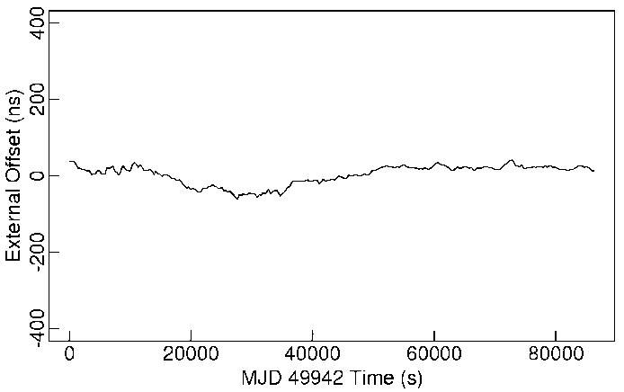
Squeezing the nanoseconds
This shows the residual error measured between the Austron 2201 GPS receiver and the HP 5061A cesium clock
The GPS receiver is stabilized using the LORAN-C receiver, which improves its accuracy to about 50 ns, in spite of the intentional degradation introduced in the GPS signal available to the public

Slide 20
A day in the life of a busy NTP server
NTP primary (stratum 1) server rackety is a Sun IPC running SunOS 4.1.3 and supporting 734 clients scattered all over the world
This machine supports NFS, NTP, RIP, IGMP and a mess of printers, radio clocks and an 8-port serial multiplexor
The mean input packat rate is 6.4 packets/second, which corresponds to a mean poll interval of 157 seconds for each client
Each input packet generates an average of 0.64 output packets and requires a total of 2.4 ms of CPU time for the input/output transaction
In total, the NTP service requires 1.54% of the available CPU time and generates 10.5, 608-bit packets per second, or 0.41% of a T1 line
The conclusion drawn is that even a slow machine can support substantial numbers of clients with no significant degradation on other network services

Slide 21
The Sun never sets on NTP
NTP is arguably the longest running, continuously operating, ubiquitously available protocol in the Internet
USNO and NIST, as well as equivalents in other countries, provide multiple NTP primary servers directly synchronized to national standard cesium clock ensembles and GPS
Over 230 Internet primary servers in Australia, Canada, Chile, France, Germany, Isreal, Italy, Holland, Japan, Norway, Spain, Sweden, Switzerland, UK, and US
Over 100,000 Internet secondary servers and clients all over the world
National and regional service providers BBN, MCI, Sprint, Alternet, etc.
Agencies and organizations: US Weather Service, US Treasury Service, IRS, PBS, Merrill Lynch, Citicorp, GTE, Sun, DEC, HP, etc.
Several private networks are reported to have over 10,000 NTP servers and clients; one (GTE) reports in the order of 30,000 NTP-equipped workstations and PCs

Slide 22
NTP online resources
Internet (Draft) Standard RFC-1305 Version 3
  Simple NTP (SNTP) RFC-2030
  Designated SAFEnet standard (Navy)
  Under consideration in ANSI, ITU, POSIX
NTP web page http://www.eecis.udel.edu/~ntp
  NTP Version 3 release notes and HTML documentation
  List of public NTP time servers (primary and secondary)
  NTP newsgroup and FAQ compendium
  Tutorials, hints and bibliography
NTP Version 3 implementation and documentation for Unix, VMS and Windows
  Ported to over two dozen architectures and operating systems
  Utility programs for remote monitoring, control and performance evaluation
  Latest version on ftp.udel.edu in pub/ntp directory

