Slide 1
The Network Computer as Precision Timekeeper
David L. Mills
University of Delaware
http://www.eecis.udel.edu/~mills
mills@udel.edu

Slide 2
Introduction
Network Time Protocol (NTP) synchronizes clocks of hosts and routers in the Internet
Provides submillisecond accuracy on LANs, low tens of milliseconds on WANs
Primary (stratum 1) servers synchronize to UTC via radio, satellite and modem; secondary (stratum 2, ...) servers and clients synchronize via hierarchical subnet
Reliability assured by redundant servers and diverse network paths
Engineered algorithms used to reduce jitter, mitigate multiple sources and avoid improperly operating servers
Unix NTP daemon ported to almost every workstation and server platform available today - from PCs to Crays
Well over 100,000 NTP peers deployed in the Internet and its tributaries all over the world

Slide 3
NTP architecture
Peer 1
Filter 1
Intersection
and
Clustering
Algorithms
Peer 2
Filiter 2
Combining
Algorithm
Loop Filter
Peer 3
Filter 3
P/F-Lock Loop
LCO
NTP Messages
Timestamps
Multiple synchronization peers for redundancy and diversity
Data filters select best from a window of eight clock offset samples
Intersection and clustering algorithms pick best subset of peers and discard outlyers
Combining algorithm computes weighted average of offsets for best accuracy
Loop filter and local clock oscillator (LCO) implement hybrid phase/frequency-lock feedback loop to minimize jitter and wander

Slide 4
NTP configurations
S1
S2
S1
S1
S2
S1
S2
S2
S2
*
S2
*
Clients
(a)
Clients
(b)
S1
S2
S1
S2
S1
S2
S2
*
S2
*
S2
*
Clients
(c)
* to buddy (S2)
(a) Workstations use multicast mode with multiple department servers
(b) Department servers use client/server modes with multiple campus servers and symmetric modes with each other
(c) Campus servers use client/server modes with up to six different external primary servers and symmetric modes with each other and external secondary (buddy) servers

Slide 5
Improved NTP local clock model
θ_{r}+
NTP
Phase
Detector
V_{d}
Clock Filter
V_{s}
θ_{o}−
LCO
V_{c}
Loop Filter
y
Frequency
Estimator
PPS
Type II, adaptive-parameter, hybrid phase/frequency-lock loop estimates LCO phase and frequency
Phase signal V_{d} = θ_{r} − θ_{o} between NTP and local clock oscillator (LCO) computed from timestamps, then filtered to produce control signal V_{c}
Auxilliary frequeny-lock loop disciplines LCO frequency y to pulse-per-second (PPS) signal, when available
Loop parameters automatically optimized for update intervals from 16 s to 16,384 s

Slide 6
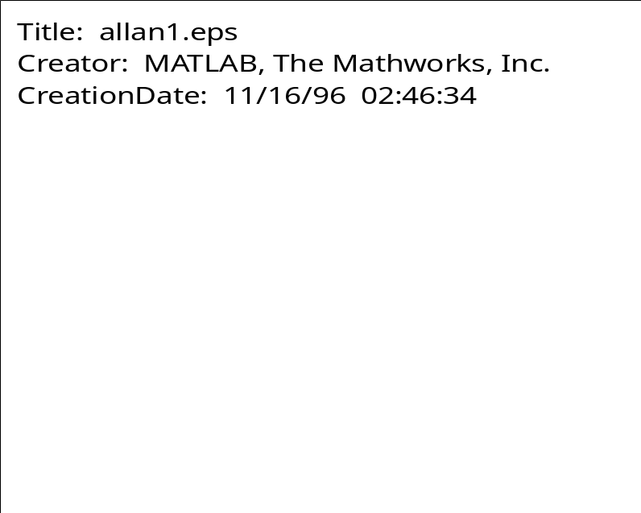
Optimizing the local clock parameters
Allan deviation shows computer clock stability calculated from free-running oscillator offsets measured over 11 days
  Characteristic to the left shows white phase variations
  Characteristic to the right shows flicker frequency variations
Inflection represents best update interval - about 1000 s
  Phase-lock mode optimum below 1000 s
  Frequency-lock mode optimum above 1000 s

Slide 7
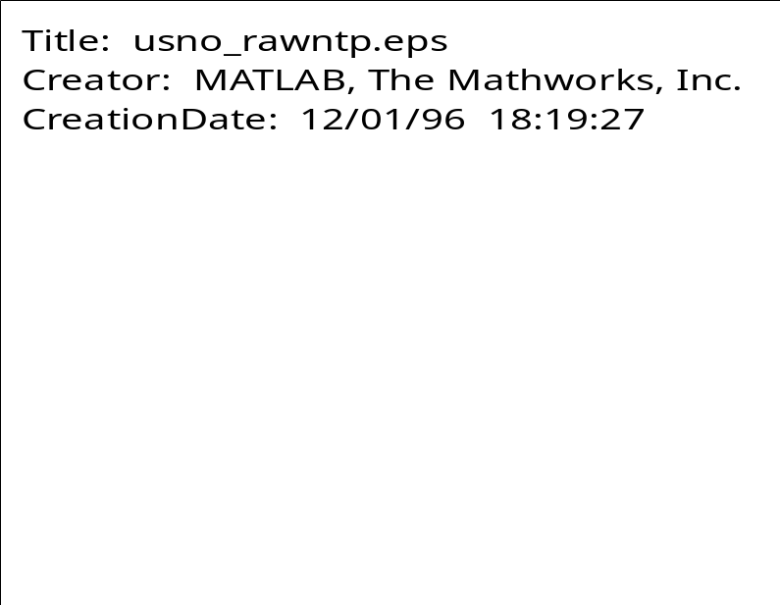
Raw Data Offsets
Data for path between U Delaware NTP server and USNO NTP server navobs.wustl.edu in St. Louis
Both servers synchronized to GPS receivers
Delay budget includes 38.1 ms propagation delay plus 26.3 ms queueing delay
Errors include .05 ms nonreciprocal delay + 4.8 ms mean offset + 19.5 ms RMS

Slide 8
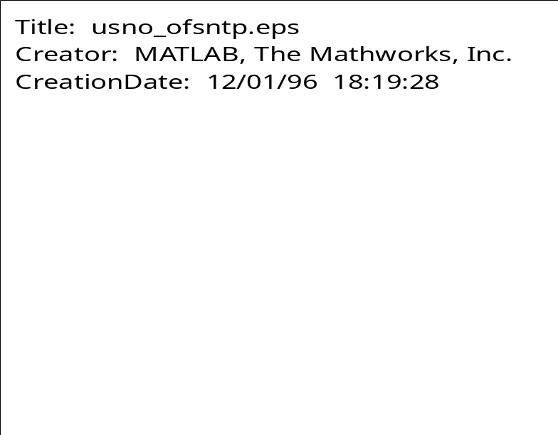
Processed Data Offsets
Data for path between U Delaware NTP server and USNO NTP server navobs.wustl.edu in St. Louis
Raw data processed by clock filter and PLL/FLL
Errors include .05 ms nonreciprocal delay +.003 ms mean offset + 0.15 RMS
Note spikes due various causes - should be eliminated with PPS discipline

Slide 9
Reference clock sources
In a survey of 36,479 peers, found 1,733 primary and backup external reference sources
231 radio/satellite/modem primary sources
  47 GPS satellite (worldwide), GOES satellite (western hemisphere)
  57 WWVB radio (US)
  17 WWV radio (US)
  63 DCF77 radio (Europe)
  6 MSF radio (UK)
  5 CHU radio (Canada)
  7 modem time service (NIST and USNO (US), PTB (Germany), NPL (UK))
  25 other (precision PPS sources, etc.)
1,502 local clock backup sources (used only if all other sources fail)
For some reason or other, 88 of the 1,733 sources appeared down at the time of the survey

Slide 10
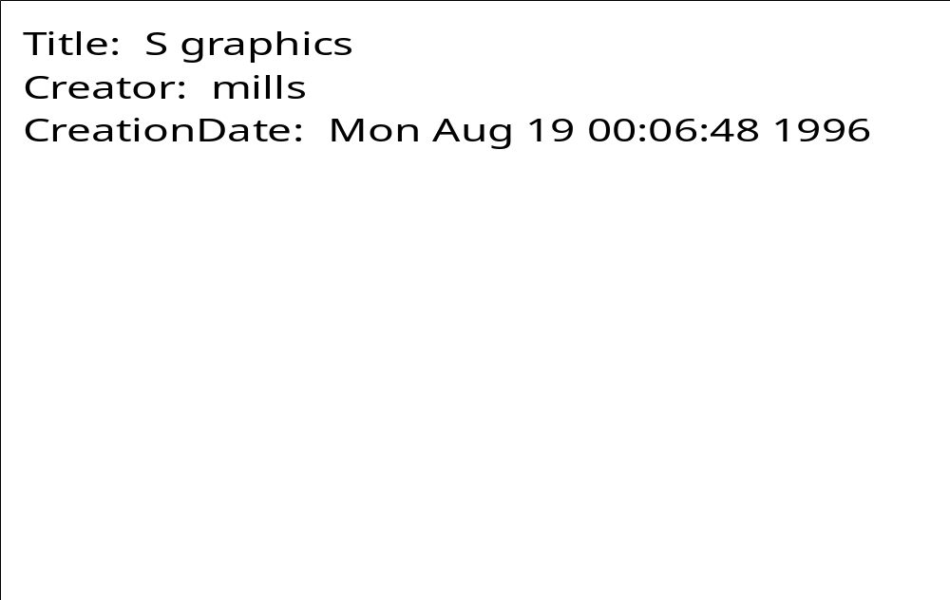
Peer clock offsets - filtered/unfiltered data
Cumulative distribution function of peer-peer absolute clock offsets
  182,538 peers used by 34,679 clients; 94,489 peers survived intersection and clustering algorithms.
  Upper curve: unfiltered (median 23 ms, mean 231 ms, max 686 s)
  Lower curve: filtered (median 19 ms, mean 148 ms, max 686 s)

Slide 11
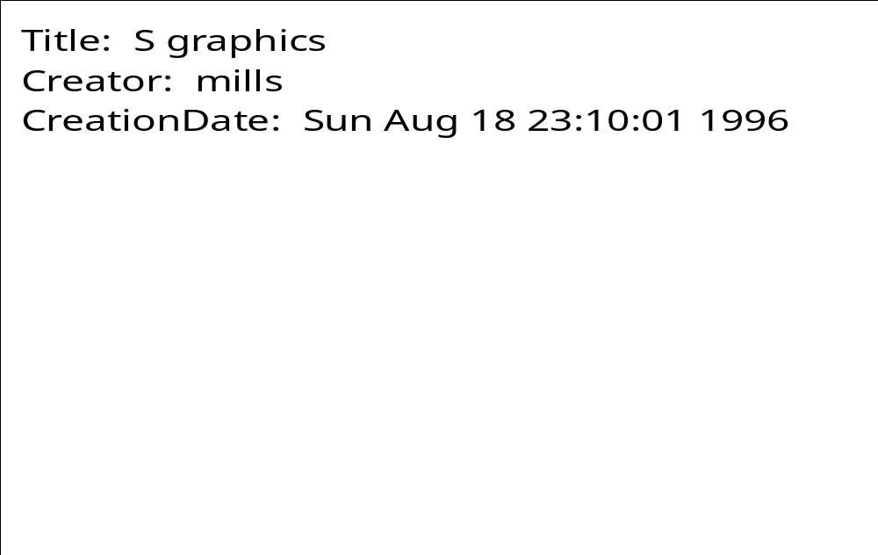
Peer clock offsets-same/different subnets
Cumulative distribution function of peer-peer absolute clock offsets
  182,538 peers used by 34,679 clients, 85,730 on the same subnet, 96,808 on a different subnet.
  Upper curve: different subnet (median 19 ms, mean 161 ms, max 621 s)
  Lower curve: same subnet (median 13 ms, mean 188 ms, max 686 s)

Slide 12
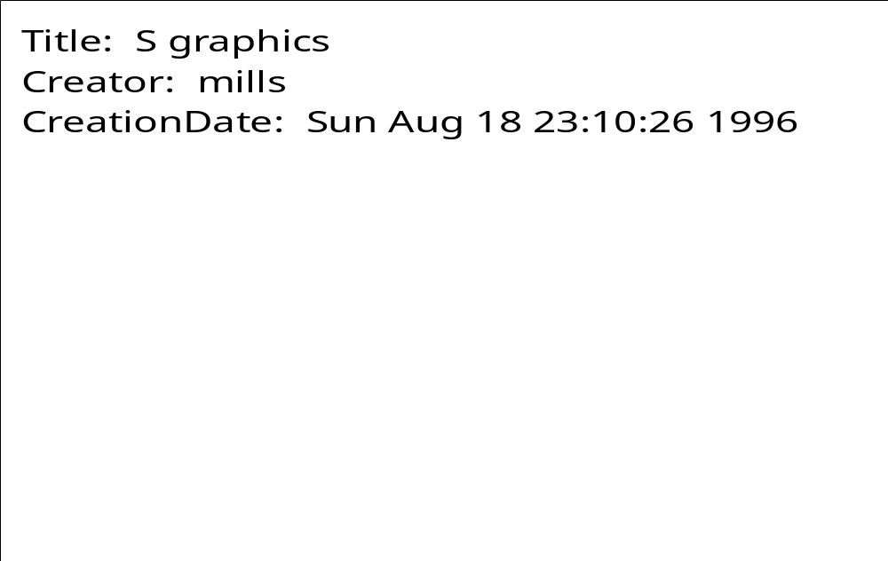
Peer roundtrip delays
Cumulative distribution function of peer-peer absolute roundtrip delays
  182,538 samples excludes measurements where synchronization distance exceeds 1 s. since by specification these cannot synchronize the local clock
  Upper curve: different subnets (median 118 ms, mean 173 ms, max 1.91 s)
  Lower curve: same subnet (median 113 ms, mean 137 ms, max 1.40 s)

Slide 13

Local clock phase offsets
Histogram of local clock absolute phase offsets
  19,873 Internet peers surveyed running NTP Version 2 and 3
  530 offsets equal to zero deleted as probably unsynchronized
  664 offsets greater than 128 ms deleted as probably unsynchronized
  Remaining 18,679 offsets: median 7.45 ms, mean 15.87 ms

Slide 14

Local clock frequency offsets
Histogram of local clock absolute frequency offsets
  19,873 Internet peers surveyed running NTP Version 2 and 3
  396 offsets equal to zero deleted as probably spurious (self synchronized)
  593 offsets greater than 500 PPM deleted as probably unsynchronized
  Remaining 18,884 offsets: median 38.6 PPM, mean 78.1 PPM

Slide 15
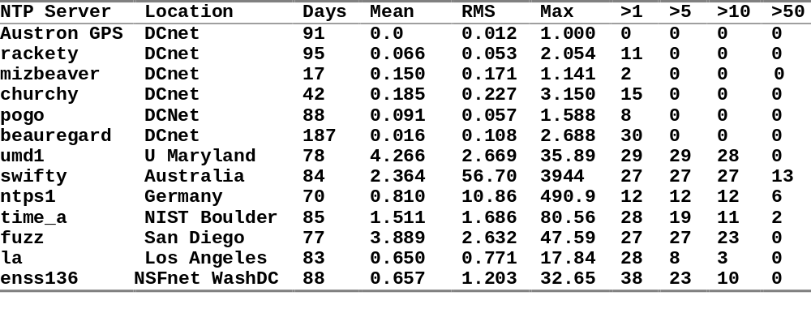
Performance of typical NTP servers in the global Internet
Table shows number days surveyed, mean absolute offset, RMS and maximum absolute error and number of days on which the maximum error exceeded 1, 5, 10 and 50 ms at least once
Servers represent LANs, domestic WANs and worldwide Internet
Results show all causes, including software upgrades and reboots

Slide 16
A day in the life of a busy NTP server
NTP primary (stratum 1) server rackety is a Sun IPC running SunOS 4.1.3 and supporting 734 clients scattered all over the world
This machine supports NFS, NTP, RIP, IGMP and a mess of printers, radio clocks and an 8-port serial multiplexor
The mean input packat rate is 6.4 packets/second, which corresponds to a mean poll interval of 157 seconds for each client
Each input packet generates an average of 0.64 output packets and requires a total of 2.4 ms of CPU time for the input/output transaction
In total, the NTP service requires 1.54% of the available CPU time and generates 10.5, 608-bit packets per second, or 0.41% of a T1 line
The conclusion drawn is that even a slow machine can support substantial numbers of clients with no significant degradation on other network services

Slide 17
The Sun never sets on NTP
NTP is argueably the longest running, continuously operating, ubiquitously available protocol in the Internet
USNO and NIST, as well as equivalents in other countries, provide multiple NTP primary servers directly synchronized to national standard cesium clock ensembles and GPS
Over 230 Internet primary servers in Australia, Canada, Chile, France, Germany, Isreal, Italy, Holland, Japan, Norway, Sweden, Switzerland, UK, and US
Over 100,000 Internet secondary servers and clients all over the world
National and regional service providers BBN, MCI, Sprint, Alternet, etc.
Agencies and organizations: US Weather Service, US Treasury Service, IRS, PBS, Merrill Lynch, Citicorp, GTE, Sun, DEC, HP, etc.
Several private networks are reported to have over 10,000 NTP servers and clients; one (GTE) reports in the order of 30,000 NTP-equipped workstations and PCs

Slide 18
NTP online resources
Internet (Draft) Standard RFC-1305 Version 3
  Simple NTP (SNTP) RFC-1769
  Designated SAFEnet standard (Navy)
  Under consideration in ANSI, ITU, POSIX
NTP web page http://www.eecis.udel.edu/~ntp
  NTP Version 3 release notes and HTML documentation
  List of public NTP time servers (primary and secondary)
  NTP newsgroup and FAQ compendium
  Tutorials, hints and bibliography
NTP Version 3 implementation and documentation for Unix, VMS and Windows
  Ported to over two dozen architectures and operating systems
  Utility programs for remote monitoring, control and performance evaluation

