Slide 1
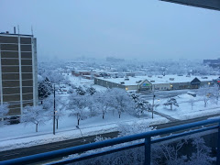
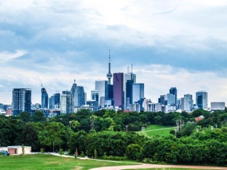
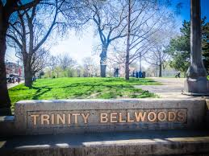
Find an outing
Suggest an Outing:
Enter description here including locations and/or contact information
Filter by location, date
Nature and the Great Outdoors
Densgrove Park
Riverdale Park
Trinity Bellwoods
Park
Submit
Suggestions from Users
Fitness and Recreation
Concerts and Festivals

Slide 2

Find an outing
Suggest an Outing:
Find an outing
Enter description here including locations and/or contact information
Filter by location, date
Densgrove Park
Very large quiet field to read a book alone or spend time with family. A small playground and two baseball fields for children and families to spend time together.
Submit
Suggestions from Users
Riverdale Park
Public park
Trinity Bellwoods Park
Trinity Bellwoods Park is a large, green space so you can always find a place to sit and chill, just read or engage in physical activity. It's relaxing and free….cont’d

