Slide 1
Task-Oriented DeepJSCC Based Semantic Communication
What a camera should send when the receiver only needs the answer
Edge camera
Short, noisy link
Receiver classifier
sees an image
loses some pictures in transit
needs one label back
Train the sender and the receiver together so the classification decision survives a short, noisy link.
The thesis
Second Review, 29 September – 3 October 2026.
Rubric: Results, Presentation
Twenty-one measured signal strengths · one frozen training run
1 / 20

Slide 2
Progress up to Sep. 30th
All learned models are trained now.
Aug · Digital system
Measured how badly it loses pictures at every setting. All 288,000 held-back combinations tested, and the settings it should use at each signal strength frozen.
Aug · Learned system
Training loop built, models trained at several seeds. Three of them are frozen at 1/6 rate.
Sep · Fair comparison
Built a control that sends learned features digitally, so the comparison includes a task-aware system alongside a compressed image.
Sep · Weak-link training
A second version, with the training signal strength picked at random each time, for comparison against the first.
Sep · Crossing question
Decided it on held-back pictures before seeing the answer: the two lines cross between −5 and −4 dB.
Sep · Power limits
Trained one model under a hard limit on how tall the signal spikes may get.
Sep · Measurements
252 measurements across twelve versions of the system and twenty-one signal strengths, 1,000 held-back pictures each.
Oct · Exam set
Opens in week 11, once the locking document is signed.
Rubric: Timeline, Results
First review 18–22 Aug 2026 · Second review 29 Sep–3 Oct 2026
2 / 20

Slide 3
Objectives
What we set out to do
1. Build it
Train a learned sender and receiver together, so the picture goes through the same kind of noise a radio adds.
2. Same radio time
At every signal strength and rate, both systems get the same number of chances to use the radio.
3. Charge the overhead
Checksums, padding and error-correction bytes come out of the budget before any picture data.
4. Pick the setting fairly
The operating point is chosen using the digital system alone, before anyone sees the learned curve.
5. Report per picture
Every row records what happened to one picture, including those that failed to arrive.
Rubric: Objectives Met, Methodology
Objectives confirmed at this review
3 / 20

Slide 4
Terminology
Every chart in this deck runs from a weak radio signal on the left to a clean one on the right.
Plain words
Our term
Where you see it
One example
How strong the signal is
SNR, in decibels
the left-to-right axis
At the weakest signal we measured:
The learned system labelled 728 of the 1,000 pictures correctly.
The digital system got almost nothing through, so every picture fell back to the same fixed answer. That answer is right 100 times out of 1,000, which is the 10%.
How many pictures got through
delivery coverage
the flat 10% line
How many we labelled correctly
top-1 accuracy
the up-and-down axis
How many times we use the radio
channel-use budget
12,800 or 3,200 per picture
Every point on every chart is the same 1,000 pictures, at that one signal strength.
That flat 10% is the fallback rule: 1,000 pictures that never arrived.
Rubric: Results, Analytical Skills
Plain language. Everything after this slide depends on it.
4 / 20

Slide 5
What we measured for this review
We built twelve versions of the system and tested each one at twenty-one signal strengths.
Item
Figure
What it is
Measurements
252
One row each in the published record
Versions of the system
12
Five are controls, not headline systems
Signal strengths
21
From weak to clean
Pictures per point
1,000
The same held-back pictures every time
Exam pictures opened
0
Sealed until week 11
Two things to keep in mind
Radio time
1/6 rate uses the radio 12,800 times per picture; 1/24 rate uses it 3,200 times. Within one rate both systems get exactly the same amount of radio time.
Who marks it
The learned systems are marked by the classifier built into them. The digital systems are marked by one we trained on compressed-looking images. So every comparison in this deck is between whole systems, link and marker included.
Rubric: Results, Analytical Skills
252 measurements = 12 versions of the system × 21 signal strengths
5 / 20

Slide 6
The two models behind every number
One classifier reads the pictures. One learned link decides what to transmit.
The learned link
How it was trained
Part
What it is
Setting
Value
Encoder
Conv stack, 64 then 128 channels
Objective
Class scores + 3.0 × reconstruction
Blocks
2 residual blocks, Group norm, PReLU
Optimiser
Adam, learning rate 0.001
Decoder
Mirror of the encoder, two heads
Schedule
Cosine decay, no warm-up
Heads
Class scores, plus a rebuilt picture
Batch, epochs
32 pictures, 100 epochs
Width sent
8 complex symbols per position, 1,600 positions
Augmentation
Random crop, horizontal flip
Parameters
1.57 M at the 1/6 rate reported here
Precision
Mixed 16-bit
The classifier
ResNet-18, 11.18 M parameters, trained from scratch. It reads 89.8% of held-back pictures correctly. The digital side is marked by a copy of it retrained on compressed pictures.
Training cost
48.7 seconds per epoch and 1.0 GiB of graphics memory, measured on a laptop GPU.
Rubric: Results, Analytical Skills
Both trained from scratch on this dataset; no pre-trained weights
6 / 20

Slide 7
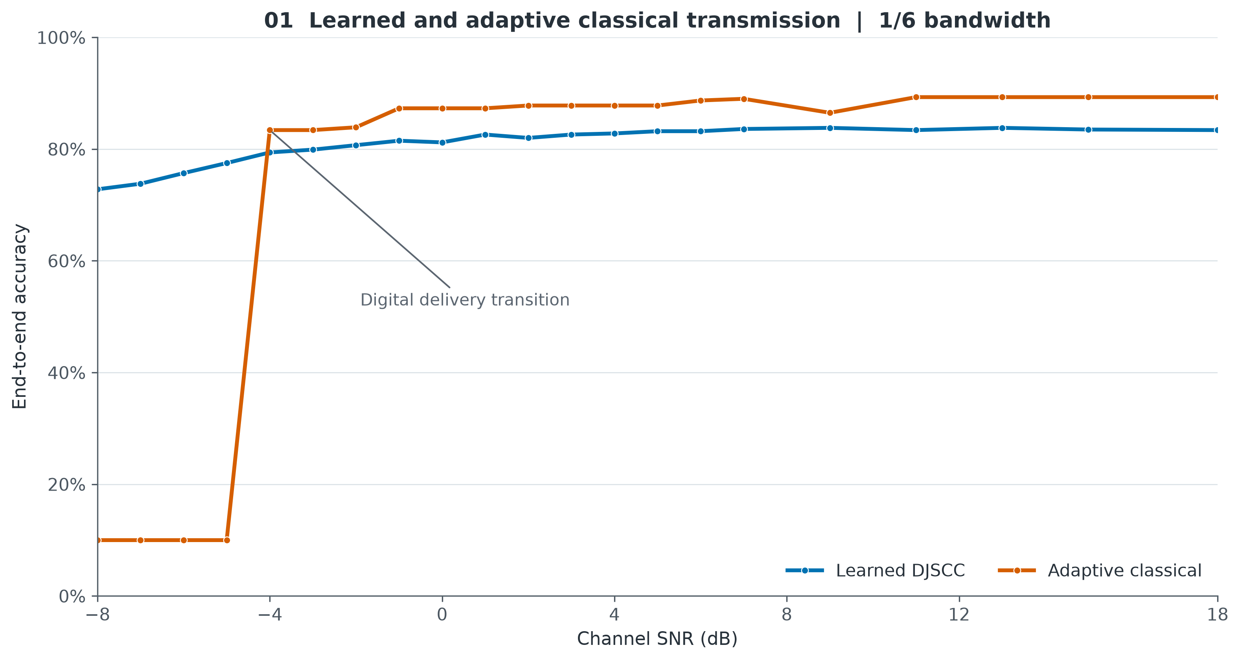
Where the digital system gives up, and where it takes over
One line runs the whole width of the chart. The other has a step in it near the left.
At the weakest signal the learned system is right on 728 of 1,000 while the digital system delivers nothing. From −4 dB it delivers and goes ahead. At +18 dB it is well ahead.
Rubric: Results
1/6 rate · all 21 measured signal strengths · held-back pictures
7 / 20

Slide 8
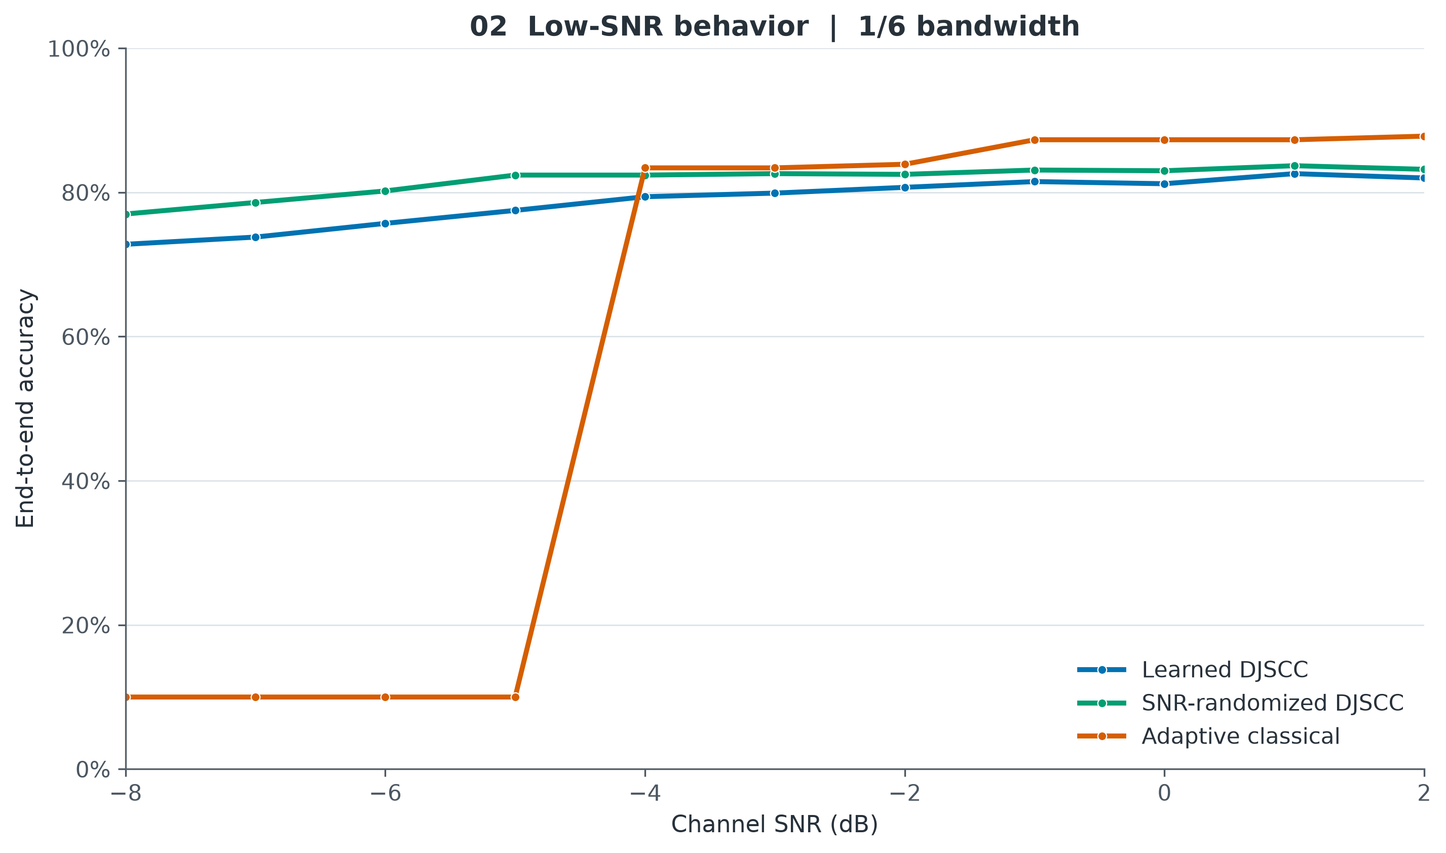
Close-up: the moment the digital system starts working
Between −5 and −4 dB the digital system begins getting pictures through, and its score jumps 73 points.
At −8 dB
The learned system is right on 728 of 1,000. The digital system got nothing through, so it scores 10%.
At −4 dB
The digital system now gets everything through and reaches 83.4%, ahead of the learned system's 79.4%.
After that
It dips at −2 dB and again at +9 dB.
Rubric: Results, Analytical Skills
−8 to +2 dB
8 / 20

Slide 9
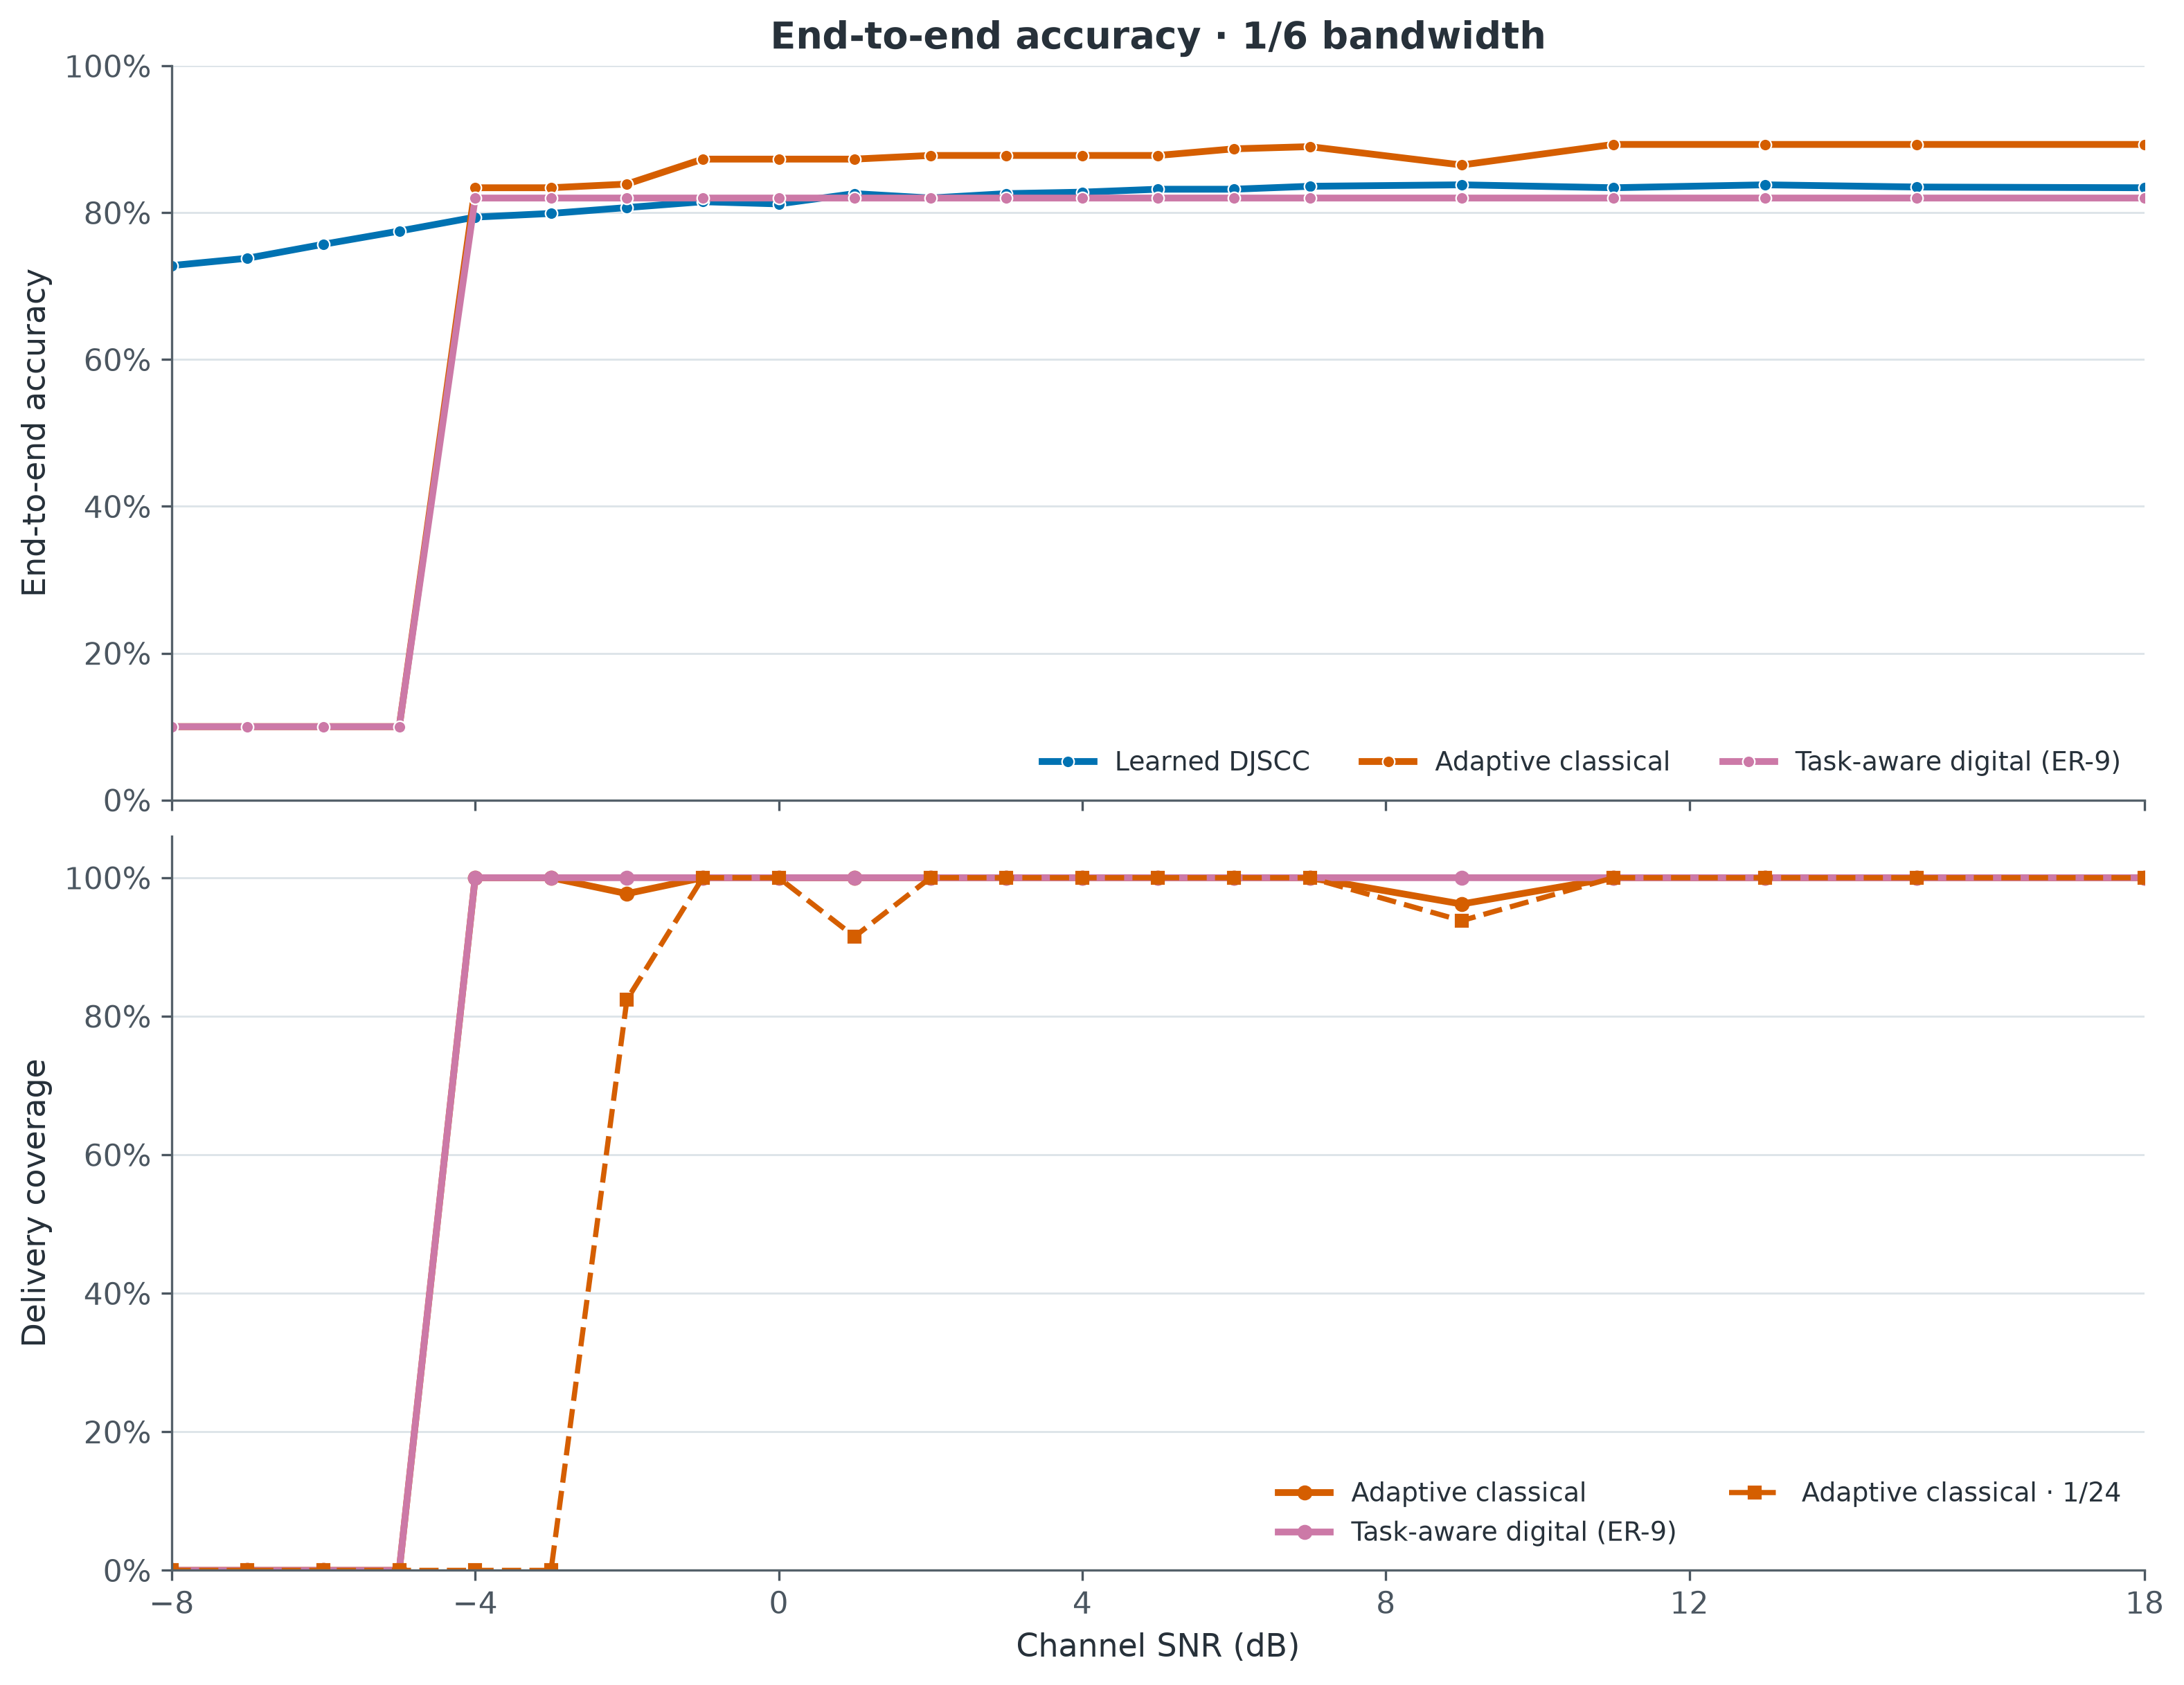
Why the digital line breaks where it does
The score only moves when the pictures start or stop arriving.
The 10% is a rule
Every picture takes the same fallback answer when delivery fails. On an evenly split set that is right 100 times in 1,000.
Outages are part of it
We report how many pictures arrived next to how many we got right, so a broken link is distinguishable from a wrong guess.
Learned always answers
Its rules promise a label at every strength, so its curve never flattens against a floor.
Rubric: Analytical Skills, Results
When pictures stop arriving, the score drops to match
9 / 20

Slide 10
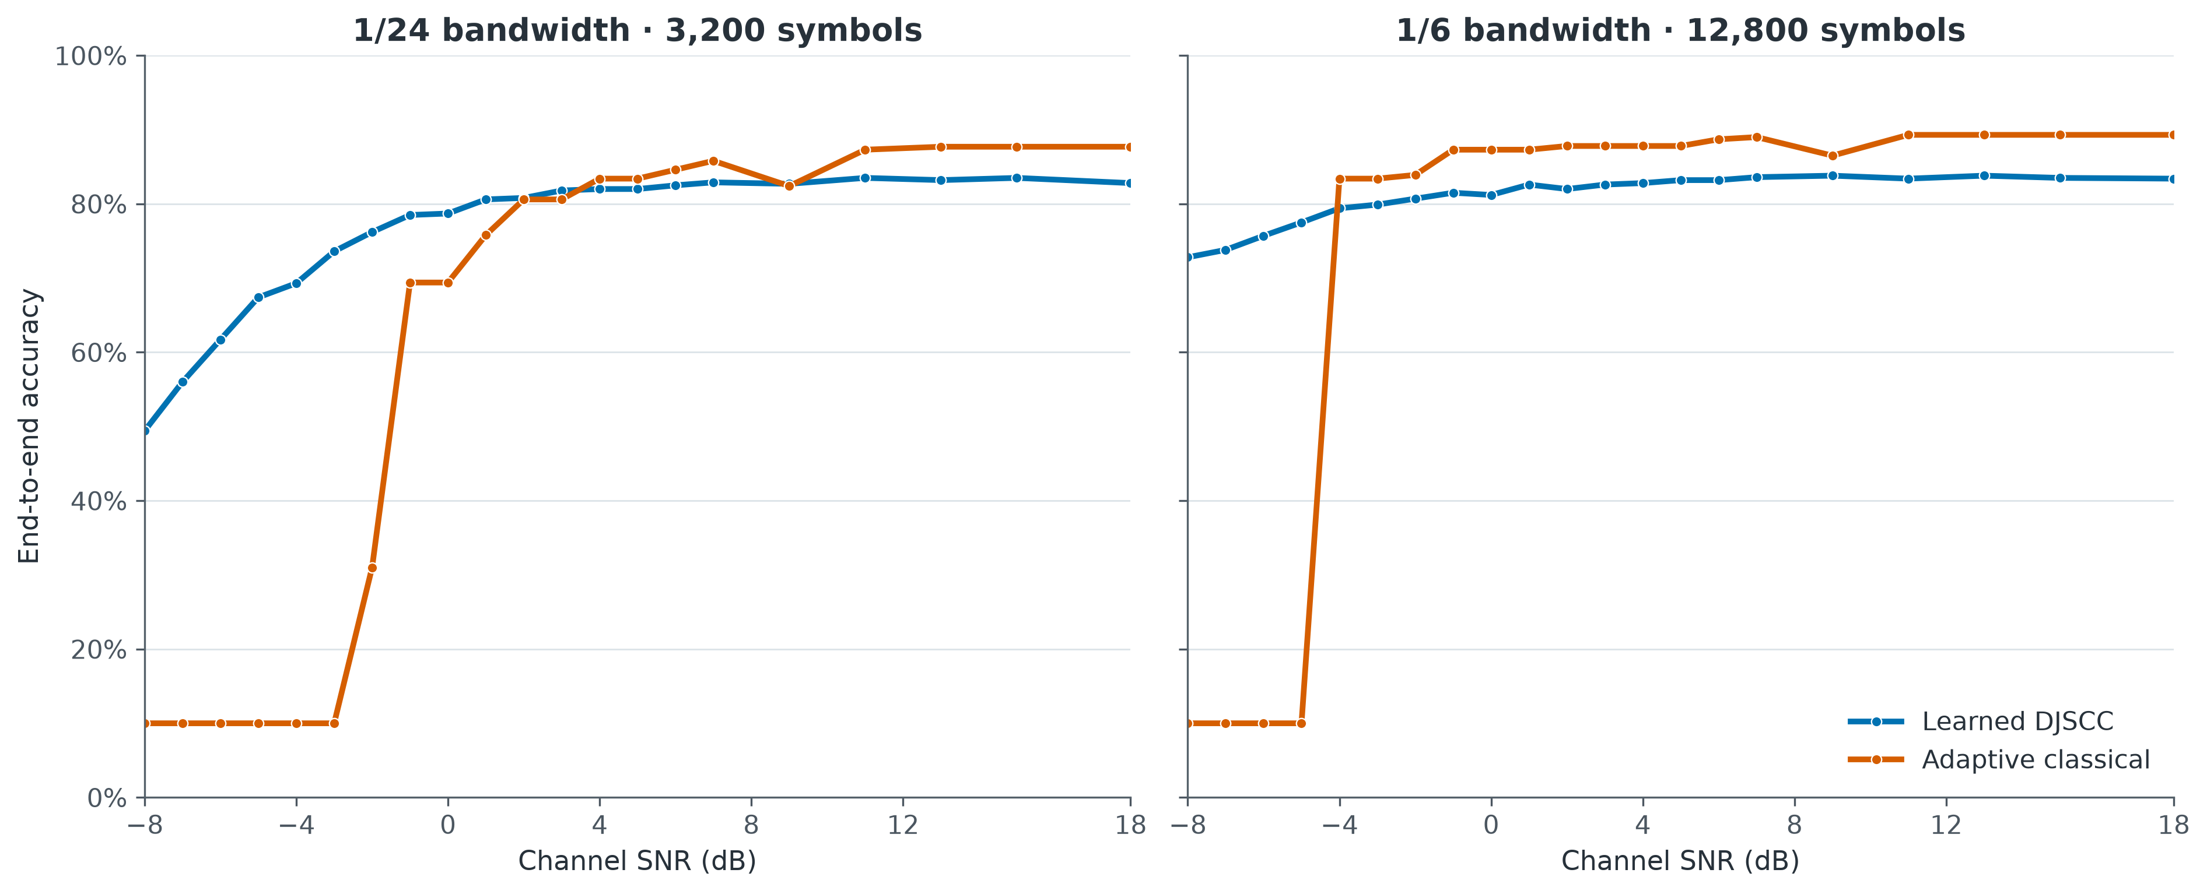
What happens when we cut the radio time fourfold
With four times less radio time, the digital system loses far more at the weak end than the learned one does.
Weak signal
Cutting from 1/6 to 1/24 rate drops the learned system from 72.8% to 49.4%.
At 0 dB, 1/24 rate
Learned 78.7% against digital 69.4%. The learned system is still ahead.
Catches up, then slips
Digital passes learned at the +4 dB point, loses the lead at +9 dB, then goes ahead again.
Rubric: Results, Analytical Skills
1/24 rate against 1/6 rate · compare within each panel
10 / 20

Slide 11
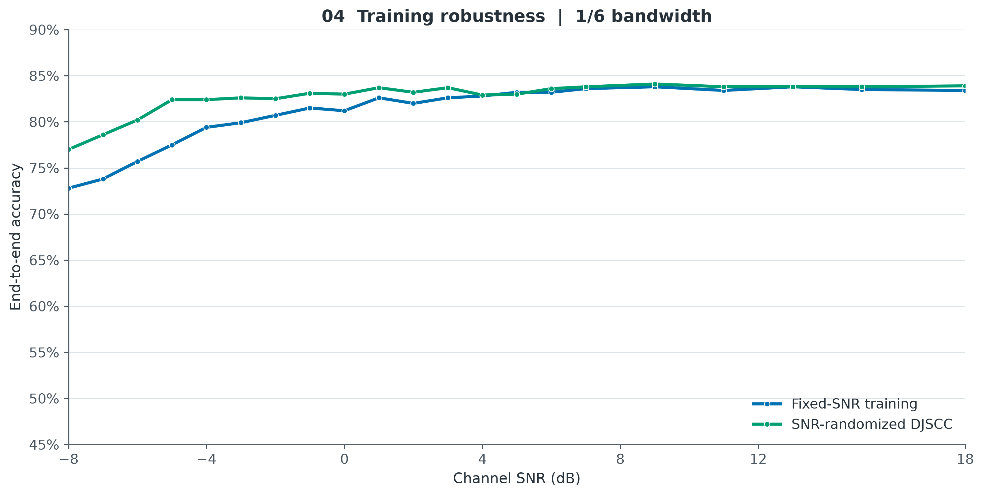
Training across signal strengths instead of one
Picking the training signal strength at random each time lifts the whole weak end of the line.
Training
−8 dB
−4 dB
0 dB
+9 dB
+18 dB
Random each time
77.0
82.4
83.0
84.1
83.9
One fixed strength
72.8
79.4
81.2
83.8
83.4
Rubric: Results, Analytical Skills
Two separately trained versions of the learned system
11 / 20

Slide 12
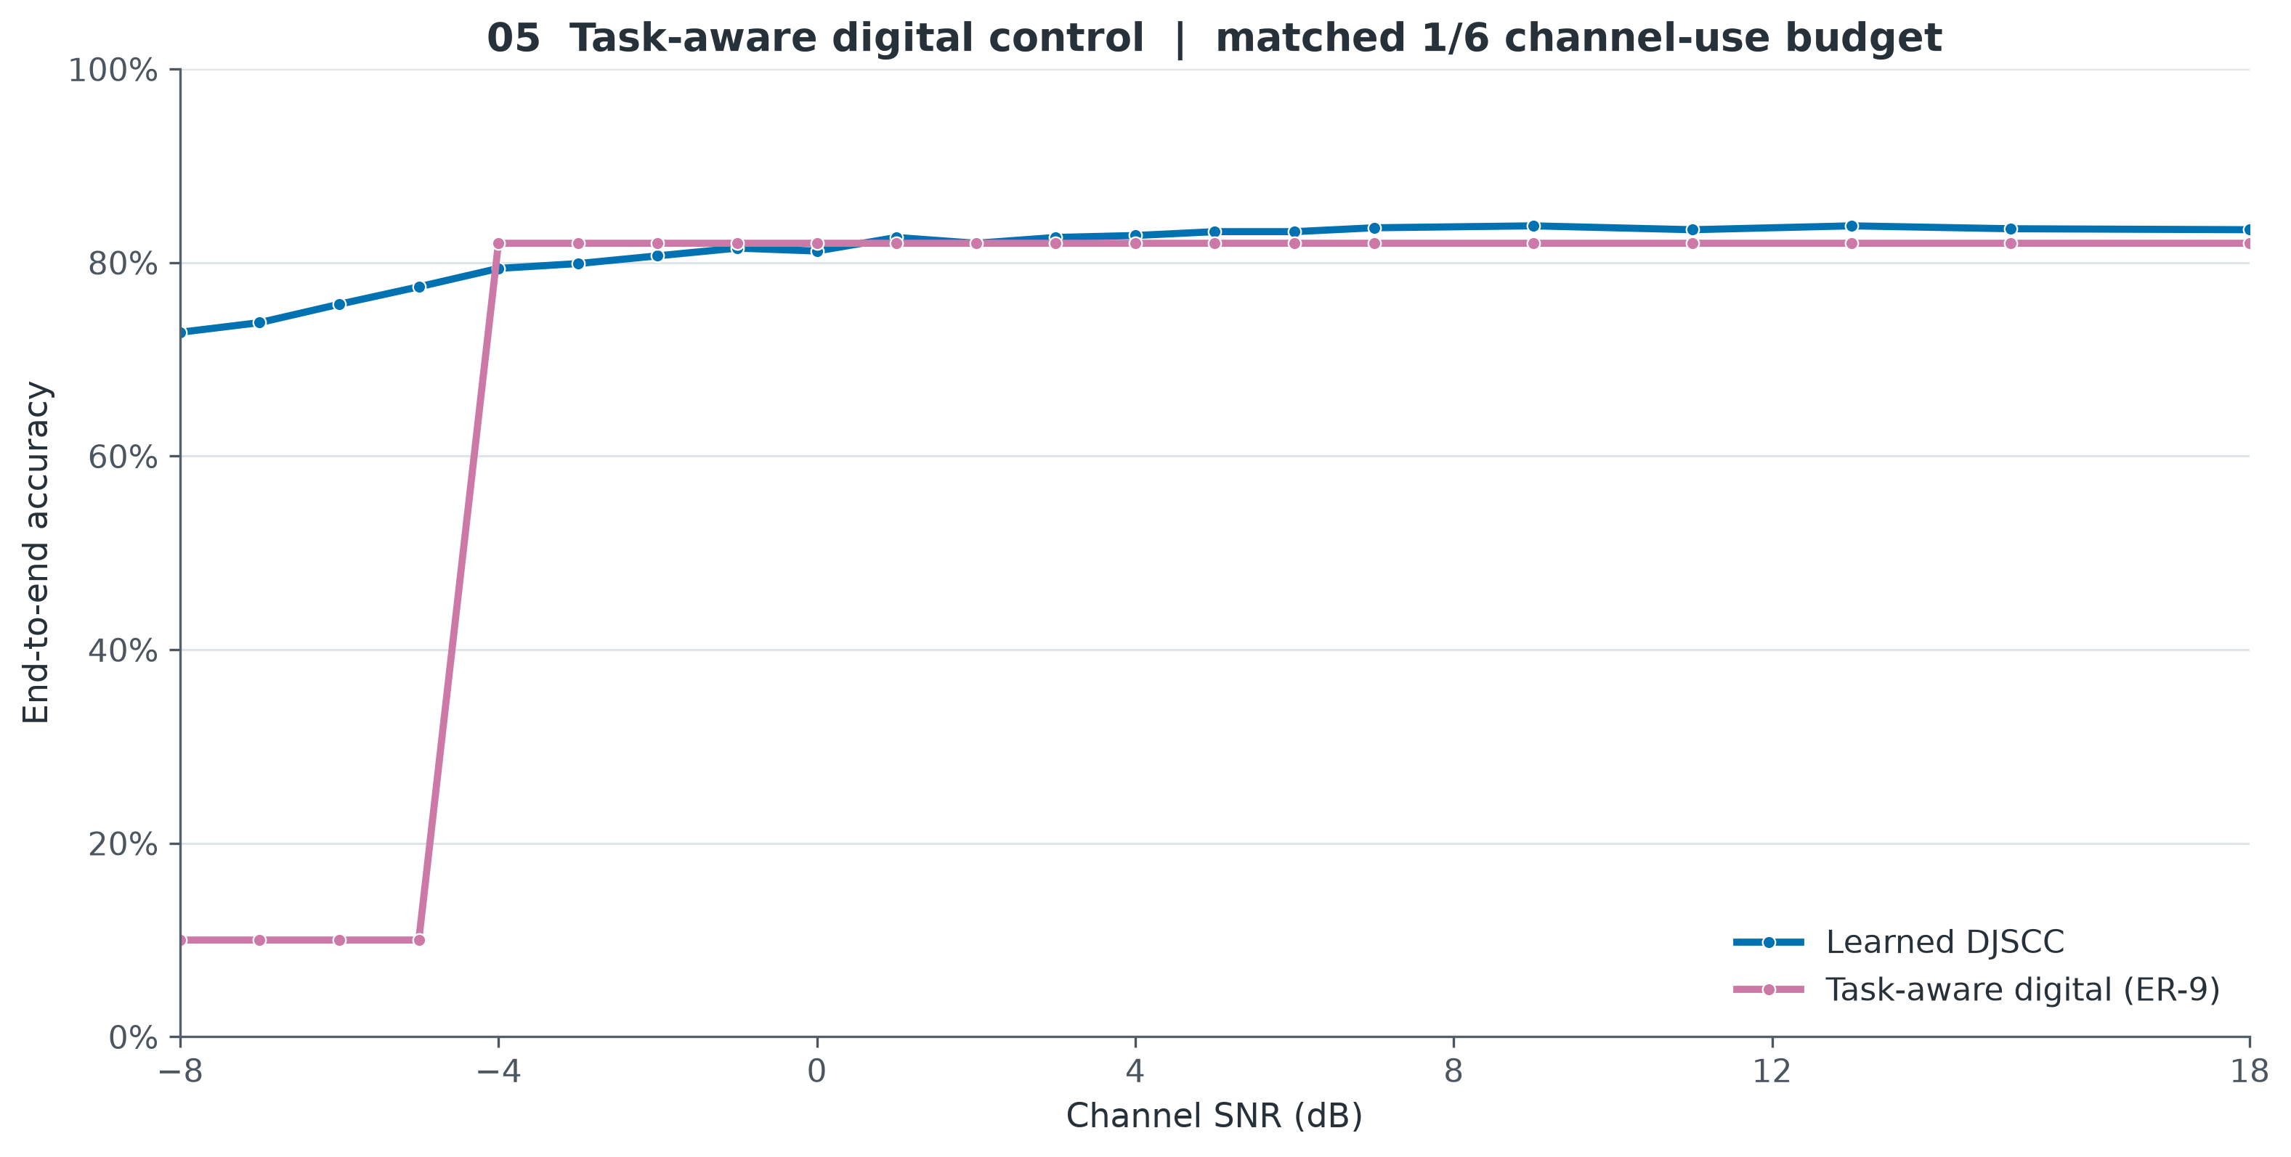
The control that keeps the comparison honest
A compressed image is one kind of digital system. This one sends what the task needs, so it is the harder test.
What this system does
Instead of a JPEG image it sends the learned features themselves, through the same error-correction code and radio settings, using the same 12,800 uses of the radio. It separates “knows the task” from “codes both at once”.
What it settles
It holds 82.0% at every strength from −4 dB up. Sending learned features digitally is strong once pictures get through, so the weak-signal gap is about failed deliveries as much as representation.
Rubric: Results, Analytical Skills
Same radio time, same error-correction code, same modulation
12 / 20

Slide 13
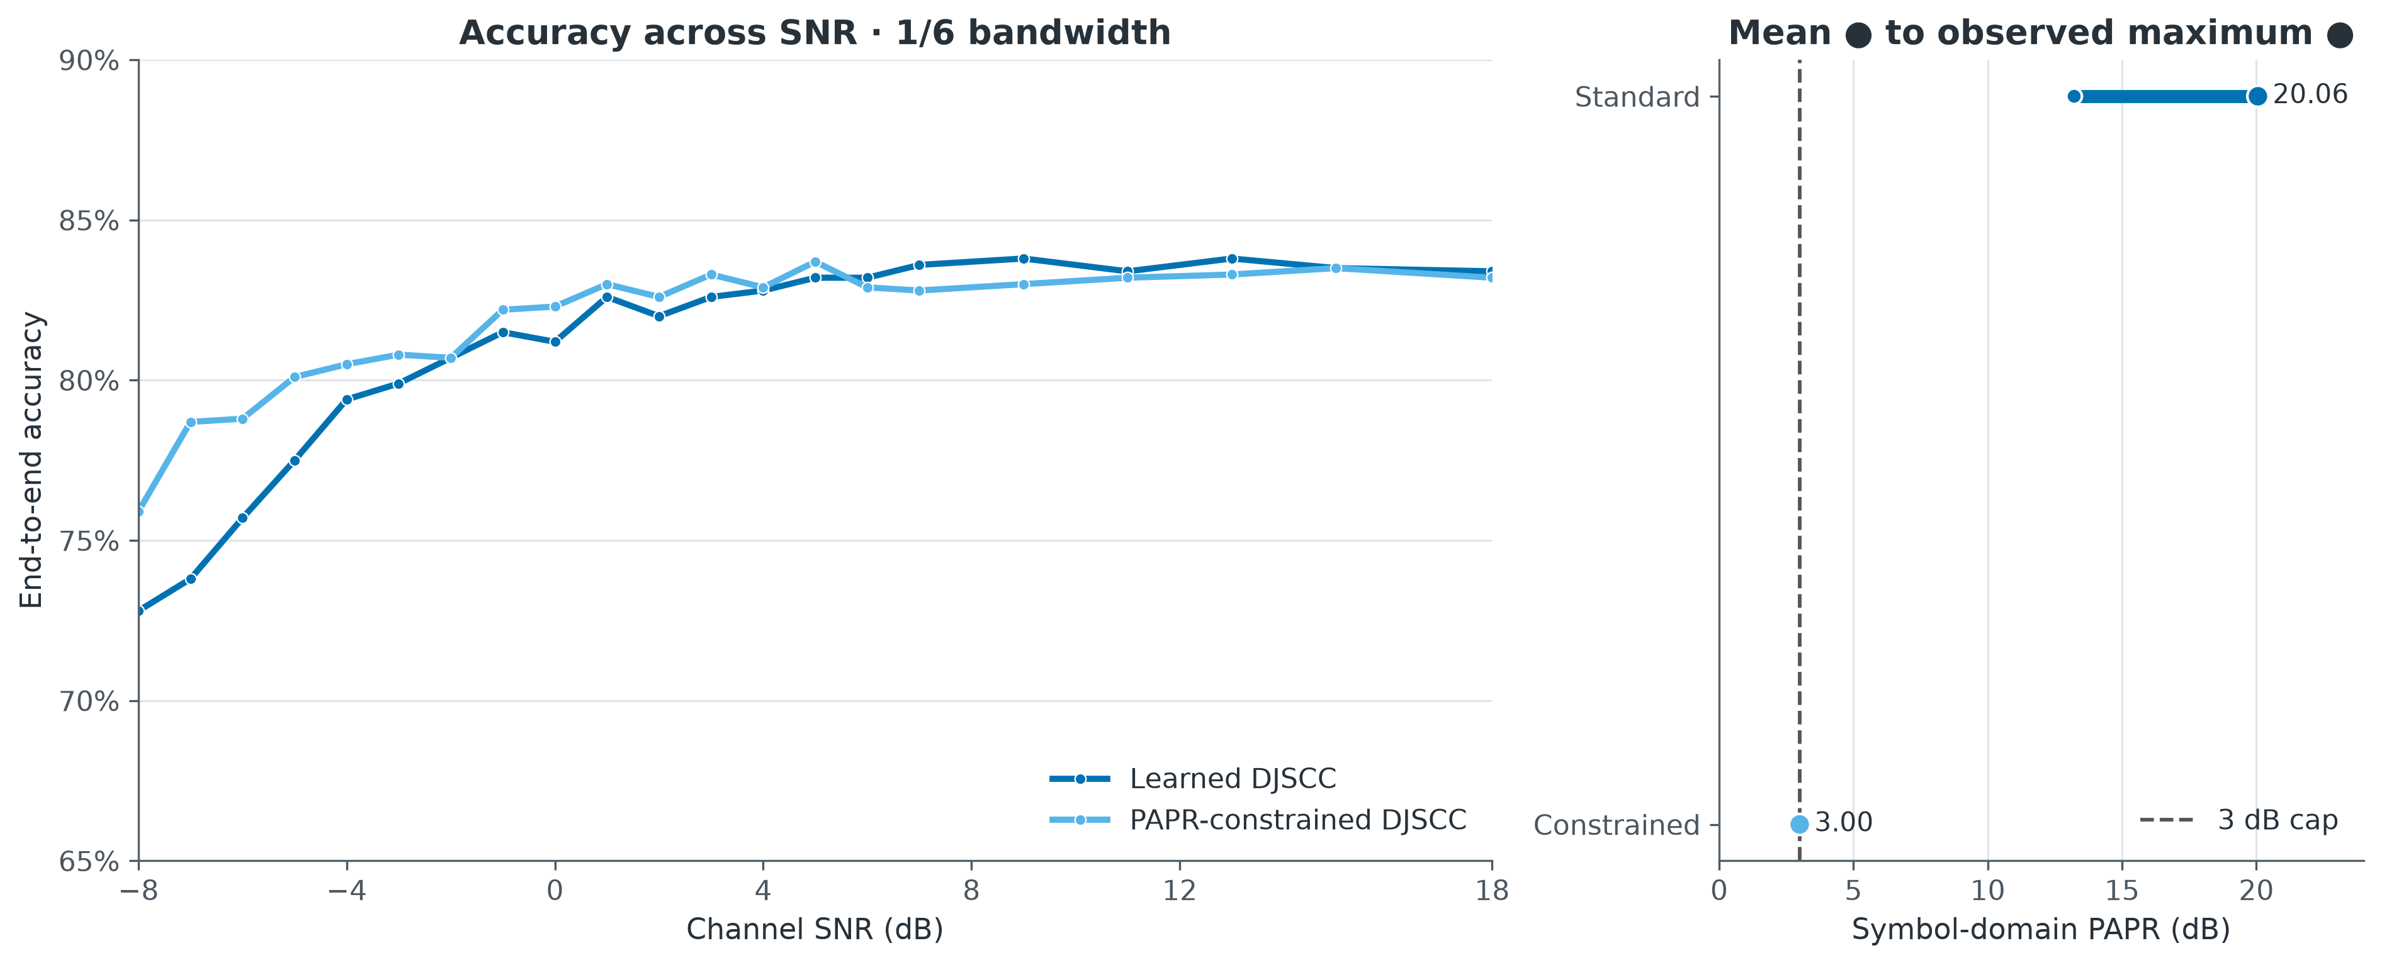
Keeping the signal peaks from getting too tall
A real transmitter needs a limit on signal peaks, so we trained a second model under one.
“Peak-to-average power ratio” = how much taller the tallest spike is than the average.
Model
Tallest spike
At −8 dB
At +18 dB
Power-limited
3.0 dB
75.9%
83.2%
Ordinary learned
20.1 dB
72.8%
83.4%
Rubric: Results, Analytical Skills
Peak-to-average power ratio, measured on the numbers we send
13 / 20

Slide 14
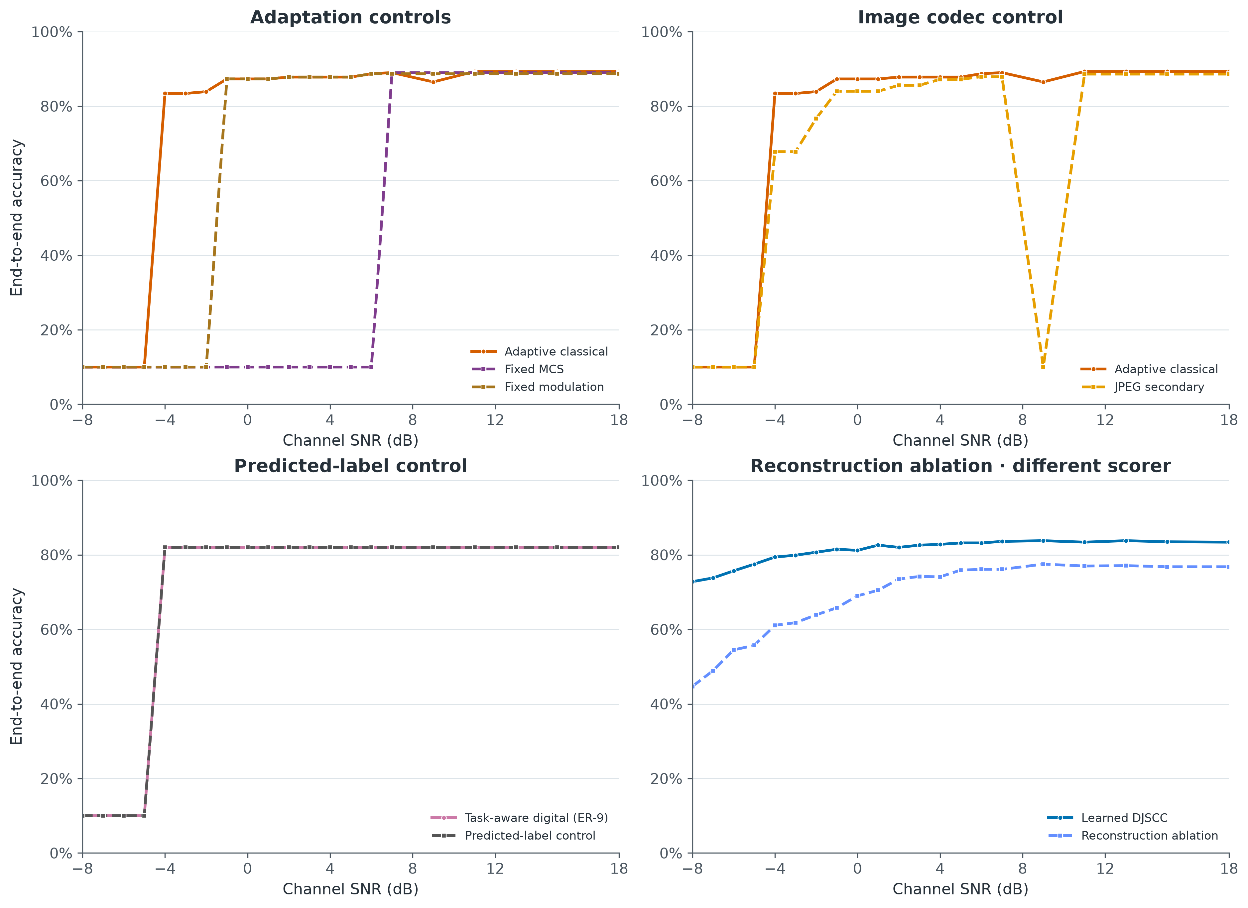
Four controls on the digital system
Each panel takes one design choice away and shows what it was worth.
Fixed settings
Sits at the fallback floor until +6 dB, then reaches 89.0%. Choosing settings per strength buys real reach.
Fixed modulation
Starts working later than adaptive selection, and settles near 88.7%.
JPEG secondary curve
88.6% at +18 dB, with a full outage at +9 dB.
Sending the answer
82.0% once it arrives, using the sender’s own predicted label.
Rubric: Results, Analytical Skills
Settings, image format, sending the answer, rebuilding the picture
14 / 20

Slide 15
The numbers behind the curves
How many of the 1,000 held-back pictures we labelled correctly, one picture at a time.
1/6 rate — 12,800 uses of the radio
1/24 rate — 3,200 uses of the radio
System
−8
−5
−4
0
+9
+18
System
−8
−4
−2
0
+4
+18
Learned, one strength
72.8
77.5
79.4
81.2
83.8
83.4
Learned, one strength
49.4
69.3
76.2
78.7
82.0
82.8
Digital, picks settings
10.0
10.0
83.4
87.3
86.5
89.3
Digital, picks settings
10.0
10.0
31.0
69.4
83.4
87.7
Learned, random
77.0
82.4
82.4
83.0
84.1
83.9
Where the two lines cross
At 1/6 rate, which system is ahead flips between −5 dB and −4 dB. We decided the crossing question on exactly that, before seeing the answer.
Digital, learned feats
10.0
10.0
82.0
82.0
82.0
82.0
Learned, power-limited
75.9
80.1
80.5
82.3
83.0
83.2
Reading the two tables
Each column is one signal strength; each cell is the number of correct labels out of the same 1,000 held-back pictures. At 1/6 rate the learned row leads up to −5 dB and the digital row leads from −4 dB. At 1/24 rate the digital row stays on the fallback floor two dB longer, then climbs past the learned row from +4 dB. The difference between the two tables is the effect of cutting radio time fourfold.
Rubric: Results, Analytical Skills
Pictures labelled correctly out of 1,000 · held-back set
15 / 20

Slide 16
How to read these results
One training run
A single observed measurement per figure, from one run over 1,000 held-back pictures.
Whole systems
Marked by their own classifier on one side, by one trained on compressed images on the other. These numbers describe whole systems.
Different amounts of work
Digital settings and grader were frozen from earlier validation work; the learned versions are separate training runs.
Simulated channel
Spike heights are measured on the numbers we send. Real-radio replay is a stretch goal for late October.
Frozen operating points
The fallback rule and fixed settings produce visible jumps. Every curve passes through measured points.
Both outcomes count as a successful project: a crossing, and the learned system winning everywhere.
Rubric: Analytical Skills, Methodology
The qualifications behind every number in this deck
16 / 20

Slide 17
Four times we changed the approach because of what we found
Each one was a decision we would have got wrong on paper.
Baseline too weak
Signal grid too coarse
We had pinned the digital system to the weakest radio setting, which made the lines crossing impossible by arithmetic. We let it pick a stronger setting as the signal improves.
Our signal strengths were spaced 2 dB apart exactly where the sharpest drop happens, so we could have missed it entirely. We added three more strengths before it mattered.
The rule we adopted: every change strengthens the digital system or is decided in advance.
Put the detail where the effect is.
A faulty check
Exam set unlocked too early
The script that checks our packet sizes reported no problems while breaking four of its own rules. We fixed the script, and every result came out the same.
The exam set was set to unlock in week 9, about three weeks before the document that locks it existed. We moved that to week 11.
All 215 configurations stayed feasible, and every scientific outcome was unchanged.
They have stayed locked ever since.
Every other change made during the project is recorded, with its reason, in the specification's amendment log.
Rubric: Methodology
What we changed once we could see the measurements
17 / 20

Slide 18
What we claim as new
The task-aware digital control
What this builds on
A second system sends learned features through the same error-correction code and radio settings, using the same amount of radio time. It tells “knows the task” apart from “codes both at once” inside one experiment.
—
Getting steadily worse as the link worsens
—
Avoiding the sudden drop-off
To our knowledge, classification studies report this gap without a matched control.
—
Sending task-aware features digitally
Charging the overhead to the digital system
—
Training a neural encoder and decoder
The picture file, framing, checksums and rate-matching bytes are all measured and counted, so the digital system is tuned on the payload it can genuinely use.
All four are established in the prior literature. This project builds on them.
Many comparisons quote a nominal rate; here every framing and checksum byte is counted.
Negative check
Each claim resolves to a specific entry in the 30-source literature review. The full written novelty statement ships with the final review package.
Rubric: Originality, Novelty
Two claims · both about experimental design
18 / 20

Slide 19
Where the remaining weeks go
29 Sep – 3 Oct
Second Review
Held-back measurements complete; package and figures frozen
done
5 – 11 Oct
Open the exam set
One guarded opening once the freeze is signed
planned
12 – 18 Oct
Decide everything
Every hypothesis settled on the exam set; first tier frozen
planned
19 – 25 Oct
Demo
Already built; rehearse it with the frozen results
planned
26 Oct – 1 Nov
Poster and hardware
Poster draft; real radio only if the first tier leaves room
planned
2 – 8 Nov
Report freeze
Report finished in the required format
planned
9 – 15 Nov
Spare week
Report completion and checking
planned
16 – 22 Nov
Final Review
Final review 17–21 Nov; report and material due 20 Nov
planned
The report is due on 20 November, inside Final Review week, so the week before it is a freeze.
Rubric: Timeline
Second Review 29 Sep–3 Oct · Final Review 17–21 Nov · report due 20 Nov
19 / 20

Slide 20
Where this leaves the project
The learned system keeps answering when the link is too weak for the digital one to get a single picture through. Once the digital system starts delivering, it is the more accurate of the two. They cross between −5 and −4 dB.
Next
One guarded run on the exam set once the locking manifest is signed.
Then
Every hypothesis settled on the exam set, and the first tier frozen.
Later
Real-radio replay and the live demo run once the first tier is frozen.
What we are asking for
Questions on the method or the numbers. The per-picture records behind any point here are available on request. The exam set stays sealed until week 11.
Rubric: Results, Methodology
Questions welcome
20 / 20

