Slide 1


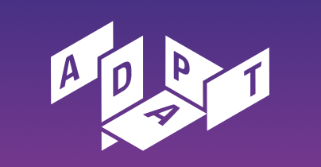

Governing Multimodal Knowledge Graphs (MMKGs)
Current Challenges and Possible Solutions
Assit. Prof. Dr. Anelia Kurteva and Gabriela Kurteva
NeXt-generation Data Governance workshop
(15th September 2026)
Co-located with 22nd SEMANTiCS, 15-17 September 2026
Ghent, Belgium

Slide 2
Why does Knowledge Graph (KG) governance matter now more than ever?
As generative AI relies heavily on KGs for factual grounding, unmonitored KG lifecycles introduce critical compliance and reliability risks.

Slide 3


Benefits and risks to MMKG/KG development and use
Grounding Truth Infrastructure
The Emerging "Black Box Development" Risk
Knowledge Graphs (KGs) improve the reliability and factual accuracy of Generative AI decisions by serving as structured domain truth.
AI increasingly automates data extraction, ontology engineering, and KG maintenance without standard governance mechanisms.
In Graph RAG (Retrieval Augmented Generation), KGs can integrate private, public, and personal domain data to help mitigate LLM hallucinations.
Without FAIR documentation of lifecycle events, automated KGs risk becoming compliance liabilities rather than reliable assets.

Slide 4
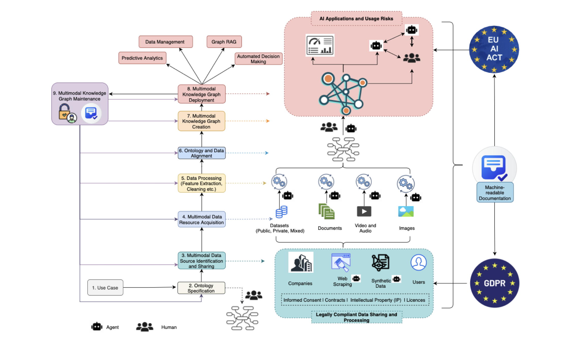
Fig 1. MMKG development from [1]

Slide 5



Motivating use cases
1. Financial Digital Twins
2. Digital Product Passports
AI-driven digital twins for financial operational risk management combining transaction logs, PDF contracts, biometrics, and identity documents.
Supply chain traceability and customs inspection under ESPR regulations, linking text reports, structured metadata, and product images.

Slide 6
Existing challenges to KG governance

Slide 7






Data & Knowledge Challenges
1. Data Protection, IP & Licensing
2. Semantic Drift
3. Modality Provenance
Handling conflicting multimodal licenses, personal data tracking, and dynamic GDPR consent withdrawal across text, image, and tabular sources.
Managing schema evolution, dynamic entity linking, and knowledge representation updates without breaking upstream RAG pipelines.
Ensuring cross-modal alignment and lineage verification when automated agents convert raw visual or textual inputs into RDF triples.

Slide 8
Human-AI & Compliance Gaps
4. Black-Box Automation
5. Missing (FAIR) Audit Trails
6. Regulatory Alignment
Over-reliance on automated LLM agents for KG construction reduces human expert oversight and validation, masking hallucinated triples.
Absence of standardized FAIR metadata documenting lifecycle events and clear maintenance actions.
Aligning fast-changing graph infrastructures with regulatory frameworks including the EU AI Act, GDPR, and data space policies.

Slide 9
Proposed Governance Framework for MMKGs/KGs
Focus areas/tasks
•
FAIR Event Documentation: Standardize semantic logging for all creation, modification, and access events.
•
Continuous Lineage Tracking: Monitor real-time metadata across automated data pipelines and human edits.
•
Automated Policy Reasoning: Execute rule-based compliance checks against legal requirements (GDPR, AI Act).
•
Proactive Transparency: Deliver actionable provenance views to end-users and downstream AI systems.

Slide 10
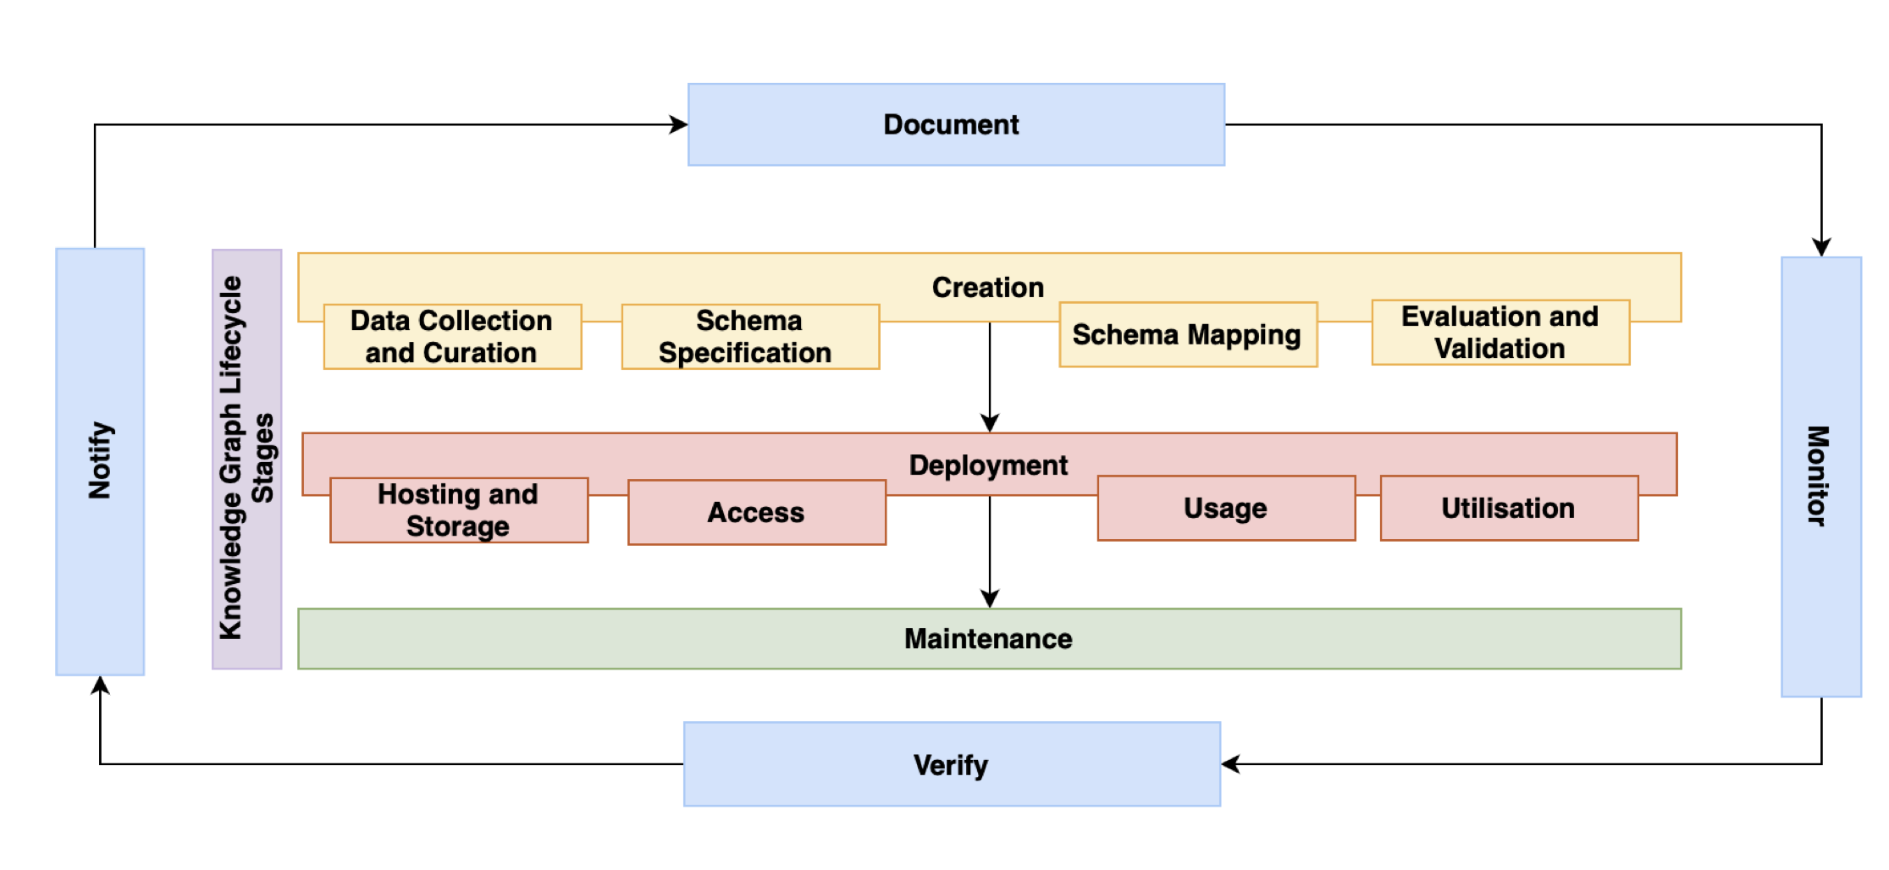
Fig. 2: Knowledge Graph Lifecycle based on Fensel et al. (2020) and proposed Governance Mechanisms (in Blue) from [1]

Slide 11


Documenting KG Lifecycle Events
Proposal: Dynamic Machine-Readable Documentation
Leverages Data & AI Cards with standard vocabularies (DCAT, PROV-O, DPV, Croissant ML) to automatically generate dynamic FAIR templates capturing metadata, rationales, timestamps, and full agent provenance.
Expected Result: Interoperable Transparency & ODRL Policies
Delivers granular insight into access, updates, and modality processing. Integrates with ODRL to enforce automated usage policies aligned with EU AI Act mandates.

Slide 12

Monitoring KG Lifecycle Events
Proposal: SPARQL Baselines & SHACL Validation
Captures authoritative KG snapshots via SPARQL queries. Applies SHACL constraint rules to compare historical documentation against active KG states, detecting structural shifts pre- and post-events.
Expected Result: Regression Detection & Data Integrity
Automatically flags unreported semantic or syntactic discrepancies, validating multimodal consistency and maintaining continuous physical-to-documentation alignment.

Slide 13

Compliance Verification
Systematically audits KG lifecycle events against regulatory frameworks including the EU AI Act and GDPR by integrating metadata documentation with active monitoring.
Reconciles multi-source data modalities with conflicting licenses and validates distinct legal processing bases.
Expected Outcome
Delivers an automated, legally auditable trail that resolves ethical and legal conflicts before compliance failures occur.

Slide 14

Proactive Communication/Notification
Establishes an automated notification layer bridging back-end monitoring and human-in-the-loop governance.
Transforms raw logs, validation states, and compliance checks into user-centric alerts displayed on a dedicated UI dashboard.
Expected Outcome
Provides a clear view of KG technical and legal health, enabling human admins and AI agents to respond instantly to anomalies or regulatory risks.

Slide 15
Conclusions and Next Steps
Governance Blind Spot: As processes shift toward automated AI (and KG) development, the lack of FAIR lifecycle documentation threatens AI safety and erodes public trust.
Hybrid Domain: MMKGs fit neither solely under data governance nor strictly under AI governance; they require an integrated framework capable of managing complex, cross-modal dependencies and applicable laws.
Regulatory Urgency: Automated data collection and cross-modal integration introduce severe compliance risks regarding legal bases under the GDPR (e.g., dynamic consent, contracts) and safety requirements under the EU AI Act.
Implement
Validate with use cases
Re-evaluate framework design

Slide 16
Thank you!

Slide 17
References
[1] Kurteva, A. and Kurteva, G., 2022. Governing Multimodal Knowledge Graphs: Current Challenges and Possible Solutions. In NeXt-generation Data Governance workshop 2026.
[2] Fensel, D., Şimşek, U., Angele, K., Huaman, E., Kärle, E., Panasiuk, O., Toma, I., Umbrich, J. and Wahler, A., 2020. How to build a knowledge graph. In Knowledge Graphs: Methodology, Tools and Selected Use Cases (pp. 11-68). Cham: Springer International Publishing.

