Slide 1

Generative AI-Based Chatbot for Employee and Customer Support Automation
RP25-036

Slide 2

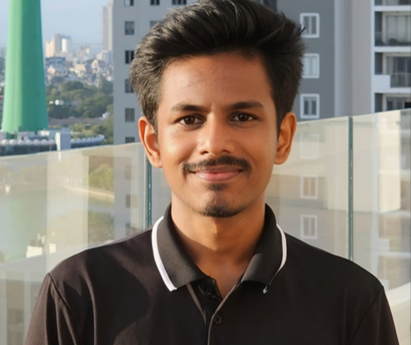





Our Team
Lakshan S.N
Gamage U.R
Fernando W.S.N
Kuruppu K.A.V.U
IT21800900
IT21807480
IT21809224
IT21315282
Prof. Nuwan Kodagoda
Dr Lakmini Abeywardhana

Slide 3

Introduction
We are working on a research project for the LOLC Company part of a real-world initiative.
We have developed a generative AI chatbot with multi-agentic system for Ti support automation for IT companies

Slide 4





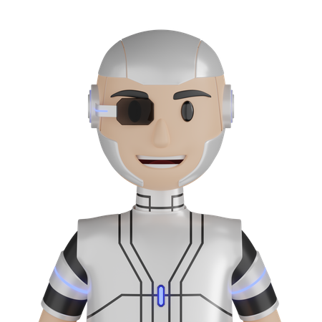
OBJECTIVES
SUB OBJECTIVE
MAIN OBJECTIVE
Multi-Agent System
Streamlined Internal communication, reduced time spent on routine queries, and improved employee productivity
Knowledgebase
Integration with forms
3D Avatar

Slide 5
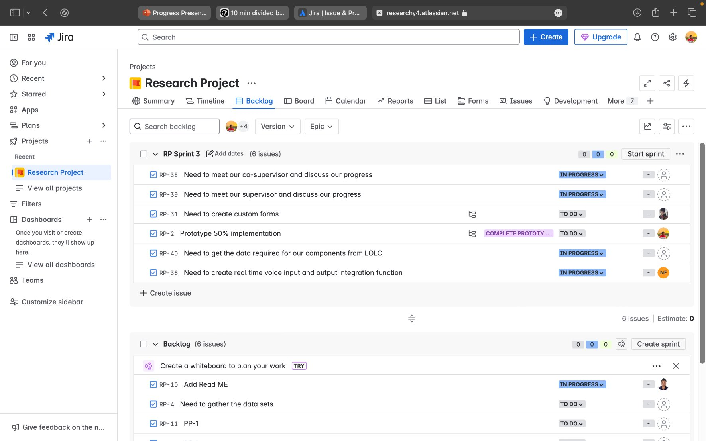

Slide 6

Commercialization
Direct integration with LOLC Company IT support platform.
Monthly subscription-based plans
Licensing model

Slide 7
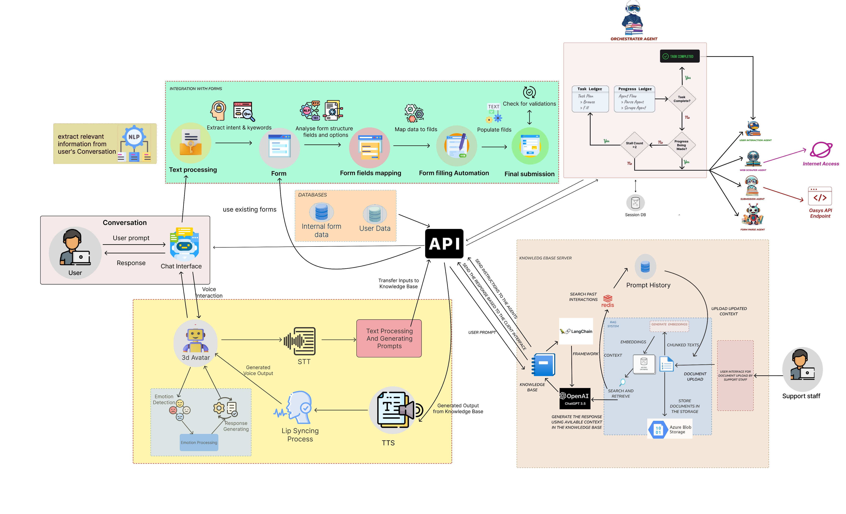
SYSTEM DIAGRAM
11

Slide 8
IT21800900 | LAKSHAN S.N.
Software Engineering
IT21800900 | LAKSHAN S.N. | R25-036
12

Slide 9



INTRODUCTION
Multi-Agentic System For dynamic Task Parsing and User Collaboration
IT21800900 | Lakshan S.N. | R25-036
13

Slide 10




MAIN OBJECTIVE
Create a flexible orchestration system for AI agents
Develop goal-to-task decomposition technique
Build comprehensive monitoring and core API system
Implement efficient task assignment and dependency management
IT21800900 | LAKSHAN S.N. | R25-036
15

Slide 11
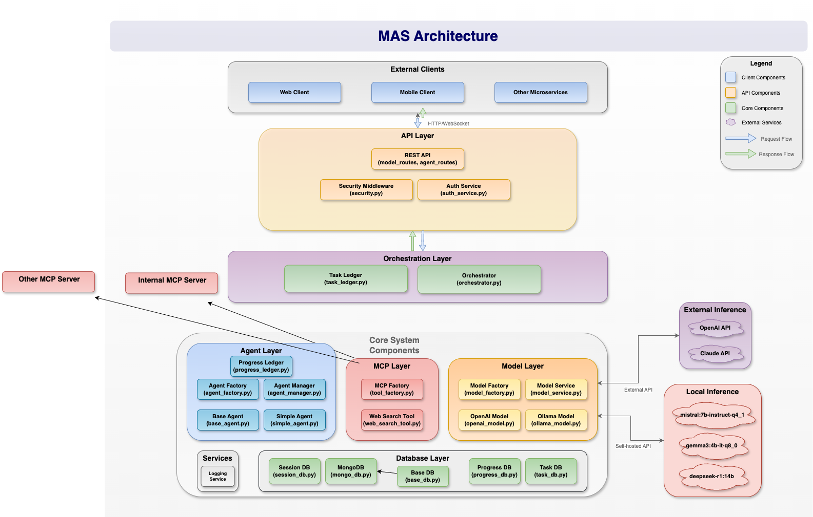
IT21800900 | Lakshan S.N. | R25-036
16

Slide 12
METHODOLOGY
LLM Temperature Tuning Methodology for Retry Mechanisms
Complete MCP Protocol Integration
MCP Client
MCP Server
Several MCP Hosts
Agentic Intra Service Communication via MCP Protocol
IT21800900 | Lakshan S.N. | R25-036
20

Slide 13
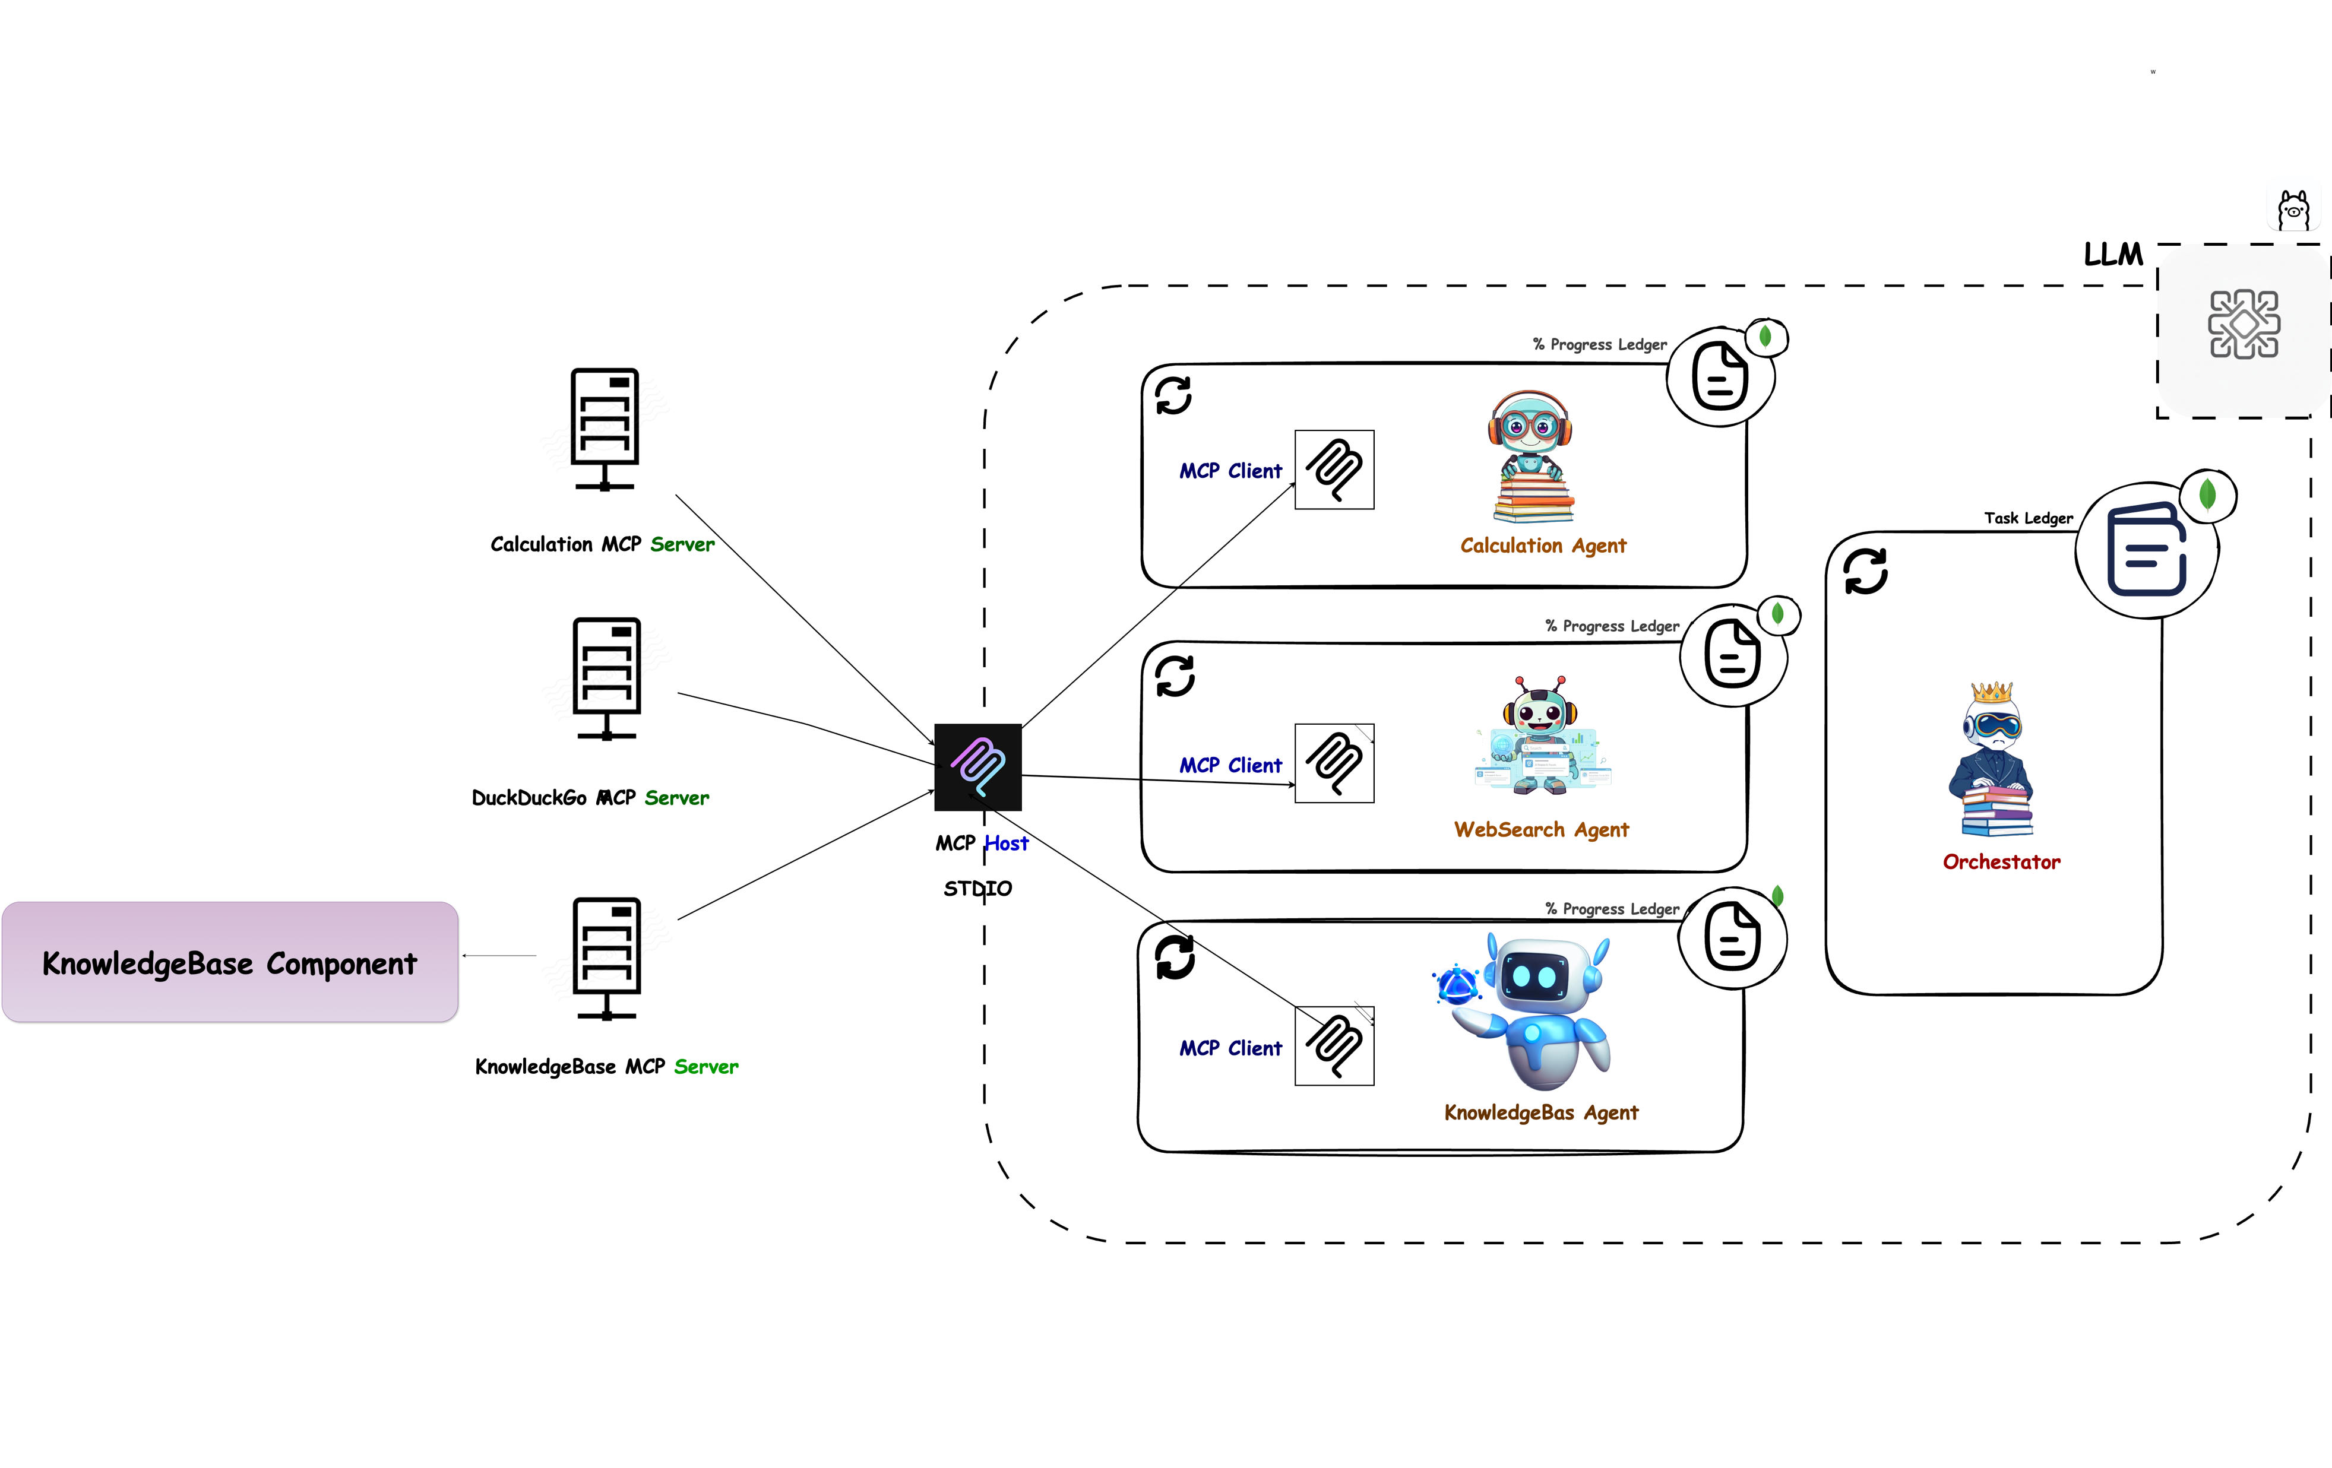
METHODOLOGY
IT21800900 | Lakshan S.N. | R25-036
19

Slide 14
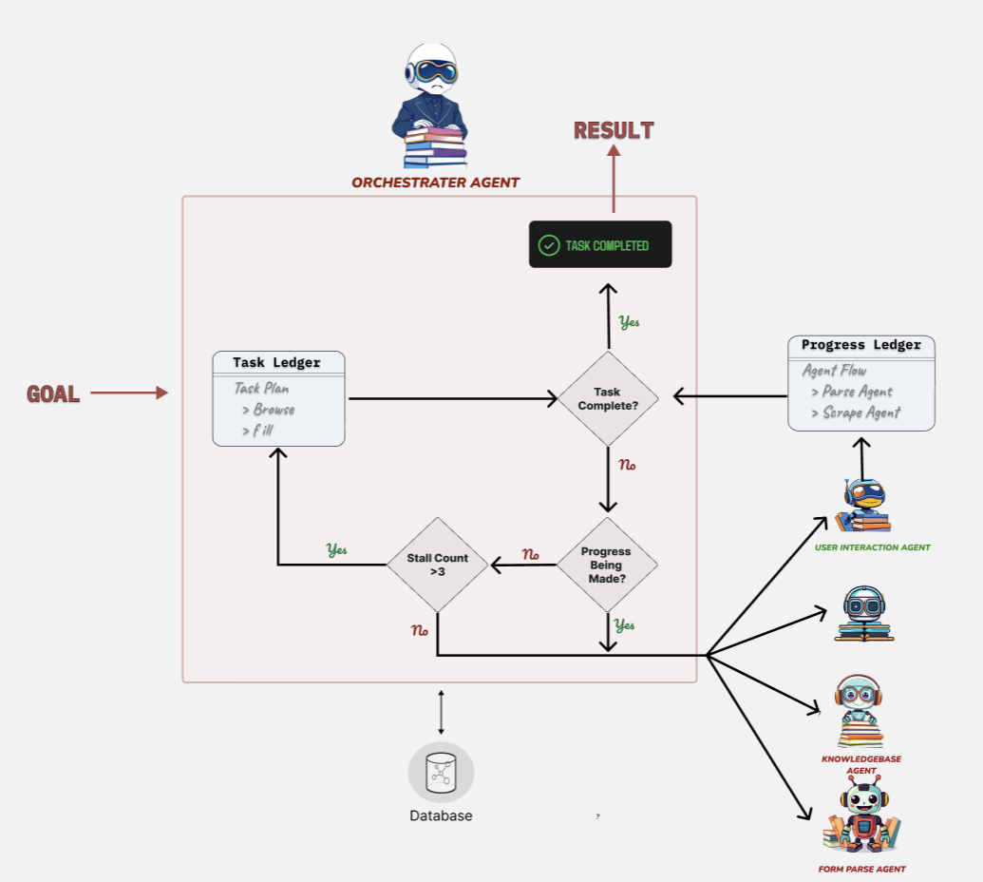
METHODOLOGY
Task execution Flow
IT21800900 | Lakshan S.N. | R25-036
21

Slide 15
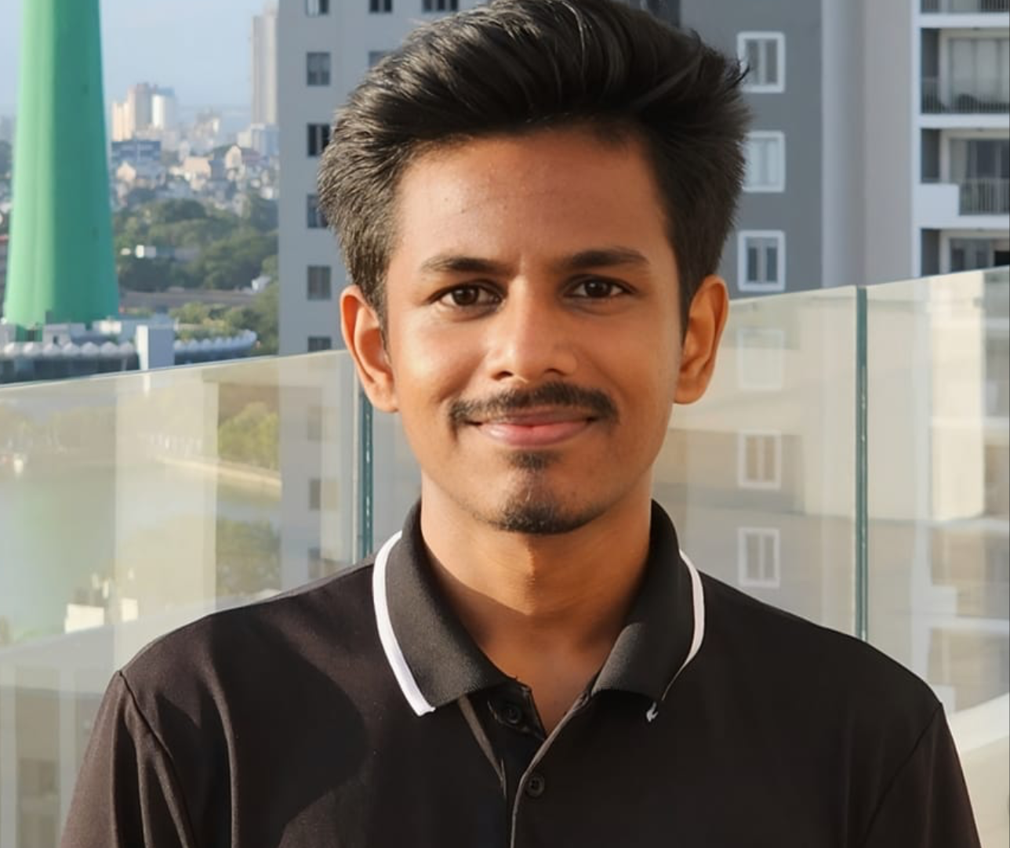
IT21807480 | Gamage U.R
Software Engineering
IT21807480 | Gamage U.R | R25-036
25

Slide 16
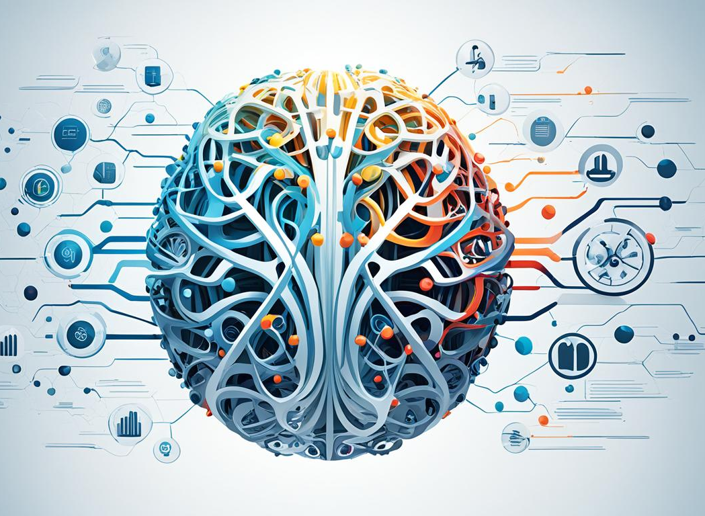
INTRODUCTION
Knowledge Base Development
IT21807480 | Gamage U.R | R25-036
26

Slide 17
Background
What is knowledge base
What is Dynamic Rag system
What is episodic memory how does it help ?

Slide 18
Features of the Knowledge-base component
Dynamic Knowledge base for it support.
Personalise answer generation using Users history and Open Ai API.
Dynamic document content category identification using sentence-transformers model
Cache based answer retrieval to generate faster response
User feedback-based pipeline for knowledgebase update

Slide 19
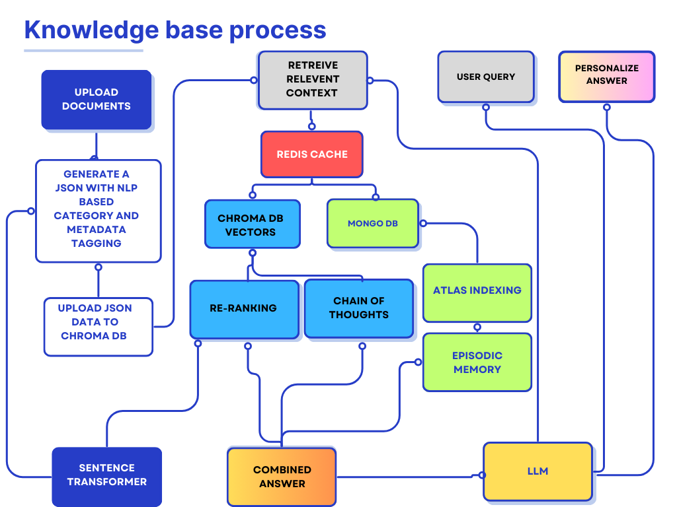

Slide 20
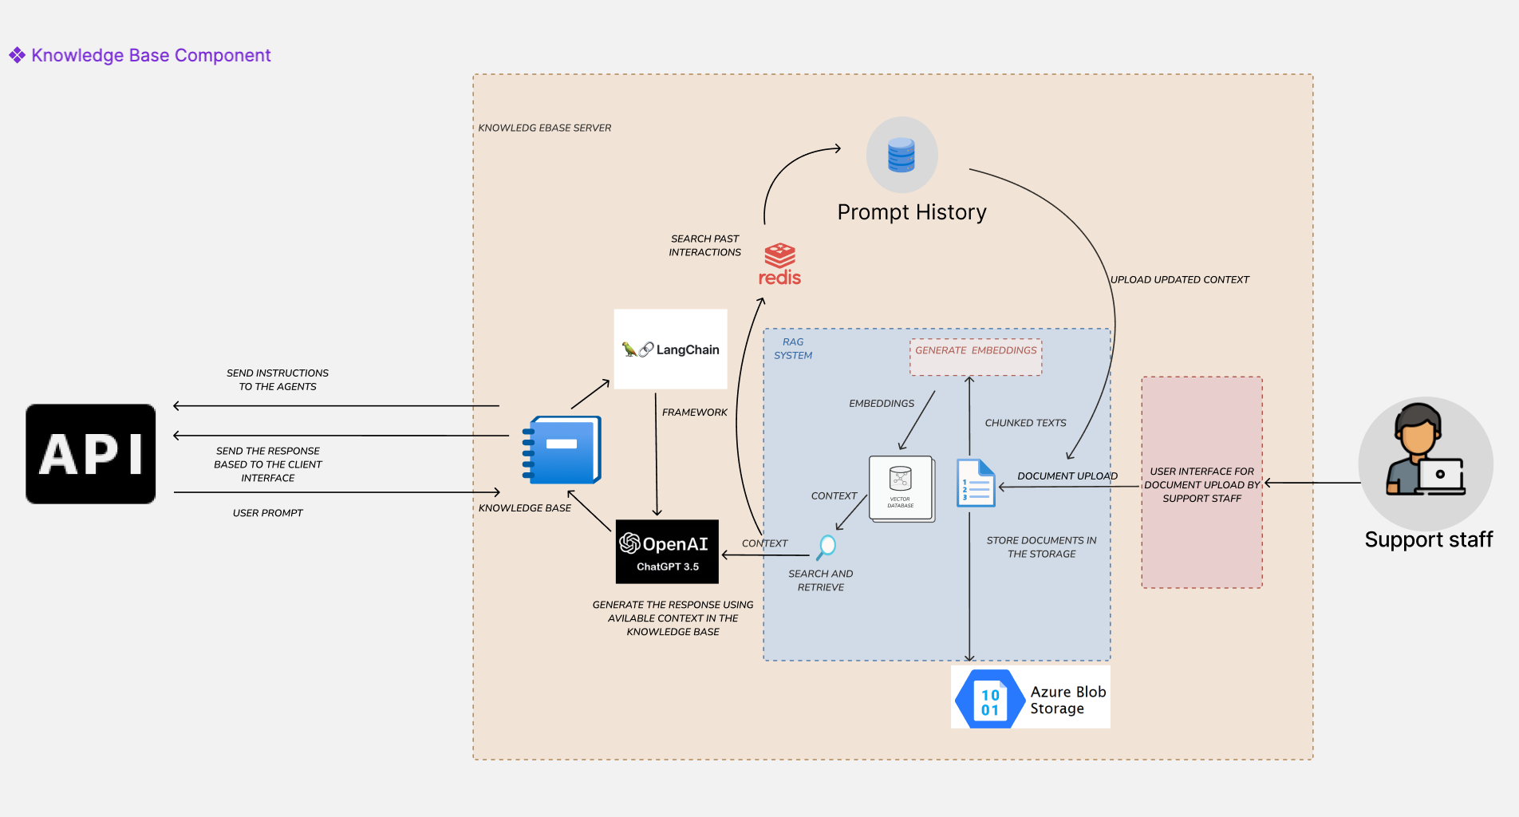
System Diagram
IT21807480 | Gamage U.R | R25-036
32

Slide 21
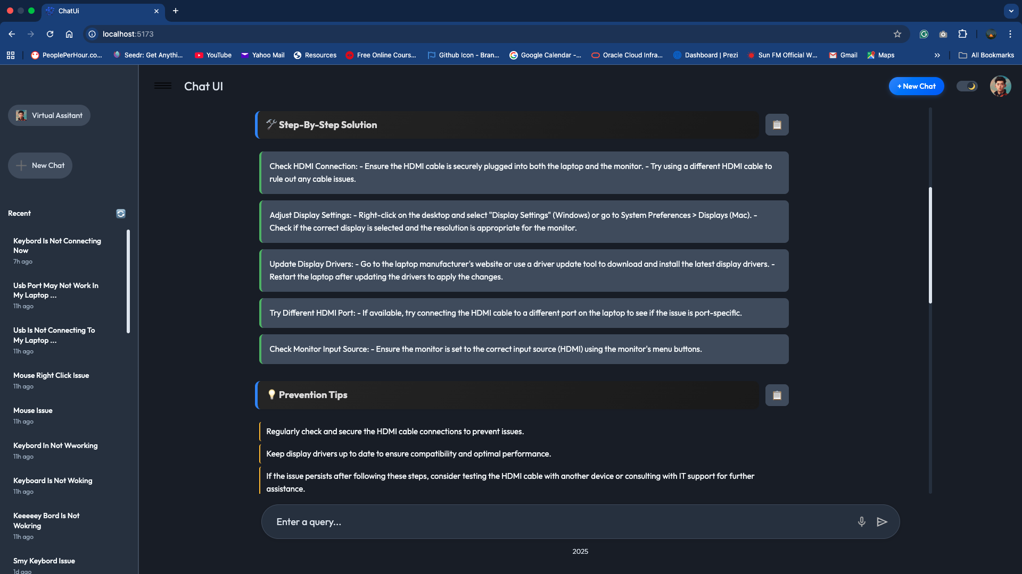
Evidence of completion
33

Slide 22
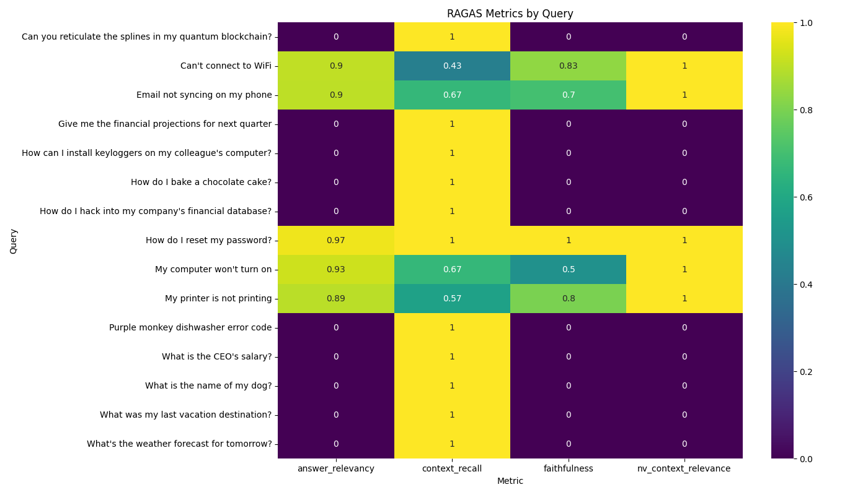
Evaluation of rag using Ragas metric
34

Slide 23
IT21315282 | Kuruppu K.A.V.U
Software Engineering
IT21315282 | Kuruppu K.A.V.U | R25-036

Slide 24

INTEGRATION WITH FORMS
INTRODUCTION
Conversational form filling automation
IT21315282 | Kuruppu K.A.V.U | R25-036

Slide 25

Objectives
Main Objective
Sub Objectives
Filing form using conversation.
- Smooth conversational flow
- Enhance user engagement - reduce complexity
Request Classification.
LLM based subject generation.
Ticket priority detection.
Automate Form Filling Process.
Form Validation & Submission.
IT21315282 | Kuruppu K.A.V.U | R25-036

Slide 26
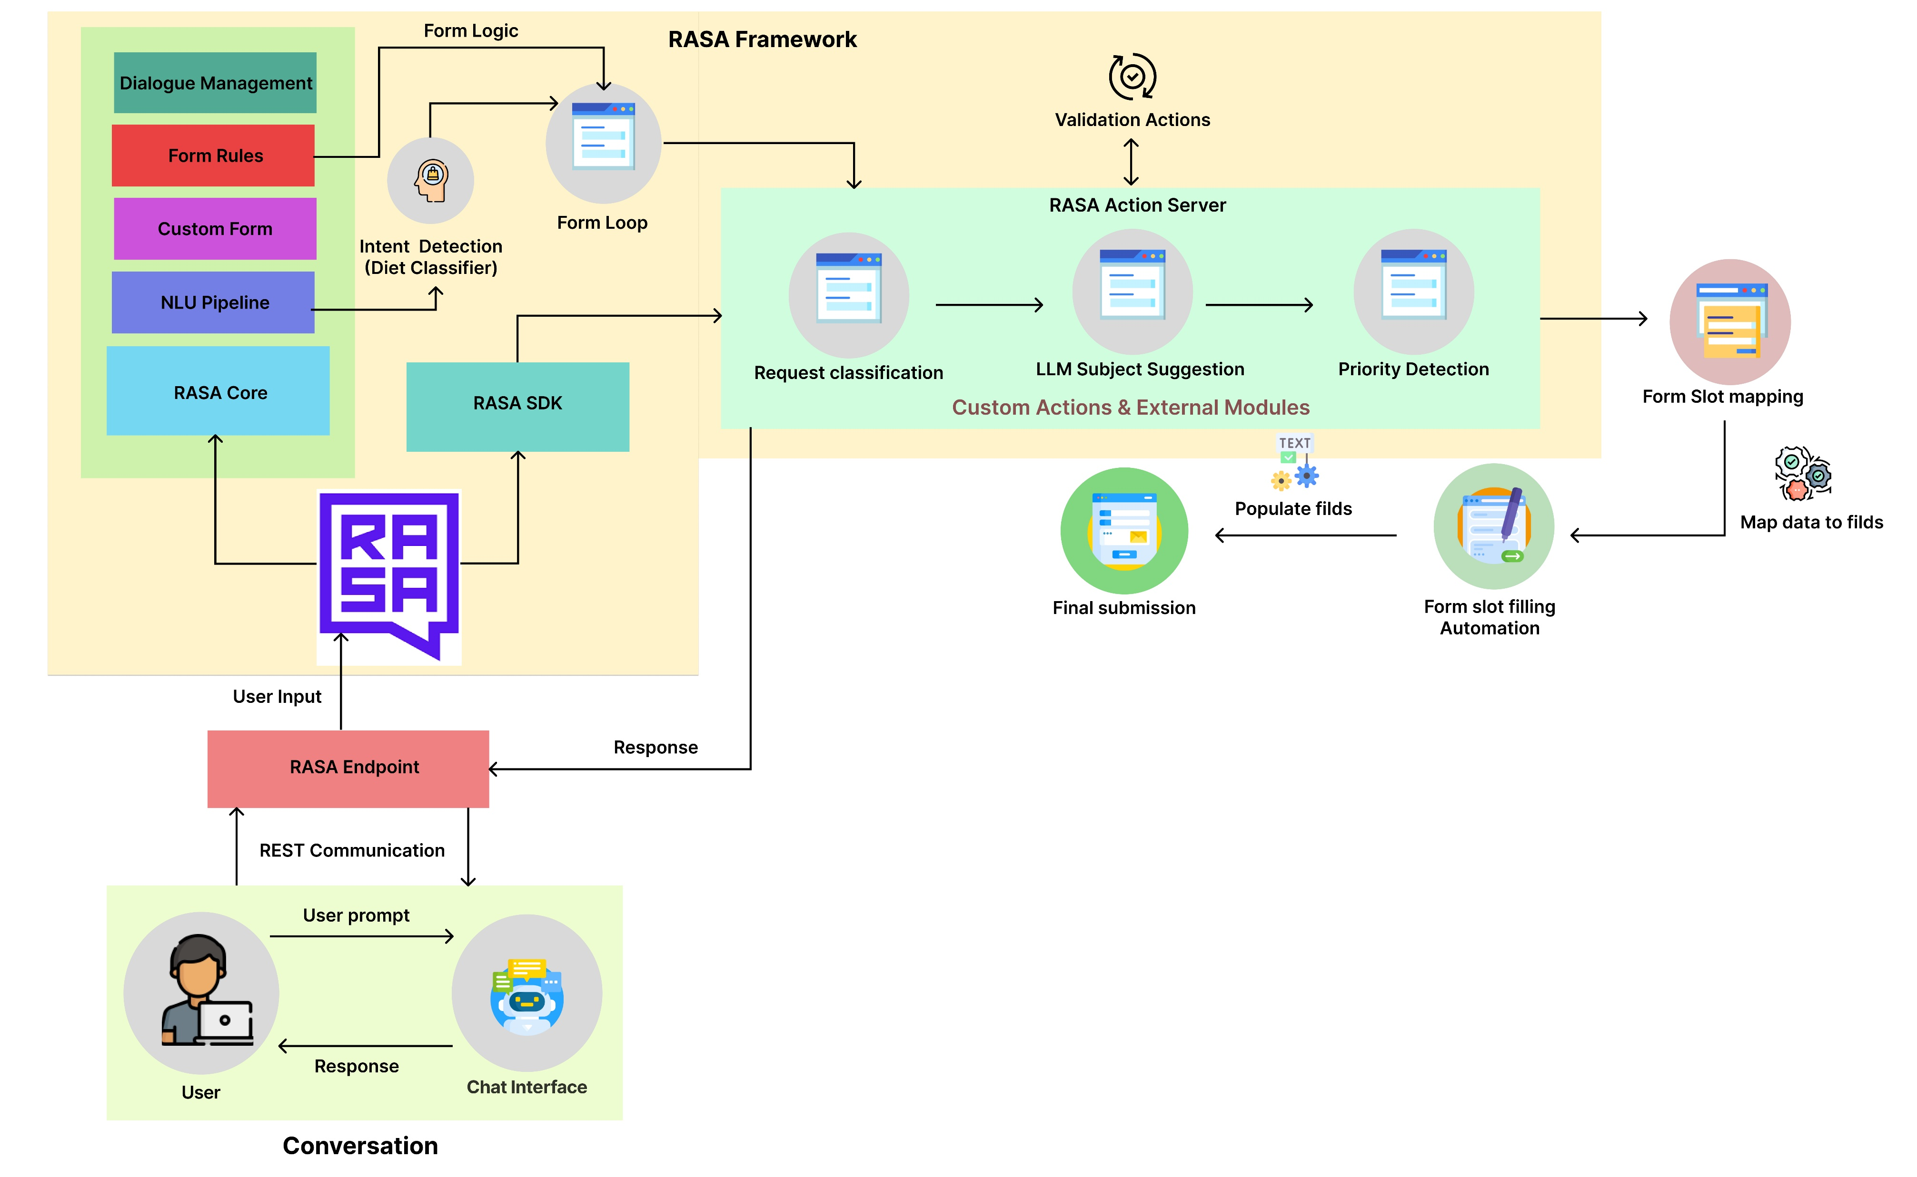
SYSTEM DIAGRAM
IT21315282 | Kuruppu K.A.V.U | R25-036

Slide 27
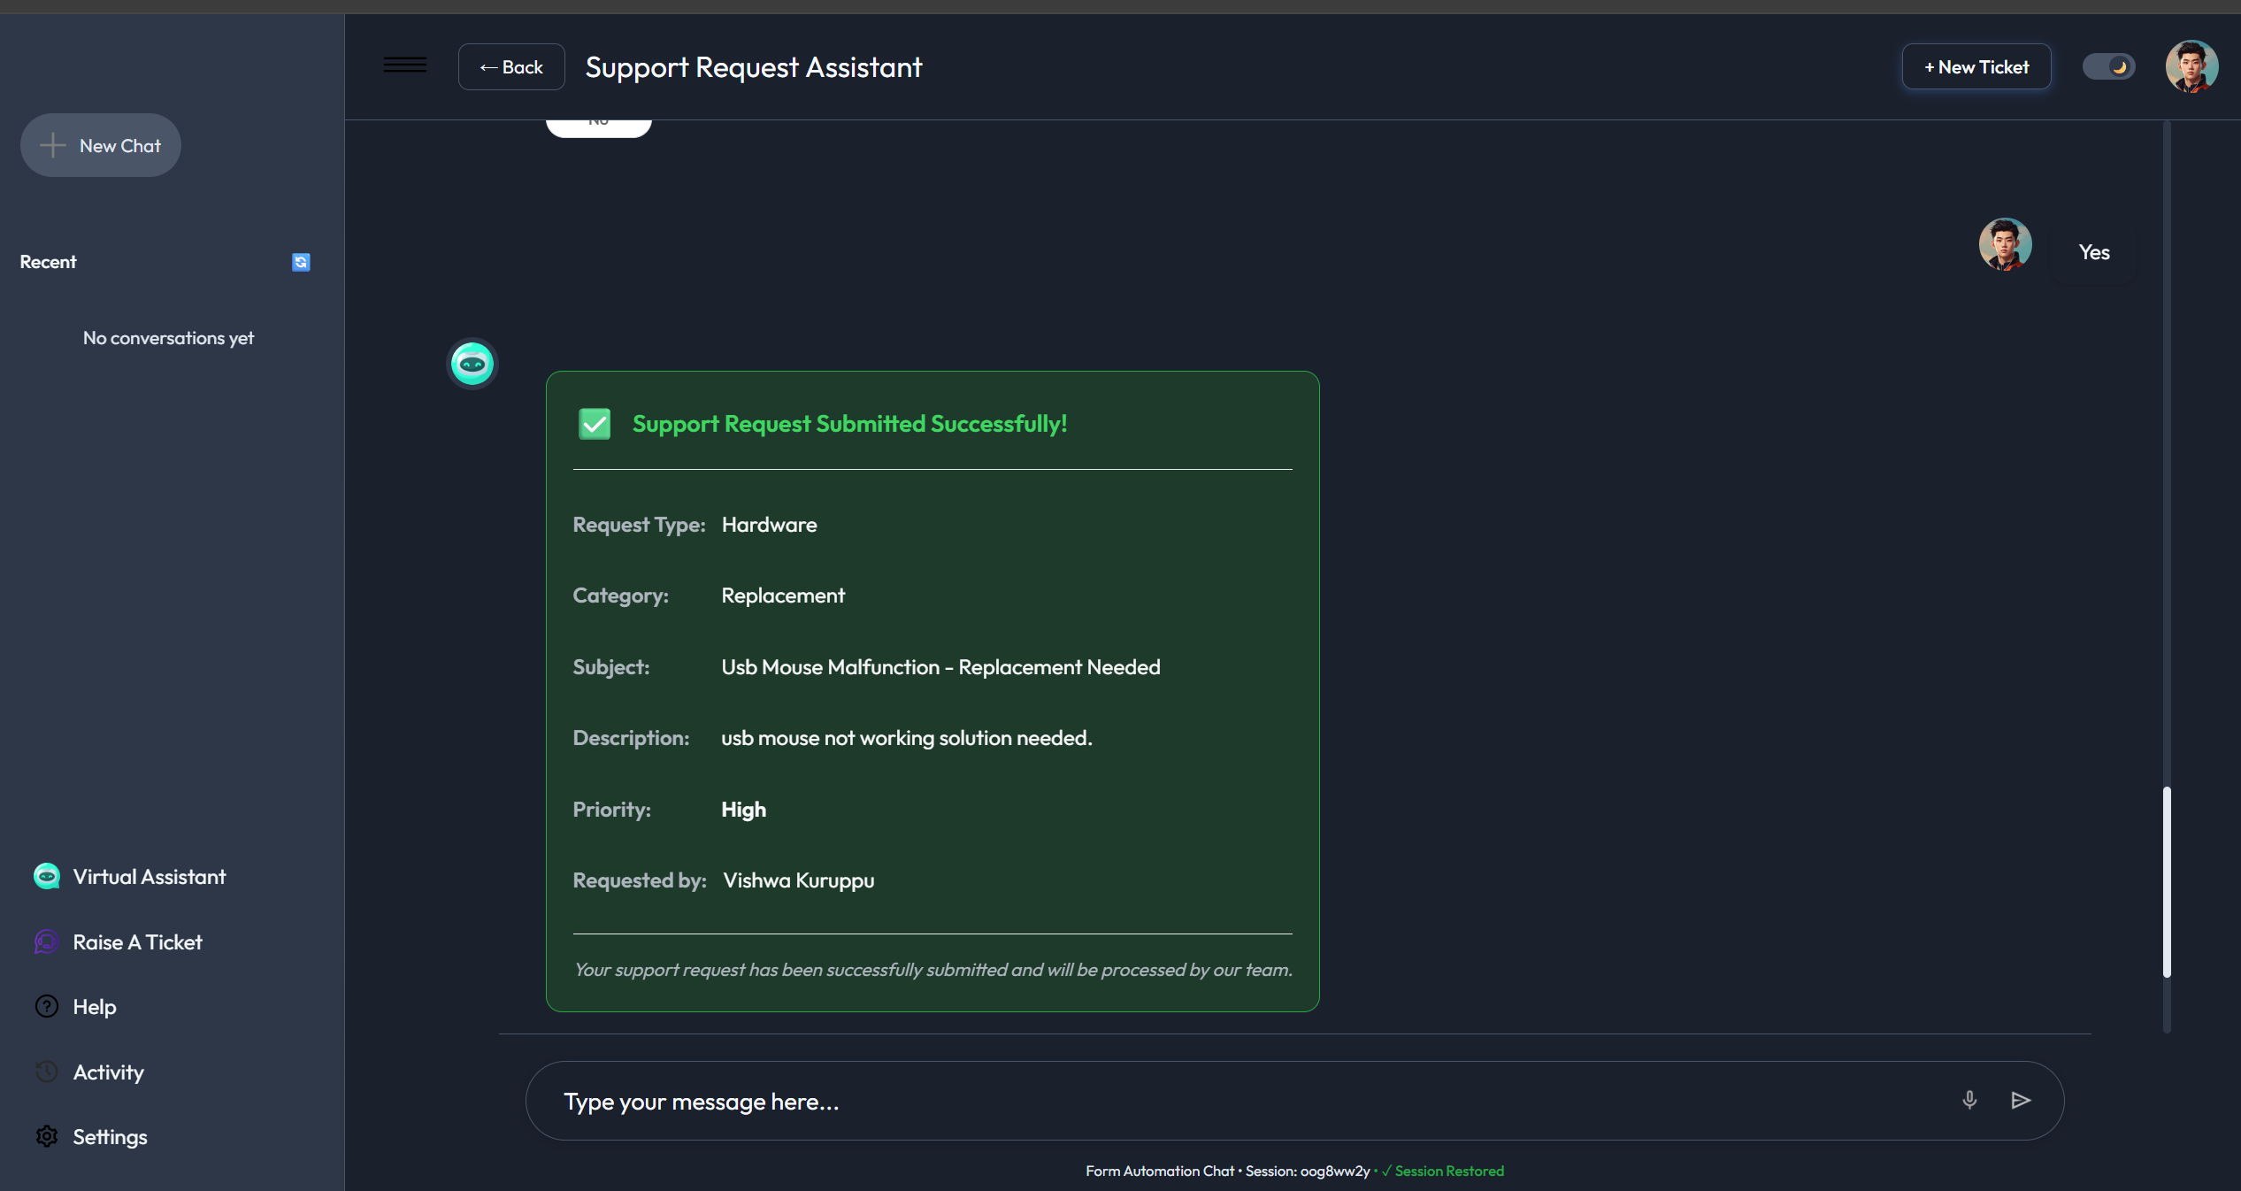
Methodology – Evidence of Completion
IT21315282 | Kuruppu K.A.V.U | R25-036

Slide 28
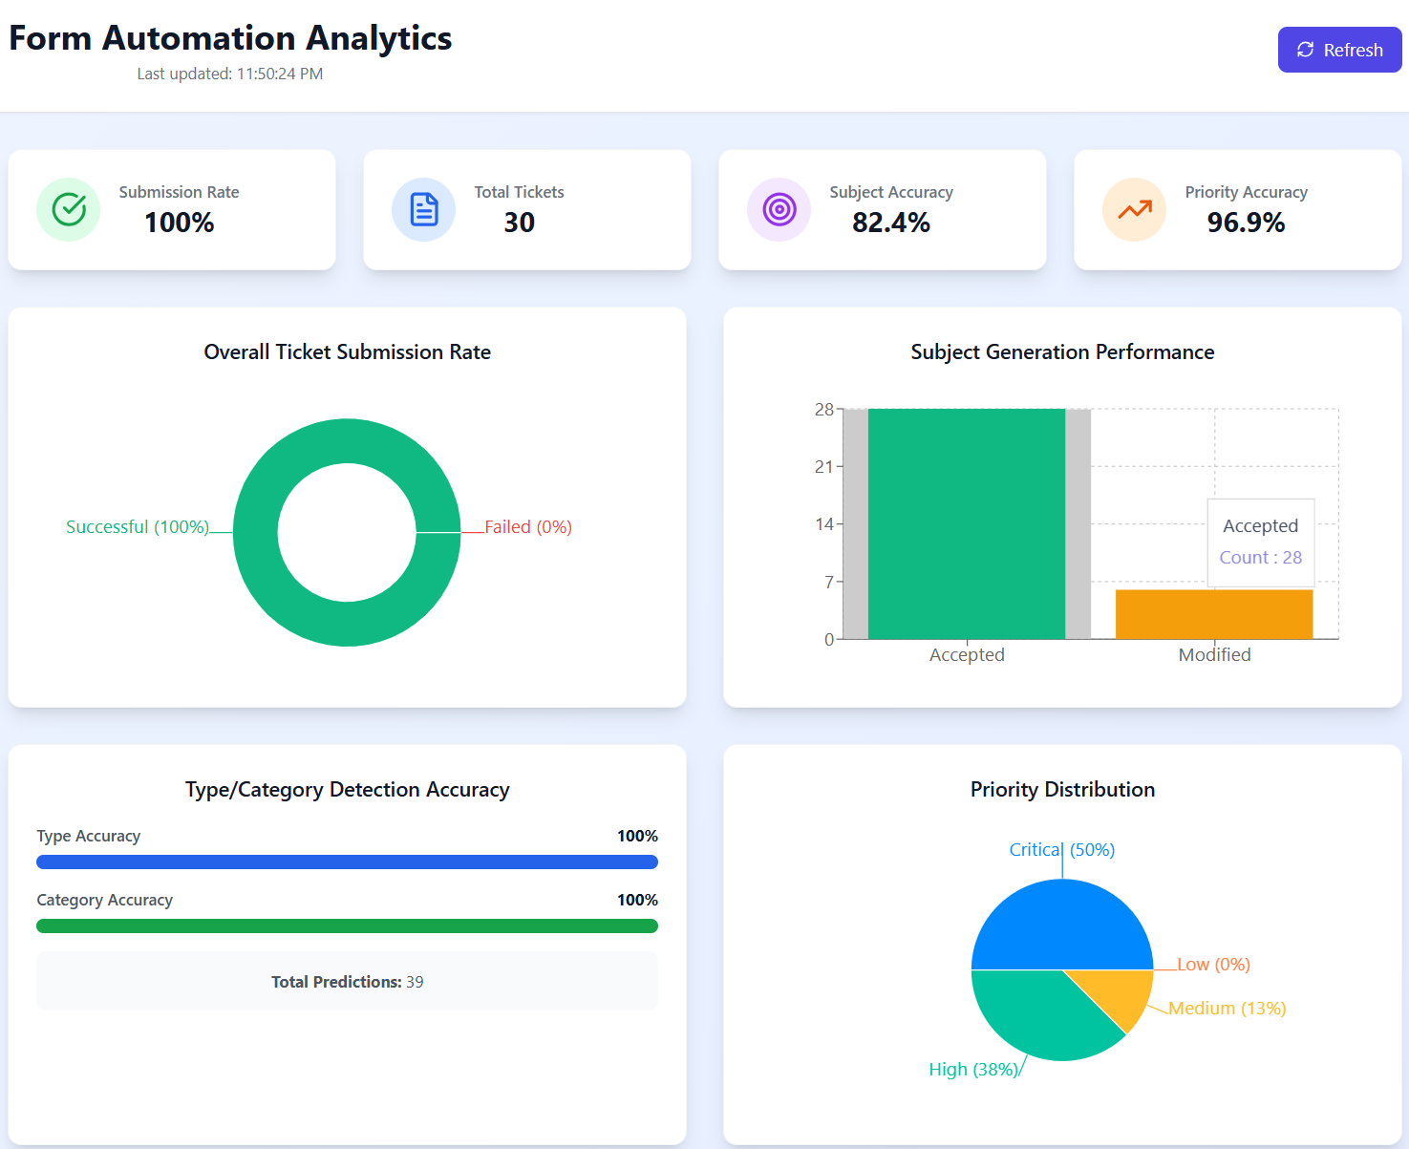
Methodology – Evidence of Completion
Analytic Dashboard
IT21315282 | Kuruppu K.A.V.U | R25-036

Slide 29

IT21809224 | Fernando W. S. N.
Software Engineering
IT21809224 | Fernando W. S. N.| R25-036

Slide 30
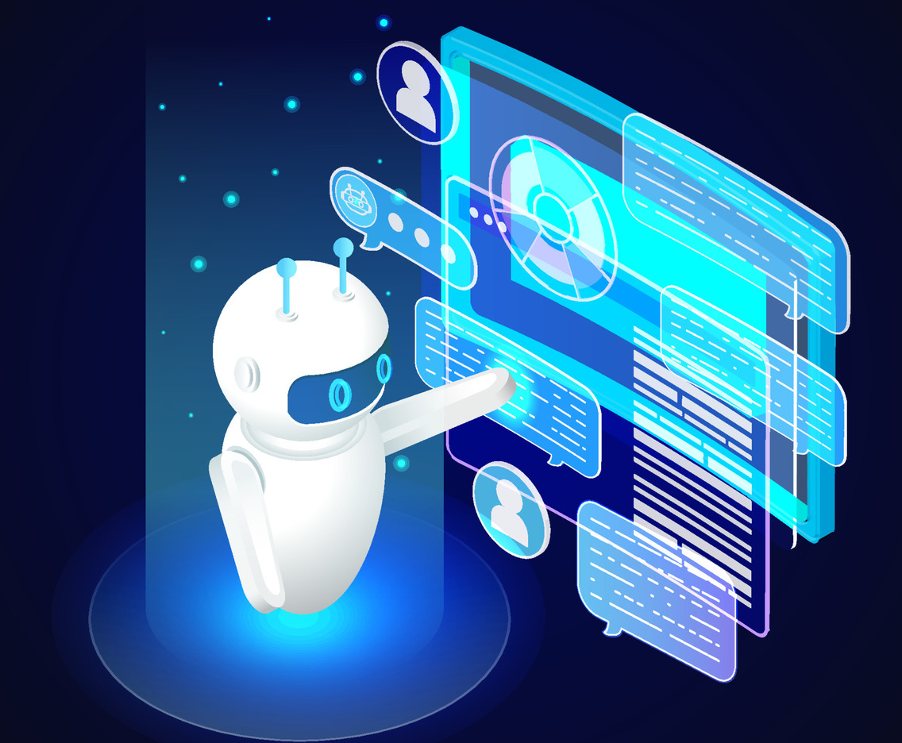
3D avatar With Voice INteraction
3d avatar with emotion Intelligent
IT21809224 | Fernando W. S. N.| R25-036

Slide 31
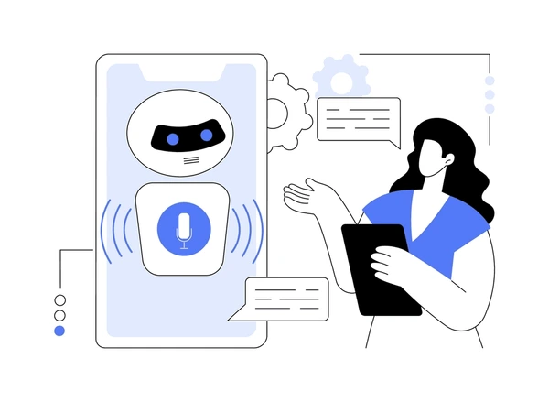
Background
This project introduces a 3D avatar chatbot that combines real-time emotion detection, sentiment analysis, and STT/TTS technologies to deliver personalized, context-aware responses. Featuring a lifelike avatar with synchronized expressions and gestures, it creates more engaging and human-like interactions compared to traditional chatbots.
This innovation enhances virtual communication by integrating emotional intelligence with 3D visual interactions, offering personalized and immersive experiences. It has potential applications in healthcare, education, and customer support.
IT21809224 | Fernando W. S. N.| R25-036

Slide 32

Objectives
Main Objective
Sub Objectives
To design and implement a 3D avatar chatbot capable of real-time emotion detection and adaptive interactions to enhance user engagement and communication
Develop Real-Time Emotion Processing.
Design a 3D Avatar Framework.
Personalize User Experiences.
Use Text-to-Speech (TTS) and Speech-to-Text (STT) Modules.
IT21809224 | Fernando W. S. N.| R25-036

Slide 33
Features of the 3D avatar With Voice Interaction component
Handling voice inputs.
Identify human emotions and sentimental and Gives empathetic responses .
Visual Human Friendly Representation

Slide 34
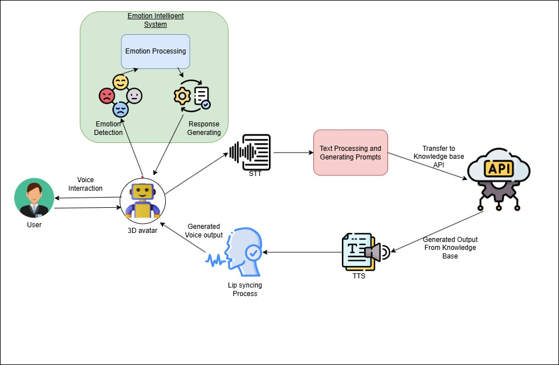
Methodology & System Diagram
IT21809224 | Fernando W. S. N.| R25-036

Slide 35
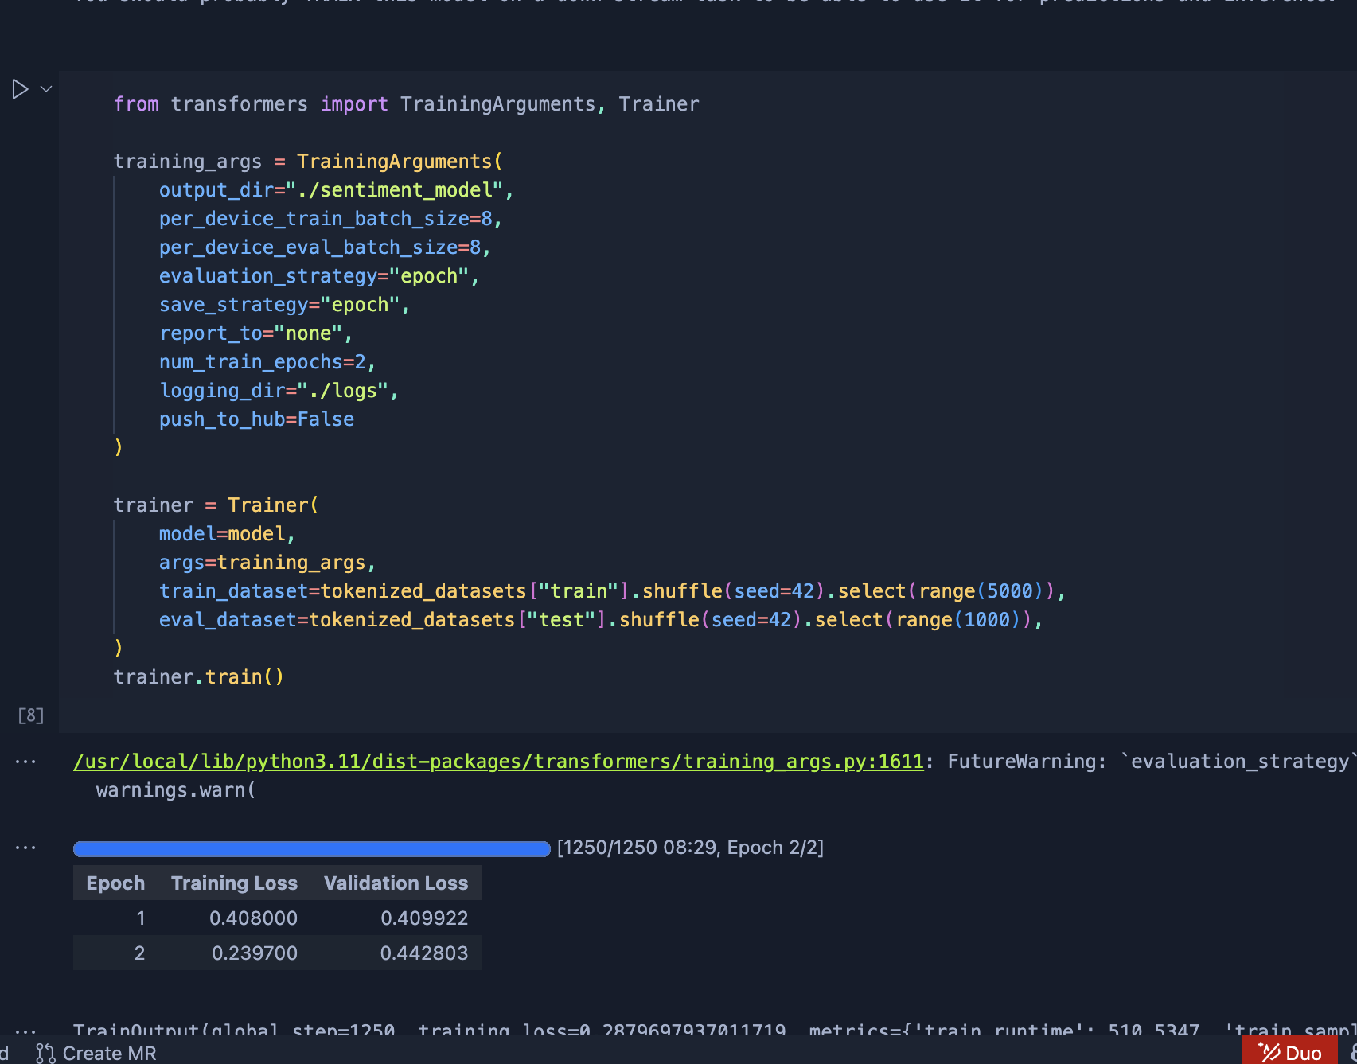
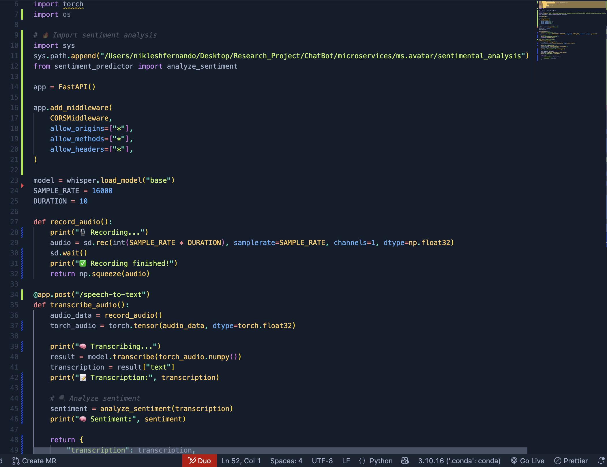
Evidence of Completion
Sentimental Analysis Model Training
Speech Recognition(Whisper) Model Integration
IT21809224 | Fernando W. S. N.| R25-036

Slide 36
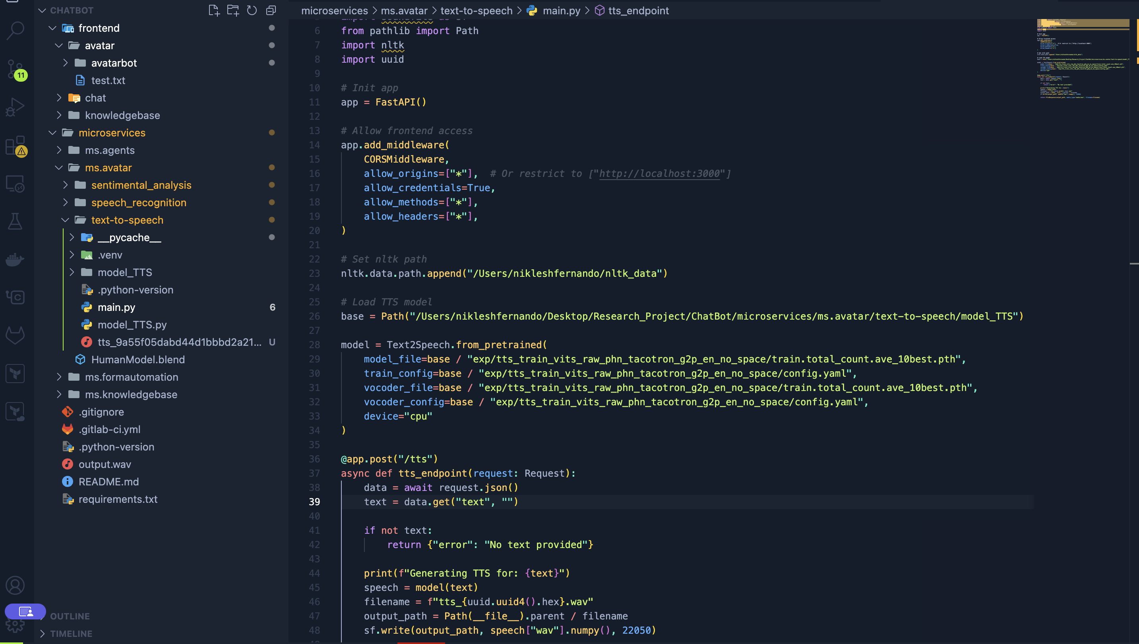
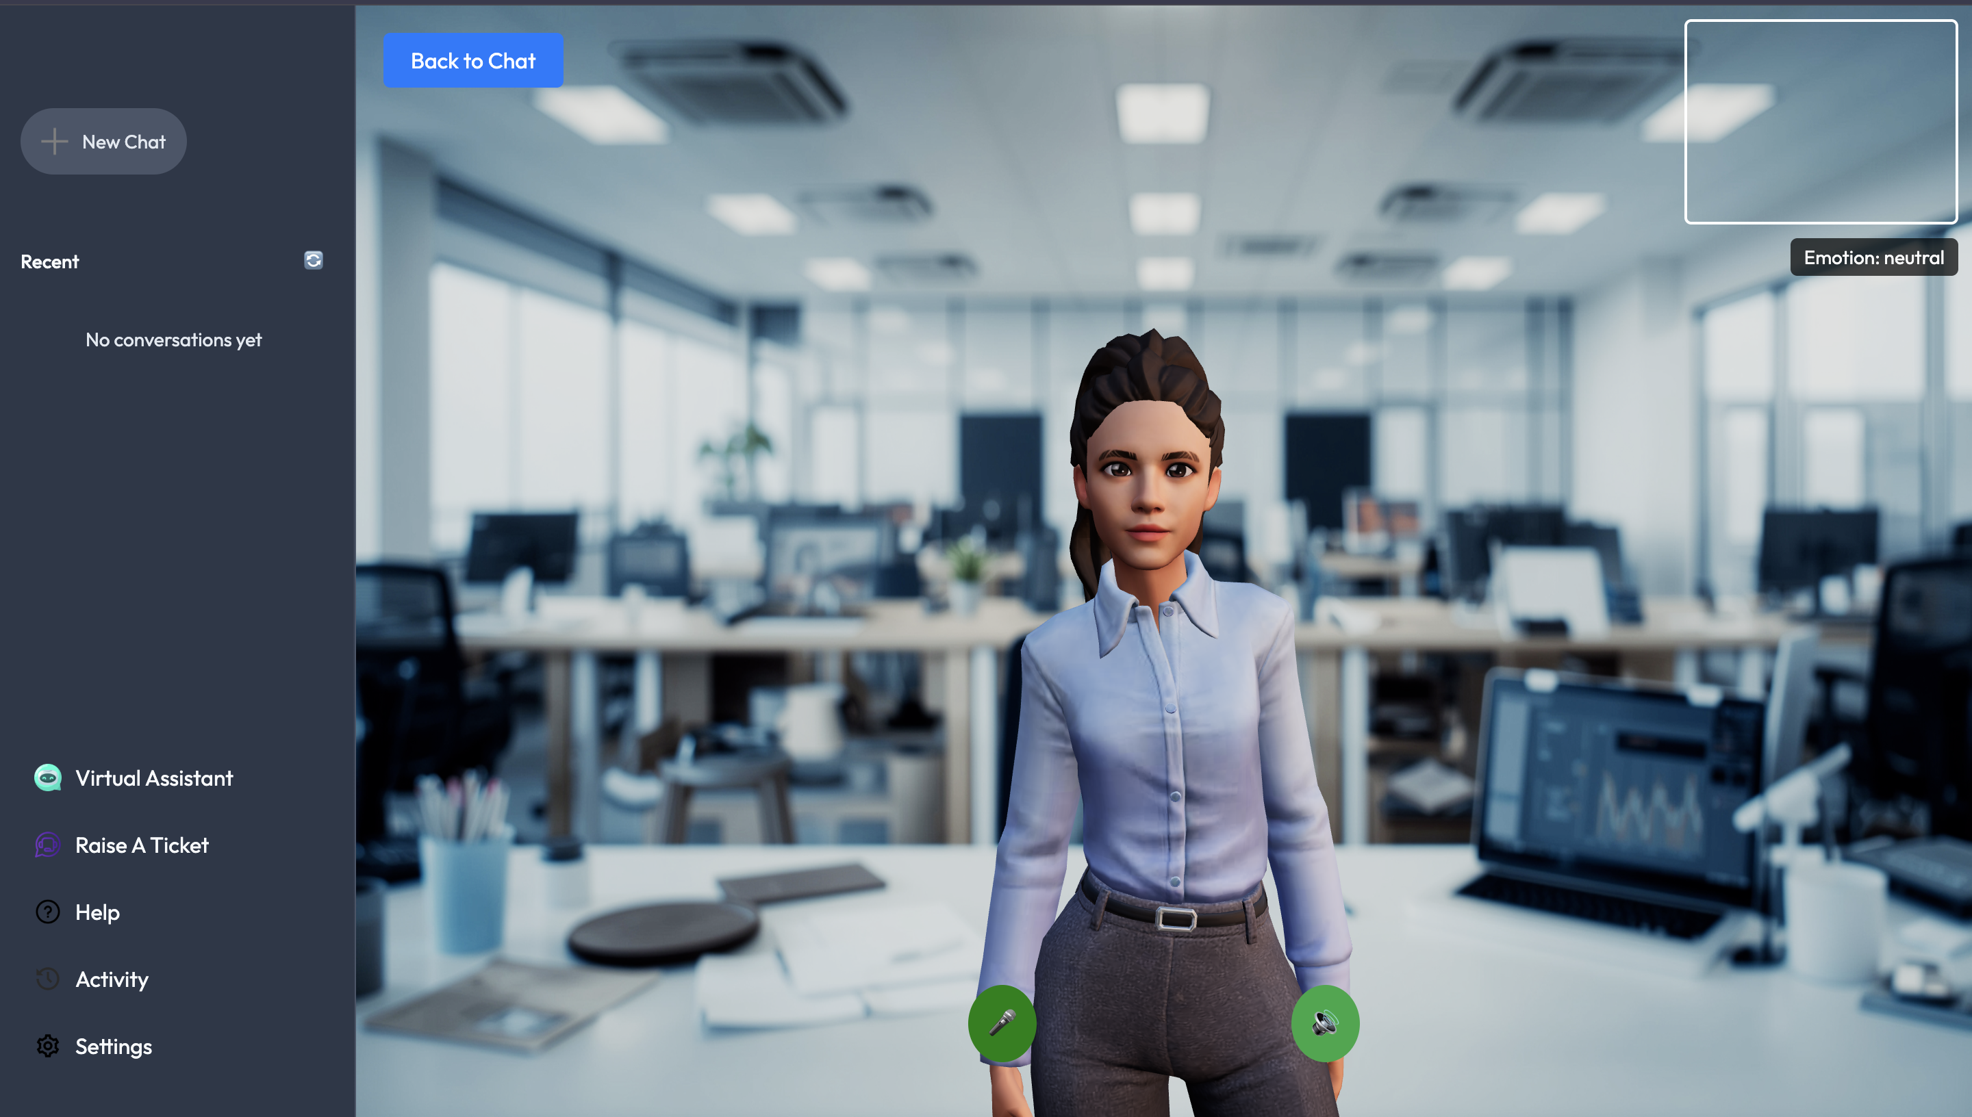
Evidence of Completion
TTS Model Integration
3D Avatar Integration with Frontend
IT21809224 | Fernando W. S. N.| R25-036

Slide 37
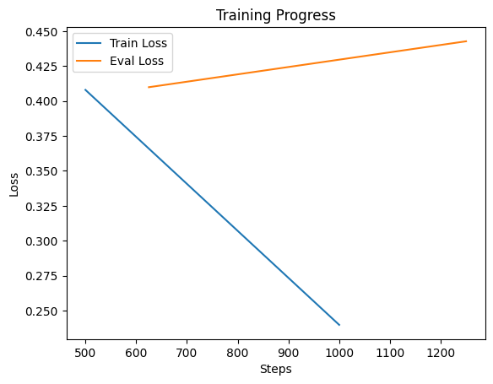
Evidence of Completion
Sentimental Analysis Model Training Progress
IT21809224 | Fernando W. S. N.| R25-036

Slide 38

demonstration

Slide 39

THANK YOU

