Slide 1
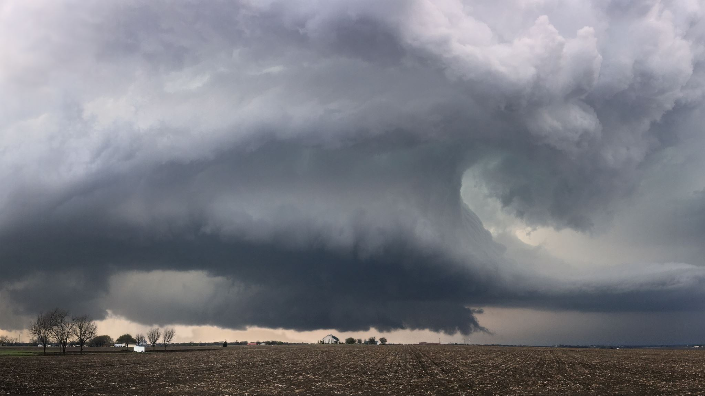
Rainfall Prediction using Machine Learning

Slide 2


Group Members
1. Vineetha Gourishetty, 700745899
2. Naveen Kumar Mahendarker, 700741944
3. Kumar Baddula, 700743017
4. Janaki Rama Satyanarayana Murthy Toleti, 700748298

Slide 3
Team Contribution
Vineetha Gourishetty
~ Worked On Dataset, Data Pre-processing, Linear Models, Model Analysis, Documentation.
Naveen Kumar Mahendarker
~ Worked On Dataset, Data Visualization, Linear Models, Documentation.
Janaki Rama Satyanarayana Murthy Toleti
~ Worked On Dataset, Decision Tree, Random Forest Algorithms, Model Comparision.
Kumar Baddula
~ Worked On Dataset,Application Building(GUI), Logistic Regression, Gradient Boosting Algorithms .

Slide 4

Motivation
Rainfall prediction is essential for preventing the negative consequences of massive storms without prior safety measures in modern society.
Rain is the largest natural source for agriculture and accurate prediction which helps farmers reap their crop and achieve a good yield.
Machine learning algorithms can effectively predict rainfall by learning from a large amount of malicious and benign requests of different patterns, helping prevent the negative impacts of excessive rain.

Slide 5
Objectives
This Project is focused on evaluating different Machine Learning Algorithms for the prediction of rainfall using the supplied dataset.
To prepare the data effectively to train the machine learning model, cleaning data without missing values or null values, results in the effective performance of the model.
To develop a UI with ease of use for the users, using the programming components and modules available in Python.
To implement and evaluate the regression models available in machine learning for the considered rainfall dataset, we have evaluated the following algorithms for prediction:
Lasso regression
Ridge regression
Elasticnet
Lassolar regression
Decision Tree Classifier
Gradient Boosting
Random forest

Slide 6
Related Work
Sawale G.J et al., used the dataset that consisted of various weather attributes, e.g., humidity, temperature, and wind speed.
Chen C. et al., used several features as input, such as past power measurements ,solar irradiance, relative humidity, and temperature. A SOM (Self organized map) was trained to classify the local weather 24 h in advance with the help of online meteorological services.
Liu J.N.K. et al., presented a framework with four weather attributes: temperature, dew point, mean sea level pressure, wind speed to predict weather changes over the next 24 h. For prediction, they used a dataset covering 30 years, from 1983 to 2012.
We have collected the dataset with rainfall measures for the states of India for 116 years month wise. We used regression techniques and analyzed the accuracy of different ML algorithms for Rainfall Prediction.

Slide 7
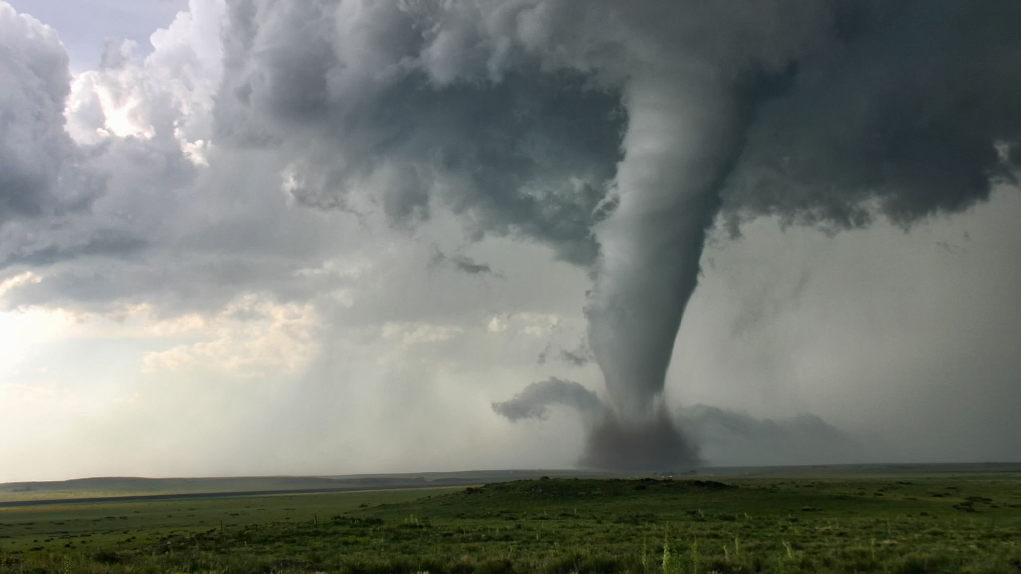
Problem Statement
The rainfall prediction is more required as it is concerned with the maximum association with other factors like land- slides, flooding, avalanches, earthquakes, and so on. Such disasters have affected the public severely for many decades. Hence, developing an effective model to predict rainfall helps to prevent natural disasters to a limited extent.
This paper investigates the performance of the various Machine Learning (ML) models, namely Lasso regression, ridge regression, elastic net regression, random forest, gradient boosting, and decision tree regressor. This also checks which algorithm performs better(accurately) in case of predicting rainfall.
The main objective of rainfall prediction is to identify the relevant atmospheric features that cause rainfall and predict the intensity of daily rainfall using machine learning techniques and measure the performance of the machine learning model.

Slide 8
Proposed Solution
Data Preprocessing: The dataset is considered for the Asian sub-divisions. The data is the rainfall metrics from the years 1901 to 2017. The columns are the month-wise, annual, and quarterly rainfall of the particular division. We handled missing values, correcting typos and inconsistencies in the data. Missing values can be imputed using statistical techniques or replaced with the median or mean of the data. After data pre-processing, feature extraction is done.
Splitting of Data: To avoid overfitting, the dataset was divided into two categories: training datasets and testing datasets, which were divided by 90 percent and 10 percent, respectively.
Model Training: In this project, we will use various ML algorithms to predict the rainfall and compare the performance of the model. Algorithms are, Lasso regression, Ridge regression, Elasticnet, Lassolar regression, Decision Tree Classifier, Gradient Boosting, Random forest.
Prediction: In classification, when we say "accuracy" we are usually referring to the degree to which something is accurate. It is one of the more visible metrics because it is the total number of cases that have been accurately detected. The best model is identified by the highest value of accuracy

Slide 9
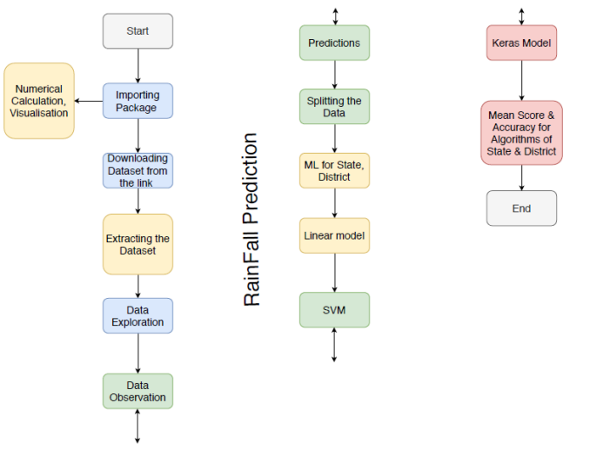

Slide 10

Results
Many ML algorithms have been successfully applied for the automatic regression of rainfall. This project summarizes and exemplifies the working logic of the six ML algorithms and empirically evaluates the regression performance of all the ML algorithms to the benchmark rainfall dataset.
Among the six algorithms, lasso regression got the highest R2 score of 99.21 at 90-10 of training and validation dataset. Apart from this, the performance of all ML algorithms is evaluated and compared to the actual target values with predicted values.
Extreme Gradient Boosting gave least value for Mean Absolute Error(MAE) compared to other algorithms which concludes that the Extreme Gradient Boosting machine learning algorithm performed better than others.

Slide 11
References
[1] S. Chowdhury and M. P. Schoen, ”Research Paper Classification using Supervised Machine Learning Techniques,” 2020 Intermountain Engi- neering, Technology and Computing (IETC), Orem, UT, USA, 2020, pp. 1-6, doi: 10.1109/IETC47856.2020.9249211.
[2]. Kapoor, A., Horvitz, Z., Laube, S., Horvitz, E.: Airplanes aloft as a sensor network for wind forecasting. In: Proceedings of the 13th International Symposium on Information Processing in Sensor Networks, IPSN 2014, pp. 25–34. Piscataway, NJ, USA, IEEE Press.
[3]. N. K. A. Appiah-Badu, Y. M. Missah, L. K. Amekudzi, N. Ussiph, T. Frimpong and E. Ahene, "Rainfall Prediction Using Machine Learning Algorithms for the Various Ecological Zones of Ghana," in IEEE Access Journal in 2022, vol. 10, pp. 5069-5082, 2022, doi: 10.1109/ACCESS.2021.3139312.
[4] N. Gnana Sankaran, E. Ramaraj, “A Multiple Linear Regression Model to Predict Rainfall Using Indian Meteorological Data”, International Journal of Advanced Science and Technology (IJAST) Vol. 29, No. 8s, (2020), pp. 746-758.
[8] Deepak Ranjan Nayak, Amitav Mahapatra, Pranati Mishra A Survey on Rainfall Prediction using Artificial Neural Network International Journal of Computer Applications (0975 – 8887) Volume 72– No.16, June 2013. James, N.K., Liu, Y.H., You, J .J., Chan, P.W.: Deep Neural Network Based Feature Representation for Weather Forecasting, 261– 267.

Slide 12

THANK YOU!!!

