Slide 1
2017 TEM Slides
Embedded machine learning in real time
Jongmin Lee & Michael Stanley Anomaly Detection toolbox 19 April 2017

Slide 2
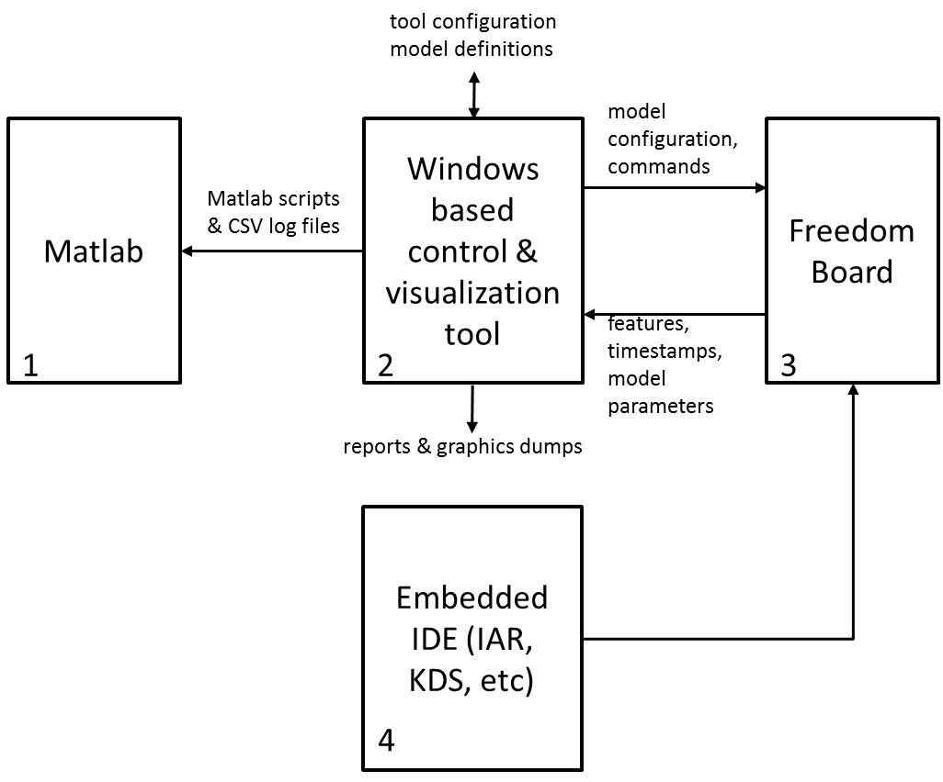
Embedded Machine Learning On Cortex M4F Jongmin Lee & Michael Stanley, BU Sensors

Slide 3
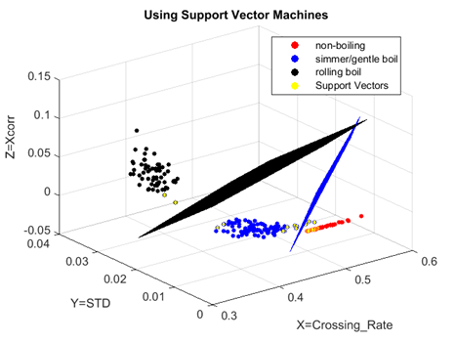
Machine Learning
Can be classified as:
Supervised vs Non-Supervised vs Semi-Supervised
one-class, two class or multi-class
clustering vs supervised classification
There are MANY techniques, each of which has many variants:
Neural Networks
Distance-Based models (K-NN)
Mixture Models
Probabilistic Models
Logistic Regression
Support Vector Machine
Ensemble Models
…

Slide 4
Rationalizations
Our project is targeted at machine condition monitoring because:
MCM is a huge untapped market
Customer interest is high, so NXP can be a thought leader
We focus on Anomaly Detection because:
it is very difficult to get labelled data for machine learning for both pass and fail conditions, so supervised learning is out
Anomaly Detection allows you to “draw a boundary” around nominal conditions, and reject everything else
We limit the complexity of our models
to two dimensions for lower level models because they are easy to visualize
and add Ensemble model support to gain higher dimensionality

Slide 5
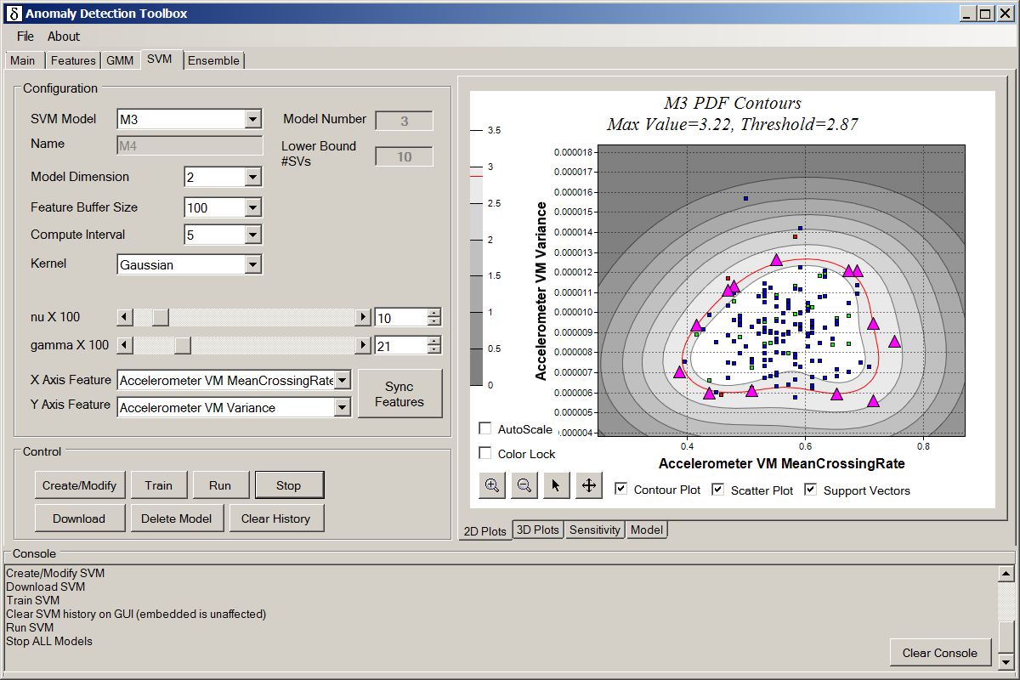
SVM Control Screen

Slide 6
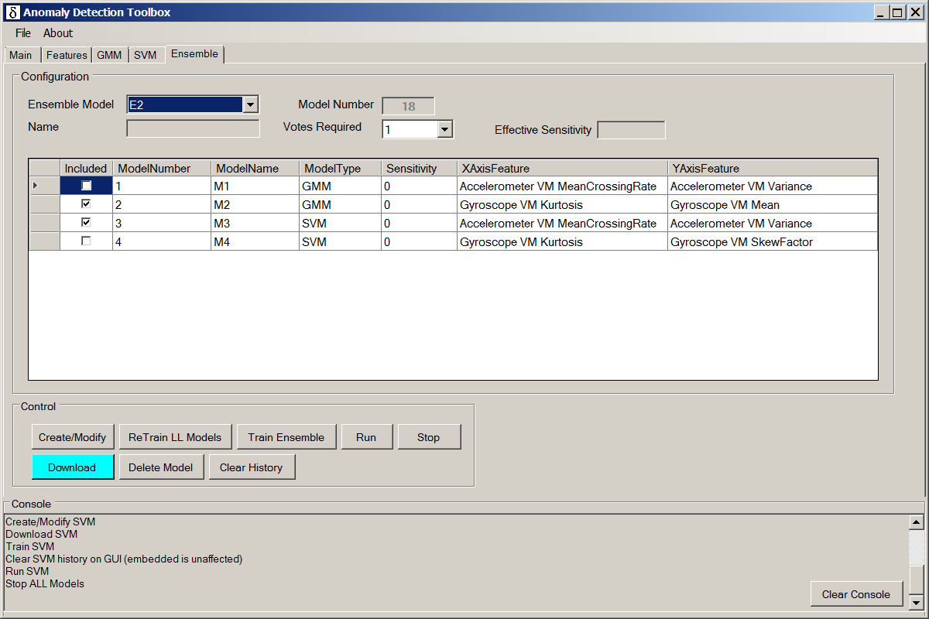
Ensemble Control Screen

Slide 7
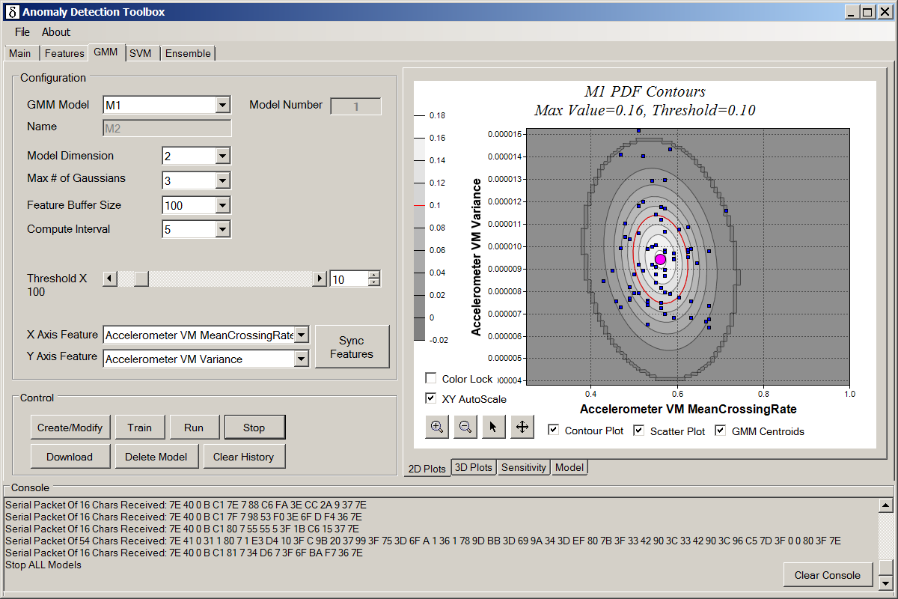
GMM Control Screen

Slide 8
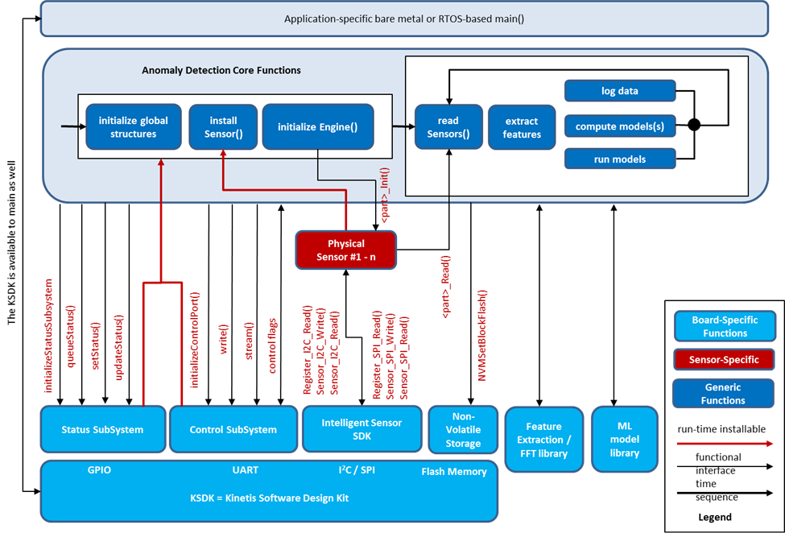

Slide 9
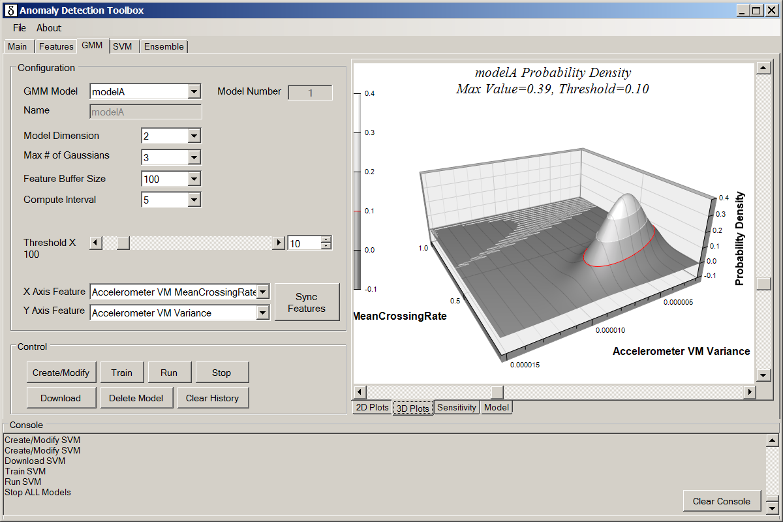
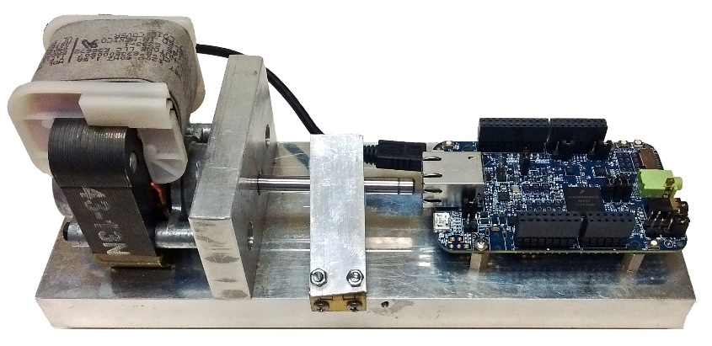
There Are Two Components
The Graphical User Interface
written in C# using Visual Studio. The GUI provides configuration screens and (soon) computation of optimal Ensemble models.
The embedded C code running on a FRDM-K66F Freedom Board. Gaussian Mixture Models and Support Vector Machines are computed right on the board.

Slide 10
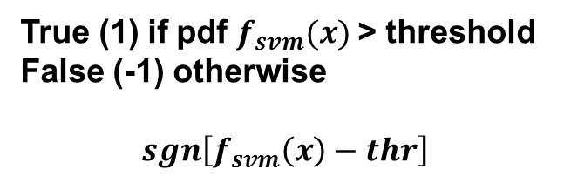
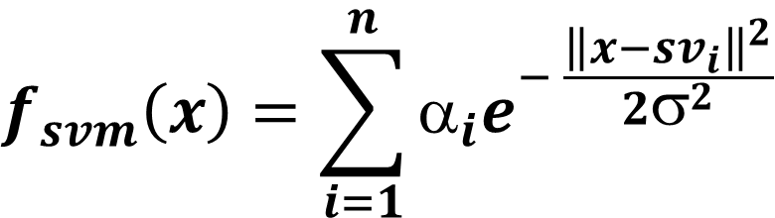
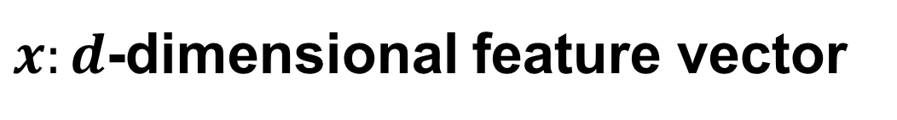
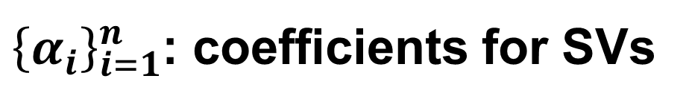
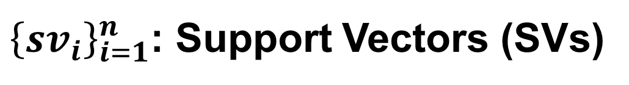
One Class Support Vector Machines
$$f_{svm}\left(x\right)=\sum_{i=1}^{n}{α_{i}e^{− \frac{{\left\|x−{sv}_{i}\right\|}^{2}}{2σ^{2}}}}$$
$x:d$-dimensional feature vector
${\left\{{sv}_{i}\right\}}_{i=1}^{n}$: Support Vectors (SVs)
${\left\{α_{i}\right\}}_{i=1}^{n}$: coefficients for SVs
True (1) if pdf $f_{svm}(x)$> threshold
False (-1) otherwise
$$sgn\left[f_{svm}\left(x\right)−thr\right]$$

Slide 11
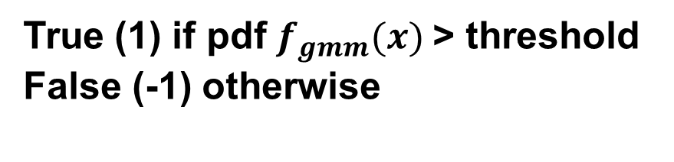
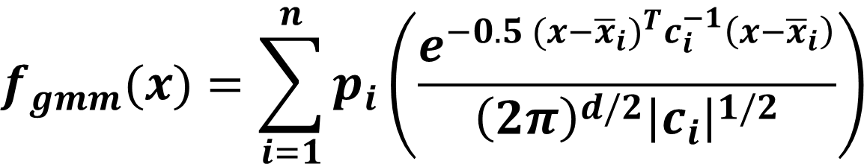
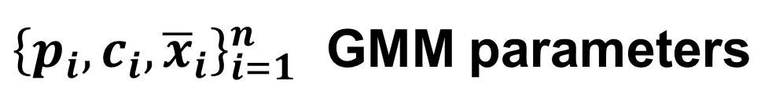

Gaussian Mixture Models (old versioin)
$$f_{gmm}(x)=\sum_{i=1}^{n}{p_{i}\left(\frac{e^{−0.5{ (x−{\overline{x}}_{i})}^{T}c_{i}^{−1}\left(x−{\overline{x}}_{i}\right)}}{{\left(2π\right)}^{d/2}{\left|c_{i}\right|}^{1/2}}\right)}$$
$x:d$-dimensional feature vector
${\left\{p_{i},c_{i},{\overline{x}}_{i}\right\}}_{i=1}^{n}$ GMM parameters
True (1) if pdf $f_{gmm}(x)$> threshold
False (-1) otherwise
$$sgn\left[f_{gmm}\left(x\right)−thr\right]$$

Slide 12
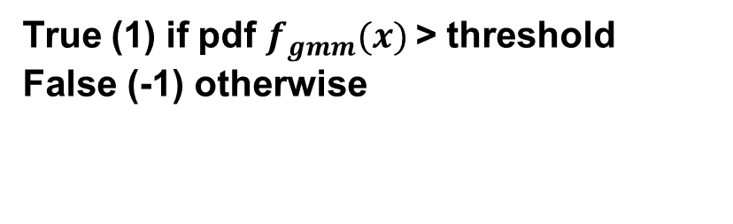
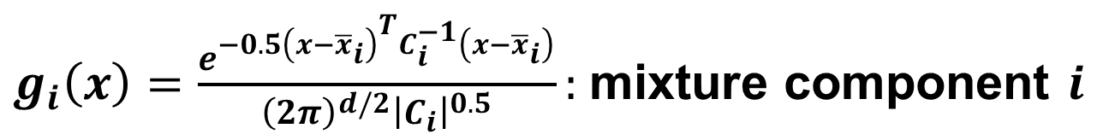

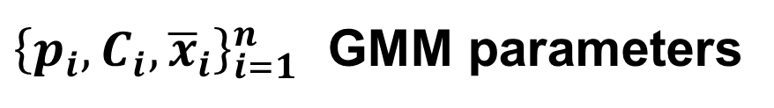


Gaussian Mixture Models
$$f_{gmm}(x)=\sum_{i=1}^{n}{p_{i} g_{i}\left(x\right)}$$
$x:d$-dimensional feature vector
$g_{i}\left(x\right)=\frac{e^{−0.5{\left(x−{\overline{x}}_{i}\right)}^{T}C_{i}^{−1}\left(x−{\overline{x}}_{i}\right)}}{{\left(2π\right)}^{d/2}{\left|C_{i}\right|}^{0.5}}:$mixture component $i$
${\left\{p_{i},C_{i},{\overline{x}}_{i}\right\}}_{i=1}^{n}$ GMM parameters
True (1) if pdf $f_{gmm}(x)$> threshold
False (-1) otherwise
$$sgn\left[f_{gmm}\left(x\right)−thr\right]$$

Slide 13
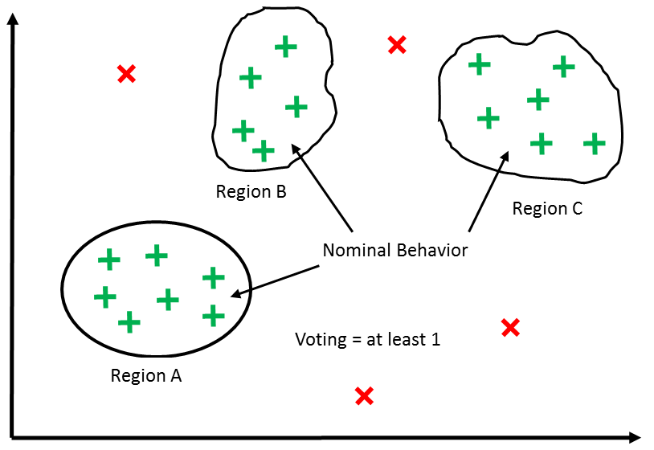
Ensemble Models
are composed of a number of lower-level models
they may:
modify lower level models for optimal fault coverage
implement an averaging scheme
implement a voting scheme
Our initial approach is a simple 1-of-n voting scheme.
Ensemble design will be done in the GUI.
Region A
Overlap area is the expected
region of nominal behavior
Voting = at least 2
Region B

Slide 14
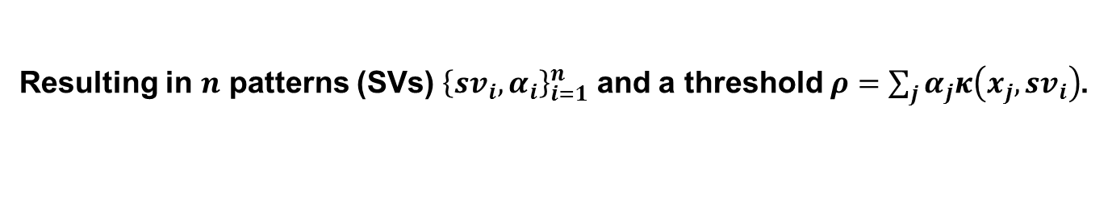
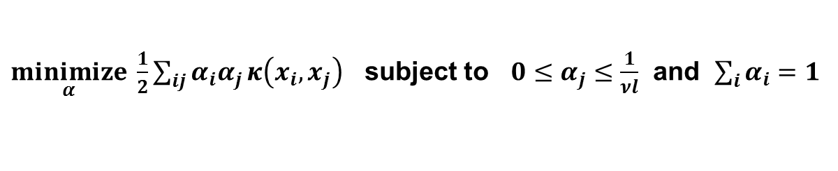

How to Build Models
Iterative Expectation-Maximization Algorithm for GMM
For ${θ^{t}=\left\{ρ_{i},c_{i},{\overline{x}}_{i}\right\}}_{i=1}^{n}$ GMM parameters at time $t$,
Estimate $θ^{t+1}←θ^{t}$ such that $f_{gmm}\left(x;θ^{t+1}\right)≥f_{gmm}(x;θ^{t})$,
Until $θ^{t+1}≈θ^{t}$.
Dual quadratic problem for OC-SVM
$\underset{α}{minimize} \frac{1}{2}\sum_{ij}{α_{i}α_{j}}κ\left(x_{i},x_{j}\right)$ subject to ${0≤α}_{j}≤\frac{1}{νl}$ and $\sum_{i}{α_{i}}=1$
For ${\left\{x_{i}\right\}}_{i=1}^{N}$ feature data points for training and a parameter $0<ν≤1$,
Solve the dual problem above,
Resulting in $n$ patterns (SVs) ${\left\{{sv}_{i}, α_{i}\right\}}_{i=1}^{n}$ and a threshold $ρ=\sum_{j}{α_{j}κ\left(x_{j},{sv}_{i}\right)}$.

Slide 15
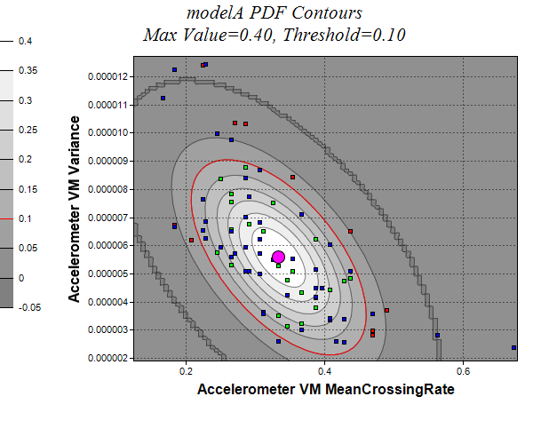
Gaussian Mixture Models
model the system via a probability distribution function (PDF) comprised of a summation of Gaussian components

Slide 16
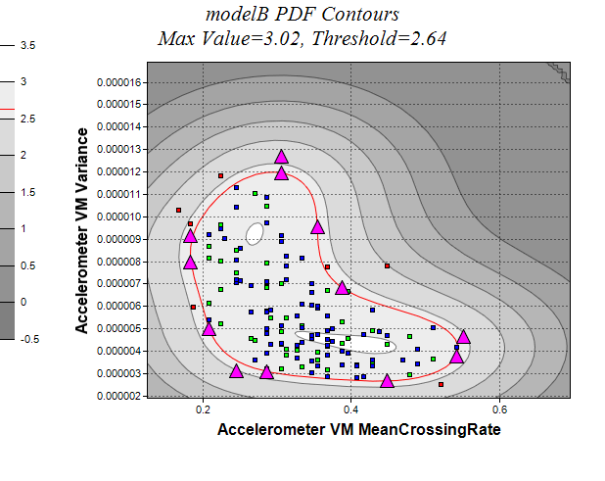
One Class Support Vector Machines
model the system via a probability distribution function (PDF) derived from a set of “support vectors”
support vector
blue dots = training samples
green dots = nominal samples
red dots = anomalies

Slide 17
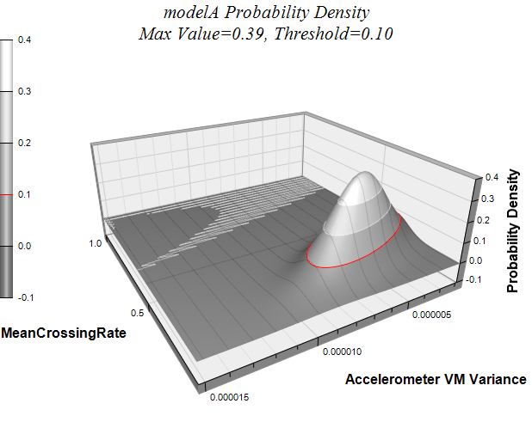
You can view PDFs in 3 dimensions…

Slide 18
The Confusion Matrix
Actual | Predicted Positive | Predicted Negative
PP = TP + FN = Positive Population | TP = True Positive | FN = False Negative
NP = FP + TN = Negative Population | FP = False Positive | TN = True Negative
Standard Metrics derived from the confusion matrix are:
Accuracy = 1 – Error = (TP + TN) / (PP + NP) = probability of a correct classification
Sensitivity = TP / PP = the ability of the test to detect a positive element from a positive population
Specificity = TN / NP = the ability of the test to correctly rule out a condition from a condition free population
TN
Red = Anomaly
Green = Nominal
Circle = Prediction Error
FP
TP
FN
Predicted region of nominal behavior
TN
Region of Abnormal behavior
TN

Slide 19
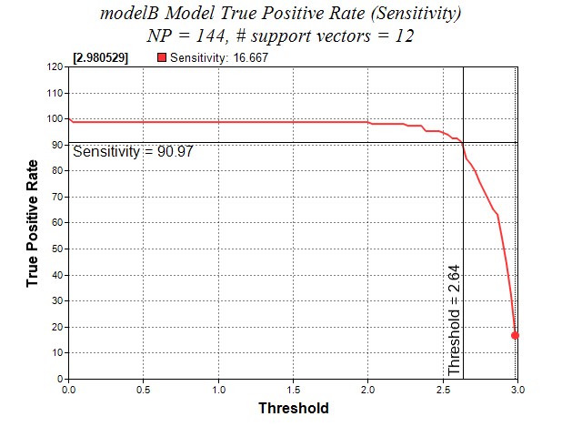
Sensitivity = the ability of the test to detect a positive element from a positive population

