Slide 1
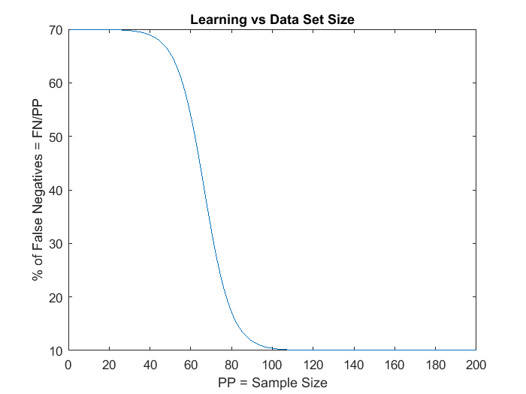
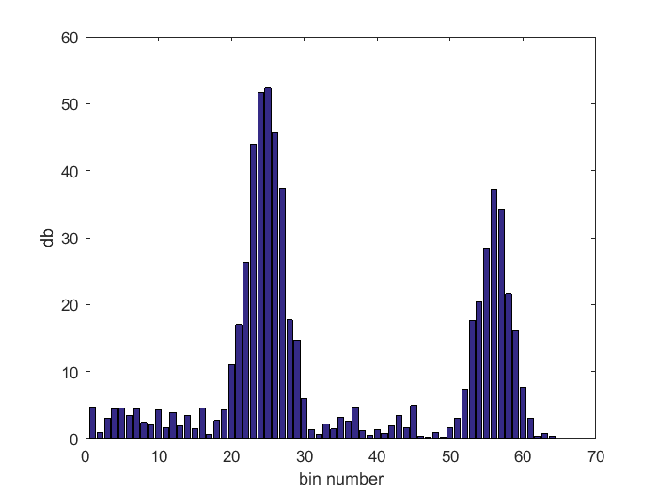
NXP Anomaly Detection Toolbox
_
X
File About
Main
Features
FFT
GMM
SVM
Composite
FFT Configuration
Feature Selection
Connections
Window Size
Accelerometer
128
Source
Microphone
Sensor Port
COM1
Auto Detect
Accelerometer X
Accerometer VM
Magnetomer VM
Magnetometer
128
Accelerometer Y
Accelerometer Z
Magnetomer X
Magnetomer Y
Window
Magnetomer Z
Temperature
Rectangular
Gyro VM
Microphone
Gyroscope
Gyro X
Pressure
128
Gyro Y
Gyro Z
Board
FRDM-K66F
# of bins
64
Firmware
Pressure
1
1.0
A
B
C
D
E
F
G
H
I
J
K
L
M
N
O
Temperature
128
Display Oversampling
16
Mean
Data Logger
1
Microphone
1024
Apply DC Notch Filter
YES
Variance
2
App Description
my application here
Skew Factor
3
Note1
any note you like
Kurtosis
4
GMM Configuration
SVM Configuration
Note2
FFT
5
another
7D Accel VM STD
6D Accel VM MCR
NONE
Features
6D Accel VM MCR
Features
Mean Crossing Rate
6
Note3
and another
STD
7
Output Folder
<output folder here>
Radial Basis Kernel
nu
Threshold
3
No Kernel
0.05
G
99%
# of bins
200
STD(X) / Total STD
8
STD(Y) / Total STD
9
STD(Z) / Total STD
10
Stop
Stop
Stop
Clear
Clear
Save Model
Clear
Save FFT Config
Save Model
Start
Start
Start

Slide 2
NXP Anomaly Detection Toolbox
_
X
File About
Main
Features
FFT
GMM
SVM
Composite
FFT Configuration
Feature Selection
Connections
Sample Rates
Sensor Port
Accelerometer
400
Source
Microphone
COM1
Auto Detect
Accelerometer X
Accerometer VM
Gyroscope
800
Accelerometer Y
Window
Accelerometer Z
Temperature
Control Port
COM2
Auto Detect
Rectangular
Gyro VM
Microphone
Pressure
Gyro X
Pressure
1
Gyro Y
Gyro Z
Board
FRDM-K66F
# of bins
64
Firmware
Temperature
128
1.0
A
B
C
D
I
J
K
L
M
N
O
Microphone
4000
Display Oversampling
16
Mean
Data Logger
1
Apply DC Notch Filter
YES
Variance
2
App Description
my application here
Skew Factor
3
Note1
Feature Interval
ms
any note you like
Kurtosis
4
1000
GMM Configuration
SVM Configuration
Note2
FFT
5
another
7D Accel VM STD
6D Accel VM MCR
NONE
Features
6D Accel VM MCR
Features
Mean Crossing Rate
6
Note3
and another
STD
7
Output Folder
<output folder here>
Radial Basis Kernel
nu
Threshold
3
No Kernel
0.05
G
99%
# of bins
200
STD(X) / Total STD
8
STD(Y) / Total STD
9
STD(Z) / Total STD
10
Stop
Stop
Stop
Clear
Clear
Save Model
Clear
Save FFT Config
Save Model
Start
Start
Start

Slide 3
NXP Anomaly Detection Toolbox
_
X
File About
Main
Features
FFT
GMM
SVM
Ensemble
FFT Configuration
Feature Selection
Connections
Window Size
Accelerometer
128
Source
Microphone
Sensor Port
COM1
Auto Detect
Accelerometer X
Accerometer VM
Magnetomer VM
Magnetometer
128
Accelerometer Y
Accelerometer Z
Control Port
COM2
Auto Detect
Magnetomer X
Magnetomer Y
Window
Magnetomer Z
Temperature
Rectangular
Gyro VM
Microphone
Gyroscope
Gyro X
Pressure
128
Gyro Y
Gyro Z
Board
FRDM-K66F
# of bins
64
Firmware
Pressure
1
1.0
A
B
C
D
E
F
G
H
I
J
K
L
M
N
O
Temperature
128
Display Oversampling
16
Mean
Data Logger
1
Microphone
1024
Apply DC Notch Filter
YES
Variance
2
App Description
my application here
Skew Factor
3
Note1
any note you like
Kurtosis
4
GMM Configuration
SVM Configuration
Note2
FFT
5
another
7D Accel VM STD
6D Accel VM MCR
NONE
Features
6D Accel VM MCR
Features
Mean Crossing Rate
6
Note3
and another
STD
7
Output Folder
<output folder here>
Radial Basis Kernel
nu
Threshold
3
No Kernel
0.05
G
99%
# of bins
200
STD(X) / Total STD
8
STD(Y) / Total STD
9
STD(Z) / Total STD
10
Stop
Stop
Stop
Clear
Clear
Save Model
Clear
Save Model
Save FFT Config
Start
Start
Start

Slide 4
NXP Anomaly Detection Toolbox
_
X
File About
Main
Features
FFT
GMM
SVM
Composite
FFT Configuration
Feature Selection
Connections
Window Size
Accelerometer
128
Source
Microphone
Sensor Port
COM1
Auto Detect
Accelerometer X
Accerometer VM
Magnetomer VM
Magnetometer
128
Accelerometer Y
Accelerometer Z
Control Port
COM2
Auto Detect
Magnetomer X
Magnetomer Y
Window
Magnetomer Z
Temperature
Rectangular
Gyro VM
Microphone
Gyroscope
Gyro X
Pressure
128
Gyro Y
Gyro Z
Board
FRDM-K66F
# of bins
64
Firmware
Pressure
1
1.0
A
B
C
D
E
F
G
H
I
J
K
L
M
N
O
Temperature
128
Display Oversampling
16
Mean
Data Logger
1
Microphone
1024
Apply DC Notch Filter
YES
Variance
2
App Description
my application here
Skew Factor
3
Note1
any note you like
Kurtosis
4
GMM Configuration
SVM Configuration
Note2
FFT
5
another
NONE
6D Accel VM MCR
7D Accel VM STD
Features
6D Accel VM MCR
Features
Mean Crossing Rate
6
Note3
and another
STD
7
Output Folder
<output folder here>
Radial Basis Kernel
nu
Threshold
3
No Kernel
0.05
G
200
# of bins
99%
STD(X) / Total STD
8
STD(Y) / Total STD
9
STD(Z) / Total STD
10
Stop
Stop
Stop
Clear
Clear
Save Model
Clear
Save FFT Config
Save Model
Start
Start
Start

Slide 5
NXP Anomaly Detection Toolbox
_
X
File About
Main
Features
FFT
GMM
SVM
Ensemble
FFT Configuration
Feature Selection
Connections
Window Size
Accelerometer
128
Source
Microphone
Sensor Port
COM1
Auto Detect
Accelerometer X
Accerometer VM
Magnetomer VM
Magnetometer
128
Accelerometer Y
Accelerometer Z
Control Port
COM2
Auto Detect
Magnetomer X
Magnetomer Y
Window
Magnetomer Z
Temperature
Rectangular
Gyro VM
Microphone
Gyroscope
Gyro X
Pressure
128
Gyro Y
Gyro Z
Board
FRDM-K66F
# of bins
64
Firmware
Pressure
1
1.0
A
B
C
D
E
F
G
H
I
J
K
L
M
N
O
Temperature
128
Display Oversampling
16
Mean
Data Logger
1
Microphone
1024
Apply DC Notch Filter
YES
Variance
2
App Description
my application here
Skew Factor
3
Note1
any note you like
Kurtosis
4
GMM Configuration
SVM Configuration
Note2
FFT
5
another
7D Accel VM STD
6D Accel VM MCR
NONE
Features
6D Accel VM MCR
Features
Mean Crossing Rate
6
Note3
and another
STD
7
Output Folder
<output folder here>
Radial Basis Kernel
nu
Threshold
3
No Kernel
0.05
G
99%
# of bins
200
STD(X) / Total STD
8
STD(Y) / Total STD
9
STD(Z) / Total STD
10
Stop
Stop
Stop
Clear
Clear
Save FFT Config
Clear
Save Model
Save Model
Start
Start
Start

Slide 6
NXP Anomaly Detection Toolbox
_
X
File About
Main
Features
FFT
GMM
SVM
Ensemble
FFT Configuration
Feature Selection
Connections
Window Size
Model # | Model Type | Input #1 | Input #2 | Epochs Required | Algorithm Parameters
1 | GMM | 7D – Accel VM STD | 6D – Accelerometer VM ZCR | 100 | 1 gaussian
2 | SVM | 7D – Accel VM STD | 6D – Accelerometer VM ZCR | 100 | kernel = radial basis function nu = 0.5 g = 200
3 | SVM | 5O – Microphone FFT | 5O – Microphone FFT | 100 | 64 bins bin 5 Total Power
4 | GMM | 3D – Accel VM Kurtosis |  | 100
5 | GMM | 3C – Accel VM Skew Factor
Accelerometer
128
Source
Microphone
Sensor Port
COM1
Auto Detect
Accelerometer X
Accerometer VM
Magnetomer VM
Magnetometer
128
Accelerometer Y
Accelerometer Z
Control Port
COM2
Auto Detect
Magnetomer X
Magnetomer Y
Window
Magnetomer Z
Temperature
Delete
Rectangular
Gyro VM
Microphone
Gyroscope
Gyro X
Pressure
128
Gyro Y
Gyro Z
Board
FRDM-K66F
# of bins
64
Firmware
Pressure
1
Delete
1.0
A
B
C
D
E
F
G
H
I
J
K
L
M
N
O
Temperature
128
Display Oversampling
16
Mean
Data Logger
1
Microphone
1024
Apply DC Notch Filter
YES
Delete
Variance
2
App Description
my application here
Skew Factor
3
Note1
Delete
Kurtosis
4
any note you like
GMM Configuration
SVM Configuration
Note2
FFT
5
another
7D Accel VM STD
6D Accel VM MCR
NONE
Features
6D Accel VM MCR
Features
Mean Crossing Rate
6
Note3
and another
STD
7
Delete
Output Folder
<output folder here>
Radial Basis Kernel
nu
Threshold
3
No Kernel
0.05
G
99%
# of bins
200
STD(X) / Total STD
8
STD(Y) / Total STD
9
Failures required for flag
Print Report
Export C Model Control File
Export Matlab Model Control File
3
STD(Z) / Total STD
10
Stop
Stop
Stop
Clear
Clear
Save FFT Config
Clear
Save Model
Save Model
Start
Start
Start

Slide 7
Embedded Application Structure
Application-specific bare metal or RTOS-based main()
Anomaly Detection Core Functions
log data
initialize global structures
install Sensor()
initialize Engine()
read Sensors()
extract features
compute models(s)
<part>_Init()
run models
The KSDK is available to main as well
Physical
Sensor #1 - n
NVMSetBlockFlash()
<part>_Read()
Register_I2C_Read()
Sensor_I2C_Write()
Sensor_I2C_Read()
Board-Specific Functions
initializeStatusSubsystem
queueStatus()
write()
updateStatus()
initializeControlPort()
Register_SPI_Read()
Sensor_SPI_Write()
Sensor_SPI_Read()
setStatus()
stream()
control flags
Sensor-Specific
Generic Functions
Status SubSystem
Control SubSystem
Intelligent Sensor SDK
Non-Volatile Storage
Feature Extraction / FFT library
ML model library
run-time installable
functional interface
GPIO
UART
I²C / SPI
Flash Memory
KSDK = Kinetis Software Design Kit
time
sequence
Legend

Slide 8
Main
Connections
Sensor Port
COM1
Auto Detect
Control Port
COM2
Auto Detect
Board
FRDM-K66F
Firmware
1.0
Data Logger
App Description
my application here
Note1
any note you like
Note2
another
Note3
and another
Output Folder
<output folder here>

Slide 9
Composite
Model # | Model Type | Input #1 | Input #2 | Epochs Required | Algorithm Parameters
1 | GMM | 7D – Accel VM STD | 6D – Accelerometer VM ZCR | 100 | 1 gaussian
2 | SVM | 7D – Accel VM STD | 6D – Accelerometer VM ZCR | 100 | kernel = radial basis function nu = 0.5 g = 200
3 | SVM | 5O – Microphone FFT | 5O – Microphone FFT | 100 | 64 bins bin 5 Total Power
4 | GMM | 3D – Accel VM Kurtosis |  | 100
5 | GMM | 3C – Accel VM Skew Factor
Delete
Delete
Delete
Delete
Delete
Print Report
Export C Model Control File
Export Matlab Model Control File

Slide 10
Features
Feature Selection
Sample Rates
Accelerometer
400
Accelerometer X
Accerometer VM
Gyroscope
800
Accelerometer Y
Accelerometer Z
Temperature
Gyro VM
Microphone
Pressure
Gyro X
Pressure
1
Gyro Y
Gyro Z
Temperature
128
A
B
C
D
I
J
K
L
M
N
O
Microphone
4000
Mean
1
Variance
2
Feature Interval
1000
ms
Skew Factor
3
Kurtosis
4
Mean Crossing Rate
6
STD
7
STD / STD(VM)
8
FFT
5

Slide 11
FFT
FFT Configuration
Source
Microphone
Window
Rectangular
# of bins
64
Display Oversampling
16
Apply DC Notch Filter
YES
Save FFT Config
Start
Stop
Clear

Slide 12
GMM
GMM Configuration
Features
6D Accel VM MCR
7D Accel VM STD
# of bins
3
No Kernel
Threshold
99%
Save Model
Start
Stop
Clear

Slide 13
SVM
SVM Configuration
Features
6D Accel VM MCR
NONE
Radial Basis Kernel
nu
0.05
G
200
Save Model
Start
Stop
Clear

Slide 15
data rate
sensor choice (singular)
filter choice
Matlab
PC-based visualization tool
Freedom Board and Sensor Shield
CSV log file
raw sensor readings, timestamps, FFT coefs
data rate
sensor choices
Matlab
PC App supporting feature extraction & visualization
Freedom Board and Sensor Shield
CSV log file
raw sensor readings & timestamps

Slide 16
model configuration,
commands
Matlab
Windows based control & visualization tool
Freedom Board
XML configuration & CSV log file
raw sensor readings,
features, timestamps, model parameters
1
2
3
model
config
file
5
Embedded IDE (IAR, KDS, etc)
4

Slide 17
tool configuration
model definitions
model configuration,
commands
Matlab
Windows based control & visualization tool
Freedom Board
Matlab scripts & CSV log files
features, timestamps, model parameters
1
2
3
reports & graphics dumps
Embedded IDE (IAR, KDS, etc)
4

Slide 18
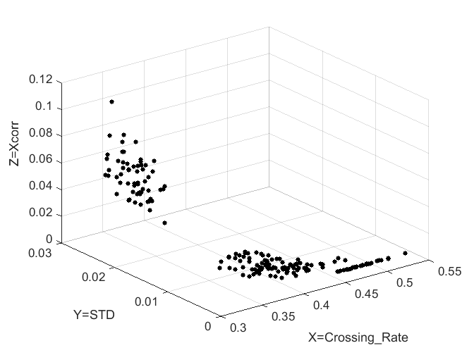
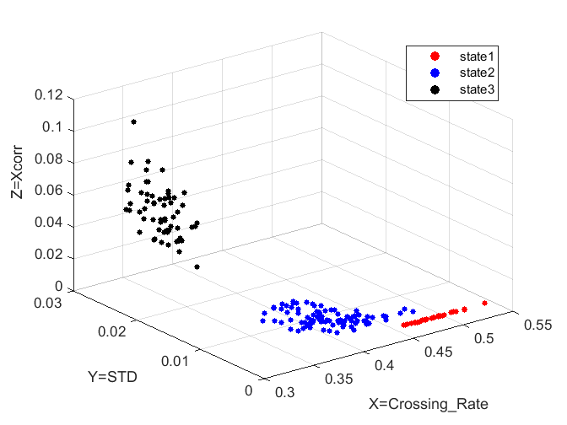

Slide 19
main
InitOrientationApp ControlPort
initializeControlPort
fusion_task
Control SubSystem Stream
Host_IO_Init
Host_IO_Receive
encodeOrient PacketStream
Host_Initialize
Host_Receive
JSON_Process_ Tx_Msg
Host_IO_Send
Host_IO_Add_ ISO_Header
HDLC_Process_ Tx_Msg
HDLC_Process_ Rx_Byte
JSON_Process_ Rx_Byte
HOST_Receive
process_host_ command

Slide 20
bool Process_host_command(
uint8_t command_tag,
uint8_t * hostCommand
uint8_t * response_buffer,
size_t * hostMsgSize,
size_t respBufferSize
)

